Slide 1
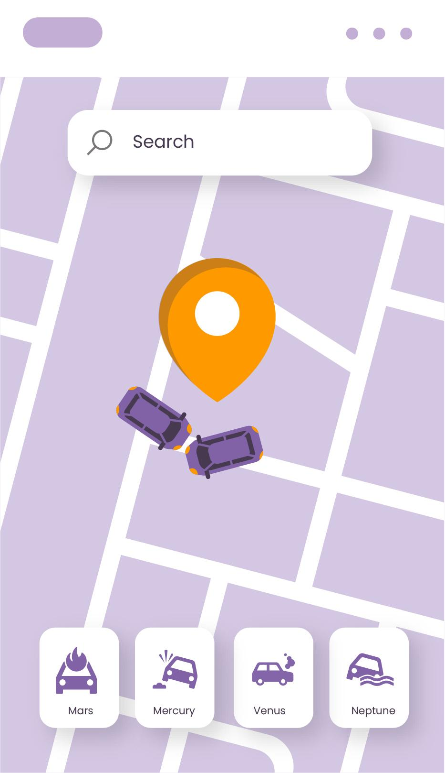
Live Transit Tracking
Late Today!
Track public bus locations live
Group B3G2:
- Saish Gawade (2641)
- Prathamesh Rane (2635)

Slide 2
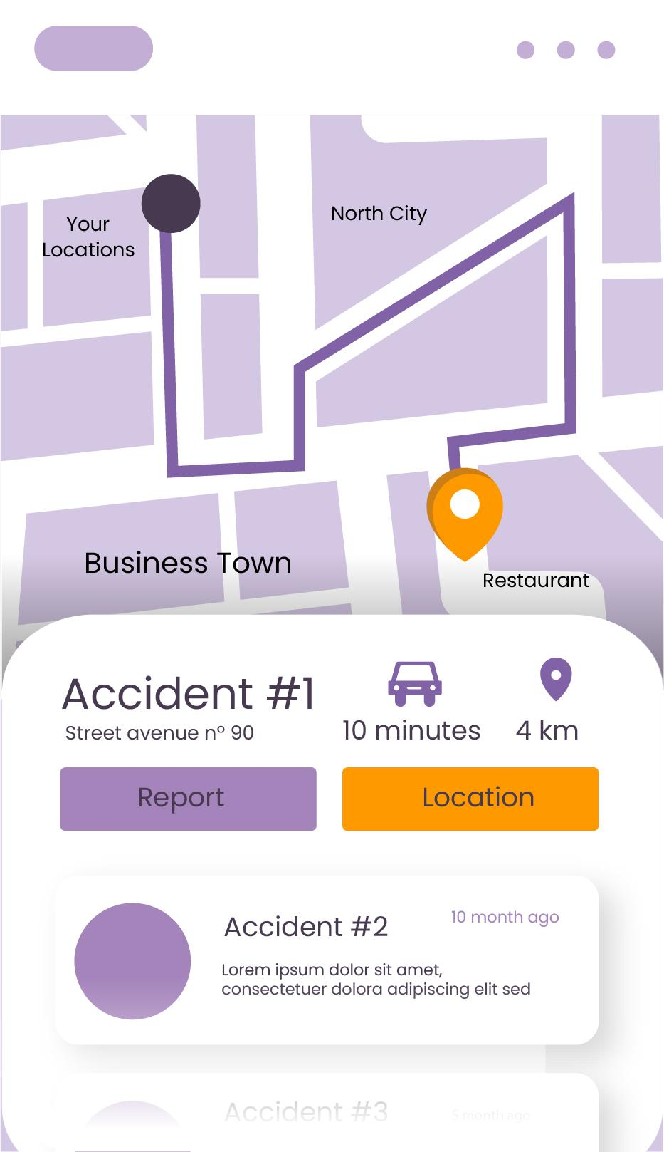
Introduction
Arriving early!
Problem: The market for public transport tracking in Goa presents a unique structure due to the dual nature of its transit system: Kadamba Transport Corporation (KTC) state-run buses and private local bus operators (which account for the majority of intra-state connectivity). Commuters want an easy access to locations of these buses.
Project Overview: Our project introduces a hardware-free, smartphone-native live public transport tracking system designed to modernize urban transit. By replacing expensive dedicated IoT GPS hardware with the built-in location sensors of drivers' Android devices, we stream real-time vehicle updates and accurate ETA predictions to commuters at zero hardware cost.

Slide 3
Market Analysis
Parameter | Data Point / Statistic | Source Reference
Daily Bus Commuter Volume | 150,000 to 250,000 passengers per day | The Times of India (CM Statement)
Private Stage Carriage Fleet | ~950 to 1,400 buses (70% intra-state connectivity) | Goa Transport Dept / DTE Report
KTCL State Fleet Size | ~630–651 buses (460 Diesel + 171 Electric AC) | KTC Official Filings / TOI
Public Transit Modal Split | 11.4% Bus vs. 59.0% Two-Wheeler daily trips | Goa Comprehensive Mobility Plan (CMP)
Off-Peak Service & Delays | 20 to 45+ min wait times; scarce services post 7–8 PM | Down To Earth Transit Analysis
Hardware GPS Deployment Cost | ₹5,000 – ₹10,000 per bus (CMVR AIS-140 compliance) | Central Motor Vehicles Rules
Mhaji Bus Scheme Subsidy | ₹3 / km operational subsidy + ₹10 Lakh replacement grant | Goa Transport Policy Notification

Slide 4
Competitor Analysis
App / Service | Features Available | Status | Key Features Lacking & Unmet Gaps
GOA ON THE GO Official KTCL App | Live KTC fleet tracking, QR ticket purchasing, KTC Smart Transit Card recharge. | Partially Working | Zero private bus coverage (~70% of market); unreliable GPS pings in weak cellular corridors; no multi-modal integration.
MajheApp KTCL / GraceFulGoa Superapp | In-app QR ticketing, pre/post booking live tracking, Pilot bike taxi booking. | Active Rollout | Private bus participation is virtually non-existent; feature bloat (e.g. delivery services) dilutes transit UX; lacks crowd-sourced location data.
Google Maps Global Navigation | Static route planning, timetable lookup for major KTC routes, stop navigation. | Static Only | No real-time GPS tracking in Goa; static timetables fail due to unscheduled delays; private operator route data missing.
Chalo App Urban Transit Leader | Live GPS tracking, ETA predictions, live occupancy status, mobile bus passes. | Non-Functional | Complete lack of local Goa coverage; zero onboard GPS hardware integration with Goan private operators.

Slide 5
Business Strategy
Tier | Monetization Channel | Price Point (Approximate) | Potential Targets
B2B Bus Operator | Subscription for the bus owners to use the app. | ₹50 – ₹90 / bus / month | Private Bus Operators (includes Driver App + Owner Dashboard).
B2C Commuters | Freemium app for the commuters | Free (Ad-supported) | Standard commuters see basic AdMob banner/interstitial ads
B2C Premium Subscription | Subscription to remove ads and unlock some features | ₹20 / month | Commuters pay to remove ads and unlock live ETA push notifications.
Local Ads | Route-Based or local sponsors | ₹1,500 / month / spot | Local cafes/shops advertising to commuters on specific routes.

Slide 6
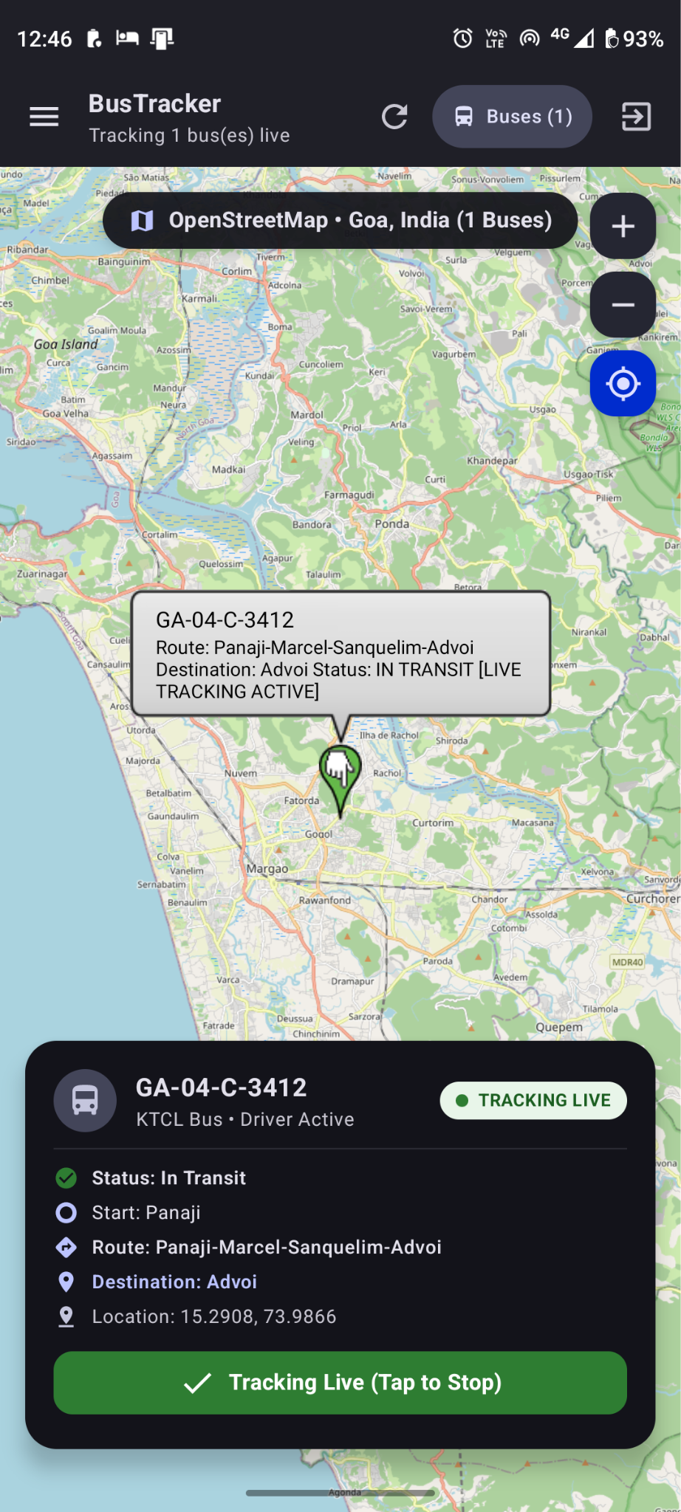
System Users: Passenger
Passenger: a commuter who wants to find and follow buses.
Sign up and log in
See all live buses on the map
Filter buses by KTCL or Private
Track a bus live and see its distance and ETA
Stop tracking a bus

Slide 7
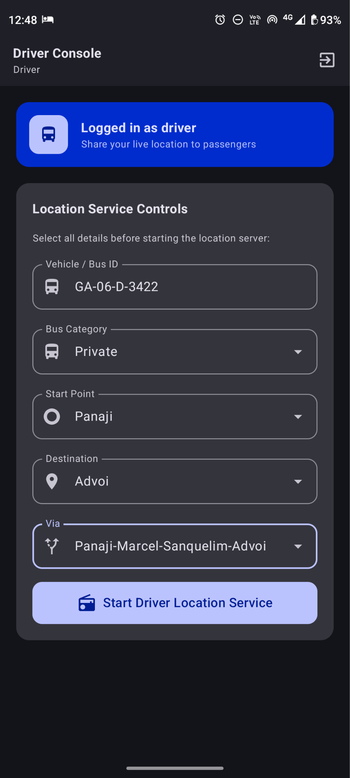
System Users: Driver
Driver: the person who shares the bus’s live location.
Sign up and log in with Bus ID and a whitelisted phone number
Choose route, start point and destination
Share live GPS location
Stop sharing location

Slide 8
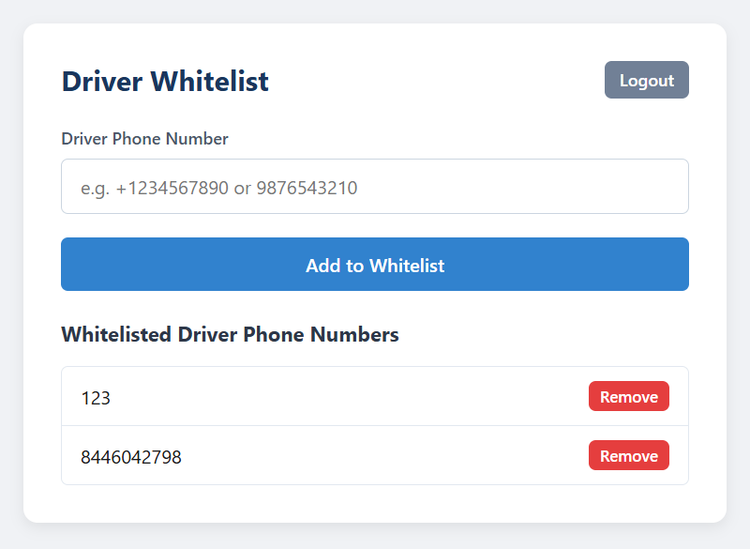
System Users: Admin
Admin: the person who manages drivers and schedules.
Log in to the admin page
Add or remove whitelisted driver phone numbers
Create, edit or delete bus schedules
Have driver credentials generated and emailed automatically when a schedule is created

Slide 9
THANKS!

