Slide 1
Sales Data Analysis Dashboard
Internship Mini Project – Data Analysis
E-Commerce Sales Analysis
Python • Pandas • NumPy • Matplotlib • Plotly

Slide 2
Project Objective
Understand and clean the sales dataset
Calculate key sales KPIs
Analyze monthly, regional, category and product performance
Create meaningful visualizations
Build a Sales Analysis Dashboard
Generate actionable business insights

Slide 3
Data Cleaning & Preparation
Original dataset inspected for structure, data types and quality issues
Missing values identified and handled
Qty and Amount converted to appropriate numeric types
Unnecessary index column removed
Zero-amount records investigated and excluded from sales analysis
Cleaned analysis dataset: 118,806 records × 22 columns

Slide 4
Key Sales KPIs
Total Revenue: ₹7.86 crore
Unique Orders: 110,661
Average Revenue per Order: approximately ₹710
Total valid sales records: 118,806
The analysis focuses on valid positive-amount sales

Slide 5
Sales & Regional Performance
Top revenue category: Set – approximately ₹3.92 crore
Second: Kurta – approximately ₹2.13 crore
Top region: Maharashtra – approximately ₹1.33 crore
Karnataka followed with approximately ₹1.05 crore
April 2022 was the strongest month – approximately ₹2.88 crore

Slide 6
Top Products & Fulfilment
Best-selling SKU: JNE3797-KR-L – 646 units
JNE3797-KR-M – 546 units
JNE3797-KR-S – 495 units
Amazon fulfilment: 82,094 orders and approximately ₹5.43 crore revenue
Merchant fulfilment: 36,712 orders and approximately ₹2.43 crore revenue

Slide 7
Dashboard
Interactive Sales Analysis Dashboard created using Python and Plotly
Total Sales and Total Orders
Monthly Sales Trend
Revenue by Category
Top 10 States by Revenue
Top 10 Best-Selling Products
Add a screenshot of sales_dashboard.html to this slide before final submission.

Slide 8
Key Business Insights & Conclusion
Set is the leading revenue category
Maharashtra is the top-performing region
April 2022 recorded the highest monthly revenue
Shipped orders dominate the order-status distribution
Amazon fulfilment contributes the majority of revenue
JNE3797 product variants show strong demand
The project follows the complete Data → Cleaning → Analysis → Visualization → Dashboard → Insights workflow

Slide 9
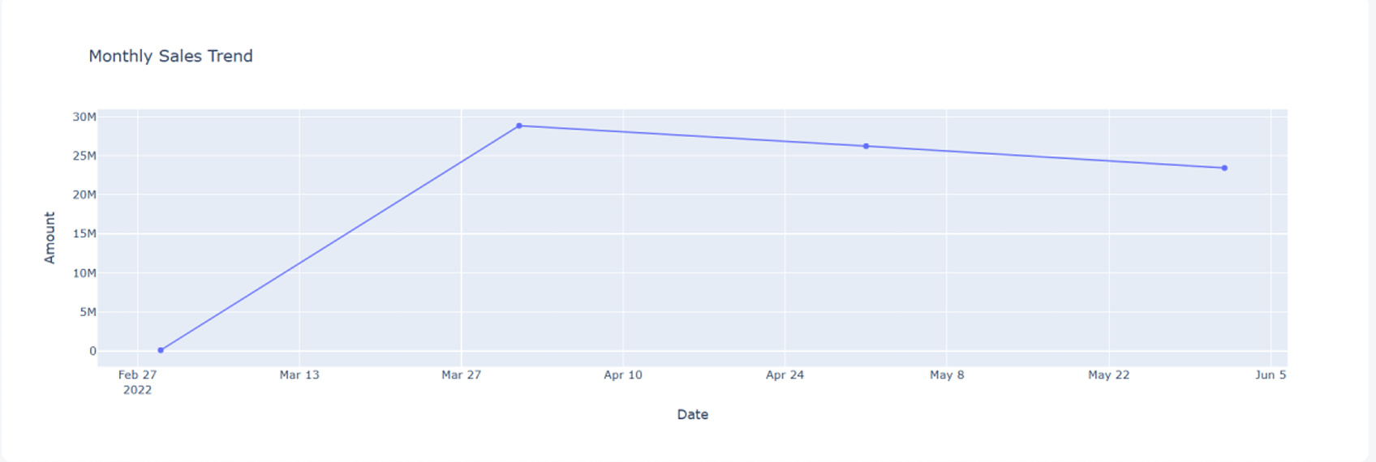
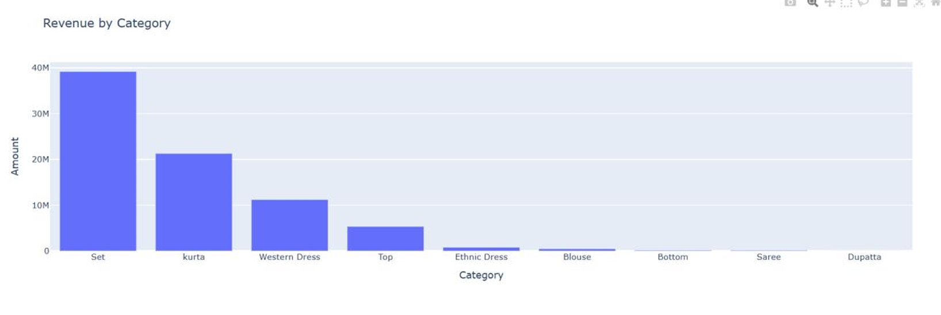

Slide 10
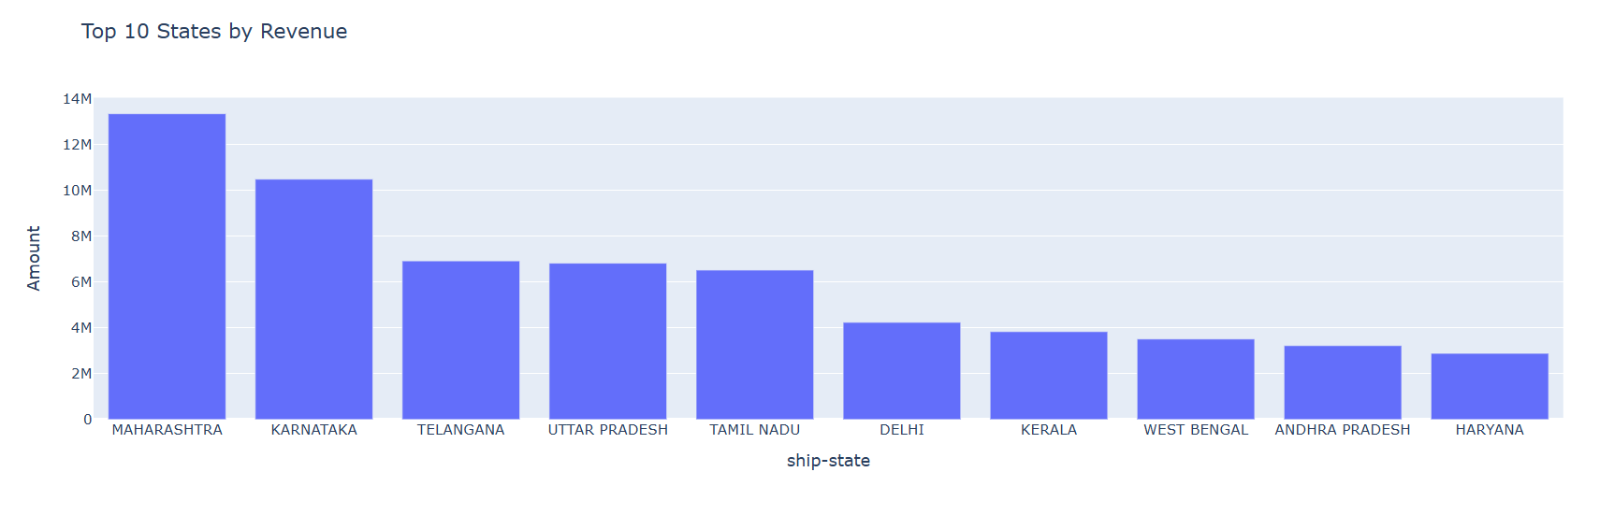
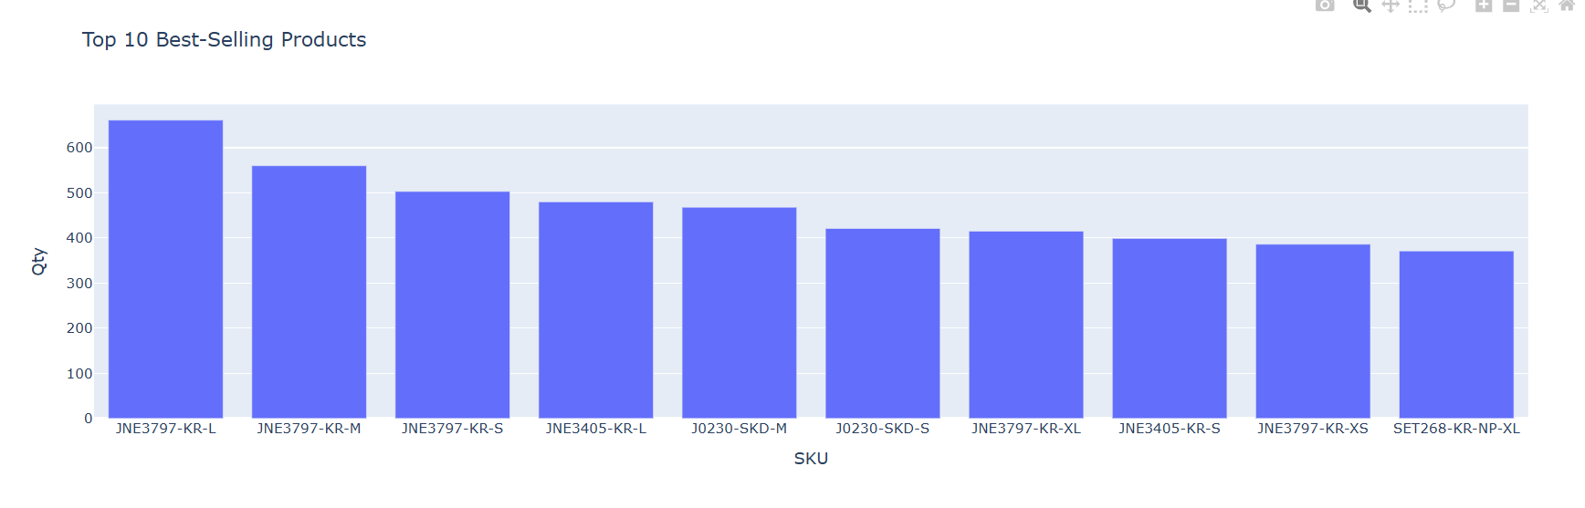

Slide 11
Thank You
Sales Data Analysis Dashboard

