Slide 1
D
YONO · Diya
UPI
Balance
Cards
Diya
Diya
आपके ₹1,240/माह एक और बीमा कंपनी को जा रहे हैं। 30 सेकंड की ईमानदार तुलना देखें?
The Agentic Adoption Copilot for YONO
Trust-first AI that turns dormant users into confident ones.
तुलना देखें
छोड़ें
Why am I seeing this?
SBI Hackathon @ GFF 2026 — AI & Emerging Tech · Digital Adoption track
Team Diya — Pratham Garg · Thapar Institute of Engineering & Technology
Notes:
We're Diya — an agentic AI copilot that lives inside YONO and fixes the two things stopping people from going deeper: discovery and trust. Everything you'll see is a working prototype on synthetic data — one API key to run it. Note the four dots on the phone: that's the agent's attention budget. We'll come back to it.

Slide 2
THE PROBLEM
Trust is the adoption bottleneck — not demand.
85M registered YONO users — most never go past UPI and balance-check. The features that help users (and earn SBI its fee income) go undiscovered, or worse, distrusted.
85M
12,000+
91%
registered YONO users — most touch only UPI + balance check
mis-selling complaints in one year — banks are the most-complained channel
of Indian account-holders are OPEN to transaction-based offers
!
Wound 1 — Insurance: the trust wound
%
Wound 2 — Investing: the self-dealing wound
Policies forced as a condition for accounts and lockers; unauthorised deductions
Pensioners duped into SBI Life policies — national news
SBI has issued internal directives to curb mis-selling: it is already under pressure to fix this
YONO's shelf feels narrow and SBI-skewed — users leave for Groww / Zerodha
Even the ₹250 JanNivesh SIP ships simultaneously on Groww, Paytm and Zerodha
No exclusivity moat: YONO competes on experience — and loses
Sources (paraphrased): Business Standard · MatrixBCG · thekanal.in · oneinsure · The Wire · Zopper/ITIJ — see appendix
Diya · SBI Hackathon @ GFF 2026 · 2
Notes:
85 million registered users — and most never go past UPI and balance-check. Two wounds keep them shallow. Insurance has a trust wound: banks are the most-complained channel for mis-selling — 12,000+ complaints in a single year, forced policies, duped pensioners. SBI is already under regulatory pressure to fix it. Investing has a self-dealing wound: the shelf feels narrow and SBI-skewed, so users leave for Groww. But 91% of account-holders are open to transaction-based offers. Demand is fine. The channel is broken.

Slide 3
THE REFRAME
Not cross-sell. Mis-selling remediation — disguised as an adoption engine.
The channel today
Diya's channel
Coercive, target-driven human sales machine
Opaque math — charges and exclusions hidden
ULIPs pushed onto buyers they never suited
Customers have learned to fear the pitch
Consent-first and revocable — opt-in even to analyse
Suitability-filtered: ULIPs hard-blocked, always
Explainable math incl. charges — and an honest “Do nothing” option in every comparison
Skip + “Talk to a human advisor” on every card
Honesty is the moat. And with the reverse mis-selling detector, remediation is literal — Diya audits the products users were already sold. SBI is under regulatory pressure to deliver exactly this.
Diya · SBI Hackathon @ GFF 2026 · 3
Notes:
Here's the reframe that wins the room. We are not pitching cross-sell. We're pitching mis-selling remediation — something SBI is already scrambling to deliver — dressed as an adoption engine. We move the sale off the coercive human channel onto an honest, opt-in, suitability-filtered, explainable digital one. And with our reverse mis-selling detector, remediation isn't a metaphor: Diya audits the products users were ALREADY sold. Honesty becomes the moat.

Slide 4
WHAT DIYA IS
An autonomous agent decides whether, what and when — and can choose to do nothing.
1
PERCEIVE
2
REASON
3
ACT
4
LEARN
Consented transaction stream
Trigger engine spots the moment: idle cash, premium leak, salary jump, feature blind spot
Claude tool-calling loop: query_rag · check_suitability · build_comparison
Devil's-advocate agent argues AGAINST the nudge before it ships
Vernacular nudge + explainability card + guided walkthrough
— or suppress. Max 4 interruptions per user per month
Adopted / skipped / escalated tunes thresholds & timing
Adoption ladder unlocks the next journey
the loop closes — every decision (including silence) is logged
Every nudge ships with: the trigger · honest math incl. charges · what's NOT covered · a “Do nothing” option · Skip · Talk to a human — in your language, read aloud.
Diya · SBI Hackathon @ GFF 2026 · 4
Notes:
Diya is not a chatbot waiting for a query. It's a continuous perceive-reason-act-learn loop. It perceives a consented transaction stream, reasons with a live Claude tool-calling loop — and before anything ships, a second adversarial agent argues against it. It acts with a vernacular, explainable nudge, or it suppresses — it can only interrupt four times a month. And it learns from every outcome. Every decision, including the decision to stay silent, is logged.

Slide 5
THE DEMO SURFACE
Six live journeys — one reusable framework.
Flow | Trigger the agent perceives | The honest action
A | ₹47k sitting idle for 150+ days | Sweep-FD vs 2.7% savings — the honest math, incl. “do nothing”
B ★ | ₹1,240/mo leaking to a competitor insurer | Side-by-side honest comparison — incl. the row where the competitor wins
C | Salary jump ₹35k → ₹55k | Open-shelf investing — the whole market on one screen, not just SBI funds
D | Bills paid every month in another app | One-time discovery nudge + guided walkthrough → the adoption ladder
S | Unused subscription renews in 3 days | Pause the UPI mandate at source → redirect the savings to a goal
R ★ | A product you ALREADY own fails Diya's suitability filter | Reverse mis-selling flag → honest exit-vs-stay path in the surrender window
B and R are the hero pair: the honest comparison for the product you're about to buy — and the honest audit of the one you were already sold.
Diya · SBI Hackathon @ GFF 2026 · 5
Notes:
Six journeys run on the same framework today — product adoption, platform adoption and engagement. A: idle cash to sweep-FD. B: the competitor-premium honest comparison — our hero. C: a salary jump opens the whole-market investing shelf. D: feature-blind-spot discovery with a guided walkthrough and an adoption ladder. S: subscription saver — pause the UPI mandate the bank sees at source. And R, new: the reverse mis-selling audit of products the user already owns. B and R together are the trust story.

Slide 6
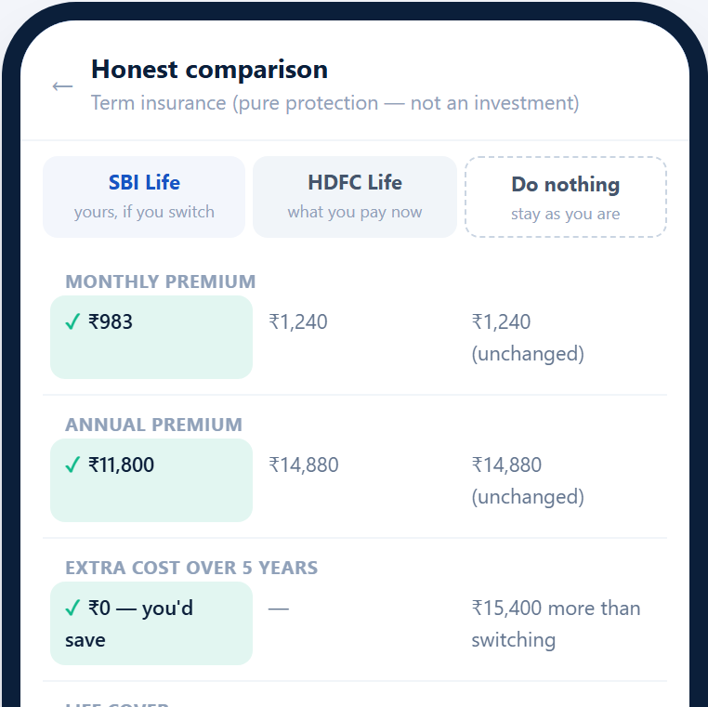
HERO DEMO — FLOW B
We show the row where the competitor wins — and what happens if you do nothing.
Diya detects ₹1,240/mo leaking to a competitor insurer and offers a 30-second honest comparison
Premium · cover · claim-settlement ratio · exclusions, side by side. The competitor's higher claim ratio is shown — in amber
Every comparison carries a “Do nothing” column: keep your policy, pay nothing new. An honest baseline — and sometimes the winner
Every figure is grounded in the cited RAG corpus — the agent cannot state a number it didn't retrieve
“Switch only if it makes sense.” Skip and Talk-to-a-human on every card
 | SBI Smart Shield | Current policy | Do nothing
Premium | ₹990/mo | ₹1,240/mo | ₹0 extra
Claim ratio | 98.4% | 99.1% — wins | —
Cover | ₹1 Cr | ₹75 L | unchanged
Figures illustrative — synthetic, corpus-grounded.
Diya · SBI Hackathon @ GFF 2026 · 6
Notes:
This is what trust-first looks like. When Diya compares an SBI policy to the one the user already pays, it shows the row where the COMPETITOR wins — the higher claim-settlement ratio — right next to where SBI is cheaper. And there's now a third column: Do nothing. Keeping your current policy is presented as a legitimate option with its own honest math. No invented numbers — everything is retrieved from the cited corpus. That honesty is exactly what the mis-selling channel never gave them.

Slide 7
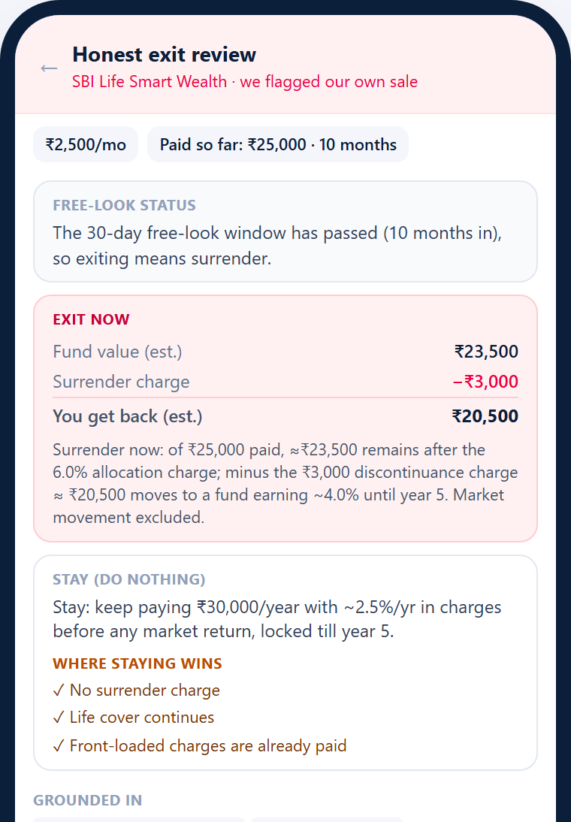
THE HEADLINE FEATURE — FLOW R
The bank's own agent flags the bank's own past mis-sale.
Diya runs its hard suitability filter over the products a user ALREADY owns — not just new recommendations
Demo: a ULIP sold through the old human channel to a customer it never suited. The filter fails it — and Diya says so, inside SBI's own app
Honest exit-vs-stay path: the free-look / surrender window, exact surrender value vs. staying, what cover is lost — and a simpler suitable alternative, or none
“Talk to a human advisor” before any action; nothing moves without explicit consent (plus Guardian co-approval where enabled)
This makes “mis-selling remediation” literal — the remediation engine SBI is under pressure to build, running inside its own app
Owns a ULIP
Suitability filter: FAIL
Exit-vs-stay honest math
User + family decide
Diya · SBI Hackathon @ GFF 2026 · 7
Notes:
This is the feature that makes judges sit up. Every other team will recommend products. Diya also AUDITS them — including the ones the bank itself sold. It runs the same suitability filter over what the user already owns. When a legacy ULIP fails, Diya flags it and lays out an honest exit-vs-stay path inside the free-look or surrender window — exact surrender value, what cover is lost, and whether a simpler product (or nothing) fits better. The bank's own agent flagging the bank's own past mis-sale: that is mis-selling remediation made literal, and it's the single strongest trust signal we can put in front of a burned customer.

Slide 8
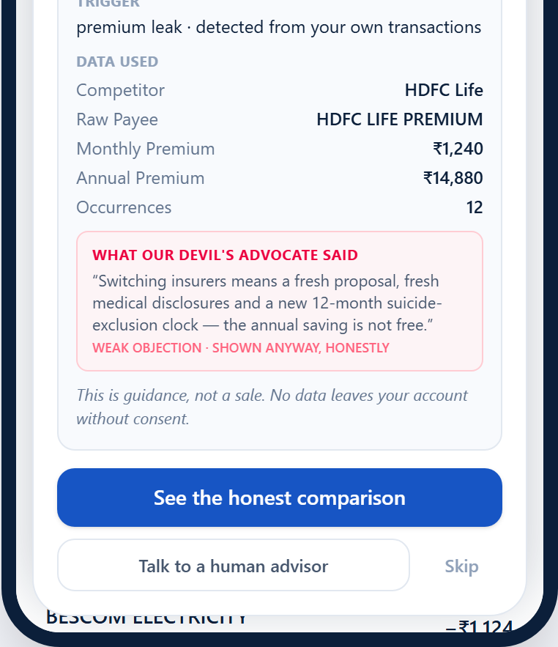
RADICAL TRANSPARENCY
Every recommendation must survive its own cross-examination.
✓
Grounded corpus
?
“Why am I seeing this?”
The agent cannot state a premium, return or fee it didn't retrieve. Every figure cited to the RAG corpus.
The explainability card: the trigger, the honest math incl. charges, exactly which data was used — and what's NOT covered.
–
The do-nothing baseline
✕
Devil's advocate agent
Every comparison includes an honest “Do nothing” column. When doing nothing wins, Diya says so — and stands down.
A second, adversarial LLM argues AGAINST every recommendation before it's shown. Strong objections suppress the nudge; the ones it survives are printed on the card.
Multi-agent adversarial reasoning, made user-visible: honesty by construction, not by copywriting.
Diya · SBI Hackathon @ GFF 2026 · 8
Notes:
Transparency is the product, not a feature — four layers deep. One: grounding — no number the agent didn't retrieve. Two: the explainability card — trigger, honest math with charges, the data used, and what's NOT covered. Three: the do-nothing baseline — doing nothing is a first-class option, and when it wins, Diya says so. Four, and new: a devil's-advocate agent. A second adversarial model attacks every recommendation before it ships. If the objection is strong, the nudge dies. If it's weak, we show the objection to the user anyway. We don't just claim honesty — we run a prosecutor against ourselves and publish the transcript.

Slide 9
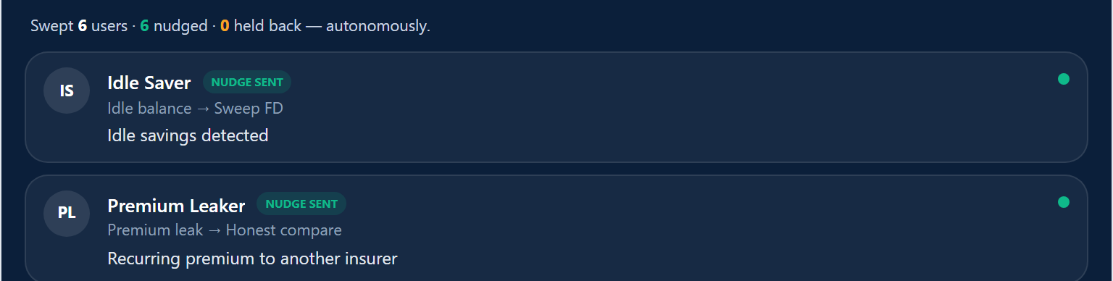
AGENTIC RESTRAINT
Four interruptions a month. A veto on every nudge. Silence is a decision.
Attention budget
✕
Adversarial veto
■
Mission Control
Strong devil's-advocate objections kill a nudge before the user ever sees it; weak ones ride along on the explainability card. Suppression is logged like any other decision — auditable restraint.
Watch the loop sweep the whole base and hold back where the moment isn't right: “Swept 5 users · 3 nudged · 2 held back — autonomously.” Cooldowns after a skip; one discovery nudge at a time.
2 of 4 spent this month
A hard cap of 4 interruptions per user per month — spent visibly in the UI. The agent must decide what deserves your attention, and users can watch it choose.
Diya · SBI Hackathon @ GFF 2026 · 9
Notes:
Everyone fears an AI that spams offers. Diya's restraint is tangible, not a promise. First, the attention budget: it can interrupt each user at most four times a month, and the budget is spent visibly in the UI. Second, the adversarial veto: the devil's-advocate agent can kill a nudge outright. Third, suppression is a first-class, logged outcome — Mission Control shows the agent sweeping the base and choosing to hold back. The agent that interrupts least is trusted most — and here you can watch it exercise that restraint.

Slide 10
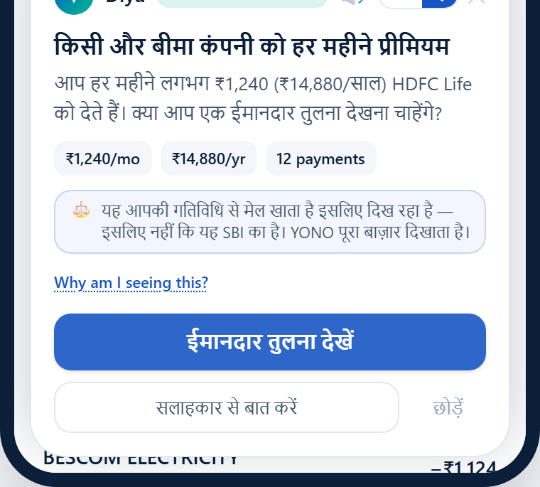
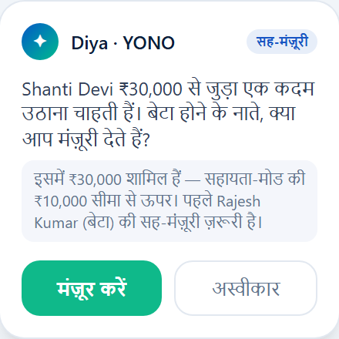
INCLUSION & PROTECTION
Built for Bharat — vernacular, voice, and a family safety net.
Vernacular + voice by default
EN / हिंदी toggle on every card; nudges read aloud (Web Speech), voice replies (“हाँ, दिखाओ”)
~35% of Indian women own smartphones; rural UPI preference ~38% — voice-guided discovery is how the other half moves past UPI-only
Guardian / Sahayak co-consent
For elderly & assisted users, any adoption above a set threshold requires a family member's co-approval on a second device before it proceeds
Built for the duped-pensioner cases that made national news — a mis-sale now needs to fool two people on two devices
Sources: coinlaw.io · 3ieimpact.org (access gaps) · The Wire / Business Standard (pensioner cases)
Diya · SBI Hackathon @ GFF 2026 · 10
Notes:
Half of SBI's base can't or won't use YONO — language, literacy, smartphone access. So Diya speaks Hindi and regional languages natively, and reads every nudge aloud. And for the users most at risk — the pensioners who were duped by the old channel — we added Guardian co-consent: above a threshold, an adoption needs a family member's approval on a second device. Consent is first-class and revocable everywhere. A mis-sale now has to fool two people on two devices.

Slide 11
TECHNICAL FEASIBILITY
A working prototype: one API key, synthetic data, a real multi-agent loop.
FRONTEND — React + Vite + Tailwind (mocked YONO shell): nudge card EN/हिंदी + voice · explainability card · walkthrough coachmarks · consent gate · attention-budget meter · Mission Control + Compliance view
REST / JSON
FASTAPI BACKEND
Trigger Engine
payee classifier · thresholds → adoption moments
Agent Core
Claude (claude-sonnet-4-6) tool-calling + devil's-advocate pass · deterministic fallback
RAG Layer
FAISS + local embeddings over the cited product corpus
Suitability Filter
hard rules — ULIPs & unsuitable products blocked; runs on owned products too (Flow R)
XAI Builder
trigger + honest math + data used + do-nothing baseline
Feedback + Audit
SQLite learn store · hash-chained suitability certificates · /verify endpoint
Only secret: ANTHROPIC_API_KEY · everything else local & free · 44 tests passing · live on Vercel · synthetic data only — no real PII, accounts, or money
Diya · SBI Hackathon @ GFF 2026 · 11
Notes:
This runs today — it is not slideware. A React shell mocks YONO; FastAPI runs the loop. The trigger engine turns the synthetic transaction stream into adoption moments. The agent core is a live Claude tool-calling loop with a deterministic fallback — now with the devil's-advocate adversarial pass. RAG grounds every number; the suitability filter is hard rules and now also audits owned products; the feedback store closes the learn loop and hash-chains every decision into the audit trail. One API key to run everything. 26 tests. Live on Vercel. Synthetic data only.

Slide 12
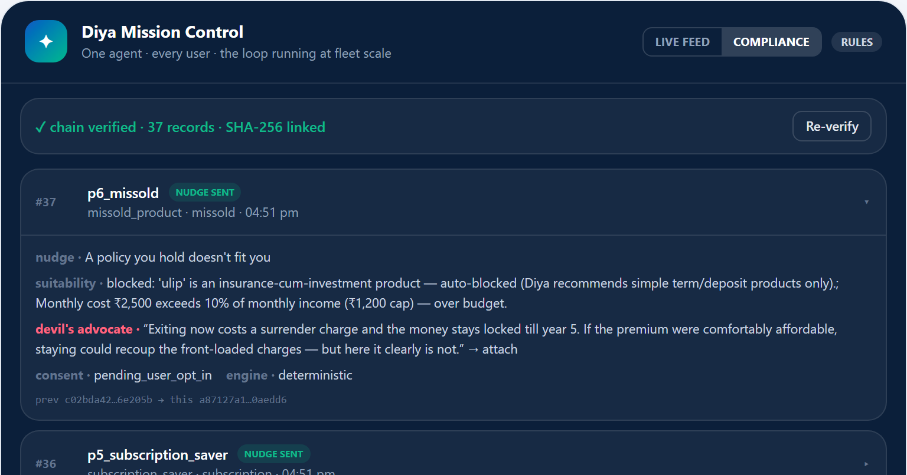
BUSINESS POTENTIAL
Diya lifts the ₹100 cr/quarter — and turns compliance into an asset.
The suitability certificate
~₹100 cr / quarter
YONO fee income from subsidiary insurance & MF distribution — lifted AND de-risked
Every recommendation — surfaced OR suppressed — is sealed as a suitability certificate: trigger, corpus evidence, filter verdict, devil's-advocate objections, user response
Certificates are hash-chained into an immutable, tamper-evident audit log with a verify endpoint — regulator-ready by construction
A Compliance view in Mission Control: when RBI / IRDAI ask “prove you didn't mis-sell”, SBI has a one-click answer
That turns Diya from a UX feature into a risk-management asset.
3 adoption dimensions
product (FD, cover) · platform (Bill Pay → ladder) · engagement (subscriptions → goals)
≪ acquisition cost
activating a dormant digital user costs a fraction of acquiring a new one
Diya · SBI Hackathon @ GFF 2026 · 12
Notes:
The business case has two engines. Revenue: YONO already earns about 100 crore rupees a quarter distributing subsidiary insurance and MF products; Diya lifts that across product, platform and engagement adoption — and reactivating a dormant user costs a fraction of acquiring a new one. Risk: every recommendation, shown or suppressed, is sealed into a hash-chained, tamper-evident suitability certificate with a verify endpoint and a Compliance view. When the regulator asks SBI to prove it didn't mis-sell, that's a one-click answer. Diya isn't just UX — it's a risk-management asset.

Slide 13
SCALABILITY
One loop. Every user. 100+ journeys. Any bank.
85M
100+
4 / month
1 secret
users swept autonomously — nudge, hold back, or stay silent, per person
planned YONO journeys — a new journey is a trigger + corpus docs, not new code
max interruptions per user — restraint scales with the base
ANTHROPIC_API_KEY — everything else local; white-label to any bank
The adoption ladder compounds: each adopted feature unlocks the next.
FD / SIP
Credit Score
AutoPay
Bill Pay ✓
Mission Control governs the whole base per-person, inside each user's attention budget
The suitability filter, devil's-advocate pass and hash-chained audit trail travel with the framework — compliance is portable too
Diya · SBI Hackathon @ GFF 2026 · 13
Notes:
Scalability is architectural, not aspirational. Mission Control already runs the same loop across every demo user at once, deciding per person within their attention budget. Adding a journey means writing a trigger and a few corpus docs — not new code — which is how this framework covers the 100+ journeys YONO has planned. And because the suitability filter, the adversarial pass and the audit chain are part of the framework, the compliance story is portable: white-label it to any bank and the guarantees travel with it. The adoption ladder compounds — Bill Pay unlocks AutoPay, then Credit Score, then FD.

Slide 14
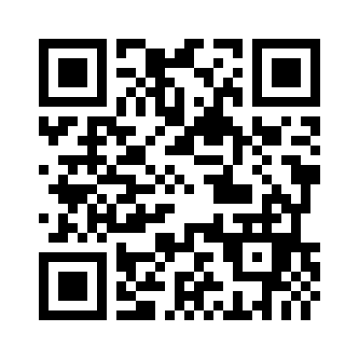
Diya turns SBI's biggest liabilities into its differentiator.
A distrusted insurance channel → an honest, audited guide. A narrow shelf → the whole market. Dormant users → confident ones.
Honest
Agentic
Consent-first
Audit-ready
Vernacular + voice
3-minute demo: Flow B honest comparison → reverse mis-selling flag → Guardian co-consent → Mission Control compliance view
Try it live: saarthi-nu.vercel.app
Thank you.
Diya · SBI Hackathon @ GFF 2026 · 14
Notes:
So: Diya takes SBI's two biggest liabilities — a distrusted insurance channel and a narrow, self-dealing investing shelf — and makes them the reason to choose YONO. Honest, agentic, consent-first, audit-ready, and it speaks your language. It lifts adoption AND removes the mis-selling risk SBI is under pressure to fix — with a hash-chained trail to prove it. It's live right now — scan the code. Thank you.

Slide 15
APPENDIX — PRODUCTION CHECKLIST (HIDDEN SLIDE)
Screenshot placeholders to swap in once the features land.
Slide | Placeholder | How to capture
6 — Hero demo (Flow B) | Flow B honest comparison — amber “where the competitor wins” row + “Do nothing” column | Premium Leaker persona → “See the honest comparison”; include the amber competitor-wins box and the Do-nothing column
7 — Reverse mis-selling detector | Reverse mis-selling nudge card — ULIP flagged, exit-vs-stay path with surrender math | Persona holding a legacy ULIP → Diya flags it; capture the exit-vs-stay card incl. free-look/surrender window and “Talk to a human”
8 — Transparency stack | “Why am I seeing this?” card — incl. the devil's-advocate objection the nudge survived | Any persona → tap “Why am I seeing this?”; capture trigger + honest math + data used + the surviving adversarial objection
9 — Agentic restraint | Mission Control feed — nudged vs. held-back decisions, with per-user attention-budget meters | Toggle to Mission Control; capture the sweep feed showing held-back users + the 4-dot budget meters
10 — Inclusion & protection | Hindi nudge card with voice read-aloud active | Any persona → toggle हिंदी + tap the speaker icon; capture the Hindi card with voice indicator
10 — Inclusion & protection | Guardian co-consent — approval request on the family member's device | Assisted-user persona → accept an above-threshold nudge; capture the second-device co-approval screen
12 — Business potential / compliance | Compliance view — hash-chained audit log + verify endpoint | Mission Control → Compliance tab; capture the certificate chain with hashes and the verify status
14 — Close | QR code → saarthi-nu.vercel.app | Generate a QR for https://saarthi-nu.vercel.app and drop it into the dashed box
Capture at 100% zoom from the live site (or locally with ANTHROPIC_API_KEY set for the “LLM live” badge). Keep rules/LLM badge consistent across shots.
Notes:
HIDDEN SLIDE — not part of the pitch. Inventory of every screenshot placeholder in this deck. 1. [Slide 6 — Hero demo (Flow B)] Flow B honest comparison — amber “where the competitor wins” row + “Do nothing” column — Premium Leaker persona → “See the honest comparison”; include the amber competitor-wins box and the Do-nothing column 2. [Slide 7 — Reverse mis-selling detector] Reverse mis-selling nudge card — ULIP flagged, exit-vs-stay path with surrender math — Persona holding a legacy ULIP → Diya flags it; capture the exit-vs-stay card incl. free-look/surrender window and “Talk to a human” 3. [Slide 8 — Transparency stack] “Why am I seeing this?” card — incl. the devil's-advocate objection the nudge survived — Any persona → tap “Why am I seeing this?”; capture trigger + honest math + data used + the surviving adversarial objection 4. [Slide 9 — Agentic restraint] Mission Control feed — nudged vs. held-back decisions, with per-user attention-budget meters — Toggle to Mission Control; capture the sweep feed showing held-back users + the 4-dot budget meters 5. [Slide 10 — Inclusion & protection] Hindi nudge card with voice read-aloud active — Any persona → toggle हिंदी + tap the speaker icon; capture the Hindi card with voice indicator 6. [Slide 10 — Inclusion & protection] Guardian co-consent — approval request on the family member's device — Assisted-user persona → accept an above-threshold nudge; capture the second-device co-approval screen 7. [Slide 12 — Business potential / compliance] Compliance view — hash-chained audit log + verify endpoint — Mission Control → Compliance tab; capture the certificate chain with hashes and the verify status 8. [Slide 14 — Close] QR code → saarthi-nu.vercel.app — Generate a QR for https://saarthi-nu.vercel.app and drop it into the dashed box

