Slide 1
Campus Ticketing and Meal Plan Exchange App
Powered by XRP Ledger (XRPL)

Slide 2
Overview
A decentralized campus ticketing and meal plan exchange system.
Students can buy event tickets, exchange meal credits, and manage transactions using XRP.
Uses blockchain for secure and transparent transactions.

Slide 3
Problem It Solves
• Limited access to campus events due to inefficient ticketing systems.
• Wasted meal credits at the end of semesters.
• Lack of transparency in spending and balances.
• Complex transactions between students for tickets and meals.

Slide 4
How It Works
• Event Ticketing System: Buy, sell, and transfer tickets using XRP.
• Meal Credit Exchange: Convert unused meal credits into XRP.
• Student Wallets: Secure XRP wallets for each student.
• Real-Time Transactions: All transactions are tracked and updated instantly.

Slide 5
Tech Stack
Frontend: HTML, CSS, JavaScript (Vanilla, with Chart.js for analytics)
Backend: Node.js, Express.js, MongoDB (Cosmos DB for production)
Blockchain: XRP Ledger (XRPL)
Hosting: Microsoft Azure (Web App, Container Registry, Cosmos DB)
Containerization: Docker (for deployment)

Slide 6
Key Features
• Secure and Transparent Transactions – Blockchain-based ticketing and meal credit exchange.
• Real-Time Balance Updates – No delays or manual tracking required.
• Easy Event Ticketing – Purchase, transfer, and manage tickets easily.
• Offline Frontend Demo – Works without internet for demonstrations.
• Scalable on Azure – Hosted with high availability and security.

Slide 7
Deployment Overview
1. Create Azure Resources – App Service, Cosmos DB, and Container Registry.
2. Build and Push Docker Image – Containerized deployment for easy scaling.
3. Configure Environment Variables – Securely store credentials and connection strings.
4. Enable Continuous Deployment – Automate updates via GitHub Actions.
5. Monitor and Scale – Use Azure Insights and scaling features.

Slide 8
Future Enhancements
• Mobile App Version – Extend to iOS and Android.
• AI-powered Analytics – Insights into spending behavior.
• Enhanced Security – Multi-factor authentication and biometric verification.
• NFT-based Event Tickets – Unique digital ticketing on XRPL.

Slide 9
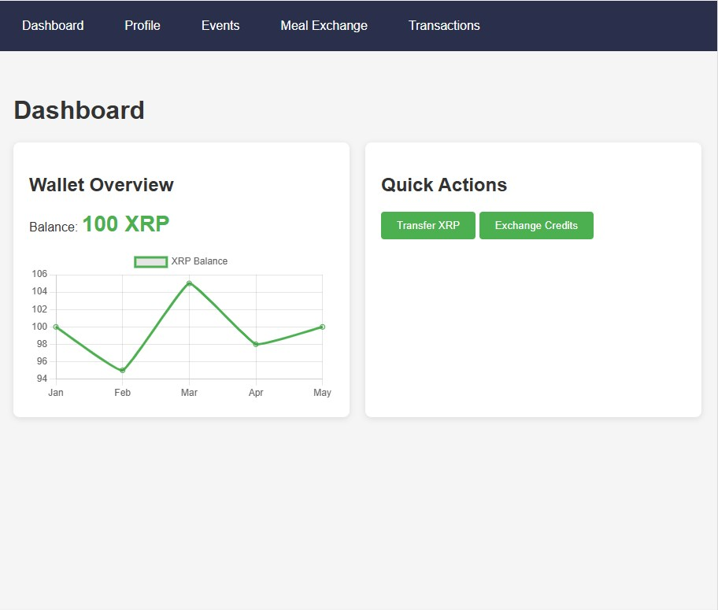

Slide 10
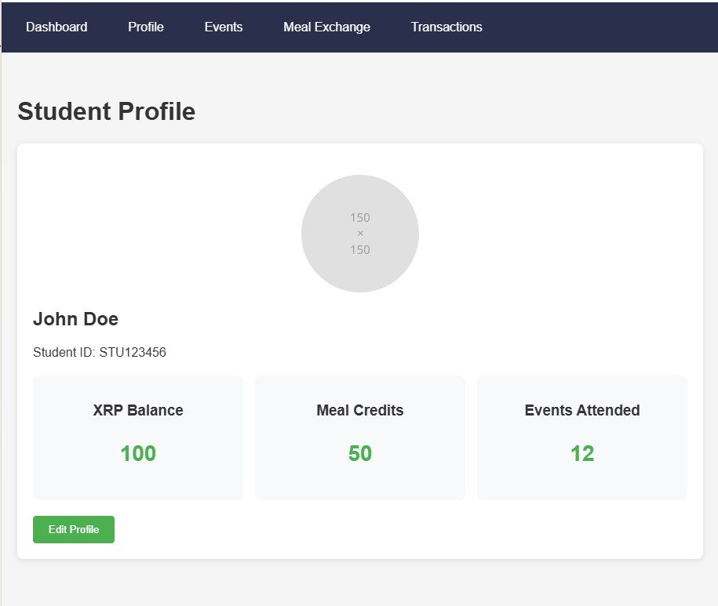

Slide 11
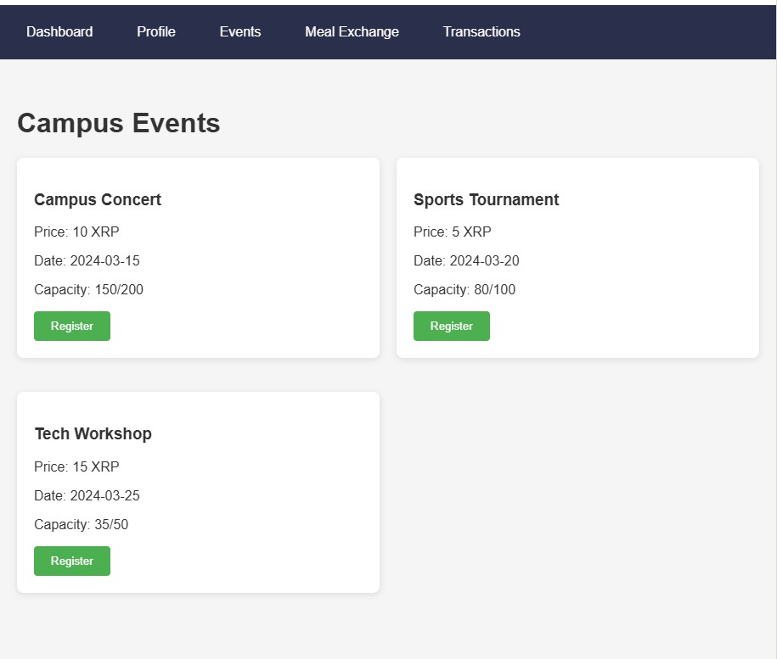

Slide 12
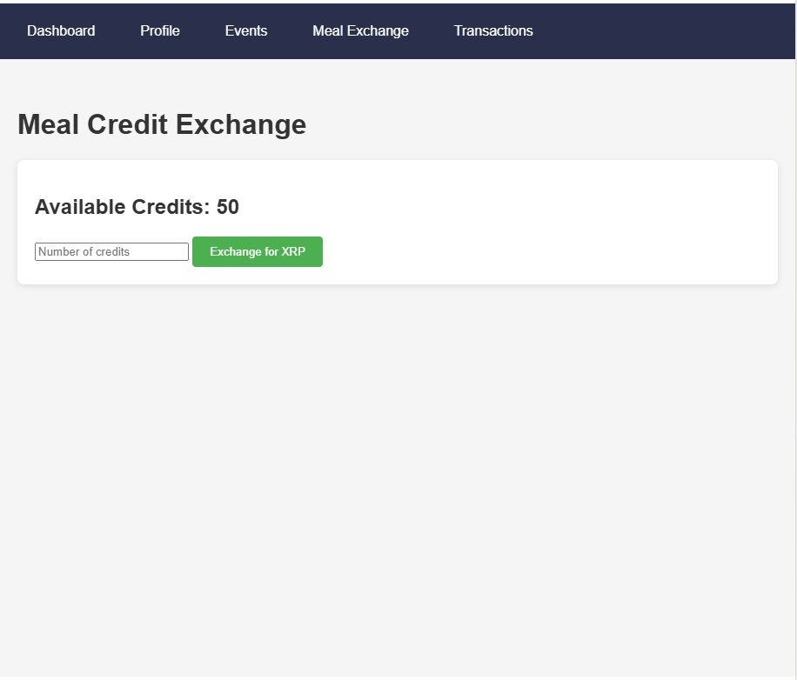

Slide 13
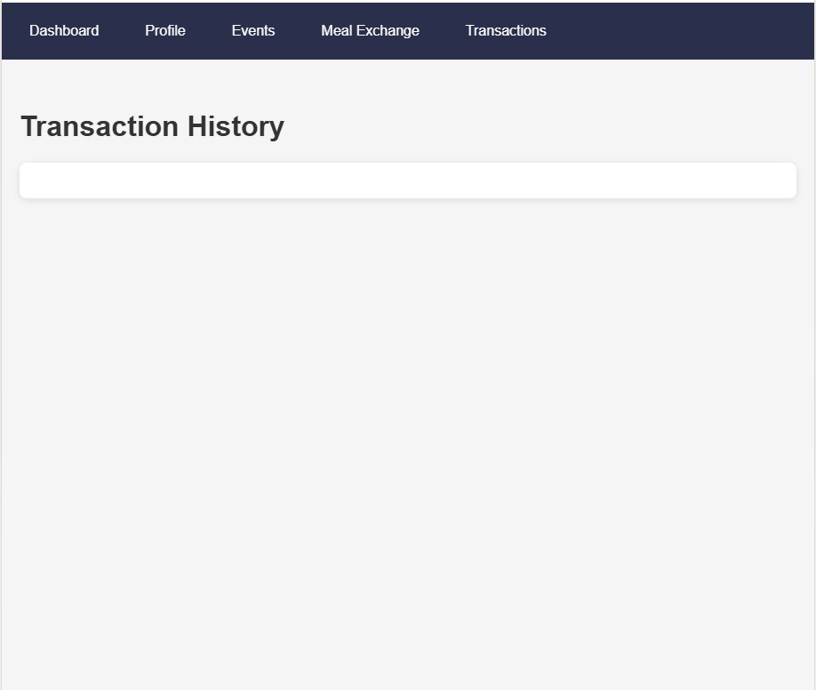

Slide 14
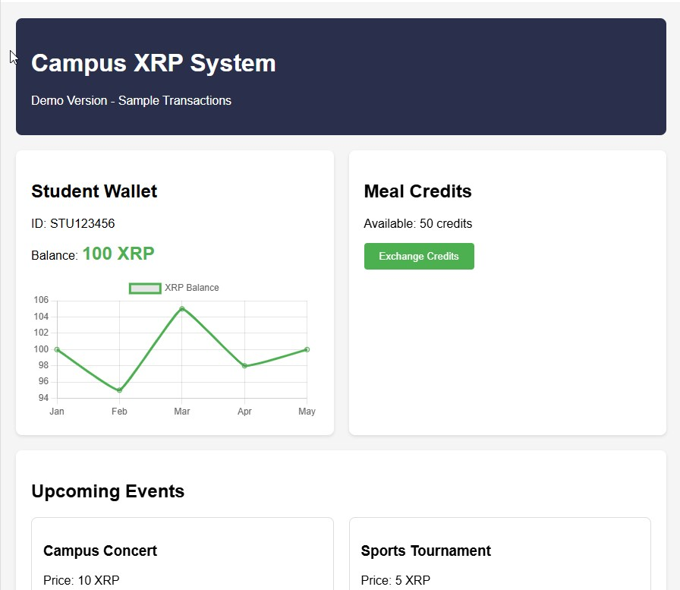

Slide 15
