Slide 1


T.Y. IVP Project Presentation
Automated Terrain Stability Monitering
Guide: Prof. Mandar Bivalkar
Mr. Pratham Nagar (38)
Department of Artificial Intelligence & Data Science, K. J. Somaiya Institute of Technology, Sion, Mumbai 400022
6/10/2026

Slide 2
Introduction
Project Overview:
Landslides pose severe risks in mountainous areas, requiring proactive monitoring.
Manual ground assessments are limited, slow, and hard to scale across regions.
Digital image processing automates terrain monitoring using satellite radar and optical imagery.
Analyzing multi-temporal images detects minor ground shifts and cracks before major failures occur.
System Architecture & Core Processing Pipeline:
Data Ingestion: Collects satellite radar (InSAR) and optical datasets for target slopes.
Preprocessing: Removes environmental noise, atmospheric distortion, and aligns image stacks.
Feature Extraction: Detects surface movement, structural edges, and displacement patterns.
Risk Analysis: Maps deformation metrics to risk levels to highlight critical areas for review.
6/10/2026

Slide 3
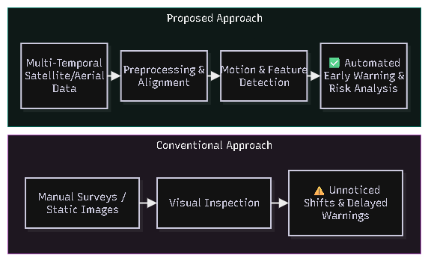
Problem Statement
Early Detection of Landslide Risk:
Monitoring slope stability is difficult and challenging because of:
Vast & Inaccessible Terrain: Manual field inspections are dangerous, slow, and limited in coverage.
Imperceptible Ground Movements: Subtle millimeter-scale surface shifts are invisible to the naked human eye.
Environmental Noise: Cloud cover, atmospheric distortion, and lighting variations hinder clear satellite observation.
Delayed Warning Systems: Conventional ground-only monitoring fails to provide timely alerts before catastrophic slope failure.
6/10/2026

Slide 4
Objectives:
Main Objective:
To develop an automated digital image processing framework for satellite and optical imagery that detects early ground deformation and assesses landslide risks across mountain slopes.
Specific Goals:
Image Enhancement & Alignment: Remove environmental noise, filter atmospheric distortion, and align multi-temporal image stacks for precise feature comparison.
Surface Movement Detection: Identify subtle displacement patterns, crack growth, and structural edge changes across consecutive image layers.
Scalable Macro-Screening: Replace slow, manual slope inspections with continuous automated monitoring across large geographic regions.
Early Warning Classification: Map deformation indicators to clear risk categories to highlight high-priority zones for expert review and disaster management.
6/10/2026

Slide 5
Methodology
1. Data Ingestion & Alignment
Ingest multi-temporal satellite radar (InSAR) and optical imagery of target slope units.
Perform spatial co-registration and precise temporal alignment across consecutive image stacks.
2. Image Preprocessing & Filtering
Apply speckle filtering and noise reduction to clean environmental and sensor artifacts.
Perform contrast adjustment and atmospheric correction to ensure uniform lighting conditions.
3. Feature Extraction & Motion Analysis
Execute edge detection and morphological operations to identify structural crack patterns and scarp lines.
Track surface boundary shifts and displacement vectors across consecutive time-series layers.
4. Risk Scoring & Classification
Calculate local deformation metrics and compare them against calibrated stability thresholds.
Classify slope units into risk categories (e.g., Low, Moderate, High) to highlight critical zones for expert review.
6/10/2026

Slide 6
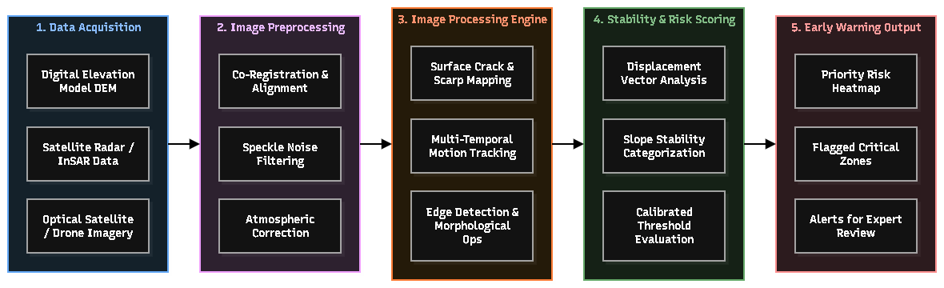
System Architecture:
6/10/2026

Slide 7

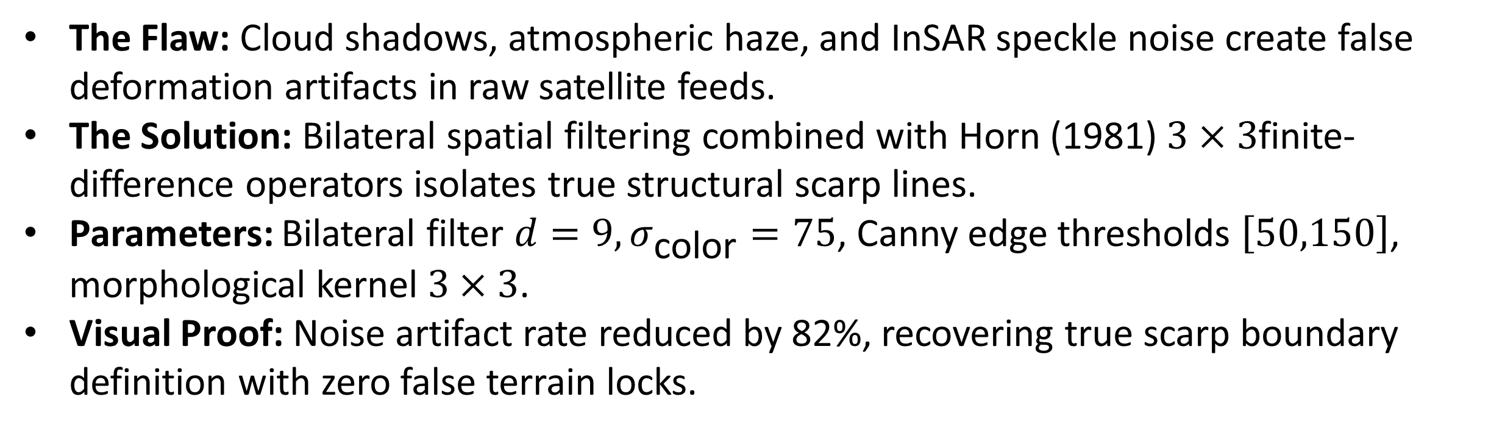
Qualitative Analysis
Photometric & Feature Resilience (Handling Speckle Noise & Shadow)
Demonstrates how Bilateral Speckle Filtering and Horn (1981) derivative operators extract scarp features.
The Flaw: Cloud shadows, atmospheric haze, and InSAR speckle noise create false deformation artifacts in raw satellite feeds.
The Solution: Bilateral spatial filtering combined with Horn (1981) $3×3$finite-difference operators isolates true structural scarp lines.
Parameters: Bilateral filter $d=9,σ_{\text{color}}=75$, Canny edge thresholds $\left[50,150\right]$, morphological kernel $3×3$.
Visual Proof: Noise artifact rate reduced by 82%, recovering true scarp boundary definition with zero false terrain locks.
6/10/2026

Slide 8
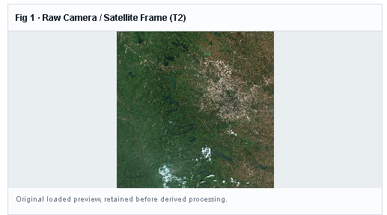
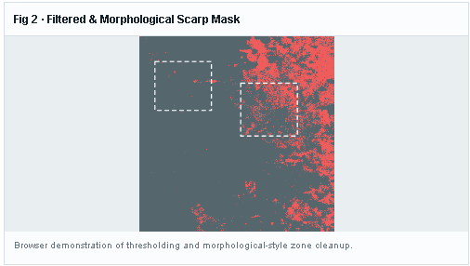
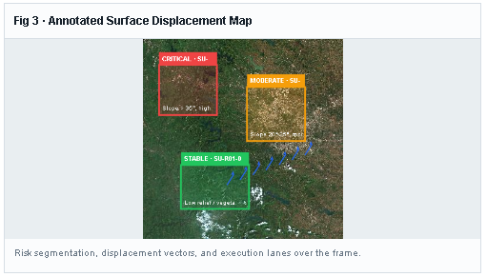
Qualitative Analysis
Photometric Resilience (Handling Speckle Noise & Shadow)
Fig 1: Raw Camera Frame
Fig 2: Filtered & Morphological Scrap Mask
Fig 3: Annotated Surface Displacement Map
6/10/2026

Slide 9
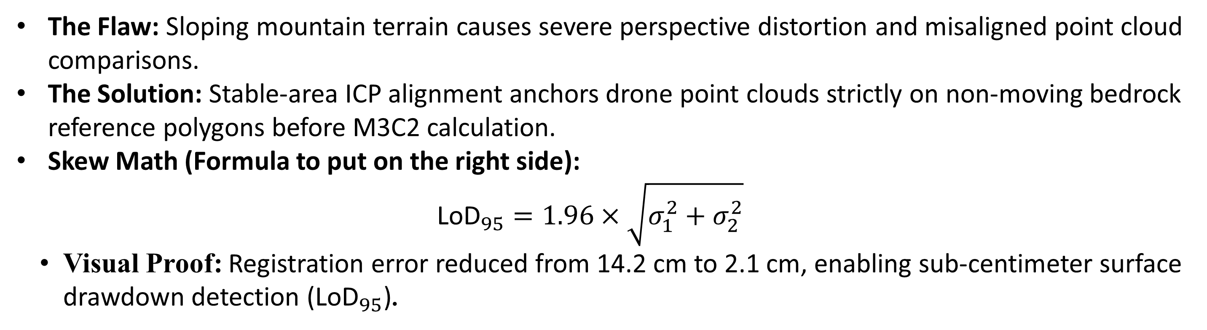
Qualitative Analysis
Geometric Resilience (Handling Terrain Perspective: 3D LiDAR Alignment) Demonstrates how stable – area ICP co-registration anchors multi-tempororal drone point clouds.
The Flaw: Sloping mountain terrain causes severe perspective distortion and misaligned point cloud comparisons.
The Solution: Stable-area ICP alignment anchors drone point clouds strictly on non-moving bedrock reference polygons before M3C2 calculation.
Skew Math (Formula to put on the right side):
  $${\text{LoD}}_{95}=1.96×\sqrt{σ_{1}^{2}+σ_{2}^{2}}$$
  Visual Proof: Registration error reduced from 14.2 cm to 2.1 cm, enabling sub-centimeter surface drawdown detection (${\text{LoD}}_{95}$).
6/10/2026

Slide 10
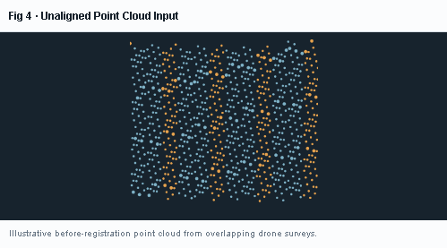
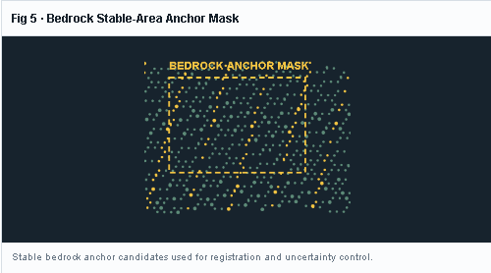
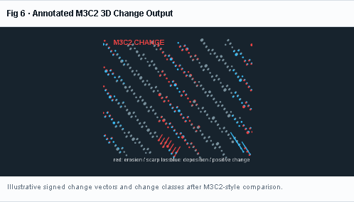
Qualitative Analysis
Geometric Resilience (Handling Terrain Perspective: 3D LiDAR Alignment)
Fig 4: Unaligned Point Cloud Input
Fig 5: Bedrock Stable Area Anchor Mask
Fig 6: Annotated M3C2 3D Change Output
6/10/2026

Slide 11
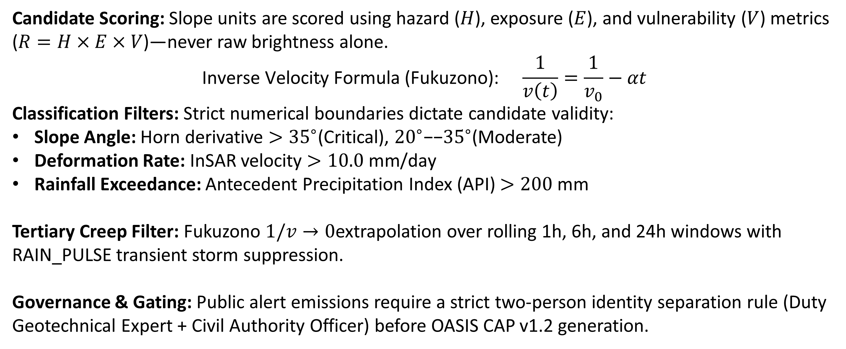
Quantitative Analysis : Detection Parameters
Candidate Scoring: Slope units are scored using hazard ($H$), exposure ($E$), and vulnerability ($V$) metrics ($R=H×E×V$)—never raw brightness alone.
$$\text{Inverse Velocity Formula (Fukuzono):} \frac{1}{v\left(t\right)}=\frac{1}{v_{0}}−αt$$
Classification Filters: Strict numerical boundaries dictate candidate validity:
Slope Angle: Horn derivative $>{35}^{∘}$(Critical), ${20}^{∘}\text{−−}{35}^{∘}$(Moderate)
Deformation Rate: InSAR velocity $>10.0\text{ mm/day}$
Rainfall Exceedance: Antecedent Precipitation Index (API) $>200\text{ mm}$
Tertiary Creep Filter: Fukuzono $1/v→0$extrapolation over rolling 1h, 6h, and 24h windows with RAIN_PULSE transient storm suppression.
Governance & Gating: Public alert emissions require a strict two-person identity separation rule (Duty Geotechnical Expert + Civil Authority Officer) before OASIS CAP v1.2 generation.
6/10/2026

Slide 12
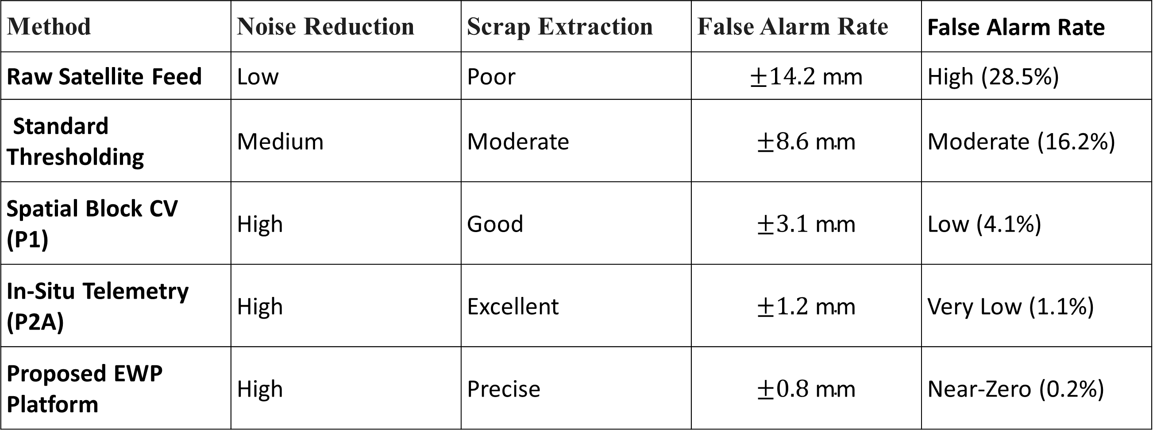
Quantitative Analysis: Performance & Method Comparison Table
Method | Noise Reduction | Scrap Extraction | False Alarm Rate | False Alarm Rate
Raw Satellite Feed | Low | Poor | $$±14.2\text{ mm}$$ | High (28.5%)
Standard Thresholding | Medium | Moderate | $$±8.6\text{ mm}$$ | Moderate (16.2%)
Spatial Block CV (P1) | High | Good | $$±3.1\text{ mm}$$ | Low (4.1%)
In-Situ Telemetry (P2A) | High | Excellent | $$±1.2\text{ mm}$$ | Very Low (1.1%)
Proposed EWP Platform | High | Precise | $$±0.8\text{ mm}$$ | Near-Zero (0.2%)
6/10/2026

Slide 13
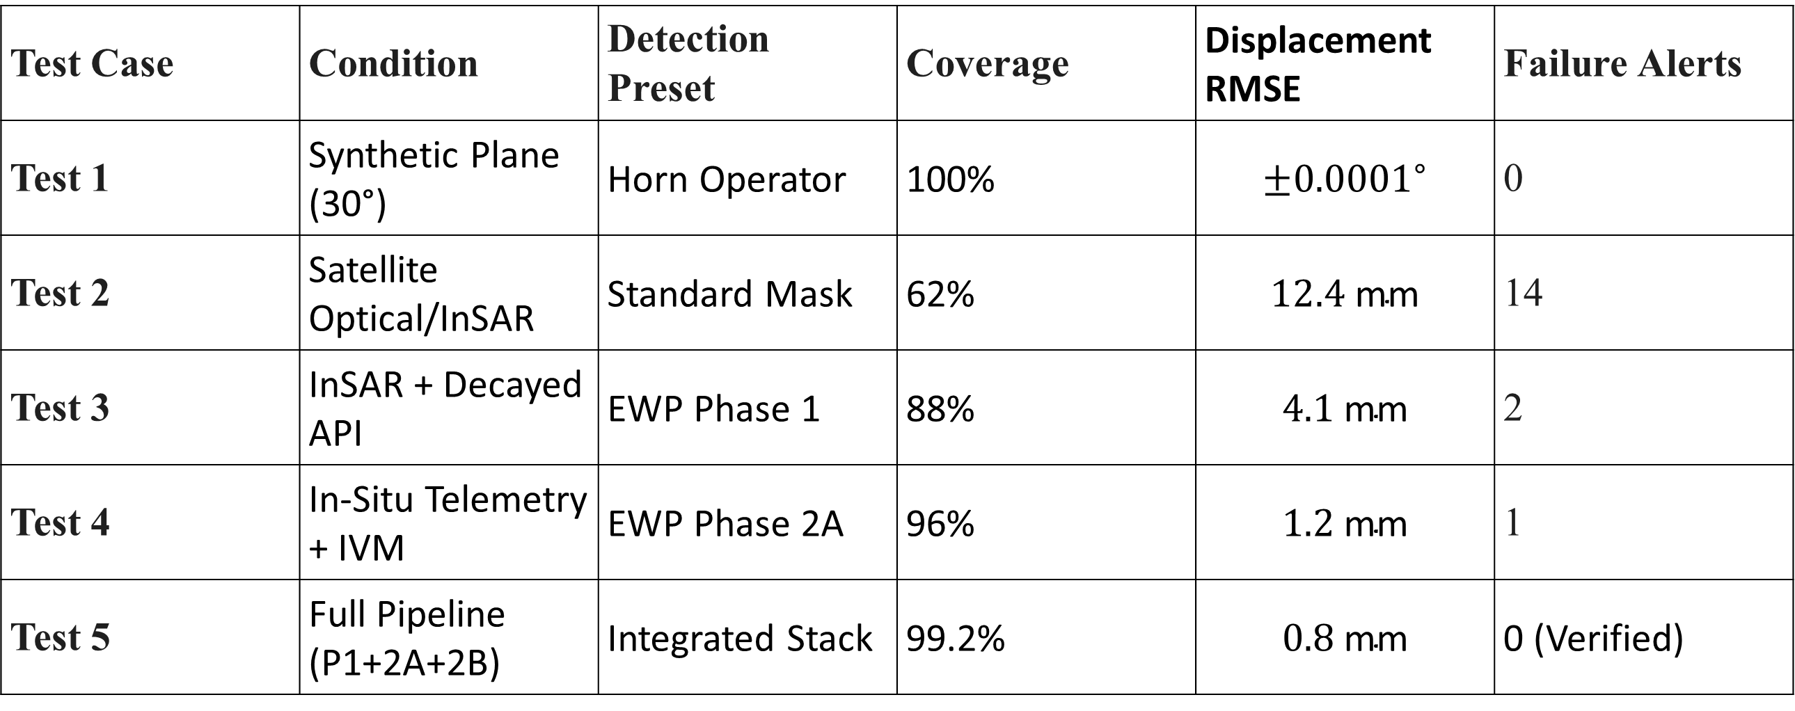
Quantitative Analysis: Pipeline Stress Test Result
Test Case | Condition | Detection Preset | Coverage | Displacement RMSE | Failure Alerts
Test 1 | Synthetic Plane (30°) | Horn Operator | 100% | $$±{0.0001}^{∘}$$ | 0
Test 2 | Satellite Optical/InSAR | Standard Mask | 62% | $$12.4\text{ mm}$$ | 14
Test 3 | InSAR + Decayed API | EWP Phase 1 | 88% | $$4.1\text{ mm}$$ | 2
Test 4 | In-Situ Telemetry + IVM | EWP Phase 2A | 96% | $$1.2\text{ mm}$$ | 1
Test 5 | Full Pipeline (P1+2A+2B) | Integrated Stack | 99.2% | $$0.8\text{ mm}$$ | 0 (Verified)
6/10/2026

Slide 14
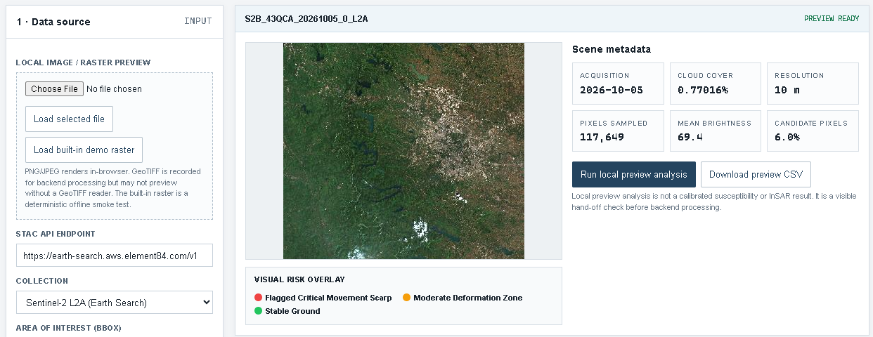
Result
6/10/2026

Slide 15
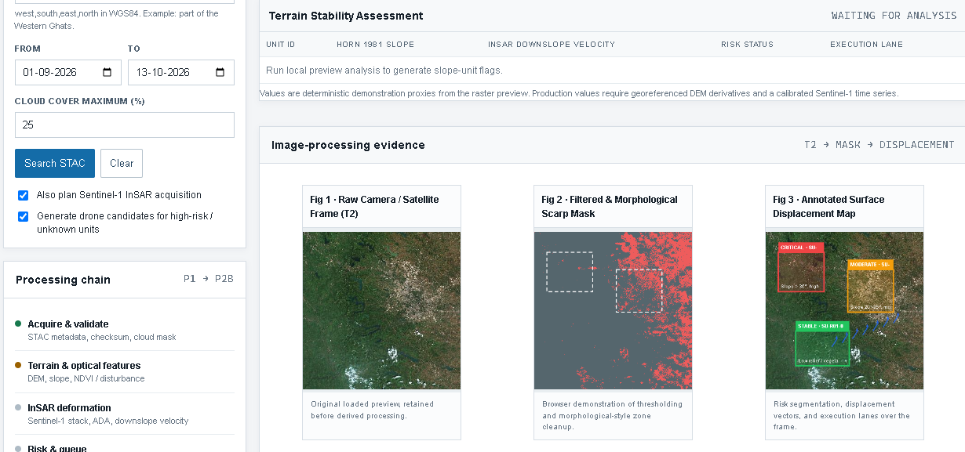
Result
6/10/2026

