Slide 1
Xerox Center Billing System
Presented By :
1.Gauri Ghogale
2.Komal Mishra
3.Shaazneen shaikh
4.Pratham pal singh bhamrah
D.S.E. (Computer)
Semester-III
Guided By : Prof. Ashwini Vitekari

Slide 2
ABSTRACT
.The project is to create an application that
should provide service to the user.
.The Billing system has the capacity to illustrate and analyze the basic billing system and the main functionalities that surround the billing system from a business prospective and explains how each interacts to complete the billing cycle.

Slide 3
INTRODUCTION
A program for XEROX CENTER BILLING SYSTEM is created to simplify Xerox center billing process.
Xpert Billing enables you to track, control and manage device usage and optimize cost recovery. With Xpert Billing you can identify cost sources and bill back those costs to departments, accounts, clients and employees.

Slide 4
Existing System
Café billing systems
Resturants billing systems
Shopping mall billing system

Slide 5
PROBLEM DEFINITION
The functionalities like stock and purchase management, payments and receivables, accounting, everyday store difficulties and more cannot be managed by a person.
Print volumes are projected to drop, and continue to drop, in industrialised countries, but are rising in countries that are not industrialised.

Slide 6
FEATURES
Manage and track all devices from one PC Simple to install and use Quotas based on black-and-white impressions, color impressions, or a dollar amount Works in peer-to-peer printing environments or print server environments No additional hardware required – Xpert Billing integrates with the Xerox device through the network.

Slide 7
FUTURE SCOPE
Creating an mobile application for Xerox center billing system
The print industry has changed massively in recent decades, particularly in the last few years due to advances in technology such as the Internet. Printing has previously tried to focus on managed print services that save companies money.

Slide 8
HARDWARE REQUIREMENTS
Monitor, Mouse , Keyboard
Processor: 1 GHz or faster.
RAM: 1GB (32-bit) or 2GB (64-bit)
Graphics: DirectX 9 or later with WDDM 1.0 driver.
16 GB available hard disk space (32-bit) or 20 GB (64-bit)

Slide 9
SOFTWARE REQUIREMENTS
Frontend
Python 3.7.5

Slide 10
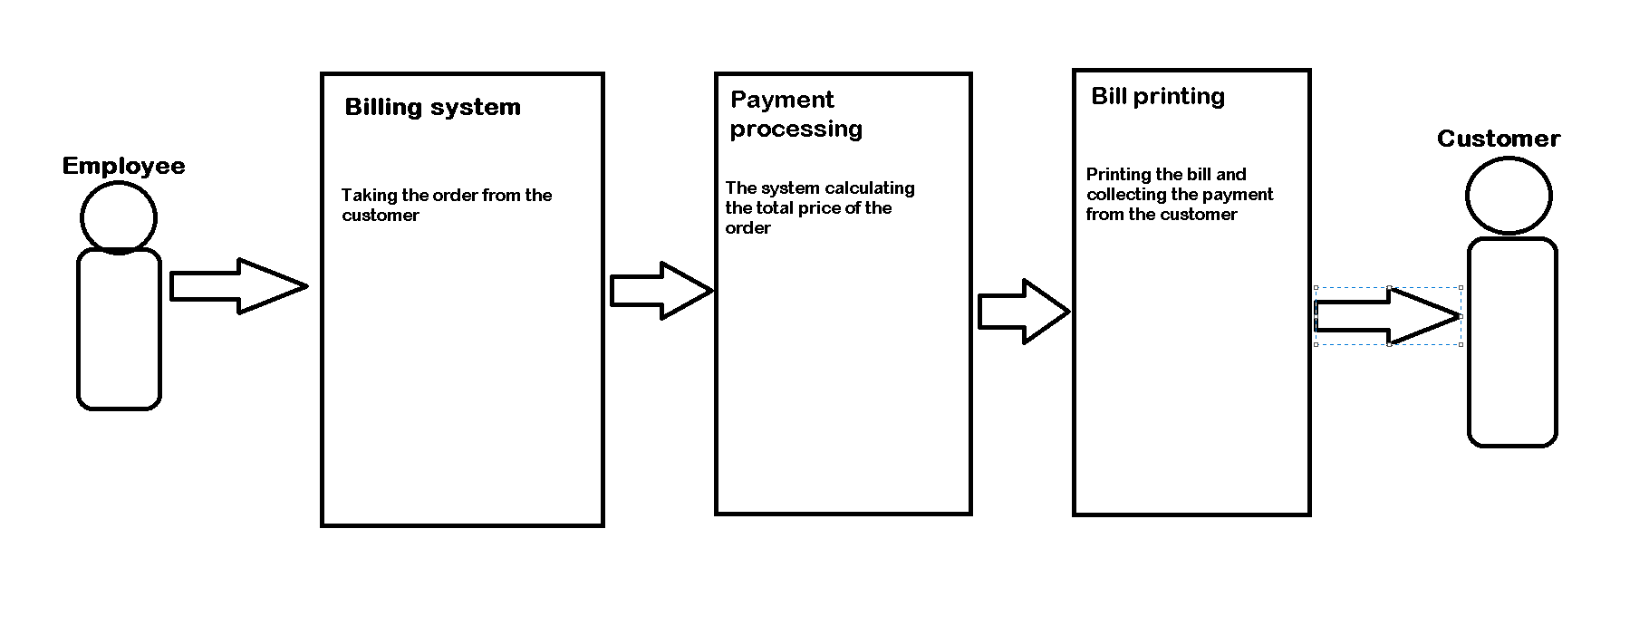
SYSTEM ARCHITECTURE

Slide 11
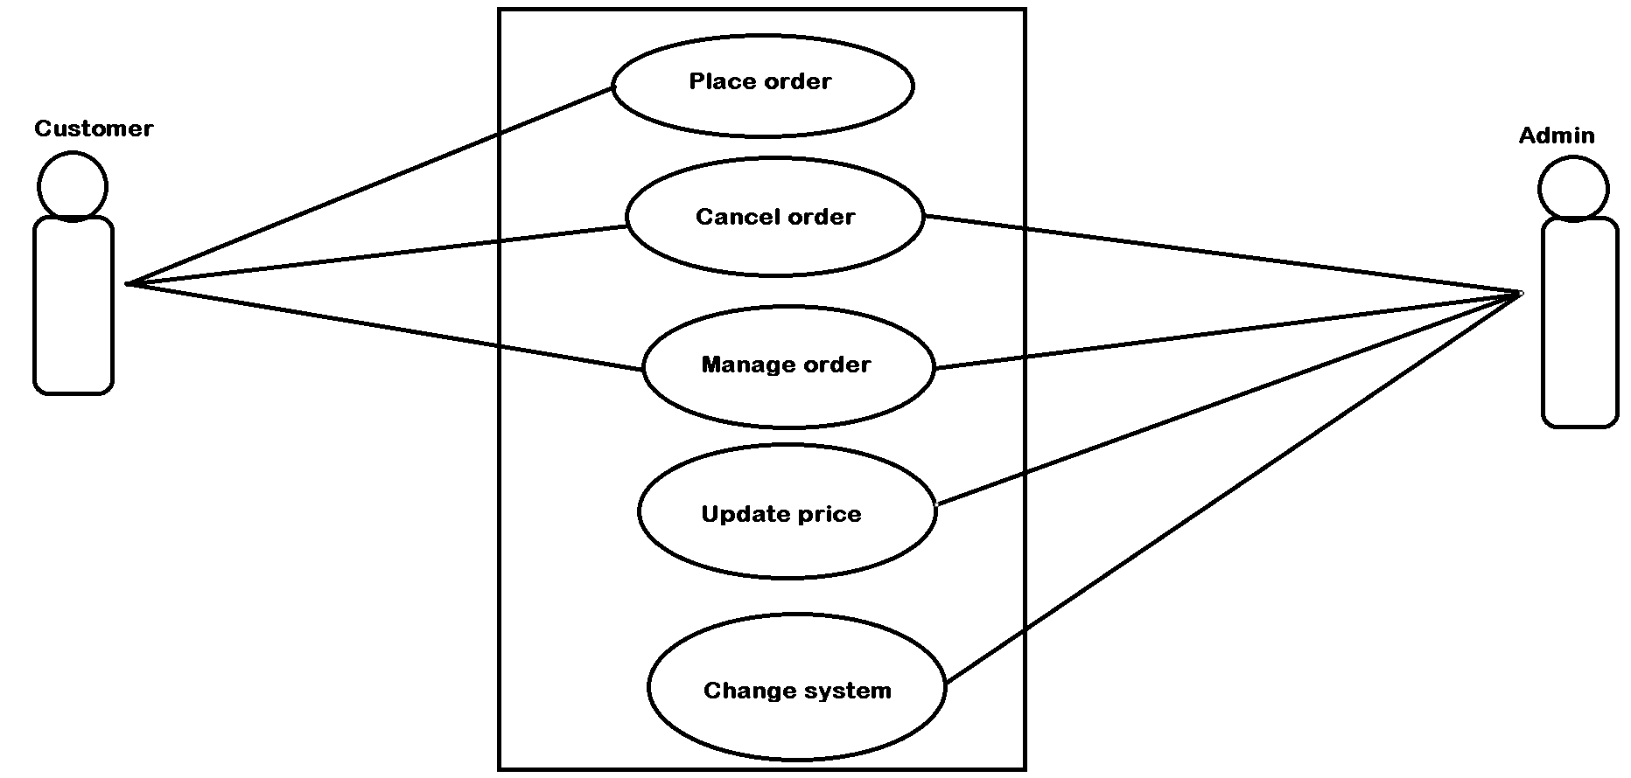
USE CASE DIAGRAM

Slide 12
CONCLUSION
The project Xerox center billing system gives us the facility to manage the Xerox centers.
This application is helpful for staff or admin for billing for Xerox,lamination,etc.

Slide 13
REFERENCES
www.Wikipedia.org
www.learnpython.com
www.geeksforgeeks.com

Slide 14
THANK YOU

