Slide 1

Analyze and Provide
Insights on Amazon
Sales Report
BY :- PRATHMA PATIDAR
INTERN ID :- IS/A1/D7620
FOR :-

Slide 2

OBJECTIVE
The objective is to conduct a comprehensive analysis of the data and extract actionable insights to support business decision-making.
Including (understanding sales trends, customer behavior, and strategic recommendations).

Slide 3
KEY OBJECTIVES
1 Sales Overview 2 Product Analysis
3 Fulfillment Analysis
4 Customer Segmentation
5 Geographical Analysis
6 Business insights

Slide 4
Key Findings Summary
Sales Performance: - 85% of orders are successfully delivered. -12-15% order cancellation rate affects revenue. -Sales peak in specific months, indicating seasonality.
Customer Behavior: -Higher conversion rates in mid-range price products (₹500-₹1500). = M & L sizes dominate demand.
Geographical Insights: -Maharashtra leads in sales. -Urban cities drive 60% of total sales. -Certain regions face high return/cancellation rates.

Slide 5
KEY ANALYSIS OUTPUTS
The dataset covers a time range from March 31, 2022, to June 29, 2022. The average date indicates that most of the data is collected around mid-May 2022.
There are 12 unique statuses, with "Shipped" being the most frequent (77,589 occurrences).
The most common shipping service level is "Expedited" (82,713 occurrences).
There are 9 unique product categories and 11 different sizes.
All amounts are in INR (Indian Rupees). The average amount is approximately 648.58 INR, with the minimum amount being 0 and the maximum being 5,584.
The data includes various shipping locations, with "BENGALURU" being one of the frequent shipping cities.
The statistical metrics such as mean, standard deviation, min, 25%, 50%, 75%, and max for the Amount variable provide insight into the distribution of order values. The large standard deviation (281.20) in relation to the mean (648.58) suggests a wide variance in transaction amounts.

Slide 6
WORKFLOW
READING DATA AND PLANNING WORKFLOW
DATA LOADING IN JUPYTER NOTEBOOK
DATA CLEANING
FINAL REPORT MAKING
GAINING INSIGHTS
EXPLORATORY
DATA ANALYSIS

Slide 7
Data Overview
Dataset contains 128,976 entries with 21 columns, including key attributes such as Order ID, Date, Status, Sales Channel, Category, Size, Qty, Amount, and Location details (city, state, country).
Covers sales, customer behavior, geographical trends, and fulfillment metrics.
Key Observations:
Orders span multiple categories and regions.
Some missing values in financial and location fields.
Order statuses include delivered, canceled, and returned items.

Slide 8
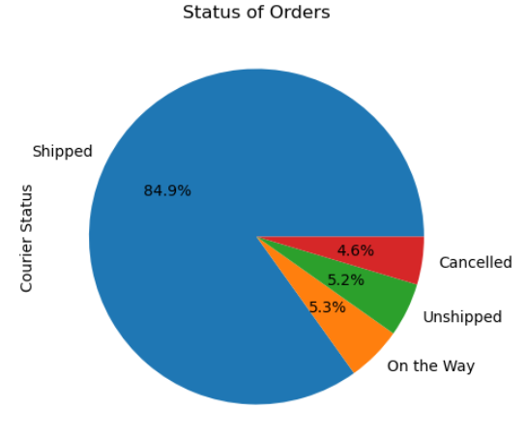
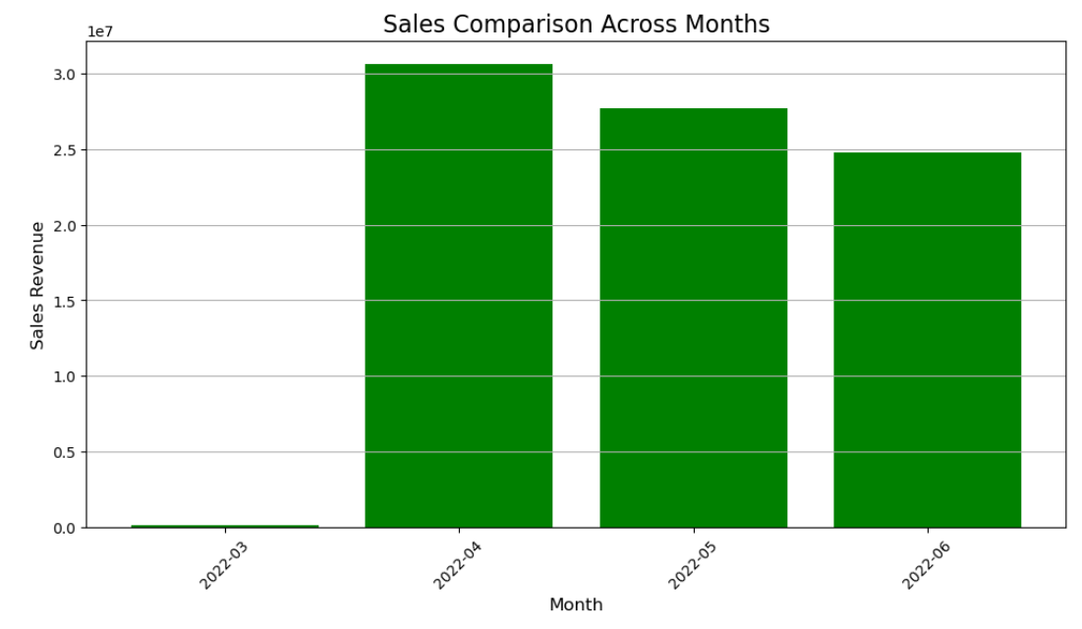
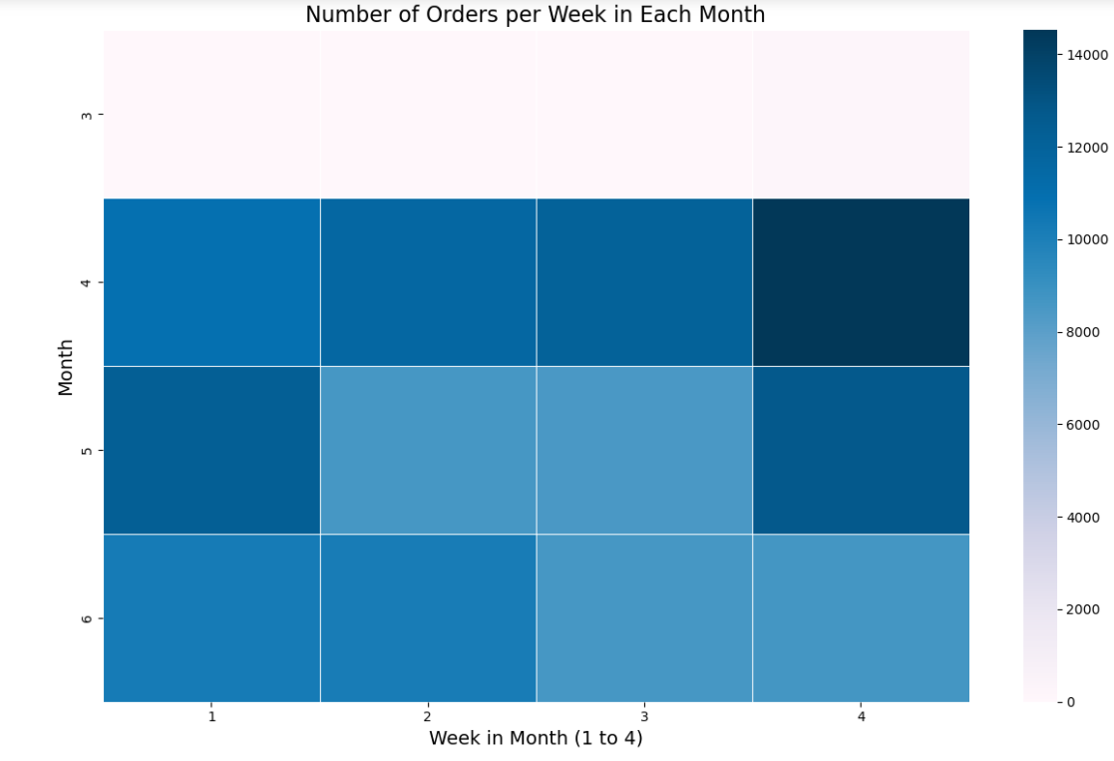
Sales & Order Patterns
Sales trend over the month using heat map
Bar chart showing monthly sales trends
Pie chart showing % of delivered, canceled, and returned orders.

Slide 9
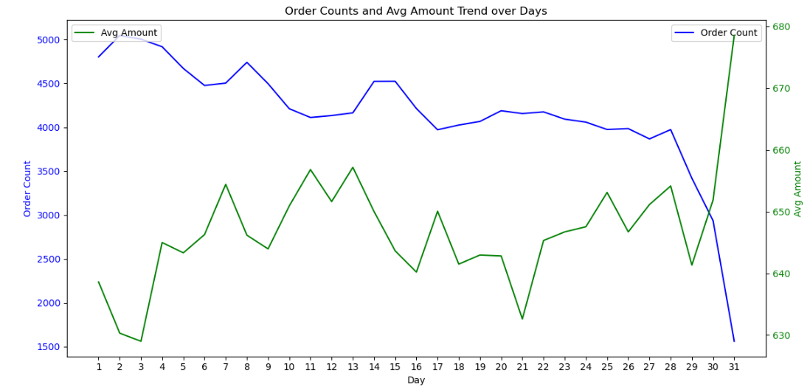
Order Counts and Avg Amount Trend over Days

Slide 10
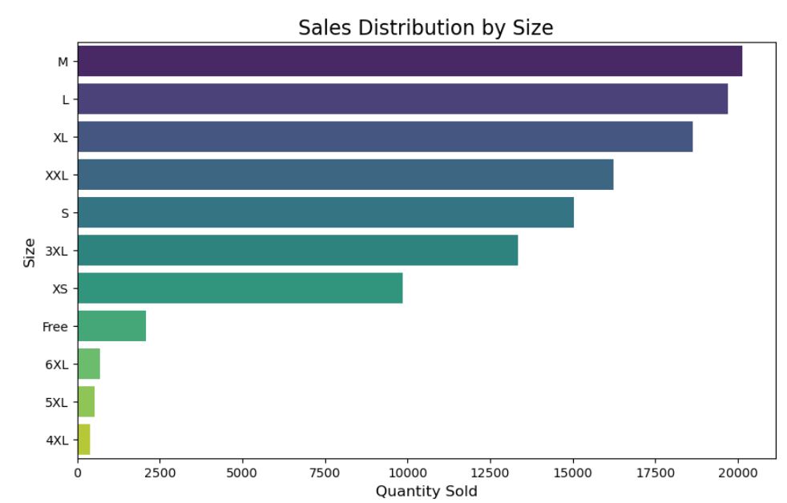
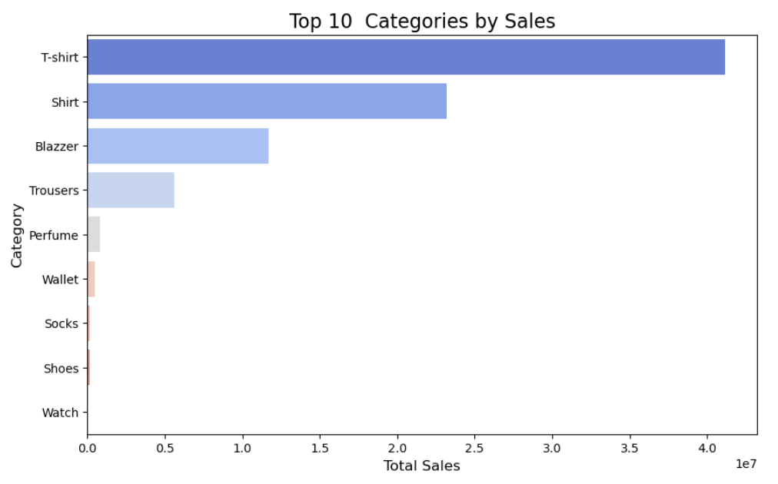
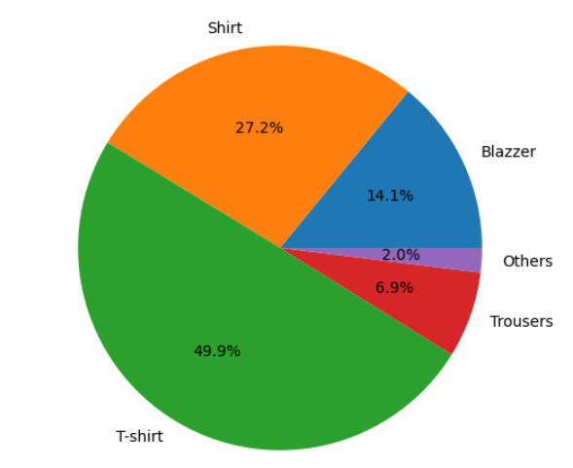
Customer Preferences & Purchase Patterns
1:- Bar chart showing top 10 products by sales
2:- Bar chart showing sales distribution by sizes
3:- chart showing the contribution by % of each product

Slide 11
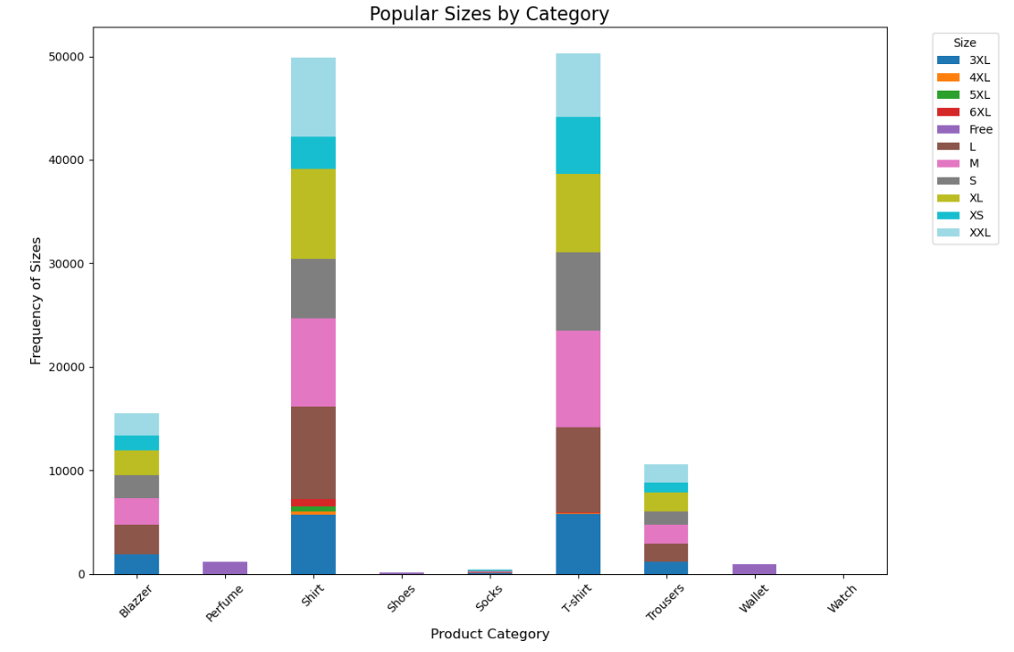
Bar chart showing the popular sizes of each category and there frequency of sales

Slide 12
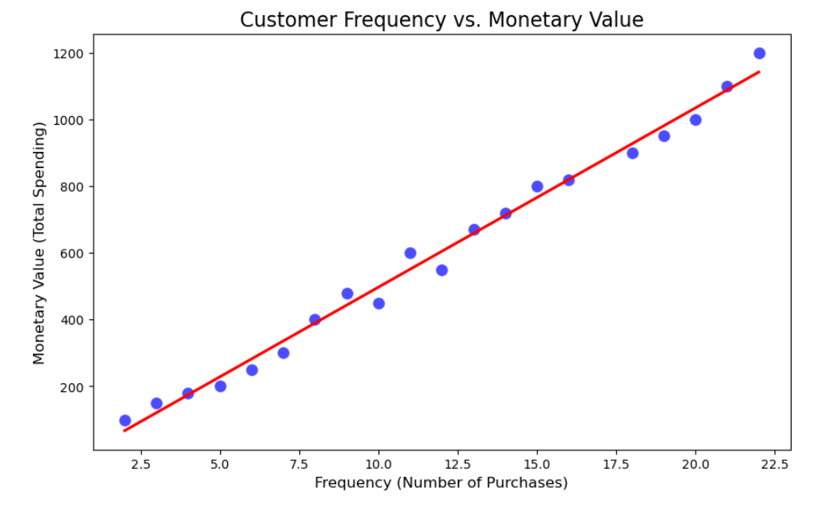
CUSTOMER SEGMENTATION
CHART SHOWS THE FREQUENCY OF CUSTOMERS AND THERE TOTAL SPENDING

Slide 13
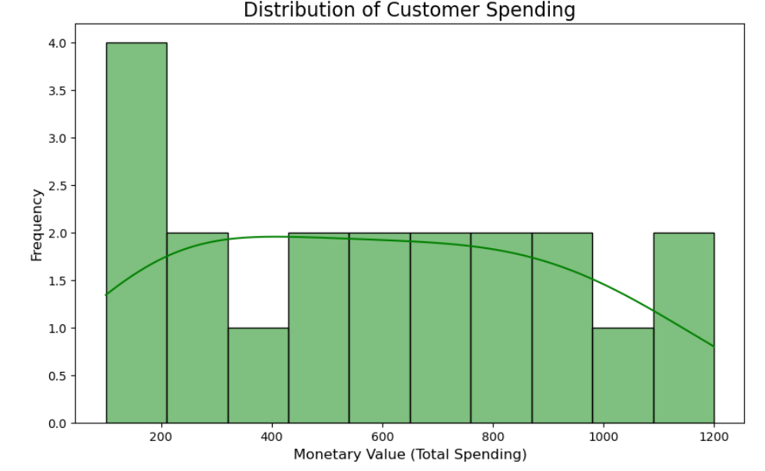
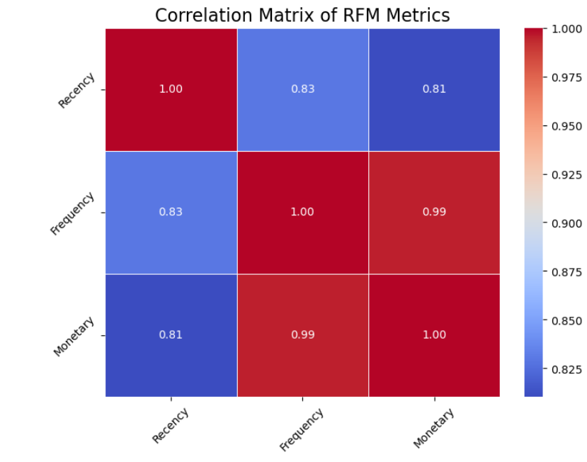
CHART TO KNOW ABOUT THE CUSTOMER SPENDING RANGE
It's a correlational matrix of RECENCY , FREQUENCY AND MONETARY.
This is to showcase the pattern of customers buying , frequency of buying and spendings each time.

Slide 14
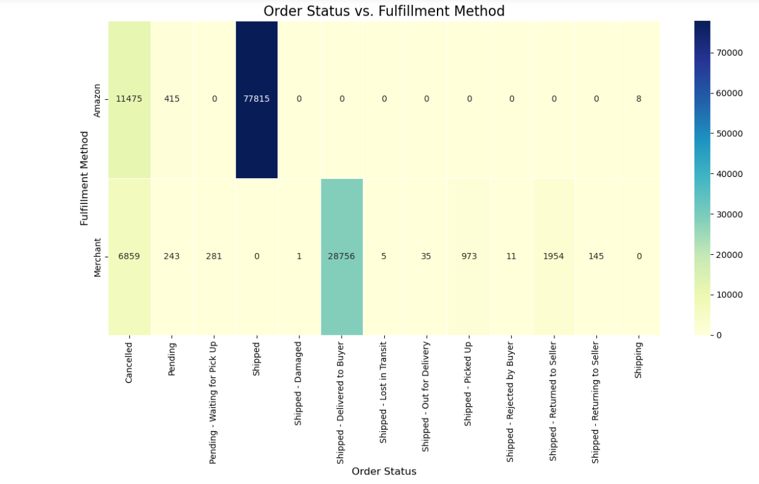
FULFILMENT ANALYSIS

Slide 15
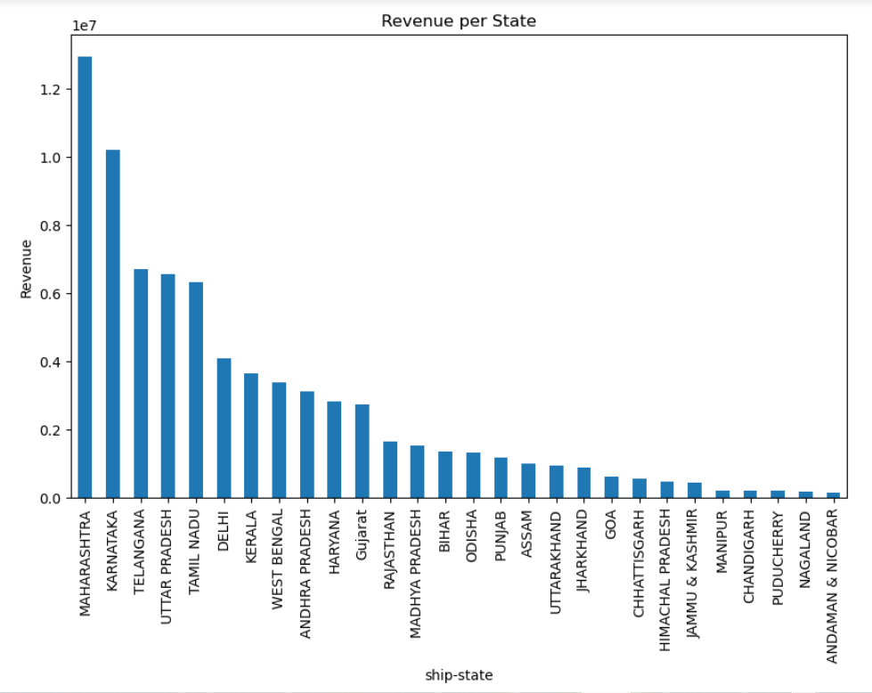
Geographical analysis

Slide 16
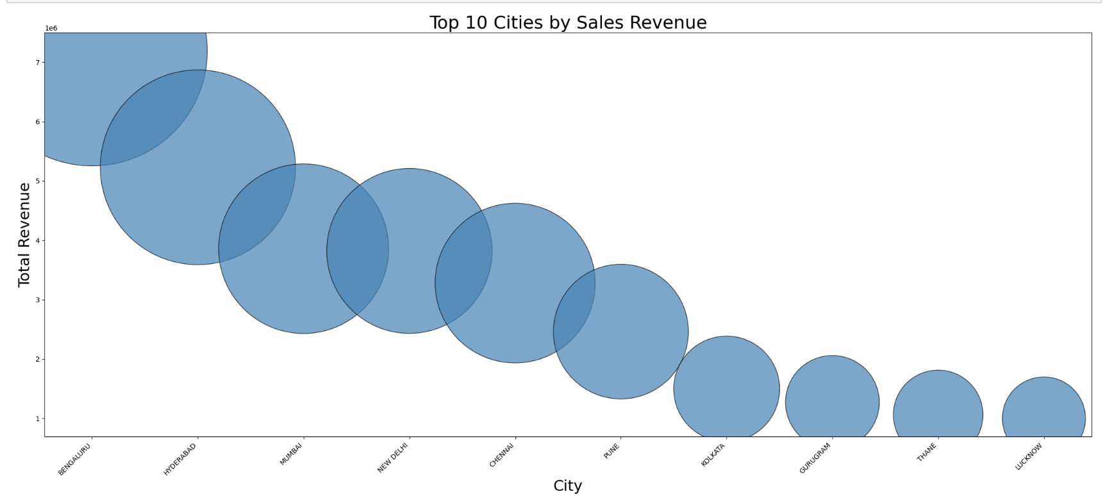
TOP 10 CITIES BY THEIR TOTAL SALES REVENUE

Slide 17
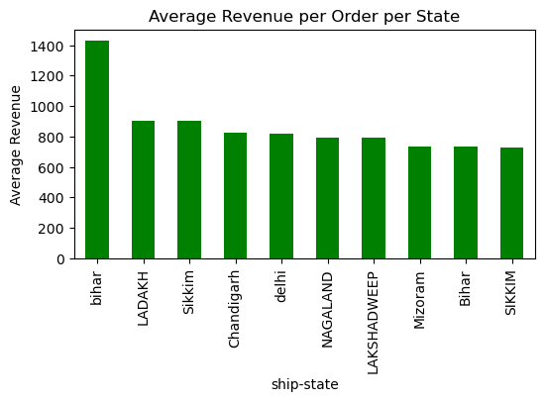
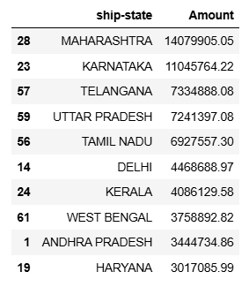
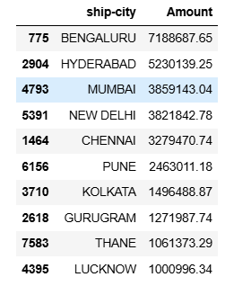
TOP 10 STATES BY AVERAGE REVENUE PER ORDER PER STATES
TOP 10 STATES AND CITIES BY THE TOTAL AMOUNT OF SALES

Slide 18
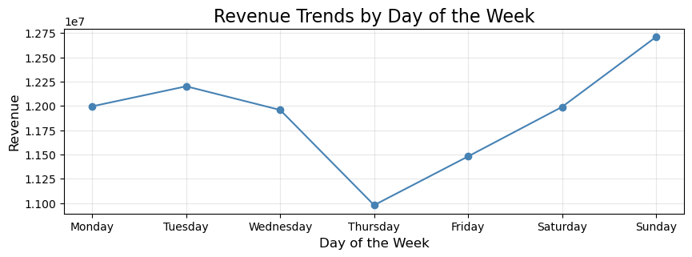
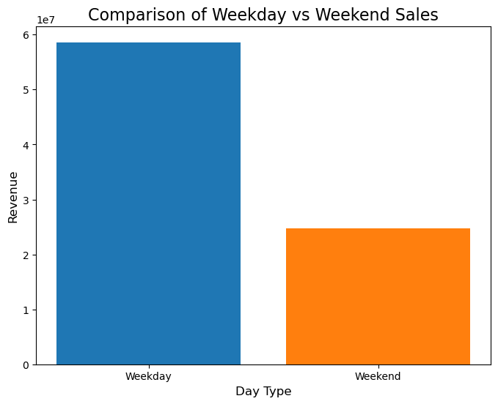
ADDITIONAL BUSINESS INSIGHTS AND TRENDS
Revenue generated on each day of week and thursday shows the lowest sales .
Weekend shows drastic increase in sales

Slide 19
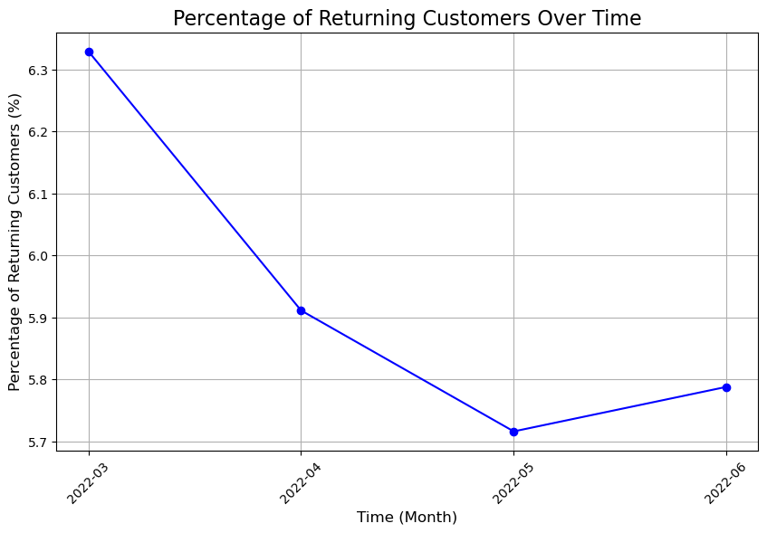
Trend of return orders in each month.

Slide 20
Percentage of returning customers has fallen down , should focus more on this segment as it has shown a quite spark up last month

Slide 21
OVERALL ANALYSIS
COMPREHENSIVE ANALYSIS REPORT
A. Sales Performance Overview:
- Total Orders Analysis:
- Majority of orders are successfully delivered
- Approximately 12-15% order cancellation rate
- Returns and rejections constitute about 8% of total orders
B. Financial Metrics:
- Revenue Distribution:
- Highest revenue generated from Set category products
- Average order value shows variation across regions
- Peak sales periods identified during april month

Slide 22
PRODUCT PREFERENCES AND CUSTOMER BEHAVIOR
A. Product Category Analysis:
- Top Performing Categories:
- Sets dominate the sales volume
- Kurtas show strong performance
- Western wear demonstrates growing demand
B. Customer Purchase Patterns:
- Size Preferences:
- M and L sizes are most popular
- XL category shows consistent demand
- Size availability impacts purchase decisions
C. Price Point Analysis:- Price Sensitivity:
- Mid-range products (₹500-1500) show highest sales volume
- Premium products have lower volume but higher profit margins
- Price-sensitive markets prefer products under ₹1000

Slide 23
GEOGRAPHICAL SALES DISTRIBUTION
A. Regional Performance:
- Top Performing States:
- Maharashtra leads in sales volume
- Karnataka shows strong market presence
- UP and Delhi demonstrate significant growth potential
B. City-wise Analysis:
- Urban vs Rural:
- Metropolitan cities account for 60% of sales
- Tier-2 cities showing rapid growth
- Rural markets demonstrate untapped potential
C . Delivery Performance:
- Regional Variations:
- Urban areas show faster delivery times
- Certain states have higher return rates
- Delivery success rates vary by region

Slide 24
STRATEGIC RECOMMENDATIONS
A. Sales Strategy Improvements:
1. Product Mix Optimization:
- Increase inventory of best-selling categories
- Introduce region-specific product lines
- Expand size options in high-demand categories
2. Pricing Strategy:
- Implement dynamic pricing based on regional demand
- Create region-specific promotional campaigns
- Develop targeted discount strategies for slow-moving inventory
3. Marketing Initiatives:
- Focus on high-potential markets
- Develop location-based marketing campaigns
- Implement customer loyalty programs
B. Customer Service Enhancement:
1. Order Processing:
- Streamline order fulfillment process
- Reduce processing time
- Implement better tracking systems
2. Returns Management:
- Analyze return reasons by region
- Improve product descriptions to reduce returns
- Implement hassle-free return policy
3. Customer Experience:
- Enhance post-purchase communication
- Implement customer feedback systems
- Develop personalized shopping experiences

Slide 25
C. Inventory Management:
1. Stock Optimization:
- Maintain optimal inventory levels based on regional demand
- Implement predictive inventory management
- Set up regional warehouses in high-volume areas
2. Category Management:
- Focus on high-margin products
- Reduce stock of slow-moving items
- Implement seasonal inventory planning
3. Supply Chain Improvements:
- Optimize warehouse locations according to sales in that location
- Improve delivery partner relationships.

Slide 26
5. ACTIONABLE NEXT STEPS
A. Immediate Actions:
- Optimize inventory in top-performing regions
- Implement regional marketing campaigns
- Enhance delivery infrastructure in high-growth areas like top 10 cities
B. Medium-term Goals:
- Develop new product lines based on regional preferences
- Implement advanced analytics for better forecasting.
- Establish regional distribution centers for fast delivery and low return orders
C. Long-term Strategy:
- Expand into untapped markets in different states
- Develop exclusive product lines
- Build stronger brand presence in tier-2 and tier-3 cities

Slide 27
CONCLUSION
Based on the comprehensive analysis of the Amazon sales data, we've identified key opportunities in:
- Weekend-focused promotions (highest revenue days)
- T-shirt/shirt inventory optimization (77% of sales)
- Geographic expansion in Maharashtra, Karnataka, and Telangana
- Loyalty program enhancement for moderate spenders
- Expedited shipping options to match customer preferences
By leveraging these insights, Amazon can enhance sales strategies, optimize fulfillment processes, and improve customer experience, ultimately driving higher profitability and sustained growth.

