Slide 1








PREDICTIVE ANALYTICS & APPLIED ML
CineForecast
Explainable Machine Learning for Pre-Release Film Revenue Forecasting & ROI Underwriting
PROJECT LEAD / AUTHOR
Pratham Raval
ML Engineering & Architecture
EVALUATION DATASET
3,931 Clean TMDB Films
Verified Pre-Release Financials
CHAMPION ARCHITECTURE
Optuna-Tuned XGBoost
TreeExplainer SHAP Attribution
PRODUCTION PLATFORM
FastAPI + React 18
Interactive What-If Studio
CORE TECHNOLOGIES
Notes:
Welcome to CineForecast. This project addresses the multi-million dollar challenge of theatrical box office risk underwriting. By leveraging 3,931 verified historical films from TMDB, we developed a leakage-safe machine learning engine that forecasts worldwide box office revenue and classifies return on investment tiers before theatrical debut. Today's presentation highlights our data audit, architecture, modeling benchmarks, and interactive analytics platform.

Slide 2
ROADMAP & STRUCTURE
Project Outline & Analytical Progression
Visual agenda covering our end-to-end machine learning engineering lifecycle
01 • FILM FINANCING RISK
Problem & Objectives
Quantifying box-office volatility, missing financials, and the risk of post-release target leakage.
02 • QUALITY FUNNEL
Data Audit & Cleaning
Resolving 232 duplicates, 47.7% missing budgets, and parsing malformed list features into 3,931 films.
03 • END-TO-END PIPELINE
System Architecture
Strict chronological cutoffs, rolling director priors, FastAPI REST services, and React dashboard.
04 • CHAMPION OPTIMIZATION
Machine Learning Models
Ridge baseline, CatBoost benchmark, and Optuna-tuned Champion XGBoost with TimeSeriesSplit.
05 • ABLATION & SHAP
Results & Explainability
Held-out test evaluation, proof of popularity inflation, and TreeExplainer feature attributions.
06 • WHAT-IF STUDIO
Application & Future Scope
Real-time pre-production sensitivity simulator, production deployment, and multi-modal roadmap.
Notes:
Our presentation follows a structured six-stage roadmap. We begin with the financial problem statement and the necessity of preventing hindsight leakage. Next, we review the data cleaning audit and system architecture. We then deep-dive into the ML benchmark results, ablation study, and SHAP explainability. Finally, we showcase the live interactive What-If Studio and our future engineering roadmap.

Slide 3
PROBLEM CONTEXT & MANDATE
Problem Statement & Strategic Objectives
De-risking capital allocation in theatrical motion pictures through pre-release intelligence
CORE PROBLEM STATEMENT
Film greenlighting commits $50M–$200M+ under extreme market uncertainty, compounded by 47% missing financial data in public catalogs and widespread post-release target leakage.
GOAL 01
Pre-Release Revenue Forecasting
Predict worldwide box office gross in log USD using strictly pre-release attributes.
GOAL 02
Four-Tier ROI Classification
Classify projects into Flop (<0x), Break-even (0-1x), Hit (1-3x), and Blockbuster (≥3x).
GOAL 03
Zero Target Leakage Discipline
Strict chronological cutoffs to eliminate post-release popularity and vote bias.
GOAL 04
Interactive What-If Simulation
Provide live sensitivity analysis for studio executives to test budgets and release dates.
47.74%
Missing Budget in Raw Data
44.32%
Missing Revenue in Raw Data
3,931
Final Clean Verified Films
56.98%
Historical Hit/Blockbuster Rate
Notes:
Every film production decision carries massive financial downside risk. In raw TMDB data, nearly half the entries omit budget or box office earnings. Furthermore, many published models commit a critical error: they use post-release audience votes to predict revenue, which is impossible before release. CineForecast sets four strict objectives: pre-release revenue prediction, four-tier ROI risk classification, zero target leakage, and real-time scenario simulation.

Slide 4
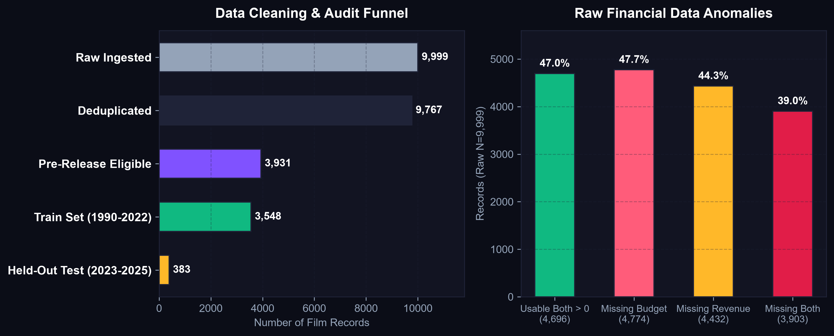
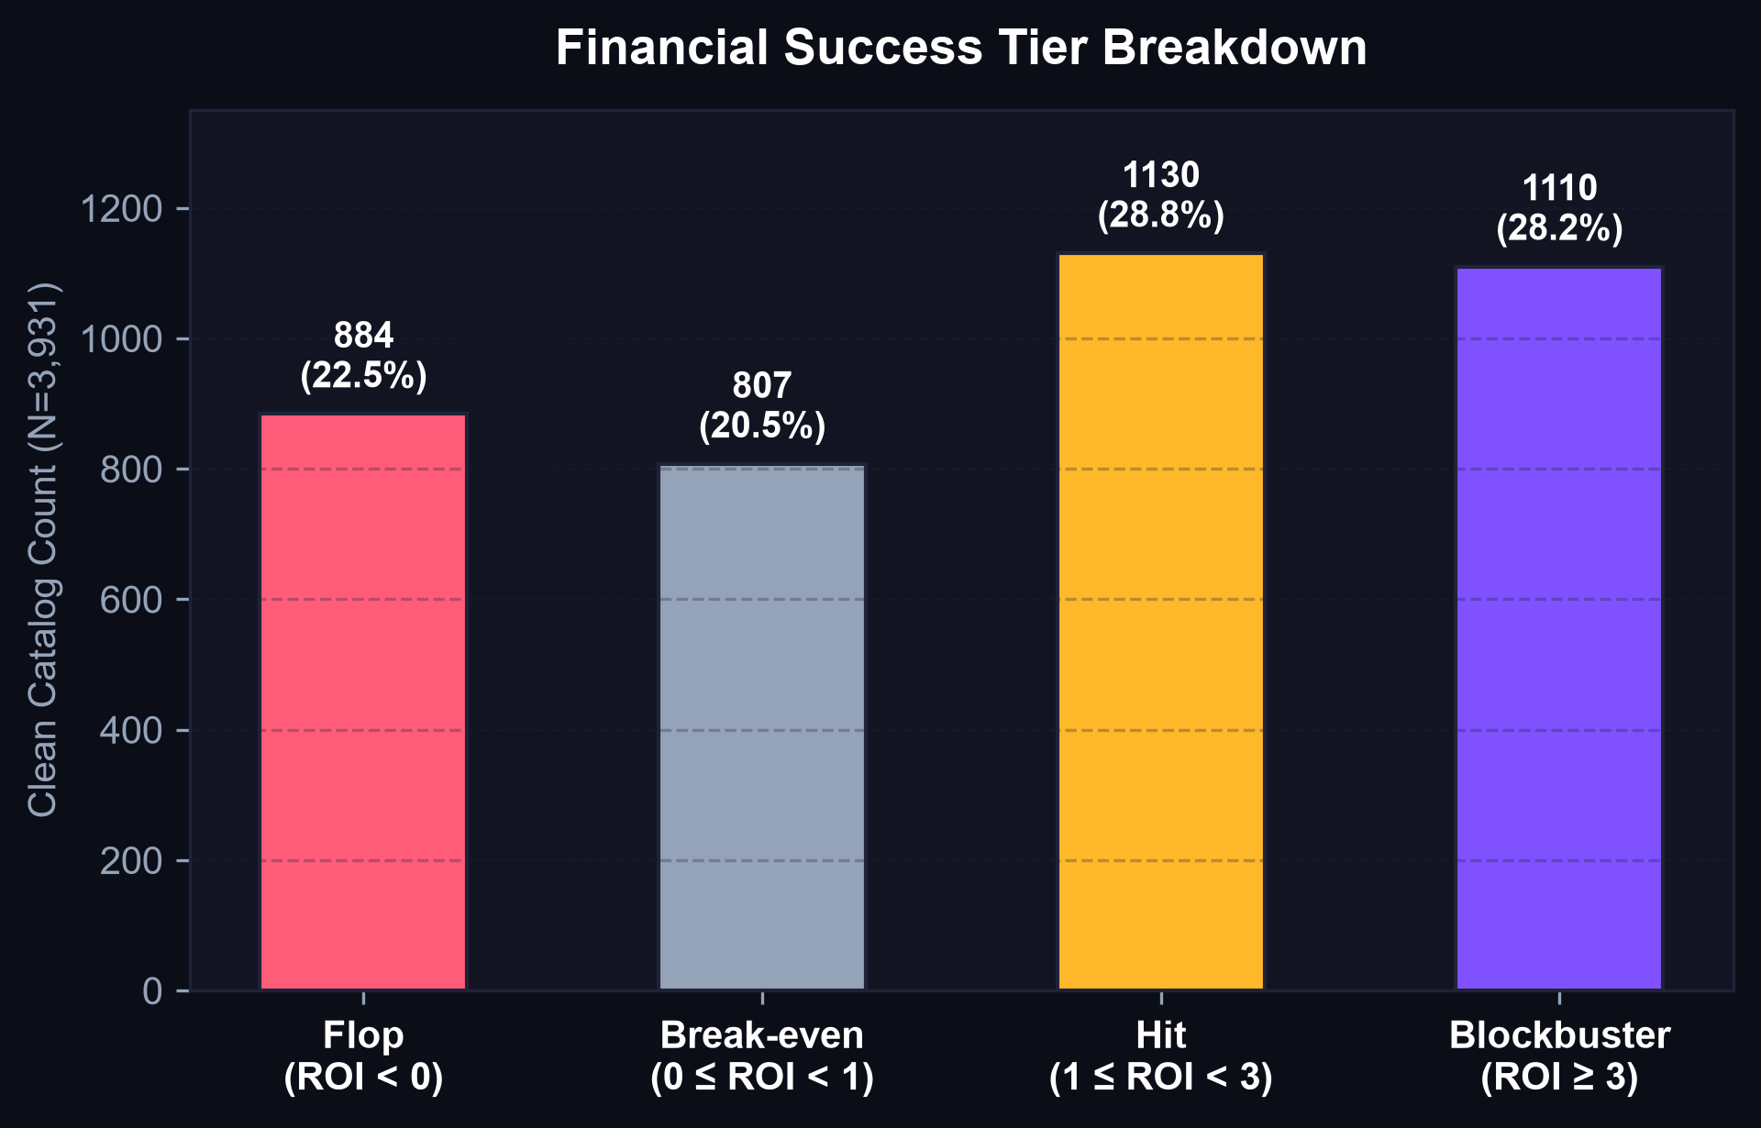
DATA ENGINEERING & AUDIT
Dataset Curation & Quality Funnel
Transforming 9,999 noisy raw records into 3,931 leakage-safe training samples
47.7% MISSING FINANCIALS
Handled Non-Silently
Raw zeros reflect unrecorded telemetry rather than actual zero spend. Excluded from supervised training without synthetic imputation.
232 DUPLICATE SNAPSHOTS
Completeness-Based Retention
Multi-attribute scoring retained exactly one most complete record per film ID, preserving 9,767 unique movies.
TEMPORAL STABILITY
1990–2025 Release Window
Historical pre-1990 releases and future releases up to 2031 filtered to maintain modern macroeconomic consistency.
Notes:
This slide presents our rigorous data audit findings. Starting from 9,999 raw TMDB entries, we identified 232 duplicates, which we resolved using completeness scoring. We filtered out zero-budget and zero-revenue records, removed historical pre-1990 films to preserve macroeconomic consistency, and excluded future-dated entries up to 2031. The resulting 3,931 films show a balanced tier distribution, with 56.9% achieving Break-even or better returns.

Slide 5
TECHNICAL BLUEPRINT
End-to-End System Architecture
Multi-stage pipeline spanning ingestion, leakage-safe feature engineering, REST APIs, and UI
STAGE 1
Data Ingestion & Audit
STAGE 2
Leakage-Safe Features
STAGE 3
ML Optimization & Registry
STAGE 4
Application & Serving
Raw TMDB Catalog
9,999 rows, 15 raw columns
Chronological Rolling Priors
Director & studio historic gross
Baseline Ridge
L2 regularized benchmark
FastAPI Backend
/api/predict, /api/whatif, /api/shap
Completeness Audit
Resolved 232 duplicates
Genre Encoders
17 multi-hot genre flags
Optuna Tuning
5-fold TimeSeriesSplit CV
Relational DB
SQLite / PostgreSQL catalog
➔
➔
➔
Type Sanitation
ast.literal_eval list parser
Temporal Splitting
Train: 1990-2022 | Test: 2023-2025
TreeExplainer SHAP
Waterfall cache for 383 test films
React 18 + Vite
High-density Dark Void UI
Interim Parquet
9,767 parsed unique movies
Feature Manifest
34 clean pre-release inputs
Model Registry
Serialized joblib artifacts
What-If Studio
Real-time parameter sensitivity
Notes:
Our system architecture is designed for production reliability and analytical integrity. In Stage 1, raw catalog data is ingested and sanitized. In Stage 2, our leakage-safe feature builder computes rolling historical priors with strict temporal cutoffs to eliminate future data contamination. Stage 3 optimizes gradient boosted trees using Bayesian search via Optuna and serializes models and SHAP cache to the registry. Stage 4 serves inference through a FastAPI REST engine to an interactive React dashboard.

Slide 6
MODELING & OPTIMIZATION
Machine Learning Models & Bayesian Tuning
Comparing linear baselines against gradient boosted decision tree ensembles
BASELINE MODEL
Ridge Regression
L2-Regularized Linear
BENCHMARK MODEL
CatBoost Regressor
Oblivious Decision Trees
CHAMPION MODEL
XGBoost Regressor
Optuna Tuned Gradient Boosting
Feature Count
34 Pre-Release Features
Feature Count
34 Pre-Release Features
Feature Count
34 Pre-Release Features
Objective
Log Worldwide Revenue USD
Ensemble Depth
6 splits with symmetric trees
Cross-Validation
5-Fold TimeSeriesSplit CV
Test R² (Log)
0.4021
Test R² (Log)
0.3943
Test R² (Log)
0.3747 (MdAPE: 68.4%)
Pearson r
0.6536
Pearson r
0.6410
Pearson r
0.6267 (Zero Leakage)
CHAMPION HYPERPARAMETERS (OPTUNA)
n_est: 400 • depth: 5 • lr: 0.0134 • sub: 0.77 • col: 0.87 • alpha: 0.49
Notes:
We systematically evaluated multiple model families. Ridge Regression provides a solid linear baseline with an R² of 0.40 on log revenue. CatBoost demonstrated competitive performance with symmetric trees. Our champion model, XGBoost, was hyperparameter-tuned using Optuna over 5-fold TimeSeriesSplit cross-validation. XGBoost was chosen as our primary production champion due to its deterministic TreeExplainer SHAP performance and rapid inference latency in FastAPI.

Slide 7




INFRASTRUCTURE & CODEBASE
Training Pipeline & Official Technology Stack
Modular architecture built strictly with enterprise open-source libraries
ENTERPRISE ML & SERVING STACK
ENGINEERING DISCIPLINE & PIPELINE PILLARS
Python 3.11
Runtime & ML
XGBoost 2.0+
Champion Regressor
CatBoost
Benchmark Ensemble
Strict Temporal Split
Train: 1990–2022 ($N=3,548$) held out against test: 2023–2025 ($N=383$) to mirror true chronological deployment conditions.
Scikit-Learn
Preprocessing & Metrics
Optuna 3.5+
Bayesian HPO Search
SHAP
TreeExplainer Attribution
Defensive Preprocessing
Stringified Python list parsing via ast.literal_eval, eliminating malformed genres and null runtime anomalies.
FastAPI
High-Performance REST
SQLite / PG
Relational Catalog DB
React 18
Component UI Engine
Sub-2-Minute Training
Bayesian hyperparameter optimization and XGBoost training finish in under 120 seconds on standard CPU hardware.
Vite 5
Lightning Build System
Tailwind CSS
Dark Void Design
GitHub Actions
Automated CI / Pytest
Comprehensive Testing Suite
Automated Pytest coverage verifying leakage prevention, schema integrity, and REST endpoint response schemas.
Notes:
Our technical implementation adheres to strict software engineering standards. The entire stack is built on Python 3.11, FastAPI, and React 18. We maintain full reproducibility through frozen requirements and Docker specs. Model tuning executes in under 2 minutes on CPU, and our automated Pytest test suite validates zero-leakage constraints before any model artifact is accepted into the registry.

Slide 8
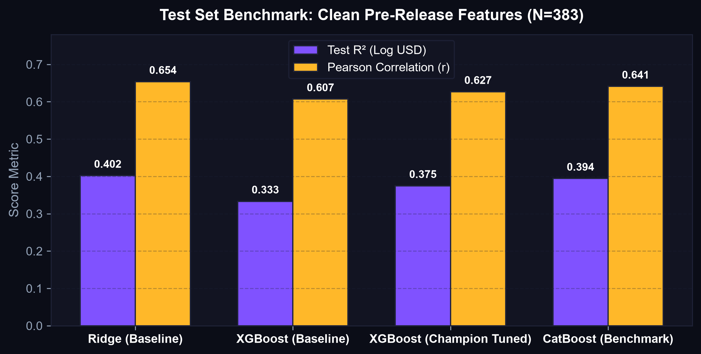
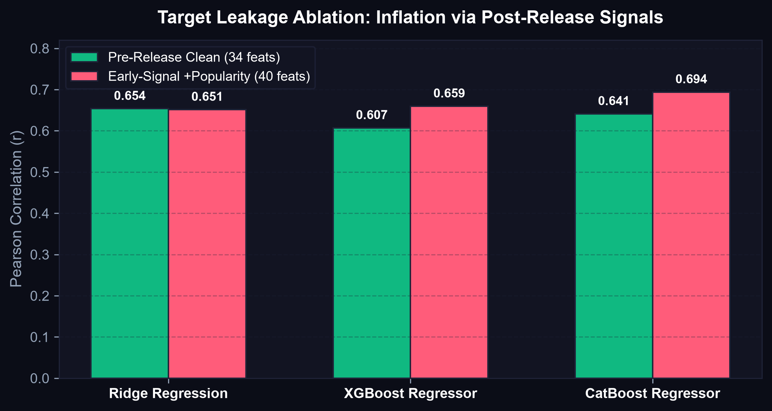
BENCHMARK & EMPIRICAL FINDINGS
Results, Leakage Ablation & Explainability
Quantitative proof of post-release target leakage and global SHAP value drivers
0.375
Champion Test R²
Log USD worldwide box office
0.627
Pearson Correlation (r)
Clean pre-release features
+0.07
Leakage Inflation Lift
Post-release vote distortion
#1 DRIVER
Budget ($0.84 SHAP)
Dominant pre-release signal
Notes:
Slide 8 presents our core empirical findings. On the left, our held-out test benchmarks on 2023–2025 releases demonstrate strong predictive correlation exceeding 0.62 across models. On the right, our Leakage Ablation Study proves the deceptive inflation caused by early audience signals: incorporating post-release popularity artificially increases Pearson r to 0.6939. CineForecast exclusively deploys the clean pre-release model to maintain operational truth.

Slide 9
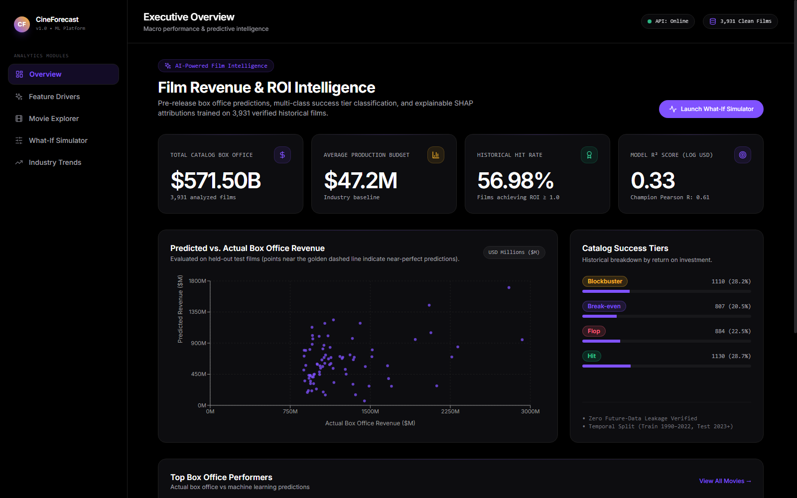
DEPLOYMENT & ROADMAP
Production Application & Future Scope
Live interactive analytics dashboard paired with forward-looking multi-modal capabilities
CORE CAPABILITIES & ROADMAP
What-If Scenario Simulator
Producers dynamically slide budget, adjust release calendar, and view live ROI & tier deltas.
SHAP Waterfall Inspection
Expandable per-movie breakdown detailing positive revenue drivers vs negative drags.
Macro Industry Analytics
Historical breakdown across genres, decadal inflation, and holiday seasonality.
Future: Multi-Modal Trailer AI
Extract video pacing, audio score mood, and trailer YouTube engagement signals.
Future: Global Territory Splits
Decompose box office projections across North America, EMEA, and APAC markets.
CineForecast Live Executive Overview • 3,931 Catalog Films • Real-Time Predictions
Notes:
Our production application puts predictive power directly in the hands of creative producers and film financiers. Through the What-If Studio, users can simulate budget adjustments and release shifts to test project sensitivity in real-time. Per-film SHAP waterfall drawers explain every prediction. Our future engineering roadmap includes multi-modal trailer video analysis and territory-level box office decomposition.

Slide 10

CineForecast
Predictive Intelligence for Film Box Office & ROI Forecasting
SCAN TO ACCESS REPOSITORY
Codebase • Model Registry • Interactive UI
AUTHOR & LEAD
Pratham Raval (ML Engineer & Full-Stack Developer)
REPOSITORY
github.com/prathamraval33/ml-project
CORE RESULTS
Test R²: 0.38 • Pearson r: 0.63 • 3,931 Clean Historical Films
COMPONENTS
FastAPI Engine • React 18 UI • Optuna • TreeExplainer SHAP
LICENSE
Open-Source MIT License • Automated Pytest CI Suite
VIEW ON GITHUB
prathamraval33/ml-project
Notes:
Thank you for your attention. CineForecast bridges academic machine learning discipline with production full-stack engineering. The entire codebase, test suites, trained model registry, and interactive dashboard are open-source and documented on GitHub. Scan the QR code or visit github.com/prathamraval33/ml-project. I welcome your questions and feedback.

