Slide 1
🎬 CineForecast
Predicting How Much Money a Movie Will Make — Before It Even Releases
A Machine Learning Project
Built with Python · XGBoost · FastAPI · React
Data Source: TMDB Movie Database · 3,931 Movies · 1990 – 2025

Slide 2
What This Project Covers
1
2
3
4
5
6
7
The Problem
The Data
The Models
How It Works
Results
The Dashboard
Key Takeaways
Why is predicting movie earnings hard?
Where our movie data comes from & how we cleaned it
Three ML models we tried and compared
Step-by-step flow from raw data to prediction
How well our models performed on unseen movies
Interactive web app to explore predictions
What we learned & what comes next

Slide 3
The Problem: Can We Predict a Movie's Earnings?
Why is this hard?
• Movies can cost millions but still flop at the box office
• There are many factors: budget, actors, genre, release date…
• No one knows for sure how audiences will react
• Studios need better tools to estimate returns early on
What we built:
A system that uses past movie data to predict:
1. How much revenue a movie will likely earn
2. Whether it will be a Flop, Break-Even, Hit, or Blockbuster
3. Which factors matter most for success
💔 Flop
Lost money
(Revenue < Budget)
⚖️ Break-Even
Just covered costs
(1x – 2x return)
🎯 Hit
Good profit
(2x – 4x return)
🚀 Blockbuster
Massive success
(4x+ return)

Slide 4
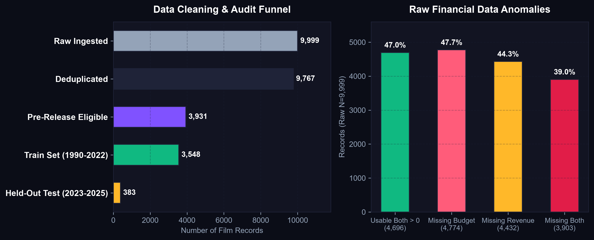
The Data: From Messy to Clean
Where the data came from
• TMDB (The Movie Database) — a public movie database
• Started with 9,999 movie records from 1990 to 2025
Problems we found
• 47.7% of movies had no budget information
• 44.3% had no revenue information
• 232 duplicate entries
• Some dates were in the future (bad data)
After cleaning
• 3,931 movies with complete, reliable data
• Training set: 1990–2022 (3,548 movies)
• Test set: 2023–2025 (383 movies, never seen during training)

Slide 5
What Information Did We Feed the Model?
We only used information available BEFORE a movie releases — no cheating!
💰 Money
🎭 Genre
📅 Timing
• Production budget
• Budget (log scale)
→ How much was spent making the movie
• Action, Drama, Comedy, Sci-Fi…
• 15+ genre flags
→ What type of movie is it
• Release month, day, quarter
• Holiday release? Summer?
→ When the movie hits theaters
🎬 Track Record
📊 Other Details
🔢 Total Features
• Director's past avg. earnings
• Studio's past avg. earnings
• Number of past films
→ How experienced is the team
• Runtime (movie length)
• Cast size
• Is it a franchise/sequel?
• International co-production?
34 pre-release features
All carefully chosen to
avoid data leakage
(no post-release info)

Slide 6
The Models: Three Approaches Compared
🏔️
🐱
🏆
Ridge Regression
CatBoost
XGBoost ★ Winner
The Simple One
The Smart Competitor
Our Best Model
A basic linear model.
Good starting point
to see how a simple
approach performs.
A tree-based model from
Yandex. Good at handling
different types of data
automatically.
A powerful tree-based model
fine-tuned with Optuna.
Best overall balance of
accuracy and reliability.
R² = 0.40 | r = 0.65
R² = 0.39 | r = 0.64
R² = 0.37 | r = 0.63
R² = how much of the variation in earnings the model explains | r = how closely predictions match actual values | Higher = Better

Slide 7










How It All Works: Step by Step
1
2
3
4
5
6
Get Raw Data
→
Clean & Filter
→
Build Features
→
Train Models
→
Test & Compare
→
Deploy & Serve
Download 9,999
movie records
from TMDB
Remove bad data
keep 3,931
reliable movies
Create 34 useful
inputs from the
raw movie info
Teach 3 models
using movies
from 1990-2022
Test on 383
new movies
from 2023-2025
Serve predictions
through API &
web dashboard
Tools & Technologies Used
Python
XGBoost
CatBoost
Scikit-Learn
Optuna
SHAP
FastAPI
React
Vite
SQLite

Slide 8
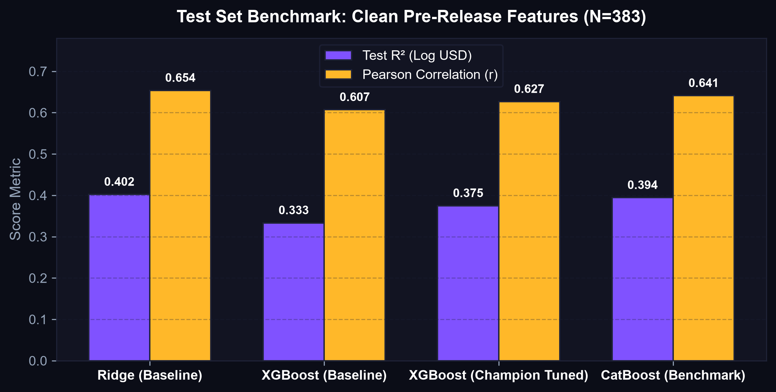
Results: How Good Are Our Predictions?
What the numbers mean
Our best model (XGBoost) can explain about
37% of the variation in movie earnings.
That may sound low, but predicting movie
revenue is extremely hard — even experts
at studios often get it wrong!
Key findings:
✅ Budget is the #1 predictor of revenue
✅ Release year matters a lot (inflation effect)
✅ Studio track record is important
✅ Action genre movies tend to earn more
✅ Ridge Regression actually beat XGBoost on R²!
Tested on 383 movies the model never saw
during training (released 2023–2025)

Slide 9
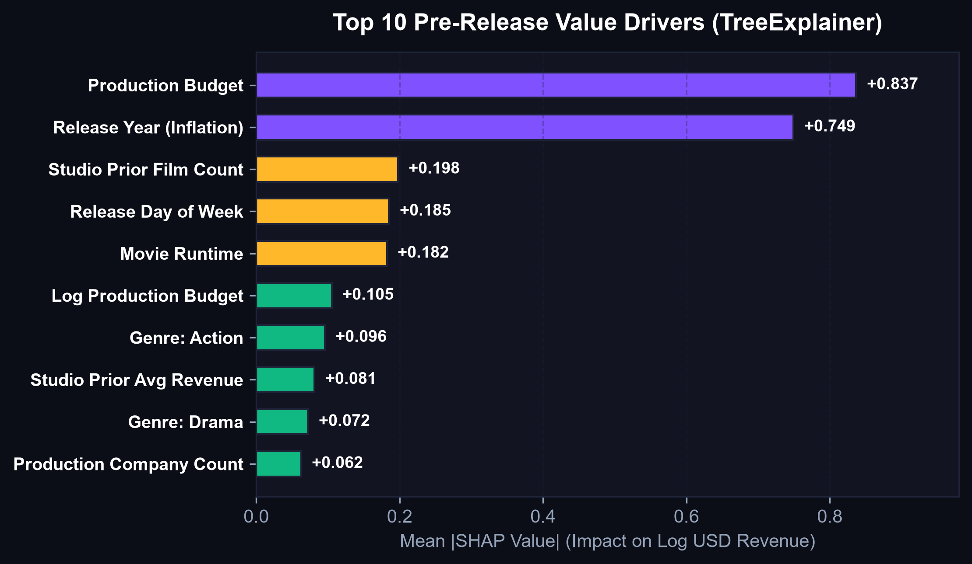
What Matters Most? Top Factors That Drive Revenue
We used SHAP (a method to explain AI decisions) to find which features push predictions up or down
💰 Budget
The most important factor. Higher budget → higher expected earnings
📅 Release Year
More recent movies tend to earn more (inflation + bigger markets)
🏢 Studio Experience
Studios with more past films tend to produce higher-earning movies
📆 Release Day
The day of the week a movie opens affects opening weekend sales
⏱️ Runtime
Movie length plays a surprising role in predicting earnings

Slide 10
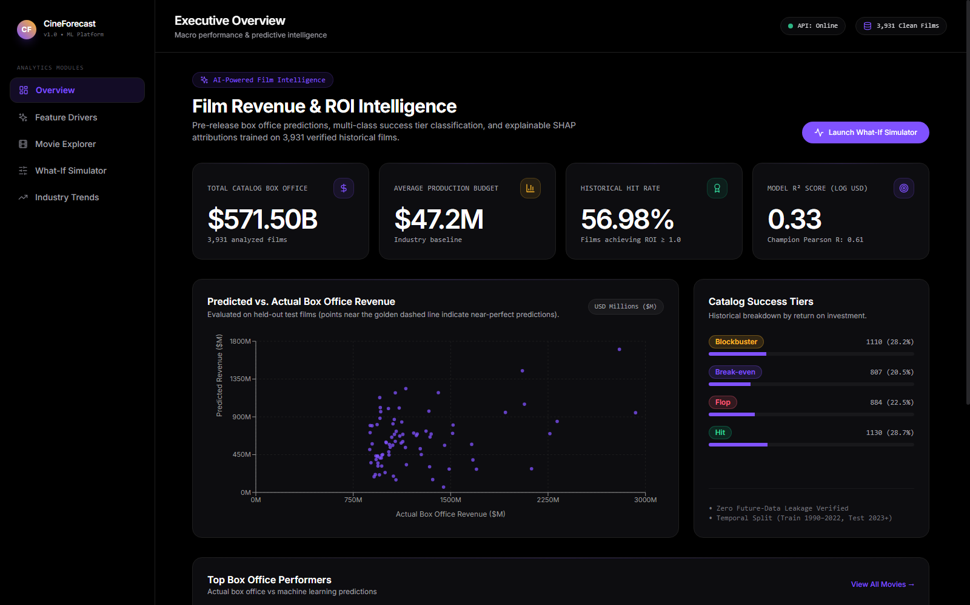
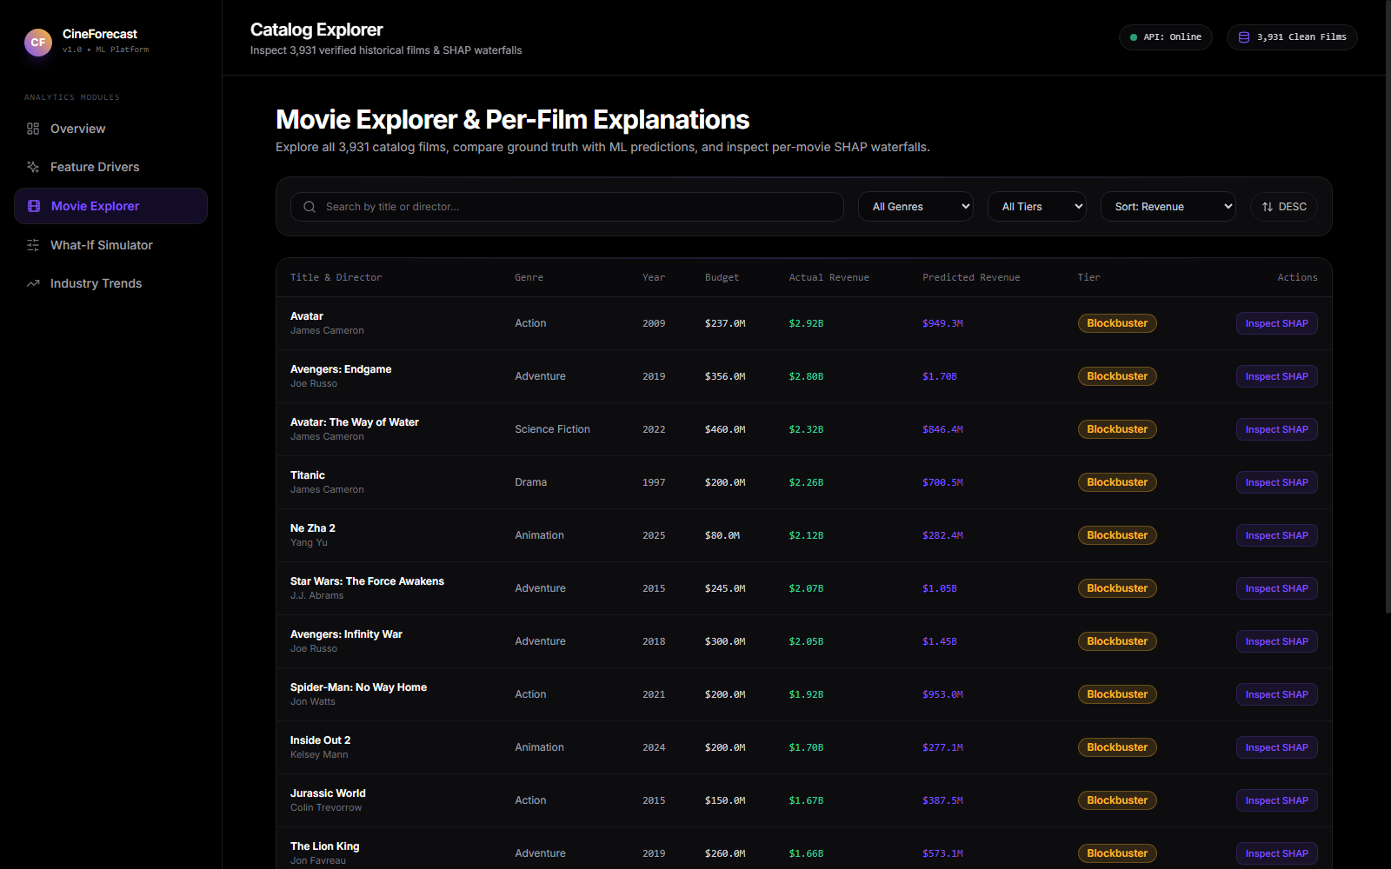
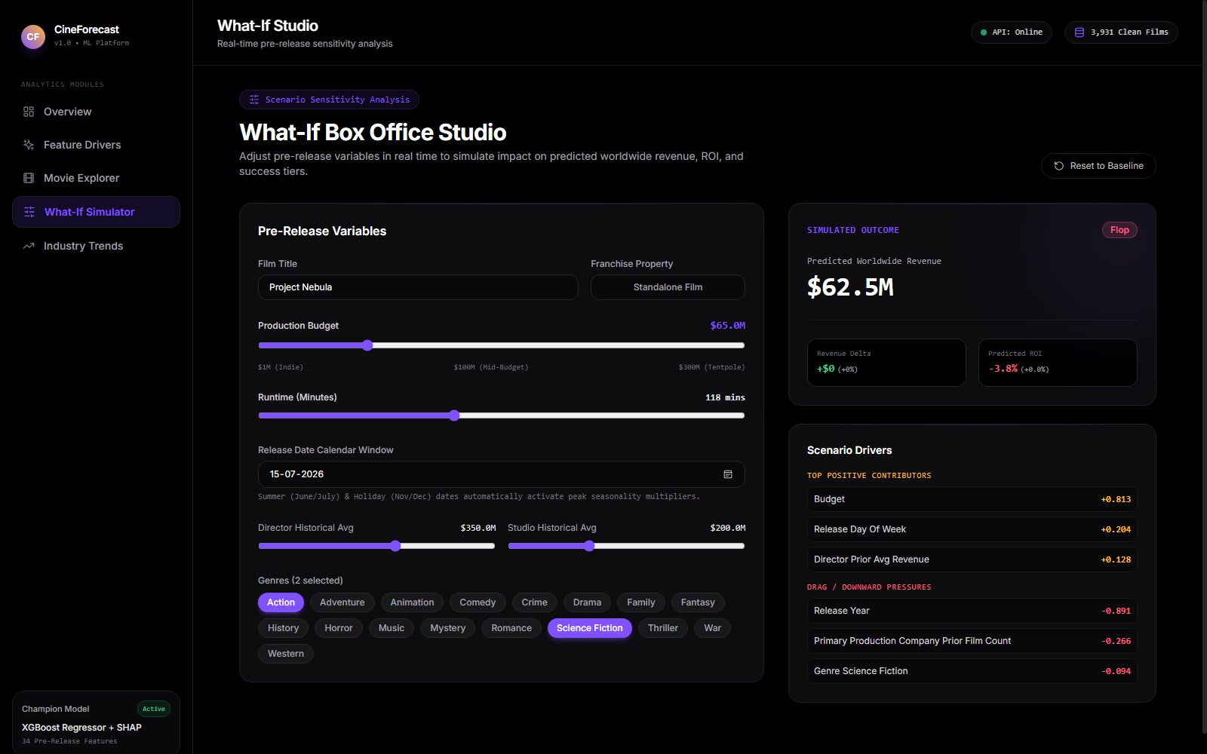
The Dashboard: Explore Movies Visually
Overview Page
See all movies at a glance
Movie Explorer
Dig into individual predictions
What-If Simulator
Change inputs & see impact
Dashboard Features:
📊 Scatter plots showing predicted vs actual earnings • 🔍 Search & filter any movie • 🔬 SHAP explanations for every prediction • 🎮 What-If simulator to test scenarios

Slide 11
What We Learned & What Comes Next
⚠️ Current Limitations
🚀 Future Improvements
• Almost half the original data had missing budget/revenue info
• Model can't predict viral moments or unexpected events
• Doesn't account for marketing spend (data not available)
• Mostly US-focused; limited international movie data
• Predictions are estimates, not guarantees!
• Add trailer analysis (use AI to analyze movie trailers)
• Include social media buzz as a predictor
• Break down predictions by country/region
• Try deep learning models for better accuracy
• Add real-time data updates as new movies release

Slide 12

Thank You! 🎬
CineForecast: Predicting Movie Revenue with Machine Learning
3,931
34
3
383
Movies
Analyzed
Features
Used
Models
Compared
Test
Movies
Scan for GitHub Repo

