Slide 1
ECE501 : Digital Image Processing
Adaptive Fabric Surface Detection and Localization using Classical Texture Descriptors
Pratham Sandesara - AU2340239
Even Patel - AU2340241
Dharman Patel - AU2340237
Shine Shah - AU2440148
Group No. - 2
Project No. - 17
Mentor - Prof. Mehul Raval

Slide 2
Motivation
Why fabric defect detection really matters?
Speed & Fatigue: Human eyes miss micro-flaws on fast looms.
Quality Cost: Undetected defects lead to heavy customer penalties and material waste.
Zero Deep Learning: No expensive GPUs or labeled defect datasets required.
Periodic Principle: Repetitive weave textures allow purely mathematical anomaly detection.
2. Literature Review
Silvestre-Blanes et al. (2014): Fabric defect detection using projection profiles and texture features.
Haralick et al. (1973): Statistical texture features for image classification.
Gonzalez and Woods (2018): Digital image processing techniques for image analysis.
Research Gap: Fixed-size filters struggle with different weave patterns and defect sizes.
Proposed Approach: Adaptive weave-pitch estimation and multi-scale classical image processing for defect detection.

Slide 3
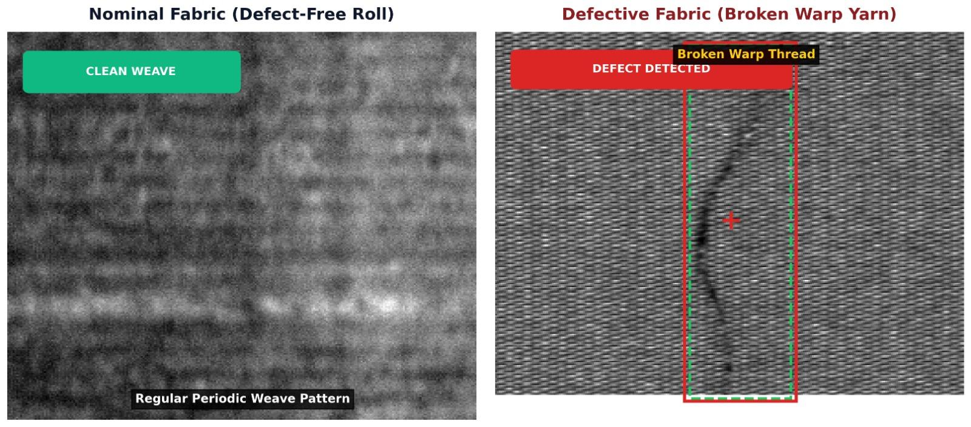
3. Problem Definition & Scope
Problem Statement:
  Automated, real-time detection and localization of subtle fabric surface anomalies from grayscale line-scan images using strictly classical DIP (zero deep learning / CNNs).
Central Research Question:
  "Can weave-adaptive multi-scale texture descriptors outperform fixed-parameter classical baselines?"

Slide 4
4. Dataset: AITEX Fabric Image Database (AFID)
Attribute | Specification | Project Role / Significance
Source & Modality | Industrial Line-Scan Camera | Grayscale, high aspect ratio (1:16)
Image Resolution | 256 × 4096 pixels | Preserves micro-texture weave threads
Total Samples | 247 Images | 141 Defect-Free | 106 Defective
Ground Truth | Pixel-Level Binary Masks | Exact spatial boundaries (0 vs 255)
Weave Diversity | 7 Distinct Patterns (00–06) | Varies warp/weft spacing & periodicity
Defect Spectrum | 12 Defect Classes | Holes, oil stains, broken threads, cracks
Data Partitioning | Train: 136 | Val: 49 | Test: 62 | Leakage-Safe: Train uses defect-free only

Slide 5
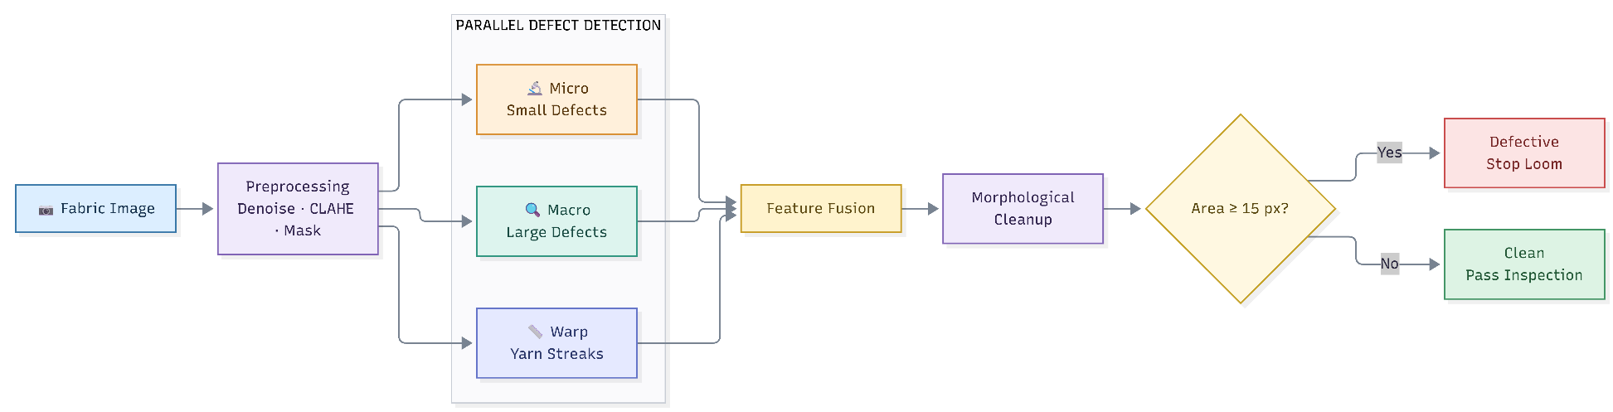
5. Methodology / Pipeline
1. Micro Branch Top-Hat Filtering
- Small knots & slubs
- Pinholes
- Fine defects
2. Macro Branch Gaussian Envelope
- Large tears & cracks
- Shade bars
- Broad defects
3. Warp Branch Column Profiling
- Vertical yarn streaks
- Column variations
- Warp irregularities

Slide 6

6. Results
Evaluation Tier | Metric | Fixed Control (15x15) | Proposed Weave-Adaptive
Image-Level (Roll Triage) | Screening Accuracy | 58.02% | 75.31% +17.3%
 | Defect Sensitivity (Recall) | 49.06% | 77.36% +28.3%
 | Screening Precision | 78.79% | 83.67%
 | Screening Specificity | 75.00% | 71.43%
Pixel-Level (Mask Boundary) | Pixel Precision | 80.29% | 78.56%
 | Pixel Recall | 66.85% | 67.38%
 | Pixel F1-Score (Dice) | 72.96% | 72.54%
 | Pixel IoU (Jaccard) | 57.43% | 56.91%
Noise Safety | Clean False Alarm Rate | 0.0052% | 0.0051%
Roll Outcome | Fixed Control | Proposed Adaptive
True Positive (TP) (Defects Caught) | 26 / 53 | 41 / 53
False Negative (FN) (Defects Missed) | 27 / 53 | 12 / 53
True Negative (TN) (Clean Passed) | 21 / 28 | 20 / 28
False Positive (FP) (False Alarm) | 7 / 28 | 8 / 28

Slide 7
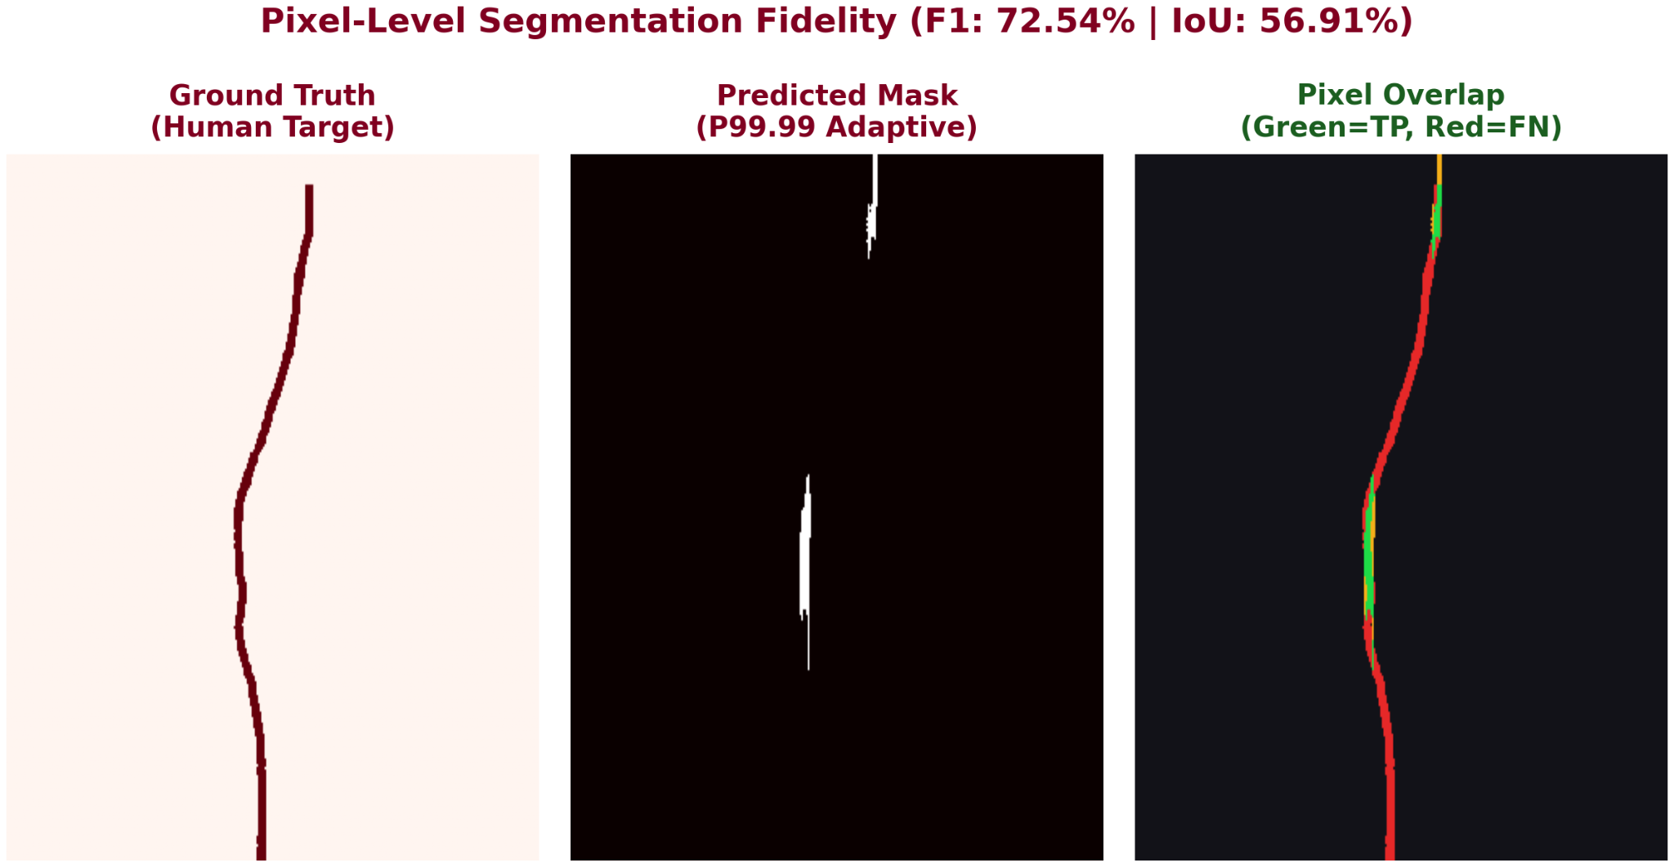
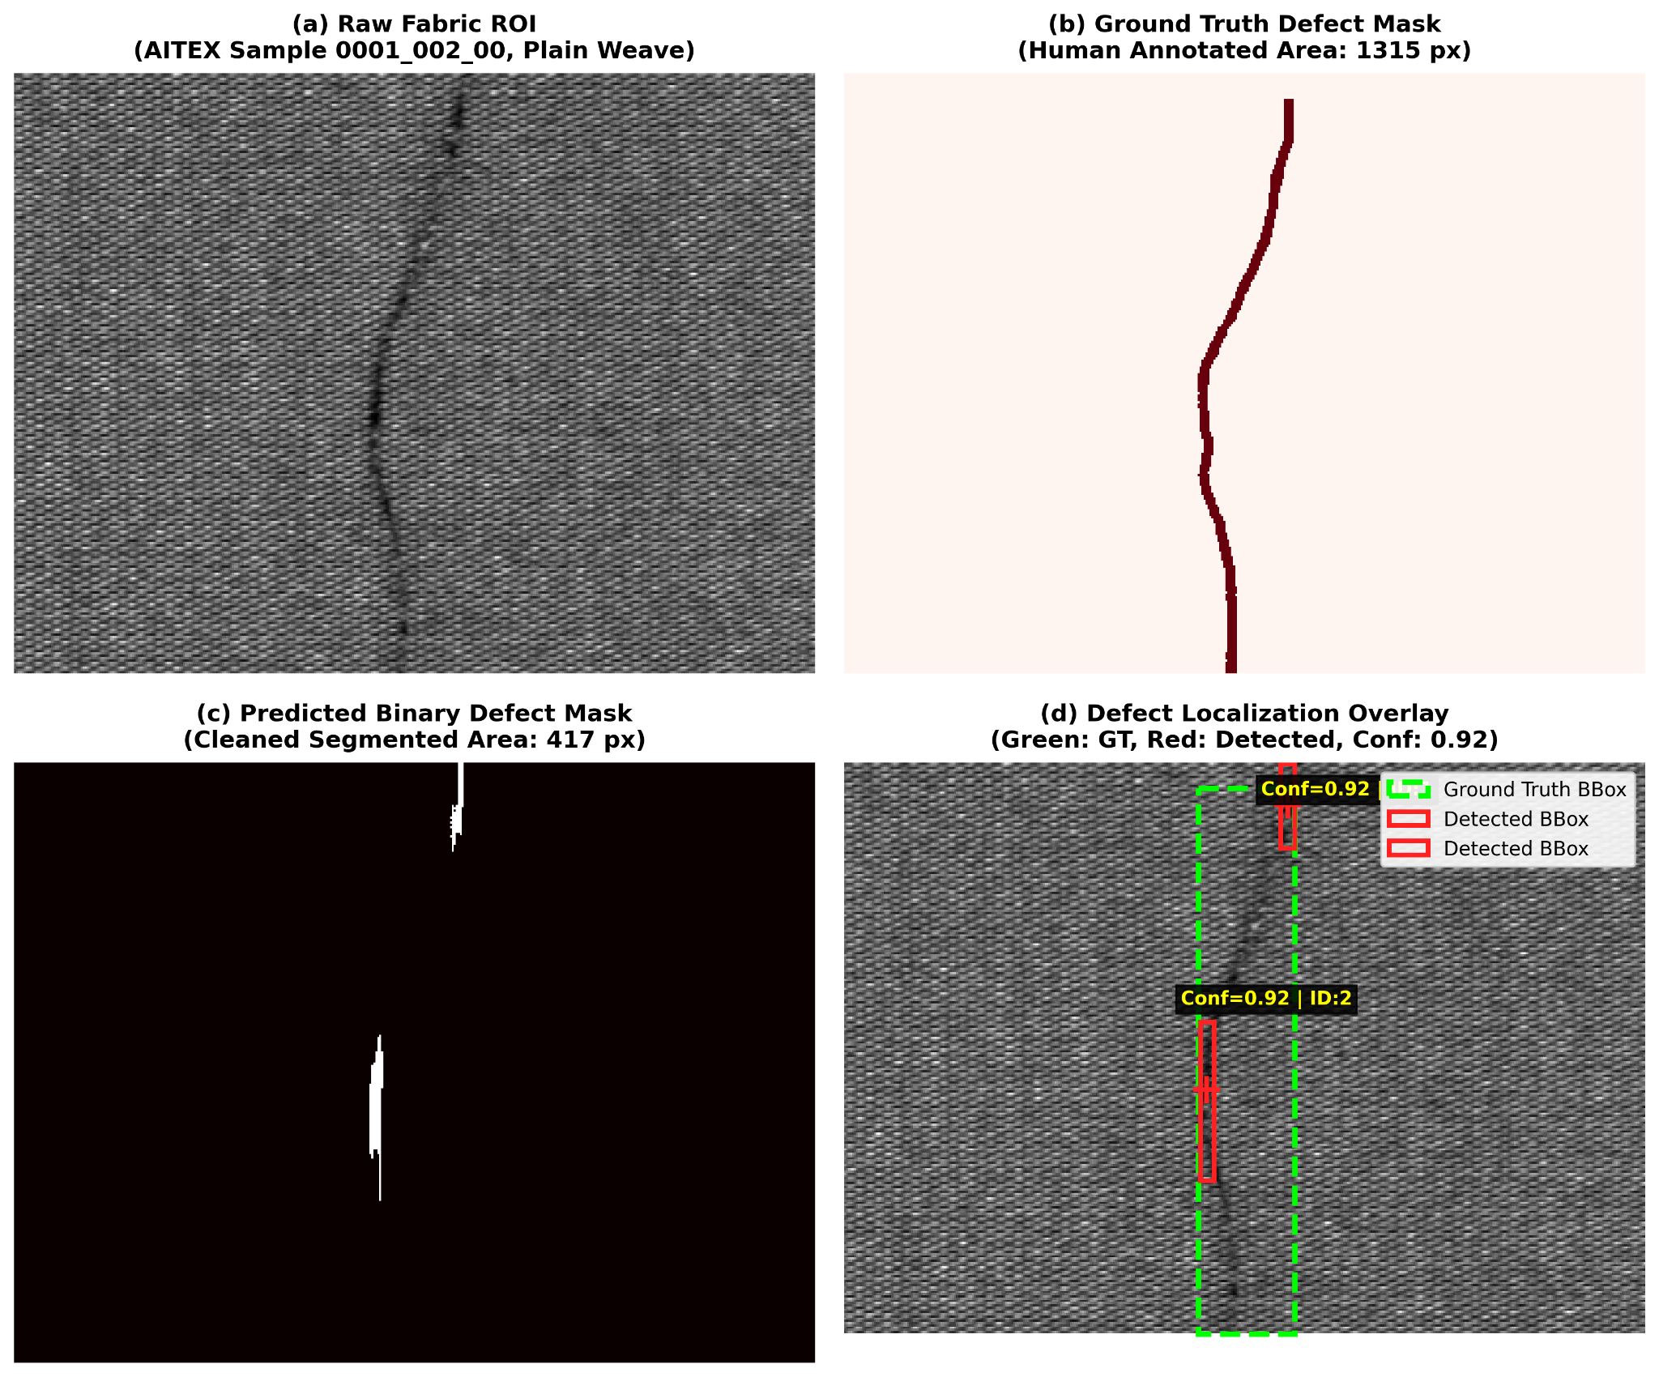
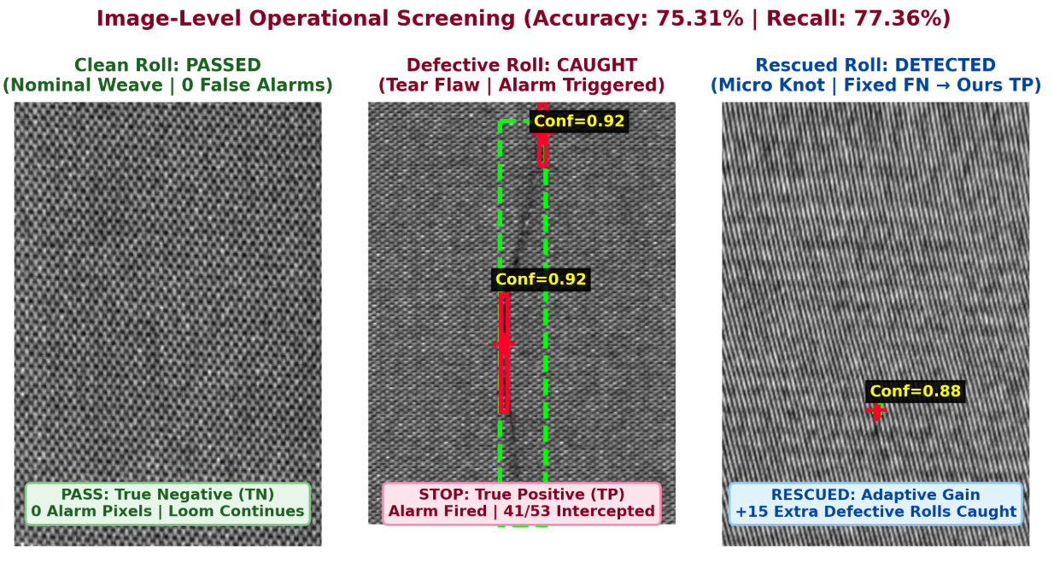
7. Results

Slide 8
8. Future Work
Multi-Class Defect Categorization: Extending binary detection into deterministic taxonomy classification (e.g., Holes, Knots, Oil Stains) using invariant shape moments without machine learning.
Fabric Alignment Correction: Detect the direction of fabric threads and correct tilted images. Align the fabric before detecting defects for better accuracy.
Pattern Removal Using Frequency Filtering: Reduce repetitive fabric patterns to highlight defects. Make irregular flaws easier to detect against the normal fabric texture.
9. References
Silvestre-Blanes, J., et al. (2014). A public fabric image database for defect detection through projection profiles and texture features. Autex Research Journal, 14(4), 248–255.
Ngan, H. Y. T., Pang, G. K. H., & Yung, N. H. C. (2011). Automated fabric defect detection—A review. Image and Vision Computing, 29(7), 442–458.
Gonzalez, R. C., & Woods, R. E. (2018). Digital image processing (4th ed.). Pearson.

Slide 9
10. Individual Contribution
Pratham Sandesara | Segmentation & Evaluation , Statistical Thresholding
Even Patel | Adaptive Modeling & Multiscale Morphology
Dharman Patel | Data & Preprocessing & 2D FFT Autocorrelation
Shine Shah | Texture Descriptors & Directional Profiling
Thank You

