Slide 1
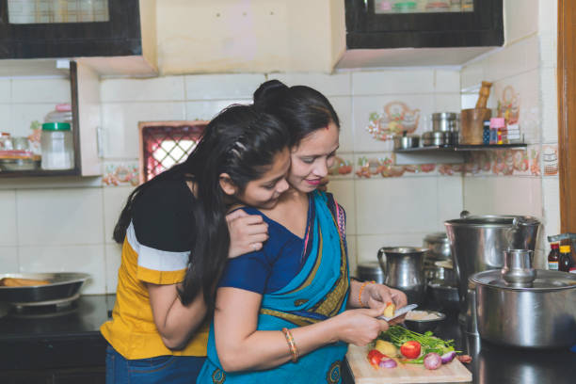
Mana
A platform for home made delights

Slide 2
Problem Statement
Challenges face by people to find good quality homemade meals
The underutilization of cooking skills of housewives
Women depending on their husbands for everything as they are not financially independent

Slide 3
About Mana
Mana will provide a platform for connecting Housewives and consumers
As there is increasing demand for home cooked meals it will give people a place to get home cook meals
It will provide opportunities for housewives to earn and can give them employment
It will bridge the gap between home cooks looking to share their culinary skills and consumers seeking authentic homemade food

Slide 4
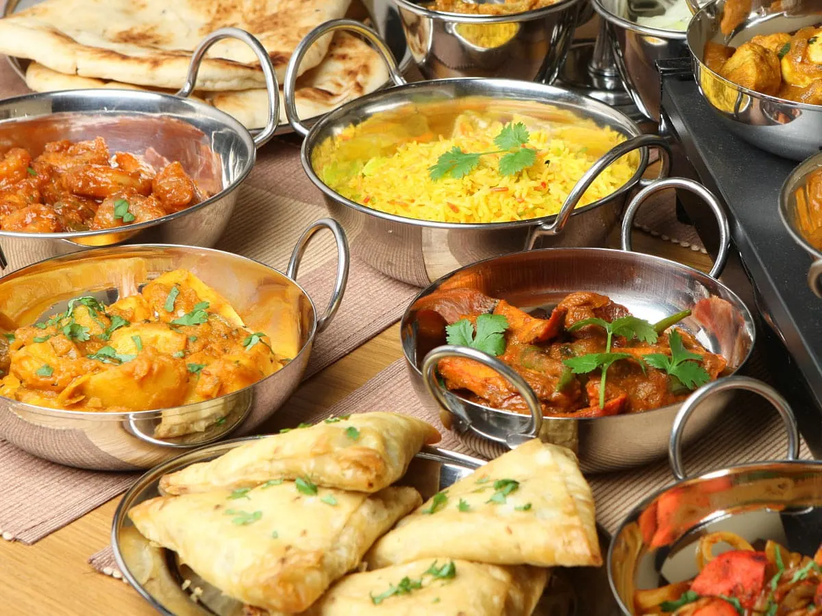
Key features Mana will have
Meal Listings and Descriptions
Scheduling and ordering
Real-time notification
Review and ratings
User authentication
Geolocation services
Payment Gateway
Cart system

Slide 5
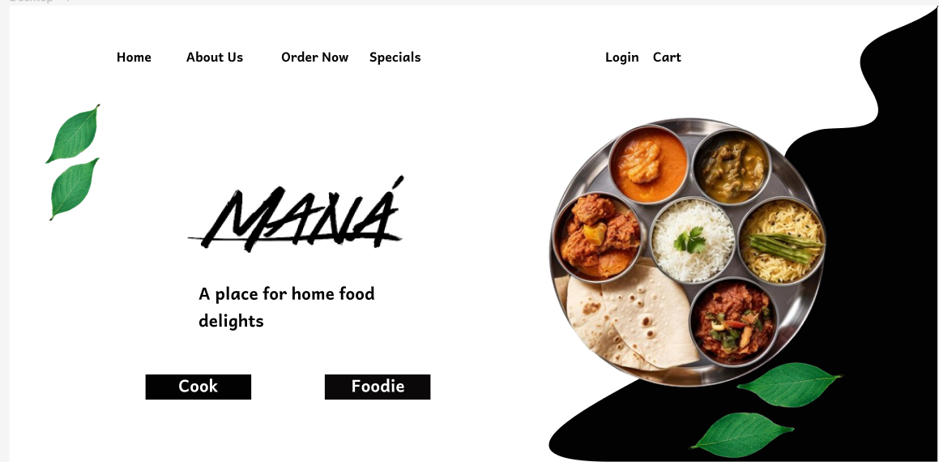
Front page figma design example

Slide 6
User roles
Home cooks (housewives)
Where they can mention their specialities and can put pricing according to them
Consumers
They can search and sort whatever they want to eat they will get sorted results according to the ratings
Admins
They can manage all the profiles

Slide 7
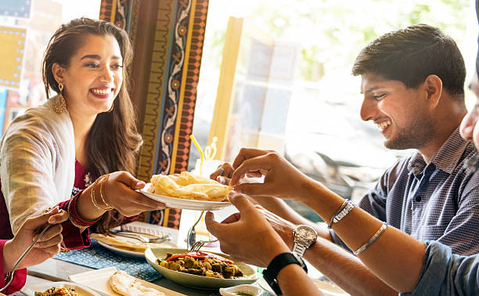
Technology Stack
Prototyping
Figma
Front end
HTML CSS javascript and react with bootstrap
Back end
Spring boot and Sql and no sql(mongodb)
Some microservices for payment and some API

Slide 8

Implementation Phases
Prototyping making UI of our website (Ram , Pratham)
Front end development (Everyone)
Backend Development (Everyone)
Database Setup
Sql(Himasri , Rakshith)
No sql (Pratham)
Microservices implementation (Everyone)

Slide 9
Business model
We can get our revenue from each transaction
The cooks will put the prices and it will automatically list 40% more priced on website
From that 18 percent will go for gst and 10% for ordering and 2% for mantaning the sites and server
But we can get the clear idea only after implementing it in real time

Slide 10

Thankyou
Think once before wasting the food

