Slide 1
LeftOver’s
Let us build a BRIDGE between surplus food and famished people.

Slide 2
Team Member
PRATHAM
PARISHA

Slide 3
What is Food Waste ?
The word "food waste" is used to describe food that was not eaten for any cause and was instead allowed to go bad.
Whenever the food doesn’t manage to complete its journey to the consumption phase, it is termed food waste.
Food loss is now a much bigger problem due to the growing accessibility of food sources. Ironically, there is a correlation between rising poverty and rising food waste. Simply put, it indicates that while we have enough food, there isn't a reliable source to distribute it to those in need.

Slide 4
Introduction
According to the FSSAI (Food Safety and Standards Authority of India), one-third of all food in India is wasted or gets spoilt before it is eaten.
68,760,163 tonnes of food is wasted annually in Indian homes, or approximately 50 kilograms per person.**************
This Project is a mission to end hunger and no waste of food to make a hungry-free world.
In this case, nothing but technology is the solution to this gap.

Slide 5
Objective of Project
We're bridging the gap in this area just like mobile applications have done in terms of connecting suppliers and seekers.
We intend to serve an increasing number of seekers and lower the number of empty bellies sleeping.

Slide 6
How will the project help us in academics?
We will learn a lot of new things by working on this project, additionally it will help us to have a better handle on the subject.
With this subject, we learned about a significant problem in society and had the opportunity to address it.
We are learning about a real-world problem as a result of this research.
Put a theoretical concept into practice.
Learned to discuss the efficacy of offered solutions with peers. And many more.

Slide 7
Technology Over View
We are using the world wide used technology which is “ANDROID”.
According to a recent survey android leads the smartphone market with a global share of 71.7%.

Slide 8
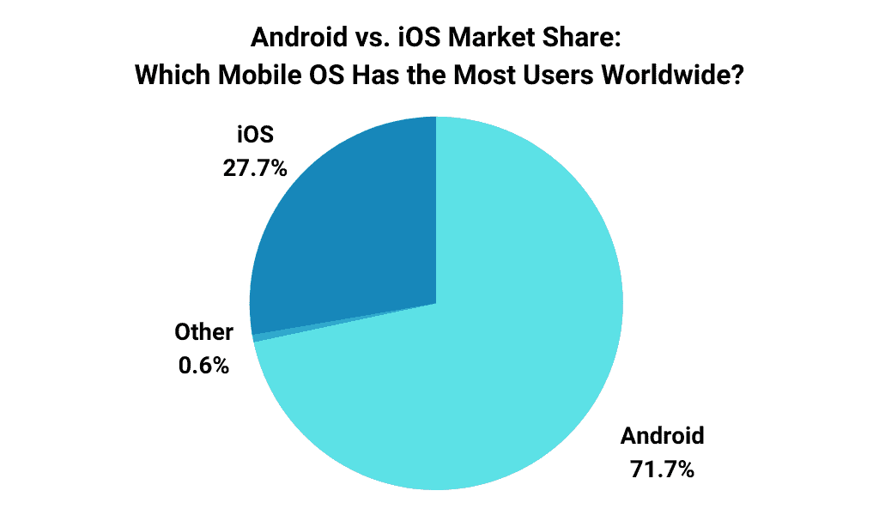
The reason behind using Android is
According to a recent survey android leads the smartphone market with a global share of 71.7%.
As a result, it becomes more accessible to clients.
As a result, it becomes more accessible to clients.

Slide 9
Features and Functionality
Review system:- App will provide a review system by which we can improve our Functionality.
Transparent Service:- In many cases the donor has trust issues. But we provide a Transparent and seamless service.
Providing a Map for accurate location:- We will be using google maps for providing the current location. By which it would be easy for both parties to do direct contact and trace each other.
Contribution:-
Record:- One can easily view their past activities in the record section.

Slide 10
Advantages of Application
Convenience: Food donation applications provide a convenient way for donors to give food to those in need. With just a few taps on their phone, donors can quickly find local food banks or charities and arrange for a donation.
Reduction of food waste: Food donation applications can help reduce food waste by connecting donors with surplus food for those in need. This can help divert perfectly good food from landfills and reduce the environmental impact of food waste.
People will get food:- The food which was wasted till date would be lent to needy peoples
Positive impact on the environment:- It will reduce the overall food waste, initially, it will not harm nature.

Slide 11
Future Scope
Feature of Expiry Date Management
It will scan food items’ barcodes and send notifications when the food is about to expire.
By which the user will know what he has and when food is going to expire.
Suggesting unique recipes
When the food is on the edge of expiring, people might not prefer to consume it the usual way. So, the app will share unique recipes that make such food items tasty and safer to consume.
__________ it over to suggesting multiple recipes following the same.

