Slide 1

Data Cleaning, Statistical Analysis, Visualization, and KNN Classification on Diabetes Dataset
Assignment Part B – Diabetes Dataset Analysis and KNN Classification
Student
Roll No.
Pratham Shah
25BCE380
Division
J

Slide 2
Introduction and Objective
Diabetes is one of the most prevalent chronic diseases worldwide, affecting millions of people across all demographics. Early and accurate prediction of diabetes is critical for timely intervention and improved patient outcomes. Machine learning methods offer powerful tools to assist clinicians in identifying at-risk individuals from symptom and demographic data.
Why This Dataset?
Project Objectives
The diabetes_data_upload.csv dataset captures real-world clinical symptoms and demographic information, making it ideal for exploring classification workflows in a healthcare context. It provides a practical, domain-relevant challenge for end-to-end data science.
Understand and explore the diabetes dataset structure and features
Perform data cleaning including handling missing values via imputation
Conduct statistical analysis and unique value investigation
Visualize data patterns using subplots
Build and evaluate a KNN classification model for diabetes prediction

Slide 3
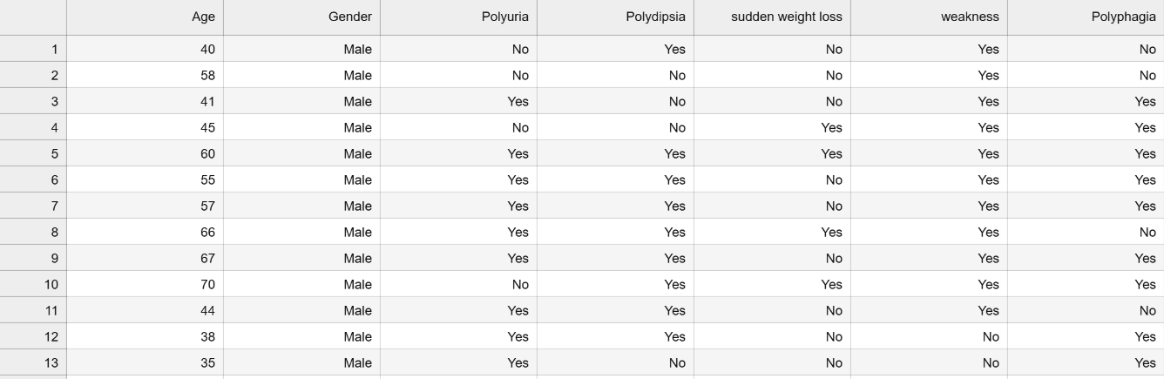
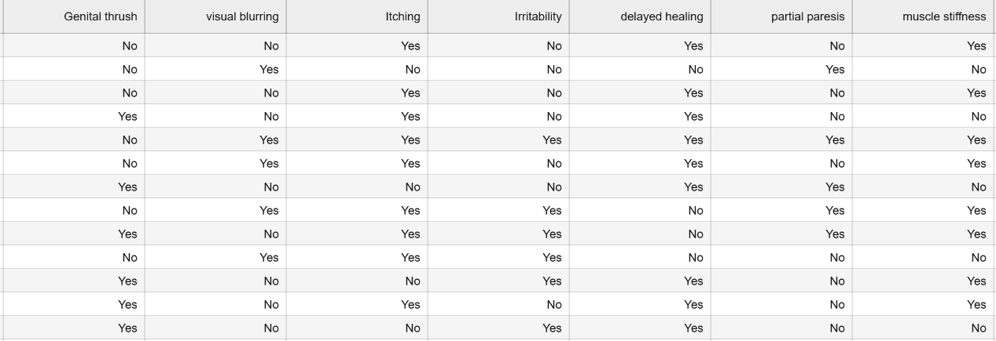
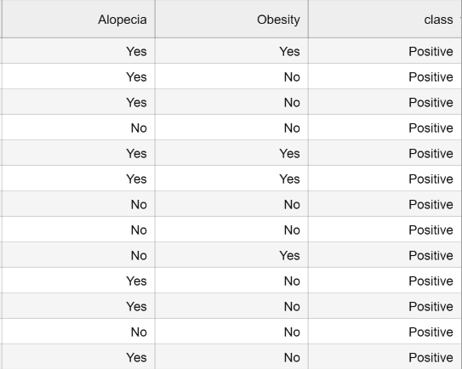
Dataset Overview (Q1)
The dataset diabetes_data_upload.csv belongs to the Healthcare / Medical domain. It contains 520 records across 17 columns, capturing patient age, gender, and 14 clinical symptoms alongside a binary class label for diabetes diagnosis.
Feature
Type
Description
520 Rows
Age
Numerical
Patient age (integer)
Total patient records in the dataset
Gender
Categorical
Male / Female
Polyuria, Polydipsia, etc.
Categorical (Binary)
Symptom columns (Yes/No)
17 Columns
class
Target Label
Positive / Negative
Features including demographics and symptoms
Class Label
Binary target: Positive or Negative

Slide 4
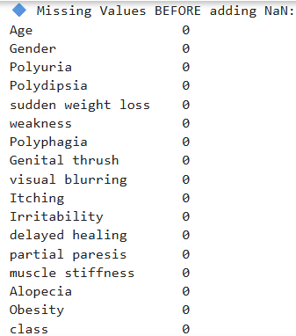
Data Characteristics and Class Label (Q1 Continued)
Feature Types at a Glance
Missing Value Summary (Original)
The original dataset contained zero missing values. All 520 rows had complete records across all 17 columns — no null entries were present in the raw data.
Numerical
Age — the only continuous numerical column. Ranges from young adults to elderly patients.
Artificial NaN values were intentionally introduced in the preprocessing stage purely for academic demonstration of imputation techniques. This ensured that the data cleaning workflow could be fully exercised and documented.
Categorical (Binary)
Gender (Male/Female) and 14 symptom columns (Yes/No) — all binary categorical features.
Non-null entries per column: 520 / 520 before artificial insertion.
Target / Class Label
class column — values: Positive (diabetic) and Negative (non-diabetic).

Slide 5
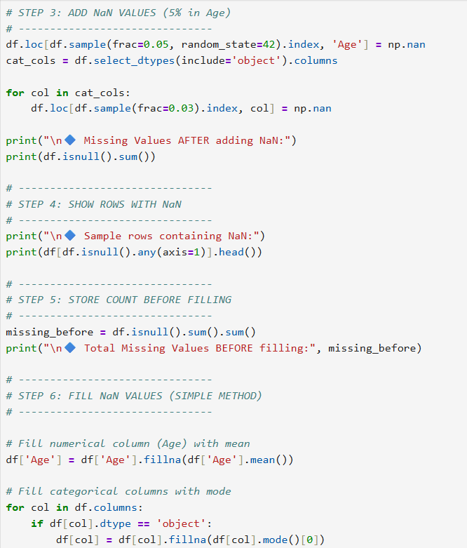
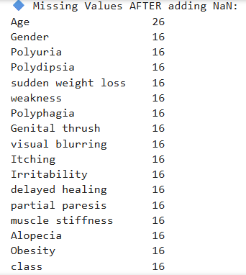
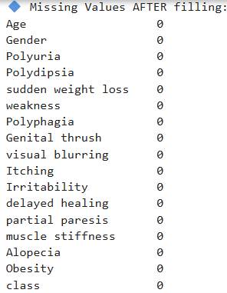
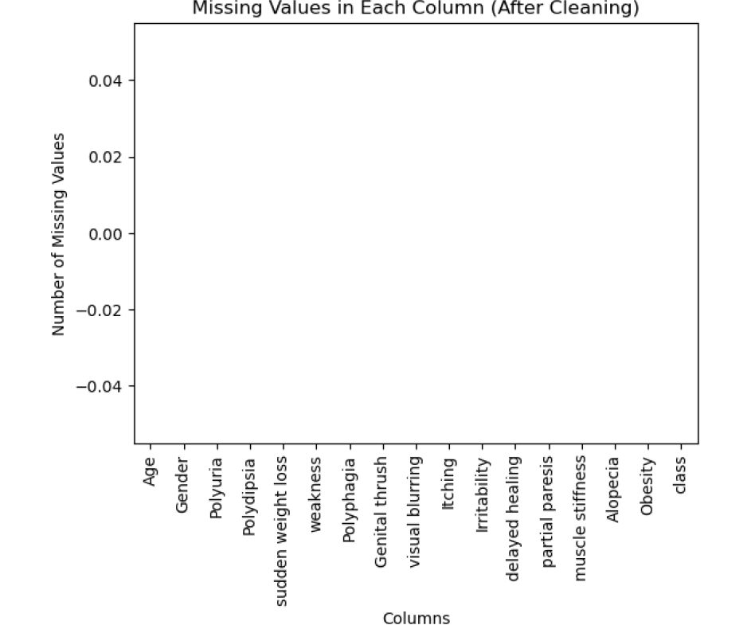
Data Cleaning and Missing Value Handling (Q2)
To simulate a real-world preprocessing scenario, 282 artificial NaN values were randomly inserted across the dataset. Two targeted imputation strategies were then applied to restore completeness — with zero missing values remaining after cleaning.
🔢 Missing Before Filling
✅ Missing After Filling
282 NaN values across numerical and categorical columns after artificial insertion.
0 missing values remaining — full dataset restored after imputation.
📊 Numerical Imputation
🔤 Categorical Imputation
Mean imputation applied to the Age column. Fills gaps without skewing distribution.
Mode imputation applied to all categorical columns (Gender, symptoms, class).
Bar chart confirming 0 missing values in all columns after cleaning
Code: Artificial NaN insertion and imputation logic in Python/Pandas

Slide 6
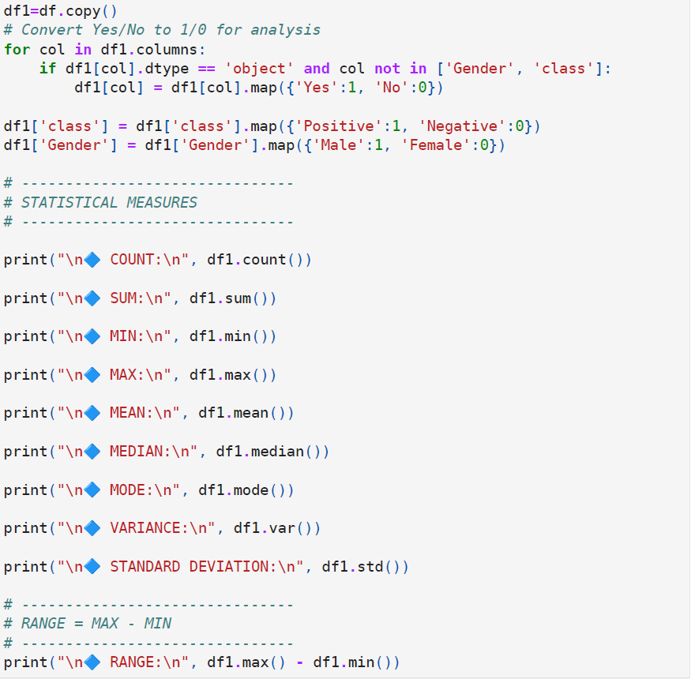
Statistical Analysis (Q3)
Descriptive statistics were computed for all columns. Since Age is the only numerical feature, the key statistical measures below apply to it. Categorical columns were analyzed separately for frequency and mode.
Statistic
Value (Age)
48.04
Count
520
Mean
48.0425
Mean Age
Median
48.0
Average patient age across all 520 records
Std. Deviation
11.8775
11.88
Minimum
16
Maximum
90
Std. Deviation
Range
74
Spread of age values around the mean
Variance
~141.07
Mode
45
74
Age Range
From age 16 (min) to age 90 (max)

Slide 7
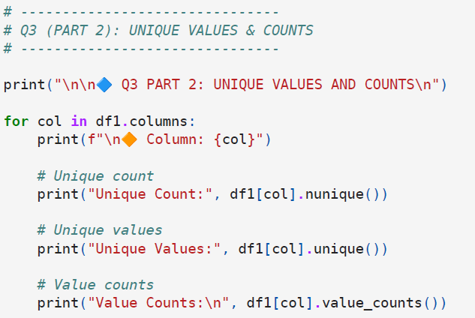
Unique Values and Frequency Counts (Q3 Part 2)
A systematic analysis of unique values was performed across all 17 columns. This step provides insight into feature cardinality and confirms the binary nature of most symptom variables — a key property for categorical encoding.
Column
Unique Values
Type
Age: 52 Unique Values
Binary Symptoms: 2 Unique Values
Age
52
Numerical
Wide distribution across the full integer range — from age 16 to 90.
Gender
2 (Male/Female)
Categorical
All 14 symptom columns are binary (Yes/No), ideal for label encoding.
Polyuria
2 (Yes/No)
Binary
Polydipsia
2 (Yes/No)
Binary
Class Label: 2 Unique Values
sudden weight loss
2 (Yes/No)
Binary
Positive (diabetic) and Negative (non-diabetic) — clean binary target.
… (other symptoms)
2 (Yes/No)
Binary
class
2 (Positive/Negative)
Target

Slide 8
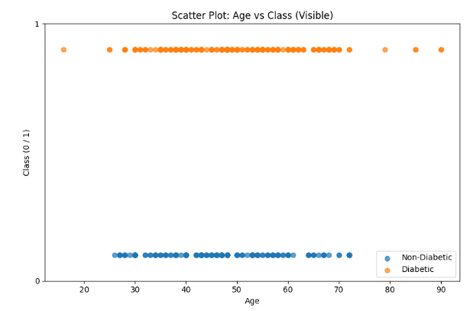
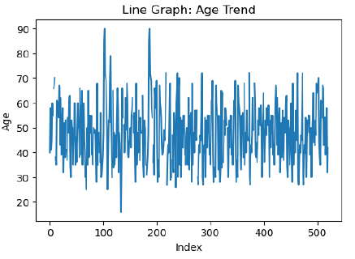
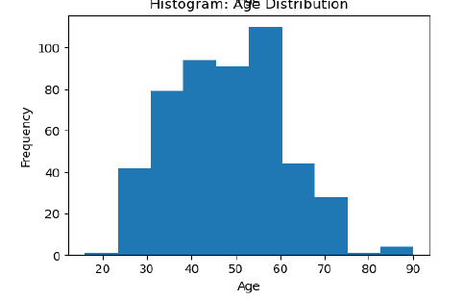
Data Visualization Using Subplots (Q4)
Four visualizations were created in a single subplot figure using Matplotlib, each revealing a distinct aspect of the data's structure and distribution.
Scatter Plot: Age vs. Class
Line Graph: Age Trend
Histogram: Age Distribution
Bar Chart: Missing Values After Cleaning
Visualizes how patient age distributes across Positive and Negative diabetes classes. Reveals that diabetic patients tend to cluster in middle to older age groups.
Plots age values across the 520 records in sequence. Highlights the variability and spread of patient ages throughout the dataset without binning.
Shows the frequency distribution of age values. The near-symmetric distribution around the mean (48.04) indicates a reasonably balanced age range in this dataset.
Confirms that all 17 columns have 0 missing values after imputation — a clean, ready-to-model dataset.

Slide 9
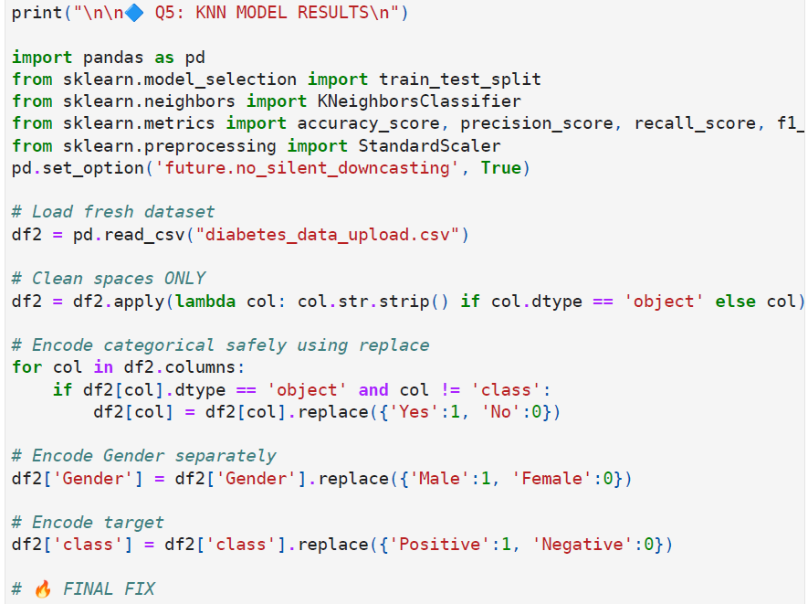
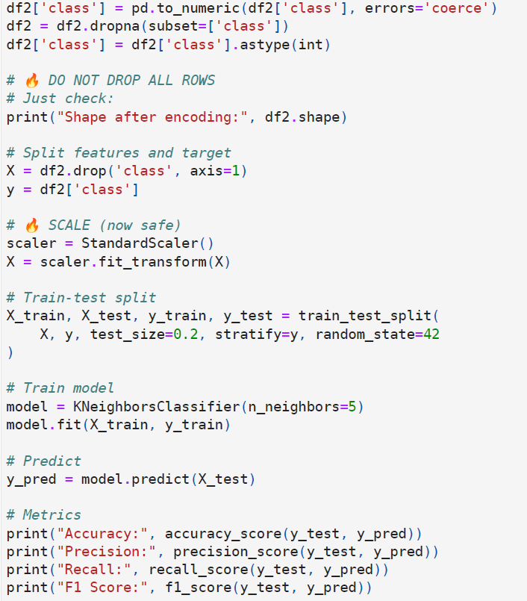
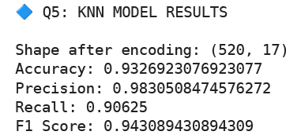
KNN Model and Performance (Q5)
Before training, categorical features were encoded (Yes/No → 1/0; Male/Female → 1/0; Positive/Negative → 1/0) and all features were scaled using StandardScaler. The dataset was split 80% training / 20% testing, and a KNeighborsClassifier with n_neighbors=5 was trained and evaluated.
Encoding
Scaling
Final Performance Metrics
Binary categorical columns label-encoded. Yes→1, No→0. Male→1, Female→0. Positive→1, Negative→0.
StandardScaler applied to normalize all feature values before KNN — essential for distance-based algorithms.
93.3%
Accuracy
Split
98.3%
80% training set (416 records) / 20% test set (104 records). Random state fixed for reproducibility.
Precision
90.6%
Recall
94.3%
F1 Score
The model achieved strong results across all four metrics, indicating reliable classification with minimal false positives and a solid true positive rate for diabetes detection.
Code: KNeighborsClassifier training and prediction in scikit-learn

Slide 10

Conclusion and Key Learnings (Q6)
Explore
Clean & Impute
Statistical Analysis
Visualize
KNN Classify
Summary
This project demonstrated a full end-to-end data science pipeline on the diabetes_data_upload.csv dataset (520 records, 17 columns). From introducing and resolving artificial missing values, to computing descriptive statistics, generating meaningful visualizations, and building a KNN classifier — every stage of the workflow was exercised and validated.
Model Verdict
KNN performed strongly — suitable for healthcare classification tasks with proper preprocessing.
Preprocessing (imputation + encoding + scaling) is critical before applying KNN
StandardScaler is essential for distance-based classifiers like KNN
KNN with n_neighbors=5 achieved 93.3% accuracy and 94.3% F1 Score
The model is well-suited for early diabetes prediction in clinical settings

