Slide 1
MCQ GENERATION USING ARTIFICIAL INTELLIGENCE ALGORITHM
Group no: C29
Group Members
Harsh Pandya 1011035
Pratham Vasa 1011081
Rajendran Seetharaman 1011087
Utsav Agrawal 1011112
Mentor: Professor Rajni Pamnani

Slide 2
Introduction
Adaptive question generation system successively selects tests for the purpose of maximizing the precision of the exam based on what is known about the examinee from previous tests.
For example, if an examinee performs well on a test of intermediate difficulty, he will then be presented with a more difficult test. Or, if he performed poorly, he would be presented with a simpler test.

Slide 3
Motivation
There are lakhs of students who apply for engineering stream every year but there are hardly a few students who have the confidence to call themselves true engineers.
We have attempted to create a system wherein the faculty can summarize most of the syllabus within the system and as per the student's convenience the important concepts can be revised.
This system will help the students to cover the important topics within the syllabus and prepare these students to face the vivas with full confidence.

Slide 4
Problem Definition
The aim is to create a mock test generation system like globally recognized GRE,GMAT,CAT etc test systems to prepare the students for their examinations.
Hence we have built it for engineering students and thus our system currently contains questions of third year computer engineering.
The level of test in each session of the user may change depending upon his performance in the previous test.

Slide 5
SCOPE
Our proposed algorithm Exponential smoothing is implemented using web technologies for the following reasons.
This can be used in educational institutions as well as in corporate world.
It can be used anywhere at any time as it is a web based application(user location or platform does not matter).
No restriction that examiner has to be present when the candidate takes the test since it is online.
Also students get immediate and accurate results hence this is a good system in terms of efficiency.
Since students are evaluated by comparing to their previous performance and not how well others have performed it adds to the system a sense of personalization.

Slide 6
Proposed System
Our system is divided into the following modules:
1. Client module
User Login
Student Home
Faculty Home
Admin Home
Test Interface
Result Interface

Slide 7
2.Server Module
Question Generator
Test Generator
Exponential Smoothing
Result Generator
3.Database Module
Databases

Slide 8
Exponential smoothing technique
What is exponential smoothing?
Exponential smoothing is a technique that can be applied to time series data, either to produce smoothed data for presentation, or to make forecasts.
Exponential smoothing is simply an adjustment technique which takes the previous period's forecast.
It adjusts it up or down based on what actually occured in that period.
It accomplishes this by calculating a weighted average of the two values.

Slide 9

Formula-
D_{t} is the actual value.
F_{t} is the forecasted value.
Alpha is the weighing factor ,ranges from 0-1
t is the current time period.

Slide 10
Merits:
Exponential smoothing relies on only two pieces of data (the last period's actual value and the forecasted value for the same period), it minimizes the data storage requirements.
Exponential smoothing is very simple in concept and very easy to understand.
Exponential smoothing is very powerful because of its weighting process.
Demerits:
Exponential smoothing will lag.
In other words, the forecast will be behind, as the trend increases or decreases over time.
Exponential smoothing will fail to account for the dynamic changes at work in the real world.

Slide 11
An example….
A defense management wants to order guns for the soldiers.
Guns required in past 6 months are shown in the following table-
An officer wants to forecast the number of guns required next month.
He calculates a three period moving average.
MA(3) = M_{t+1} = [D_{t} + D_{t-1} + D_{t-2}] / 3
[141 + 138 + 137] / 3 = 138.67 = 139
MONTH | RIFLES
1 | 150
2 | 140
3 | 132
4 | 137
5 | 138
6 | 141

Slide 12
Each of the observations to compute the forecast value is weighted equally.
In certain situations, it might be beneficial to put more weight on the observations that are closer to the time period being forecast .
When this is done, it is referred to as the weighted moving average technique.
The weights must sum to 1, alleviating the need to divide the total by N (number of observations).
Weighted MA(3) = M_{t+1} = wt₁(D_{t}) + wt₂(D_{t-1}) + wt₃(D_{t-2})
Let us apply a weighting scheme of (0.6, 0.3, 0.1) to the above three month moving average example. Note that 0.6 is applied to the most recent data point.
Weighted MA(3) = 0.6(141) + 0.3(138) + 0.1(137) = 139.7
A particular type of weighted moving average model is exponential smoothing.

Slide 13
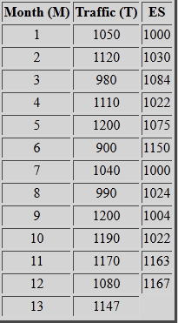
Exponential smoothing working
Suppose we have set of data on the average monthly network traffic on a software module during a year.
If we solve this problem using weight of 0.6 and an initial forecast of 1000 the results will be as shown below:
The exponential smoothing value for the 2nd month = (0.6)(1050) + (1 - 0.6)(1000) = 1030.
The other values were calculated in a similar fashion.

Slide 14
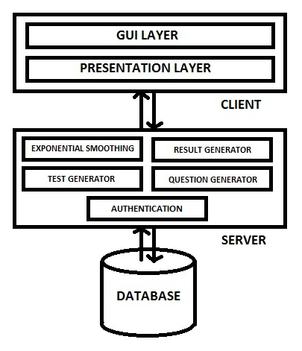
ARCHITECTURE DIAGRAM

Slide 15
Module 1:Client Module
1)User Login
This is the web page for user login into the system.
Users have three options of logging in.
2)Student Home
Student can appear for the test.
Student can appear for a subject of his choice.
3)Faculty Home
Faculty can schedule the test.
Faculty can add more questions and subjects.

Slide 16
4)Admin Home
Admin is the system monitor.
Admin performs validation of users, question generation, security etc.
5)Test Interface
A web page which has questions from different subjects.
Each question has 4 options.
6)Result Interface
A web page which shows results of the test.
5 marks for a correct response and 0 marks for an unattempted or a wrong response.

Slide 17
Module 2: Server Module
1)Test Generator
Test of the required subject is generated.
Test is generated according to the previous results.
2)Question Generator
Questions are generated directly from the database.
3)Result Generator
This component is the result evaluator.
Results are important to decide the difficulty level of the next test.

Slide 18
4)Exponential Smoothing
It is the heart of the system.
This component deals with the generation of user level.
This component computes an entity called as running average.
Depending upon the running average value the user difficulty level is decided.
The formula is as follows:
s0 = x0
s(t) = alpha * x(t-1) + ((1-alpha) * s(t-1)), t>0
alpha : Smoothing Factor
0 < alpha < 1

Slide 19
Module 3: Database Module
The database module consists of the system data.
The database module consists of –
-User information
-Test questions with four options
-Test Schedules
-Results
It is one of the most important module.

Slide 20
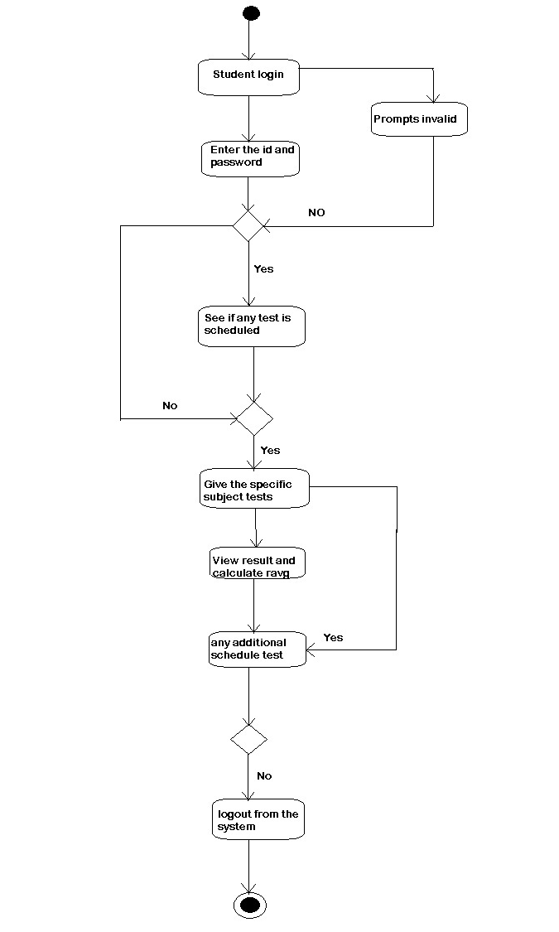
DIAGRAMS
ACTIVITY DIAGRAM

Slide 21
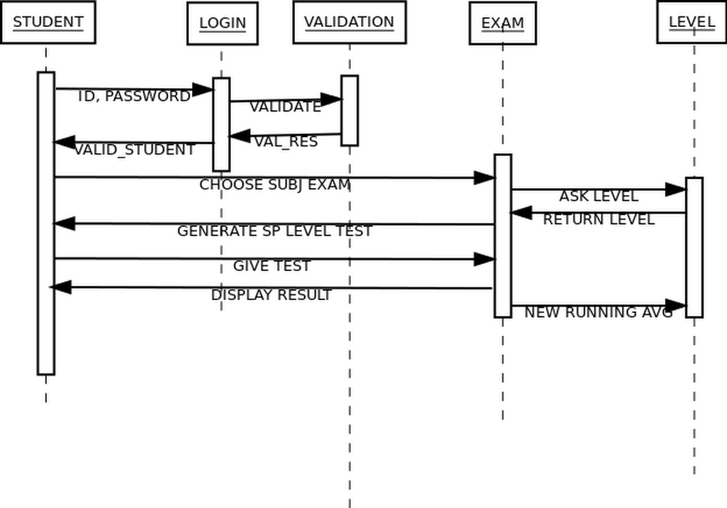
SEQUENCE DIAGRAM

Slide 22
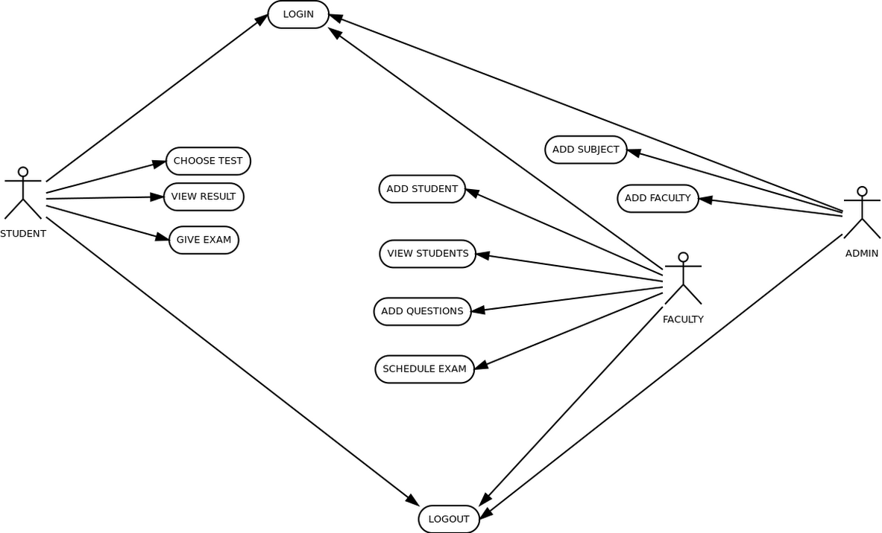
USE CASE DIAGRAM

Slide 23
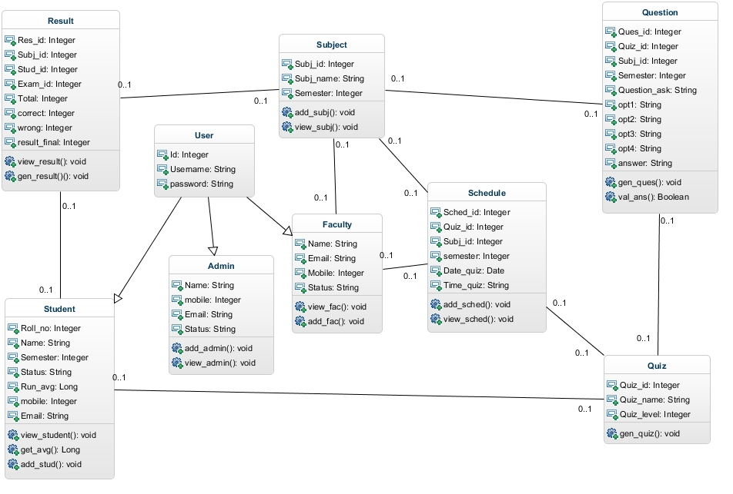
CLASS DIAGRAM

Slide 24


SCREEN SHOTS

Slide 25

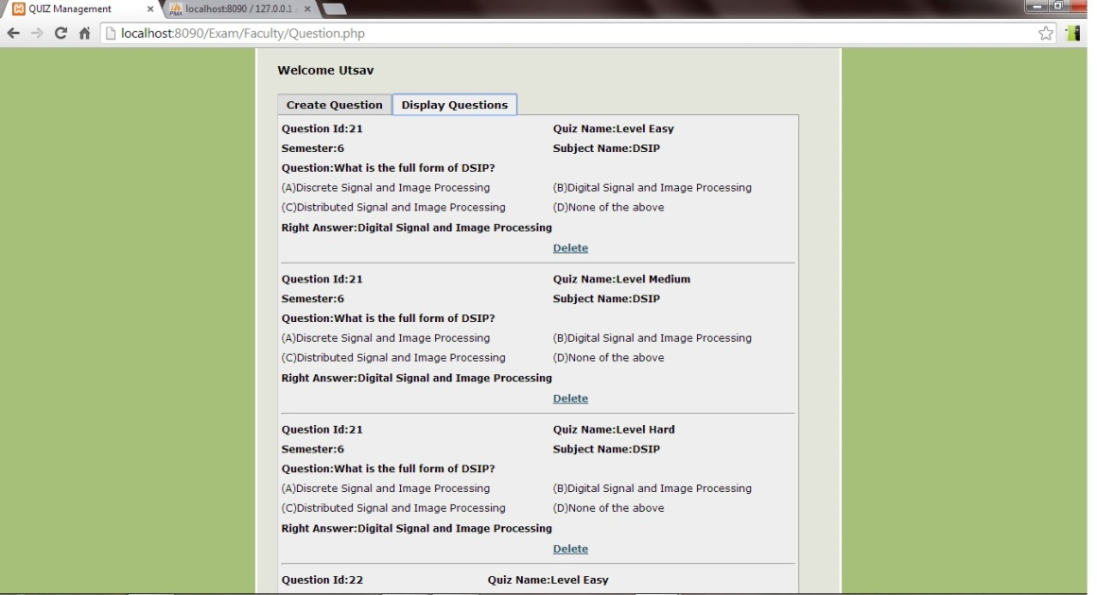

Slide 26
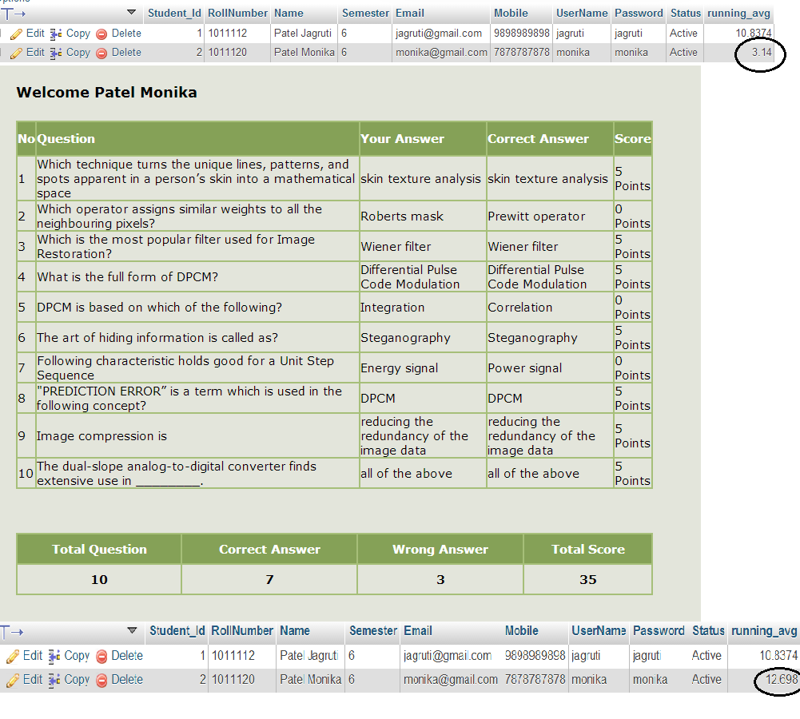
MONIKA GIVES TEST
SHE DOES WELL, HEREBY IMPROVING RUNNING AVG
RUNNING AVERAGE INITIAL- 3.14
RUNNING AVERAGE FINAL- 12.698

Slide 27
CONCLUSION
The project intends at developing a test system for the students of engineering.
The test system aims at preparing these students with the concepts which can be covered by the means of multiple choice questions.
Question generation software successively selects tests for the purpose of maximizing the precision of the exam.
It is based on what is known about the examinee from previous tests.
Compared to static multiple choice tests. our system provides better student learning.

Slide 28
References
BROWN, R. G., MEYER, R. F., The fundamental theory of exponential smoothing, Operations Research, 9, 1961, p. 673-685,
ACZEL, A. D., Complete Business Statistics, Irwin, 1989, ISBN 0-256-05710-8
MONTGOMERY, D. C., JOHNSON, L. A., GARDINER, J. S., Forecasting and Time Series Analysis, McGraw-Hill, Inc., 1990, ISBN 0-07-042858-1
[4] Eva Ostertagová ., Oskar Ostertag., The Simple exponential smoothing model Research,10,2010

