Slide 1




PRODUCTATHON
Team Name: Morpheus
Team members names:
Deepak Dara
Hemant Jindal
Siddhant Agarwal
Pratham Agarwal
Siddharth Shekar
Tools and Languages Used: Arduino, Ultrasonic Sensor, Flask, HTML,CSS, MongoDB, PHP, Google Maps API

Slide 2
Providing a clean and smart environment to cities
The India has been struggling with litter and waste since long time and though government has taken steps to encounter it but they neither been efficient nor effective. So for a “Swachh Bharat” we provide you a Smart waste management system where with minimum energy in terms of fuel and work power, optimal Output can be achieved making a difference in current municipality trends .

Slide 3
Proposed solution
Combined with recent technologies like IoT, we have created a smart garbage collection system, where our software interacts with an IoT device installed on garbage bins which enables us to provide a dynamic optimal solutions for the garbage vehicles path thus making it fuel efficient and avoiding garbage overflow hence keeping the city clean and smart.

Slide 4
Solution Architecture
Hardware:
Arduino UNO
Ultrasonic sensor
Wifi module ESPN8266
Software:
Flask framework
Google API
IoT(PHP)
.io(Arduino)
MongoDB

Slide 5
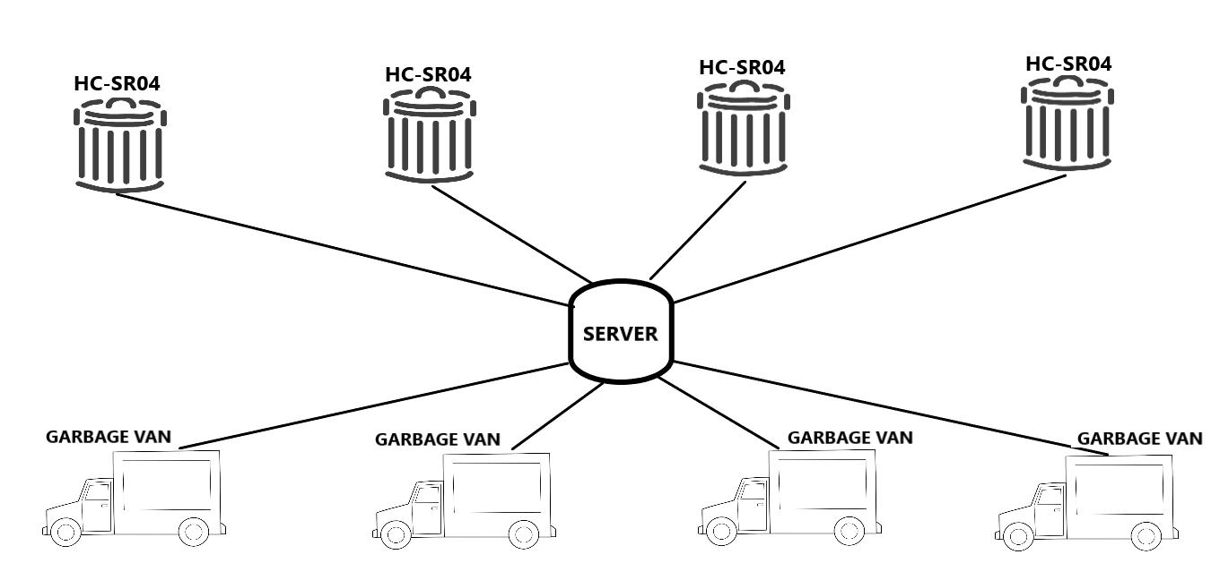
Deployment Architecture

Slide 6
Flow diagram/Algorithm
Start
Repeat
Check whether dustbin is full
Send data to server
Repeat
Update status of dustbin
Send vehicle for cleaning following optimal path

Slide 7
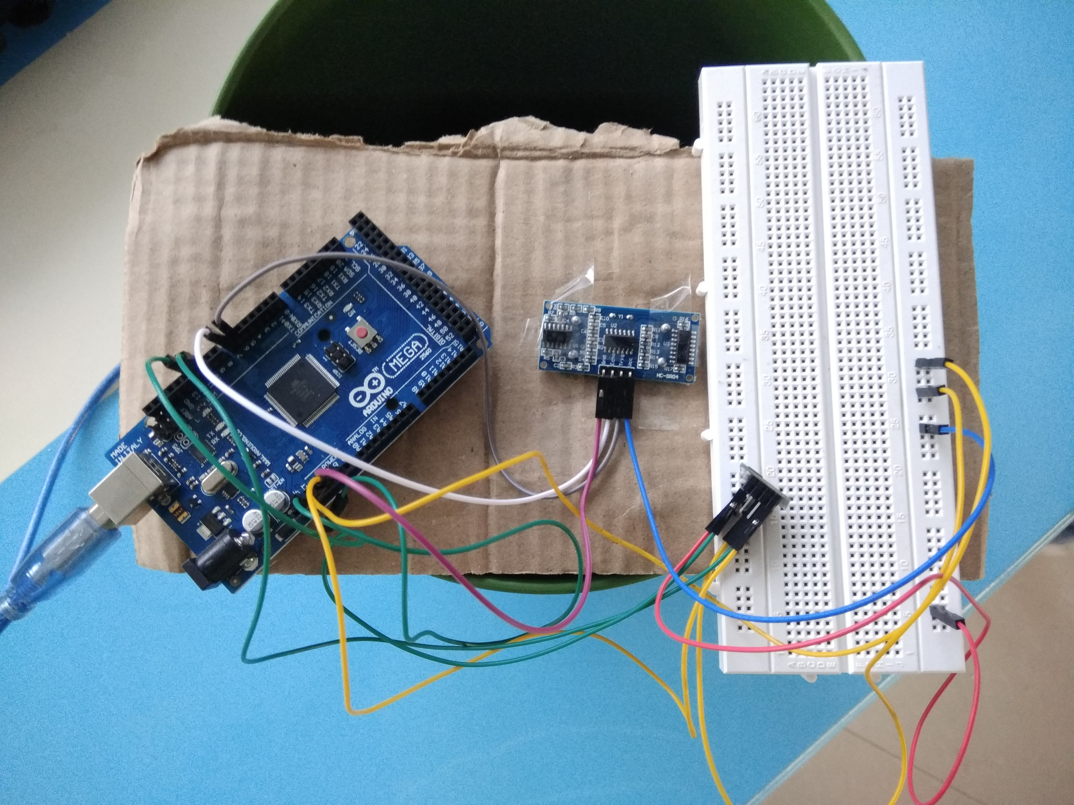
Diagram

