Slide 1
Board Summary: E-Commerce Analytics
Generated from integrated data, SQL, Python analytics, and ML outputs

Slide 2
Executive KPI Snapshot
Revenue: 7,273,684,809.51
Profit: 2,461,320,844.96
Margin: 33.84%
Delivered Orders: 108,982
Average Order Value: 66,742.07

Slide 3
Demand and Profit Insights
Peak month: 2025-12 (429,045,348.98)
Lowest month: 2025-02 (221,143,036.36)
Top profit category: Electronics (1,625,934,342.31)
Lowest margin category: Beauty (31.39%)

Slide 4
Customer Segmentation (RFM)
Highest value segment: Champions
Segment customers: 3,015
Segment revenue: 1,870,408,866.71
Use CRM priority tags P1/P2/P3 from export to sequence campaigns.

Slide 5
Forecast and Actions
Forecasted peak month: 2026-06 (305,811,615.32)
Scale inventory and logistics 6-8 weeks ahead of projected peaks.
Activate cross-sell recommendations for high-frequency cohorts.
Protect margins by reviewing deep-discount categories monthly.

Slide 6
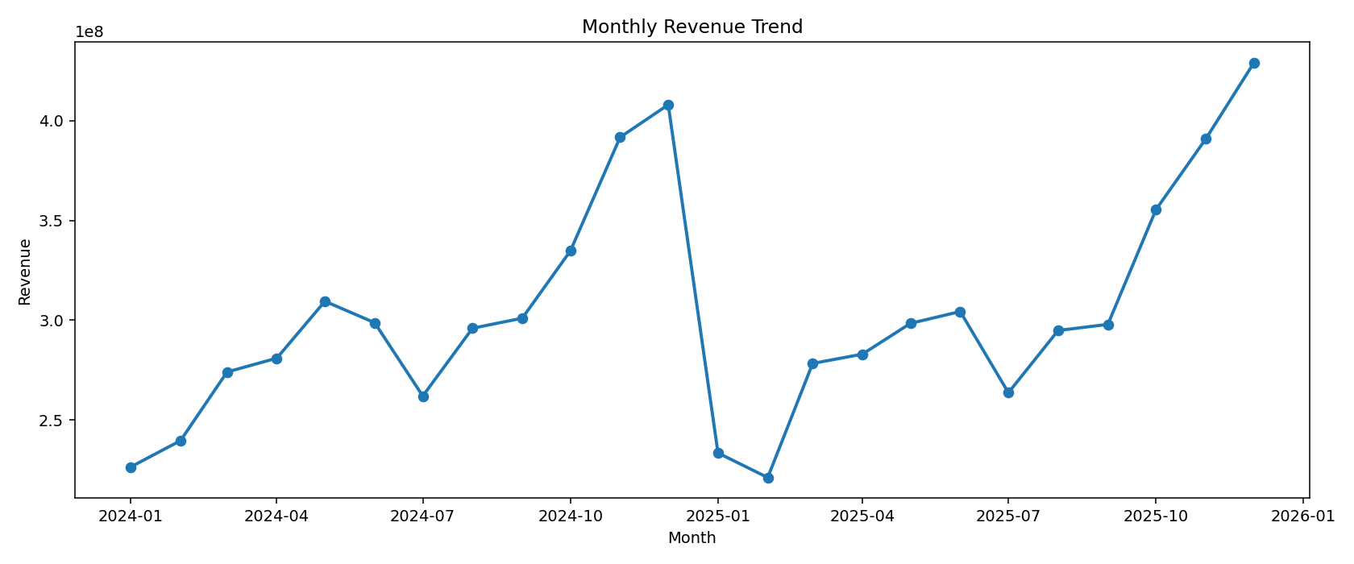
Monthly Revenue Trend

Slide 7
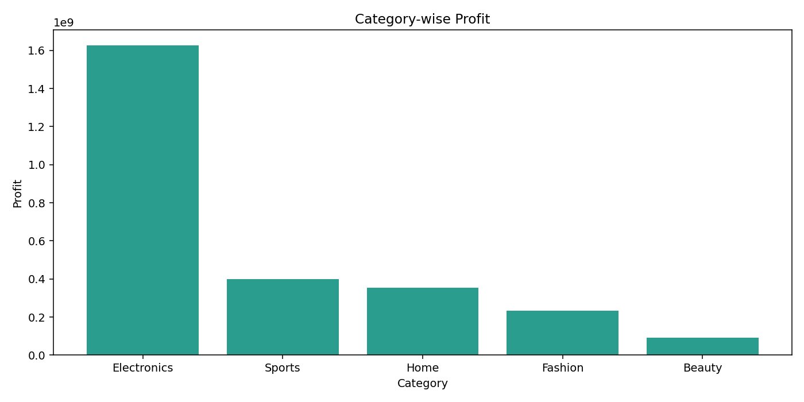
Category Profit

Slide 8
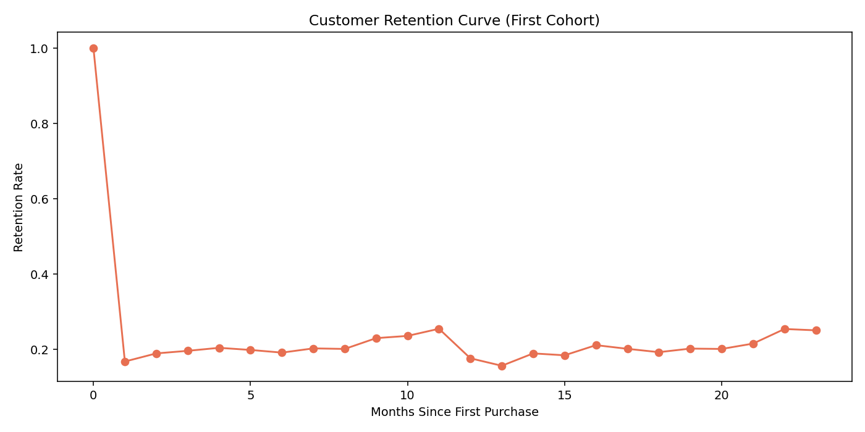
Retention Curve

