Slide 1
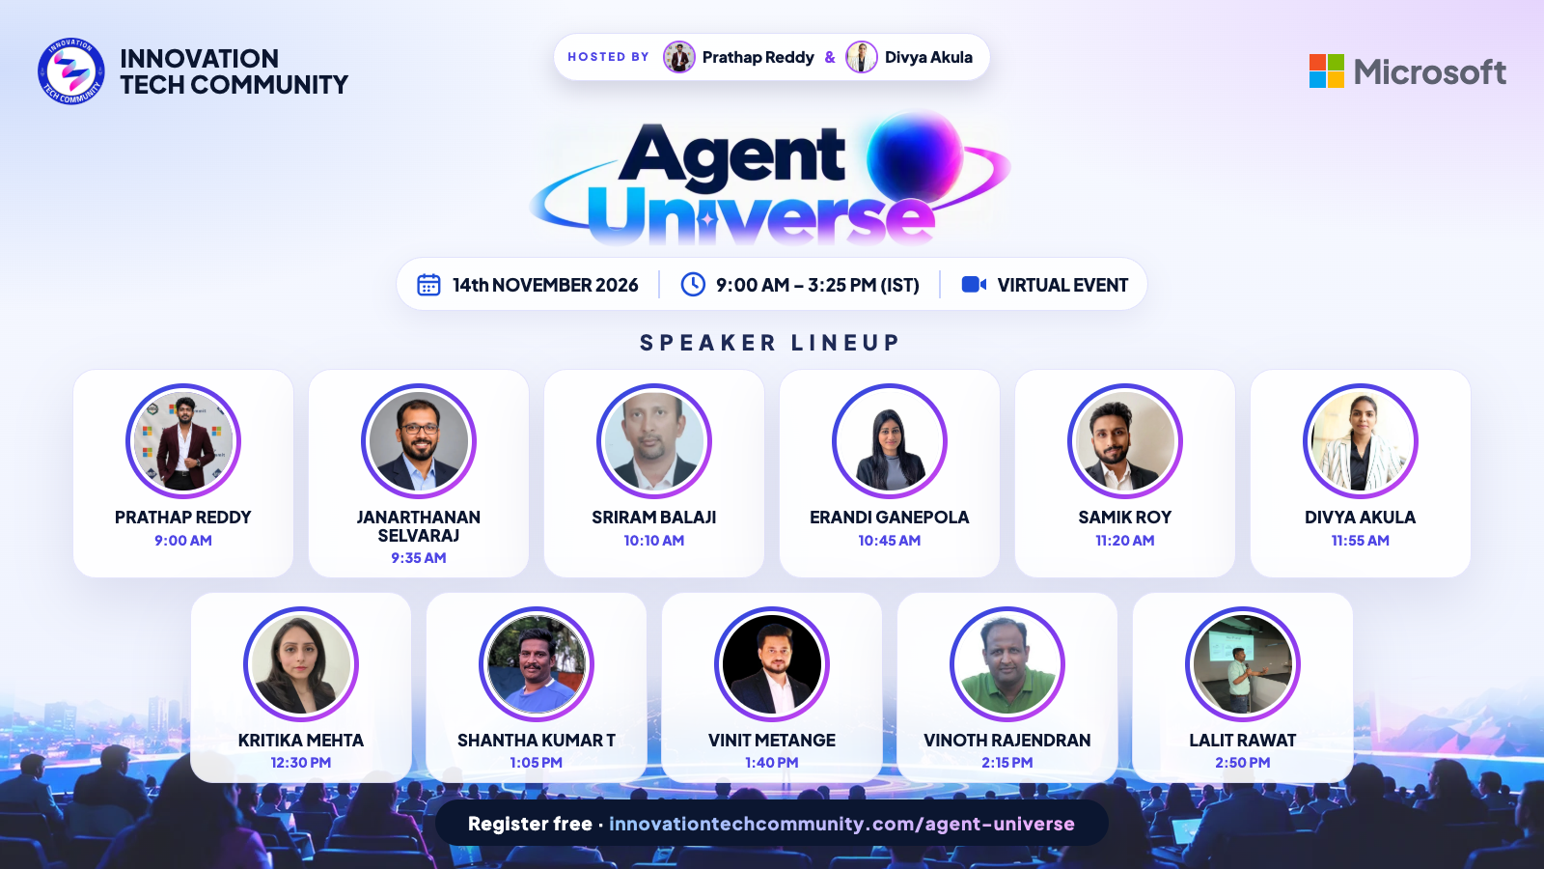
Agent Universe 2026
WELCOME TO
Saturday, 14 November 2026 · 9:00 AM – 3:25 PM IST
Hosted by Prathap Reddy & Divya Akula · Live on YouTube & LinkedIn
Notes:
[Prathap & Divya] Welcome everyone to Agent Universe 2026! Introduce yourselves as today's hosts, thank everyone for joining live on YouTube and LinkedIn, and set the tone: a full day of practical sessions from 11 speakers, 8 of them Microsoft MVPs.

Slide 2
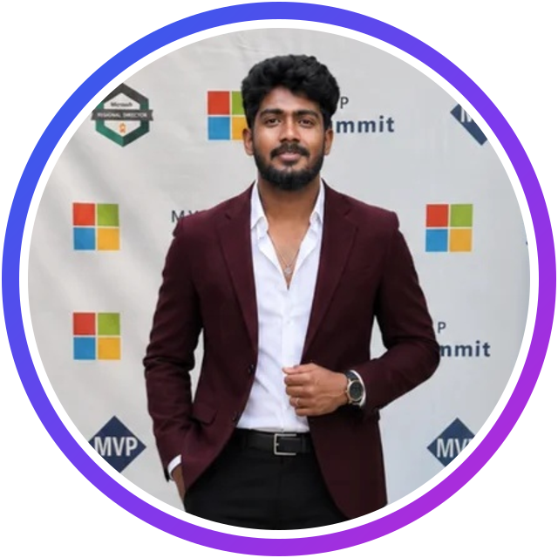
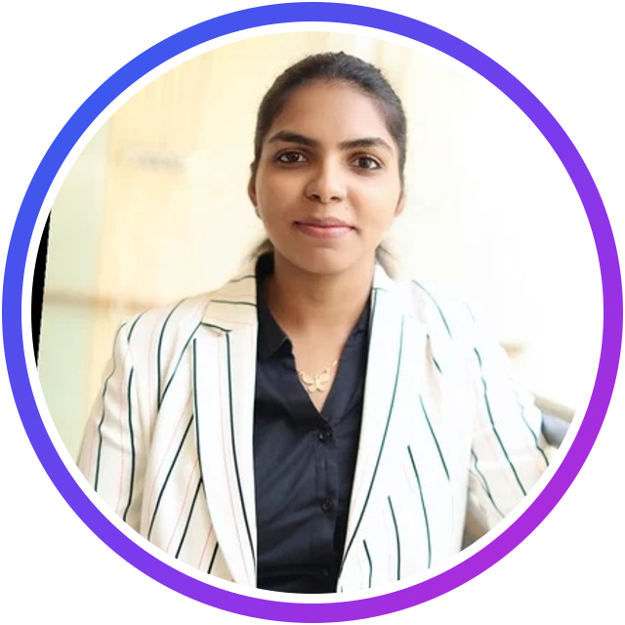
Your hosts today
Prathap Reddy
Divya Akula
Founder, Innovation Tech Community
Co-founder, Innovation Tech Community
Microsoft AI MVP · AI Engineer, Sulava Mea
Microsoft MVP (Copilot Studio) · Responsible AI Architect
We take turns introducing every speaker, read your questions from the chat and keep the day on time.
Notes:
[Prathap & Divya] Say a quick hello each, and explain how the day works: 35-minute sessions (30 minutes plus 5 minutes of Q&A), questions in the chat, and you'll take turns introducing the speakers.

Slide 3




Before we begin
Ask in the chat
Share the day
Claim your stamp
Watch it again
Drop your questions any time. Speakers take questions at the end of each session.
Post your takeaways with #AgentUniverse2026 and tag Innovation Tech Community.
Registered? Sign in at innovationtechcommunity.com and claim your passport stamp.
Every session stays on our YouTube channel, so you can catch up later.
Notes:
Quick housekeeping: questions in the chat, share with #AgentUniverse2026, registered attendees can claim their passport stamp, and every session will be on YouTube afterwards.

Slide 4

About Innovation Tech Community
Learn together. Build together. Grow together.
An open, independent community for technology enthusiasts, started in Bengaluru
Meetups, workshops and summits, online and in person
A stage for first-time and experienced speakers alike
Your own learning passport with badges and stamps
FOUNDED BY
Prathap Reddy
Divya Akula
Sujith Sukumaran
Lingaraj Benni
Say hi to ITC Cat, our mascot! 🐾
Notes:
Introduce Innovation Tech Community in a few lines: an open, independent community started in Bengaluru. Mention the founders and invite people to join the WhatsApp community and create a member account for the learning passport.

Slide 5
Today at a glance
11
11
8
1
sessions
speakers
Microsoft MVPs
day of Agentic AI
Talks and live demos across Microsoft Foundry, Foundry IQ, Copilot Studio, Agent Framework, MCP, RAG evaluation, agent security and multi-agent systems.

Slide 6
Agenda · All times IST
Time | Speaker | Session
9:00 AM – 9:35 AM | Prathap Reddy | From Idea to Agent: Building Enterprise AI Agents with Microsoft Foundry and Copilot Studio
9:35 AM – 10:10 AM | Janarthanan Selvaraj | Building Intelligent Enterprise AI Agents with Microsoft Foundry and Foundry IQ
10:10 AM – 10:45 AM | Sriram Balaji | Build agents using Copilot Studio and Microsoft Foundry
10:45 AM – 11:20 AM | Erandi Ganepola | One API Endpoint Is Not One MCP Tool: Designing Business Capabilities for AI Agents
11:20 AM – 11:55 AM | Samik Roy | Building a Secure Harness for Autonomous AI
11:55 AM – 12:30 PM | Divya Akula | Agents That Know Their Limits: Shipping Governed Multi-Agent Systems with Copilot Studio and Azure AI
12:30 PM – 1:05 PM | Kritika Mehta | Rethinking ERP Workflows with Multiple AI Agents: An Azure Logic Apps Experiment
1:05 PM – 1:40 PM | Shantha Kumar T | Beyond the Chatbot: Building Proactive AI Teammates with Copilot Studio
1:40 PM – 2:15 PM | Vinit Metange | Red-Team Your Agent Before Your Users Do: Testing and Securing Microsoft Foundry Agents
2:15 PM – 2:50 PM | Vinoth Rajendran | Building Smarter AI Agents with Microsoft Agent Framework Harness
2:50 PM – 3:25 PM | Lalit Rawat | Securing AI Agents: From Autonomous Intelligence to Enterprise-Grade Trust
Notes:
Walk through the day quickly. Every session is 35 minutes: 30 minutes plus 5 minutes of Q&A. Encourage people to stay for the whole day and to add the stream to their calendar.

Slide 7

UP NEXT · 9:00 AM – 9:35 AM IST
Prathap Reddy
Microsoft AI MVP · AI Engineer, Sulava Mea
Microsoft AI MVP
ITC founder
SESSION
From Idea to Agent: Building Enterprise AI Agents with Microsoft Foundry and Copilot Studio
Live demo · Intermediate · 35 minutes
AI Engineer and Agentic AI consultant: Azure AI Foundry, Azure OpenAI, Copilot Studio and Microsoft 365 Copilot
Designs enterprise-grade agents, RAG architectures and multi-agent systems
Founder of Innovation Tech Community
Notes:
[About 2 minutes · Host: Divya Akula]
Good morning everyone, and welcome to Agent Universe 2026! To open the day, it is my pleasure to introduce the founder of Innovation Tech Community and my co-host today, Prathap Reddy.
Prathap is a Microsoft AI MVP and an AI Engineer at Sulava Mea. As an Agentic AI consultant, he specialises in Microsoft AI technologies: Azure AI Foundry, Azure OpenAI, Microsoft Copilot Studio and Microsoft 365 Copilot. He helps organisations design and build enterprise-grade AI solutions with agents, RAG architectures and intelligent automation, and his focus is on turning innovative ideas into secure, scalable, production-ready applications.
His expertise spans agent orchestration, multi-agent systems, enterprise knowledge integration, workflow automation and responsible AI, and he regularly shares practical, real-world lessons with the community.
His session is "From Idea to Agent: Building Enterprise AI Agents with Microsoft Foundry and Copilot Studio". Prathap will show where each platform fits in an enterprise AI architecture, and walk through a practical scenario: from an AI use case to an agent that reasons over information, uses tools and enterprise capabilities, and gives users a conversational experience.
Please welcome Prathap!

Slide 8
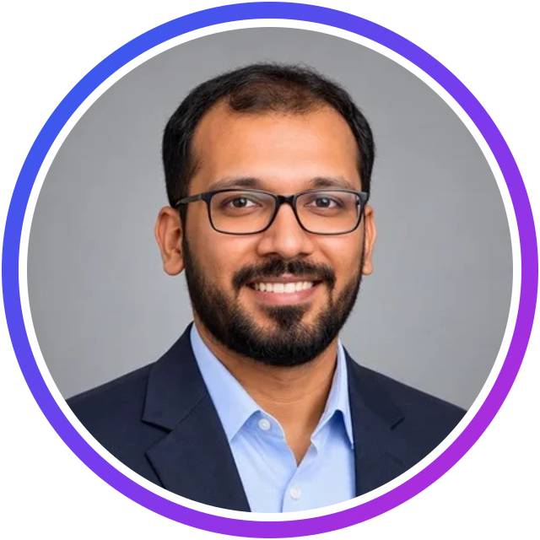
UP NEXT · 9:35 AM – 10:10 AM IST
Janarthanan Selvaraj
Microsoft AI MVP · Senior Manager, Technology & AI, Atos
Microsoft AI MVP
40 certifications
SESSION
Building Intelligent Enterprise AI Agents with Microsoft Foundry and Foundry IQ
Talk · Intermediate · 35 minutes
Microsoft MVP in AI for his expertise in Microsoft Foundry; Guinness World Record holder
Alumnus of the University of Cambridge FUEL Leadership programme; six-time Microsoft Certified Trainer
Microsoft Certified Community Lead, Microsoft Learn Expert and C# Corner MVP; 40 cloud certifications
Notes:
[About 2 minutes · Host: Prathap Reddy]
Our next speaker has a remarkable list of achievements: Janarthanan Selvaraj.
Janarthanan is a Senior Manager, Technology and AI Expert at Atos. He is an alumnus of the University of Cambridge's FUEL Leadership flagship programme and a graduate of Anna University, and he received the Microsoft MVP award in the AI category for his expertise in Microsoft Foundry.
He is also a Guinness World Record holder, a Microsoft Certified Community Lead, a six-time Microsoft Certified Trainer, a Microsoft Learn Expert in Data and AI, and a C# Corner MVP. And he holds 40 cloud certifications across Microsoft Azure, AWS, Google Cloud, Oracle and Aviatrix!
His session is "Building Intelligent Enterprise AI Agents with Microsoft Foundry and Foundry IQ". Janarthanan will show how Foundry IQ connects agents to enterprise knowledge sources, so they understand context and give accurate, grounded answers, and how to build knowledge-driven agents that work with enterprise data, APIs and business systems, securely and at scale.
Please welcome Janarthanan!

Slide 9
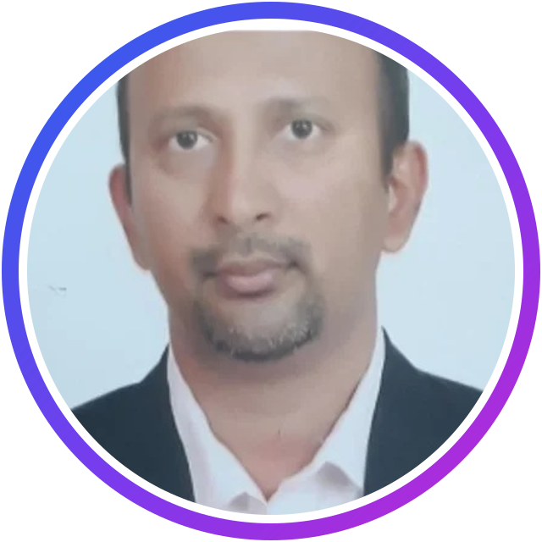
UP NEXT · 10:10 AM – 10:45 AM IST
Sriram Balaji
Microsoft MVP · Director, Kerv Digital
Microsoft MVP
27 yrs Microsoft
SESSION
Build agents using Copilot Studio and Microsoft Foundry
Talk · Beginner · 35 minutes
27 years in Microsoft technologies
Around 16 years with Dynamics 365 and Power Platform
Now focused on agentic AI with Copilot Studio and Microsoft Foundry
Notes:
[About 2 minutes · Host: Divya Akula]
Our next speaker brings a huge amount of experience to the stage: Sriram Balaji.
Sriram is a Microsoft MVP and a Director at Kerv Digital. He has been working with Microsoft technologies for 27 years, around 16 of them with Dynamics 365 and the Power Platform. Today his focus is agentic AI with Copilot Studio and Microsoft Foundry.
His session is "Build agents using Copilot Studio and Microsoft Foundry", and it is a great one if you are getting started. Sriram will show how to build agents declaratively in Microsoft Foundry with prompt agents, and how to build agents with no code at all in Copilot Studio, with demos in both.
Keep your questions coming in the chat. Please welcome Sriram!

Slide 10
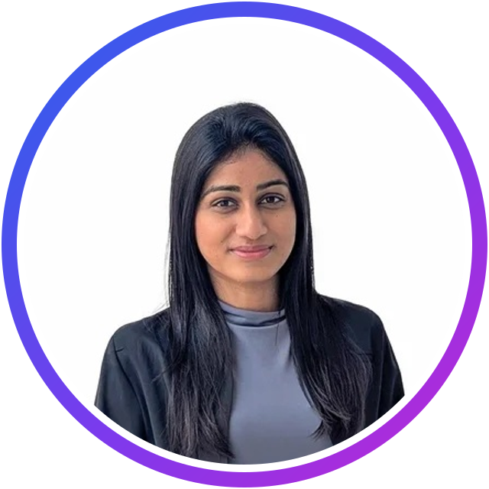
UP NEXT · 10:45 AM – 11:20 AM IST
Erandi Ganepola
Lead Solutions Engineer, Solutions Architecture · WSO2
~10 yrs APIs
Co-author
SESSION
One API Endpoint Is Not One MCP Tool: Designing Business Capabilities for AI Agents
Talk · Intermediate · 35 minutes
Nearly a decade of enterprise API and integration experience at WSO2
Works with North American customers on API platforms, integration and cloud-native architectures, including MCP and AI agents
Co-author of Cells as the Containment Unit for Agentic Systems
Notes:
[About 2 minutes · Host: Prathap Reddy]
Our next speaker joins us from the world of enterprise APIs: Erandi Ganepola.
Erandi is a Lead Solutions Engineer in WSO2's Solutions Architecture team, with nearly a decade of experience in enterprise APIs and integration. She works mostly with North American customers on API platforms, integration and cloud-native architectures, including bringing MCP and AI agents into existing enterprise environments. She was previously part of the WSO2 engineering team, and she co-authored "Cells as the Containment Unit for Agentic Systems". Her work today helps enterprises expose their business capabilities to AI agents while keeping domain ownership, security and operational control.
Her session is "One API Endpoint Is Not One MCP Tool: Designing Business Capabilities for AI Agents". Wrapping existing APIs as MCP tools is a fast start, but agents explore, chain calls and retry in ways those APIs were never designed for. Erandi will share what she has seen in real customer projects, and how to design capabilities that agents can use well.
Please welcome Erandi!

Slide 11
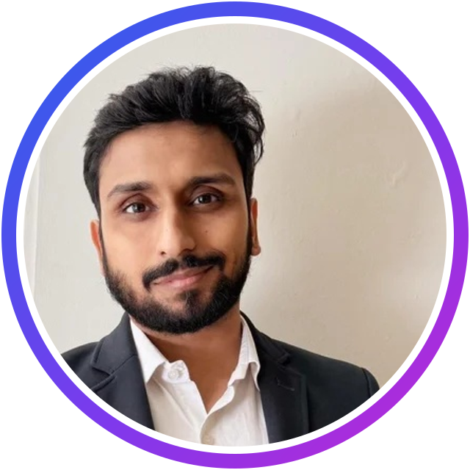
UP NEXT · 11:20 AM – 11:55 AM IST
Samik Roy
Microsoft MVP · Threat Intelligence & Microsoft Security
Microsoft MVP
Author
SESSION
Building a Secure Harness for Autonomous AI
Talk · Intermediate · 35 minutes
Specialises in Microsoft Sentinel, Defender XDR and the Azure security stack
Has led enterprise-scale Sentinel deployments and trained hundreds of analysts
Author of a book on KQL for Microsoft Sentinel; publishes the Signals & Shadows newsletter
Notes:
[About 2 minutes · Host: Divya Akula]
Our next speaker brings a security lens to agentic AI: Samik Roy.
Samik is a Microsoft MVP specialising in threat intelligence, Microsoft Sentinel, Defender XDR and the Azure security stack. His work sits at the intersection of practical security engineering and clear, actionable education. He designs and modernises SOC architectures, builds KQL-powered detection libraries and automation, and creates tools like ms-sentinel-scout. He has led enterprise-scale Sentinel deployments, trained hundreds of analysts through his KQL course on Udemy, written a book on KQL for Microsoft Sentinel, and he publishes Signals and Shadows, a monthly threat-intelligence newsletter.
His session is "Building a Secure Harness for Autonomous AI". When agents run shell commands, query databases and call internal APIs, system prompts alone cannot keep them safe. Samik will show how a deterministic agent harness, with policy-as-code guardrails, sandboxing and human-in-the-loop controls, protects you against prompt injection, tool hijacking and credential leaks.
Please welcome Samik!

Slide 12
UP NEXT · 11:55 AM – 12:30 PM IST
Divya Akula
Microsoft MVP (Copilot Studio) · Responsible AI Architect · Sulava MEA
Microsoft MVP
Author
ITC co-founder
SESSION
Agents That Know Their Limits: Shipping Governed Multi-Agent Systems with Copilot Studio and Azure AI
Talk · Intermediate · 35 minutes
16+ years in the Microsoft ecosystem: from SharePoint and Power Platform to Azure AI and Responsible AI
Works with government entities and enterprises across the UAE: aviation, tourism and culture, events, retail
Author of books on Responsible AI solutions and on Power Apps with OpenAI; co-founder of Innovation Tech Community
Notes:
[About 2 minutes · Host: Prathap Reddy]
Our next speaker is my co-host today, and one of the co-founders of Innovation Tech Community: Divya Akula.
Divya is a Microsoft MVP in Copilot Studio, a Responsible AI architect and an AI solution developer at Sulava MEA. She works with leading government entities and enterprises across the UAE, in aviation, tourism and culture, events, retail and economic development.
Over more than 16 years in the Microsoft ecosystem, she has moved from SharePoint and Power Platform into Azure AI and Responsible AI. Her focus today is multi-agent architectures with Foundry and Copilot Studio, enterprise integrations, and governance frameworks that keep AI transparent, accountable and safe to run in production. She has also written books on Responsible AI solutions and on Power Apps with OpenAI.
Her session is "Agents That Know Their Limits: Shipping Governed Multi-Agent Systems with Copilot Studio and Azure AI". Most agent demos show what an agent can do; Divya will show what it won't do, and how to prove it: scoped authority for each agent, identity-aware access through API Management and Entra ID, human-in-the-loop checkpoints, and decisions that auditors can trace.
Please welcome Divya!

Slide 13
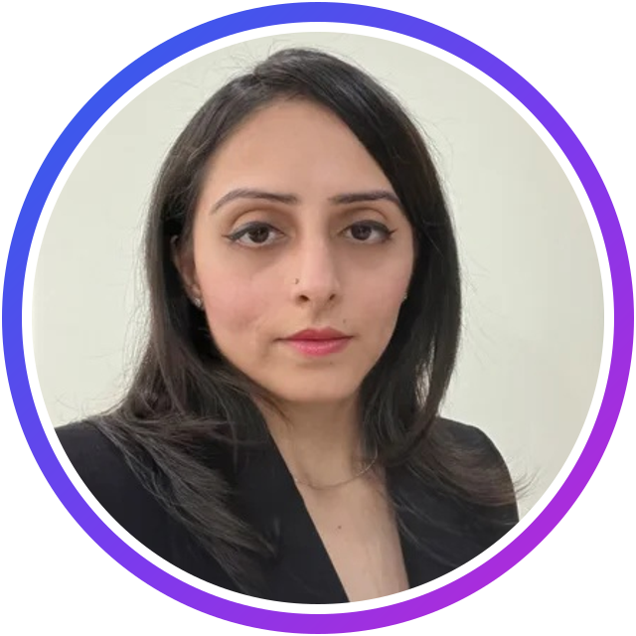
UP NEXT · 12:30 PM – 1:05 PM IST
Kritika Mehta
Solution Architect · Business Central & AI Architecture
15+ yrs Dynamics
Podcast host
SESSION
Rethinking ERP Workflows with Multiple AI Agents: An Azure Logic Apps Experiment
Live demo · Intermediate · 35 minutes
Solution Architect working with Microsoft Dynamics since the C/SIDE and Classic Client era
Shares her learning on her YouTube channel, Architect AI Lab
Hosts the podcast Architects in the AI Era
Notes:
[About 2 minutes · Host: Divya Akula]
Please welcome our next speaker, Kritika Mehta.
Kritika is a Solution Architect who has worked with Microsoft Dynamics since the C/SIDE and Classic Client era: more than 15 years in the Dynamics trenches. Her focus is not just on building features, but on understanding how AI can take away the busy work, and how years of customisations and business logic fit into an AI world.
She explores all of this in public: on her YouTube channel, Architect AI Lab, she shares what she is learning about AI in Dynamics 365 Business Central, and on her podcast, Architects in the AI Era, she talks with guests about their stories with AI. In her own words, she does not care much for the AI hype; she cares about building stable, trustworthy AI solutions that actually work for customers.
Her session is "Rethinking ERP Workflows with Multiple AI Agents: An Azure Logic Apps Experiment". Kritika will demo a solution built with agentic workflows in Azure Logic Apps, with Business Central as the ERP: an orchestrator coordinating specialist agents, while the workflow handles business rules, calculations, approvals and ERP updates.
Kritika, over to you!

Slide 14
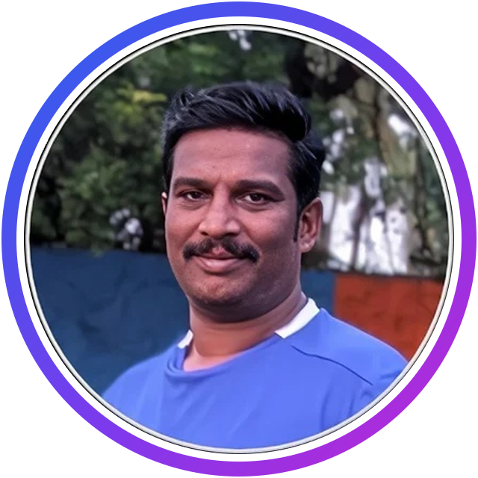
UP NEXT · 1:05 PM – 1:40 PM IST
Shantha Kumar T
Microsoft Copilot MVP · CTO, SharePoint Designs
Microsoft Copilot MVP
CTO
SESSION
Beyond the Chatbot: Building Proactive AI Teammates with Copilot Studio
Live demo · Intermediate · 35 minutes
19 years in the modern workspace as developer, UI designer and architect
Chief Technology Officer at SharePoint Designs
Focused on cloud, modern workspace and AI
Notes:
[About 2 minutes · Host: Prathap Reddy]
Our next speaker is Shantha Kumar T.
Shantha is a Microsoft Copilot MVP and the Chief Technology Officer at SharePoint Designs. He has 19 years of experience in the modern workspace, and he has worked in every role along the way: developer, UI designer and architect. Today, cloud, the modern workspace and AI are at the centre of his work.
His session is "Beyond the Chatbot: Building Proactive AI Teammates with Copilot Studio". Shantha will show how to move from conversational bots to digital teammates: autonomous agent accounts, business process memory and proactive triggers in Copilot Studio. In his live walkthrough, an agent uses its own identity, reaches out to owners and approvers with @mentions in Teams and Outlook, and pulls their answers into an executive-ready briefing.
Please welcome Shantha!

Slide 15
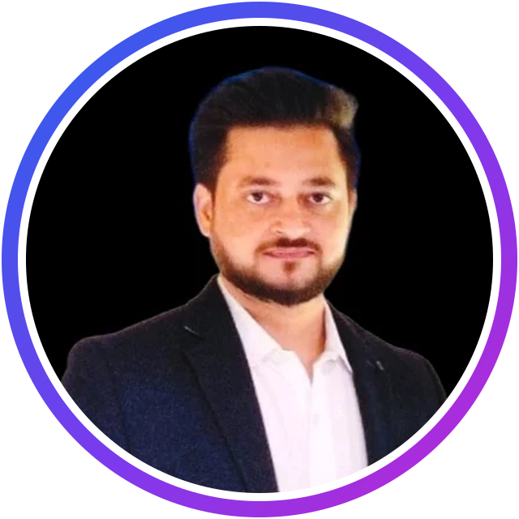
UP NEXT · 1:40 PM – 2:15 PM IST
Vinit Metange
Senior AI Product Manager · Founder, AASA & BEACON AI
18 yrs product
Founder
SESSION
Red-Team Your Agent Before Your Users Do: Testing and Securing Microsoft Foundry Agents
Talk · Beginner · 35 minutes
18 years at Nokia, Netcracker, IBM and Wipro: cloud platforms, 5G subscriber data and enterprise GenAI
Founder of AASA, which runs adversarial security tests against live AI agents, and BEACON AI
Product Management certificate from Kellogg; Leadership with AI programme from ISB
Notes:
[About 2 minutes · Host: Divya Akula]
Our next speaker builds agentic AI that holds up in production: Vinit Metange, joining us from Bengaluru.
Vinit is an AI product leader and builder. Over 18 years at Nokia, Netcracker, IBM and Wipro, he has owned cloud platform services, the 5G subscriber data platform behind operators' launches, and enterprise GenAI capabilities, from agent specifications to evaluation strategy. Today he builds AI products hands-on: he is the founder of AASA, which runs adversarial security tests against live AI agents and maps the findings to the OWASP LLM Top 10, and of BEACON AI, which helps brands with their visibility in AI answers. He holds a Product Management certificate from the Kellogg School of Management and completed the Leadership with AI programme at ISB.
His session is "Red-Team Your Agent Before Your Users Do: Testing and Securing Microsoft Foundry Agents". Building an agent takes an afternoon; trusting it with real data and real actions is the hard part. Vinit will build two versions of the same HR assistant in Microsoft Foundry and attack them both, so you can see exactly what makes one safe.
Please welcome Vinit!

Slide 16
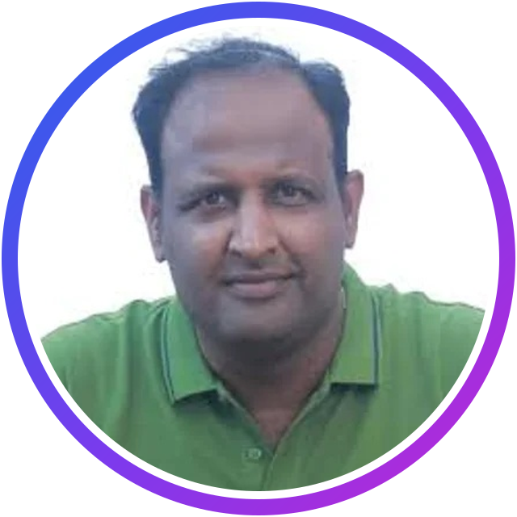
UP NEXT · 2:15 PM – 2:50 PM IST
Vinoth Rajendran
Microsoft AI MVP · Software Developer
Microsoft AI MVP
SESSION
Building Smarter AI Agents with Microsoft Agent Framework Harness
Talk · Intermediate · 35 minutes
Specialises in Generative AI, Azure AI and intelligent agents
Expertise in Copilot Studio, Semantic Kernel and .NET
Regular speaker sharing hands-on demos at community events
Notes:
[About 2 minutes · Host: Prathap Reddy]
Next, please welcome Vinoth Rajendran.
Vinoth is a Microsoft AI MVP, a software developer and a passionate technology speaker. He specialises in Generative AI, Azure AI and intelligent agents, with deep expertise in Microsoft Copilot Studio, Semantic Kernel and .NET. You will often find him at community events sharing technical sessions and hands-on demonstrations that help developers build real-world AI solutions.
His session is "Building Smarter AI Agents with Microsoft Agent Framework Harness". Vinoth will show how the Harness helps agents plan tasks, keep context, use tools, run multi-step workflows and ask for human approval, with a practical example that goes from a basic LLM call to an autonomous, tool-enabled agent.
Vinoth, over to you!

Slide 17
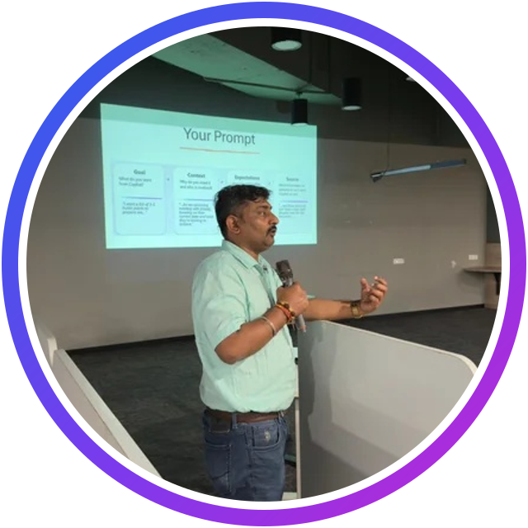
UP NEXT · 2:50 PM – 3:25 PM IST
Lalit Rawat
Microsoft MVP · MCT · CISO, Kanerika
Microsoft MVP
MCT
CISO
SESSION
Securing AI Agents: From Autonomous Intelligence to Enterprise-Grade Trust
Talk · Intermediate · 35 minutes
Chief Information Security Officer at Kanerika and Distinguished Lead Engineer; 19+ years in Microsoft technologies
Specialises in Zero Trust, DevSecOps, cloud security, AI governance and enterprise AI architecture
Helps organisations bridge innovation and security to adopt AI responsibly
Notes:
[About 2 minutes · Host: Divya Akula]
Closing our sessions today: Lalit Rawat.
Lalit is the Chief Information Security Officer at Kanerika and a Distinguished Lead Engineer, with more than 19 years of experience in Microsoft technologies, enterprise architecture, cloud security and AI-driven innovation. He is a Microsoft MVP and a Microsoft Certified Trainer, and he specialises in secure, scalable, cloud-native solutions on Azure: Zero Trust, DevSecOps, cybersecurity governance, AI security and enterprise AI architecture. His passion is helping organisations bridge the gap between innovation and security, so they can adopt new technology responsibly.
His session is "Securing AI Agents: From Autonomous Intelligence to Enterprise-Grade Trust". As agents start to access enterprise data, call APIs, run tools and write code, the risks grow too: excessive permissions, prompt injection, data exposure and identity abuse. Lalit will cover the agent threat landscape, identity and least-privilege tool execution, runtime guardrails, secure RAG and secrets management.
Please welcome Lalit!

Slide 18

Thank you!
Claim your passport stamp at innovationtechcommunity.com
Recordings: youtube.com/@innovationtechcommunity
Hosted by Prathap Reddy & Divya Akula · innovationtechcommunity.com
Notes:
[Prathap & Divya] Thank every speaker by name, the audience and the volunteers. Remind people to claim their passport stamp, that recordings are on YouTube, and invite everyone to join the community at innovationtechcommunity.com for the next event.

