Slide 1



AGENT UNIVERSE 2026 · #AgentUniverse2026
THAT'S A WRAP!
Thank you for joining Agent Universe 2026
1K+ live on YouTube · 500+ on LinkedIn Live · 10 sessions
Hosted by Prathap Reddy & Divya Akula
Innovation Tech Community · innovationtechcommunity.com
Notes:
[Prathap & Divya · start of the close, about 3:25 PM] What a day! That brings us to the end of Agent Universe 2026. More than 1,000 of you watched live on YouTube and 500+ joined us on LinkedIn Live, from India and around the world. Thank you! Before you go, we have a few thank-yous and a couple of quick things for you.

Slide 2


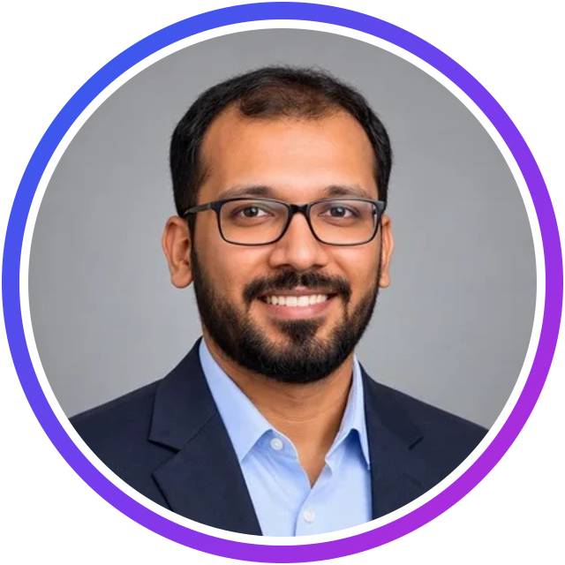
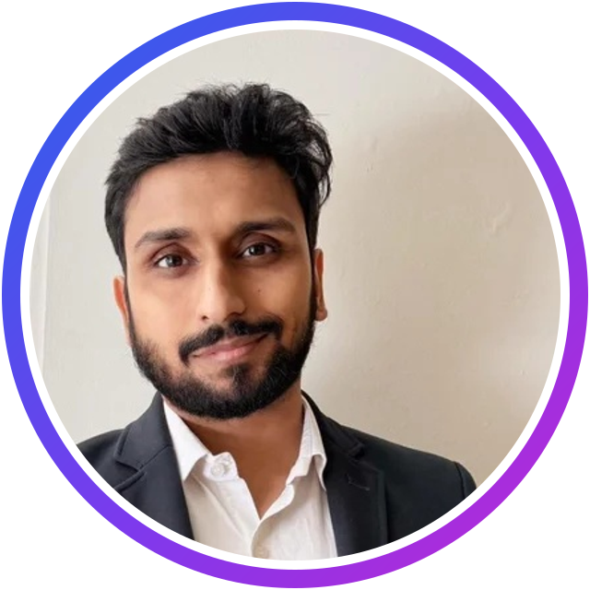
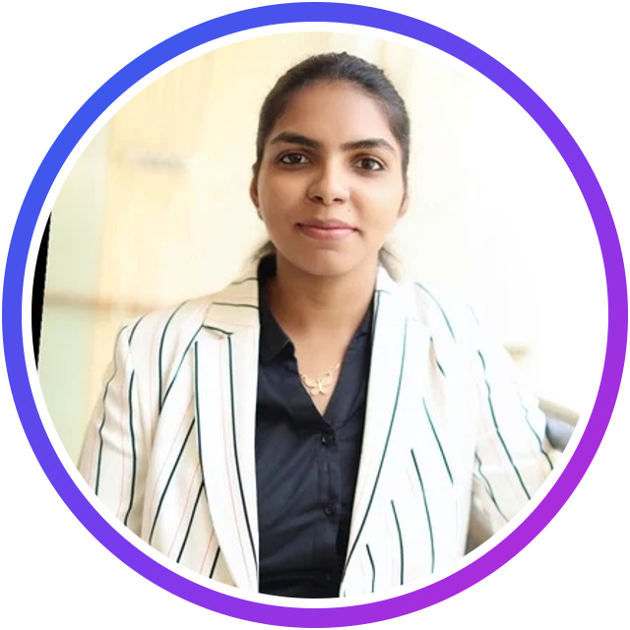
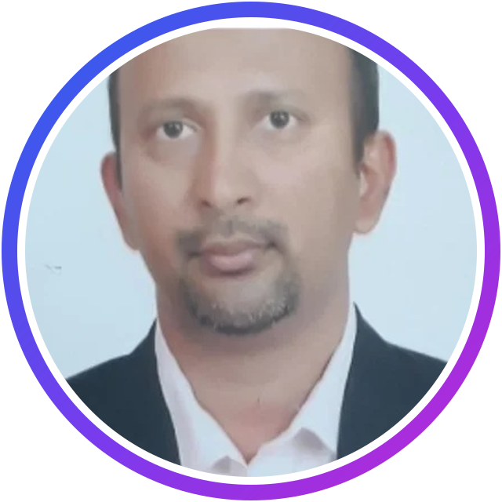
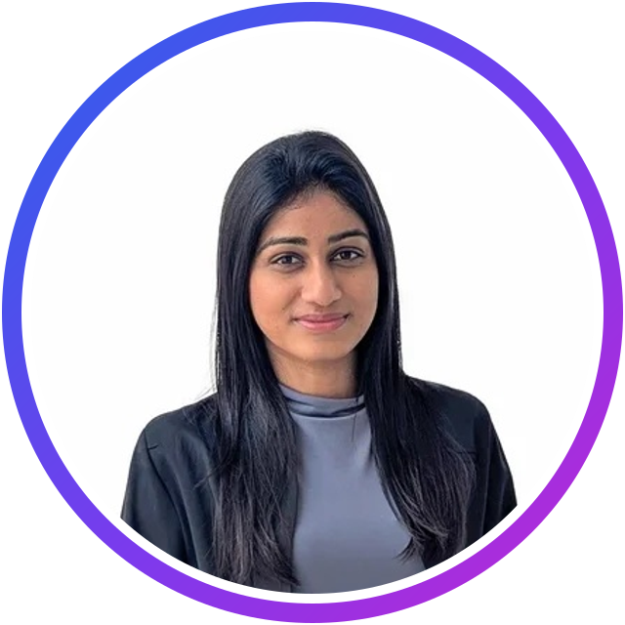
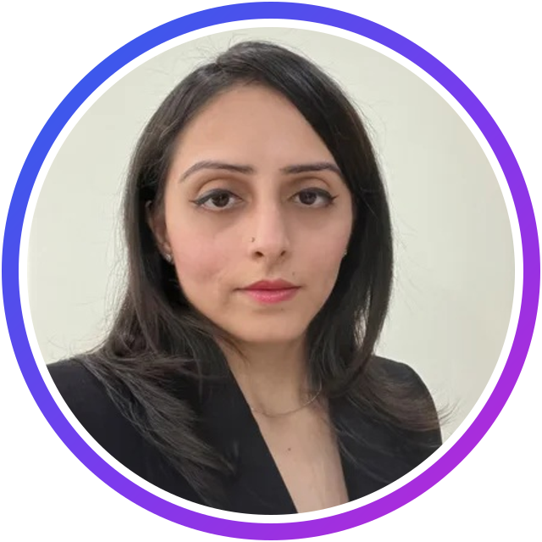
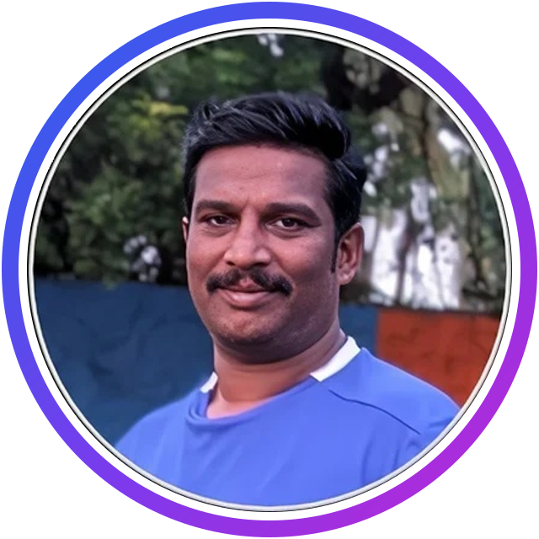
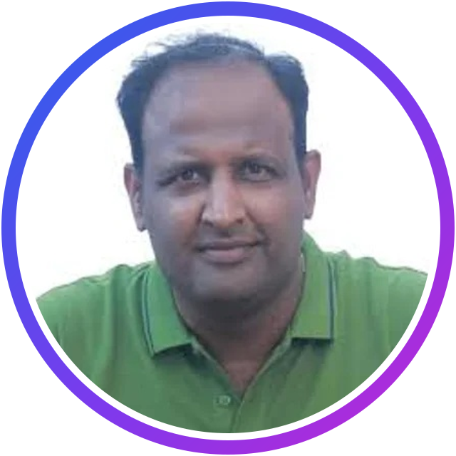
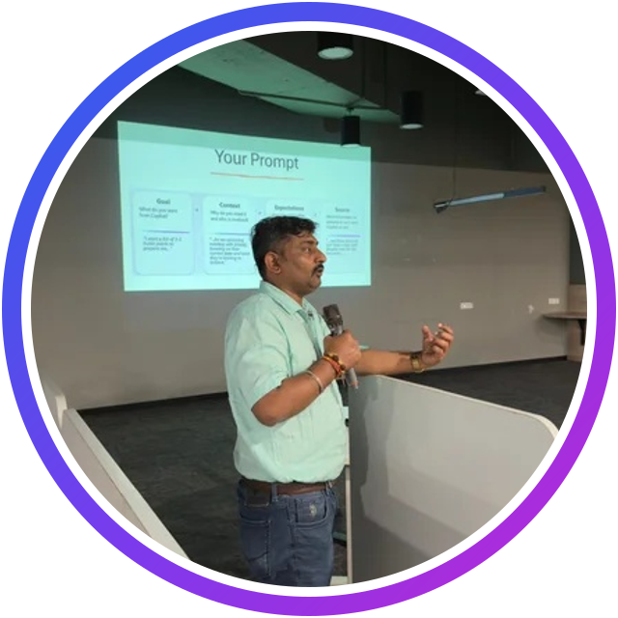
THANK YOU
A huge thank you to our speakers
Prathap Reddy
Janarthanan Selvaraj
Samik Roy
Divya Akula
Sriram Balaji
Microsoft AI MVP
Microsoft AI MVP
Microsoft MVP
Microsoft MVP
Microsoft MVP
Erandi Ganepola
Kritika Mehta
Shantha Kumar T
Vinoth Rajendran
Lalit Rawat
~10 yrs APIs
15+ yrs Dynamics
Microsoft Copilot MVP
Microsoft AI MVP
Microsoft MVP
Agent Universe 2026 · #AgentUniverse2026
2
Notes:
[Divya] The real stars of today: our 10 speakers. Thank you for your time, your expertise and your live demos, and for sharing so generously with the community. Read the names out: Prathap Reddy, Janarthanan Selvaraj, Samik Roy, Divya Akula, Sriram Balaji, Erandi Ganepola, Kritika Mehta, Shantha Kumar T, Vinoth Rajendran, Lalit Rawat.

Slide 3
RECAP
Today at Agent Universe 2026
1K+
500+
10
8
watched live on YouTube
attendees on LinkedIn Live
expert speakers & sessions
Microsoft MVPs
WHAT WE COVERED
Microsoft Foundry
Foundry IQ
Copilot Studio
Multi-agent systems
Agent governance
MCP
Azure Logic Apps
Agent Framework
AI security & trust
Enterprise AI agents
Agent Universe 2026 · #AgentUniverse2026
3
Notes:
[Prathap] A quick look back at the day. We went from idea to agent with Microsoft Foundry and Copilot Studio, through Foundry IQ, secure harnesses and governed multi-agent systems, MCP and business capabilities, ERP workflows with Logic Apps, proactive AI teammates, Agent Framework and enterprise-grade trust. And the numbers: more than 1,000 of you watched live on YouTube and 500+ on LinkedIn Live. If you missed any session, the full recording is on YouTube.

Slide 4
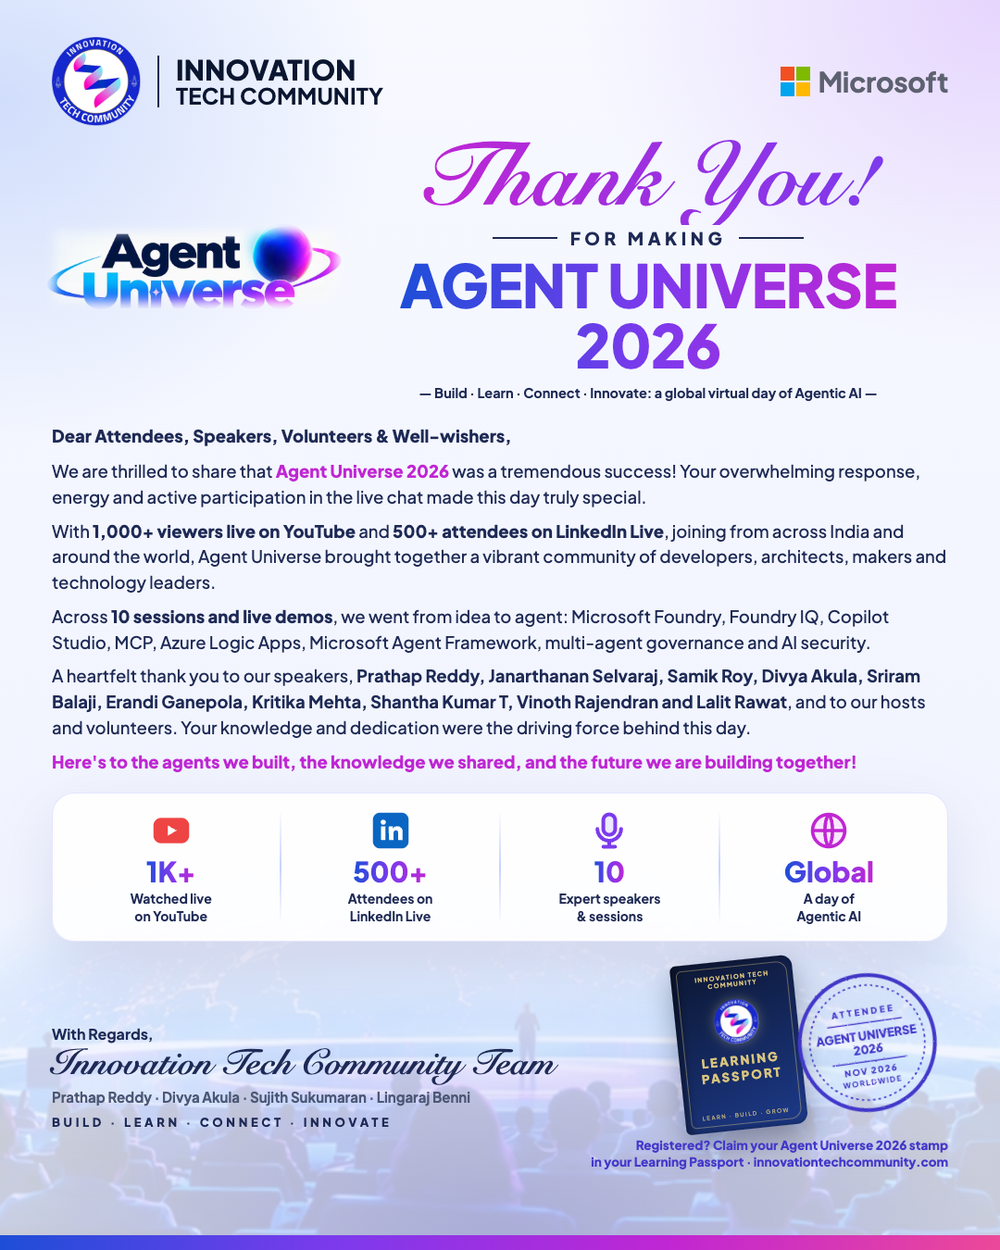
WITH GRATITUDE
A thank-you letter to our community
Dear Attendees, Speakers, Volunteers & Well-wishers,
We are thrilled to share that Agent Universe 2026 was a tremendous success! Your overwhelming response, energy and active participation in the live chat made this day truly special.
With 1,000+ viewers live on YouTube and 500+ attendees on LinkedIn Live, joining from across India and around the world, Agent Universe brought together a vibrant community of developers, architects, makers and technology leaders.
Across 10 sessions and live demos, we went from idea to agent: Microsoft Foundry, Foundry IQ, Copilot Studio, MCP, Azure Logic Apps, Microsoft Agent Framework, multi-agent governance and AI security.
A heartfelt thank you to our speakers, hosts and volunteers. Your knowledge and dedication were the driving force behind this day.
Here's to the agents we built, the knowledge we shared, and the future we are building together!
With regards, Innovation Tech Community Team
Prathap Reddy · Divya Akula · Sujith Sukumaran · Lingaraj Benni
Agent Universe 2026 · #AgentUniverse2026
4
Notes:
[Prathap · read the letter, about 1.5 minutes]
Dear Attendees, Speakers, Volunteers & Well-wishers,
We are thrilled to share that Agent Universe 2026 was a tremendous success! Your overwhelming response, energy and active participation in the live chat made this day truly special.
With 1,000+ viewers live on YouTube and 500+ attendees on LinkedIn Live, joining from across India and around the world, Agent Universe brought together a vibrant community of developers, architects, makers and technology leaders.
Across 10 sessions and live demos, we went from idea to agent: Microsoft Foundry, Foundry IQ, Copilot Studio, MCP, Azure Logic Apps, Microsoft Agent Framework, multi-agent governance and AI security.
A heartfelt thank you to our speakers, hosts and volunteers. Your knowledge and dedication were the driving force behind this day.
Here's to the agents we built, the knowledge we shared, and the future we are building together!
Our speakers today: Prathap Reddy, Janarthanan Selvaraj, Samik Roy, Divya Akula, Sriram Balaji, Erandi Ganepola, Kritika Mehta, Shantha Kumar T, Vinoth Rajendran, Lalit Rawat.
With regards,
Innovation Tech Community Team: Prathap Reddy, Divya Akula, Sujith Sukumaran, Lingaraj Benni.

Slide 5
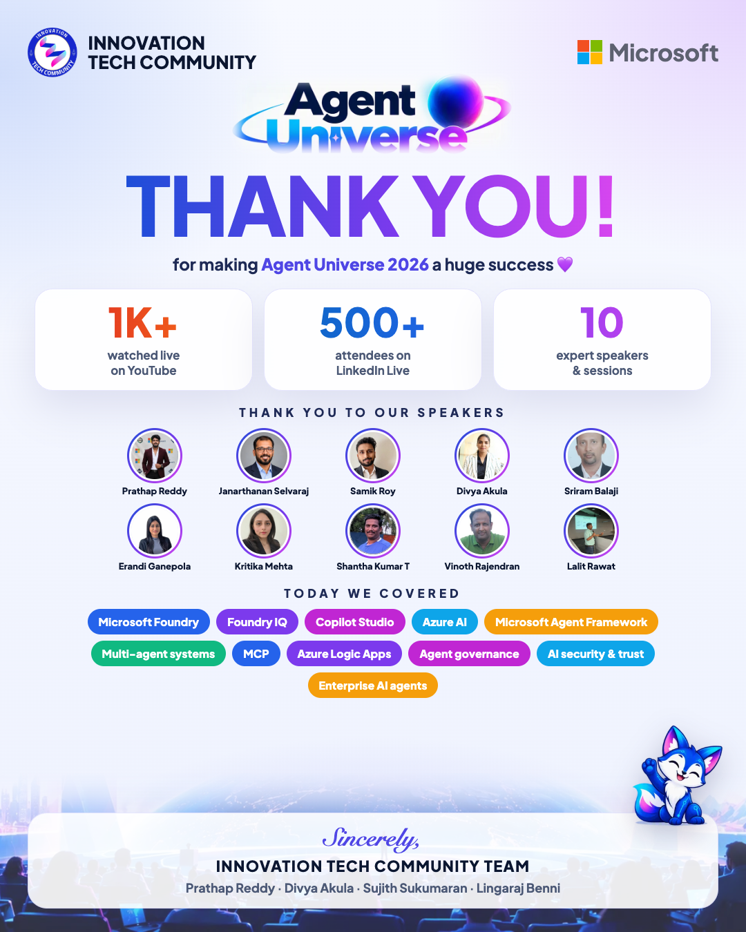
SPREAD THE WORD
Share the love: our thank-you posters
Download & share
github.com/prathapm14/agent-universe-2026
Tag Innovation Tech Community
#AgentUniverse2026
Thank-you poster
Thank-you letter
Agent Universe 2026 · #AgentUniverse2026
5
Notes:
[Divya] We've made thank-you posters for today. Please download them from our GitHub repo, share them on LinkedIn, Instagram and WhatsApp, and tag Innovation Tech Community with #AgentUniverse2026. Speakers, please share them too!

Slide 6



LEARNING PASSPORT
Claim your Agent Universe 2026 stamp
Every registered attendee gets the Agent Universe 2026 stamp in their ITC Learning Passport. Claim it today!
1. Sign in
2. Open your Passport
3. Claim your stamp
Go to innovationtechcommunity.com and sign in with Google or GitHub, using the same email you registered with.
Click Passport on the website and tap the cover to open your Learning Passport.
You'll see "You're registered! Claim your attendee stamp." Click Claim, and the stamp is yours.
innovationtechcommunity.com → Passport → Claim · Speakers get their speaker stamp automatically
Agent Universe 2026 · #AgentUniverse2026
6
Notes:
[Divya · about 1 minute] One important thing before you go! Everyone who registered for Agent Universe 2026 can claim the Agent Universe 2026 stamp in their ITC Learning Passport.
Step 1: go to innovationtechcommunity.com and sign in with Google or GitHub, using the same email you registered with.
Step 2: click Passport on the website and tap the cover to open it.
Step 3: you'll see "You're registered! Claim your attendee stamp." Click Claim.
Speakers, your speaker stamp is added automatically. Please claim it today, and share your passport on LinkedIn with #AgentUniverse2026!

Slide 7




KEEP LEARNING WITH US
Stay connected
Watch the recordings
Every session is on YouTube:
youtube.com/live/dGrWyDnP0PE
Share your takeaways
Post with #AgentUniverse2026 and tag Innovation Tech Community
Join the community
Become a member at innovationtechcommunity.com for meetups, workshops and summits
Speak at ITC
Have a story to share? Submit a talk for our next event
Agent Universe 2026 · #AgentUniverse2026
7
Notes:
[Prathap] The learning doesn't stop here. Watch the recordings, share your favourite takeaways with #AgentUniverse2026 and tag Innovation Tech Community so we can reshare them, and join the community at innovationtechcommunity.com for our next events.

Slide 8

AGENT UNIVERSE 2026 · #AgentUniverse2026
YOUR HOSTS
See you at the next event!
Learn together. Build together. Grow together.
Prathap Reddy
Divya Akula
Claim your Agent Universe 2026 stamp
Recordings: youtube.com/live/dGrWyDnP0PE
innovationtechcommunity.com
Sincerely, Innovation Tech Community Team
Prathap Reddy · Divya Akula · Sujith Sukumaran · Lingaraj Benni
Notes:
[Prathap & Divya] Thank you once more to all our speakers, to our volunteers, to our team Sujith and Lingaraj and to every one of you who joined today. Don't forget to claim your Agent Universe 2026 stamp. We'll see you at the next Innovation Tech Community event. Until then: learn together, build together, grow together. Bye for now!

