Slide 1


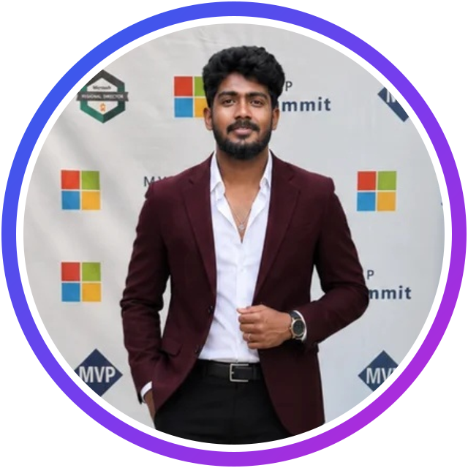
AGENT UNIVERSE 2026 · #AgentUniverse2026
9:00 AM IST · SATURDAY, 14 NOVEMBER 2026
From Idea to Agent
Building Enterprise AI Agents with Microsoft Foundry and Copilot Studio
LIVE DEMO · INTERMEDIATE
Prathap Reddy
Microsoft AI MVP · AI Engineer, Sulava Mea
Founder, Innovation Tech Community
Hosted by Prathap Reddy & Divya Akula · innovationtechcommunity.com
Notes:
Keep this on screen while Divya introduces me. Open: "Good morning everyone, and welcome to Agent Universe 2026! Let's start the day by going from an idea to a working enterprise agent."

Slide 2






YOUR SPEAKER
About me
AI Engineer & Agentic AI Consultant at Sulava Mea
Builds with Microsoft Foundry, Azure OpenAI, Copilot Studio and Microsoft 365 Copilot
Focus: multi-agent systems, RAG, enterprise knowledge and intelligent automation
Passionate about secure, responsible, production-ready AI
Prathap Reddy
Founder of Innovation Tech Community: learn together, build together, grow together
Microsoft AI MVP
From Idea to Agent · Prathap Reddy · Agent Universe 2026
2
Notes:
Keep this to 30 seconds; Divya has already introduced me.

Slide 3
AGENDA
What we'll cover
Why AI agents, now
Copilot Studio and Microsoft Foundry
01
02
Better together: the architecture
From use case to agent: six steps
03
04
Live demo
Production checklist and takeaways
05
06
From Idea to Agent · Prathap Reddy · Agent Universe 2026
3
Notes:
Six stops in 30 minutes, with the demo at the heart of it. Questions at the end, from the chat.

Slide 4
AGENT UNIVERSE 2026 · #AgentUniverse2026
01
Why AI agents, now
From answering questions to getting work done
Notes:
AI is moving from chat to action. Let's see what that means for enterprises.

Slide 5



THE SHIFT
From chatbots to agents
Chatbot
Copilot
AI agent
Scripted answers
Helps a person
Works toward a goal
Follows fixed paths and decision trees. Breaks when users go off-script.
Answers, summarises and drafts with generative AI, while the person drives every step.
Reasons, plans, uses tools and takes actions across systems, with a human in the loop.
Agent = model + instructions + knowledge + tools, working toward a goal
From Idea to Agent · Prathap Reddy · Agent Universe 2026
5
Notes:
Walk left to right. The key shift: agents work toward a goal; they reason, use tools and take actions, with people staying in control.

Slide 6




BUILDING BLOCKS
The anatomy of an AI agent
Model
Instructions
Knowledge
Understands, reasons and generates language
Role, goal, tone and guardrails
Grounded in your enterprise data
Tools & actions
Orchestration
Memory & context
Calls APIs, connectors and workflows
Plans the steps and picks the right tool
Keeps track of the conversation and the user
From Idea to Agent · Prathap Reddy · Agent Universe 2026
6
Notes:
Every agent, in any platform, has these six building blocks. We'll see where each one lives in Copilot Studio and Foundry.

Slide 7


LOW-CODE
Microsoft Copilot Studio
Natural-language authoring
Describe the agent; refine topics and instructions
Knowledge
SharePoint, Dataverse, websites and files
Microsoft Copilot Studio
Connectors & agent flows
Power Platform connectors, flows and MCP tools
Generative orchestration
Picks topics, knowledge, tools and agents
Build, test and publish agents in natural language: built for makers, and extensible for pro developers.
Publish anywhere
Teams, Microsoft 365 Copilot, websites and more
Governed
Power Platform admin center, DLP and environments
From Idea to Agent · Prathap Reddy · Agent Universe 2026
7
Notes:
Copilot Studio is the fastest way to put an agent in front of users, especially inside Microsoft 365 and Teams.

Slide 8





PRO-CODE
Microsoft Foundry
Model catalog
OpenAI and many other models to choose from
Foundry Agent Service
Hosted agents with instructions, tools and threads
Microsoft Foundry
Knowledge & search
Azure AI Search, files and enterprise data
Tools
Function calling, OpenAPI, code interpreter and MCP
Build, run and govern AI apps and agents with full control over models, tools and quality.
Evaluate & observe
Evaluations, tracing and monitoring
Safe & secure
Content safety, Entra ID and enterprise networking
From Idea to Agent · Prathap Reddy · Agent Universe 2026
8
Notes:
Foundry is where developers go deep: model choice, custom reasoning, tools in code, evaluations and observability.

Slide 9
COMPARE
Which one should I use?
 | Copilot Studio | Microsoft Foundry
Who builds | Makers, business teams and developers | Pro developers and AI engineers
Superpower | Conversation, channels and fast delivery | Model choice, custom reasoning and code-first control
Data & actions | Connectors, agent flows, Dataverse | APIs, Azure services and custom tools
Best for | Employee and customer agents in Microsoft 365 | Complex, specialised and high-scale agents
Better together: Copilot Studio is the front door, and Foundry is the specialist engine room.
From Idea to Agent · Prathap Reddy · Agent Universe 2026
9
Notes:
This is not either/or. Most enterprise solutions end up using both, each where it is strongest.

Slide 10

ARCHITECTURE
Better together: reference architecture
Channels
Copilot Studio
Microsoft Foundry
Enterprise systems
Microsoft Teams
Conversation & topics
Specialist agents
SharePoint & Dataverse
Microsoft 365 Copilot
Generative orchestration
Models & reasoning
SQL, APIs & ERP
Website & apps
Connectors & agent flows
Tools & evaluations
IT and HR systems
Security & governance across every layer: Microsoft Entra ID · Microsoft Purview · content safety · monitoring
From Idea to Agent · Prathap Reddy · Agent Universe 2026
10
Notes:
Users meet the agent where they already work. Copilot Studio handles the conversation and routing; Foundry handles specialist reasoning; both reach enterprise systems securely.

Slide 11
AGENT UNIVERSE 2026 · #AgentUniverse2026
02
From idea to agent
A real scenario, six practical steps
Notes:
Now let's make it concrete with one scenario we'll build in the demo.

Slide 12

USE CASE
Scenario: the Employee Support Agent
The problem
The agent
The outcome
Employees wait for HR and IT answers
The same questions arrive again and again
Tickets are slow to create and track
Answers policy questions from SharePoint
Creates and checks IT tickets
Hands over to a person when needed
Answers in seconds, in Teams
Support teams focus on complex work
Available around the clock
From Idea to Agent · Prathap Reddy · Agent Universe 2026
12
Notes:
A scenario every organisation recognises. It needs knowledge (policies), actions (tickets) and judgement (when to hand over to a person).

Slide 13


THE JOURNEY
Six steps from use case to agent
1. Define
2. Ground
3. Act
4. Orchestrate
5. Evaluate
6. Publish
Pick one clear use case, the users and success measures
Connect trusted knowledge sources
Add tools, connectors and flows
Let the agent plan and route to the right skill
Test with real questions; measure quality
Ship to Teams and Microsoft 365 Copilot; monitor
Start small, ship one valuable scenario, then grow.
From Idea to Agent · Prathap Reddy · Agent Universe 2026
13
Notes:
This is the repeatable recipe. Every step maps to a feature in Copilot Studio or Foundry.

Slide 14


GROUNDING
Step 2 · Ground the agent in your knowledge
SharePoint & OneDrive
Policies, handbooks, how-to guides
Grounding tips
Dataverse & business data
Structured records and tables
Curate: fewer, trusted, current sources
Respect permissions: users only see what they can access
Ask for citations in every answer
Write clear descriptions for each source
Test with the questions real users ask
Public websites
Product docs and public pages
Uploaded files
PDFs, Word and slide decks
Azure AI Search (Foundry)
Your own indexes at enterprise scale
From Idea to Agent · Prathap Reddy · Agent Universe 2026
14
Notes:
Grounding is what turns a generic model into your company's agent. Answers should come from your trusted sources, with citations.

Slide 15

ACTIONS
Step 3 · Give the agent hands: tools & actions
Copilot Studio
Microsoft Foundry
Power Platform connectors
Function calling
Agent flows
OpenAPI tools
Custom REST / OpenAPI actions
Code interpreter
MCP servers
Azure AI Search & MCP
Example: "My laptop won't start" → agent flow creates the IT ticket → the agent replies with the ticket number
From Idea to Agent · Prathap Reddy · Agent Universe 2026
15
Notes:
Knowledge lets the agent answer; tools let it act. Keep a person in control for anything that changes data.

Slide 16
ORCHESTRATION
Step 4 · Orchestrate: one agent, many skills
Knowledge
HR & IT policies
Agent flow
Create IT ticket
Employee in Teams
Copilot Studio
orchestrator agent
Foundry agent
Deep analysis & reasoning
Tip: write a clear name and description for every topic, tool and agent; the orchestrator relies on them.
From Idea to Agent · Prathap Reddy · Agent Universe 2026
16
Notes:
Generative orchestration reads the user's intent and the descriptions of topics, knowledge, tools and connected agents, then decides what to call. Good descriptions are your new prompt engineering.

Slide 17

AGENT UNIVERSE 2026 · #AgentUniverse2026
LET'S BUILD IT
Live demo
1
Foundry: the IT Troubleshooting specialist agent (model, instructions, knowledge)
2
Copilot Studio: the Employee Support Agent, grounded in HR & IT policies
3
Connect the Foundry agent as a specialist the orchestrator can call
4
Action: "Create IT ticket" through an agent flow and the Ticket API
5
Test in Microsoft Teams: a policy question, a troubleshoot, a ticket
Notes:
Switch to the demo now. Zoom the browser to 150%. Keep the recorded backup ready in case the network misbehaves.

Slide 18


PRODUCTION CHECKLIST
From experiment to production
Identity & access
Responsible AI
Evaluate
Microsoft Entra ID, least privilege and user-level permissions
Content safety, guardrails and a human in the loop
Test sets, groundedness and answer quality, before and after release
Observe
Govern
Cost
Tracing, analytics and user feedback
Environments, data loss prevention and ALM pipelines
Right-sized models, token usage and monitoring
From Idea to Agent · Prathap Reddy · Agent Universe 2026
18
Notes:
A demo is not a product. These six areas are what make an agent trustworthy at enterprise scale.

Slide 19
REMEMBER
Key takeaways
Start with the use case
Use both platforms
Ground, evaluate, govern
One clear problem, real users and a measurable outcome beat a big platform plan.
Copilot Studio as the front door; Foundry for specialist reasoning and control.
Trusted knowledge, real testing and governance turn a demo into production.
From Idea to Agent · Prathap Reddy · Agent Universe 2026
19
Notes:
Close the content here, then move to the thank-you slide for questions.

Slide 20


AGENT UNIVERSE 2026 · #AgentUniverse2026
Thank you!
Questions? Let's connect.
Prathap Reddy
Microsoft AI MVP · AI Engineer, Sulava Mea
Founder, Innovation Tech Community
innovationtechcommunity.com
Claim your Agent Universe 2026 stamp in your ITC Learning Passport
#AgentUniverse2026
Notes:
Thank everyone, take questions from the chat, then hand over to Divya for the next session (Janarthanan at 9:35 AM).

