Slide 1
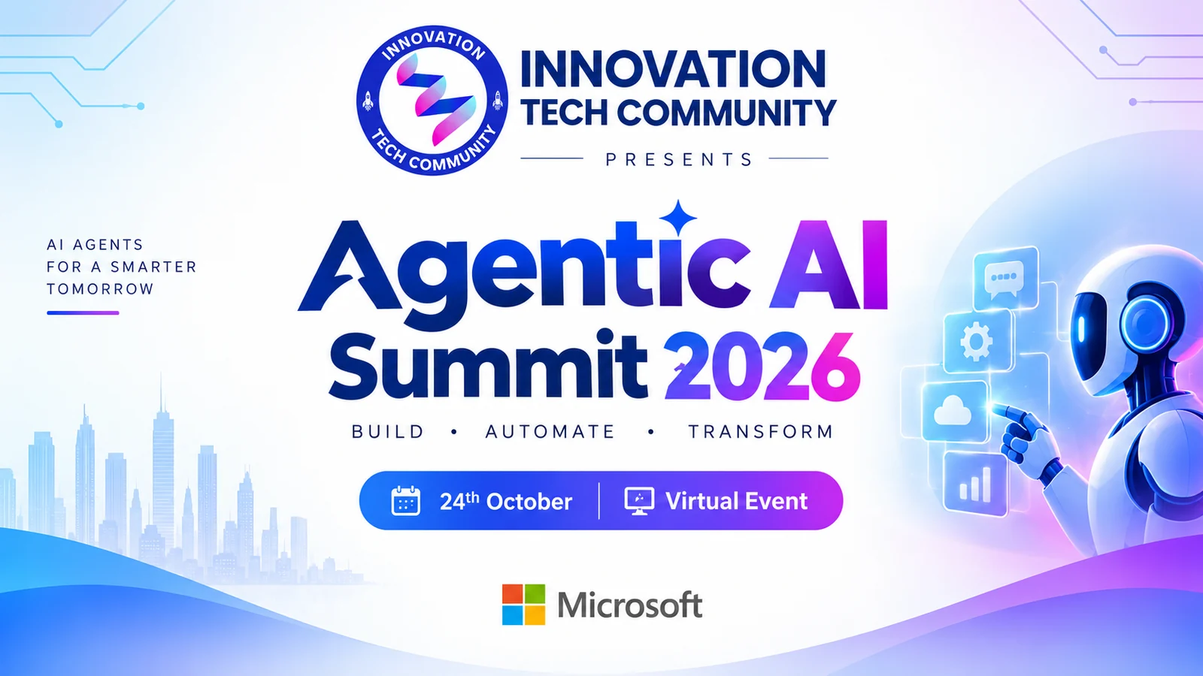
Agentic AI Summit 2026
WELCOME TO
Saturday, 24 October 2026 · 9:00 AM – 4:10 PM IST
Live on YouTube, LinkedIn & Instagram · Presented by Innovation Tech Community
Notes:
Welcome everyone to Agentic AI Summit 2026! Introduce yourself, thank everyone for joining live on YouTube, LinkedIn and Instagram, and set the tone: a full day of practical sessions from 13 speakers, 11 of them Microsoft MVPs.

Slide 2




Before we begin
Ask in the chat
Share the day
Claim your stamp
Watch it again
Drop your questions any time. Speakers take questions at the end of each session.
Post your takeaways with #AgenticAISummit2026 and tag Innovation Tech Community.
Registered? Sign in at innovationtechcommunity.com and claim your passport stamp.
Every session stays on our YouTube channel, so you can catch up later.
Notes:
Quick housekeeping: questions in the chat, share with #AgenticAISummit2026, registered attendees can claim their passport stamp, and every session will be on YouTube afterwards.

Slide 3

About Innovation Tech Community
Learn together. Build together. Grow together.
An open, independent community for technology enthusiasts, started in Bengaluru
Meetups, workshops and summits, online and in person
A stage for first-time and experienced speakers alike
Your own learning passport with badges and stamps
FOUNDED BY
Prathap Reddy
Divya Akula
Sujith Sukumaran
Lingaraj Benni
Say hi to ITC Cat, our mascot! 🐾
Notes:
Introduce Innovation Tech Community in a few lines: an open, independent community started in Bengaluru. Mention the founders and invite people to join the WhatsApp community and create a member account for the learning passport.

Slide 4
Today at a glance
12
13
11
1
sessions
speakers
Microsoft MVPs
day of Agentic AI
Talks, live demos and hands-on patterns across Microsoft Foundry, Copilot Studio, MCP, RAG, security and multi-agent systems.

Slide 5
Agenda · All times IST
Time | Speaker | Session
9:00 AM – 9:45 AM | Nanddeep Nachan & Smita Nachan | Build a Secure Multi-Tool AI Agent with Microsoft Foundry, APIs, and MCP
9:45 AM – 10:20 AM | Divya Akula | Build Your First AI Assistant: From Idea to Working Demo
10:20 AM – 10:55 AM | Prathap Reddy | From Copilots to Autonomous Agents: Building Agentic AI with Microsoft Foundry
10:55 AM – 11:30 AM | Frank Falvey | Microsoft Agentic AI: Framework Overview & Live Agent Demos
11:30 AM – 12:05 PM | Vinoth Rajendran | From Idea to Agent: Building with Microsoft Agent Framework
12:05 PM – 12:40 PM | Ashutosh Singh | Building SnowPilot: Agentic AI in Action with Copilot Studio
12:40 PM – 1:15 PM | Sujin Nelladath | AI-Powered IT Operations: Troubleshooting Smarter with MCP and Microsoft Learn
1:15 PM – 1:50 PM | Kritika Mehta | The Zero-Handoff ERP: Architecting a Multi-Agent Workforce
1:50 PM – 2:25 PM | Shantha Kumar T | Building with Confidence: Inside Microsoft’s Copilot Managed Runtime
2:25 PM – 3:00 PM | Janarthanan Selvaraj | Agents of Tomorrow: Building the Next Generation of AI with Microsoft Foundry
3:00 PM – 3:35 PM | Samik Roy | More Than Prompt Safety and IAM : Design Policy-as-Code for Deterministic Multi-Agent AI Workflows
3:35 PM – 4:10 PM | Lalit Rawat | From AI PoC Chaos to Production: Building a Secure Enterprise AI Landing Zone on Azure
Notes:
Walk through the day quickly. Each session is 35 minutes (the opening session is 45). Encourage people to stay for the whole day and to add the stream to their calendar.

Slide 6
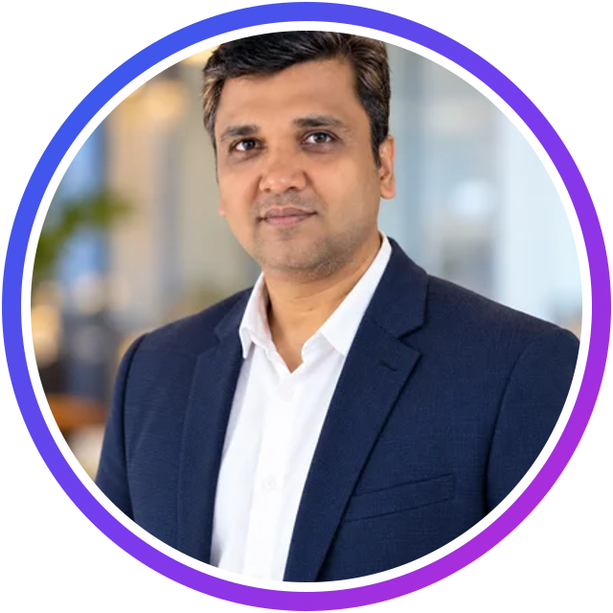
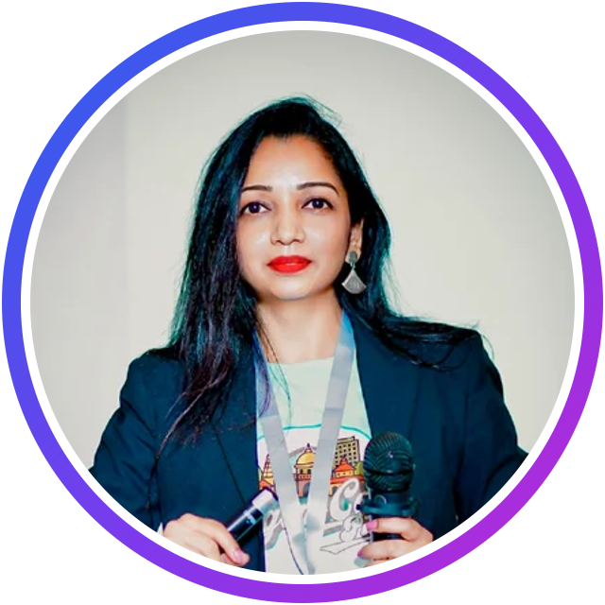

UP NEXT · 9:00 AM – 9:45 AM IST
Nanddeep Nachan & Smita Nachan
Microsoft MVP · Microsoft Certified Trainer
M365 Architect · Microsoft MVP (M365 & AI Platform)
Microsoft MVP
MCT
Author
Microsoft MVP ×2
CSM
SESSION
Build a Secure Multi-Tool AI Agent with Microsoft Foundry, APIs, and MCP
Talk · Intermediate · 45 minutes
Nanddeep: author of Mastering SharePoint Framework (Amazon bestseller) and two Apress books
Nanddeep: Udemy courses on Microsoft 365 Copilot (AB-730) and SPFx
Smita: 17+ years building large-scale SharePoint and Microsoft 365 solutions
Smita: speaker at SharePoint Saturday and Global M365 and Power Platform Bootcamps
Notes:
[About 2 minutes]
Good morning everyone, and welcome to Agentic AI Summit 2026! We are opening the day with not one but two Microsoft MVPs: Nanddeep Nachan and Smita Nachan.
Nanddeep is a Microsoft MVP and a Microsoft Certified Trainer based in Pune. He is a results-oriented consultant who has designed and delivered large-scale projects across Microsoft 365, Power Platform and Microsoft Azure. He is also a prolific author: his book Mastering SharePoint Framework is an Amazon bestseller, and he has written two books with Apress, on hybrid SharePoint environments and on Microsoft Viva Connections. On Udemy, he teaches courses including AB-730, AI Business Professional with Microsoft 365 Copilot.
Smita is a Microsoft 365 Architect with more than 17 years of experience, and she is a Microsoft MVP in two categories: Microsoft 365 and AI Platform. She is a Certified ScrumMaster, and you may have seen her speaking at SharePoint Saturdays, the Global Microsoft 365 Developer Bootcamp and the Global Power Platform Bootcamp. She also writes, podcasts and runs webinars for the community.
Today they will show us how to build a secure, multi-tool AI agent in Microsoft Foundry: an agent that calls a live weather API through an OpenAPI tool, reads Microsoft Learn through an MCP server, stays safe with content-safety guardrails, and can be audited through traces.
Please drop your questions in the chat as we go. Nanddeep, Smita, the stage is yours!

Slide 7
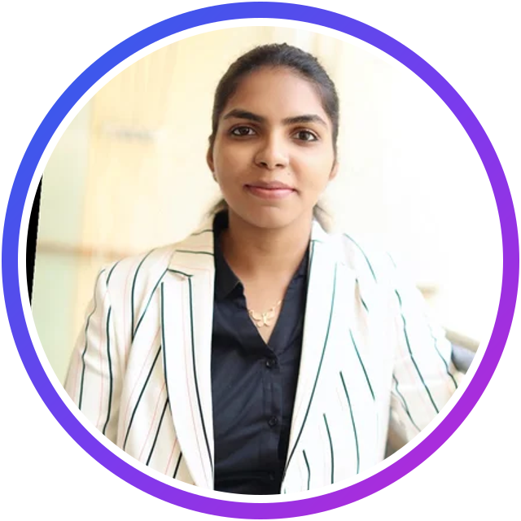
UP NEXT · 9:45 AM – 10:20 AM IST
Divya Akula
Microsoft AI MVP · Senior Technical Consultant, AI & Microsoft Copilot Solutions
Microsoft AI MVP
ITC co-founder
SESSION
Build Your First AI Assistant: From Idea to Working Demo
Talk · Intermediate · 35 minutes
Senior Technical Consultant for AI and Microsoft Copilot solutions
AI engineer and community speaker who builds practical AI applications
Co-founder of Innovation Tech Community
Notes:
[About 2 minutes]
Our next speaker is someone very close to this community: Divya Akula, one of the co-founders of Innovation Tech Community.
Divya is a Microsoft AI MVP and a Senior Technical Consultant for AI and Microsoft Copilot solutions. She is an AI engineer and community speaker who loves building practical AI applications.
[Host: add one or two personal highlights here. Divya's profile bio still needs updating.]
Her session is perfect if you have ever wanted to build your own assistant: "Build Your First AI Assistant: From Idea to Working Demo". Divya will walk us through an assistant that answers questions from your own documents: how to prepare documents for search and retrieval, connect them to an AI model, design prompts that show their sources, and test answer quality. You will leave with a clear implementation outline and a checklist for your own prototype.
Basic programming knowledge helps, but no prior AI experience is needed. Please welcome Divya!

Slide 8
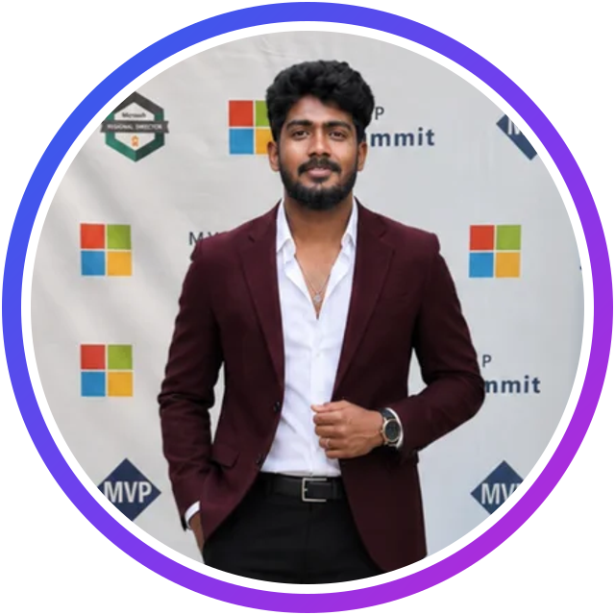
UP NEXT · 10:20 AM – 10:55 AM IST
Prathap Reddy
Microsoft AI MVP · AI Engineer, Sulava Mea
Microsoft AI MVP
ITC founder
SESSION
From Copilots to Autonomous Agents: Building Agentic AI with Microsoft Foundry
Talk · Intermediate · 35 minutes
AI Engineer and Agentic AI consultant: Azure AI Foundry, Azure OpenAI, Copilot Studio and Microsoft 365 Copilot
Designs enterprise-grade agents, RAG architectures and multi-agent systems
Founder of Innovation Tech Community
Notes:
[About 2 minutes]
It is my pleasure to introduce the founder of Innovation Tech Community, Prathap Reddy.
Prathap is a Microsoft AI MVP and an AI Engineer at Sulava Mea. As an Agentic AI consultant, he specialises in Microsoft AI technologies: Azure AI Foundry, Azure OpenAI, Microsoft Copilot Studio and Microsoft 365 Copilot. He helps organisations design and build enterprise-grade AI solutions using agents, RAG architectures and intelligent automation, and his focus is on turning innovative ideas into secure, scalable, production-ready applications.
His expertise spans agent orchestration, multi-agent systems, enterprise knowledge integration, workflow automation and responsible AI. And as the founder of this community, he has brought together everyone you are seeing on screen today.
His session is "From Copilots to Autonomous Agents: Building Agentic AI with Microsoft Foundry". He will cover the Foundry agent architecture, tool calling and orchestration, knowledge integration with RAG, multi-agent collaboration patterns, enterprise security and responsible AI, and best practices for production. The goal: moving from AI experiments to production-ready agentic solutions.
Please welcome Prathap!

Slide 9
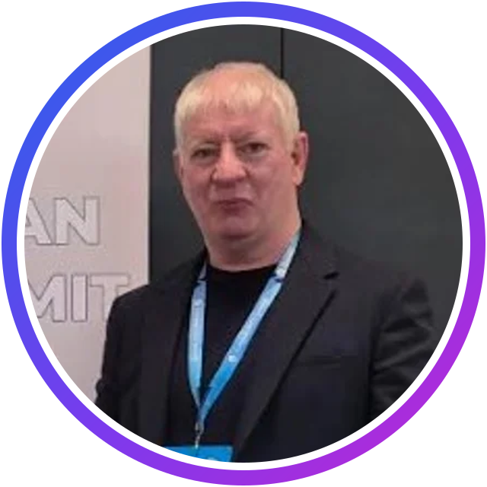
UP NEXT · 10:55 AM – 11:30 AM IST
Frank Falvey
Microsoft MVP · Microsoft Certified Trainer · Cork, Ireland
Microsoft MVP
MCT
SESSION
Microsoft Agentic AI: Framework Overview & Live Agent Demos
Talk · Intermediate · 35 minutes
Microsoft 365 Copilot specialist with 25+ years across IT, infrastructure, cloud and training
Host of the Azure and AI Show
Known for a friendly, hands-on approach that makes complex topics easy
Notes:
[About 2 minutes]
Our next speaker is joining us all the way from Cork, in Ireland: Frank Falvey. And since it is very early morning in Ireland right now, a special thank you to Frank!
Frank is a Microsoft MVP, a Microsoft Certified Trainer and a Microsoft 365 Copilot specialist. He brings more than 25 years of experience across IT, enterprise infrastructure, cloud technologies and technical training, and he is known for his friendly, hands-on approach: making complex topics easy to understand and helping people feel confident with technology.
He is an active member of the Microsoft community and the host of the Azure and AI Show, where he explores new ideas and helps people adopt emerging technologies.
His session is "Microsoft Agentic AI: Framework Overview and Live Agent Demos". Frank will take us into the world of agentic AI, where systems no longer just respond, but reason, plan and collaborate. He will look at tools from Microsoft's ecosystem, including AutoGen, Semantic Kernel and Copilot Studio, with live demos and a short case study.
Over to you, Frank!

Slide 10
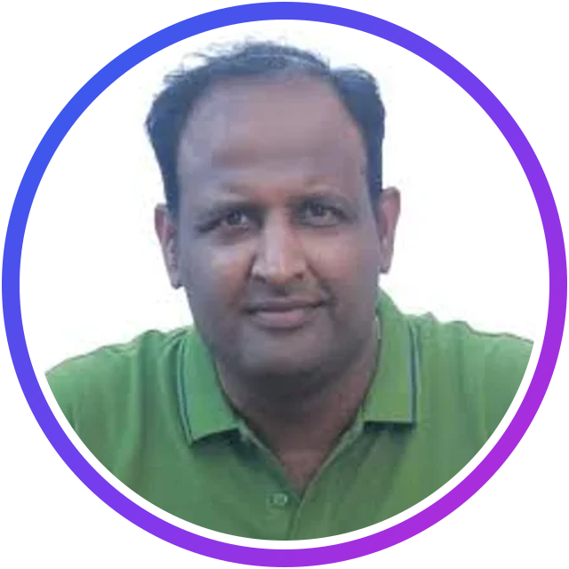
UP NEXT · 11:30 AM – 12:05 PM IST
Vinoth Rajendran
Microsoft AI MVP · Software Developer
Microsoft AI MVP
SESSION
From Idea to Agent: Building with Microsoft Agent Framework
Talk · Intermediate · 35 minutes
Specialises in Generative AI, Azure AI and intelligent agents
Expertise in Copilot Studio, Semantic Kernel and .NET
Regular speaker sharing hands-on demos at community events
Notes:
[About 2 minutes]
Next, please welcome Vinoth Rajendran.
Vinoth is a Microsoft AI MVP, a software developer and a passionate technology speaker. He specialises in Generative AI, Azure AI and intelligent agents, with deep expertise in Microsoft Copilot Studio, Semantic Kernel and .NET. You will often find him at community events sharing technical sessions and hands-on demonstrations that help developers build real-world AI solutions.
His session today is "From Idea to Agent: Building with Microsoft Agent Framework". If you have an idea for an AI agent, this is the session for you: Vinoth will show how to turn it into a practical agent with Microsoft Agent Framework, one that can reason, take action and integrate with real-world systems, and how to move from experiments towards production-ready agentic applications.
Keep your questions coming in the chat. Vinoth, over to you!

Slide 11
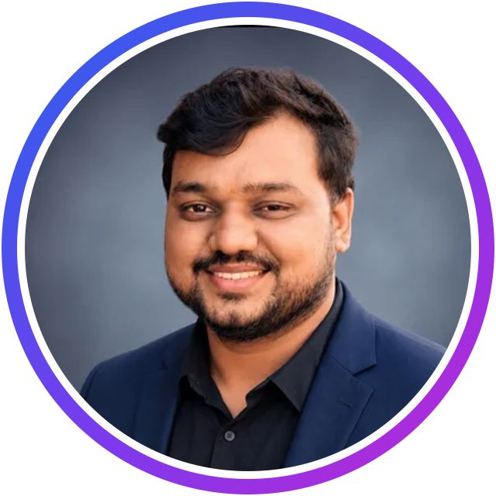
UP NEXT · 12:05 PM – 12:40 PM IST
Ashutosh Singh
Copilot Studio SME & Dynamics 365 CE · Tata Consultancy Services
Copilot Studio SME
SESSION
Building SnowPilot: Agentic AI in Action with Copilot Studio
Live demo · Intermediate · 35 minutes
Hands-on experience in CRM and Microsoft Power Platform
Builder of SnowPilot: a Copilot Studio agent connected to ServiceNow
Believes in learning by building and taking AI beyond proofs of concept
Notes:
[About 2 minutes]
Our next speaker is Ashutosh Singh, Copilot Studio subject matter expert at Tata Consultancy Services.
Ashutosh has hands-on experience in CRM and Microsoft Power Platform, with a growing focus on Copilot Studio and agentic AI. What I love about his approach is that he wants AI to solve real business problems, not stay a proof of concept. He learns by building, and he enjoys sharing practical experience so that others can start working with AI agents too.
That is exactly what his session is about: "Building SnowPilot: Agentic AI in Action with Copilot Studio". SnowPilot is an AI agent Ashutosh built with Microsoft Copilot Studio and connected to ServiceNow. It understands a support issue, checks whether a similar ticket already exists before creating a new one, and takes part in a real support workflow. He will also go behind the scenes: instructions, skills, tools and knowledge, plus the debugging lessons he learned along the way.
Please welcome Ashutosh!

Slide 12
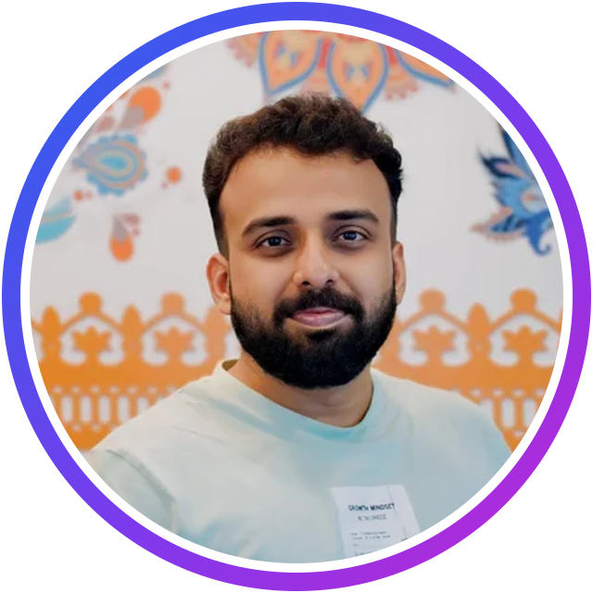
UP NEXT · 12:40 PM – 1:15 PM IST
Sujin Nelladath
Microsoft MVP · Modern Workplace Architect, NTT Data
Microsoft MVP
SESSION
AI-Powered IT Operations: Troubleshooting Smarter with MCP and Microsoft Learn
Talk · Intermediate · 35 minutes
Modern workplace architect focused on Microsoft Intune, Microsoft Graph, cloud and automation
Journey from desktop engineer in 2013 to cloud advisor for organisations
Shares knowledge through blogs and videos, and has trained many people starting IT careers
Notes:
[About 2 minutes]
Our next speaker is Sujin Nelladath, joining us from Bangalore.
Sujin is a Microsoft MVP and a modern workplace architect at NTT Data, with a particular interest in Microsoft Intune, Microsoft Graph, cloud and automation. His journey is inspiring: he started in IT as a desktop engineer in 2013, moved into SCCM, and worked his way up to advising organisations on their journey to the cloud. His expertise spans Intune, SCCM, PowerShell automation, Copilot Studio and Microsoft Foundry.
Teaching is his passion. He writes blogs, creates videos and has trained many candidates, helping them kickstart their careers in IT.
His session is "AI-Powered IT Operations: Troubleshooting Smarter with MCP and Microsoft Learn". Using real endpoint-management scenarios, he will show how Model Context Protocol and Microsoft Learn connectors bring trusted technical knowledge into AI conversations, so administrators can diagnose issues faster and spend less time searching for answers. If you manage Intune, Azure, Windows devices or Microsoft 365, this one is for you.
Over to you, Sujin!

Slide 13
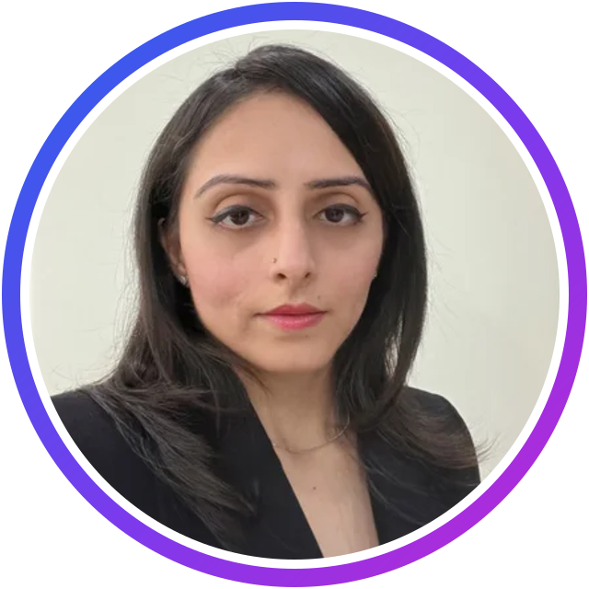
UP NEXT · 1:15 PM – 1:50 PM IST
Kritika Mehta
Solution Architect · Business Central & AI Architecture
15+ yrs Dynamics
Podcast host
SESSION
The Zero-Handoff ERP: Architecting a Multi-Agent Workforce
Live demo · Intermediate · 35 minutes
Solution Architect working with Microsoft Dynamics since the C/SIDE and Classic Client era
Shares her learning on her YouTube channel, Architect AI Lab
Hosts the podcast Architects in the AI Era
Notes:
[About 2 minutes]
Please welcome our next speaker, Kritika Mehta.
Kritika is a Solution Architect who has worked with Microsoft Dynamics since the C/SIDE and Classic Client era: more than 15 years in the Dynamics trenches. Her focus is not just on building features, but on understanding how AI can take away the busy work, and how years of customisations and business logic fit into an AI world.
She explores all of this in public: on her YouTube channel, Architect AI Lab, she shares what she is learning about AI in Dynamics 365 Business Central, and on her podcast, Architects in the AI Era, she talks with guests about their perspectives on AI. In her own words, she does not care much for the AI hype; she cares about building stable, trustworthy AI solutions that actually work for customers.
Her session is "The Zero-Handoff ERP: Architecting a Multi-Agent Workforce". Kritika will demonstrate a hub-and-spoke solution she built with Copilot Studio and Business Central, where an orchestrator coordinates specialised child agents across a multi-step business workflow.
Kritika, over to you!

Slide 14
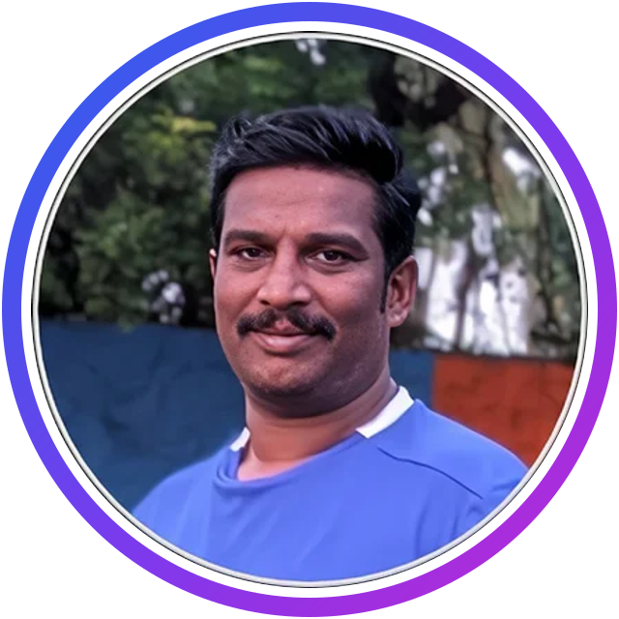
UP NEXT · 1:50 PM – 2:25 PM IST
Shantha Kumar T
Microsoft Copilot MVP · CTO, SharePoint Designs
Microsoft Copilot MVP
CTO
SESSION
Building with Confidence: Inside Microsoft’s Copilot Managed Runtime
Live demo · Intermediate · 35 minutes
19 years in the modern workspace as developer, UI designer and architect
Chief Technology Officer at SharePoint Designs, Chennai
Focused on cloud, modern workspace and AI
Notes:
[About 2 minutes]
Our next speaker is Shantha Kumar T, joining us from Chennai.
Shantha is a Microsoft Copilot MVP and the Chief Technology Officer at SharePoint Designs. He has 19 years of experience in the modern workspace, and he has worked in every role along the way: developer, UI designer and architect. Today, cloud, the modern workspace and AI are at the centre of his work.
His session is "Building with Confidence: Inside Microsoft's Copilot Managed Runtime". This is a live demo of a brand-new capability: code that runs directly inside the Microsoft 365 boundary, so you do not need to set up external cloud resources, custom runtimes or separate hosting. Shantha will build and deploy an application end to end, from the command line to a managed app, and show how it brings IT governance and developer workflows together, production-ready by default.
Please welcome Shantha!

Slide 15
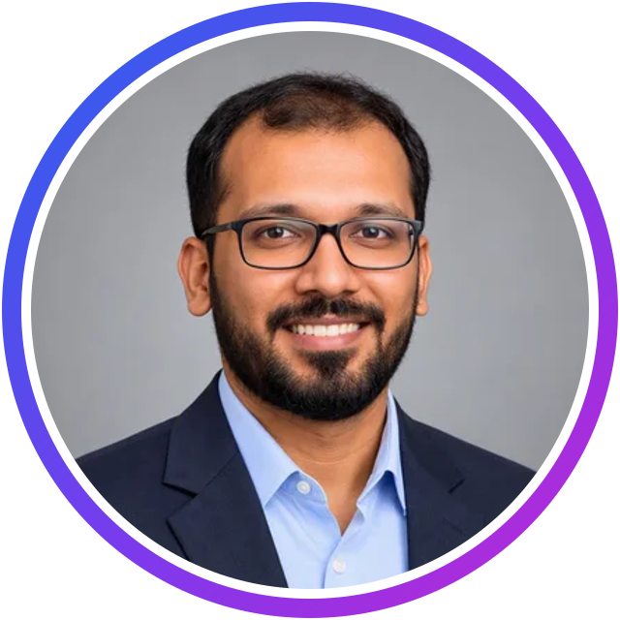
UP NEXT · 2:25 PM – 3:00 PM IST
Janarthanan Selvaraj
Microsoft AI MVP · Senior Manager, Technology & AI, Atos
Microsoft AI MVP
40 certifications
SESSION
Agents of Tomorrow: Building the Next Generation of AI with Microsoft Foundry
Talk · Intermediate · 35 minutes
Microsoft MVP in AI for his expertise in Microsoft Foundry; Guinness World Record holder
Alumnus of the University of Cambridge FUEL Leadership programme; six-time Microsoft Certified Trainer
Microsoft Certified Community Lead, Microsoft Learn Expert and C# Corner MVP; 40 cloud certifications
Notes:
[About 2 minutes]
Our next speaker has a remarkable list of achievements: Janarthanan Selvaraj.
Janarthanan is a Senior Manager, Technology and AI Expert at Atos. He is an alumnus of the University of Cambridge's FUEL Leadership flagship programme and a graduate of Anna University, and he received the Microsoft MVP award in the AI category for his expertise in Microsoft Foundry.
He is also a Guinness World Record holder, a Microsoft Certified Community Lead, a six-time Microsoft Certified Trainer, a Microsoft Learn Expert in Data and AI, and a C# Corner MVP. And he holds 40 cloud certifications across Microsoft Azure, AWS, Google Cloud, Oracle and Aviatrix!
His session is "Agents of Tomorrow: Building the Next Generation of AI with Microsoft Foundry". Janarthanan will show how Model Context Protocol lets agents discover and use tools, and how Azure Logic Apps gives a secure, low-code way to connect them to enterprise applications and APIs. Through a live demo, you will see an agent go beyond chat: retrieving data, automating workflows and taking action across an organisation.
Please welcome Janarthanan!

Slide 16
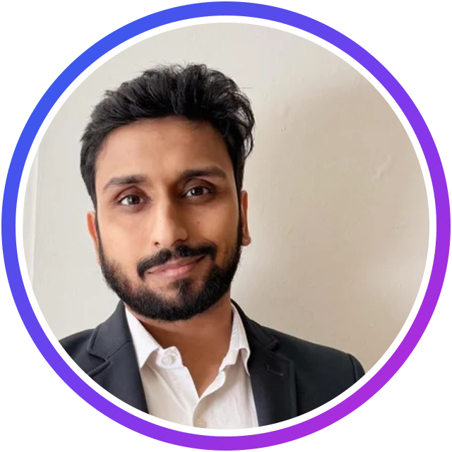
UP NEXT · 3:00 PM – 3:35 PM IST
Samik Roy
Microsoft MVP · Threat Intelligence & Microsoft Security
Microsoft MVP
Author
SESSION
More Than Prompt Safety and IAM : Design Policy-as-Code for Deterministic Multi-Agent AI Workflows
Talk · Advanced · 35 minutes
Specialises in Microsoft Sentinel, Defender XDR and the Azure security stack
Has led enterprise-scale Sentinel deployments and trained hundreds of analysts
Author of a book on KQL for Microsoft Sentinel; publishes the Signals & Shadows newsletter
Notes:
[About 2 minutes]
Our next speaker brings a security lens to agentic AI: Samik Roy.
Samik is a Microsoft MVP specialising in threat intelligence, Microsoft Sentinel, Defender XDR and the Azure security stack. His work sits at the intersection of practical security engineering and clear, actionable education. He designs and modernises SOC architectures, builds KQL-powered detection libraries and automation, and creates tools like ms-sentinel-scout. He has led enterprise-scale Sentinel deployments, trained hundreds of analysts through his KQL course on Udemy, written a book on KQL for Microsoft Sentinel, and he publishes Signals and Shadows, a monthly threat-intelligence newsletter.
His session is "More Than Prompt Safety and IAM: Design Policy-as-Code for Deterministic Multi-Agent AI Workflows". Samik will show why system prompts and traditional IAM are not security boundaries for autonomous agents, and how to intercept tool calls with policy-as-code, using live attack-and-defend scenarios based on the OWASP agentic AI risks. This is an advanced session, so get ready!
Please welcome Samik!

Slide 17
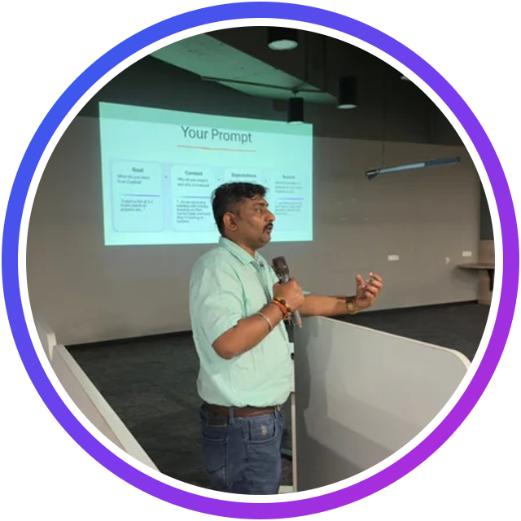
UP NEXT · 3:35 PM – 4:10 PM IST
Lalit Rawat
Microsoft MVP · MCT · CISO, Kanerika
Microsoft MVP
MCT
CISO
SESSION
From AI PoC Chaos to Production: Building a Secure Enterprise AI Landing Zone on Azure
Talk · Intermediate · 35 minutes
Chief Information Security Officer at Kanerika and Distinguished Lead Engineer; 19+ years in Microsoft technologies
Specialises in Zero Trust, DevSecOps, cloud security, AI governance and enterprise AI architecture
Helps organisations bridge innovation and security to adopt AI responsibly
Notes:
[About 2 minutes]
Closing our sessions today is Lalit Rawat, who will take us from AI experiments all the way to production, securely.
Lalit is the Chief Information Security Officer at Kanerika and a Distinguished Lead Engineer, with more than 19 years of experience in Microsoft technologies, enterprise architecture, cloud security and AI-driven innovation. He is a Microsoft MVP and a Microsoft Certified Trainer, and he specialises in secure, scalable, cloud-native solutions on Azure: Zero Trust, DevSecOps, cybersecurity governance, AI security and enterprise AI architecture. His passion is helping organisations bridge the gap between innovation and security, so they can adopt new technology responsibly.
His session is "From AI PoC Chaos to Production: Building a Secure Enterprise AI Landing Zone on Azure". As Lalit says, most AI projects don't fail at the proof-of-concept stage; they fail when someone says, "Let's take this to production". He will take a typical PoC, with public access, shared secrets and broad permissions, and redesign it into a secure, production-ready enterprise AI landing zone using Microsoft Foundry, Azure OpenAI, Microsoft Entra ID, managed identities, private endpoints, secure RAG, Azure Policy, observability and FinOps. In his words: no AI hype, just practical architecture.
Please welcome Lalit!

Slide 18

Thank you!
Claim your passport stamp at innovationtechcommunity.com
Recordings: youtube.com/@innovationtechcommunity
Next up: Agent Universe 2026 · 14 November · innovationtechcommunity.com/agent-universe
Notes:
Thank every speaker by name, the audience and the volunteers. Remind people to claim their passport stamp, that recordings are on YouTube, and invite everyone to Agent Universe 2026 on 14 November (register at innovationtechcommunity.com/agent-universe).

