Slide 1
KENWELL
Modern premium wellness brand focused on clean, science-backed supplementation.

Slide 2
Brand Vision
Build a modern wellness ecosystem combining everyday health, performance wellness, and premium nootropics.

Slide 3
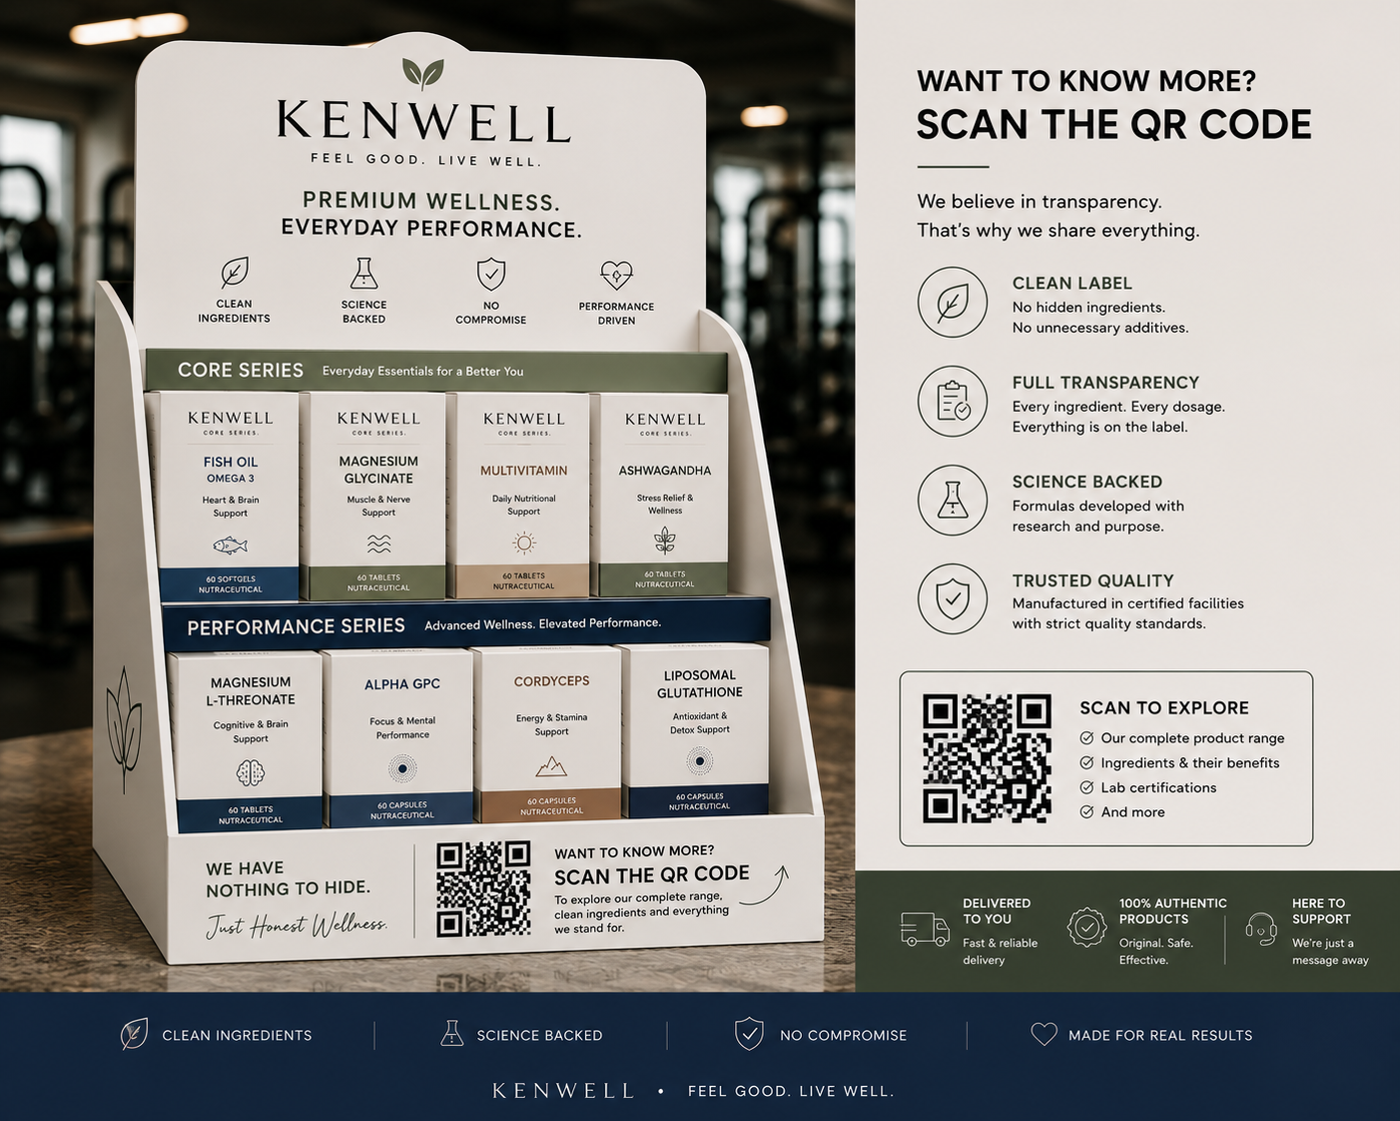
Counter Concept
Premium tabletop QR-based wellness discovery counter for gyms and wellness spaces.

Slide 4
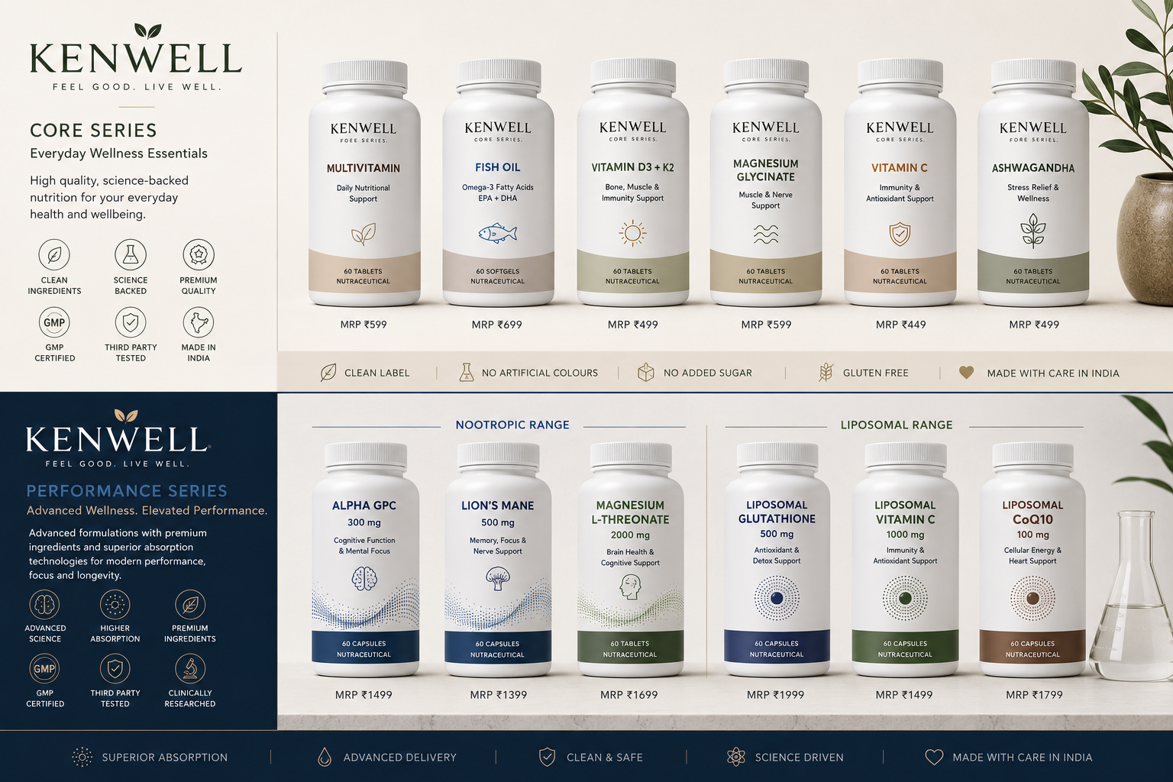
Product Architecture
CORE SERIES for daily wellness. PERFORMANCE SERIES for advanced nootropics, recovery & liposomal products.

Slide 5
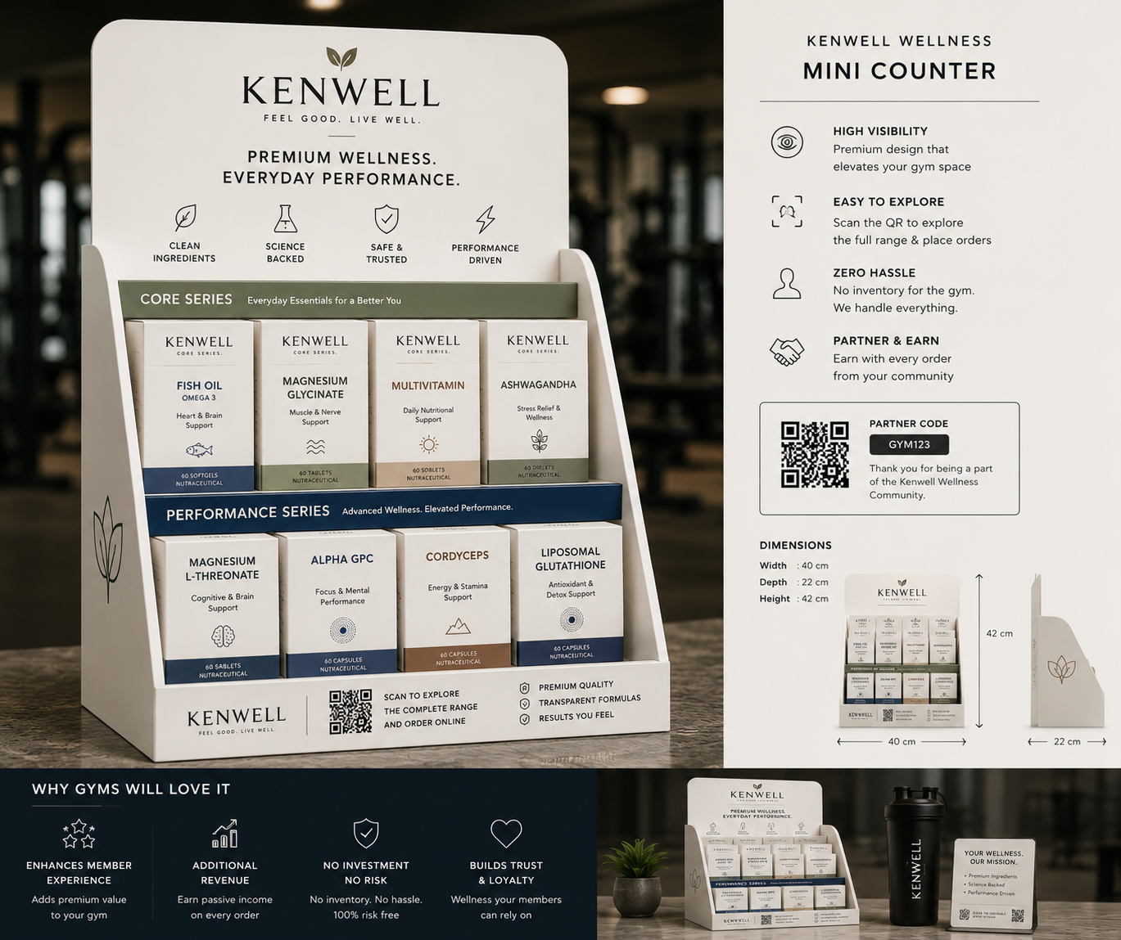
Gym Distribution Model
QR ordering + revenue sharing. No inventory risk for gyms. Offline discovery, online conversion.

Slide 6
Content Strategy
Educational reels built around wellness stacks: Brain Health, Recovery, Calm Productivity, Longevity & Cortisol Support.

Slide 7
Transparency Positioning
“We Have Nothing To Hide.” Transparent labels, clean ingredients, science-backed formulations.

Slide 8
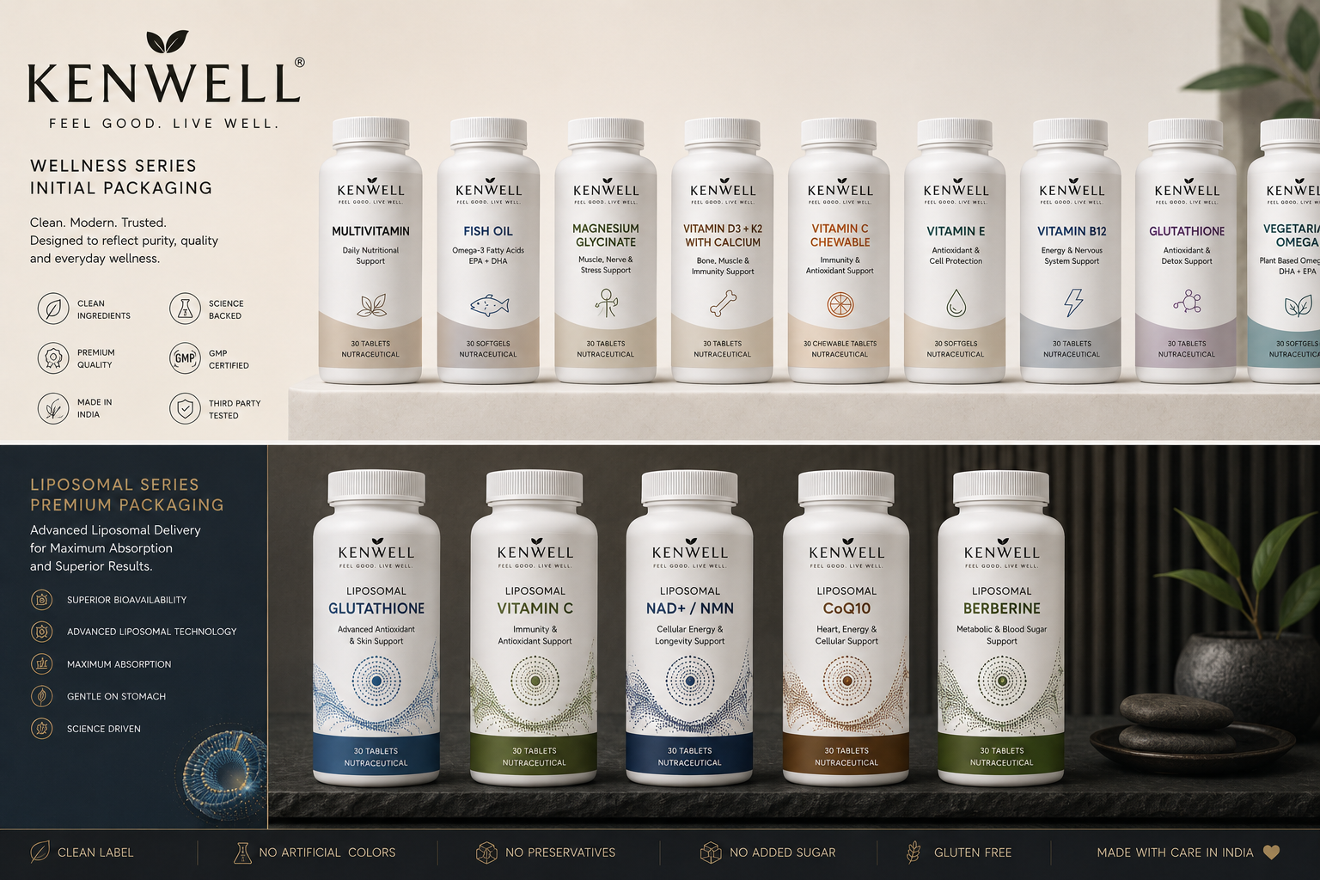
Vision for KENWELL
A premium wellness ecosystem built around performance, longevity, transparency and modern health.

