Slide 1
Classification of Texts
A threshold based approach
Under the guidance of
Mr. Anilkumar K.M
Asst. Professor, Dept of CSE
SJCE,Mysore
-By
Meghana PC
Pratheeksha D
Shruthi Sudhanva

Slide 2
Outline Of The Presentation
Introduction
Subjectivity Classification
Synopsis
Literature Survey
System Requirement Specifications
System Design
System Implementation
System Testing
Experiments and Results
Conclusion
Future Enhancements

Slide 3
Introduction
Subjectivity Classification is a part of opinion mining. It is a task which investigates whether a paragraph presents the opinion of its author or reports facts.
Consider following statements:
Statement 1: In the second expansion in three days, Karnataka Chief Minister D V Sadananda Gowda today inducted five ministers of cabinet rank into his ministry, but kept out the controversial Reddy brothers.

Slide 4
Statement 2: Nikon Coolpix P300Michael A. Hurd (Sep 27, 2011)Takes great pictures, easy to use, and the battery lasts a very long time. I've taken hundreds of pictures and still had plenty of battery left.
Statement 3: According to me, Iphone5 is a great product. Best of its kind with cool features, visual clarity and apps. I recommend it.
In General, by reading the statements, we can conclude that, statement 1 is a fact while 2 and 3 are opinions.

Slide 5
The above classification can be made systematically by:
By checking for adjective count( explained later).
Checking for presence of cues like “According to me”, “In my opinion”, “Frankly speaking” .. Which clearly classify text as opinion.

Slide 6
Synopsis
Problem Statement:
To classify given document or text into Factual or Opinionated based on an optimal approach and a threshold value.

Slide 7
Scope of the project
Subjectivity classification classifies a document into factual or opinionated based on polar word count, adjective word count , Parts of Speech patterns and presence of cues.
The project uses opinionated and factual documents collected from the following websites
www.epinions.com
www.deccanheraldepaper.com
www.thehindu.com
The documents are arranged into different input directories.
We also experiment each method with different input types: Full text, first sentence, last sentence, significant sentence, first-last-significant sentences.

Slide 8
Literature Survey
Textual information can be broadly classified into two main categories, facts and opinions.
Much of the existing research on text information processing has been focused on mining and retrieval of factual information, e.g., information retrieval, Web search, etc.,
Opinion mining is a recent sub discipline of information retrieval which is not about the topic of a document, but with the opinion it expresses

Slide 9
Literature Survey
Sentiment detection dates back to the late 1990s (Argamon, Koppel, & Avneri, 1998; Kessler, Nunberg, & SchAutze, 1997; Spertus, 1997), but only in the early 2000s did it become a major subfield of the information management discipline.
Until the early 2000s, the two main popular approaches to sentiment detection were based on machine learning techniques and based on semantic analysis techniques.
Current-day sentiment detection is a discipline at the crossroads of NLP and IR, and as such it shares a number of characteristics with other tasks such as information extraction and text-mining.

Slide 10
Literature Survey
The first step in building opinion search engines or other applications is determining which documents are topically relevant to an opinion-oriented query and hence, determining which documents or portions of documents contain review-like or opinionated material
Subjectivity in natural language refers to aspects of language used to express opinions and evaluations (Wiebe, 1994).
Point of view tracking in narrative (Banfield, 1982; Uspensky, 1973; Wiebe, 1994)
Here, we look at a threshold based approach to classify given text as opinion or fact.

Slide 11
System Requirement Specification
Functional requirements:
Module 1:
Input: Classification method, Input type and set of text files(opinion+fact).
Processing: Run specified experiment for various thresholds on input given to classify texts.
Output: Display calculated thresholds and accuracies as a graph.
Module 2:
Input: User entered text
Processing: Use most accurate method to classify text.
Output: Display input text as opinion or fact
Module 3:
Input: Classification method and Input type
Processing: Run specified experiment on varying number of files with different classification thresholds.
Output: Display the result of number of files experimented and their corresponding accuracies.

Slide 12
System Requirement Specification
Non-Functional requirements:
Hardware requirements:
A simple basic computer system
Any Intel or AMD x86 processor
Minimum of 512 MB RAM is required
Software requirements:
Windows XP or greater.
Java Virtual Machine(JVM) and JDK1.6 or above are required.
Gnuplot (gnu graph plotter) required.
User requirements:
Java based front end displaying gnuplot graphs.

Slide 13
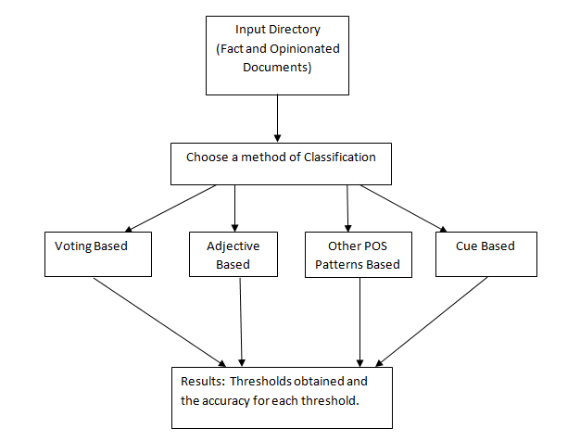
System Design
Overall design:

Slide 14
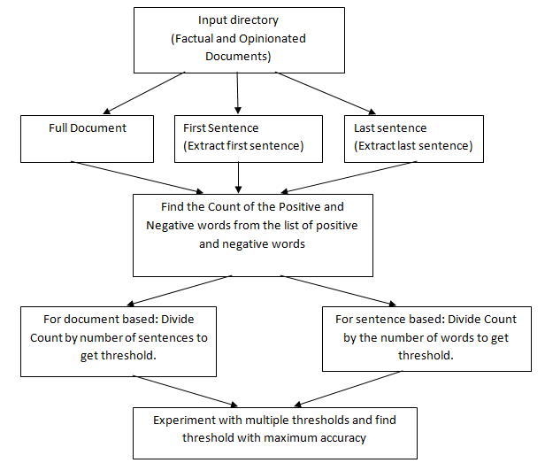
System Design
Detailed design of Voting based method

Slide 15
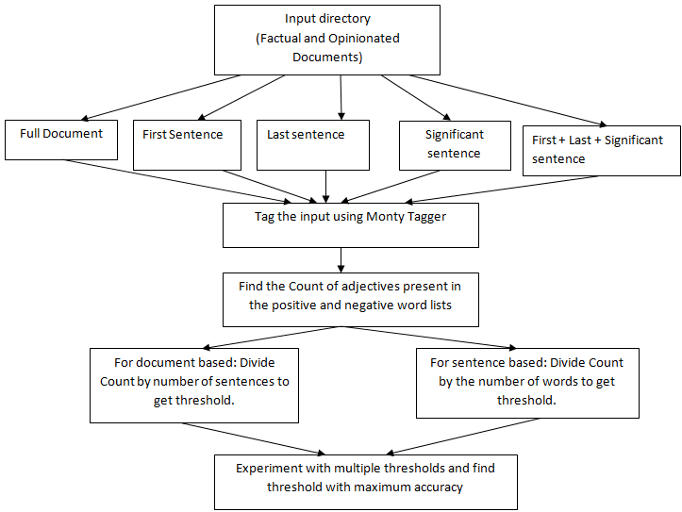
System Design
Detailed design of Adjective based method:

Slide 16
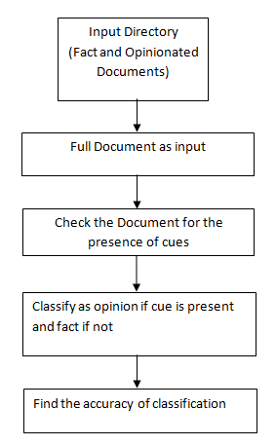
System Design
Detailed design of Cue based method

Slide 17
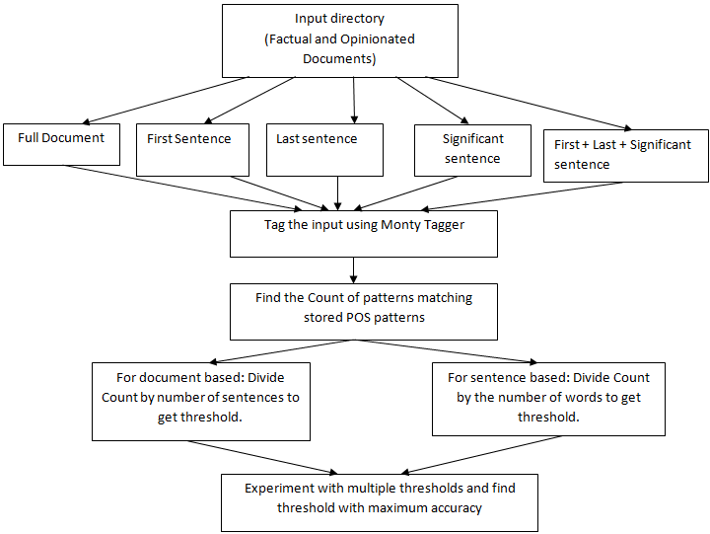
System Design
Detailed design of Other POS method:

Slide 18
System Implementation
Voting method:
This method finds the polar words in the input file using two lists of positive and negative polar words.
The resultant ratio for full document input is computed using
Resultant ratio = Σ(Polar words)/Total no. of sentences …. (5.1)
The resultant ratio for sentence based input is computed using
Resultant ratio = Σ(Polar words)/No. of. words in sentence … (5.2)
Algorithm 5.1 describes the steps involved.

Slide 19
Algorithm 5.1
ForEach(input file) { //Input is the whole document, the first sentence or the last sentence ExtractWord(Input) { IfPresent(Positive.txt) || IfPresent(Negative.txt) PolarWordCount[file]++ //for full document input If(EndOfSentence) SentenceCount[file]++ //for sentence based input If(EndOfWord) WordCount[file]++ } //For full document input ResultantRatio[file] = Sum(PolarWordCount[file])/SentenceCount[file] //For sentence based input ResultantRatio[file] = Sum(PolarWordCount[file])/WordCount[file] } AvgResultantRatio = Threshold for(Range Of Thresholds) { Accuracy = CorrectlyClassifiedTextsByProgram / Total no. of texts }

Slide 20
System Implementation
Adjective Count method
The input is assigned Part Of Speech tags(listed in Appendix A) using the Monty Tagger
The adjective count in the input is found
The resultant ratio for full document input is computed using
Resultant ratio = Σ(Adjectives)/Total no. of sentences …. (5.3)
The resultant ratio for sentence based input is computed using
Resultant ratio = Σ(Adjectives)/No. Of words in sentence …. (5.4)
Algorithm 6.2 describes the steps involved.

Slide 21
Algorithm 5.2
ForEach(input file) { //Input is the whole document, the first sentence, last sentence, significant sentence or combination of first, last, significant sentences. InputString = StoreToString(Input) //MontyTagger takes String input OutputString = Tag(InputString) ExtractWord(OutputString) { if(word == adjective && (IfPresent(Positive.txt) || IfPresent(Negative.txt)) AdjectiveCount[file]++ //for full document input If(EndOfSentence) SentenceCount[file]++ //for sentence based input If(EndOfWord) WordCount[file]++ } //For full document input ResultantRatio[file] = Sum(AdjectiveCount[file])/SentenceCount[file] //For sentence based input ResultantRatio[file] = Sum(AdjectiveCount[file])/WordCount[file] } AvgResultantRatio = Threshold for(Range Of Thresholds) {
Accuracy = CorrectlyClassifiedTextsByProgram/ Total no. Of texts }

Slide 22
System Implementation
Other Parts of Speech method
The input is assigned Part Of Speech tags using the Monty Tagger
The count of specific POS patterns in Fig 6.1 is found
The resultant ratio for full document input is computed using
Resultant ratio = Σ(Patterns)/ Total no. of sentences …. (5.5)
The resultant ratio for sentence based input is computed using
Resultant ratio = Σ(Patterns)/ No. Of words in sentence …. (5.6)
Algorithm 6.3 describes the steps involved.

Slide 23
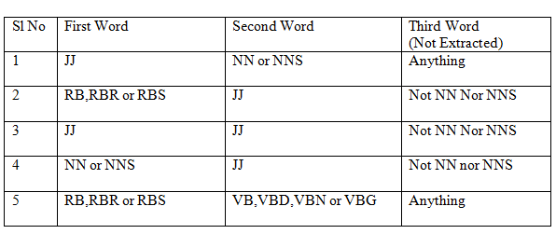
POS Patterns used
Table 5.1 POS Patterns

Slide 24
Algorithm 5.3
ForEach(input file) { //Input is the whole document, the first sentence, last sentence, significant sentence or combination of first, last, significant sentences. InputString = StoreToString(Input) //MontyTagger takes String input OutputString = Tag(InputString) ExtractPatternsOfThreeWords(OutputString) { if(pattern.matches(PatternInFile) && (IfPresent(Positive.txt) || IfPresent(Negative.txt)) PatternCount[file]++ //for full document input If(EndOfSentence) SentenceCount[file]++ //for sentence based input If(EndOfWord) WordCount[file]++ } //For full document input ResultantRatio[file] = Sum(PatternCount[file])/SentenceCount[file] //For sentence based input ResultantRatio[file] = Sum(PatternCount[file])/WordCount[file] } AvgResultantRatio = Threshold for(Range Of Thresholds) { Accuracy = CorrectlyClassifiedTextsByProgram/ Total no. Of texts }

Slide 25
System Implementation
Cue Based method
The possible cues which indicate opinionated documents are stored in a file.
For eg: I feel, According to me etc
The presence of these cues is checked in the input files.
If any cue is present, the file is classified as opinion and if not it is classified as fact.
Algorithm 6.4 describes this method

Slide 26
Algorithm 5.4
ForEach(Input File) {
//Input refers to the full document InputString = StoreToString(Input) if(Cue.Present(InputString)) Opinion = true
} Accuracy = CorrectlyClassifiedTextsByProgram/ Total no. Of texts

Slide 27
Other Algorithms
Finding the first sentence: ForEach(Input File) Extract words till the first end of sentence delimiter. Finding the last sentence: ForEach(Input File) Extract sentence by sentence till end of file and return last extracted sentence. Finding the significant sentence: ForEach(Input File) { ForEach( Sentence) { Find(AdjectiveCount) SignificantSentence = Sentence.MaxAdjectiveCount() } } First , Last and Significant Sentence as input: This method is referred to as ‘allmethod’ and re-uses the code which finds the First , Last and Significant Sentences. It applies the chosen method on all of these as input.

Slide 28
Algorithm applied for text classification on the User Input obtained from the GUI:
StoreToFile(User input string) { Run Cue based method. If(CuePresent) Result = opinionated Print(Result) return
Run First, Last, Significant sentence method
Use threshold giving maximum accuracy for classification. (0.2) if(ResultantRatio(input) > = 0.2) Result = opinionated else Result = factual Print(Result) }

Slide 29
The User Interaction Component
Three key components:
Input : User chooses experiment method, type of input and the input directory
Output : View the results in the form a graph.
2. Input : User enters text to be classified
Output: Text entered is opinionated/factual
3. Input :User chooses experiment method and type of input
Output : View the graph showing behavior of the chosen combination with respect to varying number of input files.
Component 2 applies the inferred best method to classify input text as opinion or fact.

Slide 30
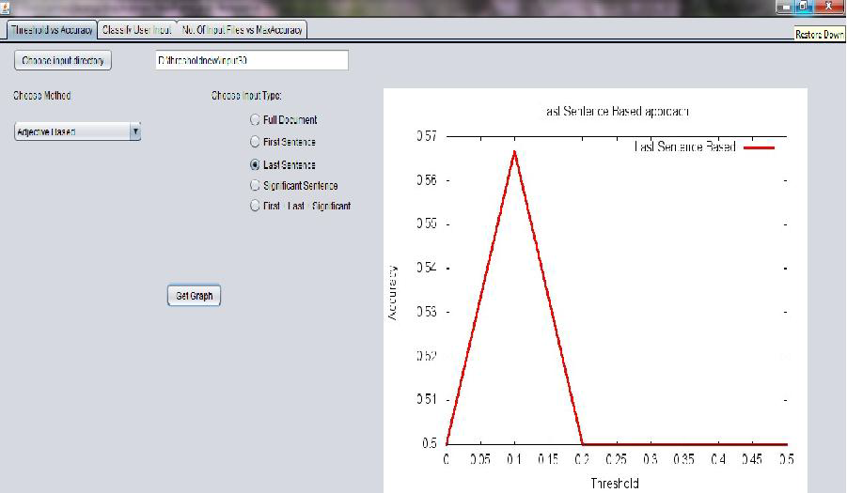
A view of the user interface

Slide 31
Testing
Unit Testing
It is used to test
Individual units of source code
Program modules
Integration Testing
It is used to test
Integrity and interaction between the program modules.

Slide 32
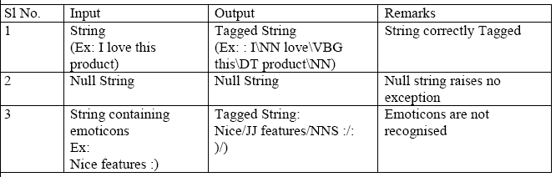
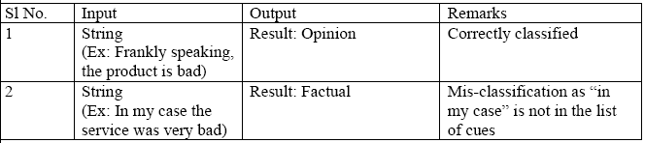
Unit testing
Table 6.1: Test case for module Monty Tagger
Table 6.2: Test case for module Cue based

Slide 33
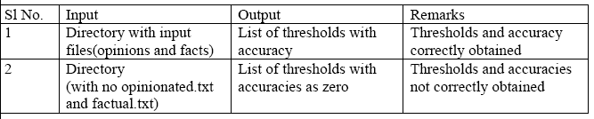
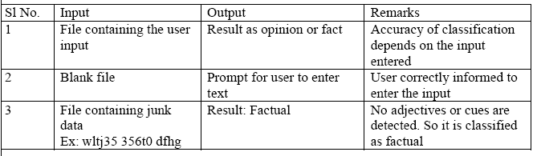
Table 6.3: Test case for adjective count module
Table 6.4: Test case for classifying user input module

Slide 34
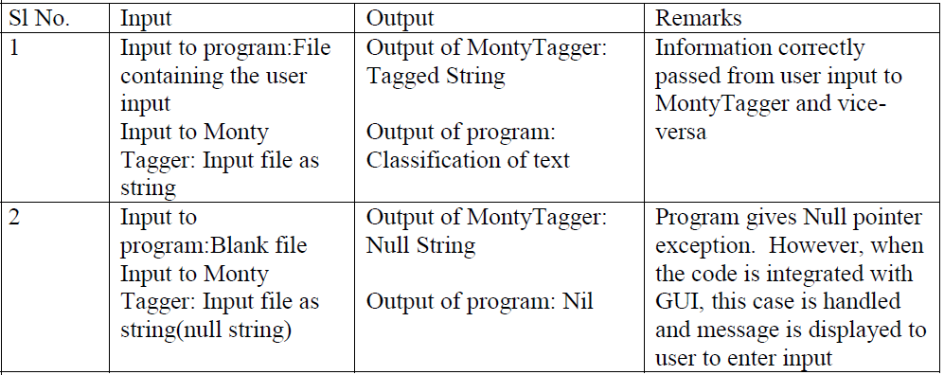
Integration Testing
Table 6.5 Test case for integration of monty tagger with code

Slide 35
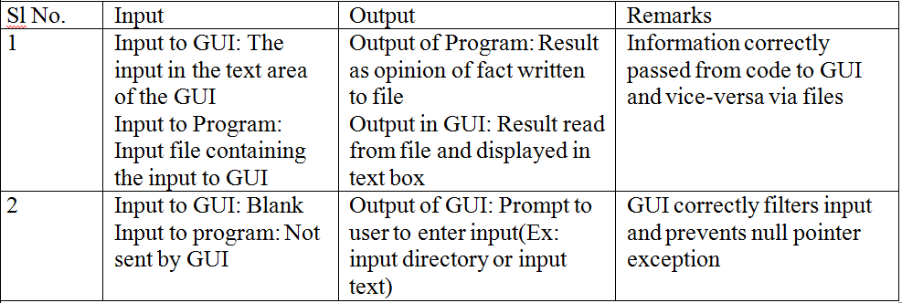
Integration Testing
Table 6.6 Test case for integration of GUI with code

Slide 36
Test Cases for the user input classification module:
Test Case 1:
Input Text:
While I was still a Verizon customer, I waited a good 8 months beyond my contract expiration for the first version of the Blackberry Storm. Then it came out, and sucked a fatty...At the time, I was a working musician, and needed the ability to access my business emails from my "real" job.
The old LG flip phone that I had was just not cutting it. So I was in the market for a smart phone. A freind turned me on to the iPhone, and I decided to give it a go!Instantly, I was amazed with what this phone could do! A very simple interface between the phone and iTunes (both mobile, and PC versions) made adding songs a breeze. And the apps... OH the apps!When you see the commercial that says they have an app for everything, they are not kidding. Some cost a few bucks, but there are plenty of free apps out there that are helpful and easily funtional.
The thing that I have probably used the most, is the built in GPS courtesy of Google Maps. This has saved many a trip for my family, with easy-to-follow turn by turn directions.There were drawbacks, intially. It was impossible to send a picture message with the original OS for the phone. Even a run of the mill Tracfone that you buy at the local mini-mart could do this! But when OS 3 came out last year, this was fixed.
Also, the phone did not take video (the later model, 3GS did this out of the box). This is still somethign you can't do without downloading an app, but the app is free, so no harm done.Voice memos, notes to self, games, reference tools... All come in plenty handy. The ability to synch multiple email addresses into one inbox is also VERY helpful.Improvement on this have been made in later models, but I still love the one I bought. I would recomend buying a hardshell case for the thing, as it would easily be scratched up if you drop it. Plus, constantly having to buy new screen protector decals just doesn't sound fun to me.You can find one of these pretty cheap these days... even a refurb... if you are looking to upgrade to a new phone, give the ol' iPhone 3G a look!

Slide 37
Result: Test Case 1
Expected Result: Opinionated
Obtained Result: Opinionated

Slide 38
Test Case 2: Input Text:
The Karnataka State Road Transport Corporation (KSRTC) on Wednesday launched buses run on bio-fuel to mark World Bio-fuel Day. Painted by students of Karnataka Chitrakala Parishat, the KSRTC?buses carried the message of urgent need to switch from fossil fuels to eco-friendly fuels.
Speaking on the occasion, Karnataka State Bio-fuel Development Board (KSDB) Executive Chairman Y B Ramakrishna said the department has planned to set up information centres to popularise bio-fuel in district headquarters across the State by December.
The quantity of ethanol used in mixed fuels will be increased from five per cent to 10 per cent by the year end.
“A unit in Peenya has already been producing 3,000 litre of bio-fuel everyday. We plan to start another unit with higher capacity in Devanahalli,” Ramakrishna said.
Flagging off the buses on Doddaballapur and Chikmagalur routes, Transport Minister R Ashoka said both BMTC and KSRTC will encourage the use of bio-fuel. “More buses will have advertisements on bio-fuels,” he said.
Besides, the KSDB announced its aim to plant 1.5 crore bio-fuel yielding saplings by 2013.
Drawings by children aged around 10 and the students of the Chitrakala Parishat on the theme of bio-fuel were on display. A book. ‘Kusu Kanda Kanasinalli’ and a CD titled ‘Halakki Nudidaite’, comprising poems on the same theme were released on the occasion.

Slide 39
Result: Test Case 2
Expected Result: Factual
Obtained Result: Factual

Slide 40
Test Case 3: Input Text:
I got this phone for my birthday. I love the size of the screen. The email application loads very quickly. Over time the applications on the phone start to take longer to load, except for the email one.
I have found that the Ipod sometimes will turn on at random times and play music by itself. I have also called people accidentally a number of times due to the fact that the phone is touch screen.
The volume button on the side of the phone broke and will no longer go on silent with out vibrating constantly. Some apps will not open when you download them. Certain apps are only compatable with the Iphone 4 or the ipad.
Apps also use a lot of the battery very quickly. The battery only holds about 10 hours at best if you dont use it frequently. This is not worth the cost. If you need this phone for business then dont buy it because your battery will run out because you are using it for its intended purpose. Make sure to buy icare so you are insured incase you drop it and crack the screen.
Most people i know who have had an Iphone, including me, have cracked the screen. In my case with this phone, it will cost me more money to fix the screen than to buy a new phone. Make sure you consider your options when buying this product. If it is purely for entertainment, then it wont hurt to buy it, but if its for business, go with a Blackberry.

Slide 41
Result: Test Case 3
Expected Result: Opinionated
Obtained Result: Factual
Comments:
The text has few adjectives and is more technical than descriptive of a user’s feelings. Also none of the cues present in our list are found in the text. This has lead to misclassification.

Slide 42
Test Case 4: Input Text:
The Anna Hazare Team today expressed satisfaction over the venue offered to them by police for holding the indefinite fast against Lokpal Bill even as they denied any going back on their stand on the legislation.
The Core Committee of the Hazare team met here this morning. The meeting was attended by Hazare and others including, activist Arvind Kejriwal.
"We are satisfied with the venue provided by Delhi Police. It is at a good location. Core committee is chalking out the plan on how to go about the fast," he told reporters.
Delhi Police last night offered Jai Prakash Narain Park adjacent to Firoz Shah Kotla Ground as the venue for his protest against the Lokpal Bill subject to permission from the land owning agency.
Kejriwal said there was no going back on the demands raised by them.
"We are not ready to compromise with anyone till our demands are met. The deadlock continues. We are open for any dialogue but there is no invitation from the government yet," he said.
His comments came when asked about activist Swami Agnivesh's comments that the Hazare team was "very very flexible" on issues like inclusion of prime minister or higher judiciary under ambit of the ombudsman but the sticking point is bringing lower bureaucracy in it.

Slide 43
Result: Test Case 4
Expected Result: Factual
Obtained Result: Opinionated
Comments:
The text is a news article and hence is considered a fact. But it expresses an opinion of the people. The sentences within quotes are opinionated and have resulted in such a classification

Slide 44
Experiments and Results
The performance metric used is the accuracy of classification
Accuracy is measured using:
Accuracy = Σ(Correct classifications by program)/No. of texts classified …(7.1)
For every method and input type we have one of the thresholds giving the maximum accuracy
This is recorded as the threshold with max accuracy against the number of input files.
The results of the described methods is available in Table 7.1

Slide 45
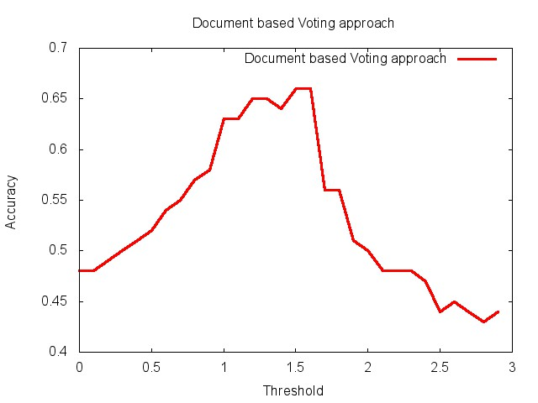
Fig 6.1 Threshold vs Accuracy for Voting Full Document Method

Slide 46
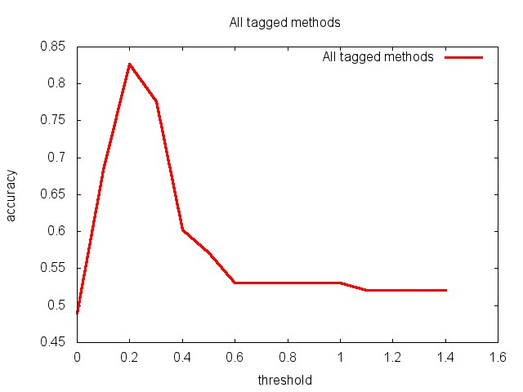
Fig 6.2 Threshold vs Accuracy
for Adjective Count Based First+Last+Significant Method

Slide 47
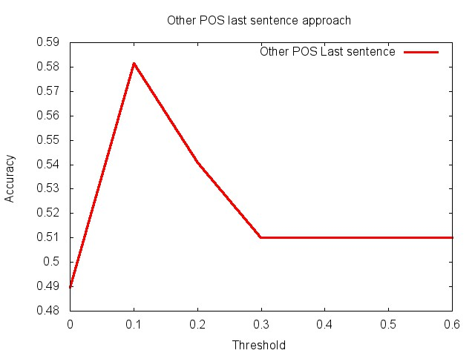
Fig 6.3 Threshold vs Accuracy for OtherPOS last sentence method

Slide 48
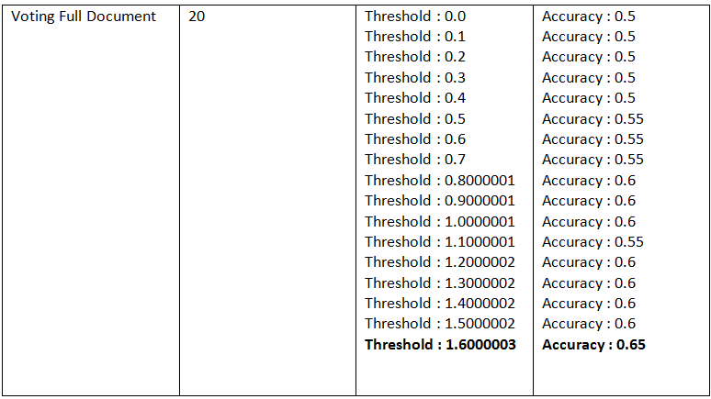
Table 6.7: Threshold and Accuracy of Methods with Different no. of input files

Slide 49
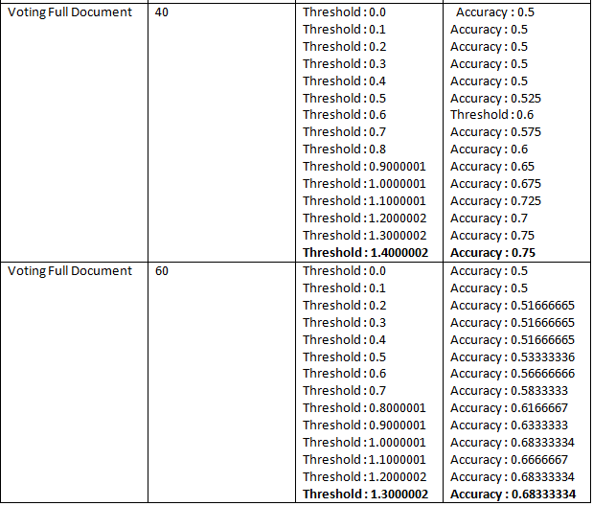
Table 6.7 Contd..

Slide 50
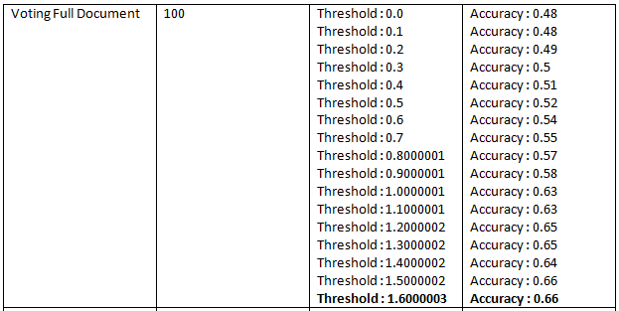
Table 6.7 Contd..

Slide 51
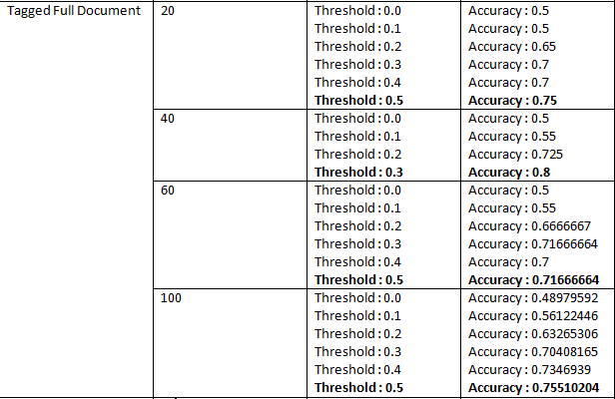
Table 6.7 Contd..

Slide 52
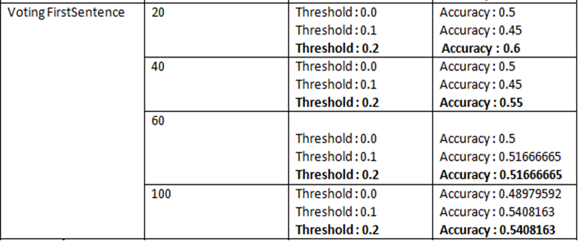
Table 6.7 Contd..

Slide 53
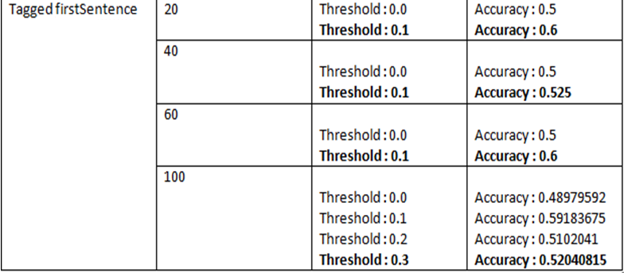
Table 6.7 Contd..

Slide 54
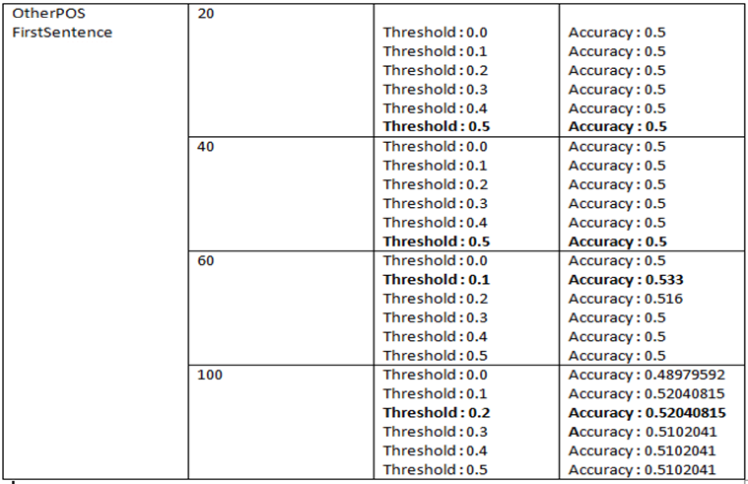
Table 6.7 contd..

Slide 55
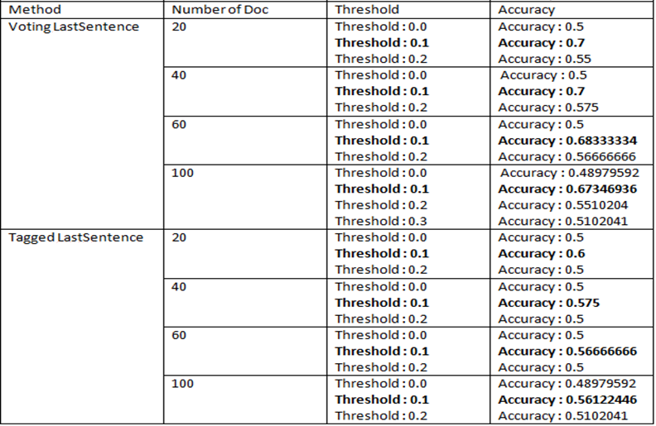
Table 6.7 Contd..

Slide 56
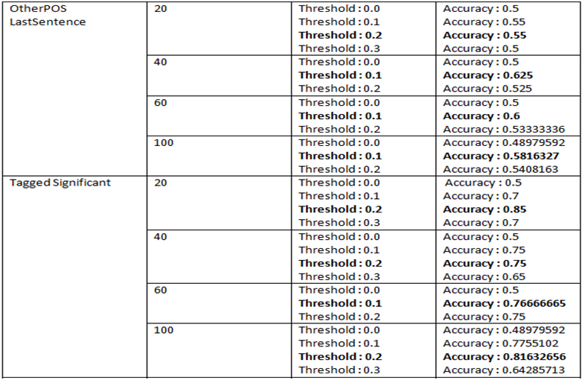
Table 6.7 contd..

Slide 57
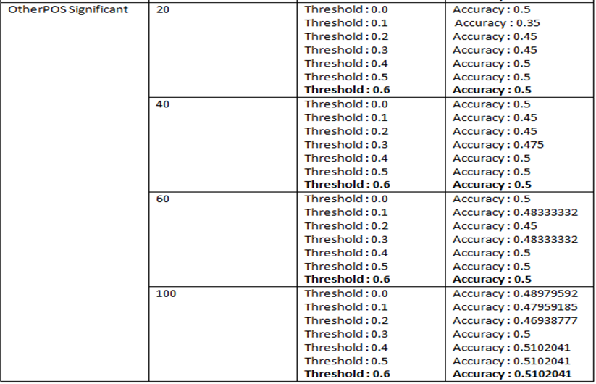
Table 6.7 Contd..

Slide 58
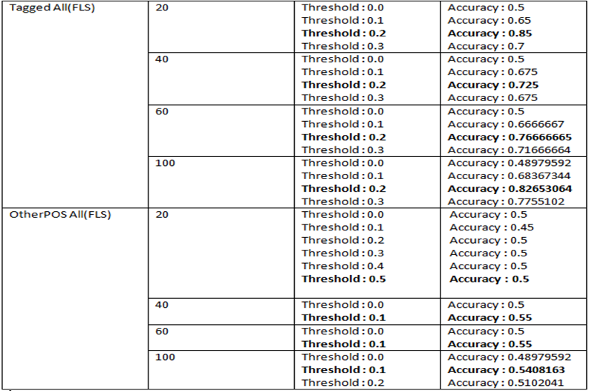
Table 6.7 Contd..

Slide 59
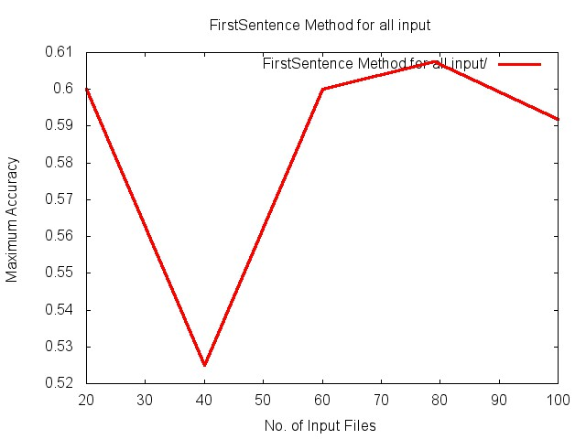
Number of input files as factor
We consider the behavior of the various methods and input types against the number of input files on which they serve.
To observe this, we run the methods on sets of 20, 40, 60, 80 and 100 files.
Get the best accuracy from each run and plot it against the input size as shown

Slide 60
Experimental Results
Text classification was attempted by various methods and the following thresholds were obtained
Average threshold to classify documents:
Adjective Based(tagged) full document based : 0.45
Adjective Based(tagged) sentence based : 0.14375
OtherPOS full document based : 0.78
OtherPOS sentence based : 0.3125
Voting full document based : 1.475
Voting sentence based : 0.15
The number of input files as a factor has also been explored.
Maximum accuracy of 85% has been achieved by the first, last, significant method for 20 documents at a threshold of 0.2. However the accuracy on the entire dataset of 100 documents is 82%.
The results of the research are applied on any random input given by the user and tested and satisfactory results are obtained.

Slide 61
Conclusion
Following aspects have been successfully achieved in the project
Collection of data
Implementation of Voting, Adjective Based, Cue Based and OtherPOS Method with FirstSentence, LastSentence, Significant sentence, full document input
Computation of accuracies for the methods with different input
Visualization of results as graphs
Study of the results and determination of the most accurate method to classify any input text as opinion or fact
User interaction with the program

Slide 62
Future Enhancements
The presence of quoted statements in a news article puts it in an ambiguous category. The statement may or may not express opinion and if it does, it could result in the document being classified as opinion.
Most reviews are written in the first person and contain patterns like 'I find' etc (general pattern of 'I' followed by a verb form) These patterns can be identified using the Monty Tagger.
Thus we could eliminate the ambiguous quoted sentences and also look for the above mentioned patterns in the text to classify it.
More cues can be added to the list of cues to make it exhaustive.
Also we can include more words in the list of polar words.

Slide 63
Applications
It can be used in review sites to classify and use opinion documents
It can be used in search engines to get opinionated or factual documents related to search topic
Application in sub-component technology: to detect the parts of web pages
To detect the flames(antagonistic language) in webpages and mails

Slide 64
References:
Monty Tagger:
Author: Hugo Liu <hugo at media dot mit dot edu>
http://web.media.mit.edu/~hugo/montytagger/
Tang Survey – sentiment detection of reviews 2009 by Huifeng Tang, Songbo Tan, Xueqi Cheng
Opinion Mining and sentiment analysis by Bo Pang, Lillian Lee
Tracking point of view narrative for subjectivity classification methods by Janyce wiebe http://www.cs.titt.edu/~wiebe/tubs/papers/CL94.pdf

Slide 65
Appendix
Appendix A: The POS tags assigned by the Monty Tagger

Slide 66
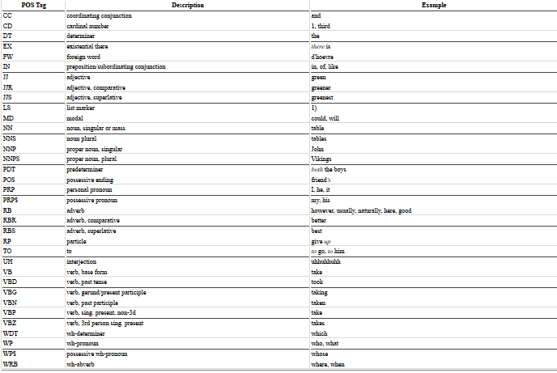
Appendix A

Slide 67
THANK YOU

