Slide 1


Effects of Advertising campaigns on Humana customers
Megha Syam Gutti
Aashesh Vontivillu Nareshchand
Sai Pratheek Banda

Slide 2
The Health Insurance Company: Humana Inc
Humana Inc. is a for-profit American health insurance company based in Louisville, Kentucky.
Humana had over 13 million customers in the U.S., reported a 2013 revenue of US$41.3 billion

Slide 3
DATASET
This is a panel data with data captured over two time periods, 2014 and 2015 for each county
Data comprises of Expenditure in various marketing campaigns.
HMO, PPO plans of the company and its competitors
Dependent Variable: Change in Customers for a year
HMO -Health Maintenance Organization*
PPO -Preferred Provider Organization*

Slide 4

Issues encountered
This is an Unbalanced Panel Data, the number of time periods (year: 2014, 2015) is not same for all cross-sectional data (ID).
So, ID’s with missing time periods are identified and omitted from the dataset to make the panel data balanced.
Python is used to clean the data and write the cleaned data to a ‘CSV’ file, for us to do our further analysis.

Slide 5
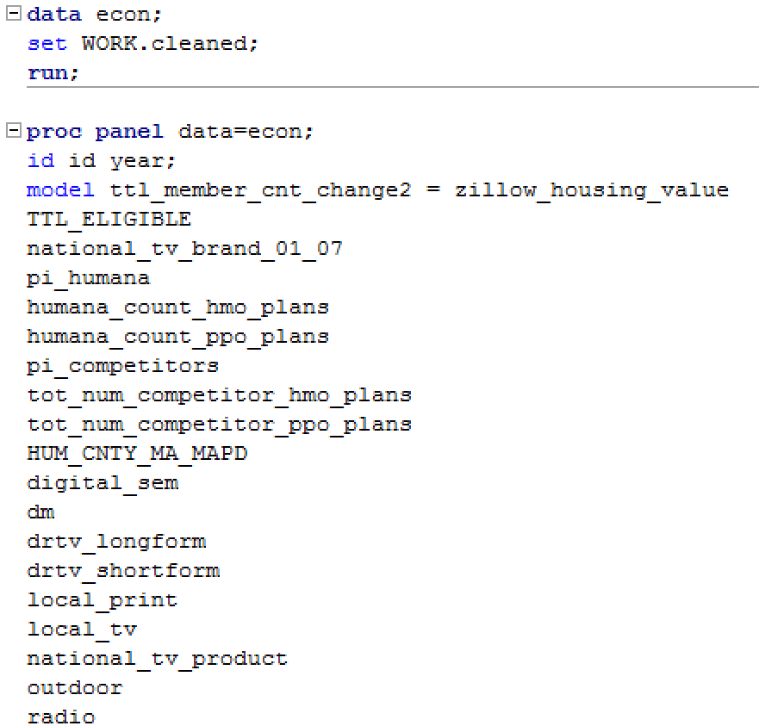
Model
Since this is a panel data, fixed effects model is used to estimate the parameters.
Why pooled OLS cannot be used here?
Does not account for the structure of panel data
OLS Assumption is violated – Correlation of dependent variable with error term is not zero.
SAS is used to run the model.

Slide 6
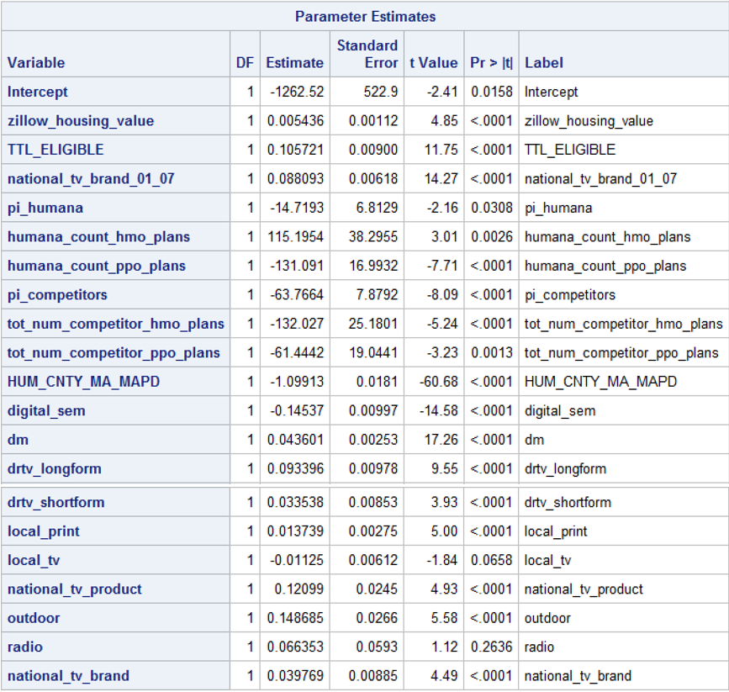
Results

Slide 7
Interpretations’ of each Independent Variable
Zillow_housing_value
For every $1000 increase in the Zillow housing value in a county, an average of 5 customers are increased in that county.
TTL_ELIGIBLE
An increase of 10 customers in Medicare insurance holders will result in 1 customer increase.
national_tv_brand_01_07
An increase of $12.5 spent on national brand tv from months 1st to 8th will result in 1 customer increase.
pi_humana
One-point increase in purchase intent from humana (scaled from 1-7, 1 being highest) will result in a decrease of 15 customers.
humana_count_hmo_plans
One unit increase in humana_count_hmo_plans will result in 115 customers increase.
humana_count_ppo_plans
One unit increase in humana_count_ppo_plans will result in 113 customers decrease.

Slide 8
Interpretations' Cont.
pi_competitors
One-point increase in purchase intent from HUMANA competitors will result in a decrease of 64 customers.
tot_num_competitor_hmo_plans
One unit increase in tot_num_competitor_hmo_plans will result in 132 customers decrease.
tot_num_competitor_ppo_plans
One unit increase in tot_num_competitor_ppo_plans will result in 61 customers decrease.
HUM_CNTY_MA_MAPD
One customer increase in humana medicare customers will result in 1 customer decrease on an average.

Slide 9
Interpretations' Cont.
Digital SEM (Search Engine Marketing)
An increase of $100 spent on digital marketing SEM will result in 14 customer decrease on an average.
Direct Mails
An increase of $100 spent on direct mails will result in 4 customer increase on an average.
Direct Response TV longform
For every 100$ increase in the spending of direct response tv longform, the average number of customers increases by 9 approx.
Direct Response TV shortform
For every 100$ increase in the spending of direct response tv shortform, the average number of customers increases by 3 approx.
Local_print
For every 100$ increase in the spending of local print, the average number of customers increases by 1 approx.
Local_tv
The spending on local tv is not a significant factor in deciding the number of humana customers

Slide 10
Interpretations' Cont.
national_tv_brand
For every 100$ increase in the spending on marketing the tv brand, the average number of customers increases by 4 approx.
Outdoor
For every 100$ increase in the spending of outdoor marketing, the average number of customers increases by 15 approx.
Radio
The spending on radio is not a significant factor in deciding the number of humana customers
national_tv_product
For every 100$ increase in the spending on marketing the tv product, the average number of customers increases by 12.

Slide 11
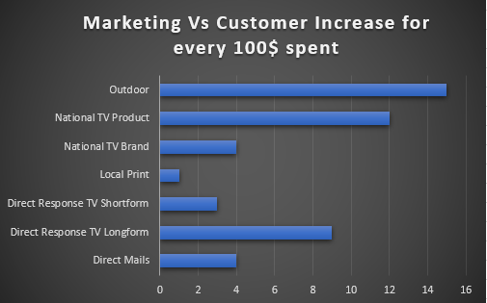

Slide 12
Recommendations
The impact caused by tv longform advertising is more than that of tv shortform advertising
Spending on marketing campaigns should be more focused on Outdoor and National TV Product
Digital Search Engine Marketing has a negative impact on the Humana customers.
Local TV and Radio marketing have no significant impact on the Humana customers

Slide 13

Thank you

