Slide 1
QuestLog
A gamified task manager that turns deadlines into rewards.
Rochan · Pratheek · Vivan · William · Satwik · Raj

Slide 2



What is QuestLog?
A task manager built for students who struggle with motivation. Every task earns XP, every streak builds momentum, and every level feels like progress.
XP REWARDS
Tasks earn base XP × multipliers
STREAKS
Daily consistency = bigger boosts
Instead of guilt-tripping users into productivity, QuestLog rewards consistency the way games reward grinding.
ACHIEVEMENTS
Big wins unlock virtual currency

Slide 3
01
Features

Slide 4
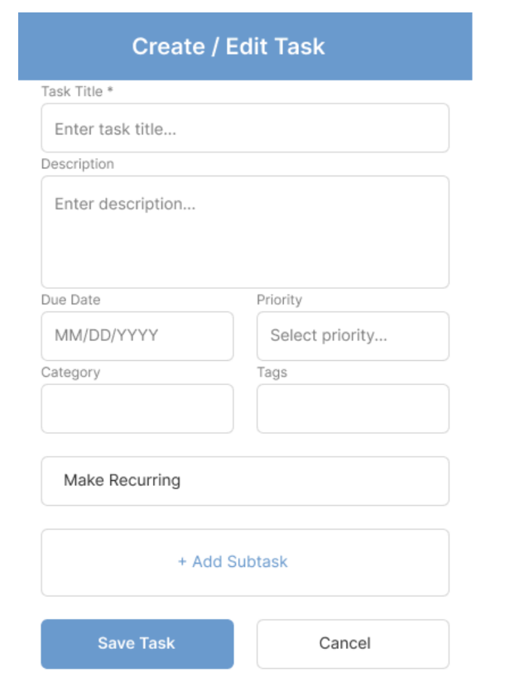

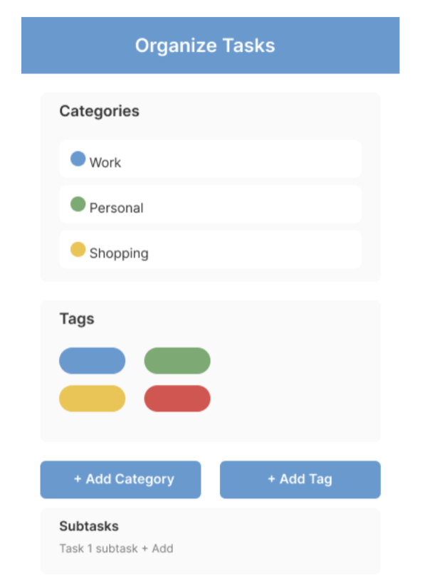


ROCHAN · CORE TASK SYSTEM
Creating the core system
Create & edit tasks
Title, description, due date, priority, category, tags, recurring toggle, and nested subtasks.
Organize & schedule
Categories with color swatches, tag chips, and a recurring scheduler with daily / weekly / custom intervals plus a live preview of upcoming occurrences.
Search & filter
Keyword search plus filters (priority, category, tag, date range) and sort controls so users find any task instantly.

Slide 5
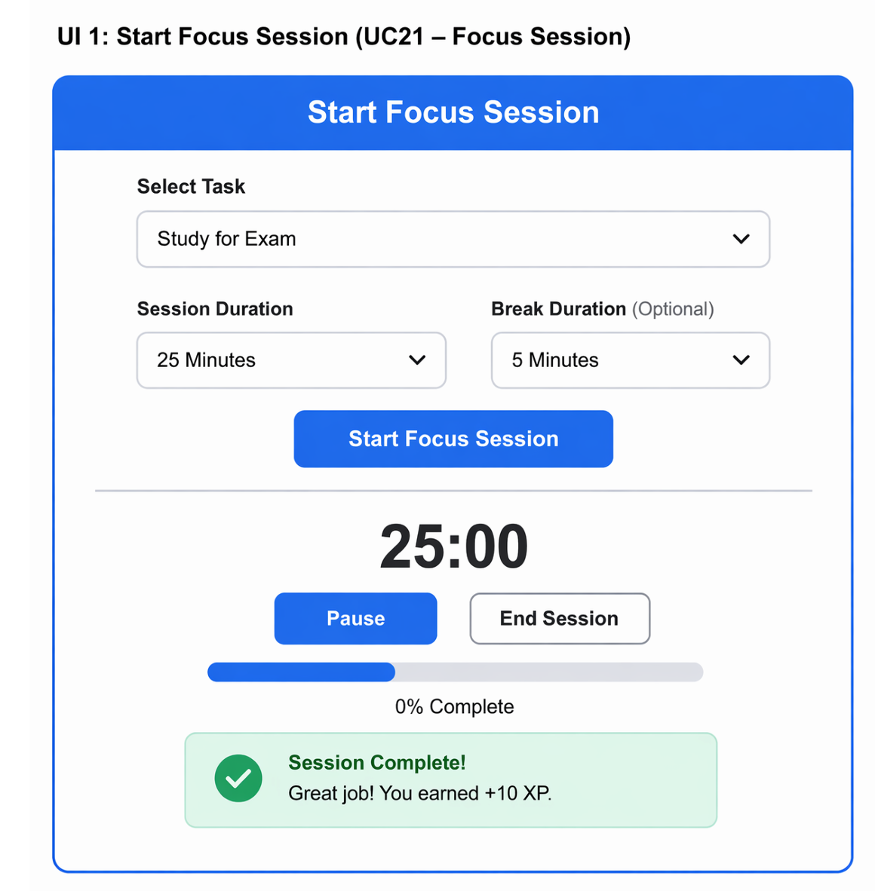



PRATHEEK · FOCUS & PRODUCTIVITY
Stay locked in
Daily goals
Users set focused targets each day to keep momentum aligned with what matters.
Distraction blocking
Block specific websites during focus sessions so context-switching can't sabotage progress.
Session review
Look back on past focus sessions to see where time actually went and adjust.

Slide 6
VIVAN · GAMIFICATION ENGINE
Make consistency rewarding
Live multiplier preview
Base XP × streak × on-time multipliers shown before the user confirms a task.
Streak tracking
Daily streaks compound XP, encouraging habit formation through visible momentum.
Level progression + history
Climb visible ranks, and review every multiplier in the XP history view.

Slide 7
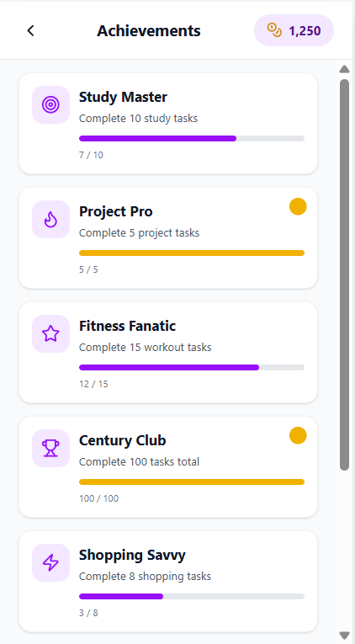



WILLIAM · ACHIEVEMENTS & REWARDS
Earn & Spend
Achievement tracking
Visualize progress toward bigger milestones — not just daily checkboxes.
Virtual currency rewards
Tasks and achievements pay out a tangible currency users can save and spend.
VC store
Spend earned currency to personalize accounts, making accomplishments visible.

Slide 8




SATWIK · SOCIAL & GAMIFICATION
Build the social layer.
Secure Authentication
users sign up and log in to a personalized account, with credentials stored safely and sessions kept active across visits.
Friends list management
Find friends by username, send and respond to requests, and remove or block users to control your social circle.
Tasks and achievements pay out a tangible currency users can save and spend.
Leaderboards
Compare progress against friends or the global community across daily, weekly, and all-time views.
1v1 task challenges
Go head-to-head with a friend over a set duration to see who can complete more tasks before time runs out.

Slide 9
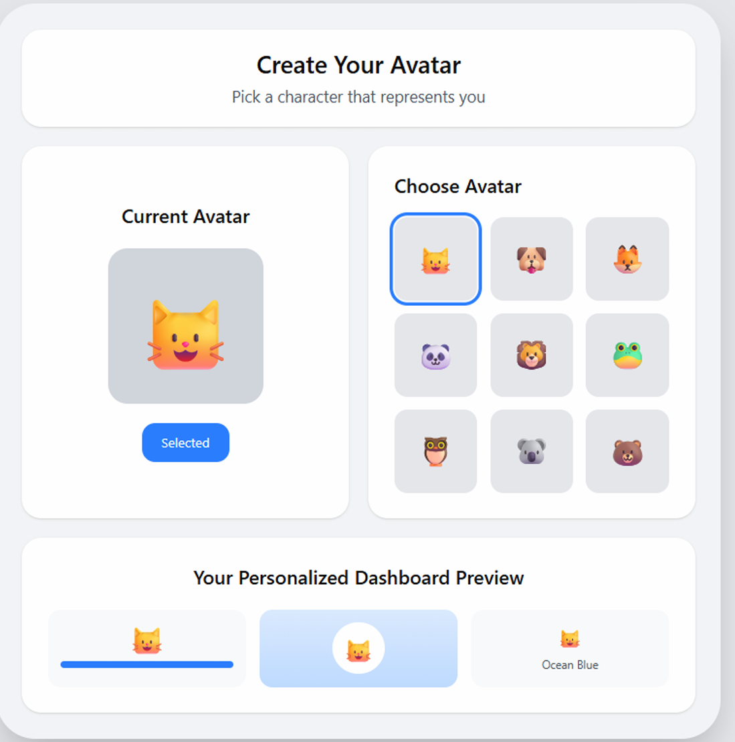
Raj Tatavarthi · Personalized Dashboard
Build a Personalized profile
Customizable dashboard
Organize your goals, stats, and achievements into a layout that adapts to your workflow.
Onboarding tutorial
Start strong with a structured system that rewards early actions and builds momentum from day one
Personalized avatar
Express your progress visually. Unlock and upgrade your avatar using earned rewards.

Slide 10
02
Challenges & Solutions

Slide 11
Problems & Solutions
CHALLENGE
CHALLENGE
CHALLENGE
Making XP feel fair
Keeping the focus session experience consistent and intuitive
Information density on the dashboard
SOLUTION
SOLUTION
SOLUTION
Show the full multiplier breakdown (base × streak × on-time) in every view.
Clearly define session states (focus, break, complete) and guide users with simple visual cues and transitions.
Prioritize 4 key stats up top; push details to expandable views.

Slide 12
The motivation balance problem
If we push too hard
Our guardrails
Users burn out. Streaks become a source of stress, not motivation. Multi-hour sessions stop being focus and start being self-punishment.
Optional blocking — distraction blocks aren't forced.
Session length capped at 5 min minimum, 90 min maximum.
Edge cases (refreshes, drop-offs) handled in the backend so the user is never punished by tech.

Slide 13



Lessons learned
What we'd carry into the next project.
"Edge cases matter more than the main case."
Most user pain happens in the 10% paths — refreshes, mid-session exits, weird streak math. We built around those instead of around the happy path.
"Designing for motivation ≠ designing for function."
Functional UI is easy. A system that feels rewarding takes deliberate work — the right multipliers, the right visible feedback, the right pacing.
"Communication beats cleverness."
Our biggest team-level slowdowns were misalignment on due dates and feature scope, not technical bugs. Shared design rules early on saved us hours later.

