Slide 1
DIGITAL DESIGN PROJECT
4-bit ALU
RTL Design • Functional Verification • Logic Synthesis • Formal Equivalence Checking
Xcelium (irun)
SimVision
IMC
Genus
Conformal LEC
Prepared by Pratheep D
Cadence EDA Flow

Slide 2
PROJECT OVERVIEW
What the ALU Does, and How It Was Proven Correct
1
RTL Design SystemVerilog ALU with 3-bit opcode selecting 8 operations
SUPPORTED OPERATIONS
2
Functional Verification Self-checking testbench simulated in Xcelium (irun)
ADD
SUB
opcode 000
opcode 001
3
Coverage Sign-off Block, expression and toggle coverage measured in IMC
AND
OR
opcode 010
opcode 011
4
Logic Synthesis Mapped to a 90nm standard-cell library using Genus
XOR
NOT
5
Formal Verification RTL vs. netlist equivalence proven with Conformal LEC
opcode 100
opcode 101
SHL
SHR
opcode 110
opcode 111
02

Slide 3
RTL DESIGN
ALU Block Architecture
alu_4bit
DESIGN NOTES
a [3:0]
result [3:0]
Language: SystemVerilog
Style: fully combinational
Overflow: carry_out on ADD/SUB/shift
Flag: zero asserted when result = 0
b [3:0]
combinational
always_comb + case(opcode)
carry_out
opcode [2:0]
zero
File: alu_4bit.sv
03

Slide 4
VERIFICATION METHODOLOGY
From RTL to Signed-off Coverage
1
2
3
4
Testbench
Simulate
Waveform
Coverage
13 self-checking
vectors, task-based
Xcelium (irun)
-access +rwc -gui
SimVision
signal inspection
IMC block / expr /
toggle metrics
Result: all 13 test vectors PASSED • 0 mismatches (errors = 0)
04

Slide 5
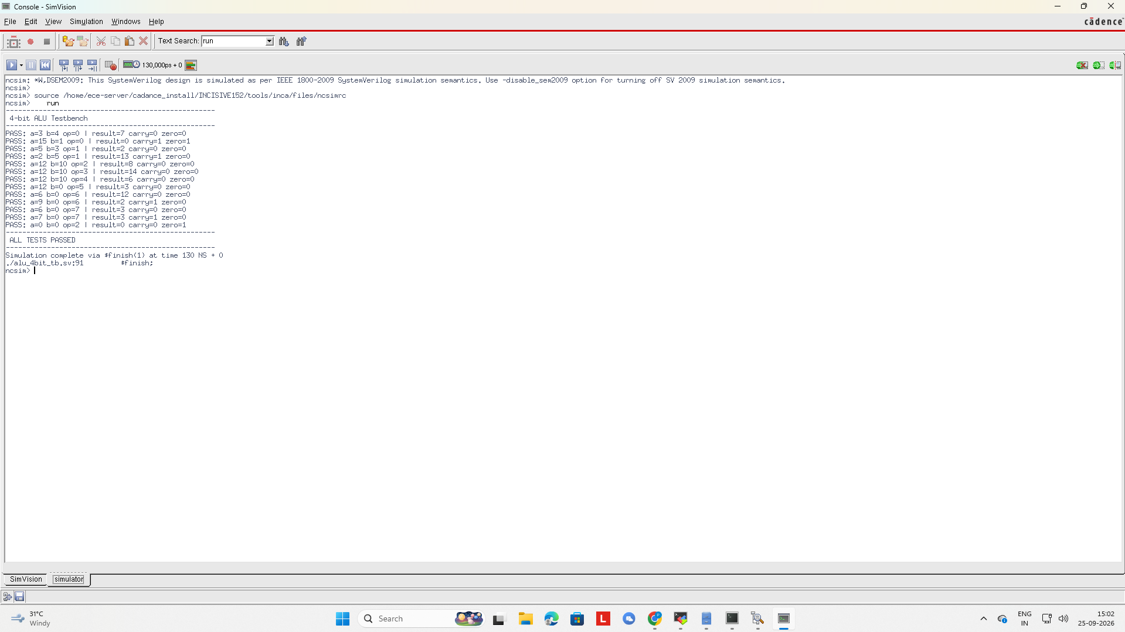
SIMULATION RESULTS
Xcelium Console Output
13 / 13
VECTORS PASSED
0
ERRORS
130 ns
SIM RUNTIME
ALL TESTS PASSED
05

Slide 6
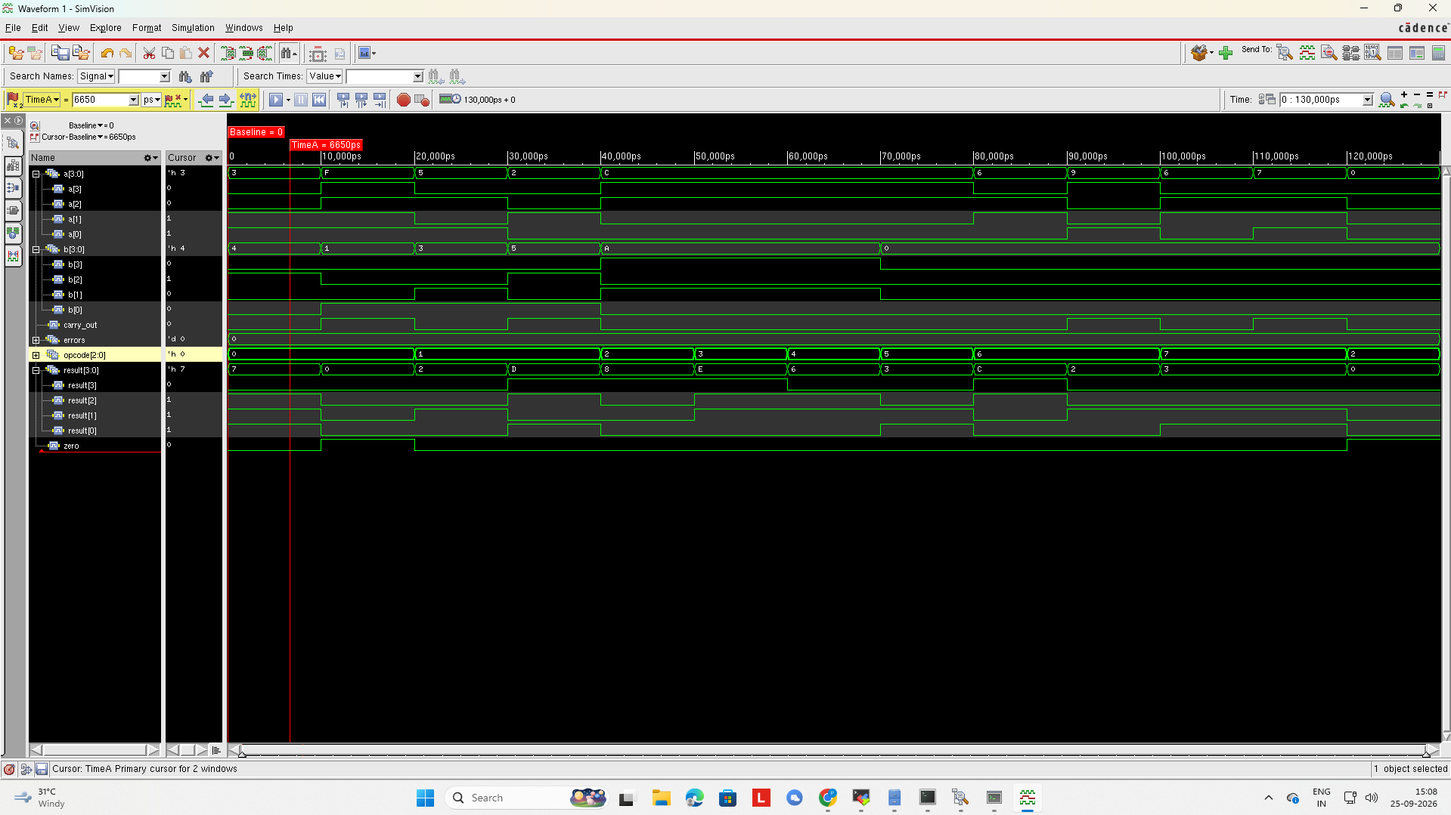
WAVEFORM ANALYSIS
SimVision Signal Trace
WHAT'S SHOWN
a[3:0], b[3:0] operands sweep across all 8 opcodes
result[3:0] bit-level breakdown alongside carry_out
errors = 0 confirms no mismatch at any timestep
zero flag stays low — no zero-result vector in this window
06

Slide 7
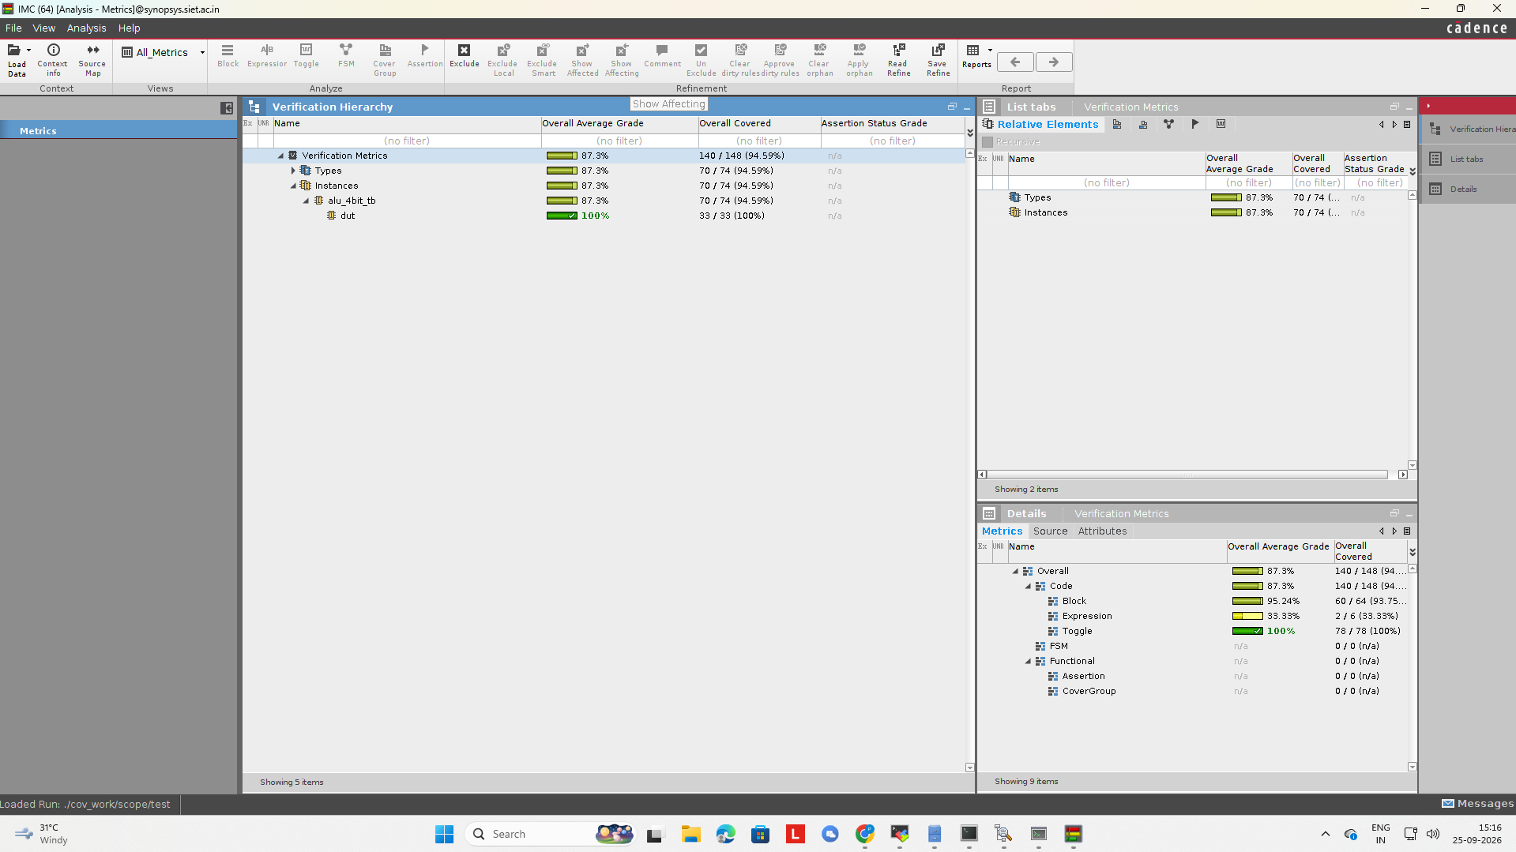
FUNCTIONAL COVERAGE
IMC Coverage Sign-off
Metric | Score
Overall | 87.3%
Block | 95.24%
Toggle | 100%
Expression | 33.33%
Toggle coverage at 100% shows every signal bit switched both directions; the lone gap is Expression coverage, expected for a case-based combinational block whose default branch is never driven.
07

Slide 8
LOGIC SYNTHESIS
Genus RTL-to-Gate Flow
read_libs
90nm lib
read_hdl
alu_4bit.sv
elaborate
syn_generic
syn_map
syn_opt
54
68
17
STANDARD CELLS
INTERNAL NETS
I/O PORTS
Netlist written to alu_4bit_netlist.v — target: 90nm standard-cell library (slow.lib)
08

Slide 9
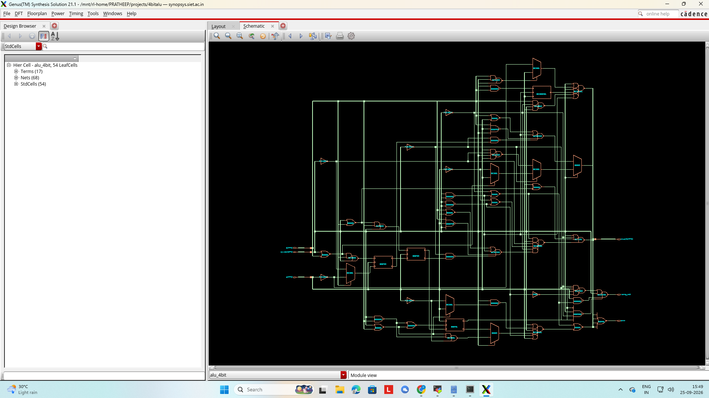
GATE-LEVEL NETLIST
Synthesized Schematic (Genus)
54
LEAF CELLS
17
TERMS
68
NETS
09

Slide 10
PPA SUMMARY
Area, Power & Timing Reports
AREA
POWER
TIMING
291.41
9.91
+6434
µm² total cell area
µW total power
ps worst slack
54 cells
leak 11% • int 57% • sw 32%
constraint MET
POWER BREAKDOWN
Critical path: opcode[0] → result logic → zero, 1566 ps data-path delay against a 10 ns virtual-clock budget — comfortable positive slack.
10

Slide 11
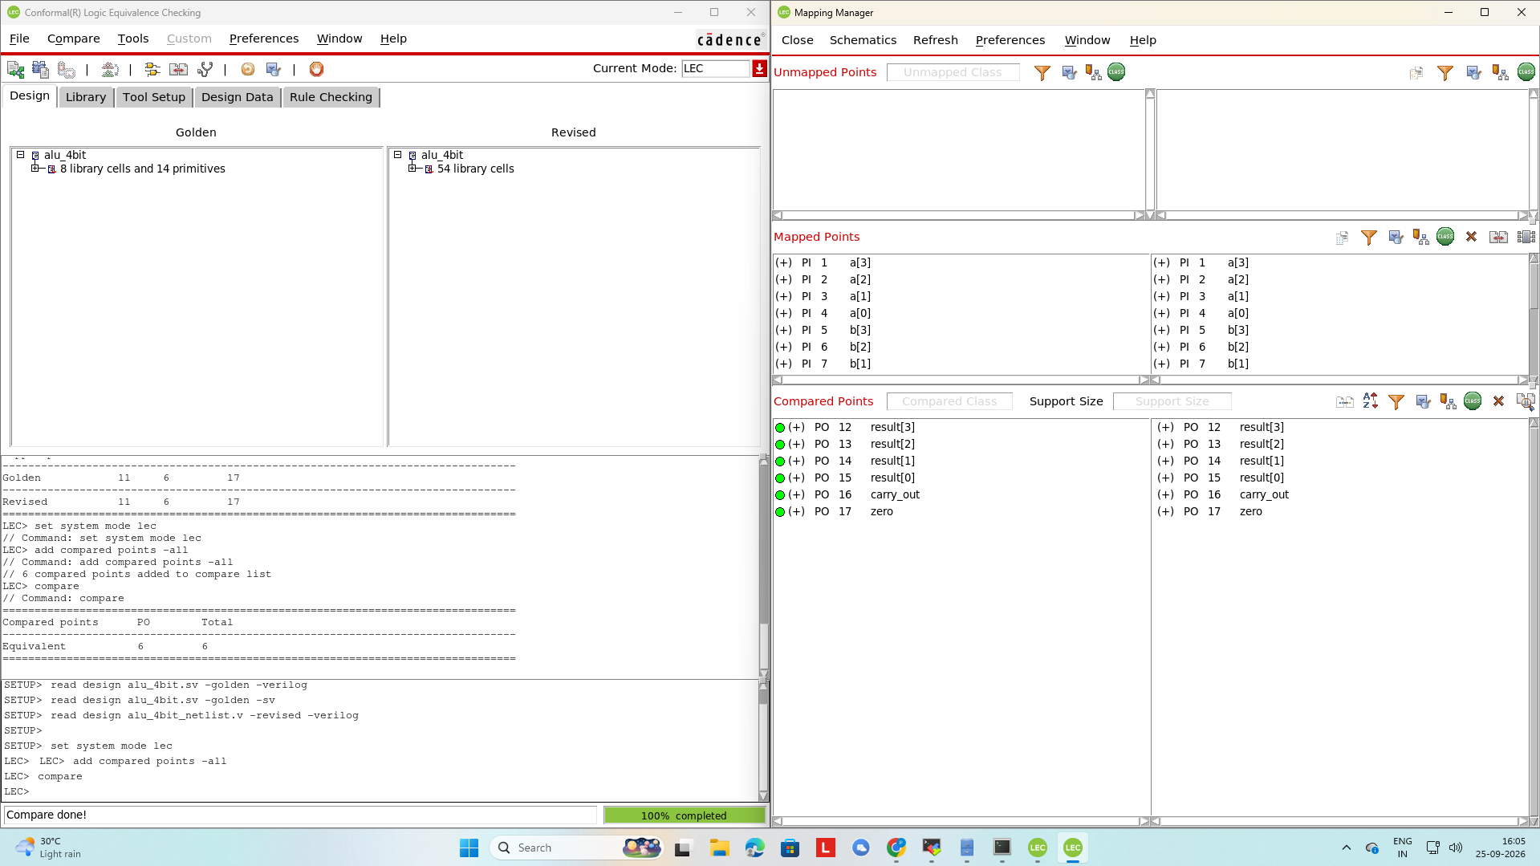
FORMAL VERIFICATION
Conformal Logic Equivalence Checking
6 / 6
OUTPUT POINTS EQUIVALENT
Golden: alu_4bit.sv (RTL) — 8 library cells, 14 primitives
Revised: alu_4bit_netlist.v — 54 synthesized cells
Compared outputs: result[3:0], carry_out, zero
Formal LEC checks equivalence exhaustively across all input combinations — a stronger guarantee than simulation coverage alone.
11

Slide 12
SUMMARY
Front-End Flow: Complete
RTL designed in SystemVerilog — 8 ALU operations, carry & zero flags
Functionally verified in Xcelium — 13 / 13 test vectors passed
Coverage signed off in IMC — 100% toggle, 95%+ block coverage
Synthesized in Genus — 54-cell netlist, timing constraint met (+6434 ps slack)
Formally verified in Conformal — RTL ≡ netlist across all 6 outputs
Next: physical design (place & route) in Innovus
Tools: Cadence Xcelium • SimVision • IMC • Genus • Conformal
12

