Slide 1

CUSTOMER SHOPPING BEHAVIOR · GROWTH STRATEGY
CUSTOMER SHOPPING
BEHAVIOR CAN BECOME
A GROWTH SYSTEM
Use 3,900 purchase records to improve engagement, loyalty, marketing efficiency, and product decisions.
DECISION BRIEF · RETAIL LEADERSHIP

Slide 2
THE BUSINESS QUESTION IS NOT WHO BUYS, BUT WHAT MAKES THEM RETURN
01
Understand the shifts
Management wants to understand shifts across demographics, categories, seasons, discounts, reviews, payments, and sales channels.
THE DECISION TO MAKE
02
Turn data into decisions
The goal is to turn fragmented transaction data into decisions that improve sales, satisfaction, and long-term loyalty.

Slide 3



THE DATA IS DECISION-READY, WITH ONE CLEAR CLEANUP PRIORITY
3,900 PURCHASES · 18 FIELDS · ONE CLEANUP PRIORITY
Purchase base
Cleanup priority
Analysis stack
3,900 purchases: 18 fields covering customers, products, fulfillment, ratings, discounts, subscriptions, and purchase frequency.
Data preparation: standardize columns, impute 37 missing review ratings by category median, engineer age groups and purchase-frequency days.
Analysis stack: Python for preparation, PostgreSQL for business queries, Power BI for stakeholder visibility.

Slide 4
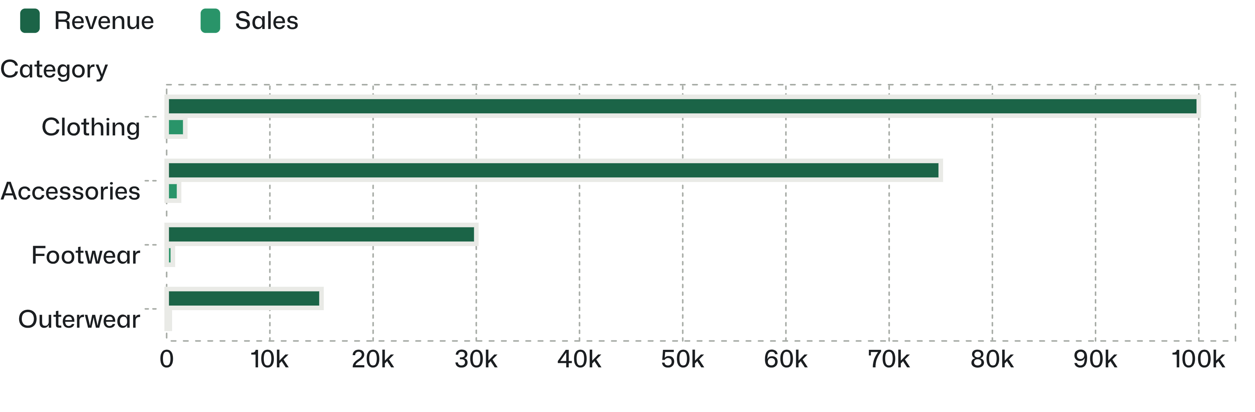
CLOTHING IS THE REVENUE ENGINE; ACCESSORIES ARE THE NEXT SCALE POOL
REVENUE AND SALES BY CATEGORY
Top-volume products: Blouse, Pants, Shirt, Jewelry, Sunglasses, Belt, Sandals, Shoes, Sneakers, Jacket, and Coat.

Slide 5
DISCOUNTS LIFT CONVERSION, BUT SOME PRODUCTS MAY BE TRAINED TO WAIT
HIGHEST EXPOSURE
Hat · 50.00%
Sneakers · 49.66%
Coat · 49.07%
PROMOTION SIGNAL
Sweater · 48.17%
839
50.00%
49.66%
Pants · 47.37%
USE TARGETED OFFERS AND MARGIN GUARDRAILS INSTEAD OF BROAD DISCOUNTING.
839 purchases were discounted and above the average purchase amount; promotions can coexist with higher baskets.
Discount exposure for Hat.
Discount exposure for Sneakers.

Slide 6
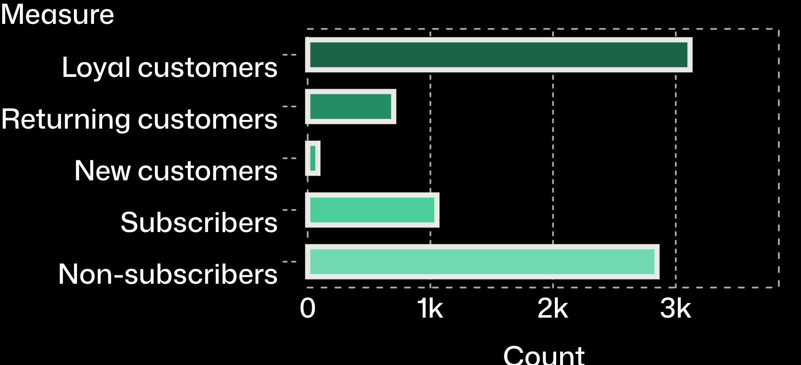
LOYALTY IS LARGE, BUT SUBSCRIPTIONS ARE UNDERDEVELOPED
Customer segments: 3,116 Loyal, 701 Returning, and 83 New.
CUSTOMER SEGMENTS AND SUBSCRIPTION STATUS
Subscriptions reach 1,053 customers, or 27%, versus 2,847 non-subscribers, or 73%.
Average spend is nearly flat between subscribers ($59.49) and non-subscribers ($59.87), so the subscription value proposition needs sharper benefits.

Slide 7
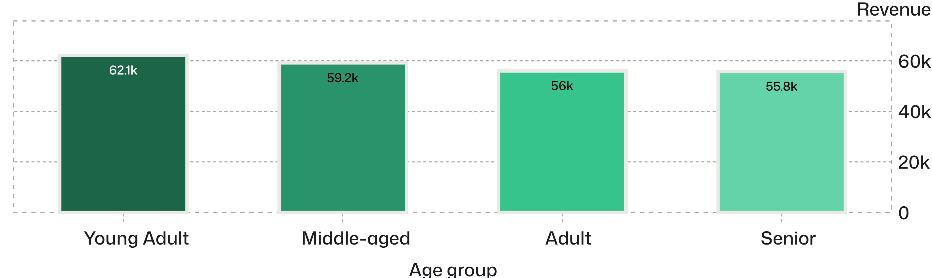
YOUNG ADULTS LEAD REVENUE, WHILE EVERY AGE GROUP CONTRIBUTES
REVENUE BY AGE GROUP
Prioritize acquisition and lifecycle campaigns for Young Adults.
Tailor creative and offers for the other groups rather than treating the market as one segment.

Slide 8
PRODUCT PROOF IS STRONGEST WHERE RATINGS AND VOLUME OVERLAP
TWO-AXIS PRODUCT PLAN
FEATURE IN CAMPAIGNS
PROTECT AVAILABILITY
3.86
High-volume staples
Feature high-rated items in campaigns; protect availability for high-volume staples.
Gloves
Top-rated products: Sandals 3.84, Boots 3.82, Hat 3.80, and Skirt 3.78.
3.75
Ratings average 3.75 overall, leaving room to improve product experience and review capture.

Slide 9
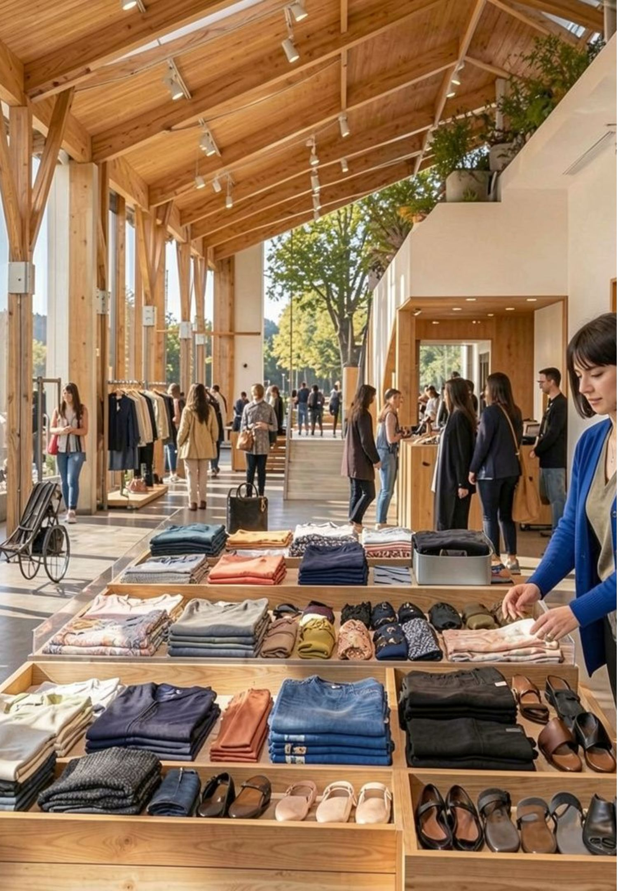
THREE MOVES CAN TURN THE ANALYSIS INTO GROWTH
01
Grow subscriptions
Package exclusive benefits, early access, and shipping value for loyal non-subscribers.
02
Protect margin
Shift from blanket discounts to product- and segment-specific offers, especially in discount-dependent categories.
03
Personalize demand
Target age groups, category affinities, and shipping preferences with tailored campaigns.

Slide 10
MEASURE THE NEXT CYCLE BY BEHAVIOR, NOT ACTIVITY
THE OPERATING SCORECARD
SUBSCRIPTION
Conversion among loyal non-subscribers
PROMOTION
Full-price share
Basket size and margin by product and segment.
Retention and incremental spend.
EXPERIENCE
Rating trend
OPERATING CADENCE
Refresh the Power BI view regularly
Review completion, repeat purchase rate, and fulfillment choice.
Use SQL segments to activate campaigns.

