Slide 1
Kubernetes basics
Presented by Pratheesh Russell

Slide 2
Kubernetes
Kubernetes (K8s) is an open-source container orchestration platform that automates the deployment, scaling, and management of containerized applications

Slide 3
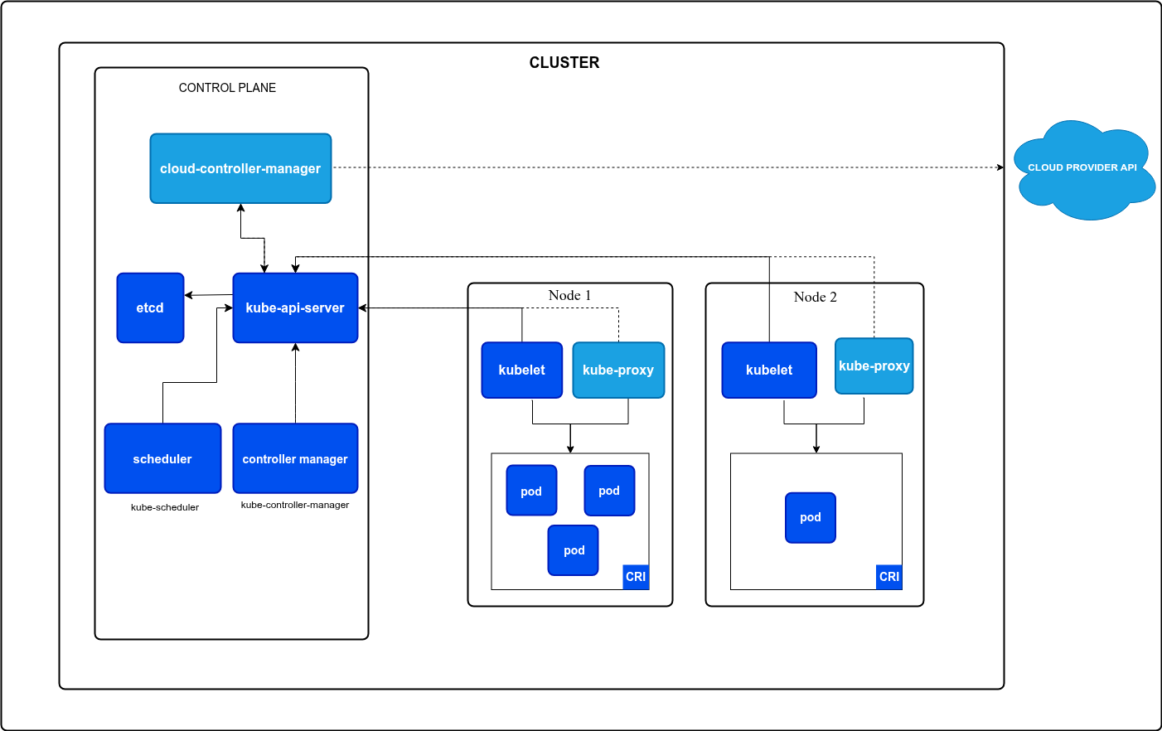
Cluster Architecture

Slide 4
Kind for local cluster setup
Kind (Kubernetes IN Docker) creates the cluster as a Docker container
Both control plane and node are created in the same container
NOTE:
Even if ports and folders are exposed to a node(like a nodeport), it won’t be exposed in our local since the node is inside a container and the container must inturn expose these ports, set it up use extraPortMappings and extraMounts

Slide 5
Kubectl context
Contexts in Kubernetes define which cluster, which user, and which namespace your kubectl commands interact with. They’re stored in your kubeconfig file (usually ~/.kube/config)
Adding to this is managed by kind (or az in case on using aks)

Slide 6
Resources
Resources can be namespaced (pods, deployments, pvc, ingress etc) or non-namespaced (pv, ingressclass, storageclass, clusterroles etc)
Custom resources can be added (percona, argocd, external secrets, sealed secrets etc)
To check the resource definition use the explain resource command

Slide 7
Workload Resources
Pod
the smallest unit in kubernetes
A host for one or more tightly coupled application containers
Not durable as they are created and destroyed easily. If a Pod dies, it is gone forever, it is not recreate itself
Replica sets
A controller that defines a Pod template and ensures a specified number of identical Pods are always running
Deployment
manages ReplicaSets and Pods
deploys/rollsback versions of your app incrementally, replacing old Pods with new ones without downtime

Slide 8
Configuration & Secrets
ConfigMaps
An object used to store non-confidential configuration data in key-value pairs
It can store Environment variables these are exposed as environment variables within a container
It can also store Configuration files (e.g., nginx.conf, properties files). Mounted as volumes inside a container
Secrets
An object used to store sensitive information
Various types are available the most common are opaque(arbitrary user-defined data like DB passwords), dockerconfigjson (store credentials for authenticating to a Docker registry) and tls (to store certificates)
Base64-encoded by default. For better security use External Secrets or sealed secrets that will create the secrets at runtime
Can be mounted as volumes or exposed as env vars like configmaps
Use configMapGenerator and secretGenerator in kustomize

Slide 9
Networking in Kubernetes
Services
Stable Network Access to Pods. A Service provides a stable IP address, DNS name, and load-balancing for a group of Pods
Common types are ClusterIP (Exposes the Service on a cluster-internal IP, only reachable inside cluster), NodePort (Exposes the Service on the IP address of each Node at a static port), LoadBalancer (Integrates with cloud provider like aks, eks)
Ingress
Acts as a reverse proxy and forwards to clusterip services. That handles the request from the nodeport/loadbalancer
Ingress Resource are a set of rules written on how to route
Ingress Controller is the actual running software that fulfills the rules set by the Ingress Resource (e.g., Nginx, Traefik, HAProxy etc). This is not added by kubernetes and should be added manually. Managed services like aks implement their own ingress controllers
IngressClass is a resource that allows you to specify which Ingress Controller should handle a specific Ingress resource

Slide 10
Storage
PersistentVolumes
A cluster resource representing a pre-provisioned storage in the cluster
Non namespaced resource
PersistentVolumeClaims
A request for storage by an app (pod)
StorageClass
Used for dynamic provisioning of PV
StorageClasses are configured to use a specific CSI driver is a standard plugin interface that allows Kubernetes to use external storage systems (cloud providers, NAS, etc.)
If a PVC has a storageclass attached and does not find a pre-made PV to bind to, the relevant CSI driver sees the claim and automatically provisions the actual storage (e.g., a new fileshare in azure) and creates the corresponding PV object to bind to the PVC

Slide 11
Jobs and Daemonsets
Job
A controller that creates one or more Pods to perform a specific task
Runs a Pod until a successful termination (exit code 0).
CronJob
A higher-level controller that manages Jobs based on a time-based schedule
Daemonset
A controller that ensures a copy of a Pod is running on all Nodes in the cluster
Used by logging agents like promtail

Slide 12
RBAC Resources
ServiceAccount: Provides an identity for processes running inside a Pod
Role: A set of rules that define permissions, what actions are allowed on which resources. Allow access within namespace
RoleBinding: Binds Role to ServiceAccount
ClusterRole: Same as roles but cluster wide
ClusterRoleBinding: Same as role binding but clusterwide

Slide 13
Other resources
There are a lot of other resources
You can list the available resources with the command
kubectl api-resources -o wide

Slide 14
Operators
Operators use Custom Resource Definitions (CRDs) to create new object types (e.g., Percona operator). Operators are designed for applications (stateful apps) with intricate lifecycles, such as databases (e.g., PostgreSQL)

Slide 15
Organizing with Kustomize
Kustomize is a configuration management tool built into kubectl
configMapGenerator/SecretGenerator to build config and secrets from literals/files
Helps separate base (common manifests) and overlays (env-specific configs)
Patches: modify replicas, images, ingress, etc. specifically for different env
Each folder has a kustomization.yaml that acts as an index and defines the resources in the folder that are added or patched

Slide 16
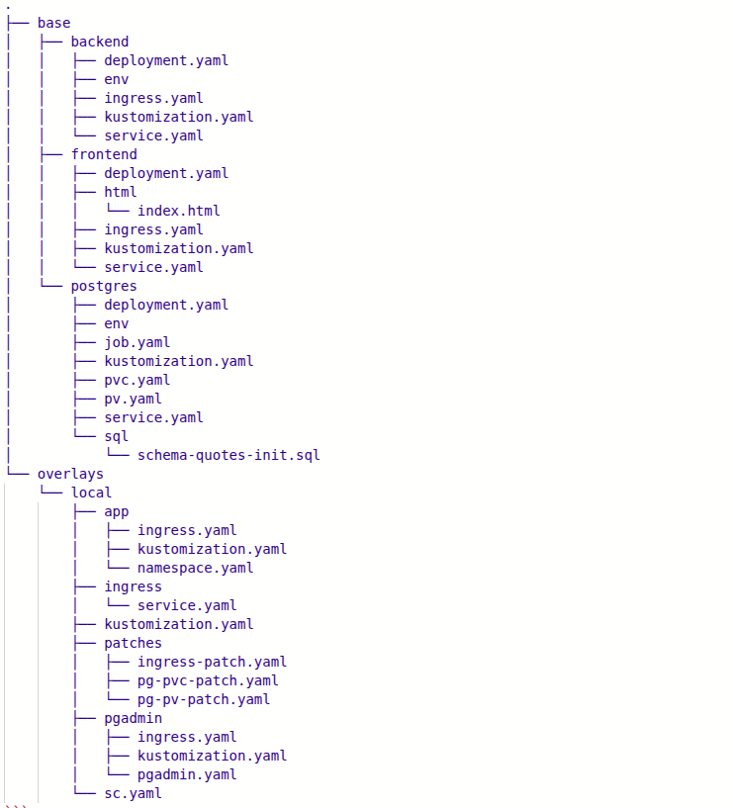
Base overlay pattern
Consider that, we want to deploy applications to Kubernetes and there are multiple environments i.e. dev, uat, prod etc and in each environment, the deployment configurations are different. The simple solution to this problem is to create three separate directories, one for each environment, and add all the Kubernetes manifest in respective folders but it is not a scalable solution
With Kustomize we can reuse the base files (common YAMLs) across all environments and overlay (patches) specifications for each of those environments

Slide 17
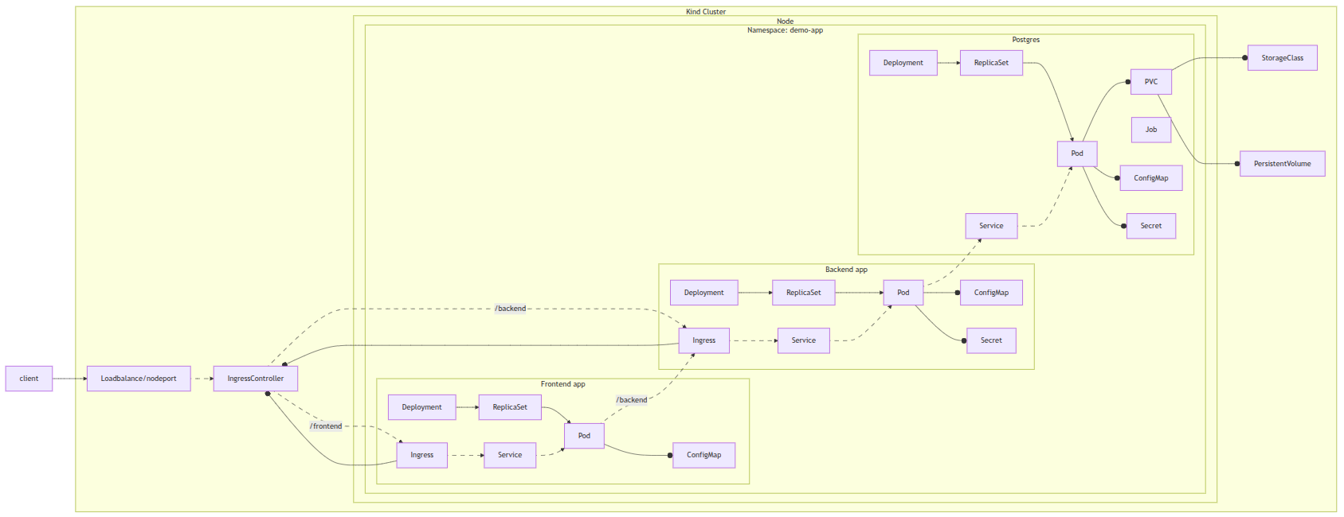
Demo app

Slide 18
Patches
Patches are used for Env specific tweaks
The patches file uses the JSON Pointer syntax, which lets you surgically add, replace, or delete specific parts of your YAML using exact paths
Commonly used ops: add, replace, remove

Slide 19
Debugging 101
Check if pod status using get command
Check logs - if pods are restarting use –previous option
Check events
Describe resources
Exec into containers if needed
Use temporary debug pods to connect and check DB

