Slide 1
GitOps basics with ArgoCD
Presented by Pratheesh Russell

Slide 2
Gitops
A DevOps approach that uses Git as the single source of truth for declarative infrastructure and application management

Slide 3
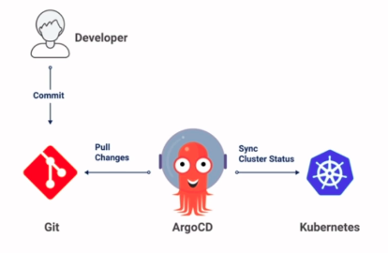
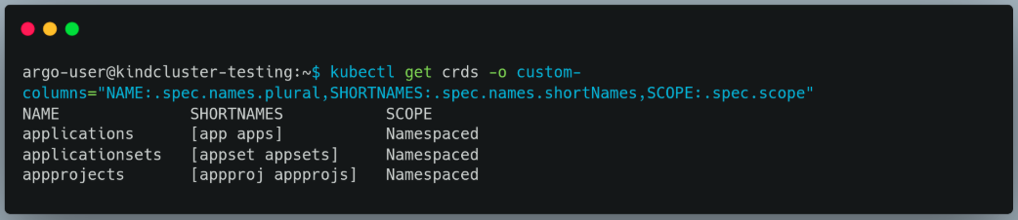
ArgoCD
A pull based GitOps CD tool for kubernetes
Will be added as a CRD in the cluster

Slide 4
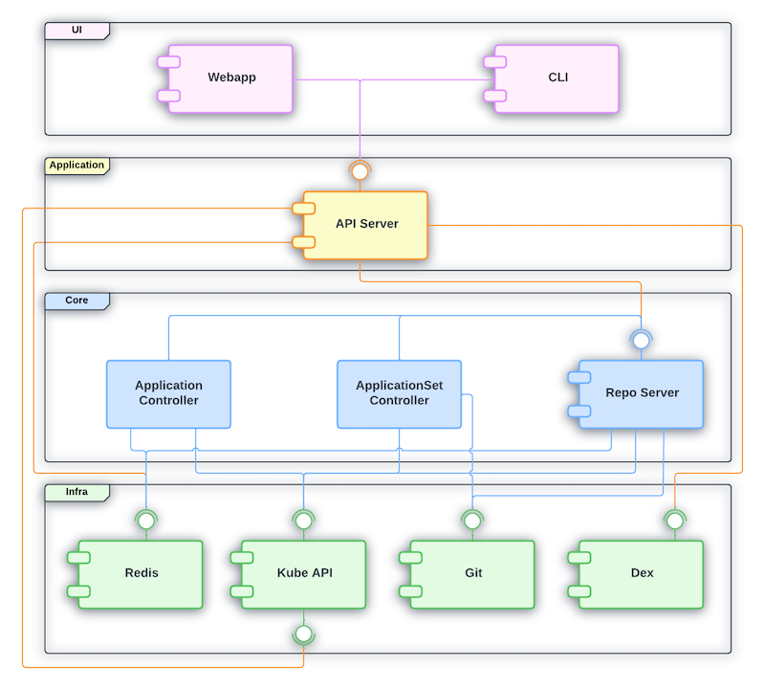
Architecture
Api server: exposes api that allows UI, CLI to interact via REST, GRPC
Repo Server: Interacts with git repo and generates configs
Application Controller: reconciles the Application resource in Kubernetes
ApplicationSet Controller: reconciles the Application set resource in Kubernetes

Slide 5
Setup
Install the crd
Portforward/setup ingress
kubectl port-forward svc/argocd-server 9010:443 --namespace=argocd
Find admin password (username is admin)
kubectl get secrets argocd-initial-admin-secret -o yaml -n argocd
decode base64 password

Slide 6
Application
Can be created from yaml, web ui, cli
Supports kustomize, helm and plain kubernetes yaml to create resources
It is possible to specify tool to be used if not
It detects as kustomize if kustomization yaml is found
It detects as helm id charts yaml is found
Otherwise considers as plain kubernetes config file

Slide 7
Kustomize options
Argocd allows to specify various options related to kustomize
Name prefix: added to all resources
Name suffix
patches
Images: to override images
Version: to set kustomize version
NOTE: not all options are available when created from UI
List of available options can be found here https://argo-cd.readthedocs.io/en/stable/user-guide/kustomize/

Slide 8
Project
A group of applications
An application can not exist out of a project. If not specified the default project created by argocd will be used
Allows to set user access restriction, cluster restriction, repo restriction etc
Can be created with yaml, cli, web ui

Slide 9
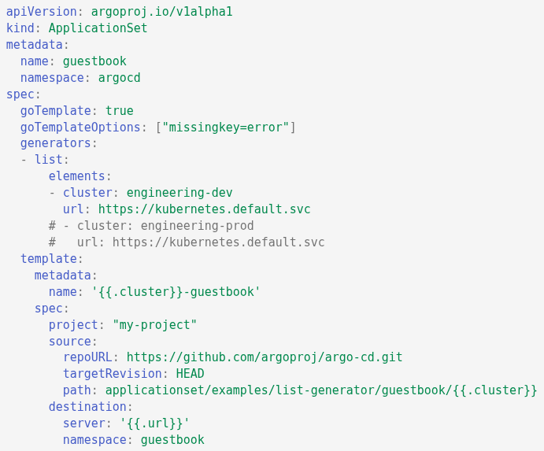
Application sets
It manages create/update/delete of applications in argocd
Used to deploy a kubernetes config in multiple clusters
Defines templates for applications and use generators to fill in template variables
Various types of generators are available (Read here)

Slide 10
Repos
Track by commit sha, tags, branch

Slide 11
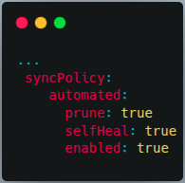
Sync policy
Sync is making actual state = desired state
Refresh compares the state (done every 3 mins)
Sync can be done automatically but if auto sync is enabled, rollback cannot be performed.
Auto pruning can be enabled to delete unused resources after autosync
If Self heal is enabled then argocd corrects manual updates to the cluster as well

Slide 12
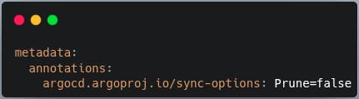
Sync Options
Further controls on sync can be done using spec.syncPolicy.syncOptions
Some of these can also be managed at resource level by adding annotations
For example we can prevent sync settings like pruning in a particular resource
All sync options can be found here https://argo-cd.readthedocs.io/en/latest/user-guide/sync-options/

Slide 13
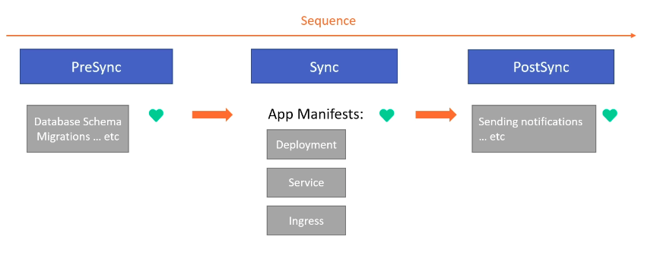
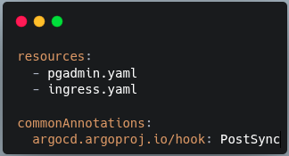
Sync phases
To deploy a resource in a particular step use annotation argocd.argoproj.io/hook
For example to setup pgadmin at end use PostSync
More details can be found in the following link
https://argo-cd.readthedocs.io/en/stable/user-guide/sync-waves/

Slide 14
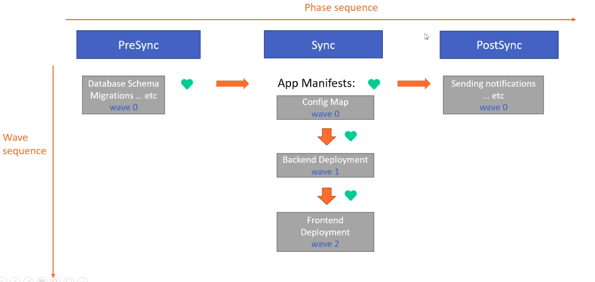
Sync Waves
NOTE: check the migration job resource provided with the demo app to see how this is setup

Slide 15
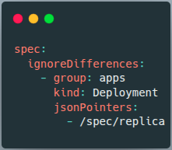
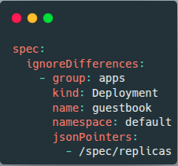
Ignoring Diffing updates
Argo CD allows you to optionally ignore differences of problematic resources.
READ https://argo-cd.readthedocs.io/en/stable/user-guide/diffing/

Slide 16
App of apps
Argo apps are are kubernetes resources themselves. Add multiple apps to a git folder and create a root app that points to this folder.
Whenever a new app is added to this folder, argocd will sync the new app

Slide 17
Kubectl commands
Get apps
kubectl get app -n argocd
Remove finalizers

