Slide 1
Web Vitals
Pratheesh Russell S

Slide 2
Note:
Throughout this training session, I will be using Google Lighthouse to demonstrate the various webvital metrics.
Turn off chrome extensions or run Lighthouse in incognito (or via command line) to avoid unwanted script injections.
Turn off antivirus if any before running Lighthouse
By Lighthouse I mean Lighthouse version 9. Metrics and weightage may vary for other versions.
Some webvital metrics are dependant on viewport (LCP, CLS, SI). Take care where you dock the webtools panel.
I have changed the throttling setting to DevTools Throttling (this is required only for the demo and not otherwise)
Refer the following link for details
https://github.com/pratheeshrussell/webvitals-testing/blob/main/doc/lighthouse_setting.png

Slide 3
Lab data vs Field data
Lab data is performance data collected within a controlled environment with predefined device and network settings, while Field data is performance data collected from real page loads experienced by your users in the wild.
Lab Data is collected using tools like LightHouse
Field data (aka Real User Monitoring) is obtained from Chrome User Experience Report (CrUX) report (basically data recorded from real browsers)
Ref: https://web.dev/how-to-measure-speed/#lab-data-vs-field-data

Slide 4
Core WebVitals
The 3 core web vitals are determined based on 3 major aspects of user experience (Loading,Visual Stability,Interactivity)
Largest Contentful Paint (LCP)
Cumulative Layout Shift (CLS)
First Input Delay (FID)
Equivalent Lab Data: Total Blocking Time

Slide 5
Largest Contentful Paint (LCP)
This is a core webvital that can be measured directly in Lighthouse.
The Largest Contentful Paint metric reports the render time of the largest image or text block visible within the viewport, relative to when the page first started loading.
LCP accounts for 25% of overall score in Lighthouse(ver 9).
Warning: In the document it has been mentioned that any value below 2.5s is good and anything over 4s is bad, this is for version 5. Lighthouse version 9 scores LCP differently, ie., anything below 1.2s is good and over 2.4s is bad (Compare with 2.5s - mentioned in doc :) )
Check: Lighthouse scoring calculator
Ref: https://web.dev/lcp/

Slide 6
Largest Contentful Paint (LCP)
Elements considered for LCP
<img> elements
<image> elements inside an <svg> element
<video> elements (the poster image is used)
An element with a background image loaded via the url() function (as opposed to a CSS gradient)
Block-level elements containing text nodes or other inline-level text elements children.
We can use a performanceObserver to get the value programmatically (check demo).
Ref: https://web.dev/lcp/

Slide 7
Optimize LCP
Preload Lcp resources
<link rel="preload" href="/styles/other.css" as="style">
<link rel="preload" as="image" href="important.png">
Increase fetch priority
<img fetchpriority="high" src="/path/to/hero-image.webp">
Defer non critical css/js (inline supercritical ones)
Refer: https://web.dev/optimize-lcp/

Slide 8
LCP-Demo
Notice how the metric is dependent on viewport

Slide 9
Cumulative Layout Shift (CLS)
This is a core webvital that can be measured directly in Lighthouse.
It is the measure of the largest layout shift that occurs during page load.
CLS accounts for 15% of overall score in Lighthouse(ver 9).
Anything below 0.1 is good and over 0.25 is bad.
Calculated based on 2 parameter impact fraction and distance fraction. (Refer Demo for details)
We can use a performanceObserver to get the value programmatically (check demo).

Slide 10
Optimize CLS
Add dimensions to images
<img src="puppy.jpg" width="640" height="360" alt="Puppy with balloons" />
Add placeholders to content that load later
Avoid inserting new content above existing content, unless in response to a user interaction. This ensures any layout shifts that occur are expected
Refer: https://web.dev/optimize-cls/

Slide 11
First Input Delay (FID)
FID is a core webvital that can not be measured directly in Lighthouse.
FID measures the time from when a user first interacts with a page (i.e. when they click a link, tap on a button, or use a custom, JavaScript-powered control) to the time when the browser is actually able to begin processing event handlers in response to that interaction.
Anything below 100ms is considered good and over 300ms is bad.
NOTE: Since FID requires field data and thus cannot be measured in the lab. The Total Blocking Time (TBT) which is lab-measurable, correlates well with FID in the field, and also captures issues that affect interactivity. Optimizations that improve TBT in the lab should also improve FID.

Slide 12
Total Blocking Time (TBT)
TBT is the lab equivalent of FID
We will get back to TBT once we understand FCP and TTI

Slide 13
First Contentful Paint (FCP)
FCP is not a core web vital - however, it is used to calculate TBT which is a lab equivalent to FID.
The First Contentful Paint (FCP) metric measures the time from when the page starts loading to when any part of the page's content(independent of viewport) is rendered on the screen.
FCP accounts for 10% of overall score in Lighthouse(ver 9).
Warning: In the document it has been mentioned that any value below 1.8s is good and anything over 3s is bad, this maybe for a previous version. Lighthouse version 9 scores FCP differently, ie., anything below 950 ms is good and over 1600 ms is bad.
Check: Lighthouse scoring calculator
Note: We can use a performanceObserver to get the value programmatically (check demo).

Slide 14
Time to Interactive (TTI)
TTI is not a core web vital - however, it is used to calculate TBT which is a lab equivalent to FID.
TTI measures how long it takes a page to become fully interactive. TTI is a point when the last Long Task(greater than 50ms) finishes and is followed by 5 seconds of inactivity on the main thread.(Refer Demo)
TTI accounts for 10% of overall score in Lighthouse(ver 9).
Warning: In the web.dev document it has been mentioned that any value below 3.8s is good and anything over 7.3s is bad, this seems to be for version 5. Lighthouse version 9 scores TTI differently, ie., anything below 2468 ms is good and over 4500 ms is bad.
Check: Lighthouse scoring calculator

Slide 15
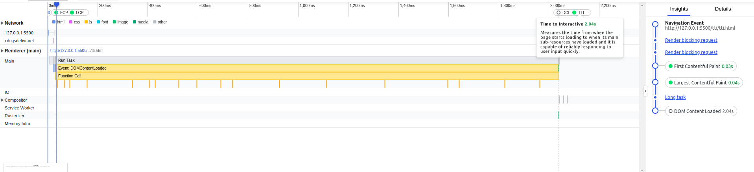
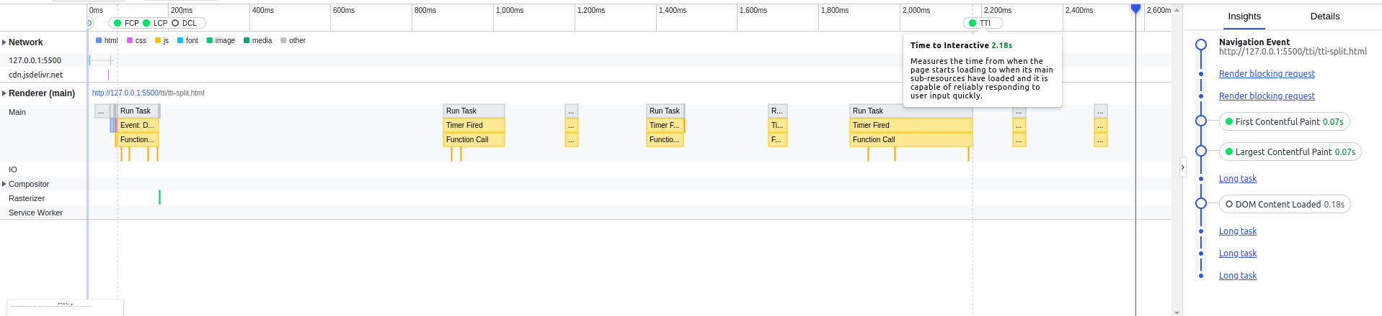
Understanding TTI

Slide 16
Understanding TTI
In both the case seen in the previous slides the TTI should be almost the same, although the tasks in case 2 were not continuous, as in case 1, and the page would have been interactive.
You can also notice that there were smaller tasks that run after TTI within the 5second delay but are not considered.
Note: if a tasks starts after a delay of 5s, it will not contribute to TTI (or TBT as we will see in the next topic)

Slide 17
Total Blocking Time (TBT)
TBT is not a core web vital - however, it is a lab replacement for FID
TBT measures the total amount of time that a page is blocked from responding to user input, such as mouse clicks, screen taps, or keyboard presses from FCP to TTI.
TBT sums up the blocking time for all long tasks that occur between FCP and TTI.
Any task that executes for more than 50 ms is a long task.
The amount of time after 50 ms is the blocking time.
TBT accounts for 30% of overall score in Lighthouse(ver 9).
As per Lighthouse version 9 a TBT value below 150 ms is good and over 350 ms is bad.

Slide 18
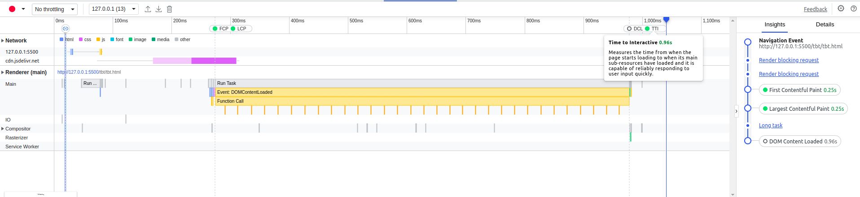
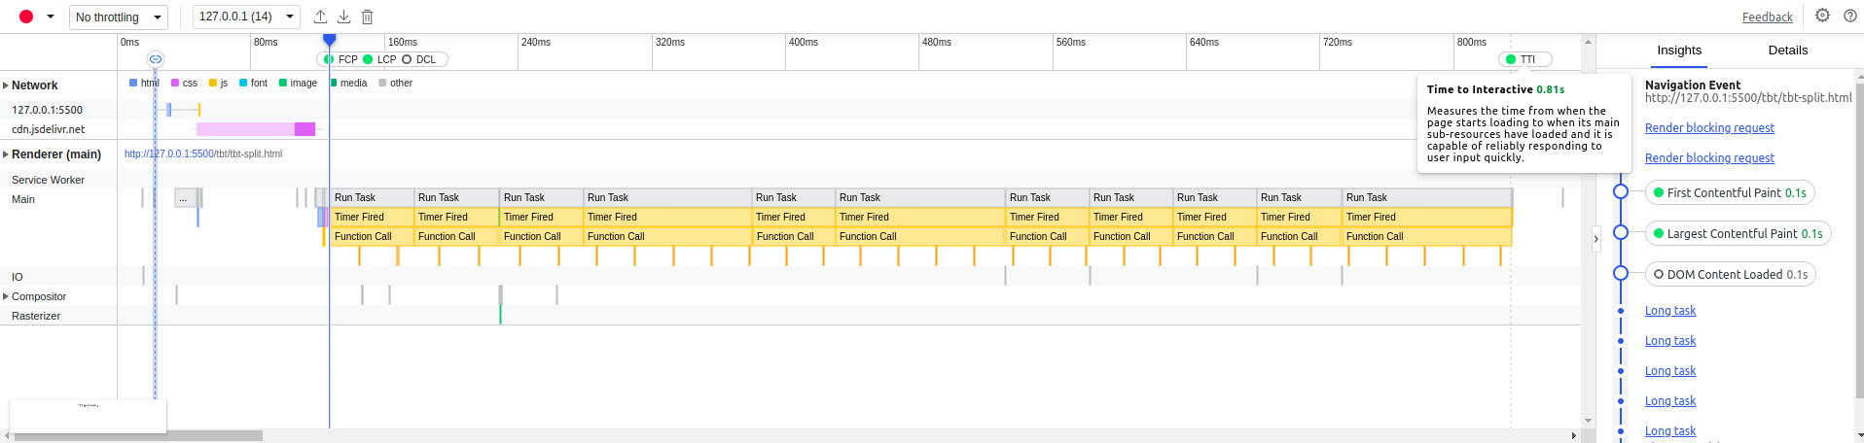
Understanding TBT

Slide 19
Understanding TBT
In both the cases seen in previous slide the difference between FCP and TTI is almost the same. However, the way the tasks are executed are different, in case 1 the task is continuous however in case 2, multiple smaller tasks are executed and hence the TBT will be low.
Note: if a tasks starts after a delay of 5s, it will not contribute to TBT. Since TBT considers tasks between FCP and TTI, and tasks with a delay of 5s won’t be taken into account for TTI it won’t be considered for TBT as well.

Slide 20
Speed Index (SI)
SI is not a core web vital - however it is tracked by Lighthouse
On a high level, Lighthouse first captures a video of the page loading in the browser and computes the visual progression between frames. Lighthouse then uses the Speedline Node.js module to generate the Speed Index score.
SI accounts for 10% of overall score in Lighthouse(ver 9).
As per Lighthouse version 9 a SI value below 1.3s is good and over 2.3s is bad.

Slide 21
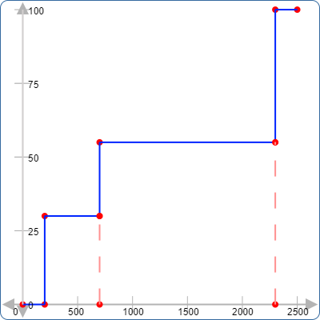
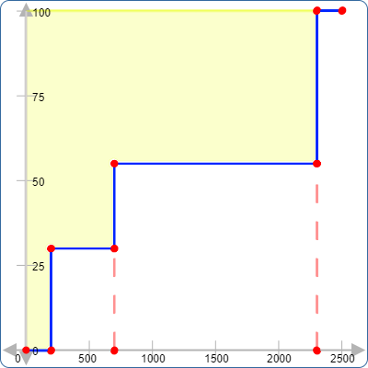
Speed Index
It plots the %loaded(Y) with respect to time(X) and calculates the area above the curve to find the SI.
Refer: https://github.com/WPO-Foundation/webpagetest-docs/blob/main/src/metrics/SpeedIndex.md

Slide 22
Other Webvitals
Time to First Byte* (TTFB)
Interaction To Next Paint* (INP)
Time to last byte
Time to title
Time to start render
DNS lookup time
Connection time
Overall weight
Overall asset count
Error rate
Bounce rate
Top pages
Conversion rate
Refer - https://www.keycdn.com/blog/website-performance-metrics

Slide 23
Thank you

Slide 24
Running the Demo
Getting the code
Go to https://github.com/pratheeshrussell/webvitals-testing
Add a star to the repo
Clone or download as zip
Running it
Start the back end.
In web-vital-api folder run npm install and npm run start
Run the relevant files from web-vital-fe folder with something like live server.
NOTE: The frontend assumes the backend is always listening on port 3000

Slide 25
Check out later
https://github.com/GoogleChrome/web-vitals

