Slide 1
Forecasting Tesla Stock Performance through Machine Learning Analysis

Slide 2





Introduction
Welcome to the analysis of Tesla stock performance using machine learning. This presentation will explore the potential of
in forecasting stock trends. We will delve into the
and evaluate the of our predictions.

Slide 3






Data Preprocessing
Quality data is crucial for accurate predictions. We will discuss
, , and
techniques to ensure the reliability of our models.

Slide 4
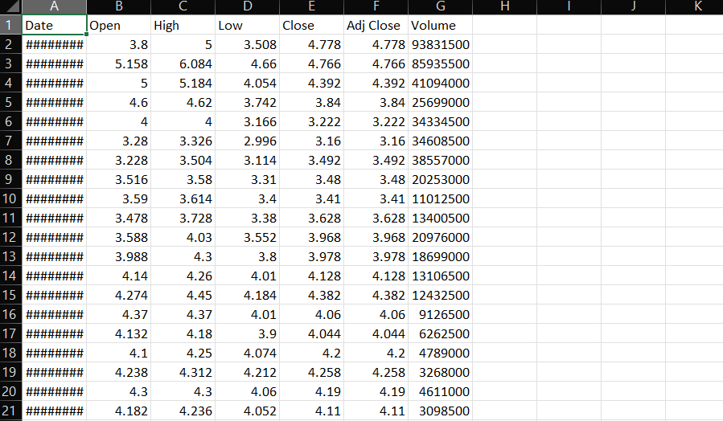
Dataset is TSLA:
The TSLA dataset could refer to a variety of data sources for the electric vehicle and clean energy company Tesla, Inc. This may include historical stock price, trading volume, and analyst estimates as a publicly-traded company. It could also contain vehicle production and delivery numbers across Tesla's different models like Model S, 3, X and Y. Technical specifications on battery sizes, range, acceleration and other vehicle configurations may be captured. The dataset might detail Tesla's expansive supercharger network for charging its EVs. Safety ratings and crash test results for Tesla vehicles could be included as well. Customer feedback, survey data, and sentiment analysis on Tesla's products and services provide another potential data source

Slide 5






Machine Learning Models
Utilizing and
, we aim to develop robust models for predicting Tesla stock performance. We will explore the use of and
algorithms for accurate
forecasting.

Slide 6





Model Evaluation
We will assess the performance of our
models using such as and
, ,
. The evaluation process will
provide insights into the and of our forecasts.

Slide 7
Our analysis will reveal the for Tesla stock performance. We will compare the forecasts with actual data to gauge the of our machine learning models.

Slide 8

Conclusion
In conclusion, our analysis demonstrates the potential of machine learning in
. The insights gained from this study can aid investors in making
regarding Tesla stock.

Slide 9
Thanks!

