Slide 1

MANGALORE UNIVERSITY
“Chatbot for college enquiry in Kannada”
Presented By
Prathibha Bharathi S D
Register No:201021387124
Under the Guidance
Dr. H.L. Shashirekha
Chairperson Department of Computer science
Department of Post-Graduate Studies and Research in Computer Science,
Mangalore University,
Mangalagangotri-574 199
April 2022

Slide 2
Outline
INTRODUCTION
PROBLEM STATEMENT
MOTIVATION
APPLICATIONS
CHALLENGES
OBJECTIVES
LITERATURE SURVEY
METHODOLOGY
LOGIC ADAPTER
RESULTS
CONCLUSION AND FUTURE WORK
REFERENCES

Slide 3
INTRODUCTION
A chatbot is a software application used to conduct an online chat conversation via text or text-to-speech, in lieu of providing direct contact with a live human agent.
Bots can be created by using language like Artificial Intelligence Mark-up Language (AIML), a language based on HTML that allow developers write rules for the bot to follow.
The chatbot has been designed to provide students feel like talking to the staff from college and their queries are addressed through the conversational text. Responses can be provided to the user in text format, pictures and with many more features provided by the chat fuel.
There are many types of chatbots like menu based , rule based , Keyword recognition-based chatbots , Voice bots etc.
In this project menu based chatbot is used to find the answers for the students or users queries.
In this project Logic Adapter is used to the select the response to a given input statement.

Slide 4
Problem Statement
Chatbot for college enquiry system has been created utilizing artificial intelligence algorithms that examine the user queries
Artificial intelligence chatbot is a technology that makes interactions between man and machines using natural language possible
This chatbot system is an internet application that gives an answer to the broken-down queries of a user. Users simply need to choose the classification for inquiries.
The system answers to users' queries with the assistance of effective Graphical User Interface (GUI).

Slide 5
MOTIVATION
As students, we have a tendency to gain more of knowledge concerning our school, college and university throughout our course. This is where we thought of using an intelligent bot delivering this information. Think about an application, where all you have to do is just ask. there is no need of doing a lengthy and hectic procedure. The aim of this project is to contribute to the solution of the problem of direct communication between applicants and the university.

Slide 6
APPLICATIONS
These are the computer program you can talk to through messaging apps, chat windows, or voice calling apps.
college enquiry chatbots help students to the right sources of information
Logic adapters determine the logic for how Chatterbot selects a response to a given input statement.
The logic adapter that your bot uses can be specified by setting the (logic_adapters) parameter to the import
path of the logic adapter you want to use.

Slide 7
CHALLENGES
One of the biggest challenges with using chatbots in customer support comes with interpreting the messages and understanding the user intention.
Chatbots Don’t Understand Human Context.
They Can’t Make Decisions.
Chatbots can't answer all the queries and hence it can be seen as lacking personal touch.
Different chatbots require different installation procedures and hence increases initial installation cost unlike human beings.
Chatbots Have the Same Answer for a Query.

Slide 8
OBJECTIVES
The aim of this project is to contribute to the solution of the problem of direct communication between applicants and the university.
To develop a graphical user interface which aims to give the ability to potential students and their families to submit questions in a chatbot and get convincing replies.
Applying machine learning approach for the best matching response.
Making application to produce best response within less time.

Slide 9
LITERATURE SURVEY
It all started in 1950 with the ‘Turing Test’ by Alan Turing; an English computer scientist in his article “Computer Machinery and
Intelligence” proposed a question “Can Machine Think?” He theorized that a real intelligent machine would be indistinguishable
from a human during the text only conversation. The test was a way to measure whether one was interacting to the human or a
chatbot. This idea has laid some foundations for the evolution of chatbot.
In 1996, Joseph Weizenbaum created one of the first chatbot named ‘ELIZA’. This chatbot was quite intelligent in making the
conversation but failed to pass Turing Test. However, ELIZA has laid a platform towards building the structured chatbots.
In 1972, Kenneth Colby built PARRY to simulate a person who suffered with paranoid schizophrenia. In a test undertaken by the
psychiatrists, only 48% were able to find out the difference between PARRY and a real human being. JABBERWACKY developed
in early 1980s came live in 1997. This was a chatbot designed to simulate the natural human chat in a humorous or entertaining
manner.
A.L.I.C.E. (Artificial Linguistic Internet Computer Entity) came in 1995 which was a Natural Language Processing bot. She was
rewarded as the most advanced bot of her time though she failed to pass the Turing test.She could apply the heuristic pattern matching
rules to the inputs provided by humans in order to make conversation with them.

Slide 10
Fig. 1. General model of Chatbot system

Slide 11
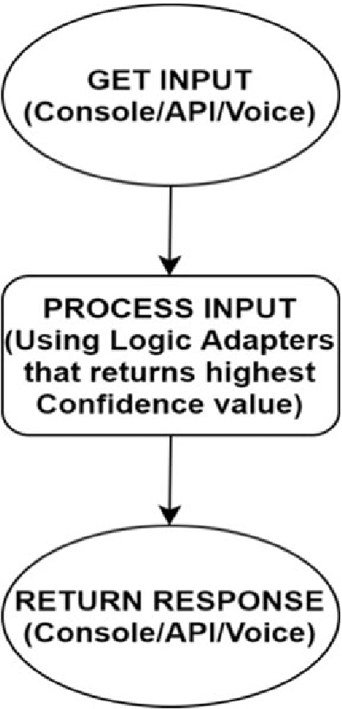
Fig 2. Flow chart of the proposed model

Slide 12
METHODOLOGY
A set of methods, practices, processes, procedures and standards is called a
methodology. Chatbot responds to the user by greeting him/her and then asks user to
provide his/her name. Then the user finds the buttons in the UI which corresponds
to the different categories of the college.
In this project, we have predefined questions and answers as dataset.
The utilization of logic adapters to choose a response is another algorithm used
for chatbot applications. The aim of an input adapter is to get input from bot source,
and then convert it into a format that makes chatbot understand.

Slide 13
The chatbot system uses a special logic adapter that allows to pick the fitting response from all the responses. The Multi Logic Adapter is used to choose a single response from the responses returned by all of the logic adapters that the chat bot has been configured to use.
A typical logic adapter designed to return a response to an input statement will use two main steps to do this. The first step involves searching the database for a known statement that matches or closely matches the input statement. Once a match is selected, the second step involves selecting a known response to the selected match. Frequently, there will be a number of existing statements that are responses to the known match.

Slide 14
Pre-processing of information is done by word embedding. Here each word is mapped to a vector and the vector structure is spoken to in one-hot encoded structure which implies 1 represents the presence of word and 0 for everything else.
Natural Language Toolkit (NLTK) is a python library which offers assistance for Natural Language Processing (NLP). NLTK has inbuilt tokenizers. The NLTK incorporates a wide scope of tokenizers which are as per the following norm, letters, path, words, keywords, class, N-gram, pattern and so on. The most usually utilized tokenizer is the word-punkt tokenizer which parts the sentences at the blank spaces.

Slide 15
LOGIC ADAPTER
The logic adapter that your bot uses can be specified by setting the logic_adapters parameter to the import path of the logic adapter you want to use.
It is possible to enter any number of logic adapters for your bot to use. If multiple adapters are used, then the bot will return the response with the highest calculated confidence value. If multiple adapters return the same confidence, then the adapter that is entered into the list first will take priority.
chatbot = Chatbot(
"My Chatterbot",
logic_adapters=[
"chatterbot.logic.BestMatch"
]
)

Slide 16
ChatterBot is a Python library that makes it easy to generate automated responses to a user’s input. ChatterBot uses a selection of machine learning algorithms to produce different types of responses.
Chatterbot comes with several built-in preprocessors.
chatterbot.preprocessors.clean_whitespace(statement)[source]
Remove any consecutive whitespace characters from the statement text.
chatterbot.preprocessors.unescape_html(statement)[source]
Convert escaped html characters into unescaped html characters.
chatterbot.preprocessors.convert_to_ascii(statement)[source]
Converts Unicode characters to ASCII character equivalents.

Slide 17
ChatterBot includes tools that help simplify the process of training a chat bot instance. ChatterBot’s training process involves loading example dialog into the chat bot’s database. This either creates or builds upon the graph data structure that represents the sets of known statements and responses.
Several training classes come built-in with ChatterBot. These utilities range from allowing you to update the chat bot’s database knowledge graph based on a list of statements representing a conversation, to tools that allow you to train your bot based on a corpus of pre-loaded training data.
The ListTrainer function is used to train our chatbot. we are passing a conversation to the train function, on which our chatbot will be trained.
from chatbot import chatbot
from chatterbot.trainers import ListTrainer
trainer = ListTrainer(chatbot)
trainer.train([
"Hi there!",
"Hello",
])
trainer.train([
"Greetings!",
"Hello",
])

Slide 18
Python offers multiple options for developing GUI (Graphical User Interface). Out of all the GUI methods.
Tkinter is a standard library in python used for creating Graphical User Interface (GUI) for Desktop Applications.
Tkinter standard widget attributes
Tkinter widget state.
Tkinter widget padding. The padx and pady attributes add extra horizontal and vertical space to the widgets.
Tkinter widget padding. The padx and pady attributes add extra horizontal and vertical space to the widgets.
Width and height
Tkinter fonts

Slide 19
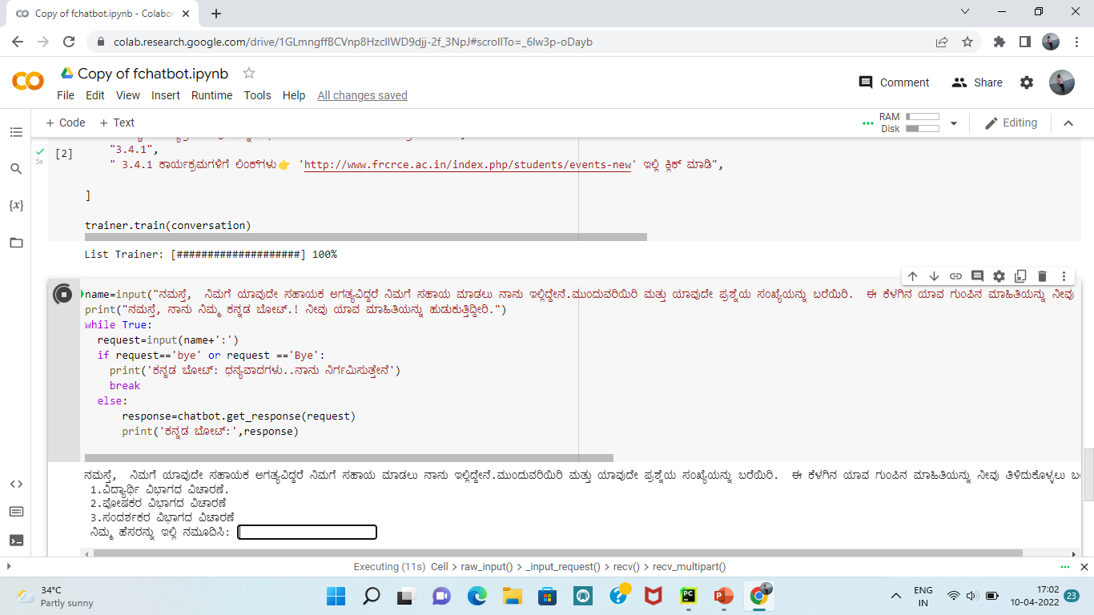
RESULT

Slide 20
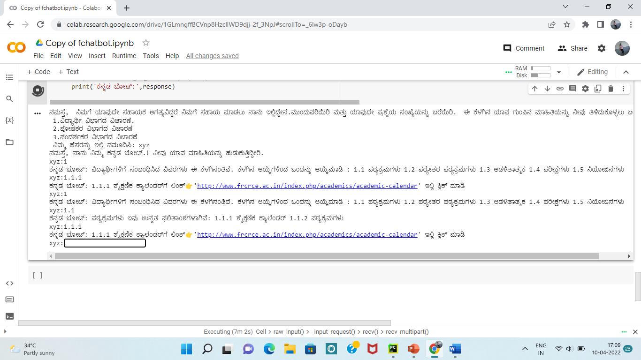

Slide 21
CONCLUSION AND FUTURE WORK
The main objectives of the project were to develop an algorithm that will be identify the answers associated with user submitted queries. A chatbot in an educational institute or university will be efficient enough to resolve the various queries from the students or any end users. However, making these bots more intelligent and rational to deal with different types of questions is actually a challenging task. A chatbot, typically being a machine, cannot predict all possible queries and questions from the users and that is where it faces the uncertainty. The proposed system is also one such kind of machine which answers the questions based on the pattern matching. it can answer several pre-defined questions by searching the matching answer to the specific question.

Slide 22
FUTURE WORK
In the future enhancement of our project, we can include speech-based questions and responses. The users just need to provide voice-based input and the developed bot will provide the text-based output and while giving it, it will provide a voice-based output as well. Just by means of adding speech-to-text and text-to-speech we can improve the functionality to our project.

Slide 23
REFERENCES
https://github.com/Candida18/College-Enquiry-Chatbot/blob/main/CRCE%20Bot/chatbot.py
https://medium.com/analytics-vidhya/building-a-simple-chatbot-in-python-using-nltk-7c8c8215ac6e
https://github.com/huzaifsayed/coronabot-chatterbot/blob/master/app.py#L5
https://youtu.be/LdmAxUrR0lM
https://keyua.org/blog/how-to-make-a-chatbot-in-python/
https://youtu.be/RNEcewpVZUQ

Slide 24
THANK YOU

