Slide 1
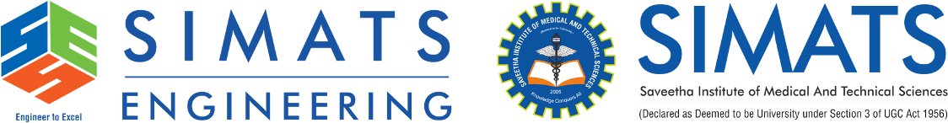
Future of Reliable Networking Beyond the Traditional OSI Model
Presented by:
S.Prathika

Slide 2


Introduction
The OSI (Open Systems Interconnection) Model is a 7-layer framework that standardizes network communication.
It has been the foundation of computer networking for many years.
Modern technologies such as Cloud Computing, IoT, AI, and 5G/6G require faster and smarter networks.
The traditional OSI model struggles with latency, scalability, flexibility, and security in modern environments.
Emerging technologies like SDN, NFV, Edge Computing, and AI-driven networking overcome these challenges.
The future of networking focuses on intelligent, automated, secure, and highly reliable communication.

Slide 3
Limitations of the Traditional OSI Model
Challenges
Fixed layered architecture limits flexibility.
High latency due to multiple processing layers.
Difficult to support billions of IoT devices.
Manual network configuration and management.
Security is handled separately rather than integrated.
Limited adaptability to changing network conditions.

Slide 4
Technologies Beyond the OSI Model
Next-Generation Networking Technologies
Software Defined Networking (SDN) – Centralized and programmable network control.
Network Function Virtualization (NFV) – Replaces hardware devices with software-based services.
Artificial Intelligence (AI) – Enables intelligent routing, automation, and threat detection.
Edge Computing – Processes data closer to users for lower latency.
Cloud Networking – Provides scalable storage and computing resources.
5G/6G Networks – Deliver ultra-fast, reliable, and low-latency communication.

Slide 5
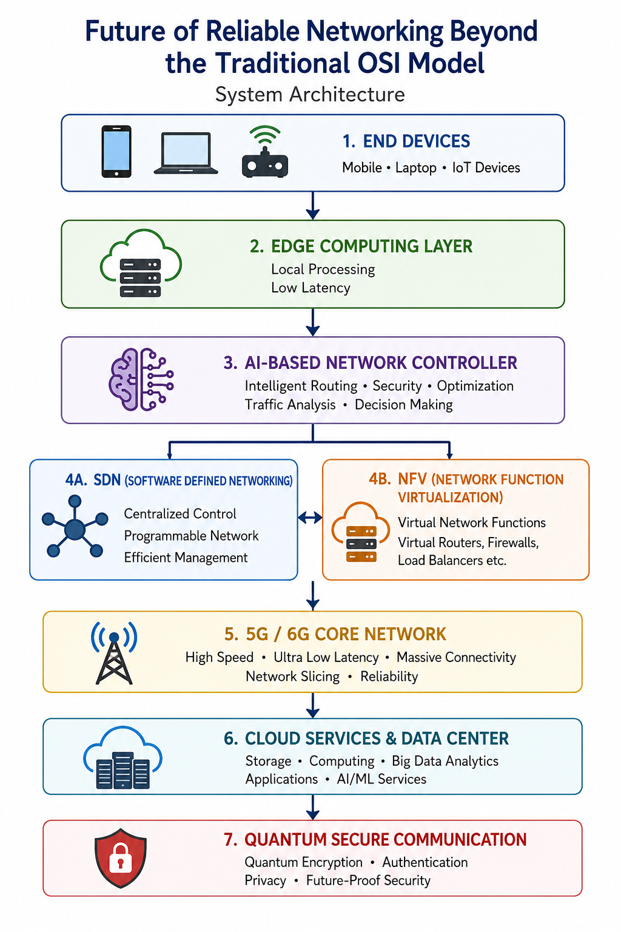
System Architecture

Slide 6
Conclusion
The OSI model remains an important reference for learning networking concepts.
Modern applications demand faster, more secure, and adaptive networking solutions.
Technologies such as AI, SDN, NFV, Edge Computing, Cloud Computing, and 5G/6G are transforming network architecture.
Future networks will be intelligent, self-managing, scalable, and highly reliable.
These innovations will support emerging applications like smart cities, autonomous vehicles, industrial IoT, and real-time communication

Slide 7
Thank you

