Slide 1


Hybrid Static–Trace Analysis for Synthesizing Interaction Diagrams in Event-Driven Systems
MSc Software Engineering · Thesis Defence · University of Amsterdam
Scenario-Specific Interaction Diagrams in SysML v2
Student: | Prathik Anand Krishnan
Daily Supervisor: | Dr. Rosilde Corvino, TNO – ESI
Academic Supervisor: | Dr. L. Thomas van Binsbergen (CCI, UvA)
Second Reader: | Prof. Dr. Benny Åkesson (PCS, UvA)
Host Organization: | TNO – ESI, Eindhoven, High Tech Campus 25
Hybrid Static–Trace Interaction Model Synthesis · Prathik Anand Krishnan · UvA · TNO-ESI
1
Notes:
This research is all about creating a tool that can create - more complete and more accurate Interaction Diagrams in an EDS – by utilizing a hybrid static-trace analysis approach.
The key idea is to improve scenario-specific understanding of system behavior as the runtime traces are incomplete.
This work is supervised jointly by the university and TNO.

Slide 2
Agenda
1
Motivation
2
State-of-the-art & Gaps
3
Research Questions
4
Approach, Methodology & Implementation
5
Experiments
6
Results & Findings
7
Contributions, Limitations & Conclusion
Hybrid Static–Trace Interaction Model Synthesis · Prathik Anand Krishnan · UvA · TNO-ESI
2
Notes:
[0:30] Here's the roadmap. I'll start with the motivation and the concrete
problem, state my three research questions, then walk through the approach —
the pipeline and the shared property graph. After a quick look at the case
study, CPSCore, I'll present the three experiments and their results, and close
with contributions, limitations, and conclusions.

Slide 3
Problem Statement & Motivation
Large Event-Driven Systems
↓
Traces - Incomplete / Noisy - often instrumentation limited
↓
Static Code Analysis - Over-Approximates behaviour
↓
Reverse-engineered manually & Costly to maintain
↓
No Scenario-Specific Accurate Interaction Diagrams
Hybrid Static–Trace Interaction Model Synthesis · Prathik Anand Krishnan · UvA · TNO-ESI
3
Notes:
Interaction diagrams support developers in understanding the runtime behavior of event-driven systems.
But in industry they are typically reverse-engineered manually. A process that is costly and hard to keep consistent with the evolving implementation.
Existing automated techniques rely on either static analysis or trace analysis, each capturing only part of the system's true interaction behavior.
Goal is to understand the system behavior accurately under certain scenarios – to then be able to take architectural calls / refactoring decisions / fix the bugs, etc.
Because these mission critical systems require proper understanding of the nuances of things – like what all components are interacting
With each other and what orchestration is happening under the hood – then be able to isolate those part of the code and refactor it / add more tests and increase its long-term maintainability

Slide 4
State of the Art & Research Gap
Work | Static | Dynamic | Hybrid | Scenario-Scoped | Interconnection view | Sequence view | UML | SysML v2
Grove et al. (1997) [1] | ✓ |  |  |  | ✓
Briand, Labiche & Leduc (2006) [2] |  | ✓ |  | ✓ |  | ✓ | ✓
Labiche, Kolbah & Mehrfard (2013) [3] | ✓ | ✓ | ✓ | ✓ |  | ✓ | ✓
Abdelmalek, Khriss & Jakimi (2023) [4] | ✓ | ✓ | ✓ |  |  | ✓ | ✓
This Thesis | ✓ | ✓ | ✓ | ✓ | ✓ | ✓ |  | ✓
Research Gap:
No existing approach combines static structure and runtime traces to infer interactions for scenario-scoped reconstruction of SysML v2 interconnection and sequence models.
Hybrid Static–Trace Interaction Model Synthesis · Prathik Anand Krishnan · UvA · TNO-ESI
4
Notes:
Traces are often instrumentation-limited (logs, performance constraints) overheads, access constraints, and cost.
Static code analysis shows all the possible behaviors possible, but often lacks information about execution order and runtime conditions.
Hybrid approach is what we are going to perform – previously there has been some work done – but their goals and objectives have been different. Some used it to reduce logging and runtime instrumentation, other used it understand if they had control-flow loops in the execution path - such as repeated method invocations
Existing work either relies on traces, static structure, or uses hybrid analysis for other goals.
None focus on synthesizing interaction diagrams for a specific scenario when traces are incomplete.
Goal is to create a more richer, more accurate and more complete interaction diagrams – which can assist the engineers in taking architectural decisions
In contrast, this thesis assumes that runtime traces are incomplete and uses static call graphs to not only enrich observed behavior, but to infer unobserved interactions within a bounded scenario.

Slide 5
Research Questions
Hybrid Analysis - Interaction Diagram
Static Code Structure
Runtime Traces
RQ1: How does combining static analysis and runtime traces improve accuracy and completeness of scenario-specific interaction model reconstruction?
RQ2: How does guiding trace collection with the static call graph remove noise without losing scenario coverage?
RQ3: How well do reconstructed SysML v2 interaction (interconnection and sequence) diagrams consolidate static and dynamic evidence into abstract artifacts sufficient for system behavior comprehension?
Hybrid Static–Trace Interaction Model Synthesis · Prathik Anand Krishnan · UvA · TNO-ESI
5

Slide 6
Codebase Selected: CpsCore [7]
Codebase overview:
A Modular Autopilot Framework for UAVs [7]
154 source/header files
~13,000 LOC (3,800 in .cpp files, 9,200 in headers)
Heavy template-based static polymorphism (~470 occurrences)
No cross-module call resolves through a virtual table. Inter-module calls go through concrete class references or boost::signals2 (external dependency) slot connections.
Test suite: 1,425 assertions across 61 test cases is the ground truth for behavioural verification.
Hybrid Static–Trace Interaction Model Synthesis · Prathik Anand Krishnan · UvA · TNO-ESI
6

Slide 7
Approach: Agent Skill Pipeline
Skill | Role in Final Pipeline
get-neo4j-schema | Static Analysis - graph introspection
text-to-cypher + get-cypher + cypher-to-output | Scenario-scoped query generation, execution & standalone Cypher authoring
get-interface-dependency-table | Static Analysis - Structural dependency extraction
get-sequence-dependency-table | Static Analysis – Sequence / call chain extraction
draw-sysml-structural-model | SysML v2 Output - Structural Diagram
draw-sysml-sequence-model | SysML v2 Output - Sequence Diagram
add-runtime-instrumentation | Trace Collection - csp_matcher probe injection
agentic-synthesis | Evidence judgement, pruning false positives
draw-mermaid-structural-diagram | Mermaid Diagrams – For Quick Analysis
draw-mermaid-sequence-diagram | Mermaid Diagrams – For Quick Analysis
Twelve modular, composable, LLM-invocable skills: eleven follow a fixed rule set, one (agentic synthesis) applies judgement instead.
Key design property: Each skill is independently testable. Scenario focus is expressed as a natural-language query, translated into a Cypher query that scopes the graph before instrumentation runs — this is what makes guided instrumentation possible, the mechanism RQ2 actually tests (guiding trace collection with the static graph to remove noise without losing coverage).
Hybrid Static–Trace Interaction Model Synthesis · Prathik Anand Krishnan · UvA · TNO-ESI
7
Notes:
BDD – Block Definition Diagram - Components (Blocks) Dependencies Associations Hierarchical relationships Composition relationships
IBD – Internal Block Diagram - Parts (instances of blocks) Ports Connectors Internal communication paths
IBD – to understand How these components communicate. BDD - These components exist.
Sequence Diagram - What happens during execution and in what order?

Slide 8
Four Evaluation Scenarios were Selected
Scenario | Nature | What it exercises | Test Case Reference
S1 | Pre-existing | Aggregation chain | RunnerTest.cpp - "Synchronized Runner Test“
S2 | Pre-existing | Config mapping | PropertyMapperTest.cpp - "Optional test"
S3 | Pre-existing | Multi-component runner | SchedulerTest.cpp - “MultiThreaded Test 1“
S4 | Constructed | Publish/subscribe | StageEventBridgeTest.cpp - "Stage Event Bridge Pub-Sub Routing"
Hybrid Static–Trace Interaction Model Synthesis · Prathik Anand Krishnan · UvA · TNO-ESI
8
Notes:
S2 (Configuration property mapping) — selected as the easy-case baseline: a mostly-static, linear chain expected to be reconstructed well even by static-only analysis.
S1 - Exercises the synchronization pattern: shared-memory coordination between master and runner threads, and the runner's dependency on the Aggregation component to retrieve runnable objects.
S3 (Multi-component runner orchestration) — Fan-out from a single orchestrator to multiple independent subsystems
selected as the hardest case for static analysis: fan-out to multiple subsystems where call targets are resolved via template dispatch only at runtime, producing static false positives. It tests whether agentic synthesis can recover genuine trace-only edges that strict intersection would otherwise throw away for lacking static corroboration.
S4 – A classic pub-sub event – Where StageEventBridge publishes a stage-completion event over a runtime dependency binding of boost::signals2::signal; StageEventListener connects onStageEvent as a slot with no static call site anywhere in the codebase.

Slide 9
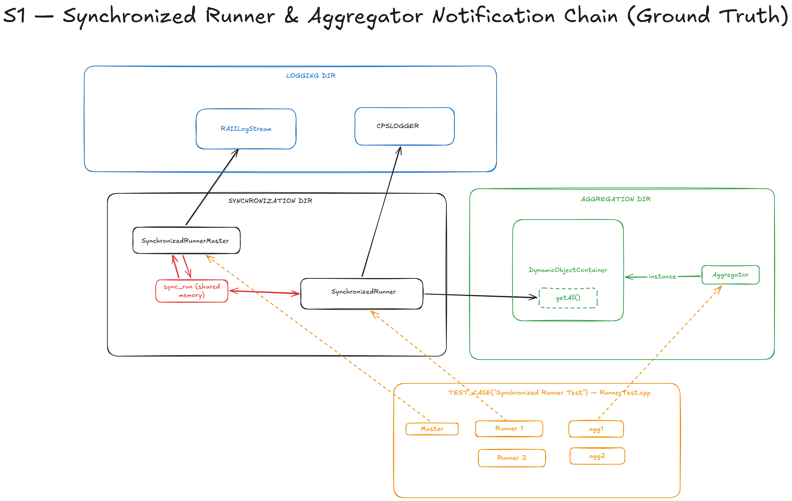
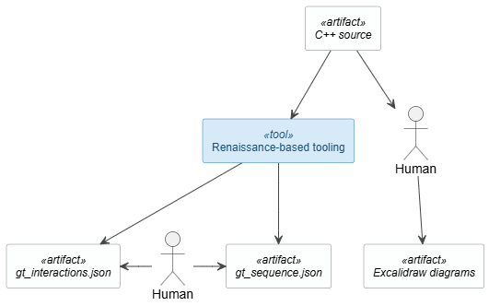
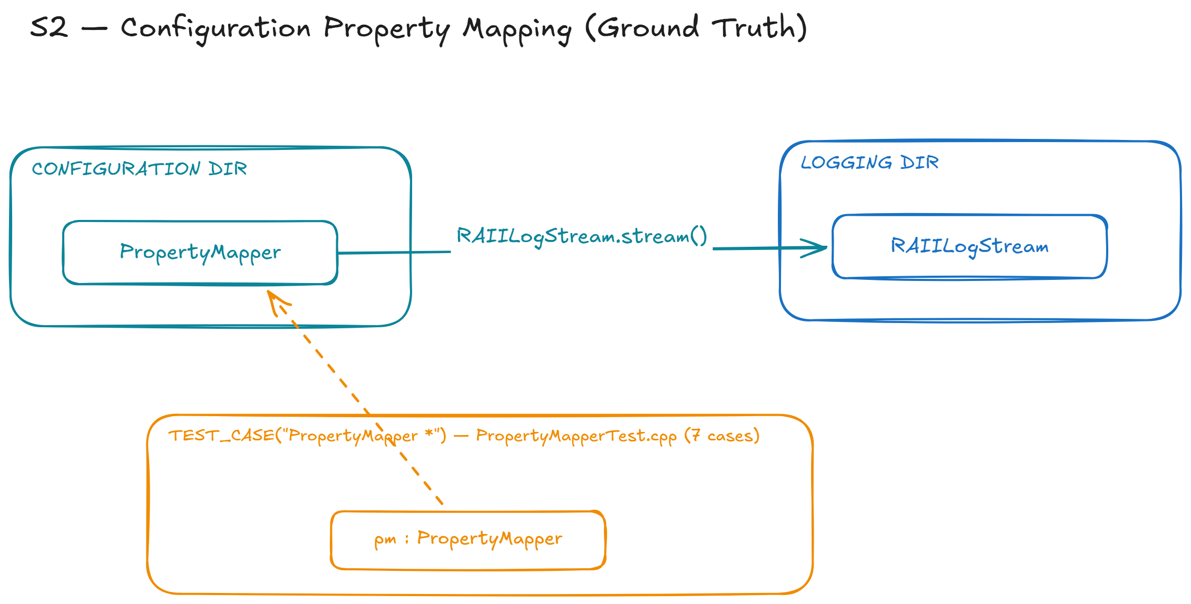
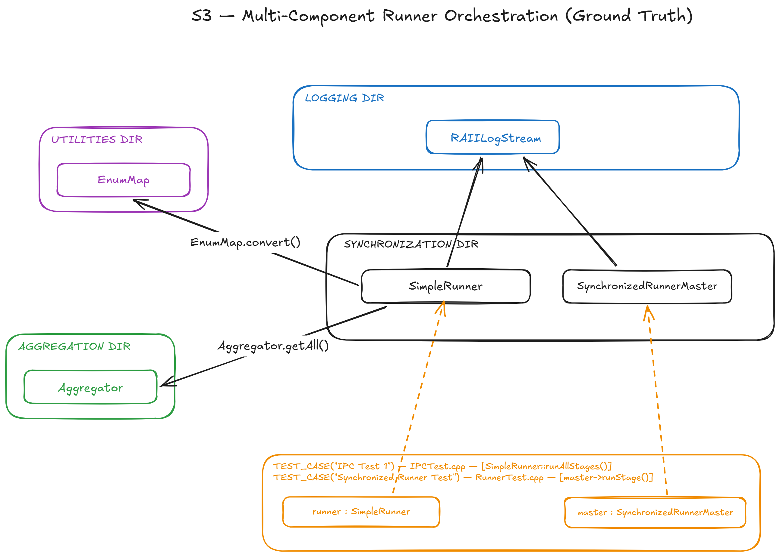
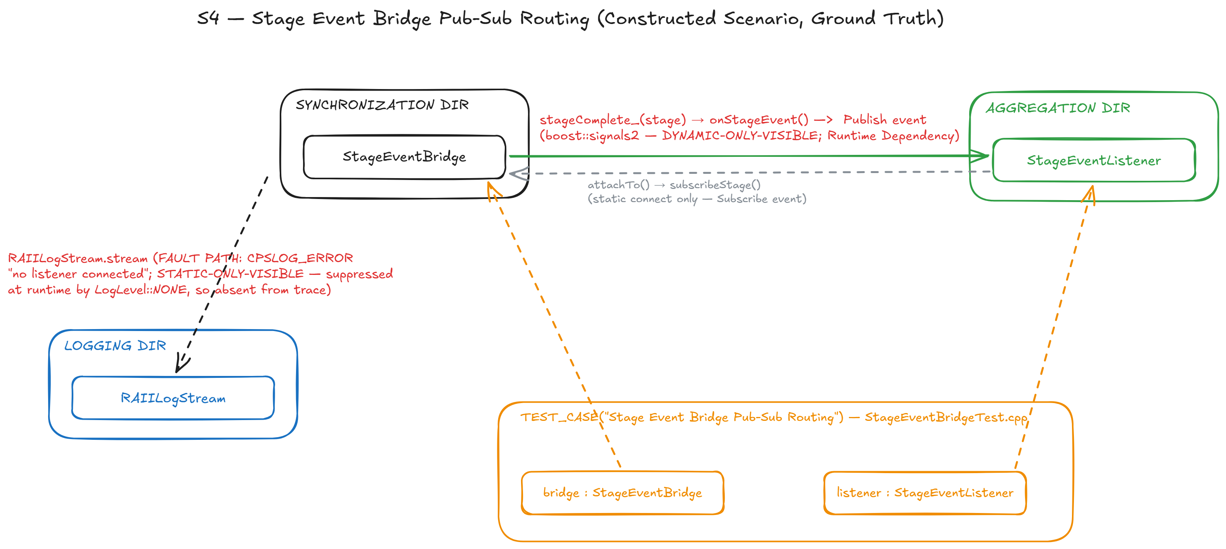
Ground Truth
Hybrid Static–Trace Interaction Model Synthesis · Prathik Anand Krishnan · UvA · TNO-ESI
9
Notes:
S2 (Configuration property mapping) — selected as the easy-case baseline: a mostly-static, linear chain expected to be reconstructed well even by static-only analysis.
S1 - Exercises the synchronization pattern: shared-memory coordination between master and runner threads, and the runner's dependency on the Aggregation component to retrieve runnable objects.
S3 (Multi-component runner orchestration) — Fan-out from a single orchestrator to multiple independent subsystems
selected as the hardest case for static analysis: fan-out to multiple subsystems where call targets are resolved via template dispatch only at runtime, producing static false positives. It tests whether agentic synthesis can recover genuine trace-only edges that strict intersection would otherwise throw away for lacking static corroboration.
S4 – A classic pub-sub event – Where StageEventBridge publishes a stage-completion event over a runtime dependency binding of boost::signals2::signal; StageEventListener connects onStageEvent as a slot with no static call site anywhere in the codebase.

Slide 10
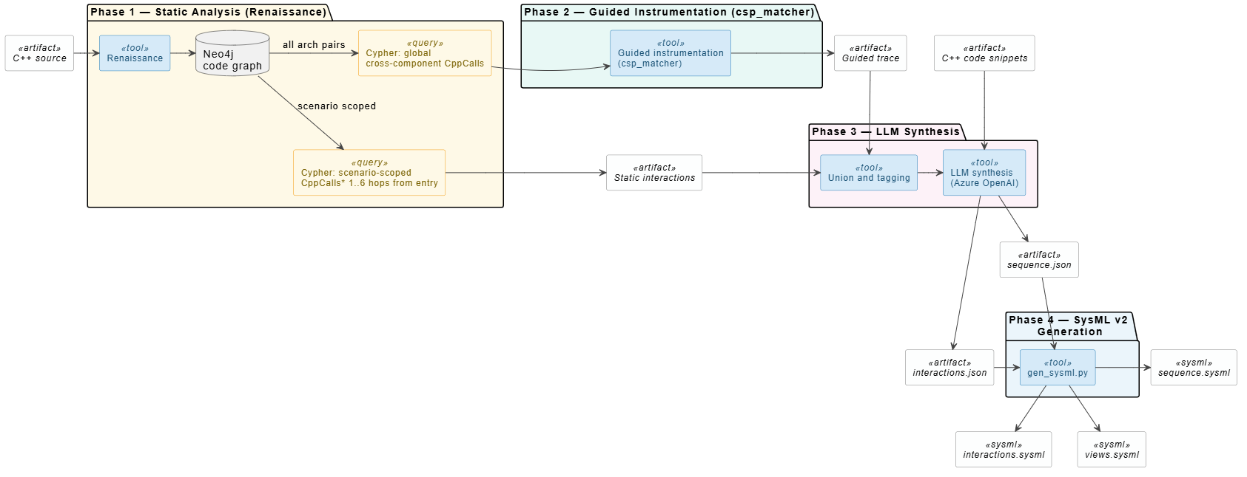
Methodology - The Hybrid Pipeline
Experiments:
Six stages, evaluated across four CPSCore scenarios (S1–S4)
Three hypotheses H1, H2, H3 were tested.
Hybrid Static–Trace Interaction Model Synthesis · Prathik Anand Krishnan · UvA · TNO-ESI
10
Notes:
Scenario Definition
“We start by clearly defining a single functionality or algorithm as the scenario of interest. This keeps the scope focused and narrow and avoids over-generalizing the system’s behavior.”
Static Analysis
“We provide scenario specific cypher query to get the scenario-relevant subgraph. This prunes irrelevant code paths and constrains what interactions are theoretically possible.”
Runtime Trace Collection
“Next, Global query of all cross-component CppCalls subgraph. We then collect timestamped runtime events corresponding to all the possible trace events that can happen across the codebase. We do this by the tool we developed - AST-pattern search and replace tool for C++. Parses a CSP pattern into a Clang AST (via LibTooling), emits ASTMatcher DSL, runs it against target files, and optionally rewrites matched code. communicating sequential processes (CSP)
Hybrid Reconstruction
“Static and dynamic information are then aligned through trace-to-code mapping. Static reachability analysis is used to infer missing interactions, but only when they are consistent with both code structure and observed traces.”
SysML v2 Interaction Diagram
“Finally, the reconstructed interactions are exported as SysML v2 interaction diagrams. These diagrams are scenario-specific, human-readable, and suitable for engineers and stakeholders.”
SysML v2 (Systems Modeling Language v2) is a next-gen textual modern, formal systems modeling language – which has its own textual syntax and formal semantics
SysML v2 provides formal semantics and a textual representation, making it suitable for automated generation and analysis. In this work, SysML v2 is used as the output representation to express reconstructed, scenario-specific interactions inferred from static code and runtime traces.

Slide 11
H1 Experiment Design
These experiments were run with full and guided traces, both computed via csp_matcher tool.
Condition | Phase 1 (Renaissance/Neo4j) | Phase 2 (Guided Instrumentation) | Phase 3 (Synthesis) | Phase 4 (SysML)
C1 LLM-only | ✗ | ✗ | LLM + source only (no static/dynamic evidence) | ✗
C2 Static-only | ✓ full | ✗ | ✗ (Static graph only) | ✗
C3 Dynamic-only | ✗ | ✓ full | ✗ (de-duplicated + ordered trace) | ✗
C4 Static + Dynamic | ✓ | ✓ | Set union (no LLM) | ✗
C5 Intersection | ✓ | ✓ | Set intersection (no LLM) | ✗
C6 Full pipeline | ✓ | ✓ | Full LLM synthesis (C2+C3+source) | ✓
Hybrid Static–Trace Interaction Model Synthesis · Prathik Anand Krishnan · UvA · TNO-ESI
11
Notes:
C1 — LLM-only (source code)
C2 — Static graph only - The scenario-scoped static call graph (CppCalls edges from Renaissance/Neo4j) alone. Sees everything reachable in source, whether or not it actually runs.
C3 — Runtime traces only - The guided runtime traces (csp_matcher instrumentation) alone. Sees only what actually executed during the test, nothing more. Filtered to scenario-relevant events
C4 — Static ∪ Dynamic (raw union) - Every edge either C2 or C3 reports, pooled together with no filtering. Inherits both sources' false positives along with their true positives
C5 — Intersection (Static ∩ Dynamic) - Only edges both C2 and C3 independently report. Pure set algebra. This case cancels each source's own false positives, but at the cost of dropping any true edge only one source sees.
C6 — Full pipeline (C4 + agent synthesis / pruning false positives - An LLM gets C2 and C3 and code snippets as separately-labelled evidence (not pre-merged) and it reasons about corroboration, suppression and indirect dispatch and judges each disputed single-source edge by provenance, plus orders the reconstructed sequence.

Slide 12
H1 – Metrics Calculations Example
S1- Reference (REF):
[ { "source": "Synchronization", "target": "Aggregation", "interaction": "Aggregator.getAll" }, // Runner.Test
{ "source": "Synchronization", "target": "Logging", "interaction": "CPSLogger.flush" }, // Runner.Test
{ "source": "Synchronization", "target": "Aggregation", "interaction": "Aggregator.getAll" }, // Runner.Timeout
{ "source": "Synchronization", "target": "Logging", "interaction": "CPSLogger.flush" }, // Runner.Timeout
{ "source": "Synchronization", "target": "Logging", "interaction": "RAIILogStream.stream" } ] // Runner.Timeout
S1- C1_LLM_only (GEN):
TP=3, FP=0, FN=2 P=3/(3+0)=1.00 R=3/(3+2)=.60 F1=2(1)(.6)/(1.6)=.75
[ { "source": "Synchronization", "target": "Aggregation", "interaction": "Aggregator.getAll" }, TP1 // Runner.Test
{ "source": "Synchronization", "target": "Logging", "interaction": "CPSLogger.flush" }, TP2 // Runner.Test
{ "source": "Synchronization", "target": "Logging", "interaction": "RAIILogStream.stream" } ] TP3 // Runner.Timeout
[ { "source": "Synchronization", "target": "Aggregation", "interaction": "Aggregator.getAll" }, FN1 // Runner.Timeout
{ "source": "Synchronization", "target": "Logging", "interaction": "CPSLogger.flush" } ] FN2 // Runner.Timeout
So, TP=3 and FN=2: C1 gets both Runner.Test edges right but on Runner.Timeout reports only stream, missing getAll/flush for that test entirely. An LLM reasons over the raw scenario description alone over the source, no static graph, no trace is provided. Baseline for what's inferable with zero pipeline evidence.
Hybrid Static–Trace Interaction Model Synthesis · Prathik Anand Krishnan · UvA · TNO-ESI
12
Notes:
True Positive: a triple the reference expects and the generated file has
False Positive: a triple the generated file has that isn't in the reference — an invented edge (GEN − REF)
False Negative: a triple the reference expects that the generated file is missing (REF − GEN)
P = Precision — of everything the condition generated, what fraction was actually correct (in GT)? Penalizes over-generation (false positives).
R = Recall — of everything that's actually in the ground truth, what fraction did the condition find? Penalizes missed items (false negatives).
F1 — harmonic mean of P and R: F1 = 2·P·R / (P+R). A single balanced score — you can't get a high F1 by only maximizing one of P or R.
Precision asks "of what I generated, how much was right"; recall asks "of what should be there, how much did I find"

Slide 13
H1 Results: Interconnections and sequence F1
Interactions F1 — all scenarios
Sequence F1 — all scenarios
Scenario | C1 | C2 | C3 | C4 | C5 | C6
S1 | 0.750 | 0.762 | 0.829 | 0.661 | 1.000 | 1.000
S2 | 0.000 | 1.000 | 1.000 | 1.000 | 1.000 | 1.000
S3 | 0.333 | 0.500 | 1.000 | 1.000 | 0.500 | 0.857
S4 | 0.400 | 0.667 | 0.667 | 0.500 | 1.000 | 0.500
Macro F1 | 0.371 | 0.732 | 0.874 | 0.790 | 0.875 | 0.840
Scenario | C1 | C2 | C3 | C4 | C5 | C6
S1 | 0.667 | 0.306 | 0.758 | 0.758 | 1.000 | 1.000
S2 | 0.000 | 1.000 | 1.000 | 1.000 | 1.000 | 1.000
S3 | 0.560 | 0.143 | 0.867 | 0.867 | 0.267 | 0.896
S4 | 0.000 | 0.667 | 0.667 | 0.667 | 1.000 | 0.667
Macro F1 | 0.307 | 0.529 | 0.823 | 0.823 | 0.817 | 0.891
Macro F1 with guided vs full instrumentation
 | Intr (guided) | Intr (full) | Seq (guided) | Seq (full)
C3 / C3f | 0.865 | 0.831 | 0.810 | 0.771
C4 / C4f | 0.764 | 0.764 | 0.810 | 0.771
C5 / C5f | 0.900 | 0.833 | 0.853 | 0.787
C6 / C6f | 0.871 | 0.900 | 0.913 | 0.873
Hybrid Static–Trace Interaction Model Synthesis · Prathik Anand Krishnan · UvA · TNO-ESI
13
Notes:
Interactions F1 (does the condition find the right set of cross-component calls?)- so intersecting the two cancels both out (2 FPs – 1 from static, 1 from dynamic) and leaves only what's genuinely confirmed by two independent evidence types.
Sequence LCS F1 (does the condition get the right order and repetition of calls?) - C6 wins here. As C5 mechanically removing "unconfirmed" events also removes real ordering information it depended on.
Effect of guided vs. full instrumentation on macro F1 - filtering with architectural knowledge as per the scenario is a more effective and cheaper noise-reduction strategy.
Precision asks "of what I generated, how much was right"; recall asks "of what should be there, how much did I find"
Macro F1 — the average of the per-scenario F1 scores
For Interactions (set F1):
TP = GT edge also in generated set
FP = generated edge not in GT
FN = GT edge missing from generated set
P = TP / (TP + FP)
R = TP / (TP + FN)
For Sequence (LCS F1):
LCS = longest common subsequence between generated and GT ordered lists
P = |LCS| / |generated| — penalizes extra/noisy events
R = |LCS| / |GT| — penalizes missing events

Slide 14
H1 Interpretation — Why the Numbers Look This Way
C5 (C2 ∩ C3 intersection) is the best condition for interactions (macro F1=0.875). In every scenario where both static and dynamic capture the same edge, the intersection removes noise from both sources.
C6 (LLM + static + dynamic + source code) is the best condition for sequence (macro F1=0.891). Adding source code enables the LLM to identify and remove test-fixture setup events from the sequence output.
Guided ≥ Full for C3-C6 interconnections and sequence.
Hybrid Static–Trace Interaction Model Synthesis · Prathik Anand Krishnan · UvA · TNO-ESI
14

Slide 15
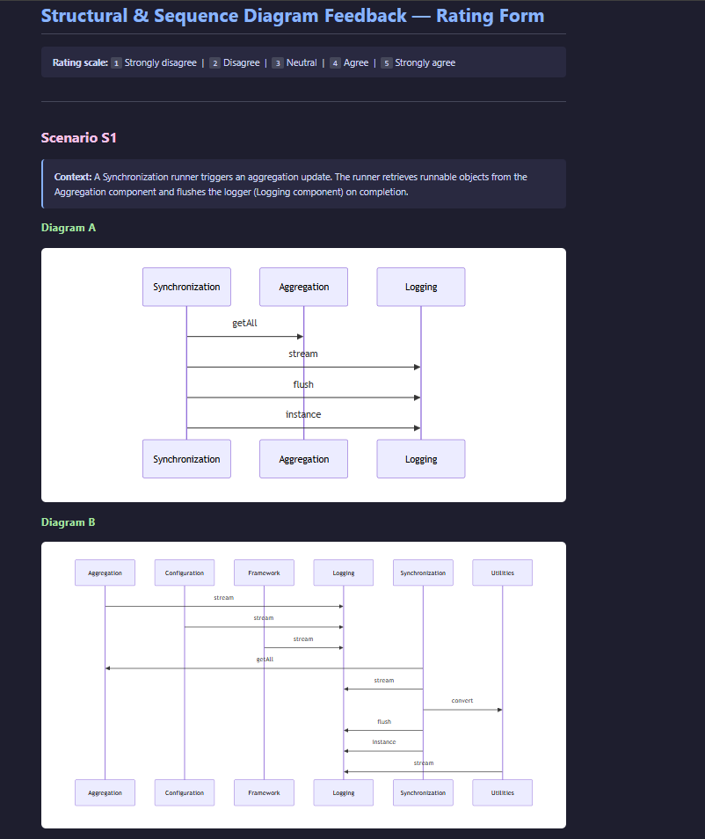
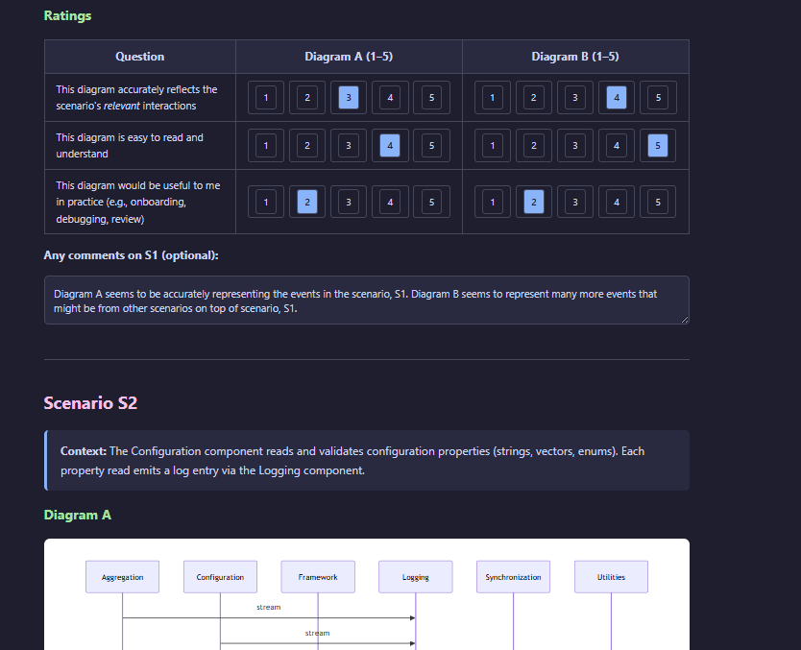
H2 Experiment
Setup:
A blind A/B comparison rating form was used:
For each scenario (S1–S3), a rater scores two anonymized diagram variants (A vs. B, unlabelled generation method) on 3 questions relevance to the scenario, accuracy, readability, and practical usefulness on a 1–5 scale plus free-text comments.
It closes with two overall questions on which style was preferred and what features they'd want added.
Hybrid Static–Trace Interaction Model Synthesis · Prathik Anand Krishnan · UvA · TNO-ESI
15
Notes:
Full instrumentation (probe everything, filter after) vs. Guided (slice first, probe only scenario-relevant call sites), on S1–S3.

Slide 16
H2 Results in Detail: Noise, Coverage & Expert Ratings
Metric | Full | Guided | What it means
Nodes (mean) | 6.0 | 3.0 | Full pulls in 2× as many components per scenario as guided on average.
Edges (mean) | 9.0 | 2.7 | Full shows 3.3× as many component-pairs on average.
Coverage (0-1.0) | 1.000 | 1.000 | Identical
Noise (0-1.0) | 0.704 | 0.000 | 70% of Full doesn't belong to scenario.
Accuracy (6-rater mean, 1–5) | 2.39 | 4.61 | Raters penalize diagrams where they can't tell which edges actually matter.
Readability (6-rater mean, 1–5) | 2.44 | 4.89 | Fewer nodes/edges directly means less to visually parse.
Usefulness (6-rater mean, 1–5) | 2.94 | 4.00 | One rater found a few "extra" Full-edges is marginally useful as context even while rating them as noise elsewhere.
Setup: Full instrumentation (probe everything, filter after) vs. Guided (slice first, probe only scenario-relevant call sites), on S1–S3.
Standout: Across 6 raters × 9 scenario-dimension pairs = 54 comparisons: Guided rated strictly higher in 47, tied in 6, lower in exactly 1: The single dissent traced to collapsing 7 repeated Configuration→Logging into 1. A trade-off, not a defect.
Hybrid Static–Trace Interaction Model Synthesis · Prathik Anand Krishnan · UvA · TNO-ESI
16

Slide 17
H3 Setup & Results : Diagram Utility
Setup: Does the pipeline's output (the C5 interaction list) help an LLM agent comprehend a scenario — alone, and in combination with source and traces? A single holistic experiment, five conditions, across all four scenarios.
Standout: Diagram only equals Source+Trace+Diagram on every measure. Even with no source and no trace, the reconstructed diagram alone is already a sufficient basis for scenario comprehension.
Condition | Component recall | Interaction recall | Completeness (1–5)
Source only | 0.917 | 0.800 | 4.25
Trace only | 0.917 | 0.900 | 4.25
Diagram only | 1.000 | 1.000 | 5.00
Source + Trace | 0.917 | 0.900 | 4.25
Source + Trace + Diagram | 1.000 | 1.000 | 5.00
Hybrid Static–Trace Interaction Model Synthesis · Prathik Anand Krishnan · UvA · TNO-ESI
17
Notes:
3-part task (list components, list interactions as Source → Target : Method, explain the flow in 3–5 sentences), varying only the evidence attached — source, trace, diagram, or combinations — across all five conditions and four scenarios. The response is then scored against ground truth for component recall, interaction recall and completeness.

Slide 18
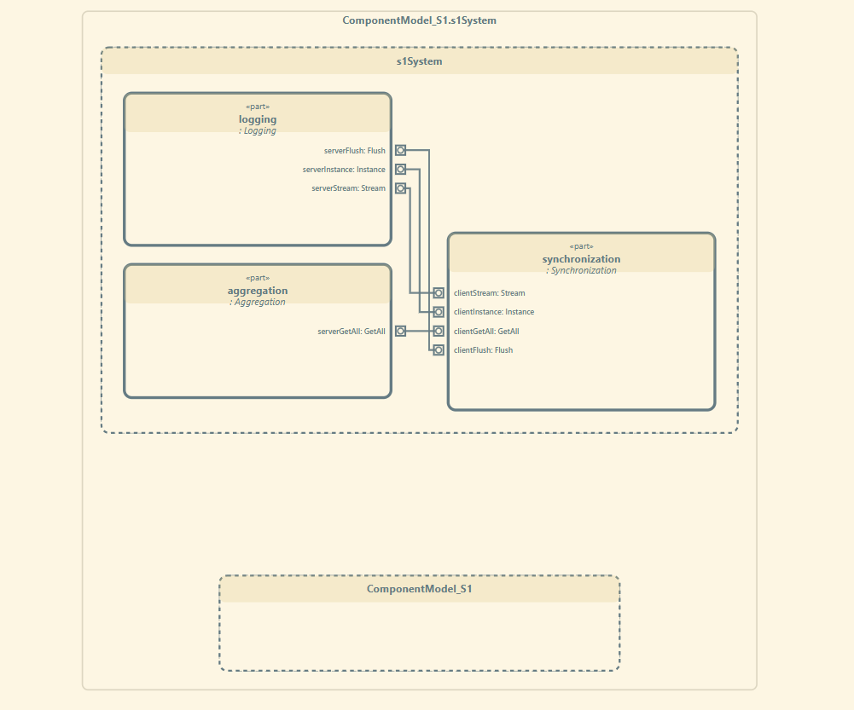
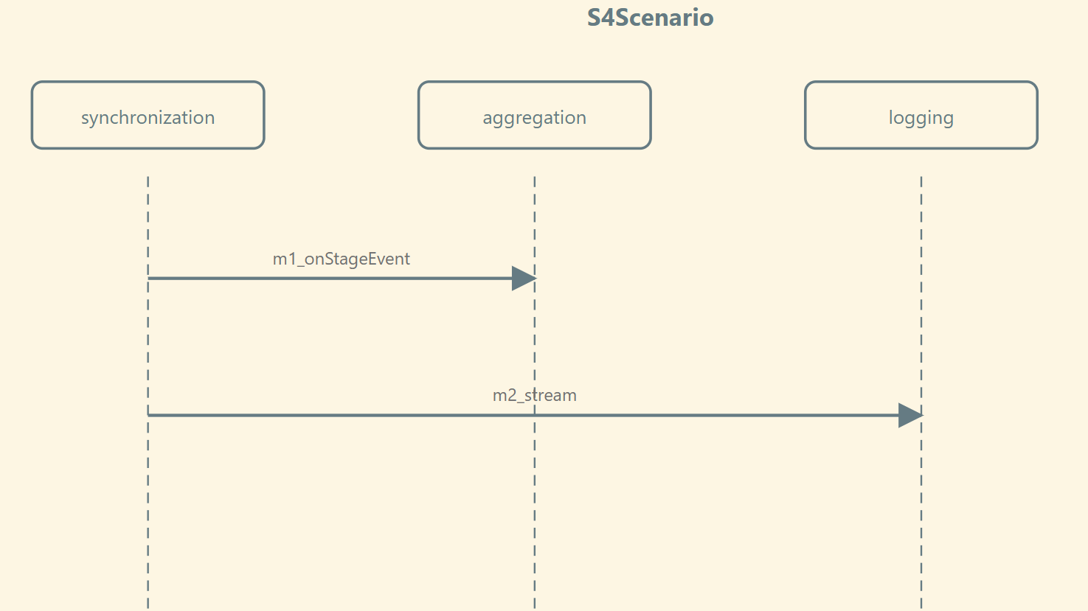
What Was Produced: SysML v2 Artifacts
Structural, Sequence and Interconnection Model:
SysML v2 structural and sequence models are generated using the draw-sysml-structural-model and draw-sysml-sequence-model agent skills.
Each element becomes a typed port pair (calls<X> / provides<X>) joined by a connect statement in the structural model, representing provider-consumer relationships between components.
Each sequence step becomes a labelled SynchronousCall part (with ref from/ref to Lifeline references) in the sequence model.
Interaction flows built from interactions.json / sequence.json.
SysML v2 models are generated from C6 (the full pipeline) output, one structural, one sequence diagram per scenario (S1, S2, S3, S4)
Hybrid Static–Trace Interaction Model Synthesis · Prathik Anand Krishnan · UvA · TNO-ESI
18
Notes:
A Block Definition Diagram (BDD) describes the static structure of the system by showing components and their relationships. An Internal Block Diagram (IBD) refines those components by showing their ports, interfaces, and connectors, explaining how they interact internally. In my project, dependency extraction is used to generate BDDs, while function-level interaction analysis is used to infer ports and generate IBDs. IBD – to understand How these components communicate. BDD - These components exist.

Slide 19
Practitioner Validation
Goal:
Does the Static Half Transfer to a Second, Larger Codebase?
Setup:
Renaissance MCP : The static-extraction + graph-querying backend exposed as an MCP tool inside GitHub Copilot.
Trialled by 4 engineers at an industrial partner on a second C++ codebase, orders of magnitude larger than CPSCore
Not a repeat of H1/H2/H3: unblinded, semi-structured hands-on session + interviews with static-extraction only, no runtime tracing.
Interview Findings | Thesis Connection
P3 resolved the proxy-leak defect using only the static graph in 5 min vs. ~5 months (anecdotal). | Same mechanism as S4/C2: static extraction alone finds architecturally-present, runtime-invisible interactions.
P2's tool found a stub definition invisible to code search. | Static analysis catches blind spots a disagreeing dynamic source could confirm. But untested here (no trace was collected).
Codebase leans heavily on proxies, virtual interfaces, dynamic connect/disconnect. | Exactly the regime where C5 should beat C4, per the S4 mechanism. Predicted, not measured, at this scale. Future Work
Dependency/structural diagrams rated useful by all 4, cleaner than existing tooling for P3. | Validates the interface dependency table. This thesis’s one of the core static artifact.
Sequence diagrams valued, but event labels judged too abstract without inline detail. | Motivates the hover-detail request via the existing sourceLineNumber property carried on CppCalls edges — future work for SysML generation.
Hybrid Static–Trace Interaction Model Synthesis · Prathik Anand Krishnan · UvA · TNO-ESI
19

Slide 20
Research Questions: How it Each Stands
RQ | Question | Status
RQ1 | Does combining a static call graph with runtime execution traces reconstruct scenario-specific Interaction Models more accurately than either source alone? | Confirmed (H1): Intersection (C5) reaches macro-F1 = 0.875. Full pipeline (C6) reaches 0.840. Sequence (C6) reaches macro-F1 = 0.891. Guided trace ≥ Full trace for C3-C6 interconnections and sequence.
RQ2 | Does guiding trace collection with the static call graph remove reconstruction noise without losing scenario coverage? | Confirmed (H2): Guided instrumentation cuts retained nodes by 50% and edges by 70%; A blinded panel preferred guided diagram in 47 of 54 comparisons.
RQ3 | How well does a reconstructed SysML Interaction Model consolidate static and dynamic evidence into a single artefact sufficient for system-behaviour comprehension? | Confirmed (H3): The diagram alone allows LLM to reach full component recall, interaction recall and completeness.
Hybrid Static–Trace Interaction Model Synthesis · Prathik Anand Krishnan · UvA · TNO-ESI
20
Notes:
A Block Definition Diagram (BDD) describes the static structure of the system by showing components and their relationships. An Internal Block Diagram (IBD) refines those components by showing their ports, interfaces, and connectors, explaining how they interact internally. In my project, dependency extraction is used to generate BDDs, while function-level interaction analysis is used to infer ports and generate IBDs.

Slide 21
Challenges Encountered & How They Were Resolved
Challenges | Solutions
C++ is context-sensitive — regex/simple parsers fail | Used the Renaissance semantic-extraction tool + Neo4j property graph.
Thousands of dependencies make SysML toolchains very slow | scenario-scoped Cypher queries trim the graph before diagram generation, hence helps with reproduction speed.
Hardcoded scenario scoping is brittle | Agent skill architecture (12 skills) expresses scenario definition as a natural-language query via text-to-cypher
Traces alone even sliced contains noise (setup-teardown). | Scenario-scoping helps with improving the precision.
Hybrid Static–Trace Interaction Model Synthesis · Prathik Anand Krishnan · UvA · TNO-ESI
21

Slide 22
Overall Summary
What was proposed:
Hybrid static + trace pipeline → generates scenario-specific SysML v2 interaction diagrams
What was delivered:
Neo4j knowledge graph of CPSCore - 121 components, 2,574 ordered static interactions
12 composable agent skills spanning extraction → scenario scoping → instrumentation → agentic synthesis → SysML v2 diagram generation
csp_matcher runtime instrumentation tool.
H1/H2/H3 confirmed on 6 scenarios: Intersection macro-F1 0.875 and Full pipeline macro-F1 0.840; Guided instrumentation cuts retained nodes by 50% and edges by 70%; the reconstructed diagram alone achieves perfect comprehension recall
Beyond the plan:
Exploratory practitioner session - 4 engineers, second much larger industrial codebase, via GitHub Copilot MCP integration; tried to resolve a real proxy-leak defect using only the static graph.
Future work:
Controlled replication on a second system, richer diagram labelling & interactivity and improved pipeline.
Hybrid Static–Trace Interaction Model Synthesis · Prathik Anand Krishnan · UvA · TNO-ESI
22

Slide 23
[1] Grove, D., DeFouw, G., Dean, J., Chambers, C. "Call Graph Construction in Object-Oriented Languages." Proc. 12th ACM SIGPLAN Conference on Object-Oriented Programming, Systems, Languages, and Applications (OOPSLA), 108–124, 1997. [2] Briand, L. C., Labiche, Y., Leduc, J. "Toward the Reverse Engineering of UML Sequence Diagrams for Distributed Java Software." IEEE Transactions on Software Engineering, 32(9), 642–663, 2006. [3] Labiche, Y., Kolbah, B., Mehrfard, H. "Combining Static and Dynamic Analyses to Reverse-Engineer Scenario Diagrams." Proc. 29th IEEE International Conference on Software Maintenance (ICSM), 130–139, 2013. [4] Abdelmalek, H., Khriss, I., Jakimi, A. "Towards a Hybrid Approach to Reverse Engineer Behavioral UML Diagrams from Source Code." Journal of Theoretical and Applied Information Technology (JATIT), Vol. 101, No. 22, 30 November 2023. [5] Kienle, H. M., Müller, H. A. "Requirements of Architecture Reconstruction Tools." Architectures for Adaptive Software Systems (LNCS), 1–22, 2009. [6] Manning, C. D., Raghavan, P., Schütze, H. Introduction to Information Retrieval. Cambridge University Press, 2008. [7] Theile, M., Dantsker, O. D., Nai, R., Caccamo, M., Yu, S. "uavAP: A Modular Autopilot Framework for UAVs." AIAA AVIATION 2020 Forum, 3268, 2020. (CPSCore, the case study framework)
References
Hybrid Static–Trace Interaction Model Synthesis · Prathik Anand Krishnan · UvA · TNO-ESI
40

Slide 24

Thank you!
Hybrid Static–Trace Interaction Model Synthesis · Prathik Anand Krishnan · TNO-ESI / UvA

Slide 25
H1 Experiment Design
Five conditions, scored against a ground truth, across all four scenarios:
C1 — LLM-only (no code context)
C2 — Static graph only
C3 — Runtime traces only
C4 — Static ∪ Dynamic (raw union)
C5 — Intersection (Static ∩ Dynamic)
C6 — Full pipeline (C4 + agent synthesis / pruning false positives)
Every entry in REF (reference) and GEN (generated) is a normalized (source, target, interaction) triple.
Metrics applied over these triple: Precision = |gen∩ref|/|gen| => TP / (TP + FP) ; Recall = |gen∩ref|/|ref|=> R = TP / (TP + FN) ; F1 = 2PR/(P+R)
Hybrid Static–Trace Interaction Model Synthesis · Prathik Anand Krishnan · UvA · TNO-ESI
12
Notes:
True Positive: a triple the reference expects and the generated file has
False Positive: a triple the generated file has that isn't in the reference — an invented edge (GEN − REF)
False Negative: a triple the reference expects that the generated file is missing (REF − GEN)
Precision asks "of what I generated, how much was right"; recall asks "of what should be there, how much did I find"

Slide 26
Trace Collection & Practitioner Validation
Goal:
Capture timestamped runtime Trace events from the CPSCore system
What was delivered:
csp_matcher: a Clang LibTooling-based instrumentation tool (developed with Dr. Rosilde Corvino) — AST-level pattern matching inserts and removes trace probes
Practitioner validation session: 4 engineers, second industrial codebase (orders of magnitude larger than CPSCore), via a GitHub Copilot MCP integration
Task: locate a real, previously-resolved proxy-leak defect using only the static graph
Participants correctly identified the modified file, the relevant test, and the proxy's construction/release sites
Independent cross-check: a ClangSharp (libclang) GraphML extractor validated against the Renaissance/Neo4j extraction
Hybrid Static–Trace Interaction Model Synthesis · Prathik Anand Krishnan · UvA · TNO-ESI
19

Slide 27
Hybrid Static–Trace Analysis for Synthesizing Interaction Diagrams in Event-Driven Systems
MSc Software Engineering · Thesis Defence · University of Amsterdam
Scenario-Specific Interaction Diagrams in SysML v2
Student: | Prathik Anand Krishnan
Daily Supervisor: | Dr. Rosilde Corvino, TNO – ESI
Academic Supervisor: | Dr. L. Thomas van Binsbergen (CCI, UvA)
Second Reader: | Prof. Dr. Benny Åkesson (PCS, UvA)
Host Organization: | TNO – ESI, Eindhoven, High Tech Campus 25
Hybrid Static–Trace Interaction Model Synthesis · Prathik Anand Krishnan · UvA · TNO-ESI
1
Notes:
This research is all about creating a tool that can create - more complete and more accurate Interaction Diagrams in an EDS – by utilizing a hybrid static-trace analysis approach.
The key idea is to improve scenario-specific understanding of system behavior as the runtime traces are incomplete.
This work is supervised jointly by the university and TNO.

Slide 28
Agenda
1
Motivation
2
State-of-the-art & Gaps
3
Research Questions
4
Approach, Methodology & Implementation
5
Experiments
6
Results & Findings
7
Contributions, Limitations & Conclusion
Hybrid Static–Trace Interaction Model Synthesis · Prathik Anand Krishnan · UvA · TNO-ESI
2
Notes:
[0:30] Here's the roadmap. I'll start with the motivation and the concrete
problem, state my three research questions, then walk through the approach —
the pipeline and the shared property graph. After a quick look at the case
study, CPSCore, I'll present the three experiments and their results, and close
with contributions, limitations, and conclusions.

Slide 29
Problem Statement & Motivation
Large Mission Critical Event-Driven Systems
↓
Concurrent & Asynchronous
↓
Traces - Incomplete / Noisy - often instrumentation limited
↓
Static Code Analysis - Over-Approximates behaviour
↓
Reverse-engineered manually & Costly to maintain
↓
No Scenario-Specific Accurate Interaction Diagrams
Hybrid Static–Trace Interaction Model Synthesis · Prathik Anand Krishnan · UvA · TNO-ESI
3
Notes:
Interaction diagrams support developers in understanding the runtime behavior of event-driven systems.
But in industry they are typically reverse-engineered manually. A process that is costly and hard to keep consistent with the evolving implementation.
Existing automated techniques rely on either static analysis or trace analysis, each capturing only part of the system's true interaction behavior.
Goal is to understand the system behavior accurately under certain scenarios – to then be able to take architectural calls / refactoring decisions / fix the bugs, etc.
Because these mission critical systems require proper understanding of the nuances of things – like what all components are interacting
With each other and what orchestration is happening under the hood – then be able to isolate those part of the code and refactor it / add more tests and increase its long-term maintainability

Slide 30
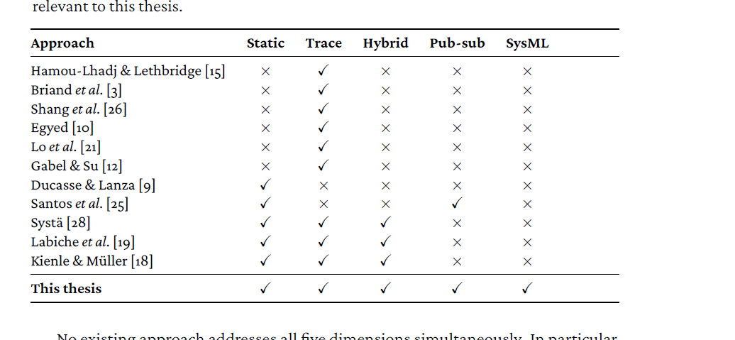
State of the Art & Research Gap
Trace-Based [1] | Static Analysis [2] | Hybrid (Existing) [1][3]
+ Concrete observed behaviour | + Complete static structure | + Used to reduce runtime logging
— Incomplete traces | — Over-approximation | — Assumes observed traces are complete
— Missing interactions | — No scenario focus | — Doesn’t complete missing interactions
Research Gap:
No existing approach infers unobserved interactions by combining static structure and runtime traces for generating scenario-specific interaction models in SysML v2 [1][3].
Hybrid Static–Trace Interaction Model Synthesis · Prathik Anand Krishnan · UvA · TNO-ESI
4
Notes:
Traces are often instrumentation-limited (logs, performance constraints) overheads, access constraints, and cost.
Static code analysis shows all the possible behaviors possible, but often lacks information about execution order and runtime conditions.
Hybrid approach is what we are going to perform – previously there has been some work done – but their goals and objectives have been different. Some used it to reduce logging and runtime instrumentation, other used it understand if they had control-flow loops in the execution path - such as repeated method invocations
Existing work either relies on traces, static structure, or uses hybrid analysis for other goals.
None focus on synthesizing interaction diagrams for a specific scenario when traces are incomplete.
Goal is to create a more richer, more accurate and more complete interaction diagrams – which can assist the engineers in taking architectural decisions
In contrast, this thesis assumes that runtime traces are incomplete and uses static call graphs to not only enrich observed behavior, but to infer unobserved interactions within a bounded scenario.

Slide 31
Research Questions
Hybrid Analysis - Interaction Diagram
Static Code Structure
Runtime Traces
RQ1: How does combining static analysis and runtime traces improve accuracy and completeness of scenario-specific interaction model reconstruction?
RQ2: How does guiding trace collection with the static call graph removes noise without losing scenario coverage?
RQ3: How well does a reconstructed SysML v2 interaction diagram consolidate static and dynamic evidence into a single artifact sufficient for system behaviour comprehension?
Hybrid Static–Trace Interaction Model Synthesis · Prathik Anand Krishnan · UvA · TNO-ESI
5

Slide 32
Codebase Selected: CpsCore [7]
Codebase overview:
A Modular Autopilot Framework for UAVs [7]
154 source/header files
~13,000 LOC (3,800 in .cpp files, 9,200 in headers)
Heavy template-based static polymorphism (~470 occurrences) vs. only 32 virtual method signatures across 12 files. All confined to one module (Utilities) or per-module config boundaries.
No cross-module call resolves through a virtual table. Inter-module calls go through concrete class references or boost::signals2 slot connections.
Test suite: 1,425 assertions across 61 test cases is the ground truth for behavioural verification.
Hybrid Static–Trace Interaction Model Synthesis · Prathik Anand Krishnan · UvA · TNO-ESI

Slide 33
Approach: Agent Skill Pipeline
Twelve modular, composable, LLM-invocable skills: eleven follow a fixed rule set, one (agentic synthesis) applies judgement instead.
Key design property: each skill is independently testable. Scenario focus is expressed as a natural-language query, translated into a Cypher query that scopes the graph before instrumentation runs — this is what makes guided instrumentation possible, the mechanism RQ2 actually tests (guiding trace collection with the static graph to remove noise without losing coverage).
Skill | Role in Final Pipeline
get-neo4j-schema | Static Analysis - graph introspection
text-to-cypher + get-cypher + cypher-to-output | Scenario-scoped query generation, execution & standalone Cypher authoring
get-interface-dependency-table | Static Analysis - Structural dependency extraction
get-sequence-dependency-table | Static Analysis – Sequence / call chain extraction
draw-sysml-structural-model | SysML v2 Output - BDD/IBD
draw-sysml-sequence-model | SysML v2 Output - Sequence Diagram
add-runtime-instrumentation | Trace Collection - csp_matcher probe injection
agentic-synthesis | Evidence judgement, pruning false positives
Hybrid Static–Trace Interaction Model Synthesis · Prathik Anand Krishnan · UvA · TNO-ESI
7
Notes:
BDD – Block Definition Diagram - Components (Blocks) Dependencies Associations Hierarchical relationships Composition relationships
IBD – Internal Block Diagram - Parts (instances of blocks) Ports Connectors Internal communication paths
IBD – to understand How these components communicate. BDD - These components exist.
Sequence Diagram - What happens during execution and in what order?

Slide 34
Four Evaluation Scenarios were Selected
Scenario | Nature | What it exercises | Test Case Reference
S1 | Pre-existing | Aggregation chain | RunnerTest.cpp "Synchronized Runner Test“, "Synchronized Runner Timeout"
S2 | Pre-existing | Config mapping | PropertyMapperTest.cpp All TEST_CASES (one per property type)
S3 | Pre-existing | Multi-component runner | RunnerTest.cpp and IPCTest.cpp ""Synchronized Runner Test", "IPC Test 1"
S4 | Constructed | Publish/subscribe dual-gap fault path | StageEventBridgeTest.cpp "Stage Event Bridge Pub-Sub Routing"
Hybrid Static–Trace Interaction Model Synthesis · Prathik Anand Krishnan · UvA · TNO-ESI
8

Slide 35
Reference Diagrams - Ground Truths
Hybrid Static–Trace Interaction Model Synthesis · Prathik Anand Krishnan · UvA · TNO-ESI
8

Slide 36
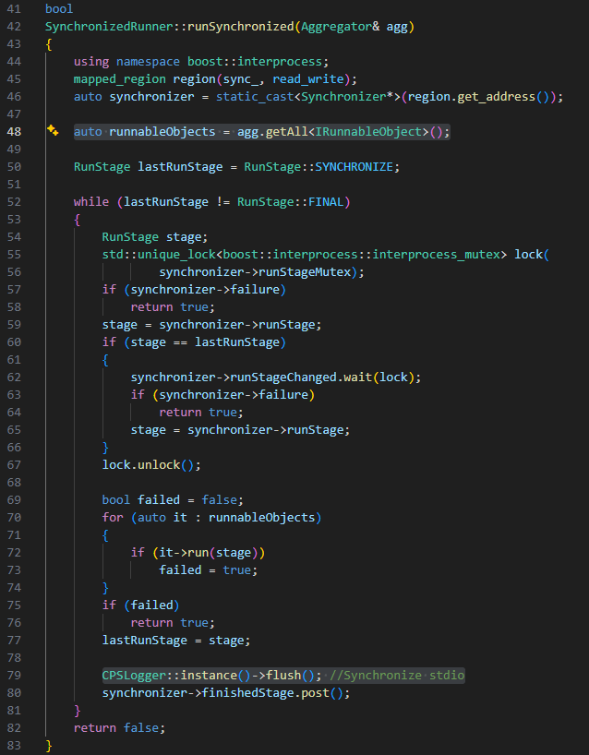
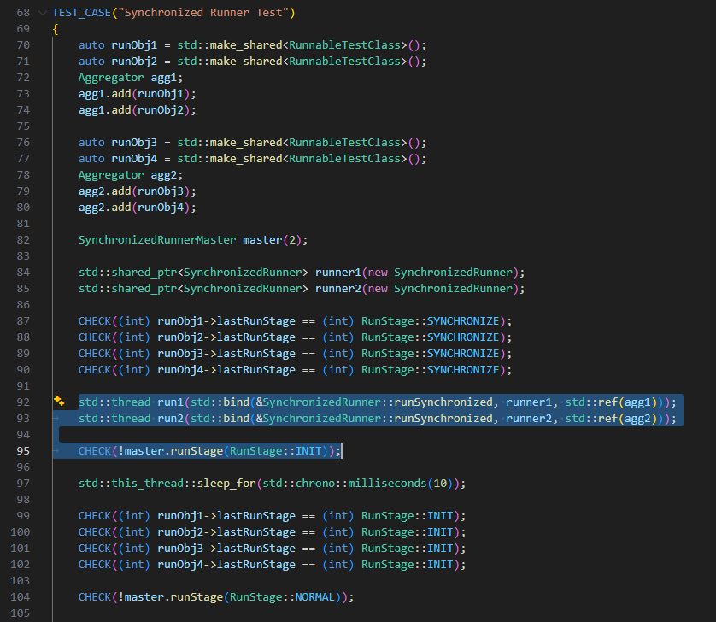
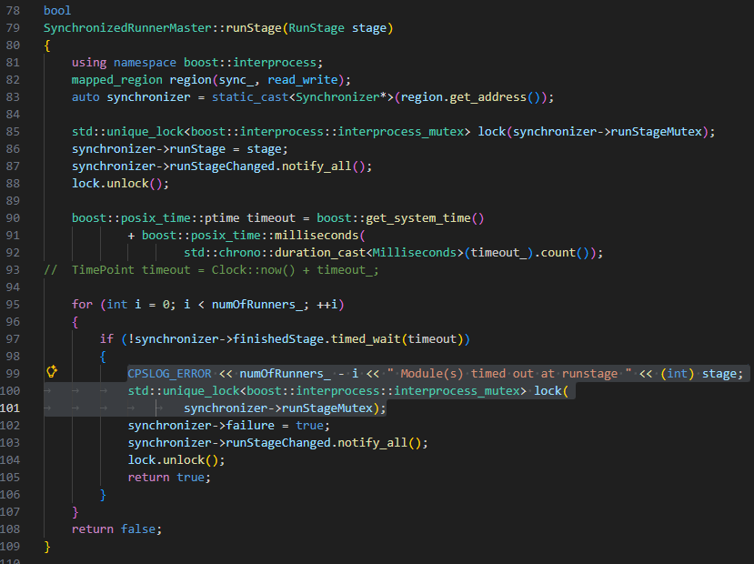
Ground Truth Explanation
Hybrid Static–Trace Interaction Model Synthesis · Prathik Anand Krishnan · UvA · TNO-ESI
8

Slide 37
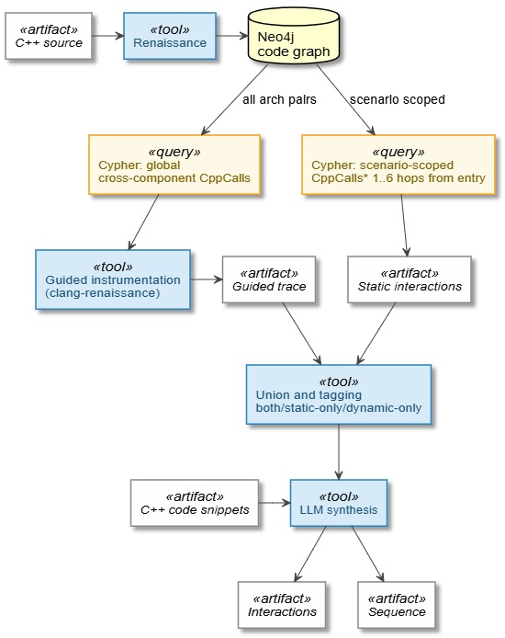
Methodology - The Hybrid Pipeline
Stage 1: Static Extraction
Stage 2: Code graph query
Stage 3: Dependency Matrix Extraction
Stage 5: Agentic Synthesis
Stage 6: SysML v2 Generation
Stage 4: Trace Instrumentation & collection
Renaissance C++ → Property graph
Property graph -> scenario-specific subgraph
Subgraphs -> dependency matrix
Dependency matrix -> Traces
Dependency Matrix + Traces -> Elements + Traces complete list
Scenario diagram
Final status:
All six stages complete, evaluated across four CPSCore scenarios (S1–S4) + An exploratory practitioner session on a second, much larger industrial codebase.
Three hypotheses H1, H2, H3 were confirmed.
Hybrid Static–Trace Interaction Model Synthesis · Prathik Anand Krishnan · UvA · TNO-ESI
6
Notes:
Scenario Definition
“We start by clearly defining a single functionality or algorithm as the scenario of interest. This keeps the scope focused and narrow and avoids over-generalizing the system’s behavior.”
Static Analysis
“We then apply dependency-based slicing on the code to retain only scenario-relevant components. This prunes irrelevant code paths and constrains what interactions are theoretically possible.”
Runtime Trace Collection
“Next, we collect timestamped runtime events corresponding to the scenario execution. Although these traces may be incomplete, they still provide concrete evidence and the order of execution information.”
Hybrid Reconstruction
“Static and dynamic information are then aligned through trace-to-code mapping. Static reachability analysis is used to infer missing interactions, but only when they are consistent with both code structure and observed traces.”
SysML v2 Interaction Diagram
“Finally, the reconstructed interactions are exported as SysML v2 interaction diagrams. These diagrams are scenario-specific, human-readable, and suitable for engineers and stakeholders.”
SysML v2 (Systems Modeling Language v2) is a next-gen textual modern, formal systems modeling language – which has its own textual syntax and formal semantics
SysML v2 provides formal semantics and a textual representation, making it suitable for automated generation and analysis. In this work, SysML v2 is used as the output representation to express reconstructed, scenario-specific interactions inferred from static code and runtime traces.

Slide 38
Stage 1 : Static Extraction: C++ → Property Graph
STAGE 1 / 6
RUNNING EDGE, ALL SIX STAGES
Synchronization::SynchronizedRunner::runSynchronized → Logging::CPSLogger::instance
Renaissance tool parses the whole cpsCore codebase into a Neo4j property graph: one node per declaration, definition, header, source file and folder. One edge per CppCalls / CppContains / CppUses / Include / Source / ParentFolder relationship.
type=CppCalls
source=cpp_funcdef//src/Synchronization/SynchronizedRunner.cpp/
SynchronizedRunner.runSynchronized
target=cpp_funcdec//include/cpsCore/Logging/CPSLogger.h/CPSLogger.instance
# sibling edge, same call site, different target:
type=CppCalls ... target=.../CPSLogger.h/CPSLogger.flush
67,104
nodes in the property graph
Our running edge exists as a raw CppCalls relationship between two function nodes, with a near-identical sibling edge to CPSLogger.flush — both fired from the exact same C++ statement. Nothing scenario-specific has happened yet.
Stage 2 is what carves S1 out of the other 67k nodes.

Slide 39
Stage 2 : Code Graph Query: Property Graph → S1 Subgraph
STAGE 2 / 6
RUNNING EDGE, ALL SIX STAGES
Synchronization::SynchronizedRunner::runSynchronized → Logging::CPSLogger::instance
User text: S1 scenario → Cypher query via text-to-cypher (schema-aware, built on get-neo4j-schema) → cypher-to-output skill then executes that query against the live graph, returning the S1-scoped subgraph.
// scoped to S1: Synchronization / Aggregation / Logging
MATCH (caller)-[:CppCalls]->(callee)
WHERE (caller.name CONTAINS '/src/Synchronization/'
OR caller.name CONTAINS '/include/cpsCore/Synchronization/')
AND (callee.name CONTAINS '/Aggregation/' OR callee.name CONTAINS '/Logging/')
RETURN DISTINCT
caller.name AS callerName, caller.symbol AS callerSymbol,
callee.name AS calleeName, callee.symbol AS calleeSymbol
Our running edge survives the filter — SynchronizedRunner.cpp is under /src/Synchronization/
CPSLogger.h is under /include/cpsCore/Logging/

Slide 40
Stage 3 : Dependency Matrix Extraction: Subgraph → Call Table
STAGE 3 / 6
The get-sequence-dependency-table skill flattens the graph into sequence_dependency_table.csv : one row per edge. One row per CppCalls edge via a direct Cypher query with file paths standing in for components. This is the static ground truth.
Seq | Event | Client file | Client fn | Server file | Server fn
149 | getAll | SynchronizedRunner.cpp | runSynchronized | Aggregator.h | getAll
264 | run | SynchronizedRunner.cpp | runSynchronized | IRunnableObject.h | run
291 | flush | SynchronizedRunner.cpp | runSynchronized | CPSLogger.h | flush
292 | instance | SynchronizedRunner.cpp | runSynchronized | CPSLogger.h | instance
139 | stream | SynchronizedRunnerMaster.cpp | SynchronizedRunnerMaster | CPSLogger.h | stream
Highlighted rows 291–292: two separate CppCalls edges from the exact same call site (CPSLogger::instance()->flush();)
Extracted as two rows because they're two distinct function calls chained on one line.

Slide 41
Stage 4 : Trace Instrumentation & Runtime Tracing
STAGE 4 / 6
RUNNING EDGE, ALL SIX STAGES
Synchronization::SynchronizedRunner::runSynchronized → Logging::CPSLogger::instance
The add-runtime-instrumentation skill injects trace emission points at the relevant call sites. rebuilds and runs the binary ("MultiThreaded Test 1", "IPC Test 1", "Synchronized Runner Test"), turning the captured [TRACE] output into runtime_traces.txt.
Every call the dependency matrix said could happen is now checked against what did happen, in real chronological order.
EventTimestamp | EventName | ClientComponent | ClientFunction | ServerComponent | ServerFunction
...686645Z|Aggregator.getAll|Synchronization|AggregatableRunner.notifyAggregationOnUpdate|Aggregation|...
...687645Z|RAIILogStream.stream|Synchronization|SimpleRunner.runAllStages|Logging|...
...688645Z|Aggregator.getAll|Synchronization|SimpleRunner.runStage|Aggregation|...
...689645Z|RAIILogStream.stream|Synchronization|SimpleRunner.runStage|Logging|...
...691645Z|RAIILogStream.stream|Synchronization|SimpleRunner.runStages|Logging|...
...693645Z|Aggregator.getAll|Synchronization|SynchronizedRunner.runSynchronized|Aggregation|...
...694645Z|CPSLogger.flush|Synchronization|SynchronizedRunner.runSynchronized|Logging|CPSLogger.flush
...695645Z|CPSLogger.instance|Synchronization|SynchronizedRunner.runSynchronized|Logging|CPSLogger.instance
...696645Z|RAIILogStream.stream|Synchronization|SynchronizedRunnerMaster.SynchronizedRunnerMaster|...
...697645Z|RAIILogStream.stream|Synchronization|SynchronizedRunnerMaster.runAllStages|Logging|...
...698645Z|RAIILogStream.stream|Synchronization|SynchronizedRunnerMaster.runStage|Logging|...
11 rows, all corroborating a static edge — our running edge is row 8, with its sibling flush at row 7, one millisecond earlier.

Slide 42
Stage 5 : Agentic Synthesis: Static + Dynamic → Elements
STAGE 5/6
This is the stage where an LLM touches the pipeline (gpt-5 via Azure OpenAI) independently. It receives static and dynamic evidence as two separately-labeled un-merged sources and reasons about corroboration, suppression and indirect dispatch itself. Outputs elements.json and sequence.json used to construct the SysML diagrams.
## STATIC EVIDENCE (no execution order)
# (a) suppressed at runtime -> still real, KEEP
# (b) over-approximation -> safe to DROP
Synchronization -> Logging : flush [ALSO dynamic]
Synchronization -> Logging : instance [ALSO dynamic]
## DYNAMIC EVIDENCE (real execution order)
[7] Sync -> Logging : flush
(from SynchronizedRunner.runSynchronized)
[8] Sync -> Logging : instance
(from SynchronizedRunner.runSynchronized)
// elements.json (final set)
{"source":"Synchronization","target":"Logging",
"interaction":"flush"},
{"source":"Synchronization","target":"Logging",
"interaction":"instance"},
...
// sequence.json, steps 7-8
{"step":7, ...,"interaction":"flush", "note":""}
{"step":8, ...,"interaction":"instance","note":""}
Empty "note" fields matter: The agent notes a step ONLY when it came from a single source. All 11 S1 steps corroborate both ways — the agent's judgment call is trivial here.

Slide 43
Stage 6 : SysML v2 Generation: Elements → Scenario Diagram
STAGE 6 / 6
SysML v2 structural and sequence models are generated using the draw-sysml-structural-model and draw-sysml-sequence-model agent skills. Each element becomes a typed port pair and each sequence step becomes a labelled SynchronousCall.
package ComponentModel_S1 {
port def Instance; // ...Flush, GetAll, Stream
part def Logging { port serverInstance : Instance; }
part def Synchronization { port clientInstance : Instance; }
part def S1System {
connect logging.serverInstance to synchronization.clientInstance;
}
}
package CPScoreInteractionModels_S1 {
part m8_instance : SynchronousCall {
ref from : Lifeline = synchronization;
ref to : Lifeline = logging;
attribute :>> label = "8. instance";
}
}

Slide 44
Whole Pipeline Summary
SUMMARY
1
2
3
4
5
6
Static Extraction
Code Graph Query
Dependency Matrix
Tracing & Collection
Agentic Synthesis
SysML Generation
Renaissance
Cypher
CSV export
run the scenario / tests
LLM
templating
• For S1 specifically, the agent's job is trivial: every static edge is corroborated by the trace and vice versa, so there's no disagreement to resolve.
• The pipeline's harder cases — like S4's suppressed fault-path log and boost::signals2 indirect dispatch are where Stage 5 actually has to do something non-trivial with the freedom it's given.
Notes:
The pipeline turns raw C++ into a scenario-specific SysML v2 diagram in six steps — extract the codebase into a property graph, scope it to the scenario, flatten it into a static call table, cross-check that against a real instrumented run, reconcile the two into elements.json and sequence.json using agent synthesis single LLM judgment call, then render the result. Five of the six steps are deterministic tooling; the LLM only ever sees evidence that's already been gathered and filtered for it

Slide 45
H1 Experiment Design
Five conditions, scored against a ground truth, across all four scenarios:
C1 — LLM-only (no code context)
C2 — Static graph only
C3 — Runtime traces only
C4 — Static ∪ Dynamic (raw union)
C5 — Intersection (Static ∩ Dynamic)
C6 — Full pipeline (C4 + agent synthesis / pruning false positives)
Every entry in REF (reference) and GEN (generated) is a normalized (source, target, interaction) triple.
Metrics applied over these triple: Precision = |gen∩ref|/|gen| => TP / (TP + FP) ; Recall = |gen∩ref|/|ref|=> R = TP / (TP + FN) ; F1 = 2PR/(P+R)
Hybrid Static–Trace Interaction Model Synthesis · Prathik Anand Krishnan · UvA · TNO-ESI
12
Notes:
True Positive: a triple the reference expects and the generated file has
False Positive: a triple the generated file has that isn't in the reference — an invented edge (GEN − REF)
False Negative: a triple the reference expects that the generated file is missing (REF − GEN)
Precision asks "of what I generated, how much was right"; recall asks "of what should be there, how much did I find"

Slide 46
H1 – Metrics Calculations for Scenario 1
S1- Reference (REF):
[ { "source": "Synchronization", "target": "Aggregation", "interaction": "Aggregator.getAll" }, // Runner.Test
{ "source": "Synchronization", "target": "Logging", "interaction": "CPSLogger.flush" }, // Runner.Test
{ "source": "Synchronization", "target": "Aggregation", "interaction": "Aggregator.getAll" }, // Runner.Timeout
{ "source": "Synchronization", "target": "Logging", "interaction": "CPSLogger.flush" }, // Runner.Timeout
{ "source": "Synchronization", "target": "Logging", "interaction": "RAIILogStream.stream" } ] // Runner.Timeout
S1- C1_LLM_only (GEN):
TP=3, FP=0, FN=2 · P=3/(3+0)=1.00 · R=3/(3+2)=.60 · F1=2(1)(.6)/(1.6)=.75
[ { "source": "Synchronization", "target": "Aggregation", "interaction": "Aggregator.getAll" }, TP1 // Runner.Test
{ "source": "Synchronization", "target": "Logging", "interaction": "CPSLogger.flush" }, TP2 // Runner.Test
{ "source": "Synchronization", "target": "Logging", "interaction": "RAIILogStream.stream" } ] TP3 // Runner.Timeout
[ { "source": "Synchronization", "target": "Aggregation", "interaction": "Aggregator.getAll" }, FN1 // Runner.Timeout
{ "source": "Synchronization", "target": "Logging", "interaction": "CPSLogger.flush" } ] FN2 // Runner.Timeout
So, TP=3 and FN=2: C1 gets both Runner.Test edges right but on Runner.Timeout reports only stream, missing getAll/flush for that test entirely. An LLM reasons over the raw scenario description alone, no static graph, no trace. Baseline for what's inferable with zero pipeline evidence.
Hybrid Static–Trace Interaction Model Synthesis · Prathik Anand Krishnan · UvA · TNO-ESI
12

Slide 47
H1 – Metrics Calculations for Scenario 1
S1- C2_Static (GEN):
[ { "source": "Synchronization", "target": "Aggregation", "interaction": "getAll" }, TP1 // Runner.Test
{ "source": "Synchronization", "target": "Logging", "interaction": "flush" }, TP2 // Runner.Test
{ "source": "Synchronization", "target": "Logging", "interaction": "instance" }, FP1 // Runner.Test
{ "source": "Synchronization", "target": "Logging", "interaction": "stream" }, FP2 // Runner.Test
{ "source": "Synchronization", "target": "Aggregation", "interaction": "getAll" }, TP3 // Runner.Timeout
{ "source": "Synchronization", "target": "Logging", "interaction": "flush" }, TP4 // Runner.Timeout
{ "source": "Synchronization", "target": "Logging", "interaction": "instance" }, FP3 // Runner.Timeout
{ "source": "Synchronization", "target": "Logging", "interaction": "stream" } ] TP5 // Runner.Timeout
TP=5, FP=3, FN=0 P=5/(5+3)=.63 R=5/(5+0)=1.00 F1=2(.625)(1)/(1.625)=.77
So, TP=5 and FP=3: static finds every real edge on both tests, but also reports instance (never in either reference), and on Runner.Test alone, stream — a call that's only actually in scope once Runner.Timeout's CPSLogger::instance()->setLogLevel path runs. Static analysis can't tell the two tests apart.
Static Only: The scenario-scoped static call graph (CppCalls edges from Renaissance/Neo4j) alone. Sees everything reachable in source, whether or not it actually runs.
Hybrid Static–Trace Interaction Model Synthesis · Prathik Anand Krishnan · UvA · TNO-ESI
12

Slide 48
H1 – Metrics Calculations for Scenario 1
S1- C3_Dynamic (GEN):
[ { "source": "Aggregation", "target": "Logging", "interaction": "RAIILogStream.stream" }, FP1 // Runner.Test
{ "source": "Synchronization", "target": "Aggregation", "interaction": "Aggregator.getAll" }, TP1 // Runner.Test
{ "source": "Synchronization", "target": "Logging", "interaction": "CPSLogger.flush" }, TP2 // Runner.Test
{ "source": "Aggregation", "target": "Logging", "interaction": "RAIILogStream.stream" }, FP2 // Runner.Timeout
{ "source": "Synchronization", "target": "Aggregation", "interaction": "Aggregator.getAll" }, TP3 // Runner.Timeout
{ "source": "Synchronization", "target": "Logging", "interaction": "CPSLogger.flush" }, TP4 // Runner.Timeout
{ "source": "Synchronization", "target": "Logging", "interaction": "RAIILogStream.stream" } ] TP5 // Runner.Timeout
TP=5, FP=2, FN=0 P=5/(5+2)=.71
R= 5/(5+0)= 1.00 F1=2(.714)(1)/(1.714)=.83
So, TP=5 and FP=2: the trace recovers every real edge on both tests, but each run also captures one incidental Aggregation→Logging:stream row — Aggregator.add's own logging call, firing in the same process, unrelated to this scenario.
Dynamic Only: The real runtime trace (csp_matcher instrumentation) alone. Sees only what actually executed during the test, nothing more.
Hybrid Static–Trace Interaction Model Synthesis · Prathik Anand Krishnan · UvA · TNO-ESI
12

Slide 49
H1 – Metrics Calculations for Scenario 1
S1- C4_ Static + Dynamic (GEN) :
[ { "source": "Aggregation", "target": "Logging", "interaction": "stream" }, FP1 // Runner.Test
{ "source": "Synchronization", "target": "Aggregation", "interaction": "getAll" }, TP1 // Runner.Test
{ "source": "Synchronization", "target": "Logging", "interaction": "flush" }, TP2 // Runner.Test
{ "source": "Synchronization", "target": "Logging", "interaction": "instance" }, FP2 // Runner.Test
{ "source": "Synchronization", "target": "Logging", "interaction": "stream" }, FP3 // Runner.Test
{ "source": "Aggregation", "target": "Logging", "interaction": "stream" }, FP4 // Runner.Timeout
{ "source": "Synchronization", "target": "Aggregation", "interaction": "getAll" }, TP3 // Runner.Timeout
{ "source": "Synchronization", "target": "Logging", "interaction": "flush" }, TP4 // Runner.Timeout
{ "source": "Synchronization", "target": "Logging", "interaction": "instance" }, FP5 // Runner.Timeout
{ "source": "Synchronization", "target": "Logging", "interaction": "stream" } ] TP5 // Runner.Timeout
TP=5, FP=5, FN=0 P=5/(5+5)=.50
R=5/(5+0)=1.00 F1=2(.5)(1)/(1.5)=.67
So, TP=5 and FP=5: union inherits every false positive from both sources on both tests. C2's instance plus C3's incidental stream with nothing to cancel them
Static + Dynamic (union): Every edge either C2 or C3 reports, pooled together with no filtering. Inherits both sources' false positives along with their true positives
Hybrid Static–Trace Interaction Model Synthesis · Prathik Anand Krishnan · UvA · TNO-ESI
12

Slide 50
H1 – Metrics Calculations for Scenario 1
S1- C5_ Intersection (GEN):
[ { "source": "Synchronization", "target": "Aggregation", "interaction": "Aggregator.getAll" }, TP1 // Runner.Test
{ "source": "Synchronization", "target": "Logging", "interaction": "CPSLogger.flush" }, TP2 // Runner.Test
{ "source": "Synchronization", "target": "Aggregation", "interaction": "Aggregator.getAll" }, TP3 // Runner.Timeout
{ "source": "Synchronization", "target": "Logging", "interaction": "CPSLogger.flush" }, TP4 // Runner.Timeout
{ "source": "Synchronization", "target": "Logging", "interaction": "RAIILogStream.stream" } ] TP5 // Runner.Timeout
TP=5, FP=0, FN=0
P=5/(5+0) = 1.00
R= 5/(5+0) = 1.00
F1= 5/(5+0) =1.00
So, TP=5 and FP=0: Only edges both C2 and C3 independently confirm survive on both tests. C2's instance isn't seen by the trace, and C3's incidental stream isn't seen statically. Neither passes, nothing real lost.
Intersection: Only edges both C2 and C3 independently report. Pure set algebra, no LLM is involved. This case cancels each source's own false positives, at the cost of dropping any true edge only one source sees.
Hybrid Static–Trace Interaction Model Synthesis · Prathik Anand Krishnan · UvA · TNO-ESI
12

Slide 51
H1 – Metrics Calculations for Scenario 1
S1- C6_ Static + Dynamic + LLM (GEN):
[ { "source": "Synchronization", "target": "Aggregation", "interaction": "getAll" }, TP1 // Runner.Test
{ "source": "Synchronization", "target": "Logging", "interaction": "flush" }, TP2 // Runner.Test
{ "source": "Synchronization", "target": "Aggregation", "interaction": "getAll" }, TP3 // Runner.Timeout
{ "source": "Synchronization", "target": "Logging", "interaction": "flush" }, TP4 // Runner.Timeout
{ "source": "Synchronization", "target": "Logging", "interaction": "stream" } ] TP5 // Runner.Timeout
TP=5, FP=0, FN=0 ·
P= 5/(5+0) = 1.00
R= 5/(5+0) = 1.00
F1= 5/(5+0) =1.00
So, TP=5 and FP=0, matching C5: the agent discards both single-source edges as unconfirmed on both tests. S1 doesn't exercise a case where C6's judgement and C5's set algebra actually diverge — that's S3 and S4.
Full pipeline: An LLM gets C2 and C3 as separately-labelled evidence (not pre-merged) and judges each disputed single-source edge by provenance, plus orders the reconstructed sequence. The complete approach this thesis proposes.
Hybrid Static–Trace Interaction Model Synthesis · Prathik Anand Krishnan · UvA · TNO-ESI
12

Slide 52
H1 Results: Precision / Recall / F1
Condition | Scenario 1 |  |  | Scenario 2 |  |  | Scenario 3 |  |  | Constructed (S4) |  |  | Macro F1
 | P | R | F1 | P | R | F1 | P | R | F1 | P | R | F1
C1 LLM-only | 1.00 | .60 | .75 | 0 | 0 | 0.00 | .33 | .33 | .33 | .25 | 1.00 | .40 | .371
C2 Static-only | .63 | 1.00 | .77 | 1.00 | 1.00 | 1.00 | 1.00 | .33 | .50 | .50 | 1.00 | .67 | .734
C3 Dynamic-only | .71 | 1.00 | .83 | 1.00 | 1.00 | 1.00 | 1.00 | 1.00 | 1.00 | .50 | 1.00 | .67 | .875
C4 Static+Dynamic | .50 | 1.00 | .67 | 1.00 | 1.00 | 1.00 | 1.00 | 1.00 | 1.00 | .33 | 1.00 | .50 | .792
C5 Intersection | 1.00 | 1.00 | 1.00 | 1.00 | 1.00 | 1.00 | 1.00 | .33 | .50 | 1.00 | 1.00 | 1.00 | .875
C6 Full pipeline | 1.00 | 1.00 | 1.00 | 1.00 | 1.00 | 1.00 | .75 | 1.00 | .86 | .33 | 1.00 | .50 | .840
Hybrid Static–Trace Interaction Model Synthesis · Prathik Anand Krishnan · UvA · TNO-ESI
13

Slide 53
H1 Interpretation — Why the Numbers Look This Way
Naive union (C4) is not protective on S4 — It can inherits each source's false positives. It doesn’t hold good on S4 (F1 0.500). But it holds good for all other 3 scenarios.
Intersection (C5) — Pure set algebra, no LLM is the actual best condition overall on interaction accuracy (F1 0.875, tied with dynamic-only), by cancelling each source's independent false positives.
Intersection is recall-bounded, not free: On S3 it's capped at C2's own weak recall (0.333), since C2 can't resolve a std::function - dispatched call C3 sees directly.
The full pipeline (C6) doesn't win on edge accuracy (F1 0.84, behind C5/C3) : It over-generates on S4 and fabricates an edge on S3. Its real value is sequence ordering, not precision/recall.
Bottom line: combining helps only via agreement, never via pooling and the LLM's contribution is presentation not correctness.
Hybrid Static–Trace Interaction Model Synthesis · Prathik Anand Krishnan · UvA · TNO-ESI
14

Slide 54
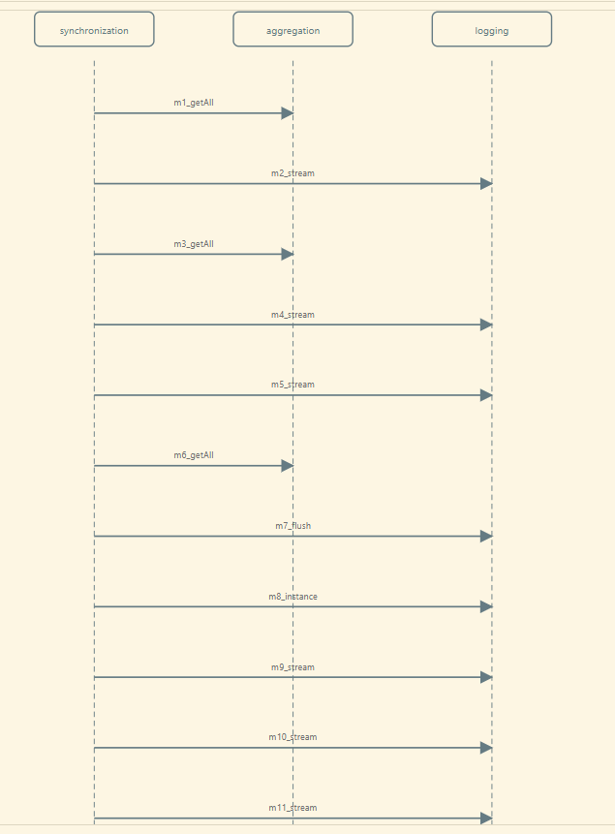
Scenario 1 - Outputs
S1 - Shows the widest fan-in: 4 Synchronization drivers all reach into both Aggregation and Logging.
4 reference interactions (getAll, stream, flush, instance)
Hybrid Static–Trace Interaction Model Synthesis · Prathik Anand Krishnan · UvA · TNO-ESI
8

Slide 55
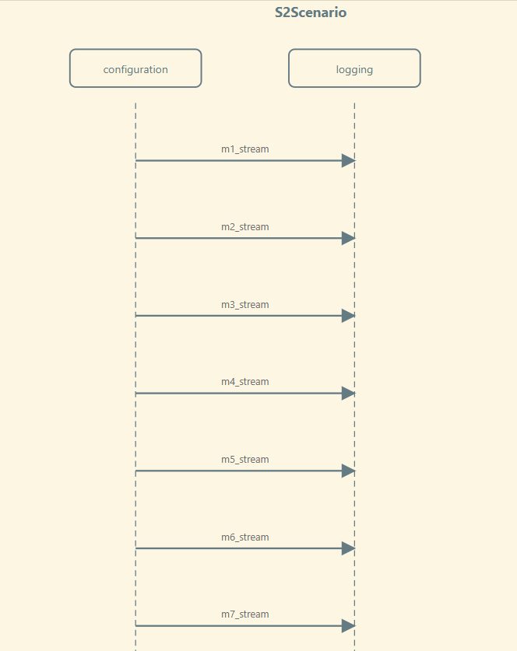
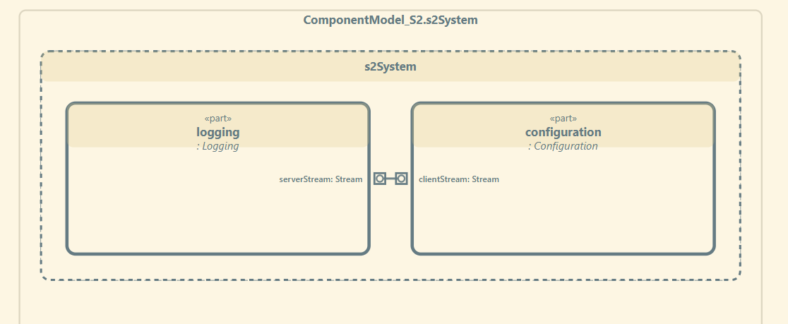
Scenario 2 - Outputs
S2 - one linear dependency, Configuration into Logging.
A mostly-static, linear chain (PropertyMapper.add variants → RAIILogStream.stream). The easy-case baseline — expected to be reconstructed well even by static-only analysis.
1 reference interaction (stream)
Hybrid Static–Trace Interaction Model Synthesis · Prathik Anand Krishnan · UvA · TNO-ESI
9

Slide 56
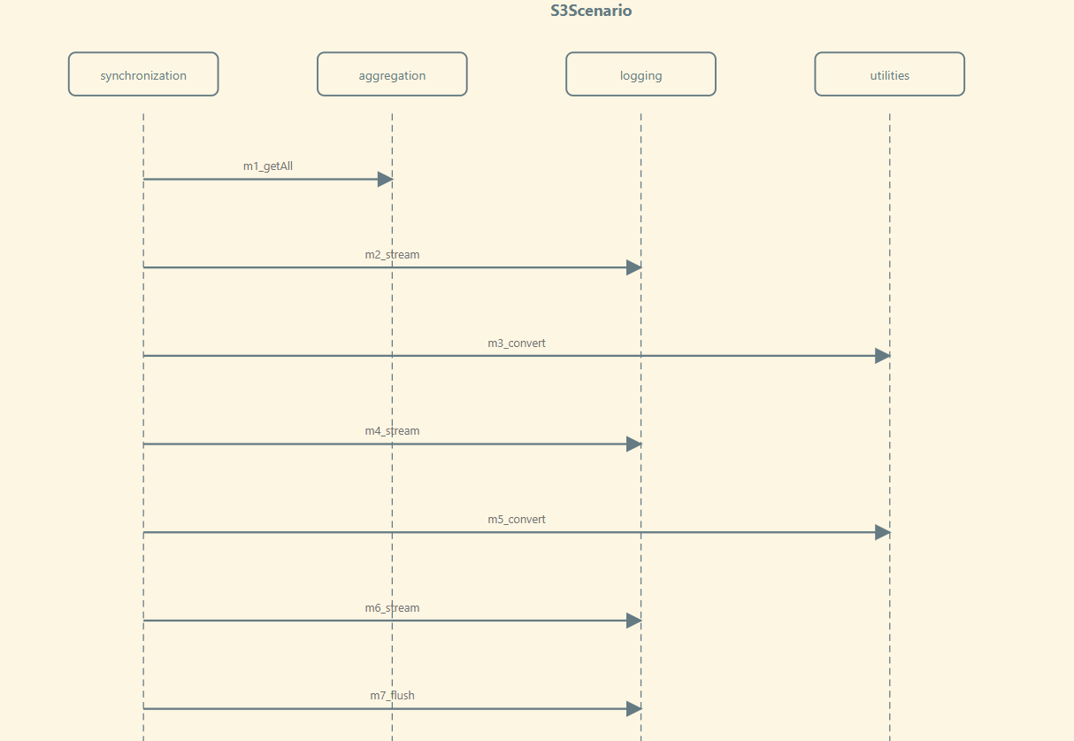
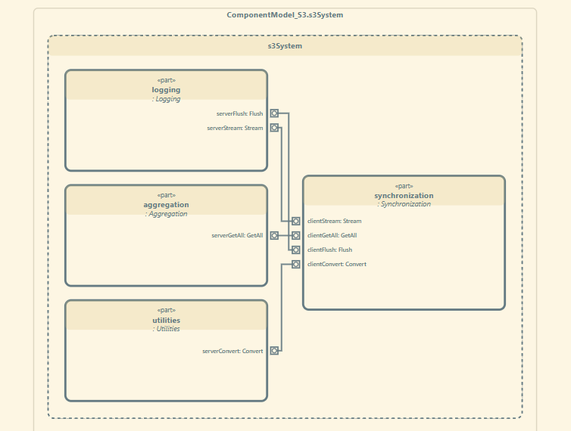
Scenario 3 - Outputs
S3 - SimpleRunner.runStage in Synchronization” fans out to all three of the other modules at once. The case where static analysis alone produces false-positive edges.
SimpleRunner.runStage to Aggregator, EnumMap, and Logging simultaneously.
The hardest static case — templated static dispatch produces false-positive static edge (instance) that only the full agentic pipeline (C5) eliminates.
4 reference interactions (getAll, stream, convert, flush)
Hybrid Static–Trace Interaction Model Synthesis · Prathik Anand Krishnan · UvA · TNO-ESI
10

Slide 57
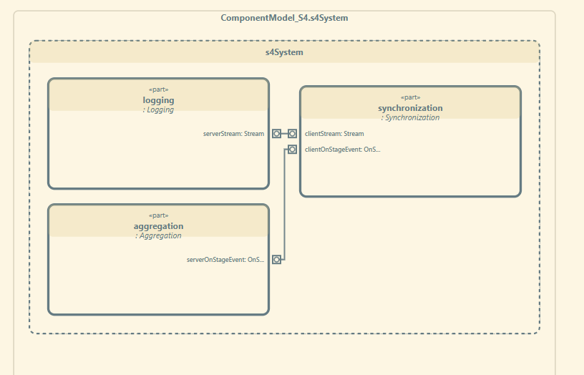
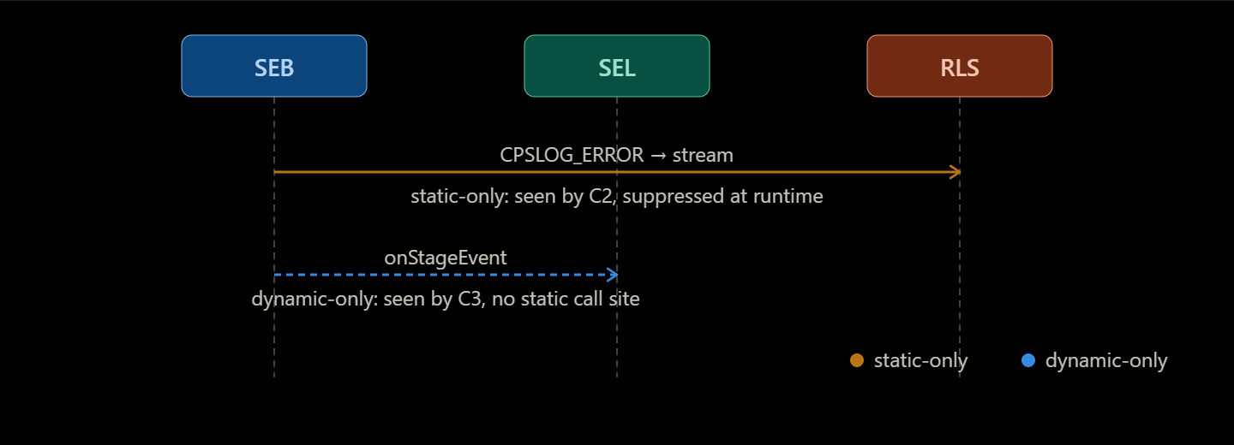
Scenario 4 - Outputs
S4 is the constructed dual-gap case: StageEventBridge() has two outgoing edges and each evidence source only sees one of them.
The amber edge is static-only (runtime-suppressed) and the blue dashed edge is dynamic-only (no static call site at all).
The only scenario where static and dynamic each catch a different edge, so combination is strictly additive.
2 reference interactions (stream, onStageEvent)
Hybrid Static–Trace Interaction Model Synthesis · Prathik Anand Krishnan · UvA · TNO-ESI
11

Slide 58
H2 Results in Detail: Noise, Coverage & Expert Ratings
Metric | Full | Guided | What it means
Nodes (mean) | 6.0 | 3.0 | Full pulls in 2× as many components per scenario as guided on average.
Edges (mean) | 9.0 | 2.7 | Full shows 3.3× as many component-pairs on average.
Coverage (0-1.0) | 1.000 | 1.000 | Identical
Noise (0-1.0) | 0.704 | 0.000 | 70% of Full doesn't belong to scenario.
Accuracy (6-rater mean, 1–5) | 2.39 | 4.61 | Raters penalize diagrams where they can't tell which edges actually matter.
Readability (6-rater mean, 1–5) | 2.44 | 4.89 | Fewer nodes/edges directly means less to visually parse.
Usefulness (6-rater mean, 1–5) | 2.94 | 4.00 | One rater found a few "extra" Full-edges is marginally useful as context even while rating them as noise elsewhere.
Setup: Full instrumentation (probe everything, filter after) vs. Guided (slice first, probe only scenario-relevant call sites), on S1–S3.
Standout: Across 6 raters × 9 scenario-dimension pairs = 54 comparisons: Guided rated strictly higher in 47, tied in 6, lower in exactly 1: The single dissent traced to collapsing 7 repeated Configuration→Logging into 1. A trade-off, not a defect.
Hybrid Static–Trace Interaction Model Synthesis · Prathik Anand Krishnan · UvA · TNO-ESI
15

Slide 59
H3 Setup & Results : Diagram Utility
Setup: Does the pipeline's output (the C5 interaction list) help an LLM agent comprehend a scenario — alone, and in combination with source and traces? A single holistic experiment, five conditions, across all four scenarios.
Standout: Diagram only equals Source+Trace+Diagram on every measure. Even with no source and no trace, the reconstructed diagram alone is already a sufficient basis for scenario comprehension.
Condition | Component recall | Interaction recall | Completeness (1–5)
Source only | 0.917 | 0.800 | 4.25
Trace only | 0.917 | 0.900 | 4.25
Diagram only | 1.000 | 1.000 | 5.00
Source + Trace | 0.917 | 0.900 | 4.25
Source + Trace + Diagram | 1.000 | 1.000 | 5.00
Hybrid Static–Trace Interaction Model Synthesis · Prathik Anand Krishnan · UvA · TNO-ESI
16

Slide 60
What Was Produced: SysML v2 Artifacts
Structural and Interconnection Model:
part def for each C++ component
port def for dependencies
connect statements for provider-consumer relationships
Sequence Model:
Interaction flows built from elements.json/sequence.json, the agentic-synthesis skill's output combining static call chains with collected runtime trace events.
Static-only, dynamic-only, raw-combined and synthesis-pruned interaction diagrams (S1/S2/S2/S4)
These form the five evaluation conditions (C1–C6) compared in H1, across all four CPSCore scenarios.
Hybrid Static–Trace Interaction Model Synthesis · Prathik Anand Krishnan · UvA · TNO-ESI
18
Notes:
A Block Definition Diagram (BDD) describes the static structure of the system by showing components and their relationships. An Internal Block Diagram (IBD) refines those components by showing their ports, interfaces, and connectors, explaining how they interact internally. In my project, dependency extraction is used to generate BDDs, while function-level interaction analysis is used to infer ports and generate IBDs. IBD – to understand How these components communicate. BDD - These components exist.

Slide 61
Trace Collection & Practitioner Validation
Goal:
Capture timestamped runtime Trace events from the CPSCore system
What was delivered:
csp_matcher: a Clang LibTooling-based instrumentation tool (developed with Dr. Rosilde Corvino) — AST-level pattern matching inserts and removes trace probes
Practitioner validation session: 4 engineers, second industrial codebase (orders of magnitude larger than CPSCore), via a GitHub Copilot MCP integration
Task: locate a real, previously-resolved proxy-leak defect using only the static graph
Participants correctly identified the modified file, the relevant test, and the proxy's construction/release sites
Independent cross-check: a ClangSharp (libclang) GraphML extractor validated against the Renaissance/Neo4j extraction
Hybrid Static–Trace Interaction Model Synthesis · Prathik Anand Krishnan · UvA · TNO-ESI
19

Slide 62
Research Questions: Where Each Stands
RQ | Question | Status
RQ1 | Does combining a static call graph with runtime execution traces reconstruct scenario-specific Interaction Models more accurately than either source alone? | Confirmed (H1): Intersection (C5) reaches macro-F1 = 0.875. Full pipeline (C6) reaches 0.839 with perfect recall on all four scenarios. Intersection is additive on constructed S4 (F1 1.000 vs. 0.667 for either source alone, naive union scores 0.500).
RQ2 | Does guiding trace collection with the static call graph remove reconstruction noise without losing scenario coverage? | Confirmed (H2): guided instrumentation cuts retained nodes by 50% and edges by 70%; a blinded panel preferred guided diagram in 47 of 54 comparisons.
RQ3 | How well does a reconstructed SysML Interaction Model consolidate static and dynamic evidence into a single artefact sufficient for system-behaviour comprehension? | Confirmed (H3): the diagram alone reaches perfect component recall, interaction recall and completeness.
Hybrid Static–Trace Interaction Model Synthesis · Prathik Anand Krishnan · UvA · TNO-ESI
20
Notes:
A Block Definition Diagram (BDD) describes the static structure of the system by showing components and their relationships. An Internal Block Diagram (IBD) refines those components by showing their ports, interfaces, and connectors, explaining how they interact internally. In my project, dependency extraction is used to generate BDDs, while function-level interaction analysis is used to infer ports and generate IBDs.

Slide 63
Challenges Encountered & How They Were Resolved
Challenges | Solutions
C++ is context-sensitive — regex/simple parsers fail | Used the Renaissance semantic-extraction tool + Neo4j property graph.
Thousands of dependencies make SysML toolchains very slow | scenario-scoped Cypher queries trim the graph before generation
Hardcoded scenario scoping is brittle | Agent skill architecture (12 skills) expresses scenario definition as a natural-language query via text-to-cypher
Traces alone are incomplete | Confirmed empirically (H1): static reachability recovers what traces miss and combining is strictly additive S4 (F1 1.000 vs. 0.667 for either source alone)
Hybrid Static–Trace Interaction Model Synthesis · Prathik Anand Krishnan · UvA · TNO-ESI
21

Slide 64
Overall Summary
What was proposed:
Hybrid static + trace pipeline → scenario-specific SysML v2 interaction diagrams
What was delivered:
Neo4j knowledge graph of CPSCore - 121 components, 2,574 ordered static interactions (complete)
12 composable agent skills spanning extraction → scenario scoping → instrumentation → agentic synthesis → SysML v2 / Mermaid generation (complete)
csp_matcher runtime instrumentation tool.
H1/H2/H3 confirmed on 6 scenarios: Intersection macro-F1 0.875 and Full pipeline macro-F1 0.840; guided instrumentation cuts noise 100% with zero coverage loss; the reconstructed diagram alone achieves perfect comprehension recall
Beyond the plan:
Exploratory practitioner session - 4 engineers, second much larger industrial codebase, via GitHub Copilot MCP integration; resolved a real proxy-leak defect using only the static graph.
Future work:
Controlled replication on a second system, richer diagram labelling & interactivity, temporal-ordering accuracy, incremental graph updates
Hybrid Static–Trace Interaction Model Synthesis · Prathik Anand Krishnan · UvA · TNO-ESI
22

Slide 65
[1] Cornelissen, B., Zaidman, A., van Deursen, A., Moonen, L., Koschke, R. "A Systematic Survey of Program Comprehension through Dynamic Analysis." IEEE Transactions on Software Engineering, 35(5), 684–702, 2009. [2] Systä, T. "Static and Dynamic Reverse Engineering Techniques for Java Software Systems." University of Tampere, Dept. of Computer Science, 2000. [3] Labiche, Y., Kolbah, B., Mehrfard, H. "Combining Static and Dynamic Analyses to Reverse-Engineer Scenario Diagrams." Proc. 29th IEEE International Conference on Software Maintenance (ICSM), 130–139, 2013. [4] Egyed, A. "A Scenario-Driven Approach to Trace Dependency Analysis." IEEE Transactions on Software Engineering, 29(2), 116–132, 2003. [5] Helm, D., Keidel, S., Kampkötter, A., Düsing, J., Roth, T., Hermann, B., Mezini, M. "Total Recall? How Good Are Static Call Graphs Really?" Proc. 33rd ACM SIGSOFT ISSTA, 2024. [6] Manning, C. D., Raghavan, P., Schütze, H. Introduction to Information Retrieval. Cambridge University Press, 2008. [7] Theile, M., Dantsker, O. D., Nai, R., Caccamo, M., Yu, S. "uavAP: A Modular Autopilot Framework for UAVs." AIAA AVIATION 2020 Forum, 3268, 2020. (CPSCore, the case study framework)
References

Slide 66
Thank you!
Hybrid Static–Trace Interaction Model Synthesis · Prathik Anand Krishnan · TNO-ESI / UvA

Slide 67
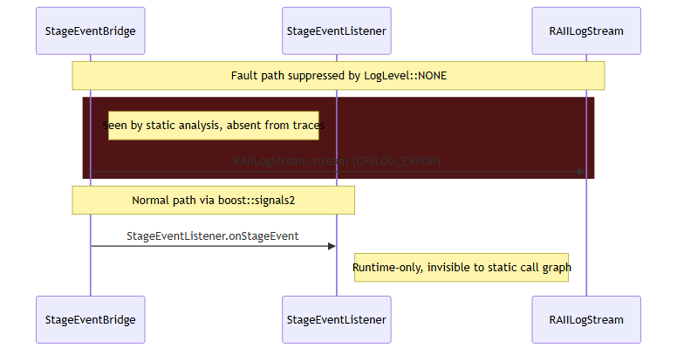
Example Output: The S4 Dual-Gap, Recovered
stream — recovered from static evidence (runtime-suppressed by a LogLevel::NONE no-op)
onStageEvent — recovered from the trace (a runtime connect(); no static call site exists)
Only the fused graph (C4/C5) surfaces both edges in one scenario-specific SysML v2 diagram — the concrete illustration of H1's headline finding.
Hybrid Static–Trace Interaction Model Synthesis · Prathik Anand Krishnan · UvA · TNO-ESI
17

Slide 68
Research Questions & Goal
Hybrid Analysis - Interaction Diagram
Static Code Structure
Runtime Traces
RQ2: How can scenario-scoped querying of the static call graph restrict reconstruction to only scenario-relevant behaviour?
Confirmed — H2
RQ1: How does combining static analysis and runtime traces improve accuracy and completeness of scenario-specific interaction model reconstruction? Confirmed — H1
RQ3: Do reconstructed interaction models improve agent task performance on scenario comprehension, vs. source code alone? Confirmed — H3
Hybrid Static–Trace Interaction Model Synthesis · Prathik Anand Krishnan · TNO-ESI / UvA
Notes:
The goal is to combine static code structure and incomplete runtime traces to synthesize a scenario-specific interaction diagram in SysML v2
How can we filter both code and traces so we only focus on behavior relevant to a given scenario?
What kind of graph can meaningfully combine static call relationships with timestamped runtime events?
Does combining both actually improve completeness and accuracy compared to static-only or trace-only approaches?
Static and dynamic information are then aligned through trace-to-code mapping.
who talks to whom, in what order, under which conditions

Slide 69
Motivation - Understanding The Behaviour
The setting
• Long-lived, safety-critical systems evolve continuously.
• Behaviour is captured by Interaction Models. ex: Scenario-specific sequence diagrams.
• In practice these diagrams drift with the code and become unreliable.
• Engineers must reconstruct behaviour by hand: slow, error-prone and expertise-dependent.
• Event-driven systems make this worse: async callbacks and pub/sub.
A REAL DEFECT THIS WOULD HAVE CAUGHT
• A stale proxy object was never released: A reset call was missing from the connection-handling code.
• After a service restart, the system silently stopped delivering change-notification events.
• The fault was visible only by following an implicit chain of events that no interaction model showed.
• Diagnosing it meant manually re-constructing exactly the kind of model this thesis automates.
Hybrid Static–Trace Interaction Model Synthesis · Prathik Anand Krishnan · TNO-ESI / UvA
3
Notes:
[2:00] The systems I care about are long-lived and safety-critical — think
medical imaging or industrial automation. Their behaviour is supposed to be
captured in interaction models, i.e. sequence diagrams. But in practice those
diagrams drift out of sync as the code evolves, so engineers end up
reconstructing behaviour by hand — slow and expertise-dependent. Event-driven
systems make it harder because async callbacks and pub/sub hide who talks to
whom.
On the right is a real, previously-resolved defect that motivated the work: a
stale proxy was never freed because a reset call was missing, and after a
restart the system silently stopped delivering notifications. It was only
visible by tracing an implicit event chain that no diagram showed — exactly the
kind of model this thesis reconstructs automatically.

Slide 70
Recap: Original 5-Stage Methodology
Scenario Definition → Static Analysis → Runtime Trace Collection → Hybrid Reconstruction → SysML v2 Interaction Diagram
Planned milestone by mid-semester:
Complete static analysis (Weeks 4–7) and begin trace collection & mapping (Weeks 7–10)
Actual position today:
Static analysis complete + SysML v2 output partially achieved ahead of schedule.
Trace collection in active progress.
Hybrid Static–Trace Interaction Model Synthesis · Prathik Anand Krishnan · TNO-ESI / UvA

Slide 71
Progress Against Original Timeline
Weeks 1–3: Literature & Scoping -- Done
Weeks 4–7: Static Analysis -- Done (evolved)
Weeks 7–10: Trace Collection & Mapping -- In progress
Weeks 10–13: Hybrid Reconstruction -- Not started
Weeks 13–17: Modelling & Evaluation -- Partially ahead
Weeks 17–21: Writing -- Planned
Overall: On track. One significant architectural evolution in the static analysis approach.
Hybrid Static–Trace Interaction Model Synthesis · Prathik Anand Krishnan · TNO-ESI / UvA

Slide 72
What Changed: The Static Analysis Layer Evolved
Originally proposed: Scenario-specific dependency-based code slicing directly on C++ source
What was built instead:
The graph representation directly addresses RQ2 ("What intermediate property graph can integrate static call graphs and runtime events?") - it is the unified IR (Neo4j Property Graph) that both static slices and runtime trace events will be merged into. The agent skill layer also makes the pipeline query-able without hardcoding scenario-specific logic.
C++ Source Code
Neo4j Property Graph (via Renaissance tool)
- Typed Nodes: Components, Functions, Namespaces
- Typed Edges: CALLS, INCLUDES, INHERITS, USES
LLM Agent Skill Pipeline (Cypher-based queries) - Natural language to graph queries - Dependency and sequence tables as intermediate output
Hybrid Static–Trace Interaction Model Synthesis · Prathik Anand Krishnan · TNO-ESI / UvA

Slide 73
Progress Against Original Timeline
Weeks 1–3: Literature & Scoping -- Done
Weeks 4–7: Static Analysis -- Done (evolved)
Weeks 7–10: Trace Collection & Mapping -- In progress
Weeks 10–13: Hybrid Reconstruction -- Not started
Weeks 13–17: Modelling & Evaluation -- Partially ahead
Weeks 17–21: Writing -- Planned
Overall: On track. One significant architectural evolution in the static analysis approach.
Hybrid Static–Trace Interaction Model Synthesis · Prathik Anand Krishnan · TNO-ESI / UvA

Slide 74
Evaluation & Expected Outcomes
Trace-Only Approach | Static-Only Approach | Hybrid Approach
Interaction Diagram (from traces alone) | Interaction Diagram (from static code alone) | Interaction Diagram (Trace enriched with static code)
Incomplete flow | Over-approximation | More complete flow
Prototype implementation
Scenario-specific SysML v2 diagrams
Comparative evaluation results
Notes:
We compare trace-only diagrams with hybrid diagrams to show improvements in completeness and clarity.
The evaluation focuses on qualitative completeness and structural accuracy metrics rather than raw performance.
We compare interaction diagrams generated using trace-only, static-only, and hybrid approaches. The expectation is that the hybrid method produces more complete flows without introducing excessive over-approximation. The outcome includes a working prototype and comparative evaluation results.
Goal is to create a more richer, more accurate and more complete interaction diagrams – which can assist the engineers in taking architectural decisions

Slide 75
Planning & Feasibility
Weeks 1–3 - Literature & Scoping
Weeks 4–7 - Static Analysis
Weeks 7–10 - Trace Collection & Mapping
Weeks 10–13 - Hybrid Modeling & Evaluation
Weeks 13–17 - Writing
Weeks 17–21 - Buffer
Notes:
The scope is intentionally limited to one scenario to ensure feasibility within the 22-week timeline.
✓ Single scenario ✓ Single industrial system ✓ Proof-of-concept focus
Point out it’s incremental
Early risk is handled early (literature + static analysis)
Buffer included → realistic planning
Optional reassurance:
“Each phase produces intermediate artifacts, reducing project risk.”

Slide 76
References
References used on Slide 4 (State of the Art & Research Gap):
[1] Cornelissen, B., Zaidman, A., van Deursen, A., Moonen, L., Koschke, R. "A Systematic Survey of Program Comprehension through Dynamic Analysis." IEEE Transactions on Software Engineering, 35(5), 684–702, 2009.
[2] Systä, T. "Static and Dynamic Reverse Engineering Techniques for Java Software Systems." University of Tampere, Dept. of Computer Science, 2000.
[3] Labiche, Y., Kolbah, B., Mehrfard, H. "Combining Static and Dynamic Analyses to Reverse-Engineer Scenario Diagrams." Proc. 29th IEEE International Conference on Software Maintenance (ICSM), 130–139, 2013.
Hybrid Static–Trace Interaction Model Synthesis · Prathik Anand Krishnan · UvA · TNO-ESI

