Slide 1


Hybrid Static–Trace Analysis for Synthesizing Interaction Diagrams in Event-Driven Systems
Student: Prathik Anand Krishnan
Academic Supervisor: Dr. L. Thomas van Binsbergen
Daily Supervisor: Dr. Rosilde Corvino, TNO-ESI
Host Organization: TNO – ESI, Eindhoven, High Tech Campus 25
Notes:
This research is all about creating a tool that can create - more complete and more accurate Interaction Diagrams in an EDS – by utilizing a hybrid static-trace analysis approach.
The key idea is to improve scenario-specific understanding of system behavior as the runtime traces are incomplete.
This work is supervised jointly by the university and TNO.

Slide 2
Recap: Original 5-Stage Methodology
Scenario Definition → Static Analysis → Runtime Trace Collection → Hybrid Reconstruction → SysML v2 Interaction Diagram
Planned milestone by mid-semester:
Complete static analysis (Weeks 4–7) and begin trace collection & mapping (Weeks 7–10)
Actual position today:
Static analysis complete + SysML v2 output partially achieved ahead of schedule.
Trace collection in active progress.

Slide 3
Progress Against Original Timeline
Weeks 1–3: Literature & Scoping -- Done
Weeks 4–7: Static Analysis -- Done (evolved)
Weeks 7–10: Trace Collection & Mapping -- In progress
Weeks 10–13: Hybrid Reconstruction -- Not started
Weeks 13–17: Modelling & Evaluation -- Partially ahead
Weeks 17–21: Writing -- Planned
Overall: On track. One significant architectural evolution in the static analysis approach.

Slide 4
State of the Art & Research Gap
Trace-Based | Static Analysis | Hybrid (Existing)
✔Concrete observed behavior | ✔ Complete static structure | ✔ Used to reduce runtime logging
✖ Incomplete traces | ✖ Over-approximation | ✖ Assumes observed traces are complete
✖ Missing interactions | ✖ No scenario focus | ✖ Doesn’t complete missing interactions
Research Gap:
No existing approach infers unobserved interactions by combining static structure and runtime traces for generating scenario-specific interaction models.
Notes:
Traces are often instrumentation-limited (logs, performance constraints) overheads, access constraints, and cost.
Static code analysis shows all the possible behaviors possible, but often lacks information about execution order and runtime conditions.
Hybrid approach is what we are going to perform – previously there has been some work done – but their goals and objectives have been different. Some used it to reduce logging and runtime instrumentation, other used it understand if they had control-flow loops in the execution path - such as repeated method invocations
Existing work either relies on traces, static structure, or uses hybrid analysis for other goals.
None focus on synthesizing interaction diagrams for a specific scenario when traces are incomplete.
Goal is to create a more richer, more accurate and more complete interaction diagrams – which can assist the engineers in taking architectural decisions
In contrast, this thesis assumes that runtime traces are incomplete and uses static call graphs to not only enrich observed behavior, but to infer unobserved interactions within a bounded scenario.

Slide 5
Research Question & Goal
Hybrid Analysis - Interaction Diagram
Static Code Structure
Incomplete Runtime Traces
RQ2 : What intermediate property graph representation can integrate static call graphs and timestamped runtime events
RQ1 : How can dependency-based slicing filter trace events and constrain code structure
to only scenario-relevant behaviour
RQ3: How can combining static analysis and incomplete traces improve accuracy and completeness of scenario-specific interaction models
Notes:
The goal is to combine static code structure and incomplete runtime traces to synthesize a scenario-specific interaction diagram in SysML v2
How can we filter both code and traces so we only focus on behavior relevant to a given scenario?
What kind of graph can meaningfully combine static call relationships with timestamped runtime events?
Does combining both actually improve completeness and accuracy compared to static-only or trace-only approaches?
Static and dynamic information are then aligned through trace-to-code mapping.
who talks to whom, in what order, under which conditions

Slide 6
What Changed: The Static Analysis Layer Evolved
Originally proposed: Scenario-specific dependency-based code slicing directly on C++ source
What was built instead:
The graph representation directly addresses RQ2 ("What intermediate property graph can integrate static call graphs and runtime events?") - it is the unified IR (Neo4j Property Graph) that both static slices and runtime trace events will be merged into. The agent skill layer also makes the pipeline query-able without hardcoding scenario-specific logic.
C++ Source Code
Neo4j Property Graph (via Renaissance tool)
- Typed Nodes: Components, Functions, Namespaces
- Typed Edges: CALLS, INCLUDES, INHERITS, USES
LLM Agent Skill Pipeline (Cypher-based queries) - Natural language to graph queries - Dependency and sequence tables as intermediate output

Slide 7
What Was Built: Agent Skill Pipeline
Skill | Maps to Proposal Stage
get-neo4j-schema | Static Analysis - graph introspection
text-to-cypher + get-cypher | Static Analysis - scenario-specific query
get-interface-dependency-table | Static Analysis - dependency aggregation
get-sequence-dependency-table | Trace Analysis - call chain extraction
draw-structural-mermaid | Modelling - structural visualization
draw-sequential-mermaid-general | Modelling - behavioural visualization
draw-sysml-structural-model | SysML v2 Output - BDD/IBD
draw-sysml-sequence-model | SysML v2 Output - Sequence Diagram
get-runtime-traces | Trace Collection - in progress
Nine modular, composable, agnostic, scalable LLM-invocable skills.
Key design property: Each skill is independently testable. Scenario focus is expressed as a natural language query - this directly enables RQ1 (dependency-based slicing to filter to scenario-relevant behavior).
Notes:
BDD – Block Definition Diagram - Components (Blocks) Dependencies Associations Hierarchical relationships Composition relationships
IBD – Internal Block Diagram - Parts (instances of blocks) Ports Connectors Internal communication paths
IBD – to understand How these components communicate. BDD - These components exist.
Sequence Diagram - What happens during execution and in what order?

Slide 8
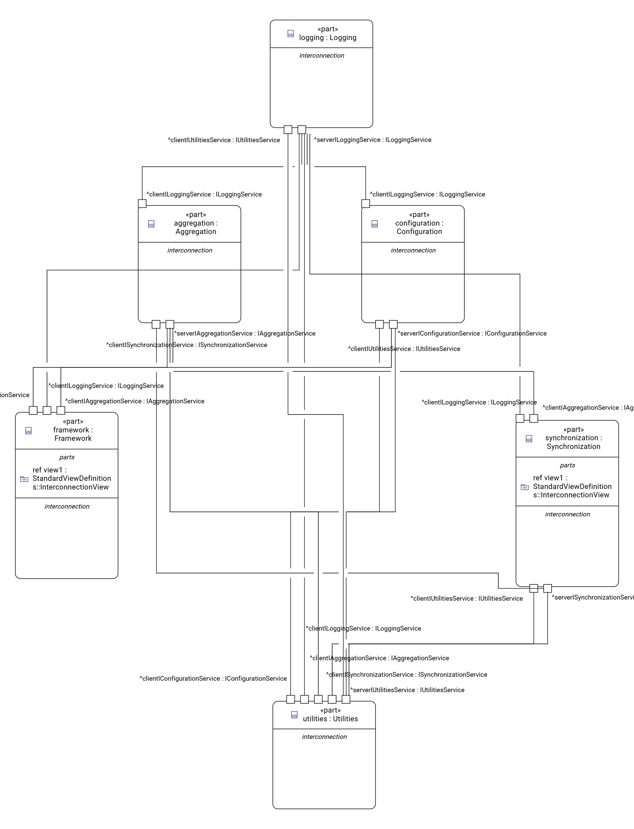
What Was Produced: SysML v2 Artifacts
Structural Model:
part def for each C++ component
port def for dependencies
connect statements for provider-consumer relationships
Sequence Model:
Runtime interaction flows derived from static call chains
Static-only baseline interaction diagrams
These form the static-only baseline for evaluation.
Notes:
A Block Definition Diagram (BDD) describes the static structure of the system by showing components and their relationships. An Internal Block Diagram (IBD) refines those components by showing their ports, interfaces, and connectors, explaining how they interact internally. In my project, dependency extraction is used to generate BDDs, while function-level interaction analysis is used to infer ports and generate IBDs. IBD – to understand How these components communicate. BDD - These components exist.

Slide 9
Current On-going Work
Goal:
Capture timestamped runtime events from the cpsCore system
Work in progress:
Generalised Trace Collector: converting output format to structured .txt logs (portable, tool-agnostic)
SysOn Docker Integration : containerised SysON instance for live SysML visualization and validation
ClangSharp Static Parser benchmarking via libclang : independent C++17-compatible extractor for benchmarking:
Produces GraphML from C++ AST via libclang
Will be compared against TNO in-house parser's GraphML as ground truth
Validates extraction accuracy of the Neo4j graph before traces are merged in

Slide 10
Research Questions: Where Each Stands
RQ | Question | Status
RQ1 | How can dependency-based slicing filter trace events to scenario-relevant behaviour? | Structurally answered via Neo4j graph + agent skill query layer. Needs trace events ingested to fully validate.
RQ2 | What intermediate property graph can integrate static call graphs and timestamped runtime events? | Answered: Neo4j typed property graph with edge-type separation (structural vs. call vs. runtime).
RQ3 | How can combining static + incomplete traces improve accuracy and completeness? | Baseline (static-only) established. Hybrid evaluation planned for Weeks 10–13.
Notes:
A Block Definition Diagram (BDD) describes the static structure of the system by showing components and their relationships. An Internal Block Diagram (IBD) refines those components by showing their ports, interfaces, and connectors, explaining how they interact internally. In my project, dependency extraction is used to generate BDDs, while function-level interaction analysis is used to infer ports and generate IBDs.

Slide 11
Some On going Challenges & How I plan to Address
Challenges | Solutions
C++ is context-sensitive - regex/simple parsers fail | Used Renaissance tool, Neo4j for semantic-level extraction. ClangSharp (libclang) for validation in progress
Thousands of dependencies crash SysML toolchains | Implemented identifier quoting and relationship deduplication in generation layer
Hardcoded scenario slicing is brittle | Agent skill architecture allows scenario definition as a natural language query
Traces alone are incomplete (per proposal) | Static reachability in graph will fill unobserved interactions, this is the core hybrid contribution

Slide 12
Overall Summary
What was proposed:
Hybrid static + trace pipeline → scenario-specific SysML v2 interaction diagrams
What has been done till now:
Working Neo4j knowledge graph of cpsCore (static layer -- complete)
Modular agent skill pipeline with 9 composable skills (tooling -- complete)
SysML v2 structural + sequence models from static analysis (partial output -- ahead of schedule)
Static-only baseline established for 3-way evaluation
What is being built now:
Runtime trace collector + SysOn / SysML v2 Editor visualization + ClangSharp validation
What remains:
Hybrid reconstruction, 3-way evaluation, writing

Slide 13
Progress Against Original Timeline
Weeks 1–3: Literature & Scoping -- Done
Weeks 4–7: Static Analysis -- Done (evolved)
Weeks 7–10: Trace Collection & Mapping -- In progress
Weeks 10–13: Hybrid Reconstruction -- Not started
Weeks 13–17: Modelling & Evaluation -- Partially ahead
Weeks 17–21: Writing -- Planned
Overall: On track. One significant architectural evolution in the static analysis approach.

Slide 14

Thank you!
14

Slide 15
Problem Statement & Motivation
Large Mission Critical Event-Driven Systems
↓
Concurrent & Asynchronous
↓
Traces - Incomplete / Noisy - often instrumentation limited
↓
Static Code Analysis - Over-Approximates behaviour
↓
No Scenario-Specific Accurate Interaction Diagrams
Notes:
Modern event-driven systems are highly concurrent and asynchronous, which makes understanding their behavior difficult.
Because of this massiveness - Runtime traces are often incomplete or noisy
Instrumentation is limited (performance, access, cost)
Static - Produces interactions that may never happen
Goal is to understand the system behavior accurately under certain scenarios – to then be able to take architectural calls / refactoring decisions / fix the bugs, etc.
Because these mission critical systems require proper understanding of the nuances of things – like what all components are interacting
With each other and what orchestration is happening under the hood – then be able to isolate those part of the code and refactor it / add more tests and increase its long-term maintainability

Slide 16
Proposed Approach - Methodology
Scenario Definition
Static Analysis
Runtime Trace Collection
Given single functionality algorithm
Time-stamped runtime events, to support reconstruction and how to export it
Hybrid Reconstruction
Trace-to-code alignment
Static reachability
Missing interaction inference
SysML v2 Interaction Diagram
Interaction model generation
Perform scenario-specific dependency based code slicing to filter trace events
Evaluation
Notes:
Scenario Definition
“We start by clearly defining a single functionality or algorithm as the scenario of interest. This keeps the scope focused and narrow and avoids over-generalizing the system’s behavior.”
Static Analysis
“We then apply dependency-based slicing on the code to retain only scenario-relevant components. This prunes irrelevant code paths and constrains what interactions are theoretically possible.”
Runtime Trace Collection
“Next, we collect timestamped runtime events corresponding to the scenario execution. Although these traces may be incomplete, they still provide concrete evidence and the order of execution information.”
Hybrid Reconstruction
“Static and dynamic information are then aligned through trace-to-code mapping. Static reachability analysis is used to infer missing interactions, but only when they are consistent with both code structure and observed traces.”
SysML v2 Interaction Diagram
“Finally, the reconstructed interactions are exported as SysML v2 interaction diagrams. These diagrams are scenario-specific, human-readable, and suitable for engineers and stakeholders.”
SysML v2 (Systems Modeling Language v2) is a next-gen textual modern, formal systems modeling language – which has its own textual syntax and formal semantics
SysML v2 provides formal semantics and a textual representation, making it suitable for automated generation and analysis. In this work, SysML v2 is used as the output representation to express reconstructed, scenario-specific interactions inferred from static code and runtime traces.

Slide 17
Evaluation & Expected Outcomes
Trace-Only Approach | Static-Only Approach | Hybrid Approach
Interaction Diagram (from traces alone) | Interaction Diagram (from static code alone) | Interaction Diagram (Trace enriched with static code)
Incomplete flow | Over-approximation | More complete flow
Prototype implementation
Scenario-specific SysML v2 diagrams
Comparative evaluation results
Notes:
We compare trace-only diagrams with hybrid diagrams to show improvements in completeness and clarity.
The evaluation focuses on qualitative completeness and structural accuracy metrics rather than raw performance.
We compare interaction diagrams generated using trace-only, static-only, and hybrid approaches. The expectation is that the hybrid method produces more complete flows without introducing excessive over-approximation. The outcome includes a working prototype and comparative evaluation results.
Goal is to create a more richer, more accurate and more complete interaction diagrams – which can assist the engineers in taking architectural decisions

Slide 18
Planning & Feasibility
Weeks 1–3 - Literature & Scoping
Weeks 4–7 - Static Analysis
Weeks 7–10 - Trace Collection & Mapping
Weeks 10–13 - Hybrid Modeling & Evaluation
Weeks 13–17 - Writing
Weeks 17–21 - Buffer
Notes:
The scope is intentionally limited to one scenario to ensure feasibility within the 22-week timeline.
✓ Single scenario ✓ Single industrial system ✓ Proof-of-concept focus
Point out it’s incremental
Early risk is handled early (literature + static analysis)
Buffer included → realistic planning
Optional reassurance:
“Each phase produces intermediate artifacts, reducing project risk.”

