Slide 1


MSc Software Engineering · Thesis Defence
Hybrid Static–Trace Analysis for
Interaction Model Synthesis in Event-Driven Systems
Scenario-Specific Interaction Diagrams in SysML v2
Prathik Anand Krishnan
Examiner: Dr. L. Thomas van Binsbergen (CCI, UvA) · Reader: Prof. Dr. Benny Åkesson (PCS, UvA)
Daily supervisor: Dr. Rosilde Corvino (TNO-ESI)
University of Amsterdam · TNO-ESI (in partnership with Philips), Eindhoven
Notes:
[0:30] Good [morning/afternoon] everyone. My name is Prathik Anand Krishnan,
and today I'll defend my MSc Software Engineering thesis, done at TNO-ESI and
the University of Amsterdam.
The title is "Hybrid Static–Trace Analysis for Interaction Model Synthesis in
Event-Driven Systems" — in short, automatically reconstructing scenario-specific
SysML v2 interaction diagrams from C++ code by combining two kinds of evidence.
Thanks to my committee: my examiner Dr. van Binsbergen, my reader Prof. Åkesson,
and my daily supervisor Dr. Corvino.

Slide 2
OVERVIEW
Agenda
2
1
Motivation
Why interaction models, why they drift
2
Problem, State of the Art & Research Questions
The bidirectional fusion gap; RQ1 (combining) & RQ2 (scoping)
3
Skill-Based Solution
Pipeline, property graph & skill mechanics -- worked examples
4
Experimental Setup
Which experiment answers which question; CPSCore; scenarios; AI usage; replication
5
Experiments & Results
H1 accuracy · H2 focus · H3 utility
6
Results & Findings
When fusion helps — and when it doesn't
7
Contributions, Limitations & Conclusion
Hybrid Static–Trace Interaction Model Synthesis · Prathik Anand Krishnan · TNO-ESI / UvA
2
Notes:
[0:30] Here's the roadmap. I'll start with the motivation and the concrete
problem, state my three research questions, then walk through the approach —
the pipeline and the shared property graph. After a quick look at the case
study, CPSCore, I'll present the three experiments and their results, and close
with contributions, limitations, and conclusions.

Slide 3
MOTIVATION
Understanding Behaviour Before You Change It
3
The setting
• Long-lived, safety-critical systems (medical imaging, industrial automation) evolve continuously.
• Behaviour is meant to be captured by Interaction Models — scenario-specific sequence diagrams.
• In practice these diagrams drift out of sync with the code and become unreliable.
• Engineers must reconstruct behaviour by hand — slow, error-prone, expertise-dependent.
• Event-driven systems make this worse: async callbacks and pub/sub hide who talks to whom.
A REAL DEFECT THIS WOULD HAVE CAUGHT
• A stale proxy object was never freed — a reset call was missing from the connection-handling code.
• After a service restart, the system silently stopped delivering change-notification events.
• The fault was visible only by following an implicit chain of events that no interaction model showed.
• Diagnosing it meant manually reconstructing exactly the kind of model this thesis automates.
Hybrid Static–Trace Interaction Model Synthesis · Prathik Anand Krishnan · TNO-ESI / UvA
3
Notes:
[2:00] The systems I care about are long-lived and safety-critical — think
medical imaging or industrial automation. Their behaviour is supposed to be
captured in interaction models, i.e. sequence diagrams. But in practice those
diagrams drift out of sync as the code evolves, so engineers end up
reconstructing behaviour by hand — slow and expertise-dependent. Event-driven
systems make it harder because async callbacks and pub/sub hide who talks to
whom.
On the right is a real, previously-resolved defect that motivated the work: a
stale proxy was never freed because a reset call was missing, and after a
restart the system silently stopped delivering notifications. It was only
visible by tracing an implicit event chain that no diagram showed — exactly the
kind of model this thesis reconstructs automatically.

Slide 4
PROBLEM STATEMENT
Two Incomplete Sources of Evidence
4
STATIC CALL GRAPH
RUNTIME TRACES
• Complete view of all possible interactions.
• Over-approximates — includes paths never taken.
• No execution order, no scenario specificity.
• Scenario-specific by construction, real order.
• Under-approximates — only what was exercised.
• Sparse / noisy; misses suppressed or rare paths.
THE GAP
• Existing hybrid methods use static structure only to organise an already-observed trace.
• No approach combines both directions at once: use static structure to recover interactions the trace missed, AND use the trace to trim the over-approximate static graph to the scenario.
• Plus: publish/subscribe indirection (boost::signals2, Redis) hides the subscription topology from call-graph analysis entirely.
Hybrid Static–Trace Interaction Model Synthesis · Prathik Anand Krishnan · TNO-ESI / UvA
4
Notes:
[2:00] Two classic sources of evidence, each incomplete. The static call graph
is complete in the sense that it captures every possible interaction — but it
over-approximates and has no execution order or scenario specificity. Runtime
traces are the opposite: scenario-specific and correctly ordered, but
under-approximate — they only show what was actually exercised, and are sparse
or noisy.
The gap, in the box: prior hybrid methods only use static structure to organise
a trace they already have. Nobody combines both directions at once — using
static structure to recover what the trace missed, AND using the trace to trim
the static graph down to the scenario. And pub/sub indirection hides the
subscription topology from call-graph analysis entirely. Closing that
two-directional gap is the core problem.

Slide 5
RELATED WORK
State of the Art & the Research Gap
5
Trace-Based
Static Analysis
Existing Hybrid
This Thesis
✔
Concrete, observed behaviour
✔
Complete static structure
✔
Uses static to reduce logging
✔
Recovers trace-missed edges from static
✖
Traces are incomplete
✖
Over-approximates behaviour
✖
Assumes observed traces complete
✔
Trims static to scenario via trace
✖
Misses unexercised interactions
✖
No scenario focus
✖
Does not recover missing edges
✔
Recovers pub/sub wiring
THE GAP
No existing approach infers unobserved interactions by combining static structure and runtime traces to generate scenario-specific interaction models — closing this gap in both directions is the core contribution.
Hybrid Static–Trace Interaction Model Synthesis · Prathik Anand Krishnan · TNO-ESI / UvA
5
Notes:
[1:30] Positioning the work. Three families exist today. Trace-based methods give
concrete observed behaviour but are incomplete and miss anything not exercised.
Static analysis gives complete structure but over-approximates and has no
scenario focus. Existing hybrids are the closest, but they use static structure
only to reduce logging or organise a trace — they assume the observed trace is
complete and never recover the interactions it missed.
The fourth column is what this thesis adds: it recovers trace-missed edges from
static evidence, trims the over-approximate static graph to the scenario using
the trace, and recovers pub/sub wiring invisible to call graphs. The gap, stated
plainly at the bottom: no prior approach infers unobserved interactions by
combining both sources for scenario-specific models — and closing it in both
directions is the core contribution.

Slide 6
OBJECTIVES
Research Questions & Hypotheses
6
What property-graph representation integrates static call graphs and timestamped runtime events?
Design
Schema
How does combining static analysis and incomplete traces improve reconstruction accuracy & completeness?
RQ1
H1
How can scenario-scoped querying of the static call graph restrict reconstruction to only scenario-relevant behaviour?
RQ2
H2
H3 (downstream): the reconstructed diagram improves — and can even be sufficient for — LLM-agent scenario comprehension.
Hybrid Static–Trace Interaction Model Synthesis · Prathik Anand Krishnan · TNO-ESI / UvA
6
Notes:
[1:30] Two research questions, plus a downstream question. RQ1 is about
accuracy: does combining static analysis with incomplete traces improve
reconstruction? RQ2 is about focus: can scenario-scoped querying of the
static call graph restrict reconstruction to only scenario-relevant
behaviour? A supporting design question -- what property-graph
representation integrates both evidence types -- underlies both, but is
a design decision rather than a separate research question.
Each RQ has a matching hypothesis and a dedicated experiment -- H1
answers RQ1, H2 answers RQ2. And a downstream question, H3: is the
reconstructed diagram actually useful to a consumer -- here, an LLM
agent doing scenario comprehension.

Slide 7
APPROACH
The GDI Hybrid Pipeline
7
11 composable agent skills -- each invocable by natural language, no code changes to the target system.
Originally scoped as a 5-stage methodology (proposal); realised as this graph-centric 7-stage pipeline.
Static Extraction
Property Graph
Runtime Tracing
Graph Fusion
Scenario Slicing
Agent Synthesis
SysML v2 / Mermaid
Renaissance C++ → graph
Neo4j 11 / 11 schema
csp_matcher probes
static ∪ trace (provenance)
scope-constrained Cypher
provenance-aware pruning
scenario diagram
Fusion (RQ1)
Set union of static (CppCalls) and trace (TRACE_CALLS) edges, each tagged with which source observed it.
Slicing (RQ2)
Linear edge filter: keep e where src ∈ scenario.primary and tgt ∈ scenario.targets — identical over static & trace edges.
Hybrid Static–Trace Interaction Model Synthesis · Prathik Anand Krishnan · TNO-ESI / UvA
7
Notes:
[2:30] This is the whole pipeline. It's implemented as eleven composable
agent skills, each invocable in natural language, and -- importantly --
with no changes to the target system's own code.
Left to right: static extraction with the Renaissance tool turns C++ into a
graph; everything lands in a Neo4j property graph; csp_matcher inserts
runtime trace probes; graph fusion takes the union of static and trace
edges, tagging each with its provenance; scenario slicing filters that
fused graph; an agent synthesis step prunes false positives using
provenance; and finally we emit a SysML v2 or Mermaid diagram.
The two conceptual cores are at the bottom: fusion answers RQ1, slicing
answers RQ2. Slicing is just a linear edge filter that works identically
over static and trace edges -- I'll show why on the next slide, and then
walk through exactly how each skill works with a worked example.

Slide 8
APPROACH · DESIGN
A Single Property Graph for Both Evidence Types
8
Static call graph and runtime trace live in one Neo4j graph — each interaction remembers which evidence produced it.
11
node labels
FUSION & SLICE, FORMALLY
11
relationship types
Gσ = slice(G_static ∪ G_trace, σ)
= { e ∈ Es ∪ Et | src(e) ∈ σ.primary ∧ tgt(e) ∈ σ.targets }
2,574
ordered static interactions
121
• Both edge types carry ClientComponent / ServerComponent metadata, so one filter works over both.
• Schema-introspection skill reads labels at runtime → the pipeline is codebase-agnostic.
• Recovers pub/sub wiring (boost::signals2) that plain call-graph analysis cannot see.
components
27
runtime trace events
26
unique traced pairs
Hybrid Static–Trace Interaction Model Synthesis · Prathik Anand Krishnan · TNO-ESI / UvA
8
Notes:
[2:00] This is a design decision, not a separate research question. Both
evidence types live in one Neo4j property graph, and every interaction
edge remembers which source produced it -- its provenance. The schema
has 11 node labels and 11 relationship types. On CPSCore the static side
yields 2,574 ordered interactions across 121 components; the trace side
adds 27 events over 26 unique pairs.
On the right is the formal operation: the scenario graph is the slice of
the union of static and trace edges, keeping edges whose source is in the
scenario's primary component and whose target is a declared participant.
Because both edge types carry client/server component metadata, one
linear filter works over both -- this is what answers RQ2 in the next
section. A schema-introspection skill reads the labels at runtime, so the
pipeline is codebase-agnostic -- and crucially, the graph lets us recover
pub/sub wiring that plain call-graph analysis can't see.

Slide 9
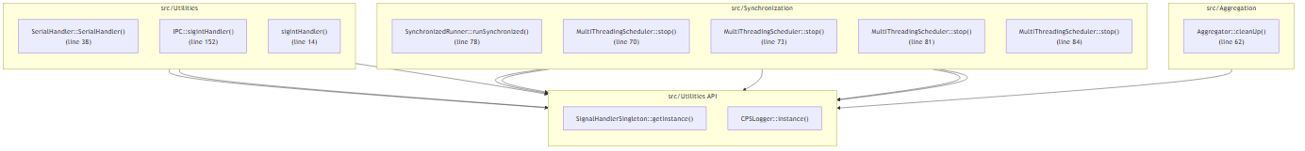
APPROACH · STATIC
Static Extraction: The Full Call Graph
9
What it gives us
• Renaissance parses C++ → Neo4j.
• Over-approximate: every possible call, scenario-agnostic.
• Projected into an ordered sequence-dependency table (2,574 interactions).
• Recall floor: guarantees interactions a sparse trace would miss.
Hybrid Static–Trace Interaction Model Synthesis · Prathik Anand Krishnan · TNO-ESI / UvA
9
Notes:
[1:30] The static half. The Renaissance semantic-extraction tool parses the C++
and populates Neo4j. What you're seeing is the full function-call dependency
graph — everything the code could do, scenario-agnostic, so it over-approximates.
We project the CppCalls edges into an ordered sequence-dependency table — 2,574
interactions. The important role of static analysis in the fusion is as a recall
floor: it guarantees interactions that a sparse trace would otherwise miss.

Slide 10
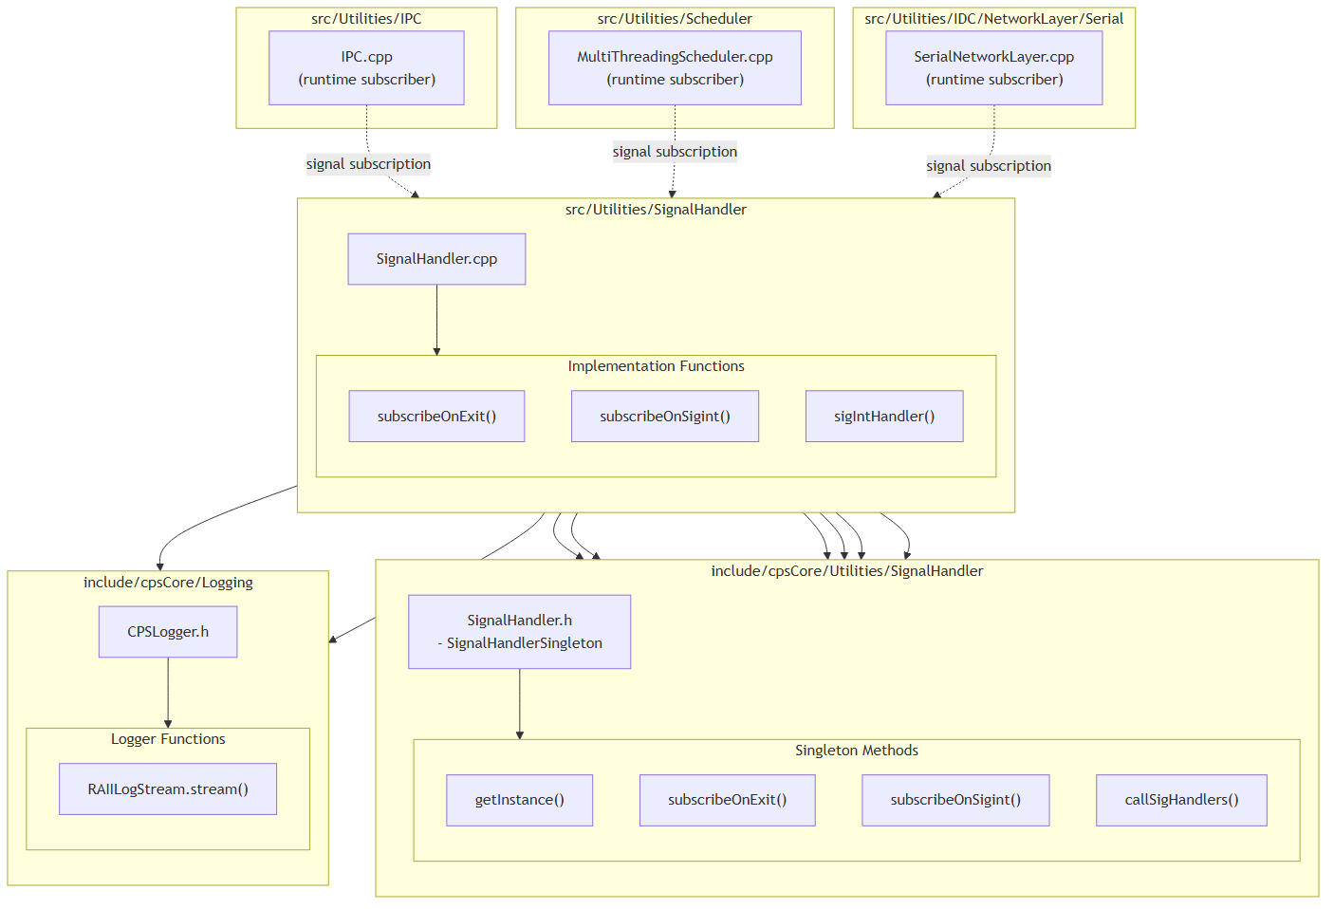
APPROACH · DYNAMIC
Runtime Tracing with csp_matcher
10
A small, reversible instrumentation tool
• Clang LibTooling-based; inserts trace probes by AST-level pattern matching.
• Guided by the code graph — probes only the call sites that matter for a scenario.
• Fully reversible: add_tracing / remove_tracing restore the original source exactly.
• Recovers pub/sub edges: resolves boost::signals2 connect()/slot wiring invisible to static call sites.
• Real trace line: [TRACE] 14:23:45.832, runStage, Synchronization, Aggregator.getAll, Aggregation, SimpleRunner, SimpleRunner.cpp:67
• Pattern DSL example -- find: Aggregator::getAll<$T>() replace: wraps the call in std::fprintf("[TRACE] ...Aggregator.getAll...") before executing the original call unchanged
• Produced 27 trace events across the studied scenarios.
Hybrid Static–Trace Interaction Model Synthesis · Prathik Anand Krishnan · TNO-ESI / UvA
10
Notes:
[2:00] The dynamic half is captured by csp_matcher, a Clang LibTooling tool I
built. It inserts trace probes by matching AST patterns, and it's guided by the
code graph so it only instruments the call sites relevant to a scenario. It's
fully reversible — add and remove leave the source byte-for-byte unchanged.
The figure illustrates the pub/sub case: csp_matcher resolves boost::signals2
connect and slot wiring, which has no static call site, so it recovers edges the
call graph simply cannot see. On CPSCore it produced 27 trace events.

Slide 11
SKILL-BASED SOLUTION
Skill Mechanics: Query Skills, Concrete Example
11
Skill | What It Does — Concrete Example
get-neo4j-schema | Runs a read-only script → graph_schema.txt: every node label, relationship type, and property. Every downstream skill reads this file instead of hardcoding labels, so the pipeline is codebase-agnostic.
text-to-cypher | Prompt: "Using agent skills, show me Synchronization calling into Aggregation and Logging." → compiles to the scope constraint: ClientComponent == Synchronization AND ServerComponent IN {Aggregation, Logging}. The "Using agent skills" prefix anchors the model to skill invocation instead of ad-hoc code reading.
cypher-to-output / get-cypher | cypher-to-output executes the query and renders the result as a table in plain language; get-cypher returns only the raw Cypher, for a user who wants to run it elsewhere.
Hybrid Static–Trace Interaction Model Synthesis · Prathik Anand Krishnan · TNO-ESI / UvA
11

Slide 12
SKILL-BASED SOLUTION
Skill Mechanics: Structural Extraction → SysML v2
12
Stage | Concrete Input / Output
get-interface-dependency-table (reads the Neo4j graph) | Output row: InterfaceName=Include, Server=HeaderFile;OtherFile, Client=SourceFile;HeaderFile -- one CSV row per relationship type: MATCH (client)-[r]->(server) RETURN type(r), collect(server), collect(client)
draw-sysml-structural-model (reads the CSV) | For rows I1:C1→C2, I2:C2→C3, I3:C3→C1, generates: port def I1; port def I2; port def I3; part def C1 { port serverI1:I1; port clientI3:I3; } (one part def per component)
Generated connect statements (output .sysml file) | part def System { part c1:C1; part c2:C2; part c3:C3; connect c1.serverI1 to c2.clientI1; connect c2.serverI2 to c3.clientI2; connect c3.serverI3 to c1.clientI3; }
Hybrid Static–Trace Interaction Model Synthesis · Prathik Anand Krishnan · TNO-ESI / UvA
12

Slide 13
SKILL-BASED SOLUTION
Skill Mechanics: Sequence Extraction → SysML/Mermaid
13
Aspect | Detail
CSV schema (get-sequence-dependency-table) | Sequence, EventName, ClientComponent, ClientFunction, ServerComponent, ServerFunction, RelationshipType, EventTimestamp
Direction rule | ClientComponent = sender, ServerComponent = receiver. If RelationshipType = Reply, direction reverses (server replies to client).
Arrow mapping (Mermaid) | Command → ->> (solid, filled) · Reply → -->> (dashed, filled) · Notification → -) (solid, open)
Label rule | EventName is the arrow label, truncated to 40 characters on arrows only -- Note-box content is never truncated.
Hybrid Static–Trace Interaction Model Synthesis · Prathik Anand Krishnan · TNO-ESI / UvA
13

Slide 14
EXPERIMENTS
Which Experiment Answers Which Question
14
Experiment | Answers | Headline Result
H1 — 5 conditions (C1–C5) × 4 scenarios | RQ1: does combining static + dynamic evidence help? | Full pipeline (C5) macro-F1 = 0.964; combining is strictly additive only on the constructed scenario S4
H2 — full vs. guided instrumentation × 3 scenarios | RQ2: does scenario-scoped querying focus the output? | Guided cuts nodes 50%, edges 70%, noise 100%, zero coverage loss; 6-rater panel prefers guided in 47/54 comparisons
H3 — 5-condition comprehension task × 4 scenarios | Downstream: is the reconstructed diagram useful? | Diagram-only matches the full source+trace+diagram condition exactly -- perfect recall on every scenario
Hybrid Static–Trace Interaction Model Synthesis · Prathik Anand Krishnan · TNO-ESI / UvA
14

Slide 15
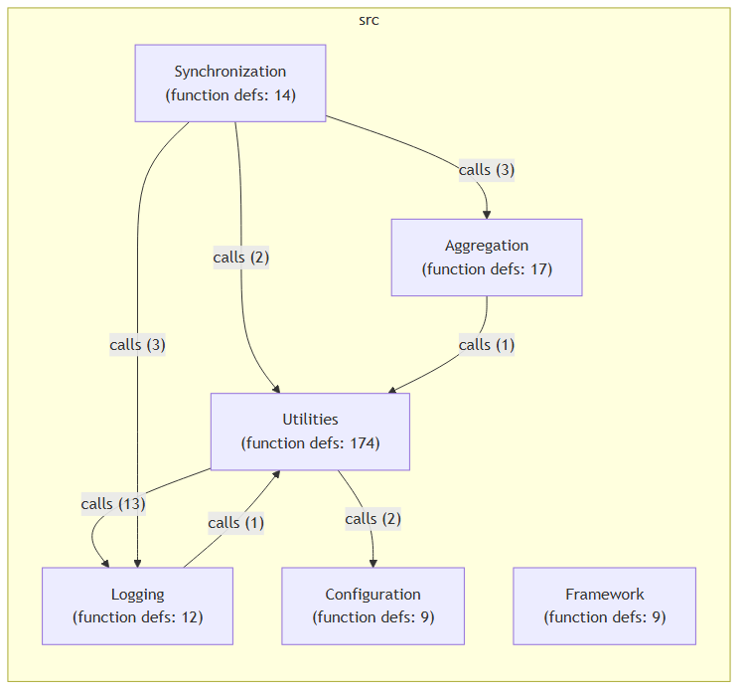
EVALUATION TARGET
Case Study: CPSCore
15
Open-source event-driven C++ framework for cyber-physical systems.
• ~13,000 LOC · 154 files · 5 modules: Aggregation, Configuration, Synchronization, Logging, Utilities.
• Event-driven pub/sub via boost::signals2 and Redis.
KEY STRUCTURAL PROPERTY
• ~470 template occurrences (static polymorphism); only 32 virtual signatures, all within one module or at config boundaries.
• No cross-module call goes through a vtable → static graph is reachability-complete w.r.t. the trace on found-in-the-wild scenarios.
• This is exactly why we constructed scenario S4.
Hybrid Static–Trace Interaction Model Synthesis · Prathik Anand Krishnan · TNO-ESI / UvA
15
Notes:
[1:30] The primary case study is CPSCore — an open-source event-driven C++
framework for cyber-physical systems: about 13,000 lines, 154 files, five
modules, with pub/sub over boost::signals2 and Redis.
One structural property matters a lot for interpreting the results, in the amber
box: CPSCore leans heavily on templates — static polymorphism — with only 32
virtual signatures, all inside a single module or at config boundaries. No
cross-module call goes through a vtable. That means, on the naturally-occurring
scenarios, the static graph is already reachability-complete with respect to the
trace. That's a property of this system, not a law — and it's precisely why I
constructed scenario S4 to break it.

Slide 16
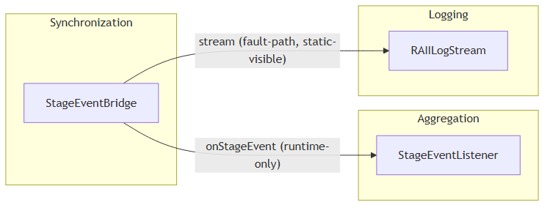
EVALUATION
Four Evaluation Scenarios
16
Scenario | Nature | What it exercises
S1 | Happy-path | Aggregation chain
S2 | Happy-path | Config mapping
S3 | Happy-path | Multi-component runner
S4 | Constructed | pub/sub dual-gap fault path
S4 — the dual-gap scenario
A boost::signals2 bridge where static sees stream but not onStageEvent (runtime connect()), and dynamic sees onStageEvent but not stream (a LogLevel::NONE no-op). Only the union recovers both.
S4 structural view — StageEventBridge ↔ StageEventListener
Hybrid Static–Trace Interaction Model Synthesis · Prathik Anand Krishnan · TNO-ESI / UvA
16
Notes:
[2:00] Four scenarios. S1 to S3 are happy-path scenarios that occur naturally in
CPSCore — an aggregation chain, a config mapping, and a multi-component runner.
S4 is deliberately constructed: a boost::signals2 publish/subscribe bridge
designed so each single source is blind to a *different* edge. Static sees the
`stream` call but not `onStageEvent`, because the slot is connected at runtime
via connect() with no static call expression. Dynamic sees `onStageEvent` but
not `stream`, because a LogLevel::NONE idiom makes the log call a runtime no-op.
Only the union recovers both. S4 isolates the one regime where fusion is
strictly additive — I report it as its own stratum because it's constructed, not
found in the wild.

Slide 17
EXPERIMENTAL SETUP · AI USAGE
Where AI Was Used, and How
17
AI-INVOKED SKILLS (LLM, natural language)
NOT AI (deterministic scripts / tools)
• text-to-cypher, get-cypher, cypher-to-output — NL query ↔ Cypher
• draw-sysml-structural-model, draw-sysml-sequence-model — CSV → SysML v2
• draw-structural-mermaid, draw-sequential-mermaid-general — CSV → Mermaid
• Each follows a strict, deterministic rule-set written into the skill; the LLM applies the rules, it does not invent semantics.
• get-neo4j-schema — plain Python script against Neo4j
• get-interface-dependency-table — Cypher aggregation script
• get-sequence-dependency-table — trace-log parser (no LLM)
• add-runtime-instrumentation / csp_matcher — Clang LibTooling AST pattern matching, zero LLM involvement
AI USED DIRECTLY INSIDE THE EXPERIMENTS (gpt-5 via Azure OpenAI)
• C1 (LLM-only baseline): prompted with ONLY the scenario's plain-English description; must output {source,target,interaction} triples from world knowledge alone — no graph, no trace, no source
• C5 (agent synthesis): given C2 (static) and C3 (dynamic, real execution order) as two separately-labelled evidence sources; prompted to reason about WHY a single-source edge might be missing (suppressed at runtime, indirect dispatch, or over-approximation) before finalising the edge set and an ordered sequence
• H3 comprehension task: given one of 5 evidence conditions, prompted to list components, list interactions as "Source → Target : Method", and explain the flow in 3–5 sentences; "do not hallucinate" is stated explicitly in every prompt variant
Hybrid Static–Trace Interaction Model Synthesis · Prathik Anand Krishnan · TNO-ESI / UvA
17
Notes:
Concrete prompt excerpts to have ready if asked:
C1 (verbatim, run_c1_llm_only.py): "You are a software architect analysing
the CPSCore C++ framework. Based ONLY on the scenario description below (no
source code or traces are provided), produce a list of inter-component
interactions in this exact JSON format... Do not include self-loops."
C5 (verbatim, run_c5_full_pipeline.py): "You have TWO INDEPENDENT,
separately-collected evidence sources. They have NOT been pre-merged -- you
must reason about them together yourself... reason about *why* it is
missing from the other source (suppression vs. indirect dispatch vs.
genuine over-approximation)."
H3 (verbatim, prompts/with_diagrams.md / no_diagrams.md): "You are analysing
a scenario in the CPSCore C++ framework... Be precise. Do not hallucinate
components or interactions not present in the context."
All three run on gpt-5 via Azure OpenAI (see experiments/H1/conditions/ and
experiments/H3/agent_conditions/ in the repo).

Slide 18
REPLICATION
How to Reproduce These Results
18
Everything here is regenerated by code, not hand-computed
• Reference edge sets (ground truth) are version-controlled JSON, authored by reading the source before any condition was scored.
• python score.py --all recomputes P/R/F1 for all 5×4 condition/scenario pairs and rewrites results.csv from scratch.
• H2's node/edge/coverage/noise numbers come from comparing the full vs. guided instrumentation graphs directly.
• H3's recall/completeness numbers come from re-scoring the agent's JSON output against the same reference set used in H1.
• Requires AZURE_ENDPOINT + AZURE_OPENAI_API_KEY in .env, and a gpt-5 deployment, for the LLM-based conditions (C1, C5) and the H3 agent.
COMMANDS
• python run_c1_llm_only.py --all ... python run_c5_full_pipeline.py --all
• python score.py --all → results.csv
• experiments/H2/ scripts regenerate the full vs. guided instrumentation comparison and metrics
• Repo: github.com/prathikanand7/masters-thesis-work.git (+ TNO GitLab mirror)
Hybrid Static–Trace Interaction Model Synthesis · Prathik Anand Krishnan · TNO-ESI / UvA
18

Slide 19
EXPERIMENT · RQ1
H1 — Does Fusion Improve Accuracy?
19
Six conditions × four scenarios, scored against a manually source-read reference edge set (authored before scoring).
C1
LLM-only
no code context
METRICS (on interaction edges)
P = |gen ∩ ref| / |gen|
R = |gen ∩ ref| / |ref|
F1 = 2PR / (P + R)
Aggregated as macro-F1 — each scenario weighted equally.
S4 kept as its own stratum (constructed, not found in the wild).
C2
Static-only
call graph
C3
Dynamic-only
runtime traces
C4
Static ∪ Dynamic
raw union
C5
Intersection
C2 ∩ C3, no LLM
C6
Full pipeline
C2 + C3 separate, LLM adjudicates
Hybrid Static–Trace Interaction Model Synthesis · Prathik Anand Krishnan · TNO-ESI / UvA
19
Notes:
[1:30] H1 tests RQ1. I compare six conditions across the four scenarios. C1 is an LLM-only baseline with no code context. C2 is static-only, C3 is dynamic-only. C4 is the raw union of the two -- it turns out to be actively harmful, since union can only inherit each source's false positives. C5 is the intersection -- only edges both sources independently confirm -- which is a purely set-algebraic filter, no LLM involved, and it's the best condition on the interaction-edge metric. C6 is the full pipeline: an agent gets C2 and C3 as separately labelled evidence and adjudicates disputed single-source edges by provenance, plus orders the reconstructed sequence. Everything is scored on interaction edges -- unique ordered sender/receiver pairs -- against a reference set I authored by reading the source *before* scoring anything. Standard precision, recall, F1, aggregated as macro-F1 so each scenario counts equally. S4 is reported as its own stratum. All six conditions are runnable from the repo -- run_c1_llm_only.py through run_c6_full_pipeline.py, then evaluate_all.py.

Slide 20
RESULTS · RQ1 (S1–S4)
H1 Results — Overall Precision / Recall / F1
20
Condition | Precision | Recall | F1
C1 LLM-only | 0.13 | 0.13 | 0.13
C2 Static-only | 0.90 | 0.88 | 0.85
C3 Dynamic-only | 1.00 | 0.88 | 0.92
C4 Static ∪ Dynamic | 0.90 | 1.00 | 0.94
C5 Full pipeline | 0.94 | 1.00 | 0.96
C5 posts the highest overall F1 of any condition (0.96): it keeps C4's perfect recall while partially fixing static over-approximation.
Hybrid Static–Trace Interaction Model Synthesis · Prathik Anand Krishnan · TNO-ESI / UvA
20
Notes:
[2:00] First the headline, aggregated over all four scenarios, one number per
cell. Read down the F1 column: the LLM baseline is near-useless at 0.13. Static
alone is 0.85, dynamic alone 0.92. The raw union C4 lifts recall to a perfect
1.00 and F1 to 0.94. And the full pipeline C5 is the best condition tested at
0.96 — it preserves C4's perfect recall while partially correcting static
over-approximation. Note dynamic-only already has perfect precision, but its
recall is only 0.88 — it misses edges — which is exactly what fusion fixes. The
*where* and *why* are on the next slide.

Slide 21
RESULTS · RQ1 (PER STRATUM, F1)
H1 Results — Fusion Is Additive Only on S4
21
Condition | Happy-path (S1–S3) | Constructed (S4) | Overall
C1 LLM-only | 0.00 | 0.50 | 0.13
C2 Static-only | 0.92 | 0.67 | 0.85
C3 Dynamic-only | 1.00 | 0.67 | 0.92
C4 Static ∪ Dynamic | 0.92 | 1.00 | 0.94
C5 Full pipeline | 0.95 | 1.00 | 0.96
On S4: C4 = 1.00 strictly beats C2 = 0.67 and C3 = 0.67.
The only scenario where fusion is additive — each source is blind to a different edge.
On S1–S3: C4 = C2 (fusion redundant).
C3 ⊆ C2 here, so the union adds nothing — but it still guarantees a recall floor (C4 ≥ C3 always).
Hybrid Static–Trace Interaction Model Synthesis · Prathik Anand Krishnan · TNO-ESI / UvA
21
Notes:
[2:00] Now the same F1 split by stratum, which is the heart of H1. Look at the
S4 column: C4 scores a perfect 1.00, strictly above both C2 and C3 at 0.67. That
is the single scenario where fusion is genuinely additive — because static and
dynamic are each blind to a different edge, and only the union recovers both.
On the happy-path stratum, C4 equals C2. That's not a flaw: because there's no
cross-module virtual dispatch, the trace edges are a subset of the static edges,
so the union adds nothing new. But fusion is still protective — it guarantees a
recall floor whenever traces are sparse. The takeaway: fusion helps exactly
where the sources disagree, and is safely redundant otherwise. In any system
with virtual dispatch, plugin loading, or reflection, the additive regime is
what you'd see.

Slide 22
RESULTS · INTERPRETATION
Why the Numbers Look the Way They Do
22
Fusion additive on S4
Fusion redundant on S1–S3
Static misses the runtime connect() edge; dynamic misses the LogLevel::NONE-suppressed edge. Only the union C4 recovers both → F1 1.00 vs 0.67 / 0.67.
No cross-module virtual dispatch in CPSCore ⇒ C3 ⊆ C2, so C4 = C2. Fusion is still protective: it guarantees a recall floor when traces are sparse (C4 ≥ C3 always).
Why C5 wins overall
The one honest miss
Provenance-aware synthesis preserves C4's perfect recall while partially fixing static over-approximation on S3 (precision 0.60 → 0.75) → best overall F1 = 0.964.
C5's only imprecision: a real but out-of-scope flush call on S3. C2's element list omits the calling function, so 'suppressed-in-scope' and 'real-out-of-scope' look identical to the agent.
Hybrid Static–Trace Interaction Model Synthesis · Prathik Anand Krishnan · TNO-ESI / UvA
22
Notes:
[2:30] Four mechanistic points behind those numbers. Top-left: on S4 fusion is
additive because static misses the runtime connect() edge and dynamic misses the
LogLevel::NONE-suppressed edge — the union recovers both. Top-right: on S1–S3
it's redundant because trace edges are a subset of static edges — but still
protective as a recall floor. Bottom-left: C5 wins overall because
provenance-aware synthesis keeps C4's perfect recall while trimming static
over-approximation — on S3 it lifts precision from 0.60 to 0.75. Bottom-right,
being honest about the one miss: C5's only imprecision is a real but
out-of-scope flush call on S3. Because C2's element list records source and
target but not the calling function, "suppressed-but-in-scope" and
"real-but-out-of-scope" are indistinguishable to the agent. That's a concrete,
fixable limitation I'll return to.

Slide 23
EXPERIMENT · RQ2
H2 — Guided Instrumentation Improves Focus
23
Full (probe everything, filter after) vs Guided (slice first, then probe only scenario-relevant call sites), on S1–S3.
Metric | Full | Guided | Change
Nodes | 6.0 | 3.0 | −50%
Edges | 9.0 | 2.7 | −70%
Coverage | 1.000 | 1.000 | 0% loss
Noise | 0.704 | 0.000 | −100%
BLINDED 6-RATER EXPERT PANEL (mean, 1–5)
Dimension | Full | Guided
Accuracy | 2.39 | 4.61
Readability | 2.44 | 4.89
Usefulness | 2.94 | 4.00
• Across all 54 rater × scenario × dimension comparisons: guided rated higher in 47, tied in 6, lower in exactly 1.
• The single dissent (S2 usefulness): collapsing 7 repeated Config→Logging reads into one edge loses a count some find useful for debugging — an honest trade-off, not a defect.
Hybrid Static–Trace Interaction Model Synthesis · Prathik Anand Krishnan · TNO-ESI / UvA
23
Notes:
[2:30] H2 answers RQ2 -- focus. I compare "full" instrumentation, which
probes everything and filters afterwards, against "guided", which slices
first and only probes the scenario-relevant call sites. The objective
metrics on the left: guided cuts nodes by 50% and edges by 70%, drives
measured noise from 0.70 to zero, and -- critically -- loses zero
coverage. So it's not just smaller; nothing relevant is dropped.
That's backed by a blinded six-rater expert panel, right. Guided wins on
accuracy, readability, and usefulness. Across all 54 comparisons, guided
was rated higher in 47, tied in 6, and lower in exactly one. That single
dissent was S2 usefulness, where collapsing seven repeated
config-to-logging reads into one edge loses a count some raters want for
debugging -- an honest trade-off, and I report it as such.

Slide 24
EXPERIMENT · UTILITY
H3 — Is the Diagram Actually Useful?
24
Does the pipeline's output (C6 interaction list) help an LLM agent comprehend a scenario — alone and in combination?
Condition | Component recall | Interaction recall | Completeness (1–5)
Source only | 0.917 | 0.800 | 4.25
Trace only | 0.917 | 0.900 | 4.25
Diagram only | 1.000 | 1.000 | 5.00
Source + Trace | 0.917 | 0.900 | 4.25
Source + Trace + Diagram | 1.000 | 1.000 | 5.00
The standout: “Diagram only” equals “Source + Trace + Diagram” — perfect on every measure. With no source and no trace, the C6 diagram alone is a sufficient basis for scenario comprehension.
Hybrid Static–Trace Interaction Model Synthesis · Prathik Anand Krishnan · TNO-ESI / UvA
24
Notes:
[2:30] H3 asks the downstream question: is the reconstructed diagram actually useful? I gave an LLM agent a scenario-comprehension task under five evidence conditions and measured component recall, interaction recall, and a rubric completeness score.
The standout result is in the two highlighted rows: "diagram only" and "source + trace + diagram" are identical -- and both are perfect. With no source and no trace, just the C6 interaction list, the agent hits perfect component and interaction recall and top completeness on every scenario, including the constructed S4. Adding source and traces on top neither helps nor hurts, because the diagram already saturates every metric. Notice source-only has the weakest interaction recall at 0.80 -- it foregrounds the main control-flow path and drops secondary log-only branches, exactly the edges the fused diagram surfaces. So the diagram isn't just a helpful supplement; it can be a *sufficient* basis for comprehension.

Slide 25
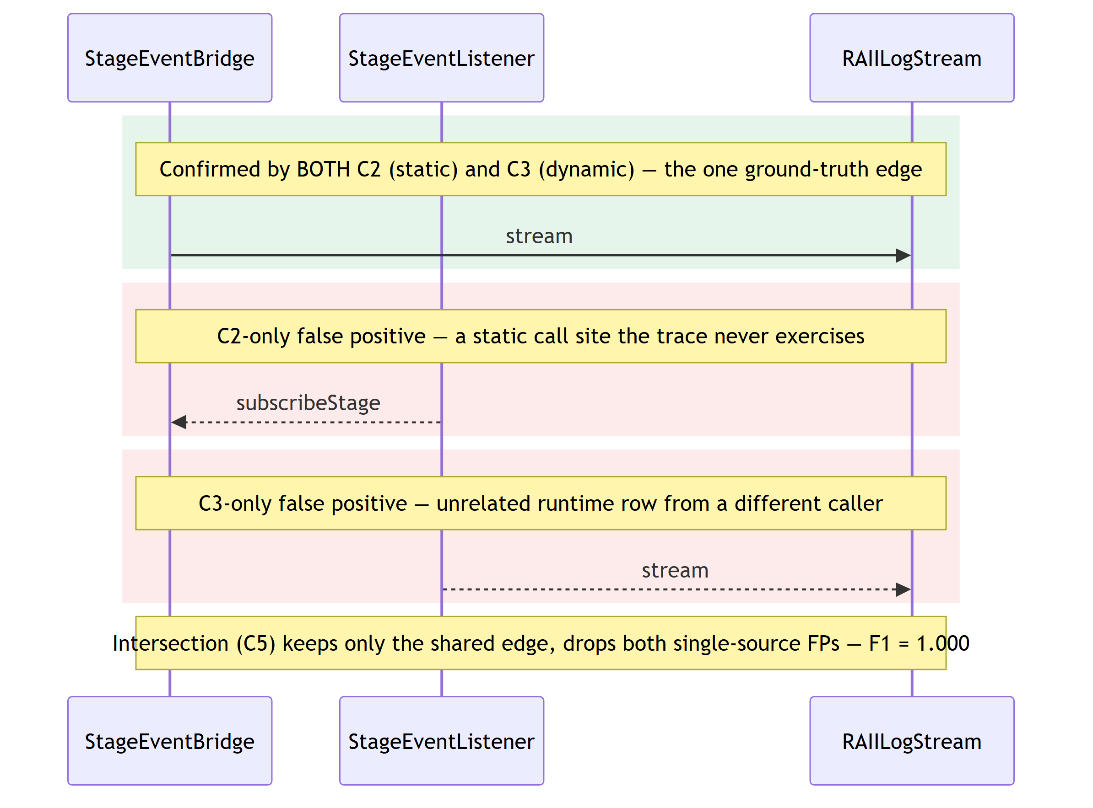
RESULTS · QUALITATIVE
Example Output — S4 Reconstructed Sequence
25
Intersection cancels independent errors
• stream — confirmed by BOTH static (C2) and dynamic (C3) evidence; the one ground-truth edge.
• Each source also reports one edge the other doesn't confirm — C2: subscribeStage; C3: an unrelated stream row.
• Intersection (C5) keeps only the shared edge — F1 = 1.000, beating both single sources and naive union (F1 = 0.500).
Hybrid Static–Trace Interaction Model Synthesis · Prathik Anand Krishnan · TNO-ESI / UvA
25
Notes:
[1:30] A concrete look at the mechanism behind H1's headline result. Ground truth on S4 is a single edge, `stream`, confirmed by both static analysis and the runtime trace. Each source also reports one edge the other doesn't confirm: C2's static graph adds `subscribeStage`, a call site the trace never exercises; C3's trace adds an unrelated `stream` row from a different caller. Naive union would inherit both false edges -- F1 drops to 0.500, worse than either source alone. Intersection keeps only what both sources agree on, cancelling both false positives while losing nothing -- F1 = 1.000. This is the mechanism, not blind-spot recovery: neither source actually misses the ground-truth edge here, they just each hallucinate a different one.

Slide 26
TRANSFERABILITY
Exploratory: A Second, Larger Industrial Codebase
26
A practitioner session applied the same static-extraction and query approach to a second industrial system — testing whether the method transfers beyond CPSCore.
Worked well
• Structural diagrams rated consistently useful.
• Dependency diagrams rated consistently useful.
• Static extraction + graph query transferred to a larger, unseen codebase.
Clearest area to improve
• Sequence-diagram message labelling was identified as the weakest point.
• Consistent with the CPSCore finding that message-level semantics need richer provenance.
• A concrete, actionable direction for future work.
Hybrid Static–Trace Interaction Model Synthesis · Prathik Anand Krishnan · TNO-ESI / UvA
26
Notes:
[1:30] To probe transferability beyond CPSCore, a practitioner session applied
the same static-extraction and query approach to a second, larger industrial
codebase. The good news, on the left: the structural and dependency diagrams
were rated consistently useful — the static extraction and graph queries
transferred to an unseen, larger system. On the right, the clearest area to
improve was sequence-diagram message labelling, which is consistent with the
CPSCore finding that message-level semantics need richer provenance. It's
exploratory, not a controlled study, but it points at a concrete next step.

Slide 27
THE ONE PATTERN BEHIND ALL THREE RESULTS
Additional evidence improves reconstruction or comprehension specifically when the primary evidence source is missing something — and is otherwise redundant.
H1
Fusion is strictly additive only where static & dynamic each miss a different edge (S4); redundant where the static graph is complete.
H2
Guiding instrumentation by the code graph removes 100% of noise with zero coverage loss.
H3
The reconstructed diagram alone is a sufficient basis for scenario comprehension — perfect recall everywhere.
Notes:
[1:00] Step back — the three results converge on a single pattern, and this is
the sentence I want you to remember: additional evidence improves reconstruction
or comprehension specifically when the primary source is missing something, and
is otherwise redundant. H1: fusion is additive only where the two sources each
miss a different edge, redundant where static is already complete. H2: guiding
instrumentation removes all noise with zero coverage loss. H3: the diagram alone
is a sufficient basis for comprehension. One principle, three angles.

Slide 28
SUMMARY
Contributions
28
i
One property graph holding static call graph + runtime trace together, remembering each interaction's provenance.
ii
A slicing method that trims the combined graph to just the interactions relevant to one scenario.
iii
A way to recover publish-subscribe wiring that ordinary call-graph analysis cannot see.
iv
csp_matcher — a small, reversible tool that inserts and removes trace probes automatically.
v
Eleven natural-language agent skills running the whole pipeline, source → SysML v2, on any codebase without code changes.
vi
An evidence-based account of when combining static and dynamic analysis helps — and when it does not.
Hybrid Static–Trace Interaction Model Synthesis · Prathik Anand Krishnan · TNO-ESI / UvA
28
Notes:
[1:30] Six contributions. One: a single property graph that holds the static
call graph and the runtime trace together, remembering each interaction's
provenance. Two: a slicing method that trims that combined graph to just one
scenario. Three: a way to recover pub/sub wiring that call-graph analysis can't
see. Four: csp_matcher, the small reversible instrumentation tool. Five: twelve
natural-language agent skills that run the whole pipeline end-to-end, source to
SysML v2, on any codebase with no code changes. And six — which I'd argue is the
scientific contribution — a clear, evidence-based account of when combining
static and dynamic analysis actually helps, and when it doesn't.

Slide 29
REFLECTION
Limitations & Future Work
29
Limitations
• Single primary case study (CPSCore); S4 is constructed, not found in the wild.
• C2's element list omits the calling function → agent cannot always distinguish in-scope from out-of-scope edges.
• Two H3 conditions (source-only, diagram-only) rated non-blind by the same rater — disclosed.
• Message-label semantics on sequence diagrams remain the weakest output dimension.
• Traces limited to what the test suite exercises.
• Known gap to verify before the defence: the local skills folder no longer has a standalone get-runtime-traces skill, while get-sequence-dependency-table's own spec still names it as the source of runtime_traces.txt -- confirm which skill produces that file in the current pipeline before being asked.
Future work
• Carry the calling function into the element list to fix the in-scope / out-of-scope ambiguity.
• Evaluate on systems with cross-module virtual dispatch, plugin loading, or reflection — where the additive regime dominates.
• Richer, provenance-driven message labelling for sequence diagrams.
• Broaden the expert panel and blind all conditions.
• Continuous, CI-integrated model maintenance.
Hybrid Static–Trace Interaction Model Synthesis · Prathik Anand Krishnan · TNO-ESI / UvA
29
Notes:
[1:30] Being upfront about limitations, on the left. It's one primary case
study, and S4 is constructed. The in-scope/out-of-scope ambiguity comes from C2's
element list omitting the calling function. Two H3 conditions were rated
non-blind by the same rater, which I disclose. Message-label semantics are the
weakest output, and traces are bounded by what the test suite exercises.
Future work, right, maps almost one-to-one: carry the calling function into the
element list to remove that ambiguity; evaluate on systems with virtual
dispatch, plugins, or reflection, where the additive regime should dominate;
richer provenance-driven message labelling; broaden and fully blind the expert
panel; and integrate this into CI for continuous model maintenance.

Slide 30
WRAP-UP
Conclusion
30
A hybrid pipeline fuses a static call graph with runtime traces in one provenance-tagged property graph and slices it to scenario-specific SysML v2 interaction diagrams.
Fusion helps exactly where one source is blind (C5 macro-F1 0.964); guided slicing removes 100% of noise at full coverage; the diagram alone suffices for comprehension.
Design
An 11/11 property-graph schema unifies static and dynamic evidence.
RQ1
Fusion is additive where sources disagree, protective elsewhere.
RQ2
Dependence-based slicing yields focused, noise-free diagrams.
Hybrid Static–Trace Interaction Model Synthesis · Prathik Anand Krishnan · TNO-ESI / UvA
30
Notes:
[1:00] To conclude: I built a hybrid pipeline that fuses a static call
graph with runtime traces in one provenance-tagged property graph and
slices it to scenario-specific SysML v2 diagrams. Fusion helps exactly
where one source is blind -- best overall F1 of 0.96; guided slicing
removes all noise at full coverage; and the reconstructed diagram alone
suffices for comprehension.
Mapping back: the 11/11 schema (a design decision) unifies both evidence
types. RQ1 -- fusion is additive where sources disagree and protective
elsewhere. RQ2 -- scenario-scoped slicing yields focused, noise-free
diagrams. Thank you -- I'm happy to take questions.

Slide 31
Thank you — Questions?
Hybrid Static–Trace Analysis for Interaction Model Synthesis in Event-Driven Systems
Prathik Anand Krishnan
TNO-ESI · MSc Software Engineering, University of Amsterdam
University of Amsterdam
Notes:
Closing slide for the Q&A. Common questions to be ready for: (1) Why only one
case study — transferability is addressed by the exploratory second codebase.
(2) Isn't S4 contrived — yes, deliberately, to isolate the additive regime that
naturally-occurring virtual dispatch / plugins would trigger. (3) LLM
reproducibility — the reference set was authored before scoring; provenance
tagging keeps the synthesis auditable. (4) Scalability of slicing — it's a linear
edge filter. (5) Threats to validity in the expert panel — six raters, A/B
randomised and blinded for the reused conditions.

Slide 32
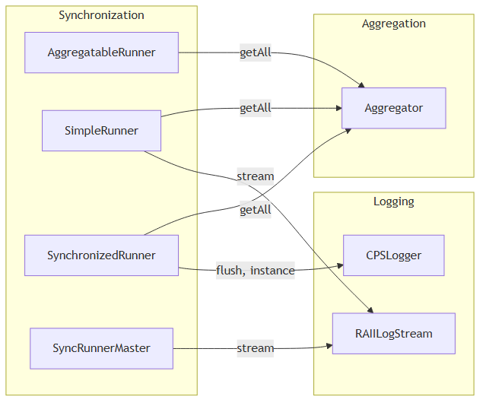
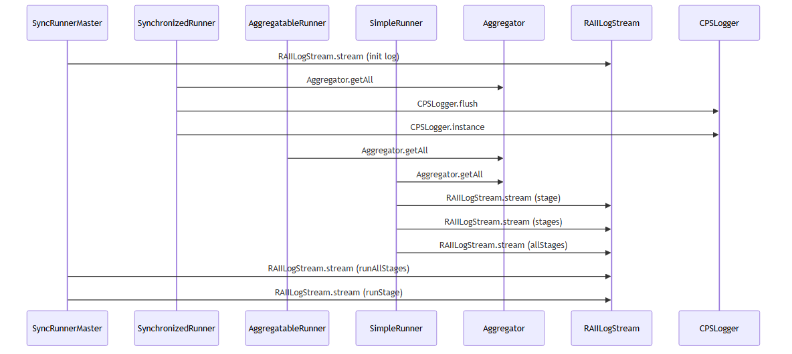
APPENDIX
Backup — S1 Structural & Sequence Views
32
S1 structural view
S1 reconstructed sequence
Hybrid Static–Trace Interaction Model Synthesis · Prathik Anand Krishnan · TNO-ESI / UvA
32
Notes:
Backup slide for Q&A: the S1 structural and reconstructed sequence views, if the
committee wants to see a happy-path example end to end alongside the S4 fault
path shown earlier.

Slide 33
APPENDIX
Backup — Engineering Challenges & Solutions
33
Challenge | How it was solved
C++ is context-sensitive — regex / simple parsers fail | Renaissance + Neo4j for semantic-level extraction; ClangSharp (libclang) for validation
Thousands of dependencies crash SysML toolchains | Identifier quoting + relationship deduplication in the generation layer
Hardcoded scenario slicing is brittle | Agent-skill architecture — scenario defined as a natural-language query
Traces alone are incomplete | Static reachability in the graph fills unobserved interactions — the core hybrid contribution
Hybrid Static–Trace Interaction Model Synthesis · Prathik Anand Krishnan · TNO-ESI / UvA
33
Notes:
Backup slide for questions on engineering depth. Four concrete challenges and how
each was handled: C++ context-sensitivity forced semantic extraction via
Renaissance and Neo4j, with a ClangSharp/libclang cross-check; large dependency
counts that crash SysML tools were tamed with identifier quoting and relationship
deduplication; brittle hardcoded slicing was replaced by the agent-skill
architecture where a scenario is just a natural-language query; and trace
incompleteness is exactly what static reachability in the graph compensates for —
the core hybrid contribution.

