Slide 1

PES UNIVERSITY ELECTRONICS CITY CAMPUS
Subject: Introduction To Data Science
Subject code:UE18CS203
Project By:
Prathik B Jain PES2201800058
Aman PES2201800112
A. Harikishan PES2201800015

Slide 2
Crimes In Boston
About the dataset:
Crime incident reports are provided by Boston Police Department (BPD) to document the initial details surrounding an incident to which BPD officers respond. This is a dataset containing records from the new crime incident report system, which includes a reduced set of fields focused on capturing the type of incident as well as when and where it occurred.

Slide 3
Number of columns:12
1.Incident Number
2.Offence code
3.Offence Code Group
4.Offence Description
5.District
6.Reporting area
7.Date
8.Year
9.Month
10.Day Of Week
11.Hour
12.Street

Slide 4
DATA CLEANING
Check if every column is in the required data type .
Removing the NaN values and replacing the value with suitable values
The methods which can be used are(used according to the data set):
Ffill
Bfill
Interpolate
Filling with mean

Slide 5
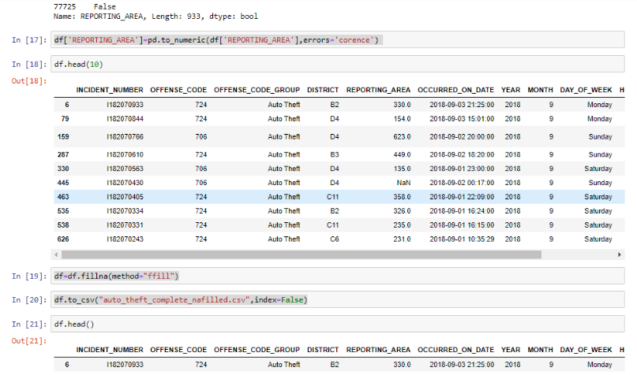

Slide 6
Normalizing and Standardization
While plotting a graph it is convenient if we have the range of values in a smaller range and common scale.
To do this we normalize using the formula
(Value-min)/(max-min)
Standardization helps to make the data more suitable for comparison.
standardize :
(value-mean)/standard_deviation

Slide 7
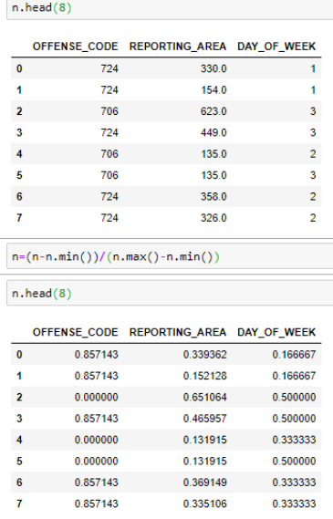
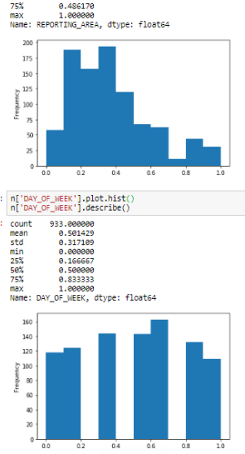

Slide 8
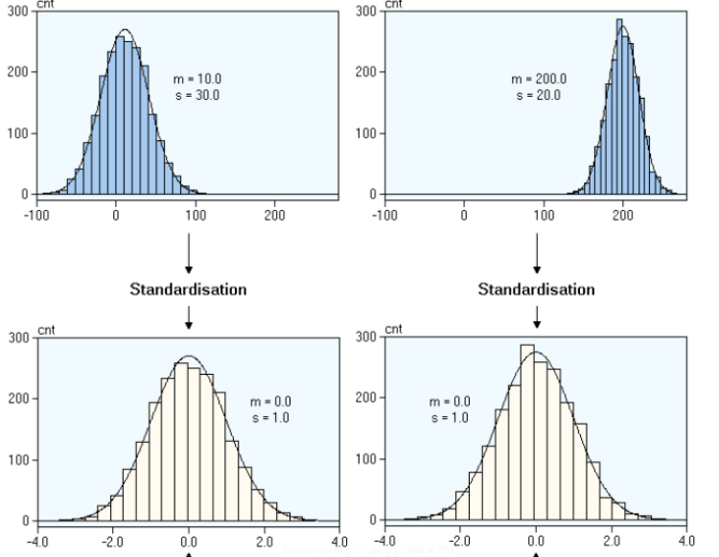
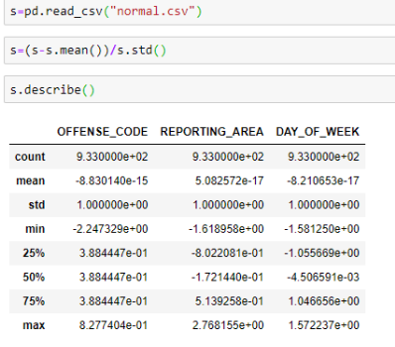

Slide 9
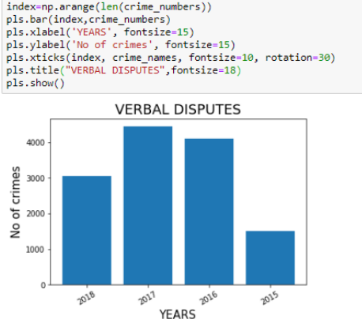
Graph Visualization

Slide 10
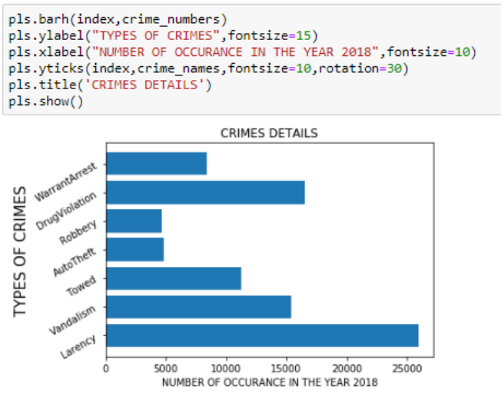
From the above graph we can visualize which crime has occurred more in the year and report and create awareness among the society and work towards it to curb and make the society safe and a better place to live

Slide 11
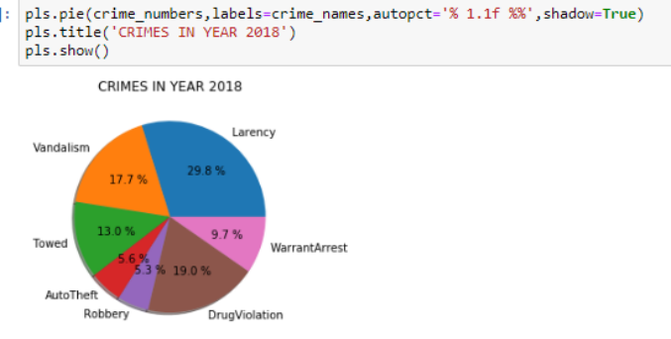

Slide 12
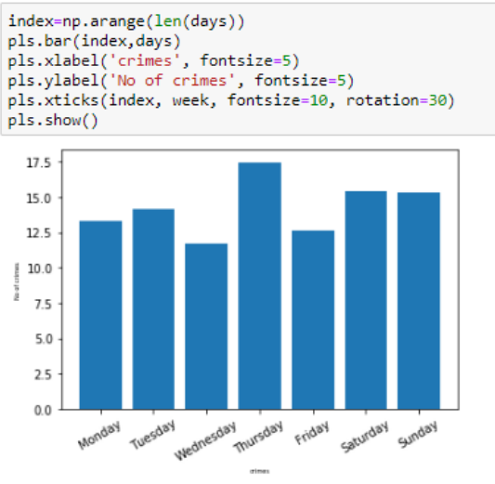
By the above graph we can see the number of crimes that occur on a particular day of the week and can see that more crimes occurs on Thursday and then Saturday and Sunday are almost the same .

Slide 13
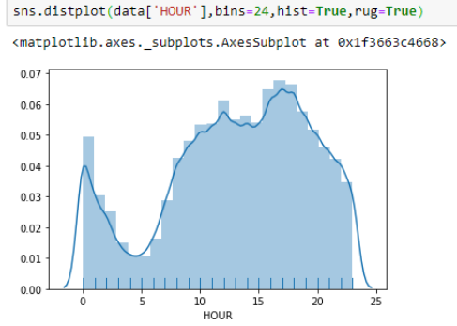
In the early hours of the morning, crime quickly drops and reaches a minima at 4 or 5 AM, then clickly rising, reaching a local minima at noon and peaking at 5 PM. What is interesting is the sudden jump from the 23rd hour to the 24th/0th hour in crimes. In the early hours of the morning, crime quickly drops and reaches a minima at 4 or 5 AM, then clickly rising, reaching a local minima at noon and peaking at 5 PM. What is interesting is the sudden jump from the 23rd hour to the 24th/0th hour in crimes.
In the early hours of the morning, crime quickly drops and reaches a minima at 4 or 5 AM, then quickly rising, reaching a local minima at noon and peaking at 5 PM.

Slide 14
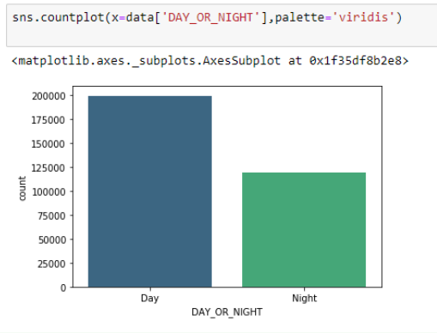
By the above graph we can conclude that most of the crimes occur in the day time . The same can be done for a particular crime and can be concluded.

Slide 15
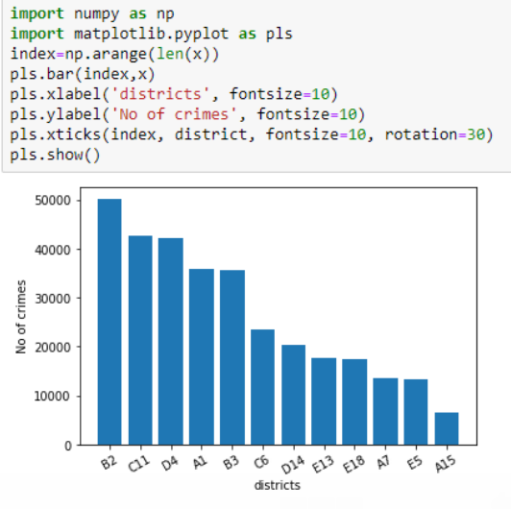
By the above graph we find the safest district in the city to stay .we can see that most of the crimes has occurred in the district B2 and very few in the district A15

Slide 16
Hypothesis Testing
The proportion calculated here is out of the total crimes 77.7% of the crimes are occurred in the day time. We are taking a sample and performing population proportion test,.
As we have the total population we are calculating the proportion and making the hypothesis .We will conclude by the hypothesis test whether our assumption is right or wrong
H0: p = 0.777
H1: p ≠ 0.777
As np=(count_row)(0.777) and n(1−p)=(count_row)(1−0.77) are above 10 so we can use normal model to find P value
We have taken a sample of size 10,000 and conduct the test and found out the p-value =0.657
By this we can conclude that we do not reject H0 that is approximately 77% of the crimes occur in the day time
[We have defined the day time as 6AM to 6PM]

Slide 17
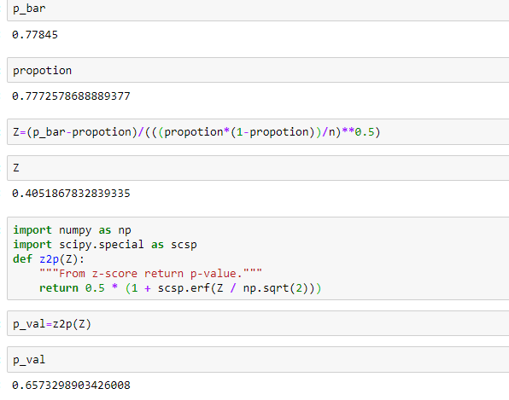

Slide 18
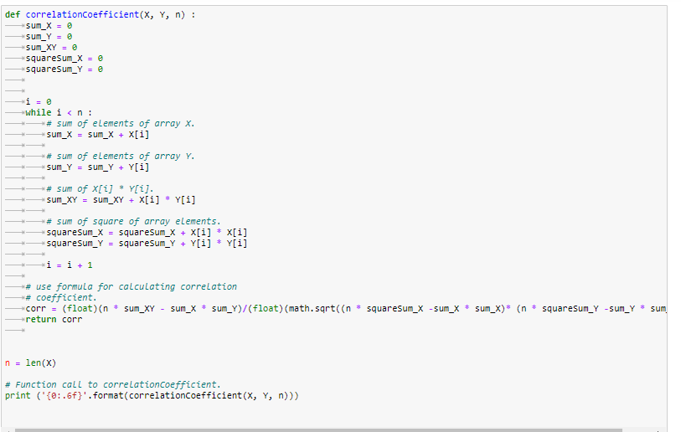
Correlation

Slide 19
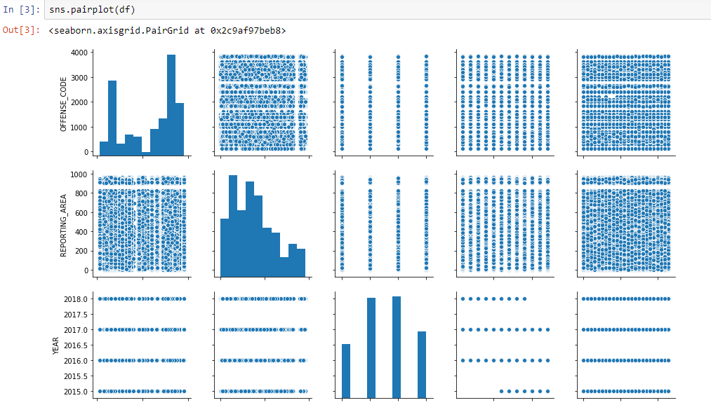

Slide 20
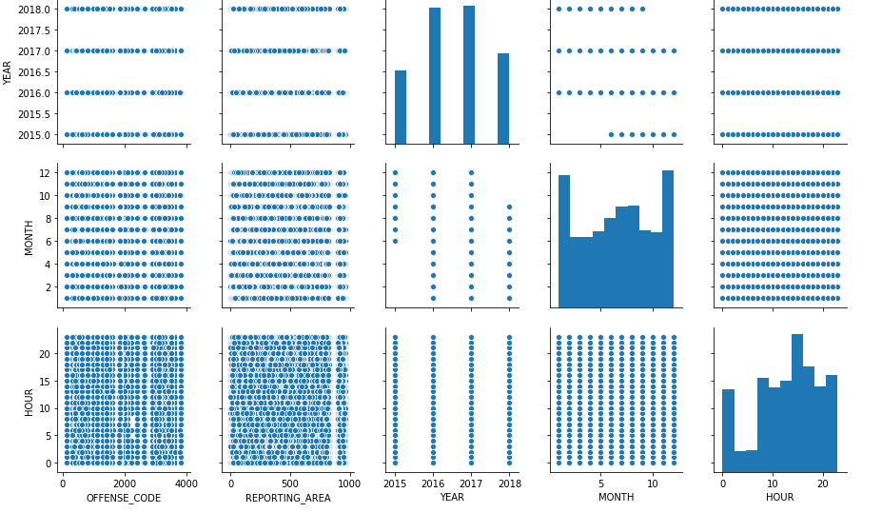

Slide 21
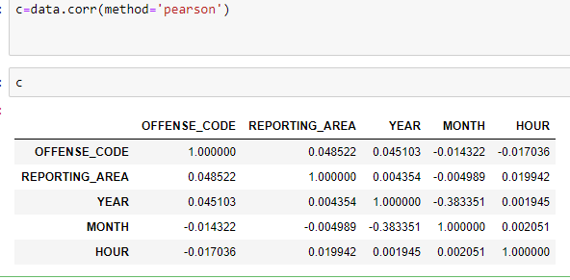
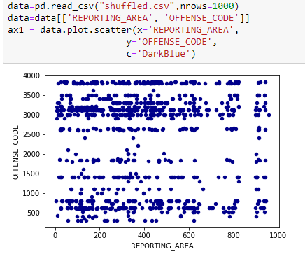
We can see that in this data set we do not have any strong correlation between any 2 columns.

Slide 22
THANK YOU……

