Slide 1
OVS (With P4) Code Walk
Namrata Limaye

Slide 2
Overview
https://github.com/ipdk-io/ovs -b ovs-with-p4
Control Plane elements:
P4proto (Dir: p4proto)
P4runtime and Openconfig IF (Dir: p4proto/p4rt) - https://github.com/stratum/stratum
https://github.com/p4lang/p4runtime
Target API IF (Dir: p4proto/bfIntf) - https://github.com/p4lang/p4-dpdk-target
Kernel Control Plane (Dir: switchlink, switchsai, switchapi)
https://github.com/opencomputeproject/SAI
ovs-p4ctl, gnmi-cli (Dir: utilities)
https://github.com/stratum/stratum
Data Planes supported:​
P4 DPDK (https://github.com/DPDK/dpdk)
New
Exists
P4 Controller
OF Controller
ovs-p4ctl
ovs-ofctl
ovs-vswitchd
OVS Configs
p4proto
ofproto
Kernel
configs
Target-API
netdev
ofproto-dpif
Netdev provider
dpif
P4-dpdk
P4-ubpf
dpif-provider
userspace
kernel
openvswitch.ko
P4-ebpf/TC-P4
external devices
P4 NICs
NIC device

Slide 3
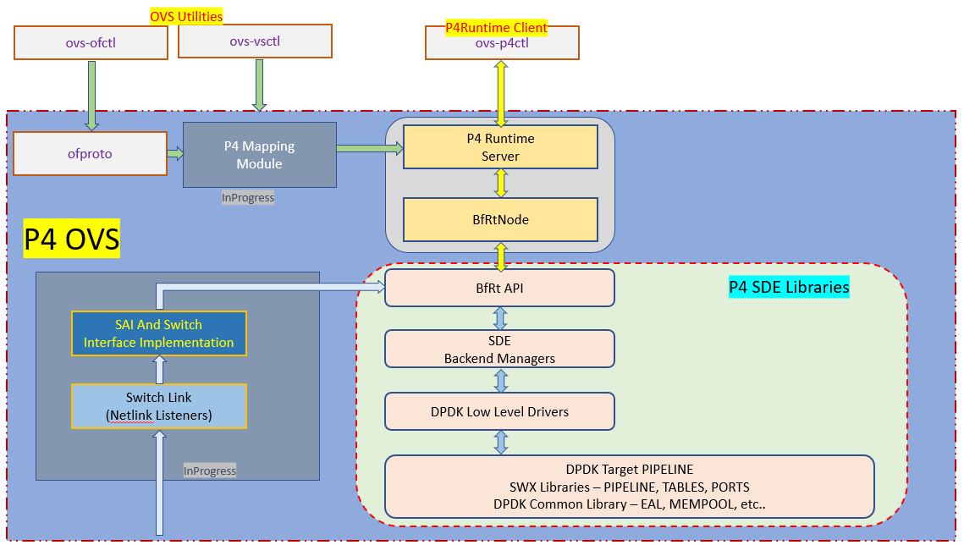
P4-OVS Design

Slide 4
IPDK Container https://github.com/ipdk-io/ipdk/tree/main/build/IPDK_Container
IPDK Container setup howto - https://github.com/ipdk-io/ipdk/blob/main/build/IPDK_Container/README
Dockerfile
https://github.com/ipdk-io/ipdk/blob/main/build/IPDK_Container/Dockerfile
ovs-with-p4 container build scripts
https://github.com/ipdk-io/ipdk/tree/main/build/IPDK_Container/scripts
P4 file –
https://github.com/ipdk-io/ipdk/blob/main/build/IPDK_Container/examples/simple_l3/simple_l3.p4
Application/Device
Consumer
VM
Application/Device
Consumer
VM
Virtio Block/Eth
Virtio Block/Eth
vHost
vHost
IPDK
Container
Reference App (P4-OVS/Storage)
IPDK Stack (P4-DPDK-target)

Slide 5
Future
Implemented:
P4Runtime and Openconfig
Ovs-p4ctl and gnmi-cli
Kernel Control Plane repos integrated
IPDK Container
P4-DPDK and Tofino backend support
Future:
Kernel Control Plane and linux_networking.p4 (vxlan, L3 Fwd, ECMP)
Ovs-vsctl add-port, bridge, p4
Exception control packet processing
P4Runtime and Openconfig v2, ovs-p4ctl dump-flows
Multiple pipelines, stacked pipelines
Counters, Meters, Mirrors
Other SW/kernel backends

Slide 6
Contacts
Namrata.limaye@intel.com
Dan.daly@intel.com
venkata.suresh.kumar.p@intel.com
Debashis.Chatterjee@intel.com

