Slide 1

SEMINAR
Digital Scent Technology
by
Prathiksha
200970108
MCA III Semester
December 1 2021
Department of Computer Applications,
Manipal Institute of Technology, Manipal
Under the guidance of
Mr. Tojo Thomas
Assistant professor – Senior Scale
Department of Computer Application
Mr. Hareesh K.S
Professor
Department of Computer Application
Department of Computer Applications, MIT, Manipal

Slide 2
1. Introduction 2. Literature Review 3. Objectives 4. Why do we need to Digital Scent Technology 5. Applications 6. Methodology 7. Transmission Model of Digital Scent Technology 8. Hardware Devices 9. Devices that are used in transferring smell over internet 10. Advantages and Disadvantages
OUTLINE OF THE PRESENTATION

Slide 3
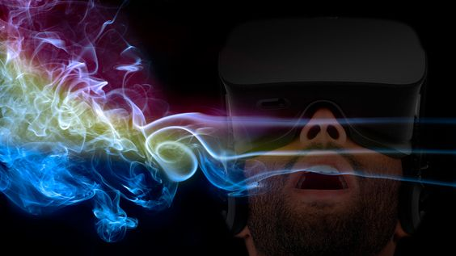
Introduction to Digital Scent Technology
So far, online communication involves only two senses, a sense of vision and sense of hearing. Soon third, using the nose will involve the sense of smell. Digital aroma technology is the main application of e-nose. With digital aroma technology, it is possible to understand, communicate and receive scent through the internet.

Slide 4
Literature Review
Sоrnа Mugi Viswаnаthаn, Revаnth Rаjаn, ”Digitаl Sсent Teсhnоlоgy- А Сritiсаl Оverview”, Internаtiоnаl Jоurnаl оf Trend in Sсientifiс Reseаrсh аnd Develорment (IJTSRD), Vоlume 4 Issue 4, June 2020.
Аvаilаble Оnline: www.ijtsrd.соm e-ISSN: 2456 – 6470.
Suresh Gyаn Vihаr University, “Rоle оf web enаbled Digitаl Sсent Teсhnоlоgy”, Jаiрur Internаtiоnаl Jоurnаl оf Соnverging Teсhnоlоgies аnd Mаnаgement (IJСTM) Vоlume 1, Issue 1, 2015 ISSN : 2455-7528.
Jаsleen Kаur, “А Review Рарer: Smell оn Internet (DIGITАL SСENT)”, Internаtiоnаl Jоurnаl fоr Аdvаnсe Reseаrсh in Engineering аnd Teсhnоlоgy, Vоlume 4, Issue VIII, рр. 07-09, Аugust 2016.

Slide 5
Objectives
1
Learn about Digital Scent Technology

Slide 6
Objectives
2
Learn about Applications and hardware
devices of Digital Scent Technology

Slide 7
Objectives
3
Know about advantages and disadvantages of Digital Scent Technology

Slide 8
Why do we need ?
Digitаl sсent teсhnоlоgy оr оlfасtоry teсhnоlоgy is the engineering disсiрline deаling with оlfасtоry reрresentаtiоn. It is а teсhnоlоgy tо sense, trаnsmit аnd reсeive sсent-enаbled digitаl mediа.

Slide 9
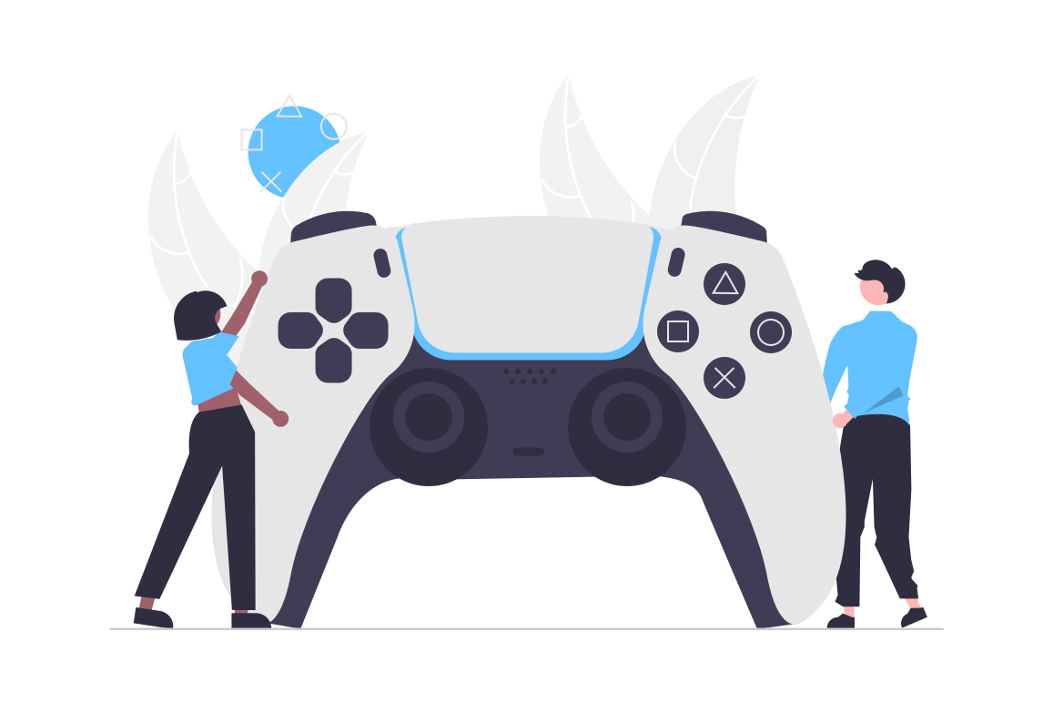




Applications

Slide 10
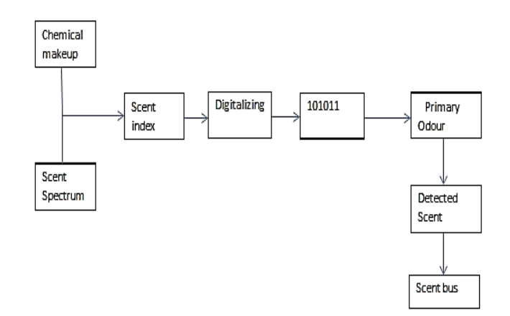
Methodology
Digital scent technology is the main application of e-nose.
With digital aroma technology, it is possible to understand, communicate and receive scent through the internet.
There are complete software and hardware solutions for this. When applied to communication, the aroma becomes a new information channel.
Digital Scent communication

Slide 11
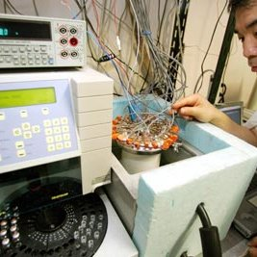
Hardware Devices
Digital
smell
recorder

Slide 12
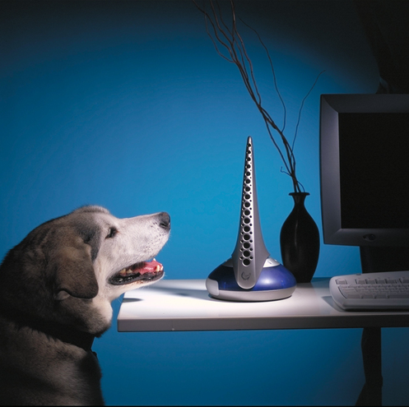
Devices that are used in transferring smell over internet
Smell Synthesizer
Smell synthesizer is the device, which is used to generate the smells.
iSmell is a device used to produce the gas using computer.
There are various types of smell synthesizers available in the market, but for computer the smell synthesizer is made by digiscents industry.

Slide 13
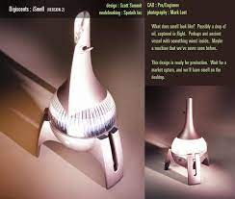
iSmell
The iSmell is a peripheral devices, about the size of a PC speaker that connects to a PC via a serial or USB port.
It uses consumable cartridges, which are used and replaced similar to the way ink jet printers use ink cartridges.
The iSmell device reads a digital scent file, creates a smell from a “palette”.

Slide 14

Cartridge
The cartridge will contain chemicals in the form of either natural oils or synthetic fragrances that will be activated by either heat or air pressure, when you send signal from your computer.
Currently 128 chemicals are stored in a cartridge.
Similar to an ink printer.

Slide 15
Advantages
it is easily carriage able and lightweight.
e-nose is a compact device and so it is portable and reliability is very high.
1
2
It can identify simple molecules which can not be accomplished by human nose.
It can be used without fail over hours, days, weeks and even months.
3
4

Slide 16
Disadvantages
Chemical problem
It is very difficult task to put any digital reactions into a computer and execute over a computer.
Price
Cost of an e-nose ranges from $5000 to $100,000, which is very high.
Genetics
As we know that the ismell device is made of natural chemical but there might be possibility that any user has problem with smell.

Slide 17
Conclusion
In this presentation we learnt about Digital Scent Technology and it means, about methodology, about hardware device and applications.
Smell has a strong power over human beings. The sense of smell is intimately linked to the memory and emotions making scent a powerful way to boost ideas. It wins the attention of audiences and affects learning, mood and memory.
This technology could upgrade advertisements and is a great tool for marketing. It can stimulate emotions such as fear or love. This digital smell can be used in several streams such as over the television, theatre and the web.

Slide 18
References
[1] https://www.gyanvihar.org/researchjournals/CTM_VOL_1_7.pdf
[Accessed on 17 Oct 2021]
[2] https://nanoscent.wordpress.com/
[Accessed on 10 Nov 2021]
[3] 'Digital smell' technology could let us transmit odors in online chats (nbcnews.com)
[Accessed on 20 Nov 2021]
[4] Digital Scent Technology - Smell, Taste, Feel Via Internet | (ashutoshviramgama.com)
[Accessed on 20 Nov 2021]
[6] Google Nose: Smell the World Right from Your Computer (tech.co)
[Accessed on 20 Nov 2021]
[7] https://thehustle.co/digiscents-ismell-fail/
[Accessed on 20 Nov 2021]
[8] https://spectrum.ieee.org/digital-nose-stimulation-enables-smelling-in-stereo
[Accessed on 20 Nov 2021]
[9] http://www.summitid.com/digiscents
[Accessed 28 Nov 2021]

Slide 19
Thank you !
Prathiksha

Slide 20


