Slide 1


Ransomware tracker
prathiksha
200970108
2ND year III Semester
18/10/2021
Department of Computer Applications,
Manipal Institute of Technology, Manipal
Mr. Akshay Bhat
Asst. Professor Senior Scale
Department of Computer Applications

Slide 2
OUTLINE OF THE PRESENTATION
Introduction
Steps to install Ransomware tool
Conclusion
Reference

Slide 3


Introduction
Ransomware is a type of malicious software that infects a computer and restricts users' access to it until a ransom is paid to unlock it. [1]
Ransomware variants have been
observed for several years and often
attempt to extort money from victims
by displaying an on-screen alert.[2]

Slide 4


Slide 5


Slide 6
Steps to downloading and installing
Visit following URL
https://www.avast.com/c-ransomware-protection-tool
Visit following URL
https://www.avast.com/c-ransomware-protection-tool
Scroll down and click on “DOWNLOAD FREE ANTI-RANSOMWARE”.
After downloading double click on .exe file.
Provide permission and go with default setting and install.
1
2
3
4

Slide 7
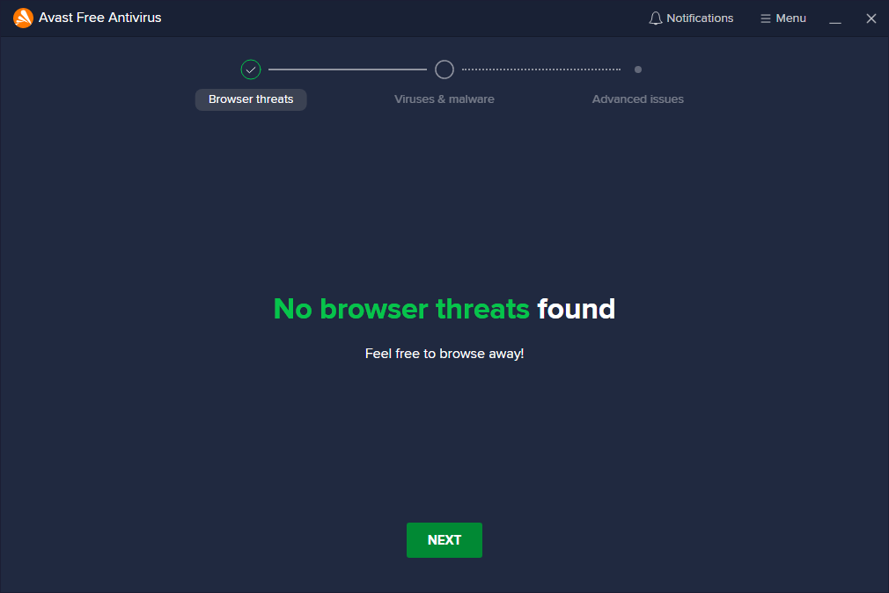
Cyber Forensics (MCA 5030)
7

Slide 8
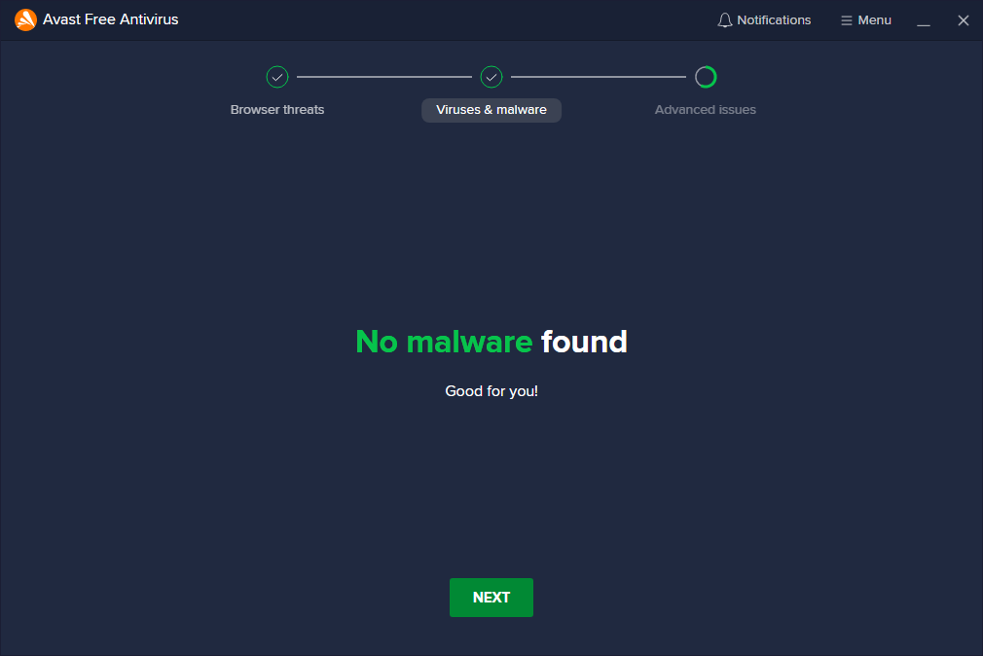

Slide 9
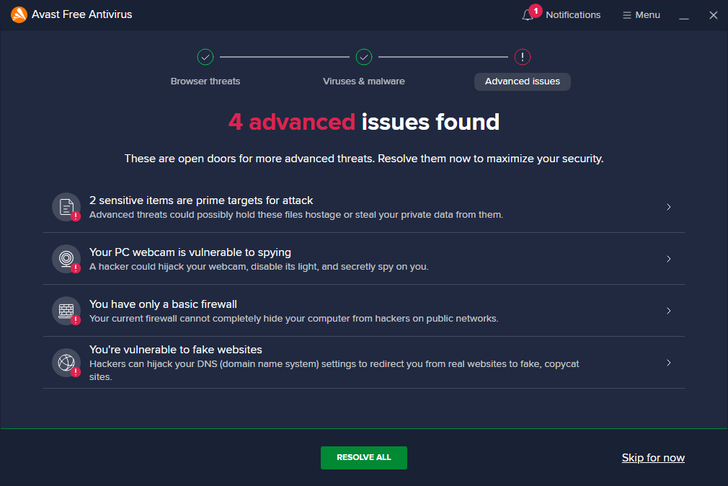

Slide 10
Conclusion
Ransomware is open source so it could be easily customized to not only look for additional files but also the way encryption is done.
This document provides information about Ransomware and its installation steps.​

Slide 11
Reference
[1] https://www.dictionary.com/browse/ransom
[Accessed on:October,14,2021]
[2] https://digitalguardian.com/blog/history-ransomware-attacks-biggest-and-worst-ransomware-attacks-all-time
[Accessed on:October,14,2021]
[3] https://www.mcafee.com/enterprise/en-in/security-awareness/ransomware.html
[Accessed on:October,14,2021]
[4] https://www.datto.com/blog/common-types-of-ransomware
[Accessed on:October,14,2021]
[5] https://umbrella.cisco.com/ransomware-defense-dummies-2nd-edition
[Accessed on:October,14,2021]
[6] https://www.statista.com/statistics/701020/major-operating-systems-targeted-by-ransomware/
[Accessed on:October,14,2021]

Slide 12
Thank you!
- Prathiksha

