Slide 1


An Analysis of Tennessee Report Card Scores
Nashville Sofware School
By, Prathima Swetha
Cohort-DDA13
August 16 2024

Slide 2

The State Report Card Is A One-stop Shop To Find Information On How Tennessee Districts And Schools Are Performing Across The State And An Important Tool For Parents And Families, Educators, Communities, And Elected Officials To Understand How Our Schools And Districts Are Serving All Our Students.
Notes:
The Tennessee Report Card Scores are a comprehensive set of metrics that reflect the academic performance and overall quality of education provided by schools in Tennessee. They include various types of scores such as academic achievement, student growth, college and career readiness, and school quality. These scores are crucial for evaluating educational effectiveness, guiding improvements, and informing stakeholders about the state of education in Tennessee.

Slide 3
Goal: To Evaluate The Overall Academic Performance Of Students In Tennessee . By Examining Report Card Scores Across Different Subjects, Providing A Comprehensive View Of Student Achievement Levels
Approach : School districts In Tennessee, and how many Schools in each Schools district
Key facts and figures from the Tennessee Reports 2018 To 2020.
Stretch Goals: Distribution of subject scores and ACT scores ,how they are corelated .

Slide 4
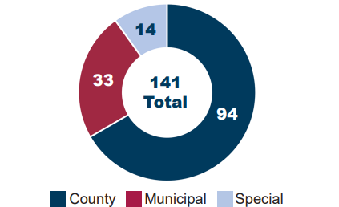
School Districts In Tennessee
Tennessee contains 141 public school districts, not including those operated by the State Board of Education and the Achievement School District.
The state has 94 county school districts, 33 municipal (or city) school districts across 22 counties, and 14 special school districts across seven counties.

Slide 5
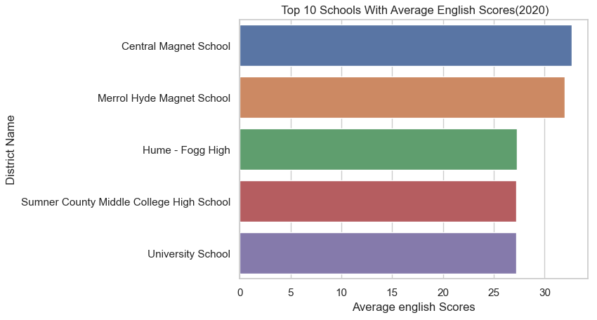
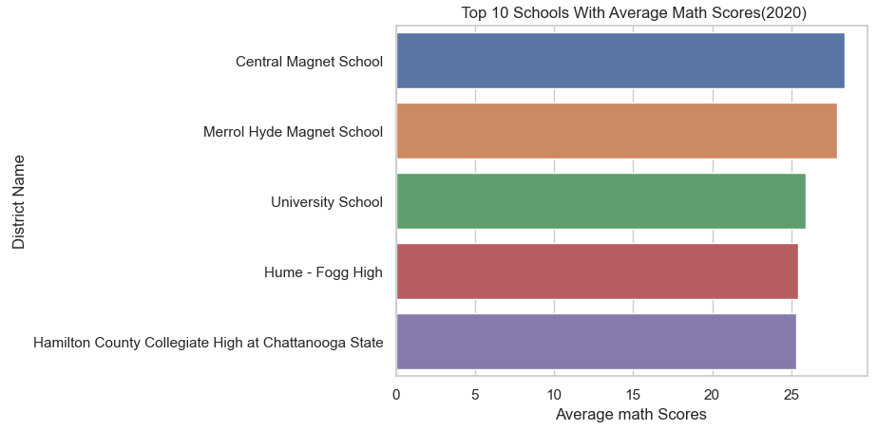
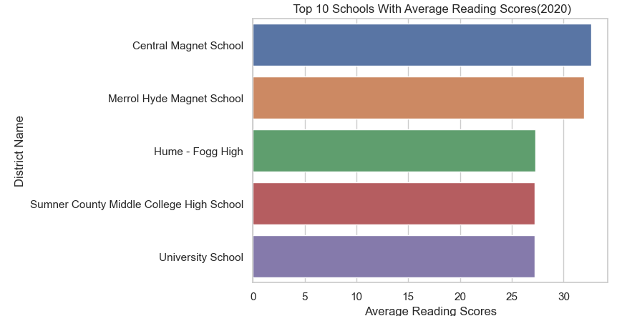
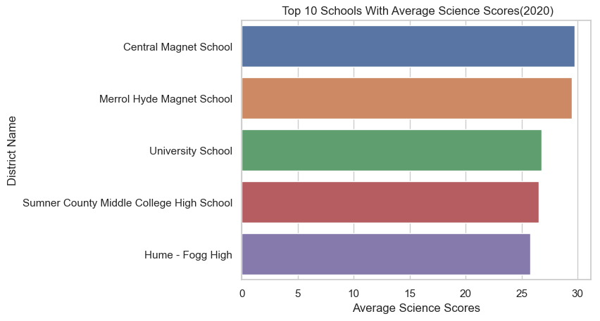
The Best Average scores of subjects with corresponding schools
After Comparing The Bar Charts, It's Clear That Central Magnet School Has The Highest Average Scores, Merrol Hyde Magnet School is next In Math, Science, And English Reading.

Slide 6
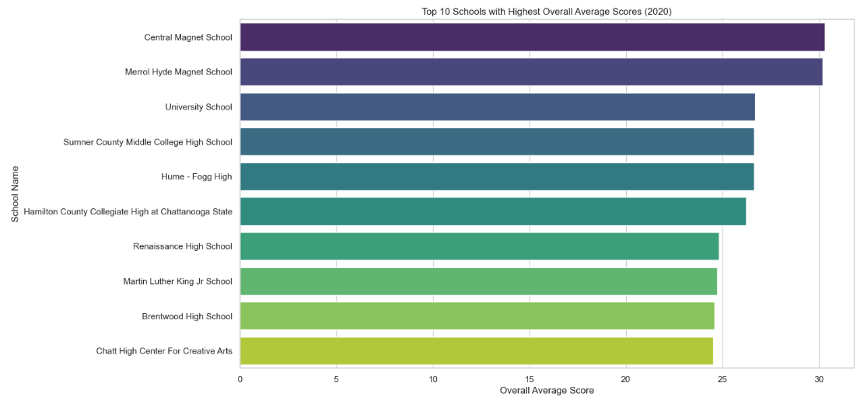
Oveall Performance
The Overall performance of Central Magnet School Has The Highest, next Merrol Hyde Magnet School

Slide 7
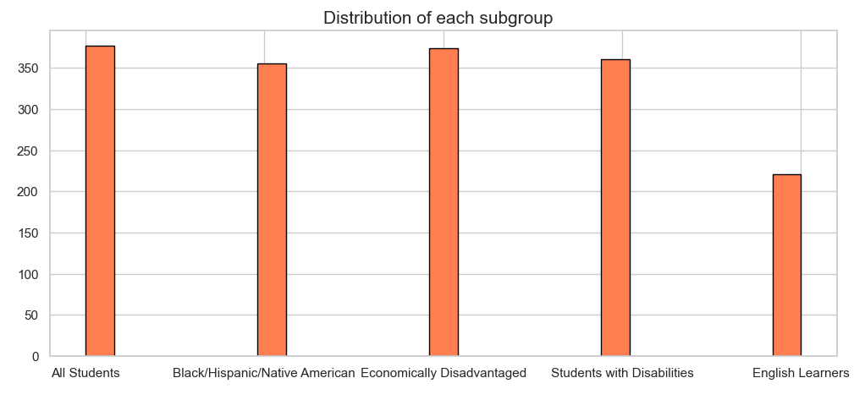
Subgroup
specific group of students within a school population who identify with both black, Hispanic, and/or native American racial or ethnic backgrounds
Historically, schools, districts, and governmental agencies have defined students as economically disadvantaged based on their eligibility to receive free or reduced-price lunch under the National school Lunch Program
Any student with an Individualized Education Program, as defined by the Individuals with Disabilities Education Act, is reported in the students with disabilities subgroup.
ELL students come from many different cultures and speak many different languages (for example, ELL students in Tennessee represent more than 150 languages); are at many different levels of English proficiency

Slide 8

Subgroup:All Students

