Slide 1
OralInsight
Explainable AI for Oral Lesion Screening — a leakage-controlled benchmark and research prototype
Annareddy Sai Prathima 2430010176
Manya Aghi - 2430010231
Notes:
Introduce the project: an eight-week study classifying clinical photographs of oral lesions as benign or malignant, with explainability and a working prototype. Emphasise from the start that this is a research prototype, not a diagnostic tool.

Slide 2
Why oral lesion screening needs better evidence
Deep learning on photographs reports AUCs of 0.86–1.00 in the reviewed studies, but…
Public datasets are tiny and scarce; the larger ones are restricted-access.
Some 96–100% results come from protocols where augmented copies of test images may be in training.
Performance drops on images from other sources (e.g. AUC 0.983 → 0.935; F1 0.84 → 0.73).
Heat maps are rarely checked on failures, and sometimes highlight teeth or gloves instead of lesions.
180,162
estimated new lip and oral-cavity cancers in men, WHO South-East Asia (GLOBOCAN 2024) — the most common cancer in men in the region
Many cancers develop from visible oral potentially malignant disorders, yet benign lesions, OPMD and early carcinoma look alike to non-specialists.
OralInsight · Explainable AI for Oral Lesion Screening · research prototype, not a diagnostic tool
2
Notes:
Clinical motivation and the problem with existing evidence. Numbers come from the verified literature matrix (Fu et al. 2020; Talwar et al. 2023; Saldivia-Siracusa et al. 2025) and the IARC fact sheet.

Slide 3
Four evidence-based research gaps
20 verified papers (Crossref/DataCite) → gaps traced to specific studies
G1
Leakage-prone evaluation
G2
Little external validation
Augmented copies in training / unclear split order (Islam 2023; Yadav 2025; Liu & Bagi 2025)
Drops on new image sources (Fu 2020; Talwar 2023; Camalan 2021)
G3
XAI missing or only on successes
G4
Few CIs, little error analysis
Off-lesion attention when checked (Saldivia-Siracusa 2025; Figueroa 2022)
Single point estimates common; errors rarely studied (Gomes 2024)
OralInsight · Explainable AI for Oral Lesion Screening · research prototype, not a diagnostic tool
3
Notes:
Each gap is mapped to papers in RESEARCH_GAP_EVIDENCE.md. We explicitly did NOT claim gaps the literature does not support, e.g. 'no prototypes exist' (two papers built apps).

Slide 4
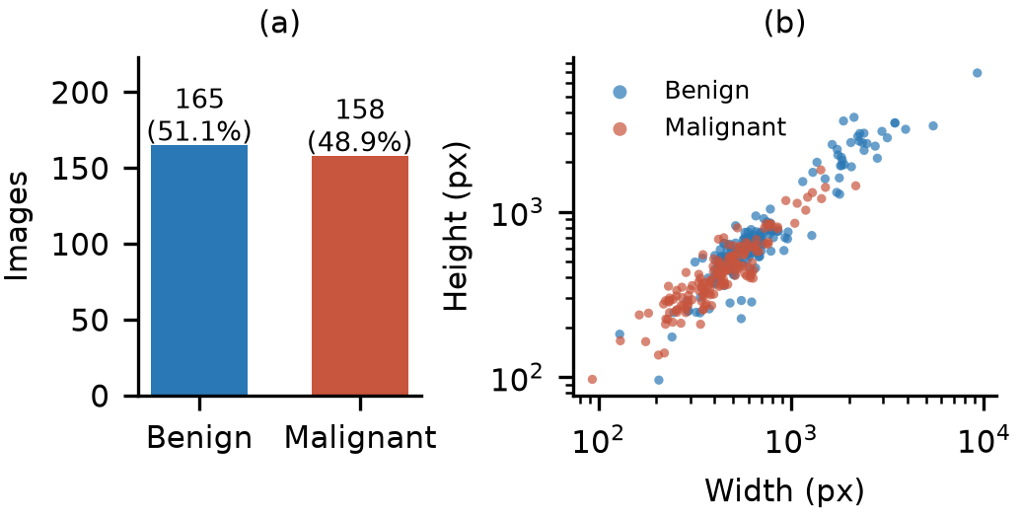
Dataset: open, balanced — and acquisition-biased
Mendeley Oral Images Dataset (Chandrashekar et al., CC BY 4.0, doi:10.17632/mhjyrn35p4.2)
323
14
original photographs
165 benign · 158 malignant
near-duplicate groups (30 images) kept in one split
0.78
65 / 258
AUC from file metadata alone (size, EXIF, JPEG)
held-out test / development (5 group folds)
Selected over 6 alternatives: the two largest datasets are restricted-access; others are web-sourced, unlicensed or histopathology.
OralInsight · Explainable AI for Oral Lesion Screening · research prototype, not a diagnostic tool
4
Notes:
All 323 files hash-verified. Malignant photos are smaller (median 0.18 vs 0.40 MP) and camera models differ by class — a shortcut risk we test later. Test split fixed before any modelling.

Slide 5
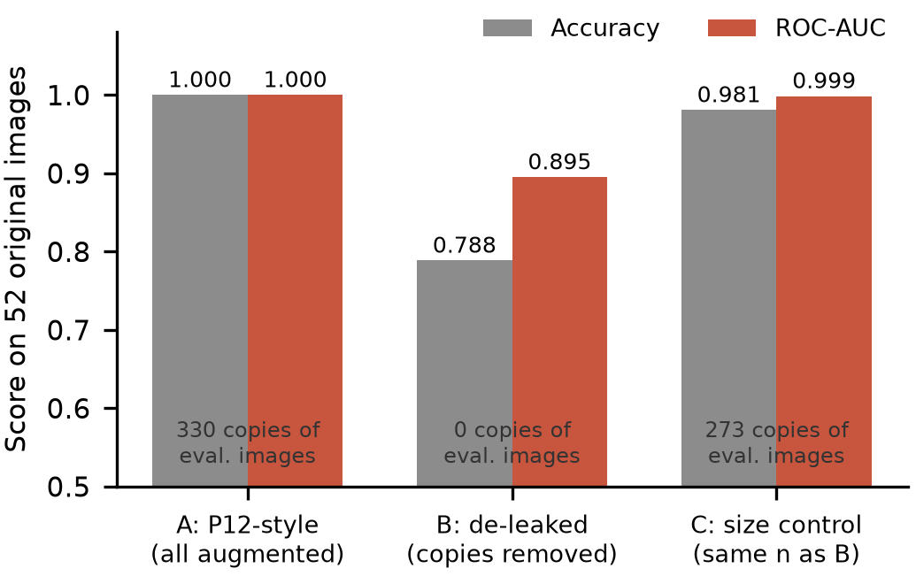
The published 100% is a leakage artefact
Replication on 52 original images (development fold 0)
Audit of the augmented folder
322 / 323 originals have a near-identical augmented copy; 39 / 40 visually confirmed
Train on all augmented: 1.000
Remove copies of eval. images: 0.788
Same-size random subset: 0.981
→ it is the copies, not the training-set size
OralInsight · Explainable AI for Oral Lesion Screening · research prototype, not a diagnostic tool
5
Notes:
Islam et al. (2023) trained on the dataset's augmented folder and tested on originals, reporting 100%. We reproduced 100%, and showed it collapses to ~79% when only the copies of the evaluation images are removed, while a random removal of the same size keeps ~98%. Answers gap G1.

Slide 6
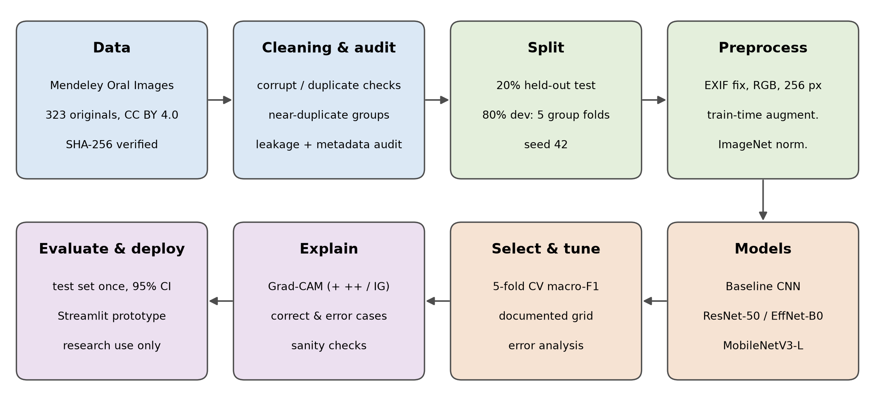
Leakage-controlled methodology
Group-aware split; test used once
On-the-fly augmentation, train only
Baseline CNN vs MobileNetV3-L, EfficientNet-B0, ResNet-50 (ImageNet, fully fine-tuned)
15-epoch cosine schedule (early stopping on noisy val. loss abandoned)
Pre-registered selection: macro-F1 → AUC → compute
OralInsight · Explainable AI for Oral Lesion Screening · research prototype, not a diagnostic tool
6
Notes:
All steps are scripts in src/. CPU-only laptop. Mention the documented protocol revision: early stopping on validation loss restored epoch-1 weights because the loss on 52 images was too noisy.

Slide 7
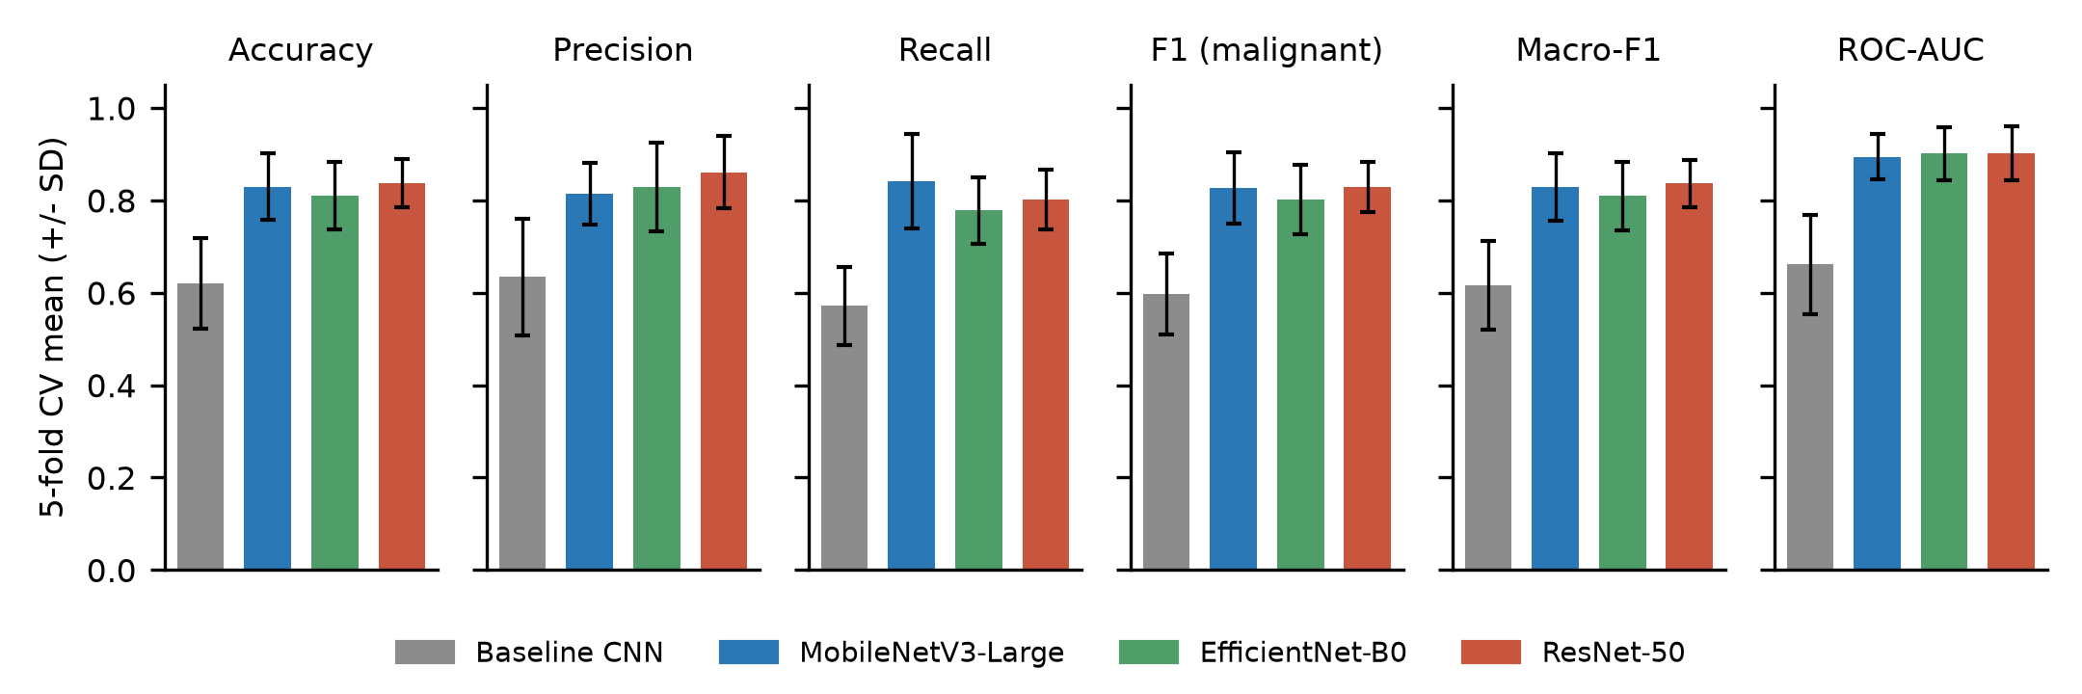
Transfer learning wins; architectures tie
5-fold cross-validation on 258 development images (mean ± SD)
CV macro-F1
Baseline CNN
0.617
MobileNetV3-L
0.829
EfficientNet-B0
0.809
ResNet-50
0.836
All three within 1 SD → cheapest selected: MobileNetV3-L (0.22 vs 4.1 GFLOPs)
OralInsight · Explainable AI for Oral Lesion Screening · research prototype, not a diagnostic tool
7
Notes:
Fold-to-fold SD (0.05-0.07) is bigger than model differences, so the pre-registered rule picked the lightest model. The from-scratch baseline is clearly worse.

Slide 8
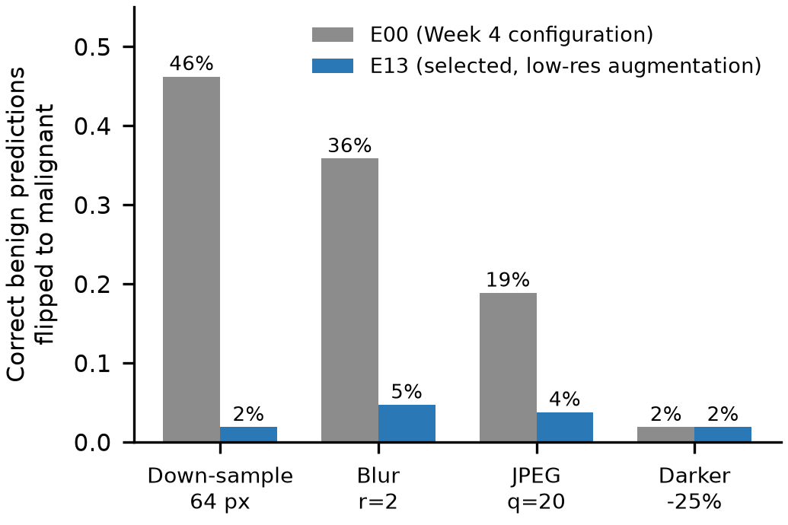
Error analysis exposed a resolution shortcut
Out-of-fold counterfactual probe: degrade correctly classified benign photos
46%
2%
benign flipped to malignant after down-sampling (Week 4 model)
after resolution-degradation augmentation (final)
Malignant photos in this dataset are smaller and blurrier → the network learned 'blurry ⇒ malignant'
14 tuned variants all tied on accuracy; robustness decided the winner (E13)
Residual correlation with resolution remains — a dataset confound only external data can fix
OralInsight · Explainable AI for Oral Lesion Screening · research prototype, not a diagnostic tool
8
Notes:
Key finding. Accuracy could not separate configurations; asking why the model failed could. Be honest that the augmentation removes sensitivity to blur but not the underlying confound (rho = -0.53).

Slide 9
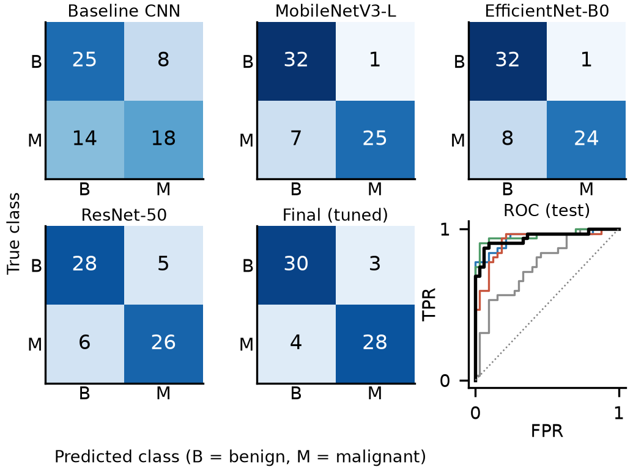
Held-out test set: one evaluation, 65 images
Final model: tuned MobileNetV3-Large (E13), threshold 0.5, 95% bootstrap CI
0.892
0.875
0.909
0.941
accuracy
[0.82–0.95]
sensitivity
[0.75–0.97]
specificity
[0.79–1.00]
ROC-AUC
[0.87–0.99]
vs baseline CNN: McNemar p = 0.0007; ΔAUC +0.176 [0.063, 0.292]
vs other pretrained models: no significant difference (all p ≥ 0.39)
Test > CV estimate (0.810 ± 0.032) — expect the CV value; 65 images give wide CIs
4 of 32 malignant and 3 of 33 benign photos misclassified
OralInsight · Explainable AI for Oral Lesion Screening · research prototype, not a diagnostic tool
9
Notes:
Report honestly: clearly better than training from scratch, but not demonstrably better than the untuned pretrained models. The CV estimate is the conservative expectation.

Slide 10
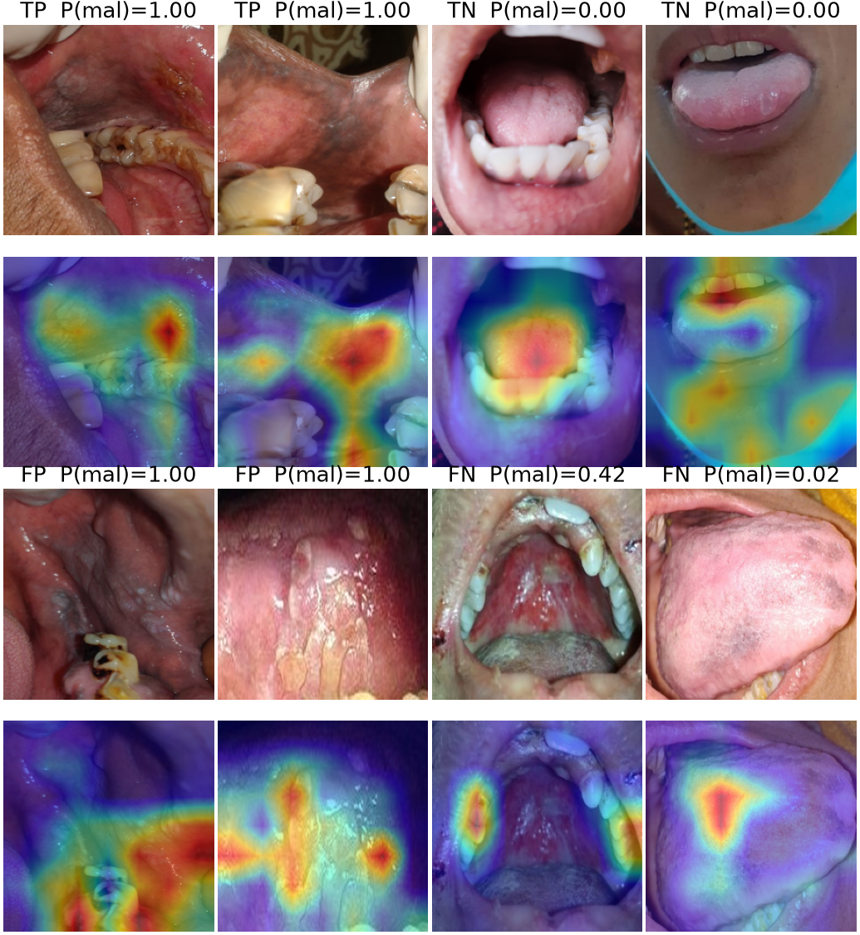
What the model looks at (Grad-CAM)
Out-of-fold explanations for all 258 development images; checks passed
Correct malignant: attention on the discoloured mucosa filling the frame
False positives: stained teeth, calculus, restorations — off-lesion
False negatives: peripheral attention, misses small central changes
Faithful but coarse: deleting top-20% pixels drops P by 0.26 vs 0.10 random; 7×7 maps
Heat maps show model attention, not lesion location or clinical evidence.
OralInsight · Explainable AI for Oral Lesion Screening · research prototype, not a diagnostic tool
10
Notes:
Grad-CAM, Grad-CAM++ and Integrated Gradients; randomisation sanity check passed (rho 0.09). Without lesion masks we cannot measure clinical relevance.

Slide 11
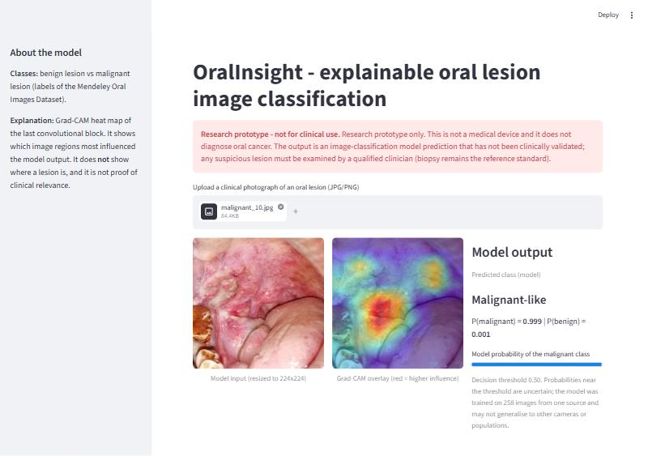
OralInsight research prototype
streamlit run prototype/app.py
1
Upload photo
2
Same preprocessing as training
3
Prediction + probability
4
Grad-CAM overlay
5
Disclaimer + low-confidence flag
Verified: identical to the evaluation on all 65 test images; 0.15 s per image on CPU
OralInsight · Explainable AI for Oral Lesion Screening · research prototype, not a diagnostic tool
11
Notes:
Live demo here if time permits (RUN_PROTOTYPE.md). Show one correct case and the benign/101 false positive to illustrate that the app cannot tell when it is wrong.

Slide 12
Limitations and next steps
Limitations
Future work
323 photos, one region, one source; no external validation
Labels from folders; no patient IDs or histopathology info
Acquisition confound (resolution, camera) not fully removable
Confident errors; probabilities poorly calibrated
XAI coarse; no lesion masks; no demographics for fairness
External validation on restricted datasets (data-use agreement)
Device-stratified reporting and acquisition harmonisation
Lesion annotations → attention-guided training
OPMD sub-classes and calibrated referral thresholds
Ethics-approved reader study with clinicians
OralInsight · Explainable AI for Oral Lesion Screening · research prototype, not a diagnostic tool
12
Notes:
Be explicit: no clinical claim can be made from this work.

Slide 13
Take-home messages
1
Leakage explains the 100% reported for this dataset (1.00 → 0.79 without copies)
2
Leakage-free test accuracy 0.892, AUC 0.941 — better than scratch, tied with other pretrained CNNs
3
Error analysis + counterfactuals found a resolution shortcut that accuracy and heat maps missed
4
A verified research prototype — not a diagnostic tool; external & clinical validation required
Code, data card, results and paper: OralInsight/ (see FINAL_DELIVERABLES.md)
Notes:
Thank the supervisor; invite questions.

