Slide 1
OralInsight
Can a computer help spot a serious oral lesion from a photograph?
A small, careful study of what works, what looks too good, and why.
Annareddy Sai Prathima 2430010176
Manya Aghi 2430010231
Department of Computer Science and Data Science, Manipal University Jaipur
Supervisor: Dr Pankaj Pandey
DSE3140 Computer Vision
Notes:
Start by saying what the talk is about: a photo-based screening aid, studied carefully, including a result that looked perfect for the wrong reason.

Slide 2
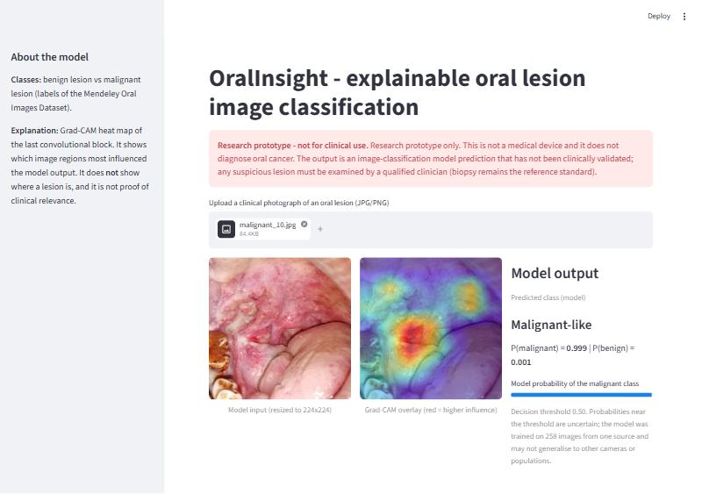
What this project is
We built a program that looks at a photo of a lesion inside the mouth.
It gives two things: a probability that the lesion is malignant-like, and a heat map of the area that influenced the answer.
The heat map is called Grad-CAM. It shows what the model used, not what a doctor should see.
It runs as a small web app where anyone can upload a photo and see the result and the map.
It is a research prototype. It does not diagnose anyone and has not been tested in a clinic.
The working web app on a test photograph
OralInsight · oral lesion image classification · research prototype, not a diagnostic tool
2
Notes:
Explain the two outputs. Stress that the heat map is a model explanation, not a medical finding.

Slide 3
The problem we wanted to study
Oral cancer is often found late. Early lesions are visible, but they can look very similar to harmless ones.
There are too few specialists to examine every mouth, especially in primary care.
AI papers report very high scores (AUC 0.86–1.00), usually on small public datasets.
Three things make those scores fragile: tiny data, augmented copies of test images in training, and heat maps that are rarely checked on mistakes.
OralInsight · oral lesion image classification · research prototype, not a diagnostic tool
3
Notes:
The motivating problem: late detection, few specialists, and over-optimistic AI reporting.

Slide 4
What we set out to do
1
Build a fair test
2
Compare four models
Split the photos so that near-duplicates never appear on both sides, and measure how much leakage inflates the score.
A small CNN trained from scratch against three pretrained models, using the same data and recipe.
3
Explain the decisions
4
Analyze the figures
Use heat maps on correct and wrong predictions, and test for hidden shortcuts.
Diagrams that report a probability and a heat map, with a clear non-diagnostic warning.
OralInsight · oral lesion image classification · research prototype, not a diagnostic tool
4
Notes:
These four goals match the paper. Goal 1 and goal 3 produced the most interesting findings.

Slide 5
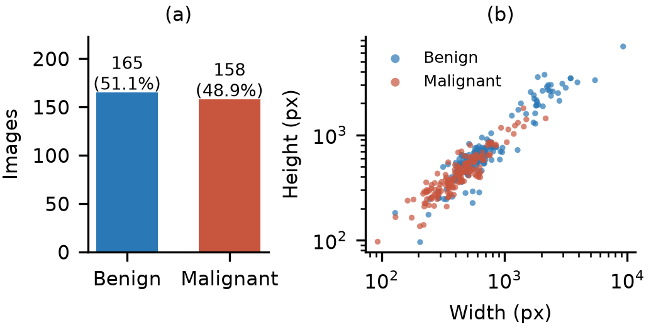
The data we used
Mendeley Oral Images Dataset (open licence, CC BY 4.0).
323 photographs: 165 benign and 158 malignant — roughly balanced.
Only the original photos were used. We did not use the dataset's pre-augmented folder.
Photos differ a lot: different cameras, sizes and lighting. Size alone hints at the class — a trap we came back to.
No patient information such as age, sex or habits, and no biopsy records.
Left: number of images per class. Right: image size by class — malignant photos were often larger.
OralInsight · oral lesion image classification · research prototype, not a diagnostic tool
5
Notes:
The dataset is small and single-source. The size difference between classes becomes a shortcut later.

Slide 6
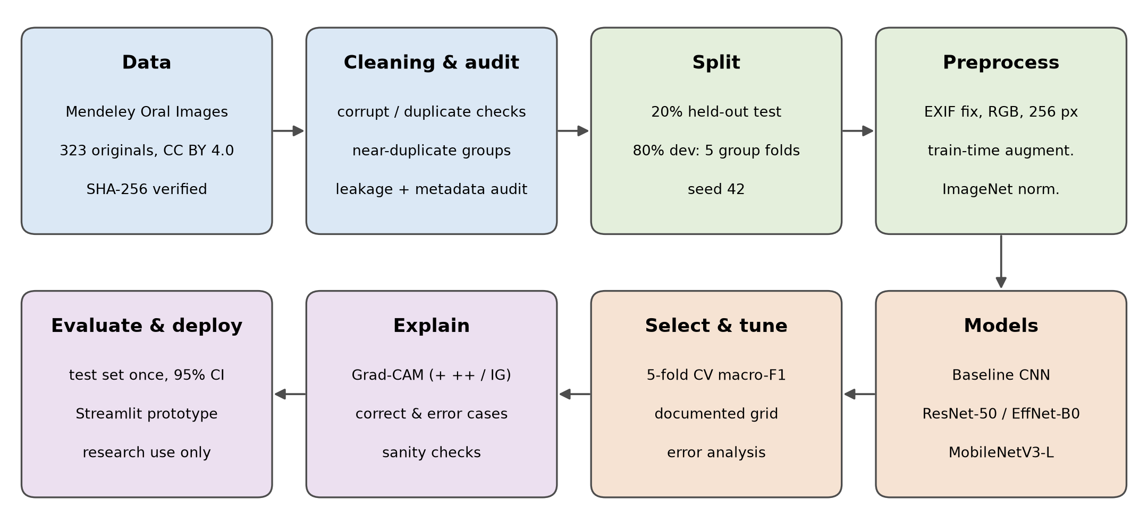
How we kept the test fair
Group near-duplicates so copies stay on one side of the split.
Lock 65 photos as a test set before training; open it once, at the end.
Use 258 photos for development in 5 cross-validation folds, grouped by duplicate.
Report confidence intervals and a baseline, so the numbers have context.
The full workflow: data, cleaning, split, models, tuning, explanations, evaluation and prototype.
OralInsight · oral lesion image classification · research prototype, not a diagnostic tool
6
Notes:
Explain the locked test set and duplicate grouping. This is what makes the evaluation believable.

Slide 7
The four models we compared
Baseline CNN
MobileNetV3-Large
EfficientNet-B0
ResNet-50
A small network trained from scratch. The reference point.
Small and fast; pretrained on everyday images (ImageNet).
Balanced pretrained model; a common strong baseline.
The largest model here; more capacity, slower on a CPU.
Why compare? A pretrained model should beat one trained from scratch on only 258 images — but does it beat it by enough to justify the extra size and cost?
OralInsight · oral lesion image classification · research prototype, not a diagnostic tool
7
Notes:
The baseline is deliberately simple. It tells us how much the pretrained models actually add.

Slide 8
How we trained and chose the final model
FINAL MODEL
Same training recipe for every model: 15 epochs, Adam, batch size 16, standard augmentation.
14 tuning runs for the strongest model, changing one setting at a time.
One extra idea: randomly shrink some training images. This teaches the model not to rely on sharpness or size.
Selection rule, fixed in advance: best cross-validated macro-F1, then fewest benign images flipped by blur, then AUC.
MobileNetV3-Large
with low-resolution augmentation
settings from tuning run E13
4.20 M parameters · 28 ms per image on CPU
OralInsight · oral lesion image classification · research prototype, not a diagnostic tool
8
Notes:
The selection rule was written down before the final test. Low-resolution augmentation is the key change.

Slide 9
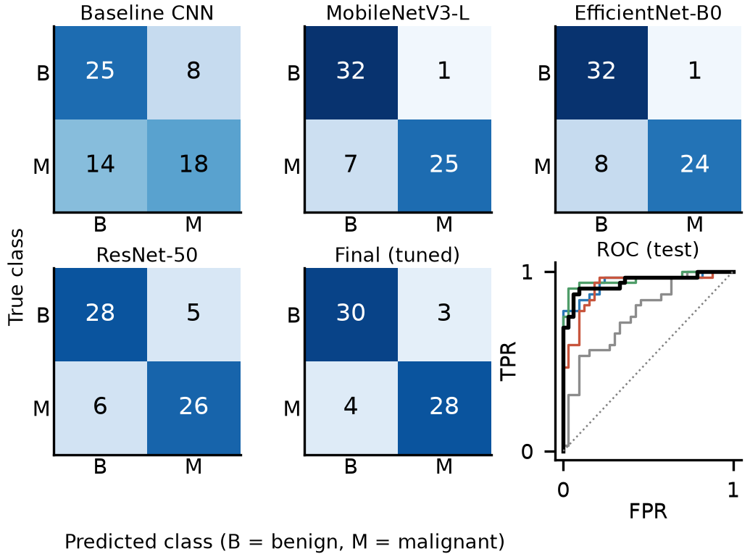
How well did it work?
89.2%
87.5%
90.9%
0.941
Accuracy
Sensitivity (cancers found)
Specificity (benign cleared)
ROC-AUC
58 of 65 correct (30 benign + 28 malignant).
7 errors: 3 benign photos flagged as malignant-like, 4 cancers missed.
Better than scratch: accuracy 66.2% → 89.2%; McNemar p = 0.0007.
But not better than the other pretrained models — differences were small and not significant.
Test confusion matrices and ROC curves
OralInsight · oral lesion image classification · research prototype, not a diagnostic tool
9
Notes:
Read the four numbers slowly. Then say that missing four cancers is the error that matters most clinically.

Slide 10
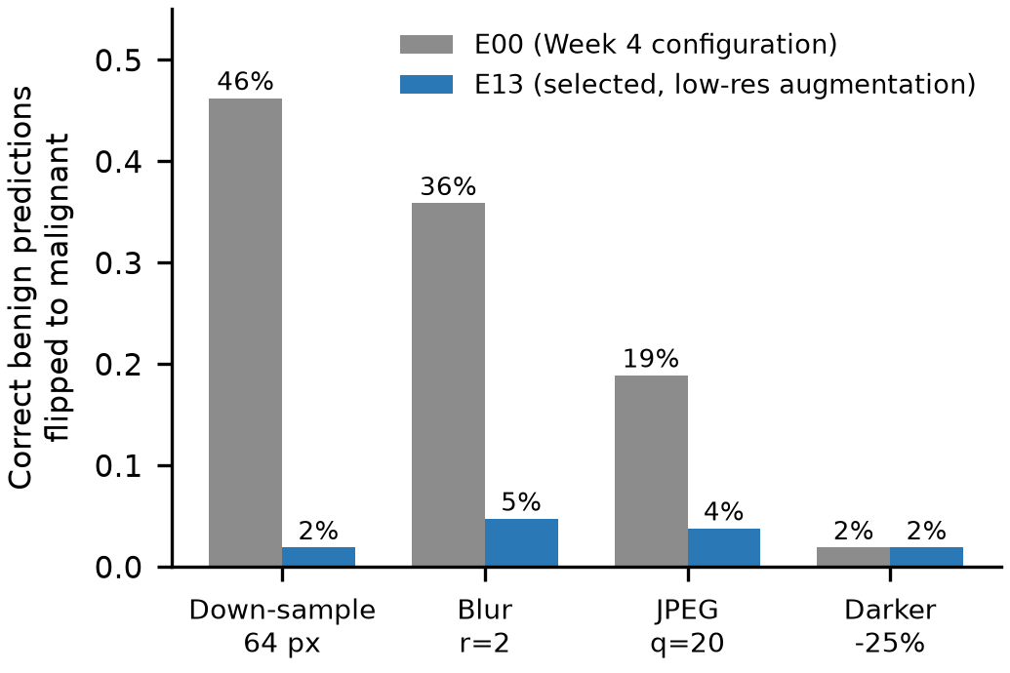
A hidden shortcut: image size
Malignant photos were often larger than benign ones in this dataset.
Without care, the model could learn “bigger image = malignant” instead of looking at the lesion.
Test: shrink the same benign photos to 64 pixels and see if the answer flips.
Before the fix: 46% of benign images flipped.
After low-resolution training: 2%.
Share of benign predictions that flip to malignant after degrading the image. The selected model is far more stable.
OralInsight · oral lesion image classification · research prototype, not a diagnostic tool
11
Notes:
This shortcut was invisible in accuracy and in the heat maps. Only a controlled test found it.

Slide 11
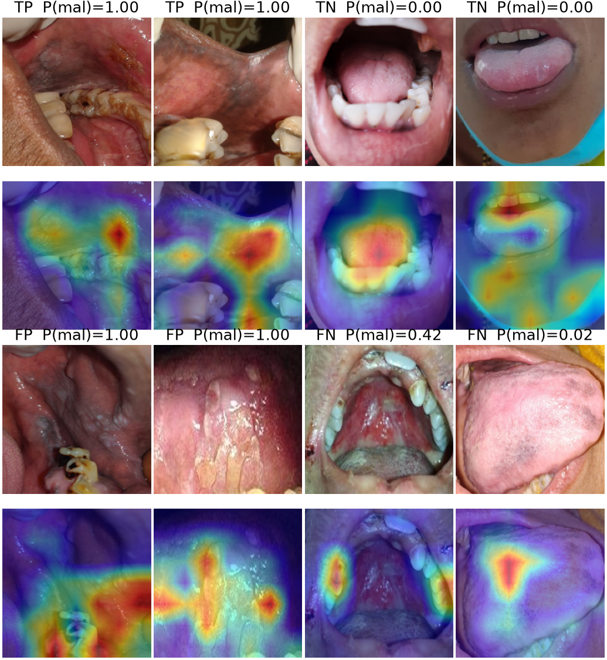
What the heat maps showed
Grad-CAM highlights the areas that pushed the decision towards one class.
On correct cases the map often sat on the lesion or nearby tissue.
On mistakes it sometimes focused on teeth, lips, gloves or the image border.
Methods partly agree: 86% with Grad-CAM++, only 39% with Integrated Gradients.
Deleting the top highlighted pixels changed the score more than deleting random pixels (26% vs 10%).
Conclusion: heat maps help us inspect the model, but they are not evidence of clinical reasoning.
False positives (FP) and false negatives (FN) are shown alongside correct cases.
OralInsight · oral lesion image classification · research prototype, not a diagnostic tool
12
Notes:
Show one correct and one wrong example. Say that agreement between methods is only partial.

Slide 12
Research gaps this work points to
1
Leakage-safe reporting
Many public benchmarks still train on augmented copies. Papers should report de-leaked scores.
2
Small, single-source data
323 photos from one source cannot cover other cameras, populations or lesion types.
3
Shortcut testing
Accuracy and heat maps can miss acquisition cues. Degradation tests should be routine.
4
Validating explanations
Heat maps are usually shown, not tested. We need quantitative checks and clinician readers.
OralInsight · oral lesion image classification · research prototype, not a diagnostic tool
13
Notes:
Tie each gap to a result: leakage to the 1.000 experiment, shortcuts to the resolution test, explanations to the heat-map checks.

Slide 13
Limitations and future work
LIMITATIONS
FUTURE WORK
One small public dataset from a single source; no external test.
Two classes only — no healthy controls, no OPMD subtypes.
No patient metadata (age, sex, habits, lesion site) or biopsy results.
Not clinically validated; no reader study with dentists or doctors.
Prototype runs on a CPU and is for research use only.
External and multi-centre validation with new cameras and populations.
Add healthy and OPMD classes; link labels to histology.
Lesion annotations and attention-guided training.
Calibrated probabilities and clinically chosen referral thresholds.
Ethics-approved reader study before any real-world use.
OralInsight · oral lesion image classification · research prototype, not a diagnostic tool
14
Notes:
Be explicit that the model is not ready for clinical use. Then point to the concrete next studies.

Slide 14
Thank You
Annareddy Sai Prathima
Manya Aghi
Notes:
Close with the leakage lesson and the clinical caution. Invite questions.

