Slide 1
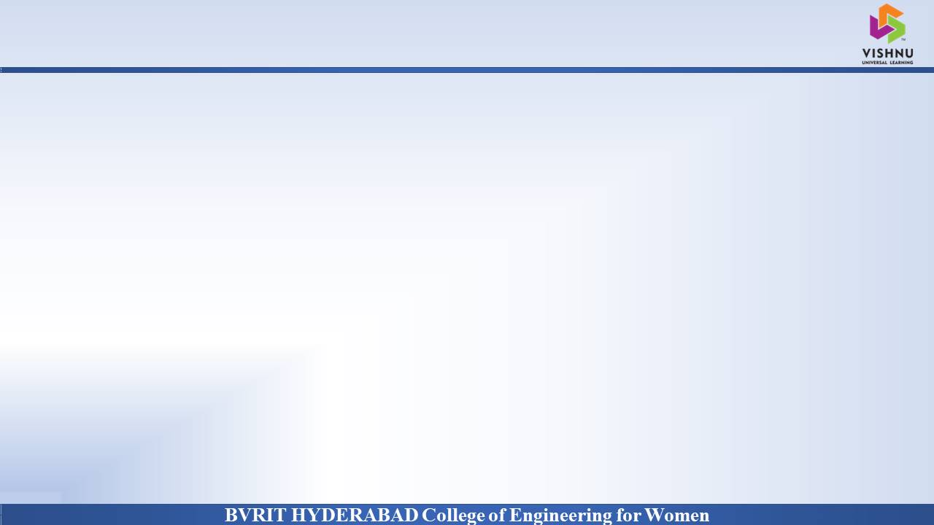
Department of Computer Science and Engineering
A Secure Searchable Encryption Framework
for Privacy Critical Cloud Storage Services
Vaddi Sri Vidya : 17wh1a0579
Aishwarya : 17wh1a0584
Prathima : 17wh1a05B8
Internal Guide: Mr. ShivaMurthy Hiremath
Designation : Assistant Professor

Slide 2

Abstract
Why Should I Study this course?
The project aims to introduce a novel Dynamic Searchable Symmetric framework , which achieves a high level of privacy, efficient search for data consumers and update for data owner, and low client storage with actual deployments on Mysql database server .
We fully implemented our framework and evaluated its performance on Mysql database.
Examples
BVRIT HYDERABAD College of Engineering for Women

Slide 3
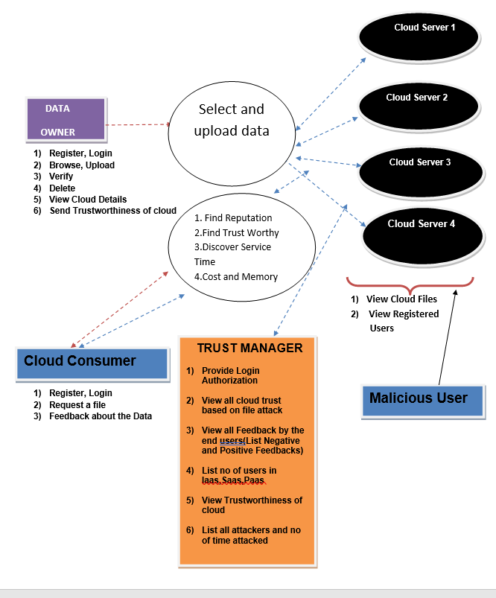
Architecture Diagram
Why Should I Study this course?
Examples
BVRIT HYDERABAD College of Engineering for Women

Slide 4
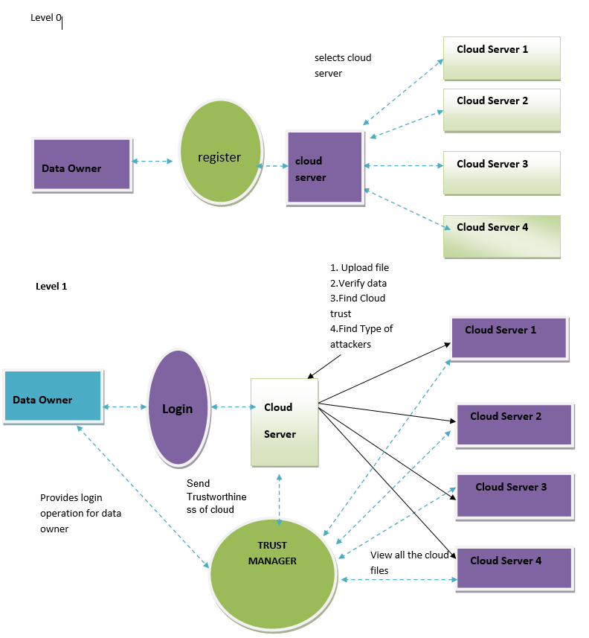
Data Flow Diagram
Why Should I Study this course?
Examples
BVRIT HYDERABAD College of Engineering for Women

Slide 6
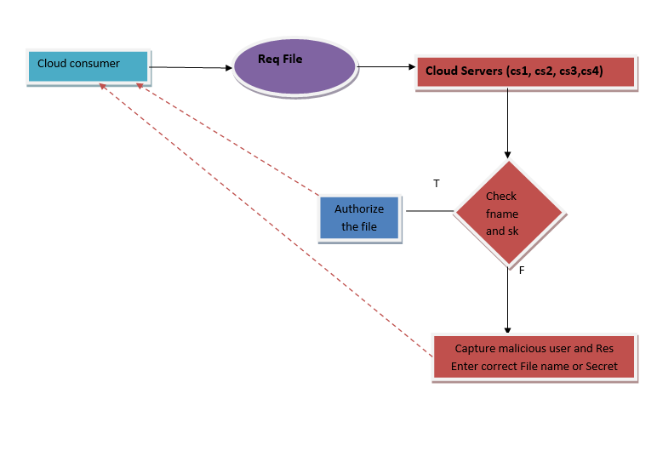

Slide 7
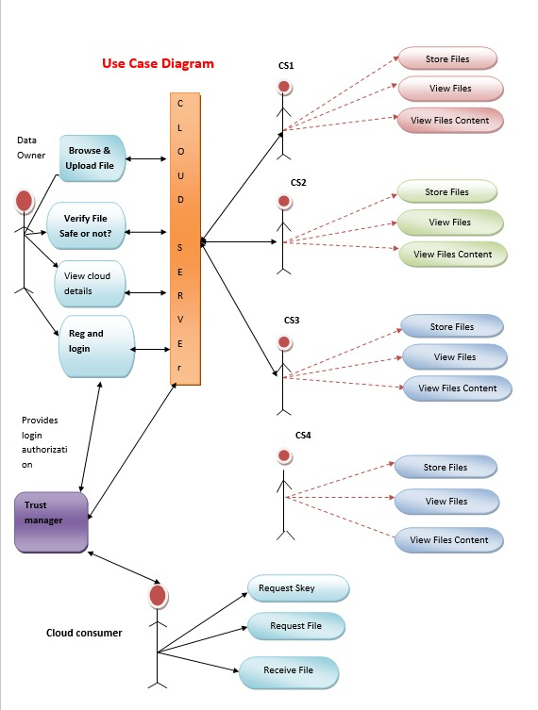
Use Case Diagram
Why Should I Study this course?
Examples
BVRIT HYDERABAD College of Engineering for Women

Slide 8
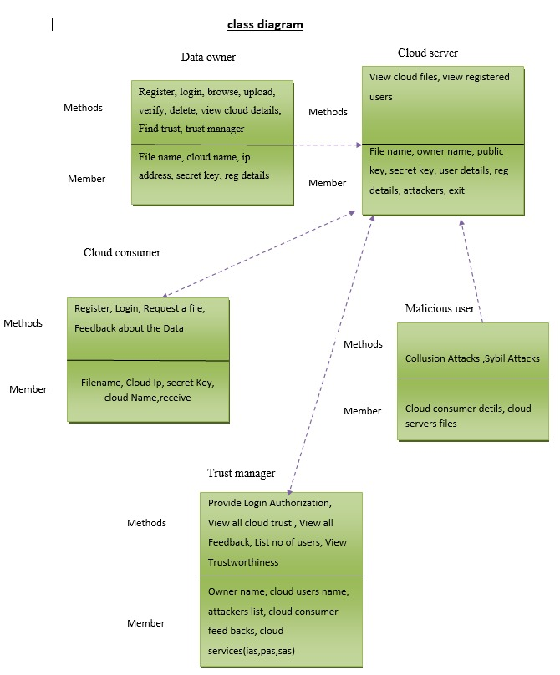
Class Diagram
Why Should I Study this course?
Examples
BVRIT HYDERABAD College of Engineering for Women

Slide 9
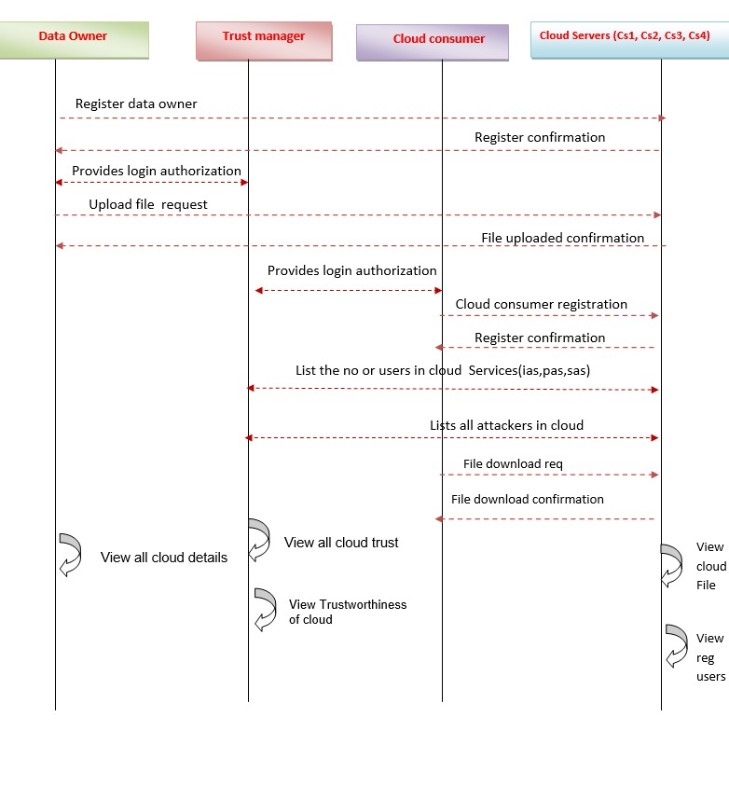
Sequence Diagram
Why Should I Study this course?
Examples
BVRIT HYDERABAD College of Engineering for Women

Slide 10
Technological Stack
Why Should I Study this course?
HTML CSS
JAVA
JSP
MySQL
MyEclipse
TOMCAT Server
Examples
BVRIT HYDERABAD College of Engineering for Women

Slide 11
System Requirements
Why Should I Study this course?
Environment | Specifications
Hardware | 20GB Storage space
 | 4GB RAM
 | Intel I5 Core Processor
Software | Eclipse
 | OS: Microsoft 10
 | Browser
Examples
BVRIT HYDERABAD College of Engineering for Women

Slide 12
Timeline
Why Should I Study this course?
Review | Excepted Completion
Review 0 | Requirements Specification Details of Features Base paper and references
Review 1 | Implementation of Design
Review 2 | Complete Implementation Scope of working with large sets of files Report for the Project
Examples
BVRIT HYDERABAD College of Engineering for Women

Slide 13
References
Why Should I Study this course?
Examples
[1] A Secure Searchable Encryption Framework for Privacy-Critical Cloud Storage Services Thang Hoang, Attila A. Yavuz, Member, IEEE and Jorge Guajardo
[2] R. Curtmola, J. Garay, S. Kamara, and R. Ostrovsky, “Searchable symmetric encryption: improved definitions and efficient constructions,” in Proc. 13th ACM Conf. Comput. Commun. security, ser. CCS ’06. ACM, 2006, pp. 79–88.
[3] E. Stefanov, C. Papamanthou, and E. Shi, “Practical dynamic searchable encryption with small leakage,” in 21st Annu. Network and Distributed System Security Symp. — NDSS 2014. The Internet Soc., February 23-26, 2014.
BVRIT HYDERABAD College of Engineering for Women

Slide 14
Thankyou

