Slide 1
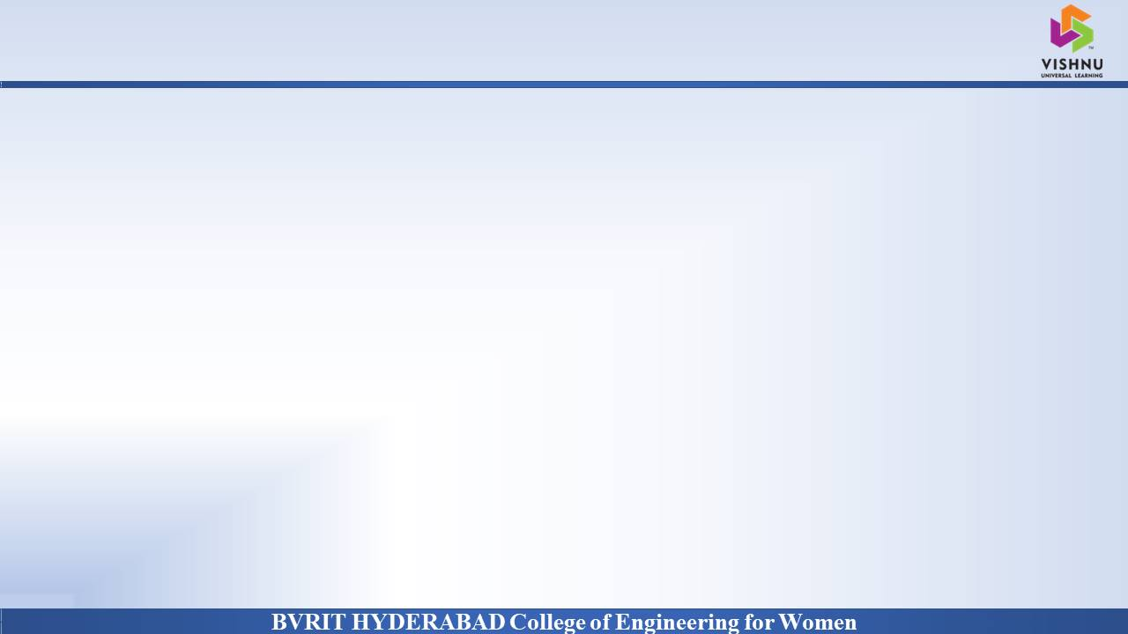
Department of Computer Science and Engineering
A Secure Searchable Encryption Framework for Privacy Critical Cloud Storage Services
Date: 27 May 2021
Vaddi Sri Vidya : 17wh1a0579
Aishwarya : 17wh1a0584
Prathima : 17wh1a05B8
Internal Guide: Mr. ShivaMurthy Hiremath
Designation : Assistant Professor

Slide 2

Abstract
Why Should I Study this course?
The project aims to introduce a novel Dynamic Searchable Symmetric framework , which achieves a high level of privacy
Efficient search for data consumers and update for data owner, and low client storage with actual deployments on DriveHq Cloud
We fully implemented our framework and evaluated its performance on Mysql database.
Examples
BVRIT HYDERABAD College of Engineering for Women

Slide 3
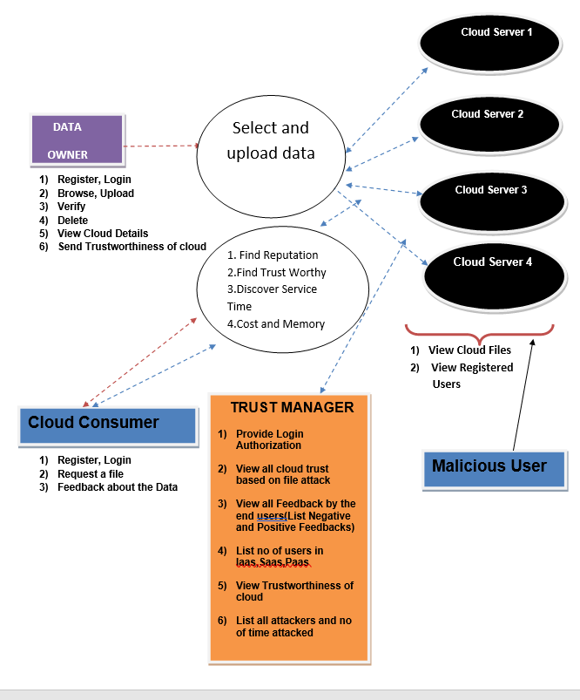
Architecture Diagram
Why Should I Study this course?
Examples
BVRIT HYDERABAD College of Engineering for Women

Slide 4
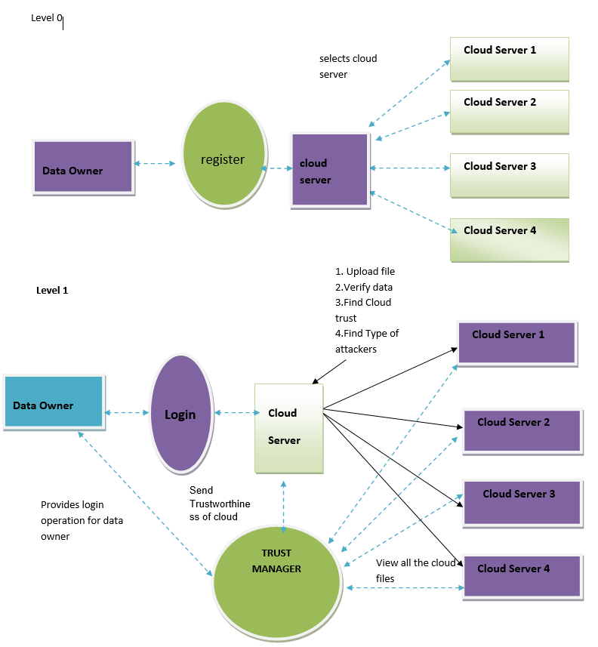
Data Flow Diagram
Why Should I Study this course?
Examples
BVRIT HYDERABAD College of Engineering for Women

Slide 6
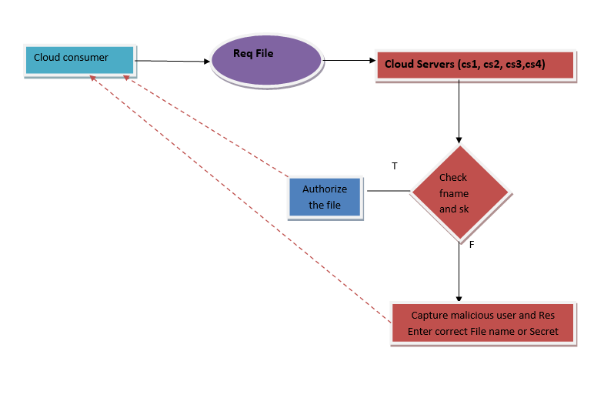

Slide 7
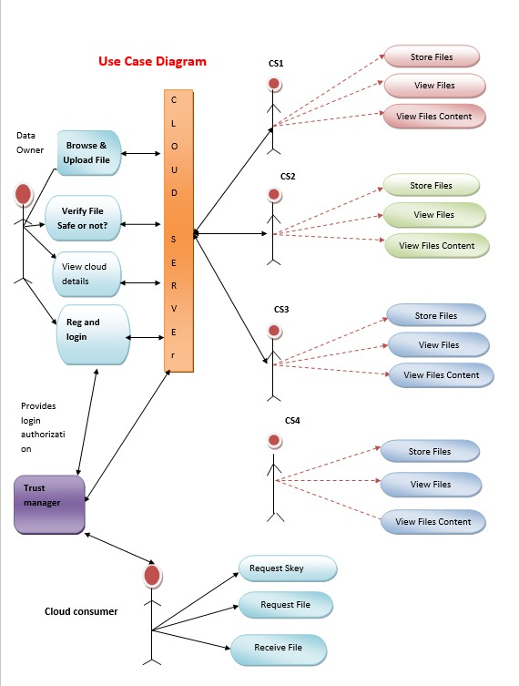
Use Case Diagram
Why Should I Study this course?
Examples
BVRIT HYDERABAD College of Engineering for Women

Slide 8
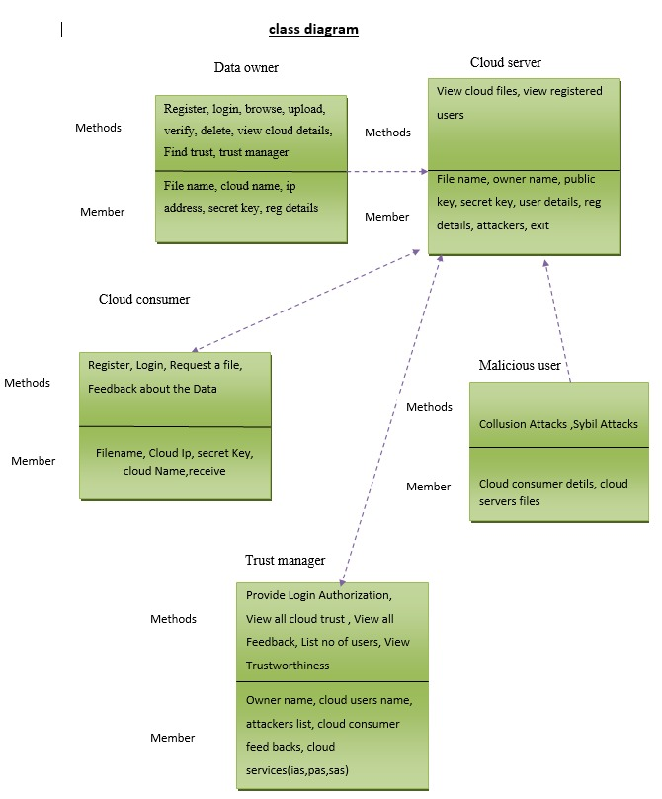
Class Diagram
Why Should I Study this course?
Examples
BVRIT HYDERABAD College of Engineering for Women

Slide 9
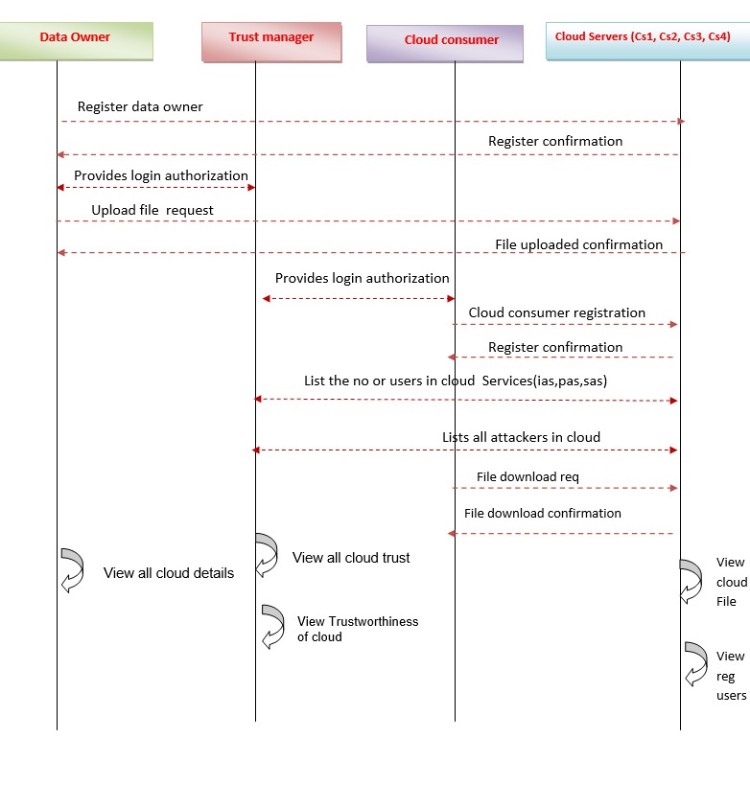
Sequence Diagram
Why Should I Study this course?
Examples
BVRIT HYDERABAD College of Engineering for Women

Slide 10
Technological Stack
Why Should I Study this course?
HTML CSS
JAVA
JSP
MySQL
MyEclipse
TOMCAT Server
Examples
BVRIT HYDERABAD College of Engineering for Women

Slide 11
System Requirements
Why Should I Study this course?
Environment | Specifications
Hardware | 20GB Storage space
 | 4GB RAM
 | Intel I5 Core Processor
Software | Eclipse
 | OS: Microsoft 10
 | Browser
Examples
BVRIT HYDERABAD College of Engineering for Women

Slide 12
Timeline
Why Should I Study this course?
Review | Excepted Completion
Review 0 | Requirements Specification Details of Features Base paper and references
Review 1 | Implementation of Design
Review 2 | Complete Implementation Scope of working with large sets of files Report for the Project
Examples
BVRIT HYDERABAD College of Engineering for Women

Slide 13
References
Why Should I Study this course?
Examples
[1] A Secure Searchable Encryption Framework for Privacy-Critical Cloud Storage Services Thang Hoang, Attila A. Yavuz, Member, IEEE and Jorge Guajardo
[2] R. Curtmola, J. Garay, S. Kamara, and R. Ostrovsky, “Searchable symmetric encryption: improved definitions and efficient constructions,” in Proc. 13th ACM Conf. Comput. Commun. security, ser. CCS ’06. ACM, 2006, pp. 79–88.
[3] E. Stefanov, C. Papamanthou, and E. Shi, “Practical dynamic searchable encryption with small leakage,” in 21st Annu. Network and Distributed System Security Symp. — NDSS 2014. The Internet Soc., February 23-26, 2014.
BVRIT HYDERABAD College of Engineering for Women

Slide 14
Thankyou

