Slide 1
Predicting Success for Movie Remakes

Slide 2
Our Model
Reproducing Original Success
Cultural Presence
Original Movie
Remake

Slide 3
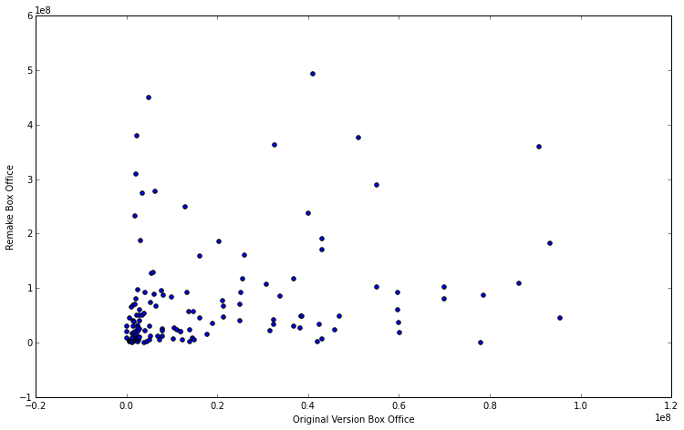
Performance of Original vs. Remake

Slide 4
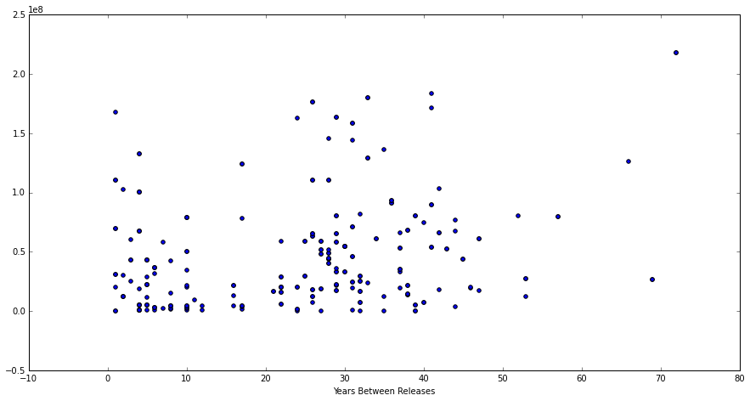
Remake Gross vs. Time Between Releases

Slide 5
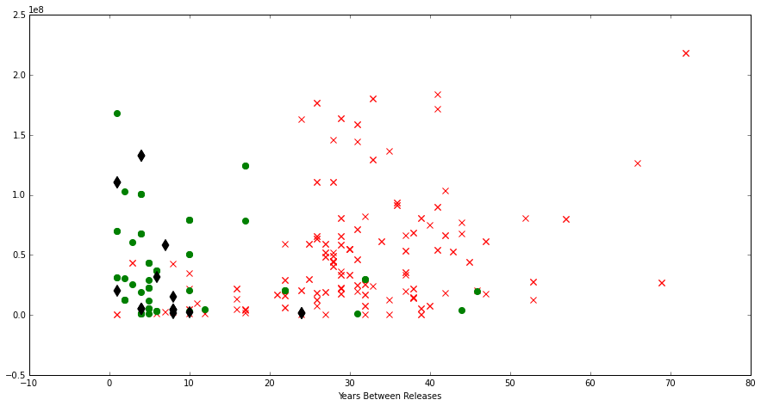
Gross vs. Time Between Releases
Asia Europe USA X

Slide 6
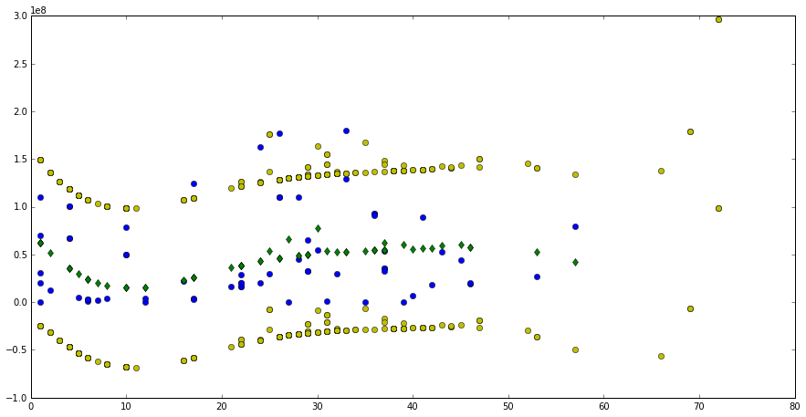
Predictive Model
Observed Results Model-predicted Results

Slide 7
Using the Model
Remake | Year | Original Gross | Projected Gross | Years Since Original
The Mummy | 2016 | $221,300,000 | $25,654,255 | 17
Point Break | 2015 | $78,550,000 | $42,577,932 | 24
Poltergeist | 2015 | $183,800,000 | $50,776,192 | 33
The Fantastic Four | 2016 | $188,199,000 | $15,071,197 | 11
MSE = $50 Million (estimate)

