Slide 1

DSC 245 - Final Project:
Evaluating Causality in LLMs
Do LLMs understand causality?
Group members:
Aseem
Dinesh
Nandita
Prathish

Slide 2
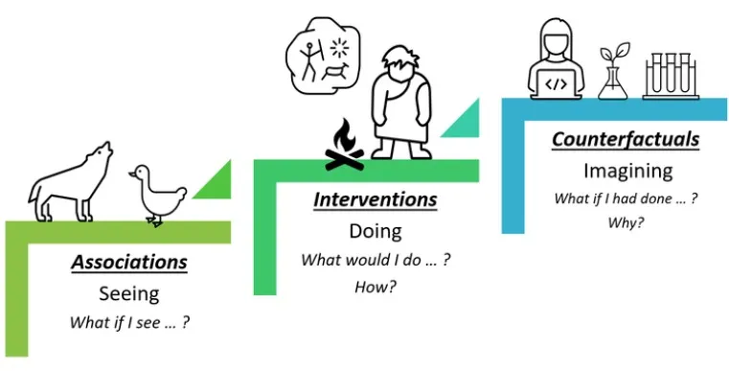
Introduction
Evaluating LLMs for causal reasoning with
the help of the CLADDER dataset.
It has symbolic questions and ground-truth answers, that assess various types of causality.
Introduce a bespoke chain-of-thought
prompting strategy, CAUSALCOT.
Do LLMs understand causality?
Previous works addresses this by focusing on commonsense causality.
LLMs may just be “causal parrots”.

Slide 3
Related Work
Previous work done for evaluating causality using LLMs on existing datasets is unreliable due to training set contamination.
Existing studies determine how well NLP models understand common sense causality and in general LLMs serve as a knowledge base of causality.
Some work focuses on evaluating LLMs on various causality-related tasks by leveraging the conceptual knowledge accrued from the training data, rather than formal causal inference.
Most work does not define explicit causal graphs making it difficult to quantitatively define the ground-truth causal relationships properly.
The CLADDER dataset formulates the task of causal inference for NLP.

Slide 4
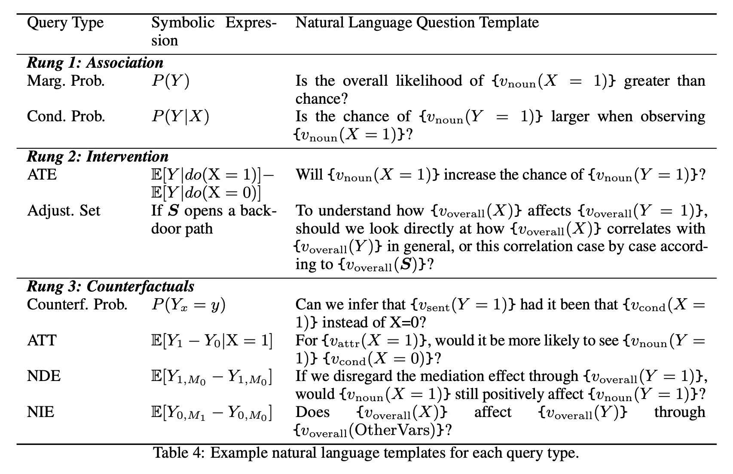
CLADDER - Dataset
CLADDER dataset question format:
The dataset contains triples, each containing a question q_{i}, binary answer a_{i} ∈ {Yes, No}, and an explanation e_{i}.
Construction of data:
the causal query
the ground-truth answer,
A step-by-step explanation
These questions are verbalized by turning them into stories and expressed in natural language, formulated with a causal inference engine.

Slide 5
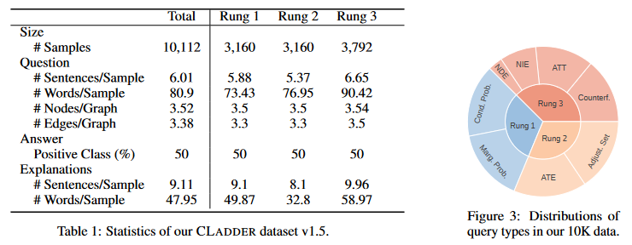
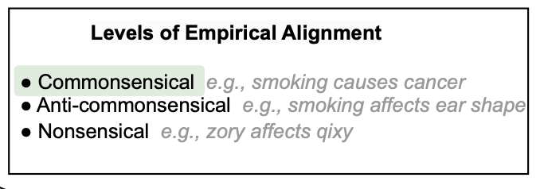
Analysis of CLADDER
Details of the CLADDER dataset:
More than 10,000 Causal Questions.
Three rungs of Ladder of Causation:
Rung 1 (associational)
Rung 2 (interventional)
Rung 3 (counterfactual)
Ground-truth explanations.
Commonsensical, anti-commonsensical and nonsensical causal relations.

Slide 6
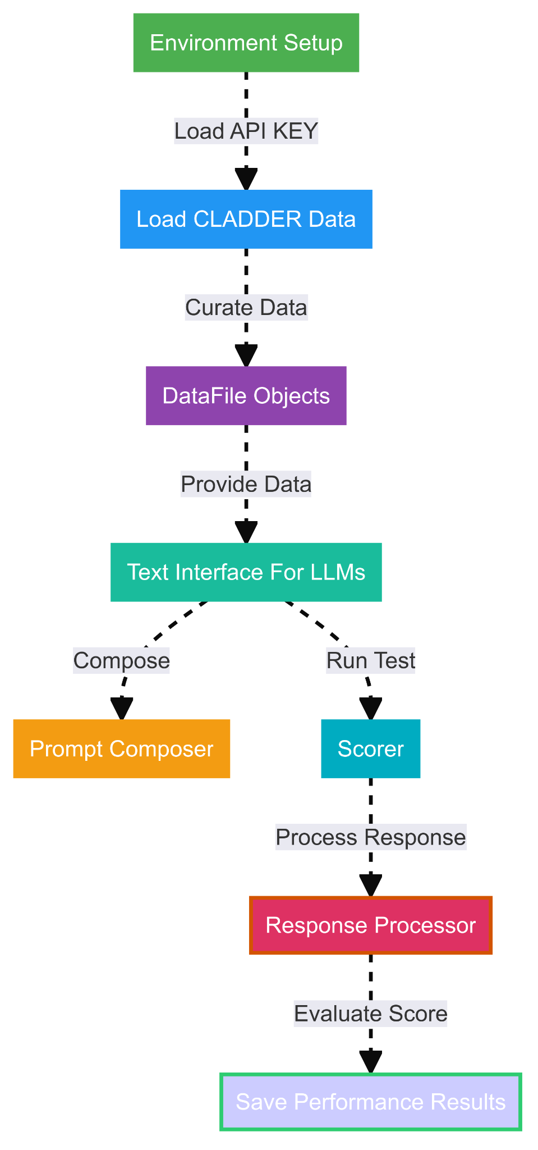
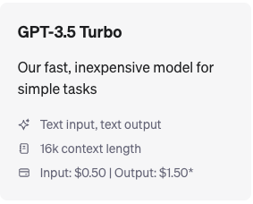
GPT models
GPT Models used
GPT-3.5-Turbo, GPT-4, GPT-4 enabling Causal COT
Data flow for GPT
Curate CLADDER data for generating prompts
Connect with the Chatbot API
Prompt the query and get response
Execute the Scorer
Scorer
Compare the prediction and ground truth
Estimate Acc. for the Classification Task
Estimate score for each query type
GPT 3.5 Turbo Tokens

Slide 7
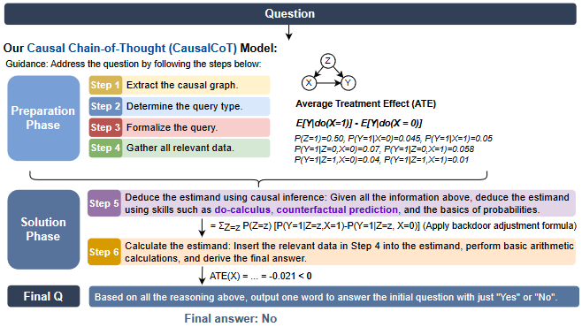
CausalCoT
What Is CausalCoT?
A multi-step causal chain-of-thought process which combines formal causal reasoning skills with the idea of chain-of-thought prompting.
Chain-of-thought prompting is a way for structuring the input prompt to enable the model for performing logical tasks.
Chain-of-thought prompting asks an LLM to mimic this process of decomposing a problem and working through it step by step.

Slide 8
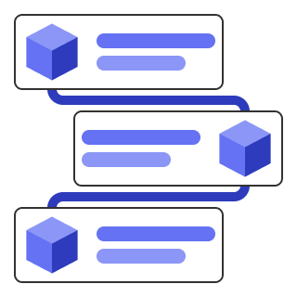
CausalCoT
Will Citrus Intake Decrease the Chance of Curly Hair?
Step 1: Extract the Causal Graph
Eating Citrus (X) -> Vitamin C (V2) -> Curly Hair (Y)
Step 2: Identify the Query Type
Query Type: Average Treatment Effect - ATE
Step 3: Formalize the Query
Formalized Query: P(Curly Hair | do(Eating Citrus))
Step 4: Gather Data from the prompt
Gathered Data: P(Eating Citrus) = 0.15 P(Curly Hair | Eating Citrus) = 0.15 P(Curly Hair | Not Eating Citrus) = 0.47
Step 5: Perform Arithmetic
ATE = P(Curly Hair | do(Eating Citrus))
ATE = 0.15
Step 6: Prediction
Predicted Answer: “Yes”
Ground Truth: “Yes”

Slide 9
Open Source Models
Models we used:
Llama 2 🦙, Alpaca 🦙 and Mixtral-8x7B
Problems with Open-Source Models:
Significant computational resources like GPU/TPU
To run the 7B model in full precision, you need 7 * 4 = 28GB of GPU RAM !!
Locally stored ⇒ Means higher disk space needed
The size of llama-2-13B is ≈ 25GB !!
Lots of dependencies
This is just for LLama, imagine for Mixtral-8x7B 🤯🤯🤯

Slide 10
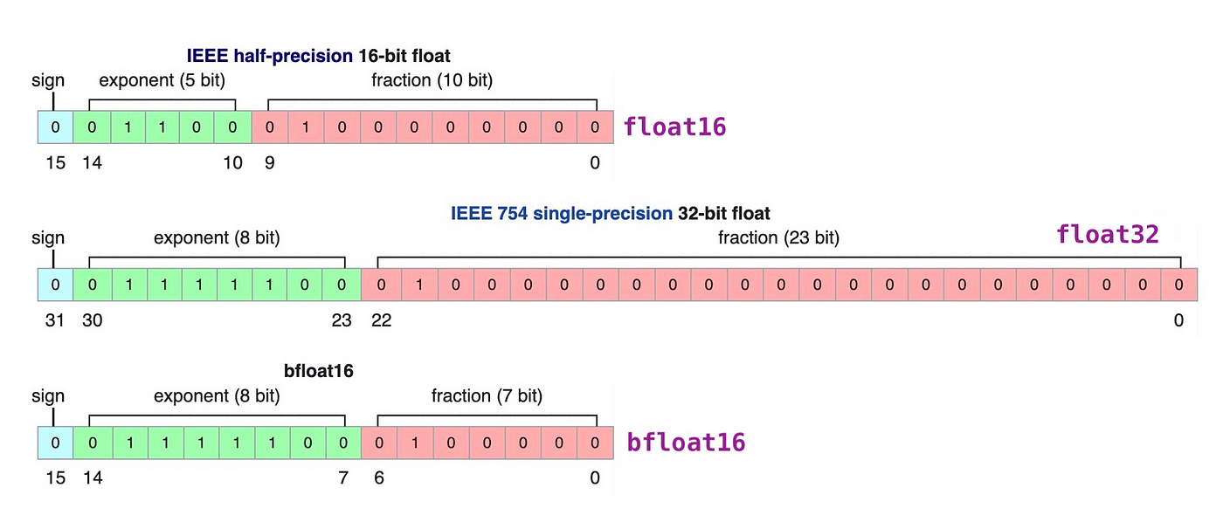
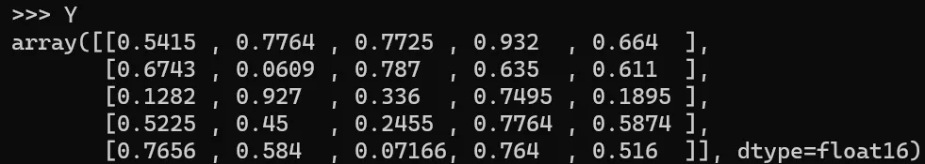
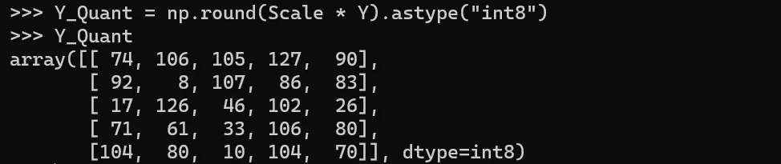
Quantization
Quantization is a technique used to reduce the size and memory usage while maintaining quality
of the LLM. Done by reducing the precision of the model parameters and weights.
We chose to use quantized versions of the models, such as the Llama-2-7B-Chat-GGUF and Mixtral-8x7B-Instruct-v0.1-GGUF

Slide 11
Llama and Alpaca🦙 and Mixtral 👾
The reduction is achieved by GGUF quantization method through llama.cpp, allowing them to run efficiently on CPUs without the need for GPU support.
We provide the LLM a list of instructions l := (s₁, . . . , s_{n}) consisting of the detailed descriptions; the model f_{LLM} : s_{i} ↦ r_{i} autoregressively produces responses r₁, · · · , r_{n} & answer a ∈ {Yes, No}
Model | Size Before Quantization | Size After Quantization
Llama2 7B | ≈ 15 GB | ≈ 6GB
Alpaca 7B | ≈ 15 GB | ≈ 6GB
Mixtral 8x7B | ≈ 26 GB (Ollama) | ≈ 15 GB

Slide 12
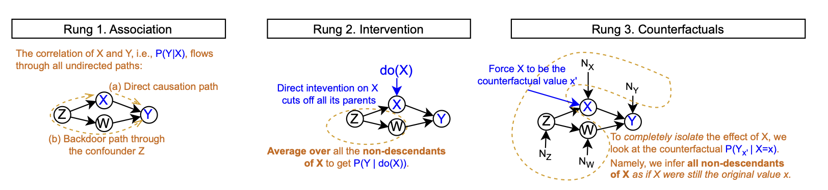
General Trends in models w.r.t causal relationships 📈📉:
There is a monotonically decreasing performance as the rungs get higher, i.e., the questions get more difficult, irrespective of the models.
Higher number of parameters in the model means better accuracy
With instruction-tuning such as Alpaca, models start to show some improvement.
Newer the model, more the chance of Data Contamination through training set.
Chain of Thought CoT improves the model’s understanding of the causal relationship.

Slide 13
Results and Metrics
Model | Overall Accuracy | Rung 1 | Rung 2 | Rung 3 | Common -Sense | NonSense | Anti-Common -Sence
GPT 4 + CausalCoT | 68.89 | 81.25 | 65.58 | 61.76 | 68.11 | 70.28 | 69.09
GPT 4 | 62.03 | 63.01 | 62.82 | 60.55 | 62.27 | 63.09 | 60.47
Mixtral | 58.82 | 58.31 | 57.9 | 55.77 | 59.22 | 57.19 | 58.46
GPT 3.5 | 52.68 | 52.5 | 53.51 | 52.12 | 52.44 | 53.06 | 52.46
Alpaca | 42.1 | 49.92 | 26.14 | 48.09 | 41.35 | 40.27 | 41.99
Llama 2 | 41.03 | 45.17 | 25.50 | 46.98 | 40.94 | 40.19 | 41.76

Slide 14
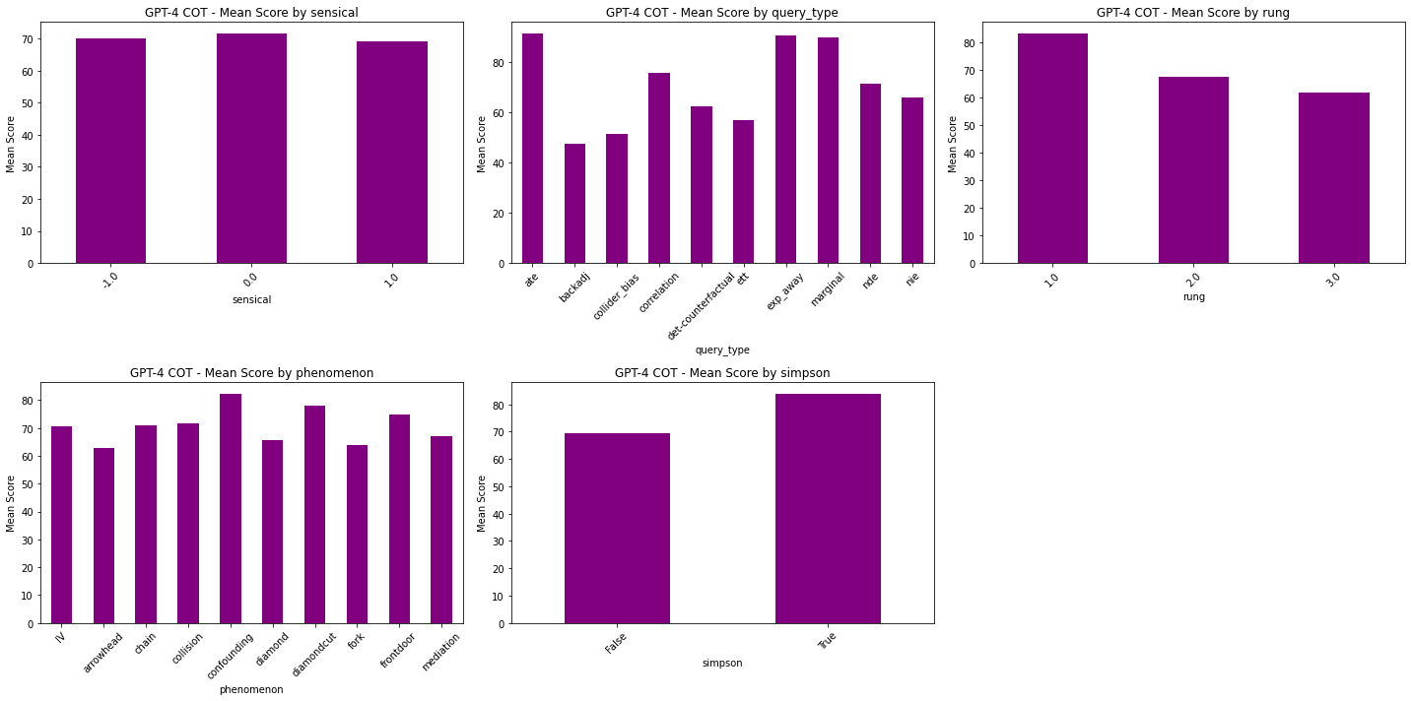
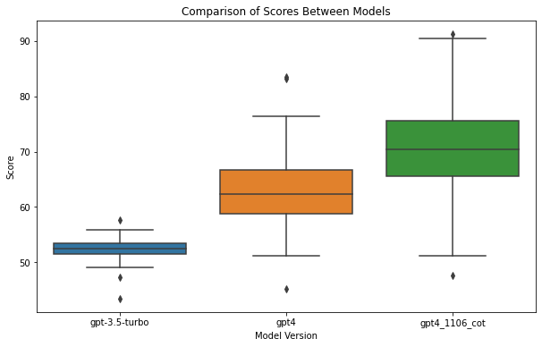
Compare GPT Models
GPT-4 with CausalCoT show significantly better performance compared to GPT-4 and GPT-3.5-turbo

Slide 15
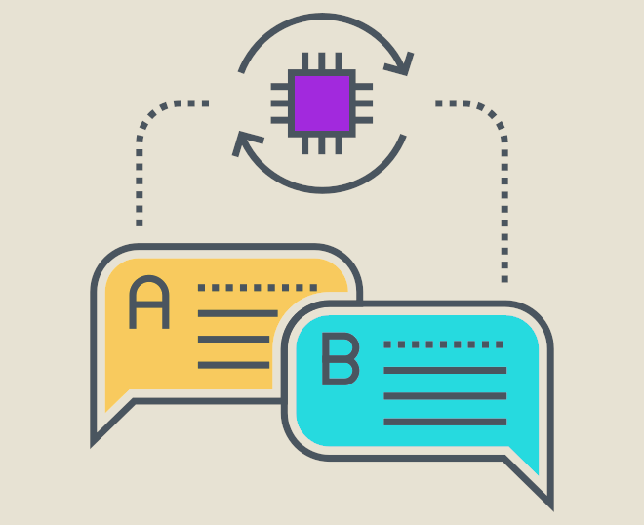
Future Work and Conclusion
The accuracy increase that is observed with the model with CoT (Chain of Thought) can be attributed to the fact that it associates statistical values with causal graphs.
In open source models, Mixtral and Alpaca seem to perform better causal reasoning in comparison to the LLaMA 2 model.
Future implementation ⇒ provide the LLM access to an actual implementation of the CI engine.
It has been claimed that LLMs understand causality to a high extent but the results obtained seem to be average at best, therefore the potential to improve LLMs and their ability to reason is quite crucial.

Slide 16

Thank you!
Visit our project in GitHub ⇒

