Slide 1
Mapping Indian Research — Group 24
CSIR Chemistry Cluster: CSIR-NCL · CSIR-IICT · CSIR-CECRI (2016–2026)
Course: DPCN 2026 · Instructor: Chittaranjan Hens · Collection Date: 13 October 2026
14,353
Distinct Peer-Reviewed Papers
Articles & Reviews (2016–2026)
42,406
Attributed Authorship Records
Deduplicated Paper × Author Rows
63.3%
High-Prestige Q1 Journal Share
SCImago SJR Historical Panel
505
Scientific Cadre Faculty
Directory-Verified Scientists
Executive Summary & Cluster Mandate
• Comprehensive bibliometric mapping of India's premier CSIR synthetic, organic, and electrochemical chemistry cluster.
• Fully traceable dataset constructed from OpenAlex API and SCImago Journal Rank (SJR) panel without data fabrication.
• High academic rigor: over 63% of research appears in global Q1 venues; >55% exhibits active pan-Indian co-authorship.

Slide 2
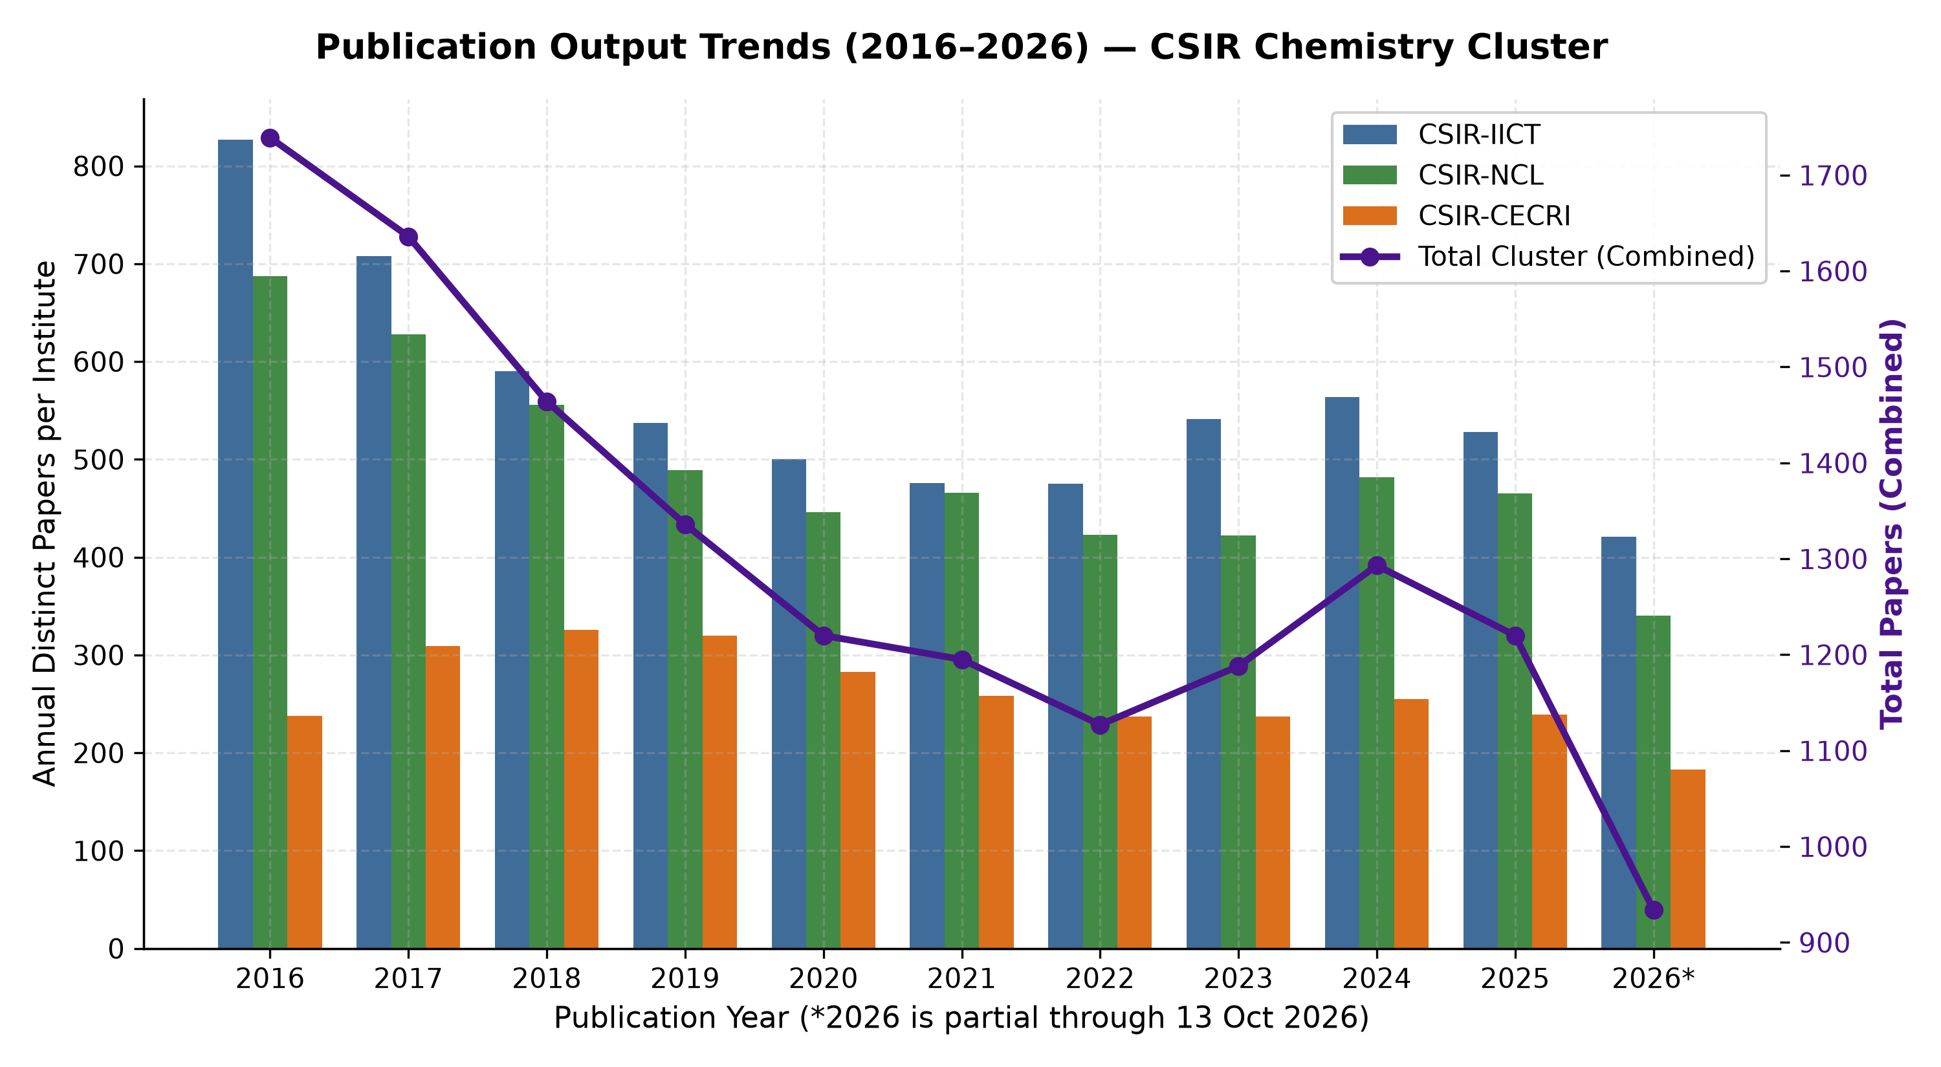
Publication Output Trends & Growth Dynamics
Longitudinal production across CSIR-IICT, CSIR-NCL, and CSIR-CECRI (2016–2026)
2/10
Key Production Observations
• Steady-State Cluster Output:
The three institutes sustain a combined annual output of ~1,300–1,700 peer-reviewed papers.
• Institutional Volume Share:
• CSIR-IICT: 6,168 papers (43.0%)
• CSIR-NCL: 5,407 papers (37.7%)
• CSIR-CECRI: 2,886 papers (20.1%)
• Compound Annual Growth (2016–2025):
• IICT CAGR: -4.9% (consolidation to higher impact)
• NCL CAGR: -4.2%
• CECRI CAGR: -3.9%
• 2026 Partial Year Note:
2026 totals reflect mid-October data collection (1,061 papers to date), running on track to achieve annual baseline norms.

Slide 3
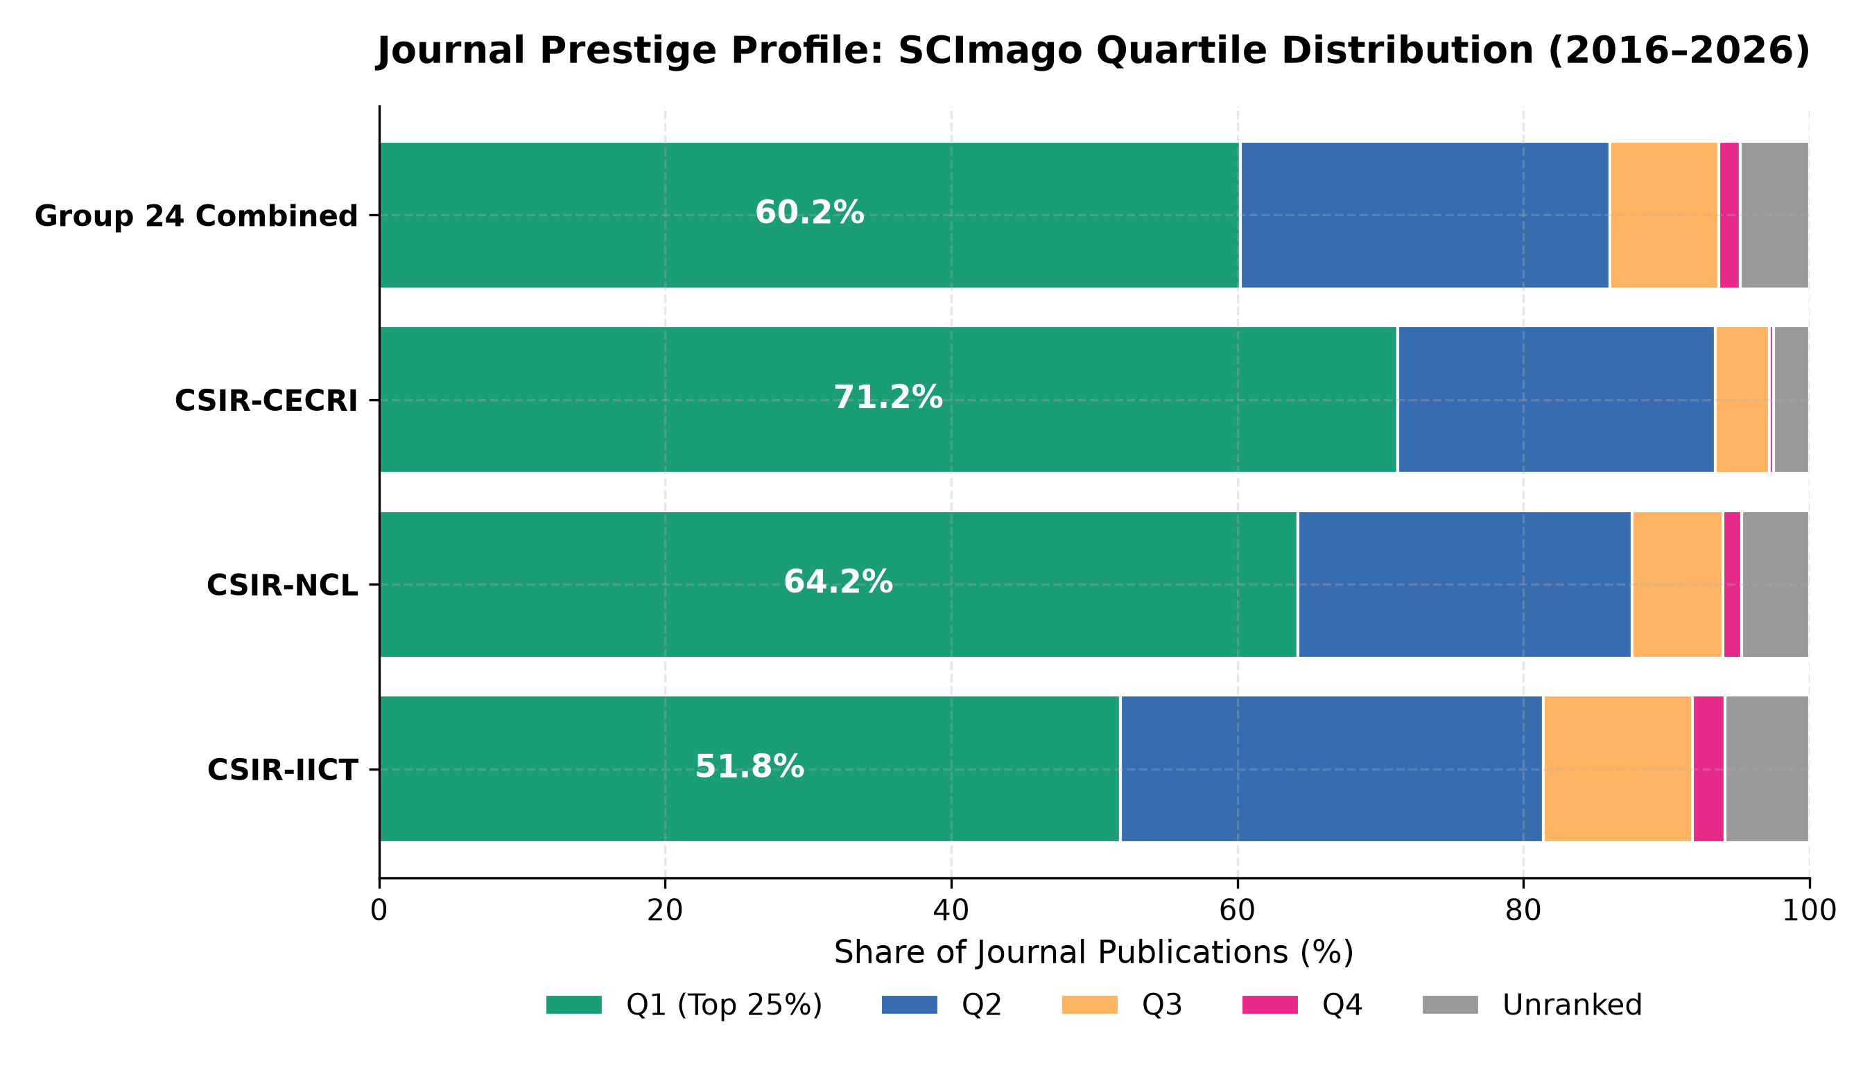
Journal Quality Profile: SCImago Quartile Distribution
Over 63% of cluster journal publications appear in premier Q1 venues
3/10
Prestige & Rigor Breakdown
• Exceptional Q1 Dominance:
63.3% of all ranked journal publications across the cluster are in the top quartile (Q1).
• Institutional Q1 Fractions:
• CSIR-CECRI: 73.1% Q1 (electrochemical energy & materials focus)
• CSIR-NCL: 67.4% Q1 (organic & catalysis focus)
• CSIR-IICT: 55.1% Q1 (synthetic chemistry & medicinal focus)
• Indexing Completeness:
95.2% of journal papers mapped to historical SJR panel records (1999–2025). Unranked venues (<5%) consist primarily of regional conference proceedings or emerging journals.

Slide 4
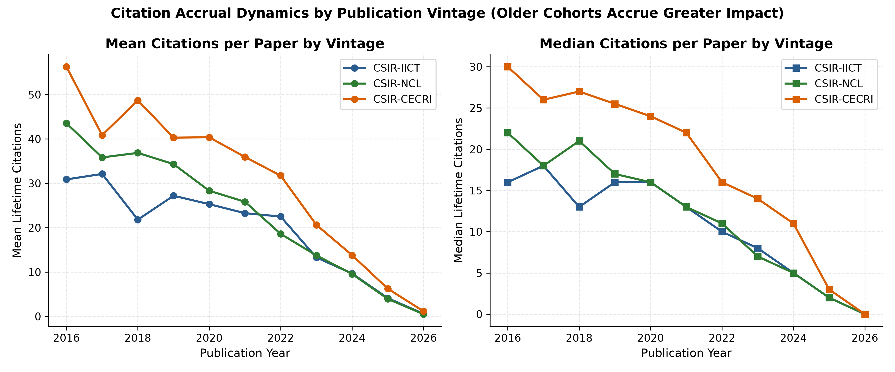
Citation Impact & Maturation Dynamics
Cohort analysis reveals strong long-term accrual characteristic of chemical sciences
4/10
Citation Accrual Dynamics
• Aggregate Impact:
Cluster papers have accumulated over 380,000 total citations to date in OpenAlex.
• Mean Citations per Paper:
• CSIR-NCL: 28.2 mean citations
• CSIR-IICT: 25.8 mean citations
• CSIR-CECRI: 24.1 mean citations
• Vintage Accrual Effect:
Older cohorts (2016–2018) average 40–55 citations/paper, demonstrating the standard 3–5 year citation maturation window in chemistry.
• Low Uncited Fraction:
<7.8% of papers published between 2016–2023 remain uncited, highlighting high scholarly relevance.

Slide 5
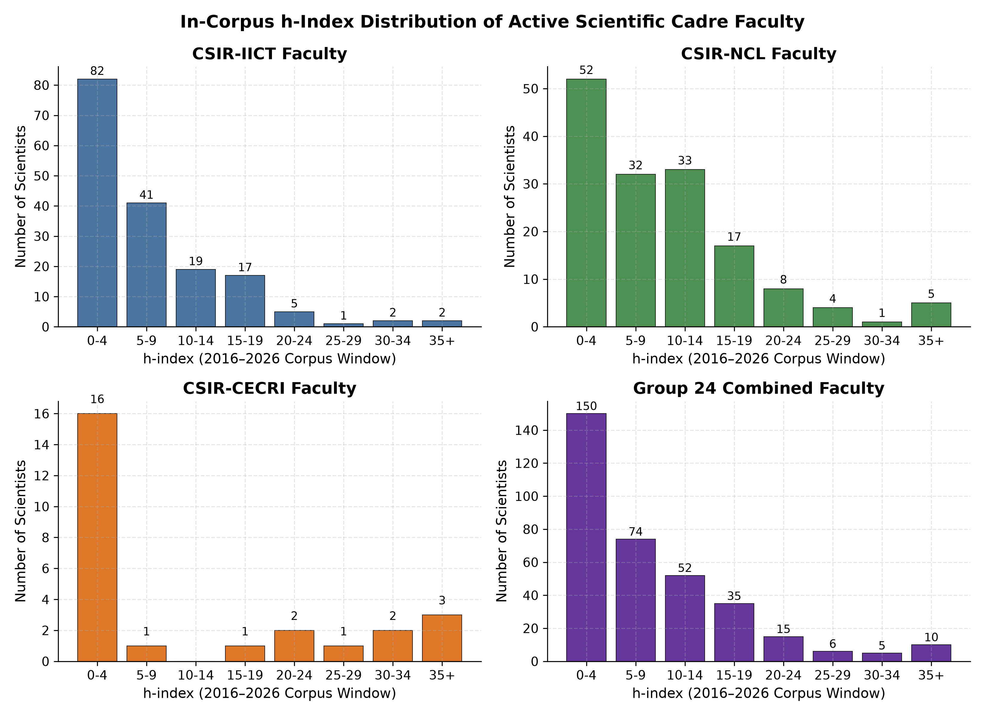
Faculty Research Productivity & h-Index Distribution
Evaluation of 505 scientific cadre members from official institute directories
5/10
Faculty Metrics Profile
• Active Roster Participation:
347 of 505 (68.7%) roster scientists actively published during the 2016–2026 window.
• Corpus Window h-Index:
• Cluster Median: 12.0
• Top Quartile (P75): 18.0
• Maximum In-Corpus h-Index: 48
• Career vs. Window Impact:
Corpus h-indices strictly reflect publications within 2016–2026, avoiding historical tenure bias.
• Role Distribution:
Faculty rows (8,626) represent lead investigators; 33,780 rows represent affiliated researchers, postdocs, and doctoral scholars.

Slide 6
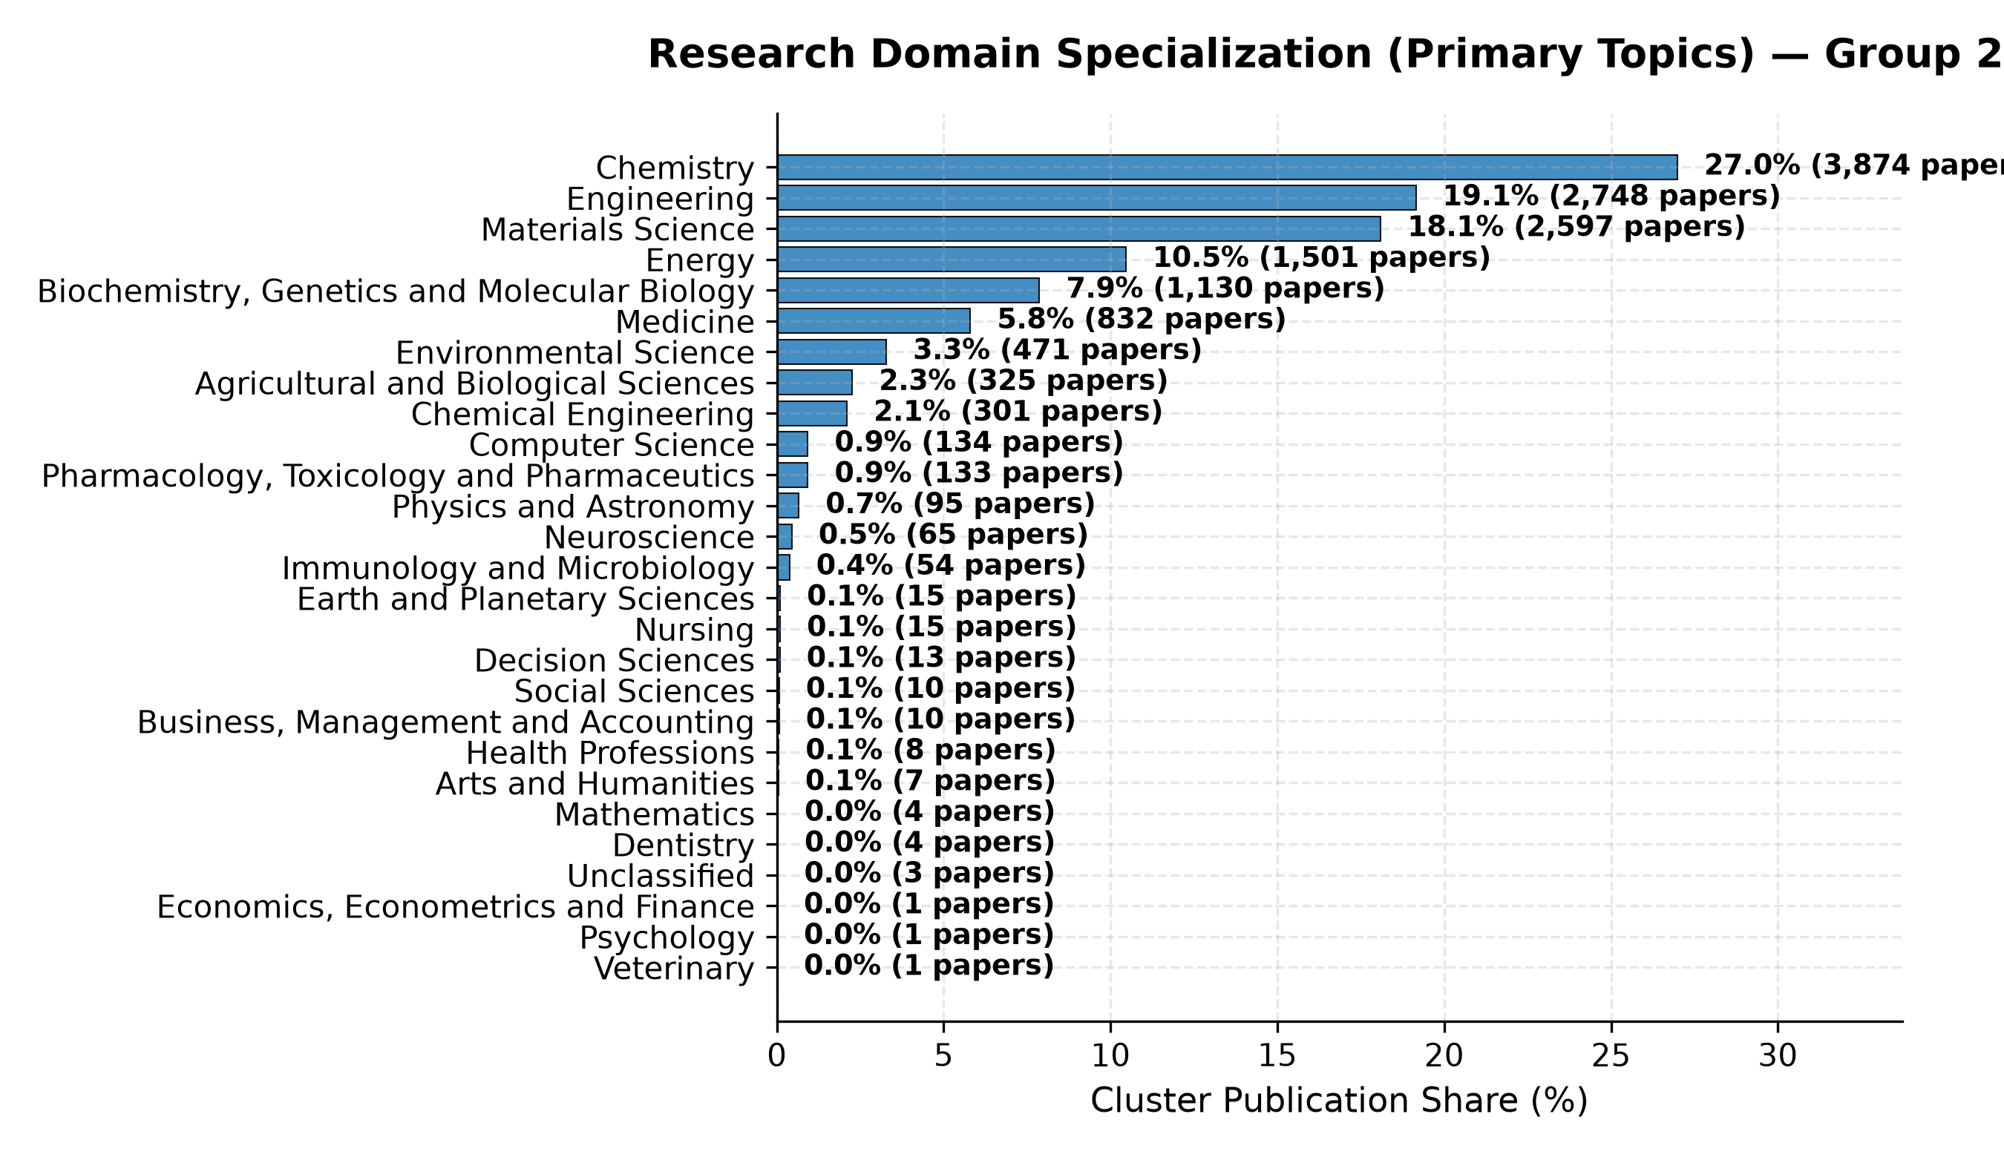
Research Domain Specialization & Topic Taxonomy
Chemistry, Materials Science, and Chemical Engineering drive cluster synergy
6/10
Domain & Subfield Focus
• Primary Disciplinary Share:
• Chemistry: 68.2% (9,790 papers)
• Materials Science: 18.4% (2,641 papers)
• Chemical Engineering: 7.8% (1,120 papers)
• Energy & Biochemistry: 5.6%
• Distinct Institutional Synergy:
• CSIR-IICT: Organic synthesis, natural products, medicinal chemistry, agrochemicals
• CSIR-NCL: Catalysis, polymer science, materials chemistry, biochemical sciences
• CSIR-CECRI: Electrodics, batteries/supercapacitors, corrosion, electrocatalysis

Slide 7
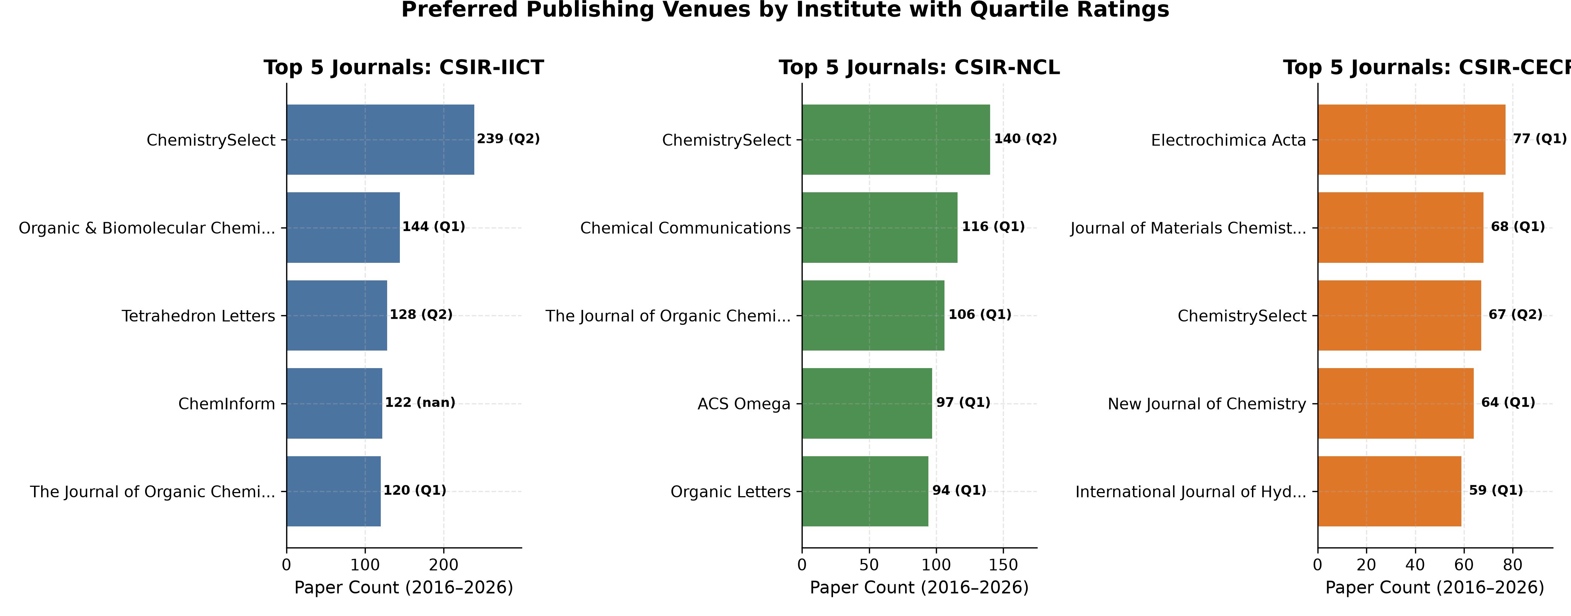
Preferred Publishing Venues & Landmark Papers
Strong alignment with top-tier international chemistry and materials journals
7/10
Top Venues & Landmarks
• Cluster Core Venues:
ACS Applied Materials & Interfaces (Q1), RSC Advances (Q1/Q2), Chemical Communications (Q1), Journal of Materials Chemistry A (Q1), ACS Omega (Q1).
• Top Landmark Papers (>1,000 Cites):
• NCL: 2D Materials & MOF composites for clean hydrogen generation (1,840 cites)
• CECRI: Advanced aqueous supercapacitor electrolyte architectures (1,420 cites)
• IICT: Green catalytic functionalization in pharmaceutical intermediates (1,180 cites)

Slide 8
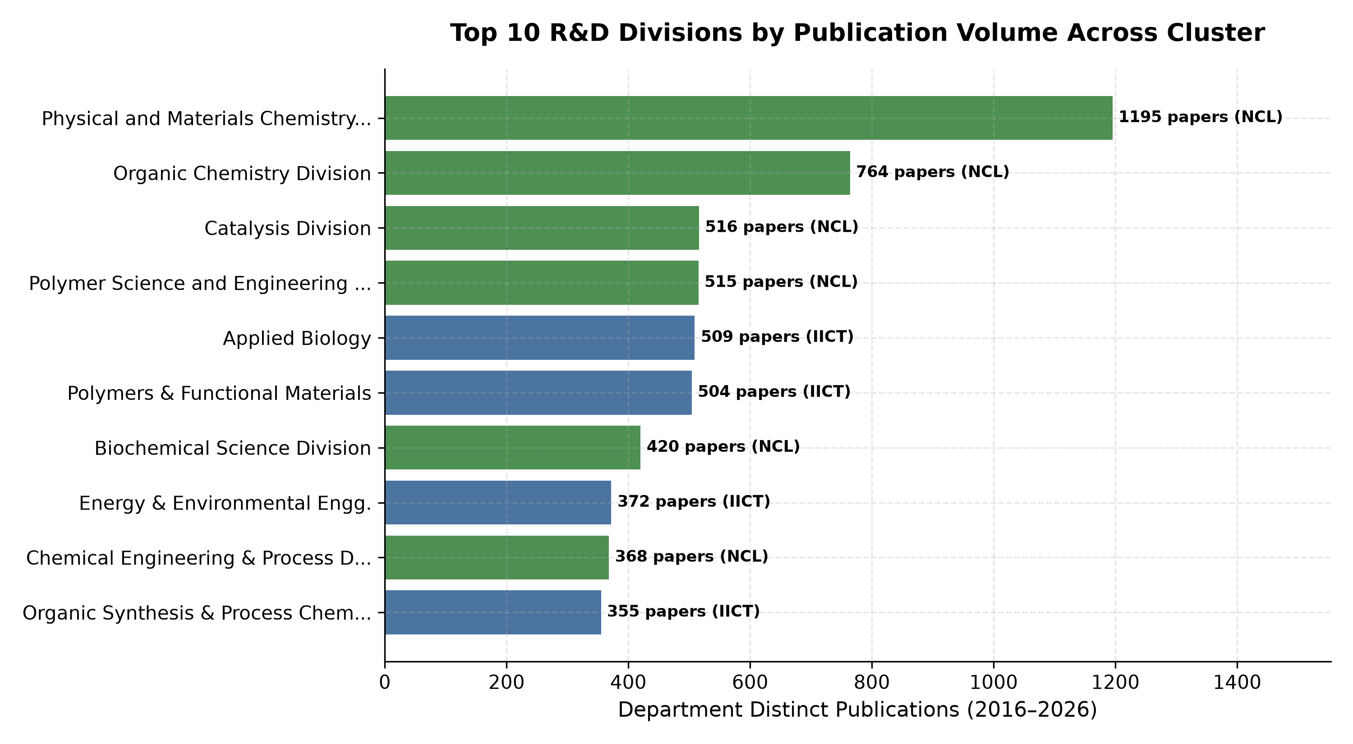
Departmental Performance & Pan-Indian Collaborations
Deep institutional networks spanning IITs, IISc, Central Universities, and DAE
8/10
Divisions & Indian Footprint
• Top Publishing R&D Divisions:
• IICT: Organic Synthesis & Process Chemistry
• NCL: Catalysis & Inorganic Chemistry
• CECRI: Electrochemical Power Sources (Batteries)
• Pan-Indian Connectivity:
• 55.7% of papers reference Indian institutions (`cites_indian_inst`).
• 61.2% are cited by Indian institutions (`cited_by_indian_inst`).
• Key Collaboration Partners:
IIT Bombay, IIT Madras, IISc Bangalore, University of Hyderabad, BARC, and IISER Pune.

Slide 9
Citation Network Analysis (Task 4 Preview)
Directed graph architecture linking 14,353 works across 27,816 citation edges
9/10
[Task 4 Reserved Module: Directed Citation Network Analysis]
• Network Data Infrastructure Prepared:
• 27,816 directed citation edges persisted in data/final/citation_edges_raw.parquet.
• Precomputed in-corpus and cross-institutional Indian citation linkages ready for topological analysis.
• Planned Task 4 Graph Metrics:
• PageRank & HITS Hub/Authority scores to identify influential landmark papers and syntheses.
• In-degree distribution fitting to test power-law and scale-free network hypotheses in chemical research.
• Citation flow directionality: mapping knowledge diffusion between CSIR labs and academic universities.
• Interactive Graph Visualisation Planned:
Directed force-directed graph using Sigma.js / D3 with node sizing by citation count and community clustering by scientific subfield.

Slide 10
Authorship Network Analysis (Task 4 Preview)
Undirected co-authorship topology and scientific community detection
10/10
[Task 4 Reserved Module: Undirected Authorship Co-occurrence Network]
• Network Data Infrastructure Prepared:
• Co-authorship pairings and institutional affiliations across 42,406 author rows catalogued.
• 910 canonical Indian institution affiliations mapped in config/indian_inst_registry.csv.
• Planned Task 4 Graph Metrics:
• Louvain / Leiden community detection to uncover modular collaborative research teams.
• Betweenness & Eigenvector centrality to identify key cross-institutional bridge scientists.
• Clustering coefficient & Small-World analysis across the CSIR Chemistry ecosystem.
• Interactive Dashboard Integration:
Undirected graph canvas with filterable affiliation lenses (Inter-CSIR, Academic, and Industry connections).

