Slide 1
Airline Passenger Satisfaction
Presented By :
Prathmesh Patil.
GitHub: https://github.com/prathmesh0707
LinkedIn : https://www.linkedin.com/in/prathmesh-patil-9ba032257/

Slide 2
Prathmesh Patil Aspiring Data Scientist
Education
Skills
Contact
kolhapur, Maharashtra
Bachelor of Technology (B.Tech)
Sharad Institute Of Technology, College Of Engineering Yadrav Ichalkaranji.
HSC |(12th) Chate Jr. College of Science, Kolhapur
Python
Statistics
SQL
7020536482
Pandas
prathmeshcp1999@gmail.com
Excel
Work Experience
Languages
Industrial Training of Four months at General Machine Tools 01/2021 – 05/2021.
Industrial Training at Panchaganga Sugar factory. 05/2019 – 06/2019.
English
Marathi
Hindi

Slide 3
Problem Statement:
The objective of this project is to guide an airlines company to determine the important factors that influences the passenger satisfaction.

Slide 4
WORK FLOW
Data Collection
and
Understanding
Data Wrangling & Feature Engineering
EDA
Model Selection and Evaluation
Preparation of data for model building.
Conclusions

Slide 5
FEATURES
Variable | Variable Description | Values
Gender | Gender of passenger | Male or Female
Age | The actual age of the passengers | -
Customer Type | The customer type | Loyal customer, disloyal customer
Type of Travel | Purpose of the flight of the passengers | Personal Travel, Business Travel)
Class | Travel class in the plane of he passengers | Business, Eco, Eco Plus
Flight distance | The flight distance of this journey
Inflight wifi service | Satisfaction level of the inflight wifi | Rating : 0(least) - 5 (highest)
Ease of Online booking | Satisfaction level of online booking | Rating : 0(least) - 5 (highest)

Slide 6
FEATURES
Variable | Variable Description | values
Departure/Arrival time convenient | Satisfaction level of Departure/Arrival time convenient | Rating : 0(least) - 5 (highest)
Food and drink | Satisfaction level of Food and drink | Rating : 0(least) - 5 (highest)
Gate location: | Satisfaction level of Gate location | Rating : 0(least) - 5 (highest)
Online boarding: | Satisfaction level of online boarding | Rating : 0(least) - 5 (highest)
Seat comfort | Satisfaction level of Seat comfort | Rating : 0(least) - 5 (highest)
Inflight entertainment: | Satisfaction level of Inflight entertainment | Rating : 0(least) - 5 (highest)
On-board service | Satisfaction level of On-board service | Rating : 0(least) - 5 (highest)
Leg room service | Leg room service: Satisfaction level of Leg room service | Rating : 0(least) - 5 (highest)

Slide 7
FEATURES
Variable | Variable Description | Values
Baggage handling: | Satisfaction level of baggage handling | Rating : 0(least) - 5 (highest)
Check-in service | Satisfaction level of Check-in service | Rating : 0(least) - 5 (highest)
Inflight service: | Satisfaction level of Inflight service: | Rating : 0(least) - 5 (highest)
Cleanliness | Satisfaction level of Cleanliness | Rating : 0(least) - 5 (highest)
Departure Delay in Minutes | Minutes delayed when departure | --
Arrival Delay in Minutes | Minutes delayed when Arrival | --
Satisfaction | Airline satisfaction level | Satisfaction, neutral or dissatisfaction

Slide 8
We had a Airplane Flight Passenger Satisfaction Data for our analysis and model building
Instances = 1,29,880 , Features = 25 , Size = 32,47,000
We have dropped 'Unnamed' and 'id' column , as id is unique for each passenger

Slide 9
Data Wrangling and Feature Engineering:
Categorical Features: Gender, Customer Type and Type of classes, flight distance, satisfaction
Zero Duplicate entries founds
We had some null values in our dataset.
We had some outlier in dataset.

Slide 10
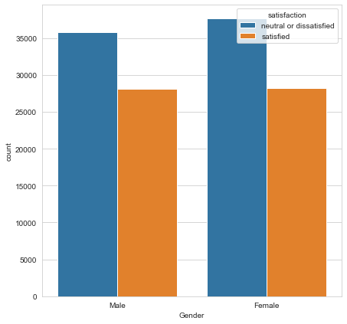
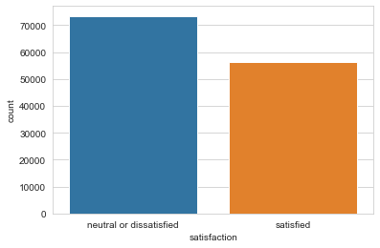
EDA
.
Females and males are satisfaction probability almost equal.
we can see that passenger neutral or dissatisfied are more than satisfied

Slide 11
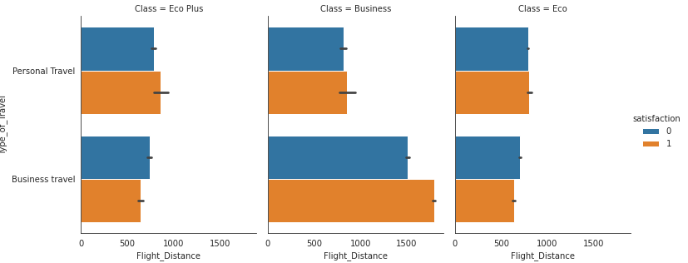
EDA
We can observed customer travelling to business class are more satisfied than customer travelling economic class

Slide 12
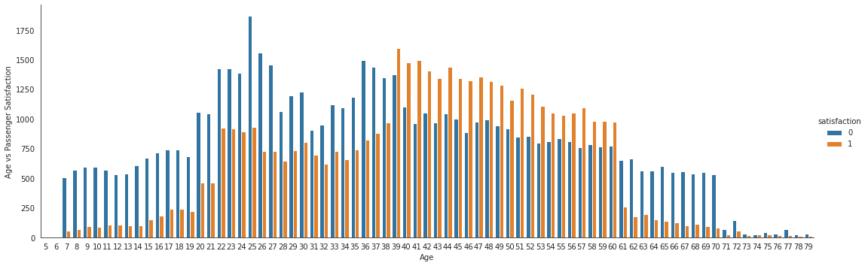
EDA
We can see that the 7-30 years old is generally neutral or dissatisfied with the flight. 39-60 years old is generally satisfied with the flight.

Slide 13
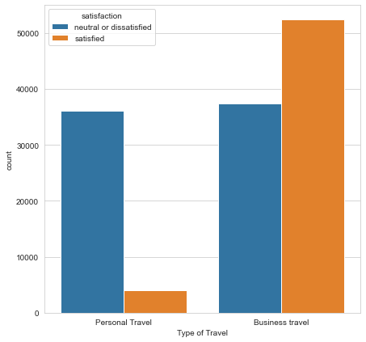
EDA
Personal travel is 90% neutral or dissatisfied with the flight

Slide 14
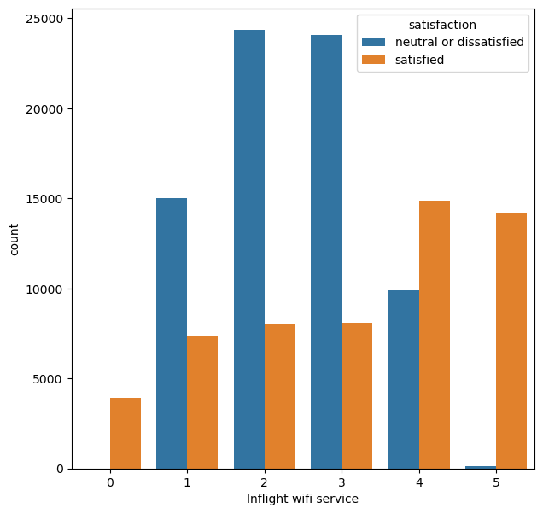
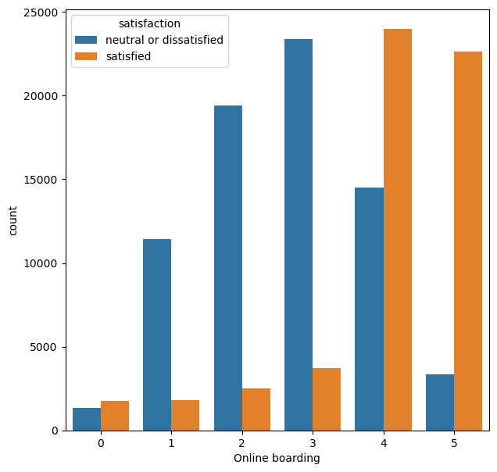
EDA
People who rated the Inflight wifi service rated more than 3 were satisfied with airlines service
People who rated the Online boarding rated more than 3 were satisfied with airlines service

Slide 15
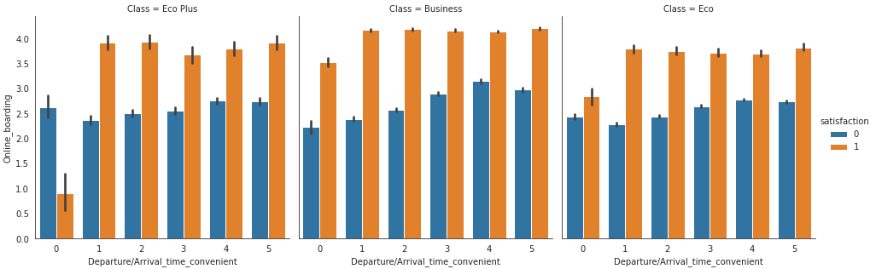
EDA

Slide 16
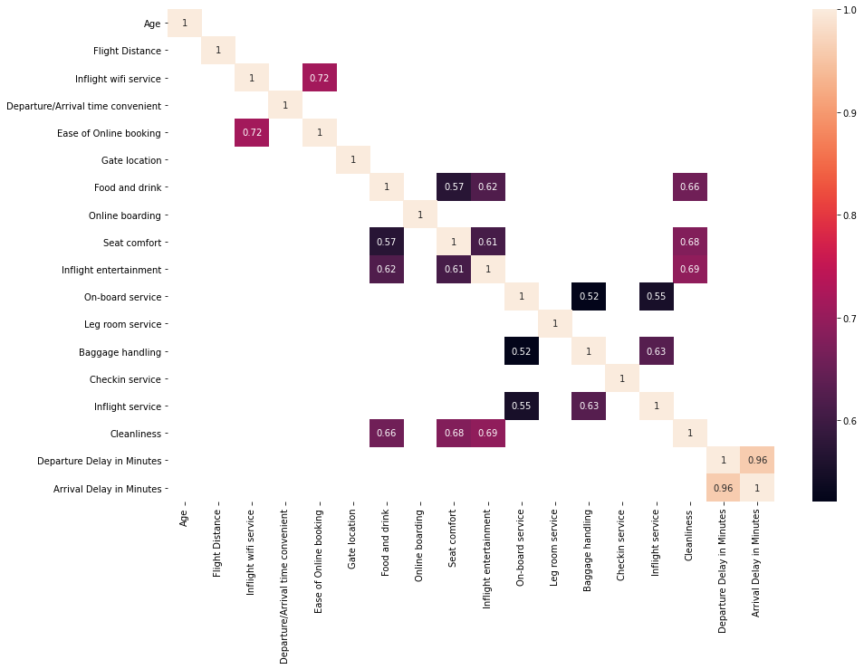
EDA

Slide 17
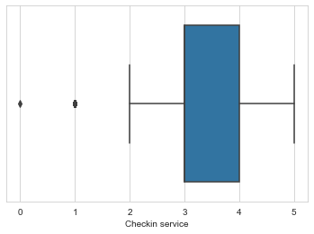
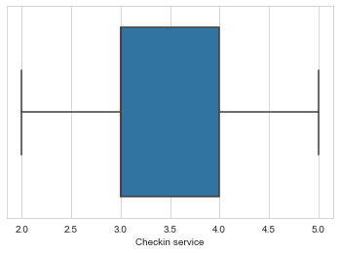
Handling Outliers

Slide 18
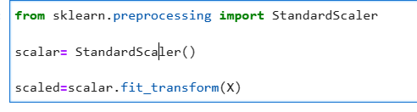
Standardization & Data Split
Standardization of data
After Standardisation split the data in Train and Test

Slide 19
Model Selection and Evaluation
Logistic Regression
Decision Tree
Random Forest
Support Vector Machine
K-Nearest Neighbors
Naive Bayes
Ensemble Method :
Bagging
Pasting
Adaboost
Xgboost
Gradient Boost

Slide 20
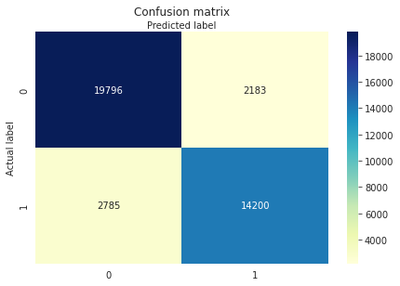
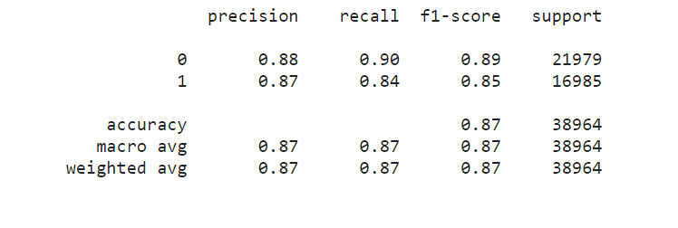
Logistic Regression

Slide 21

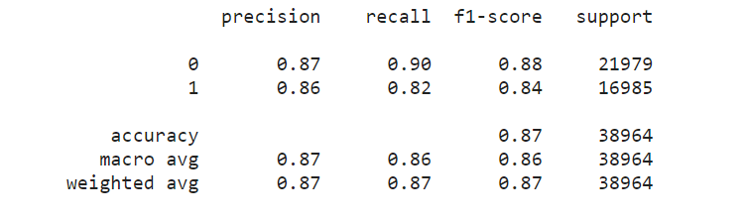
Naïve Bayes Classifier

Slide 22

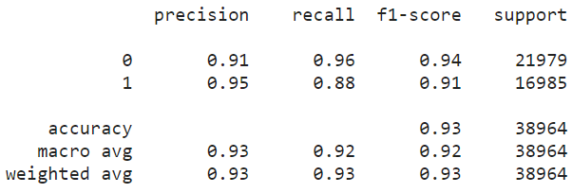
K Nearest Neighbors

Slide 23

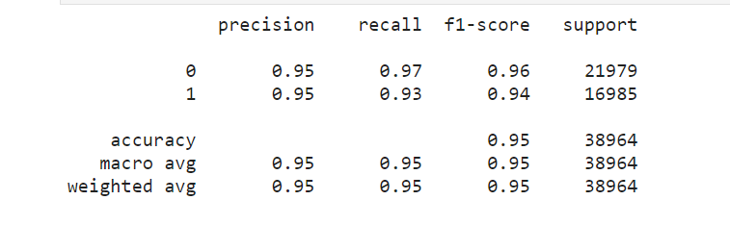
Decision Tree Classifier

Slide 24

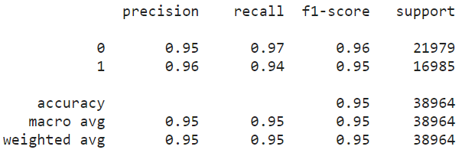
Support Vector Machine

Slide 25

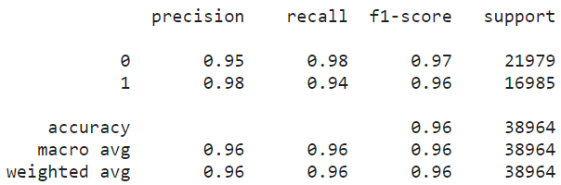
Random Forest Classifier

Slide 26

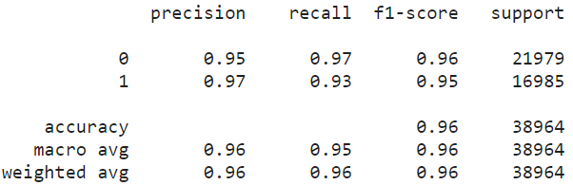
Random Forest Classifier(using hyper parameter)

Slide 27

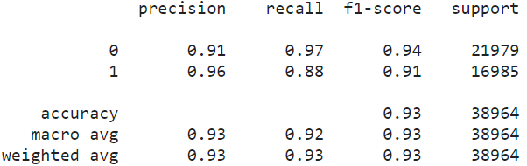
K Nearest Neighbor (Using Hyper Parameter)

Slide 28
Model Comparison
MODEL | TRAIN ACCURACY | TEST ACCURACY
Logistics Regression | 87.3025 | 87.2497
Decision Tree Classifier | 1.0 | 94.54
Decision Tree Classifier (Hyperparameter tunning) | 96.9114 | 95.1493
Random Forest Classifier | 1.0 | 96.2529
Random Forest Classifier (Hyperparameter tunning) | 96.6579 | 95.70
Support Vector Machine | 95.8038 | 95.3829

Slide 29
Model Comparison
KNN | 94.7149 | 92.6547
KNN(Hyperparameter tunning) | 1.0 | 92.8183
Naïve bayes | 86.6880 | 86.6030
Votting Classifier | --- | 95.721
Bagging | 96.96 | 95.18
Adaboost | 1.0 | 94.18
Xgboost | 94.019 | 93.8481

Slide 30
Conclusion
After analyzing all the models we can conclude that predictors Online boarding, Inflight wi-fi service, Type of Travel did played a major role for Flight Passenger Satisfaction
Comparing the accuracy of the different models, Random Forest(Hyperparameter tunning) is the best among the classification models

Slide 31
Thank You

