Slide 1


TravelXGuide
Guided By:-
Prof. Shruti Lashkari
Presented By:-
Prakhar Jain(0827CY221043)
Prathmesh Patil (0827CY221045)
Priyanshu Pareek(0827CY221047)
Vijendra Patel(0827CY221067)

Slide 2
Problem Statement
Lack of personalized tools for travelers.
Limited platforms for community-driven tourism.
Inadequate visibility for local guides.
Need for sustainable travel practices.

Slide 3
Objectives
Develop a platform for travelers and local guides.
Promote cultural and community-driven tourism.
Encourage sustainable tourism practices.

Slide 4
Review of Literature:
Title | Reference | Date/Year | Features
Trip Advisor | https://www.tripadvisor.in/ | 14 february,2000 | User-generated reviews, travel forums, comparison tools
MakeMyTrip | https://www.makemytrip.com/ | 21 April ,2000 | Comprehensive travel booking, itinerary planning, package deals
Booking.com | https://www.booking.com/ | February 21,1996 | Wide range of accommodations, price match guarantee, user-friendly interface

Slide 5
UML Designs
ER Diagram: Relationships between data entities (Users, Tours, guides).
DFD: Data flow between modules like User, Admin, and System.
Sequence Diagram: Interaction between the user and chatbot.
Activity Diagram: Flow of travel planning and booking.

Slide 6
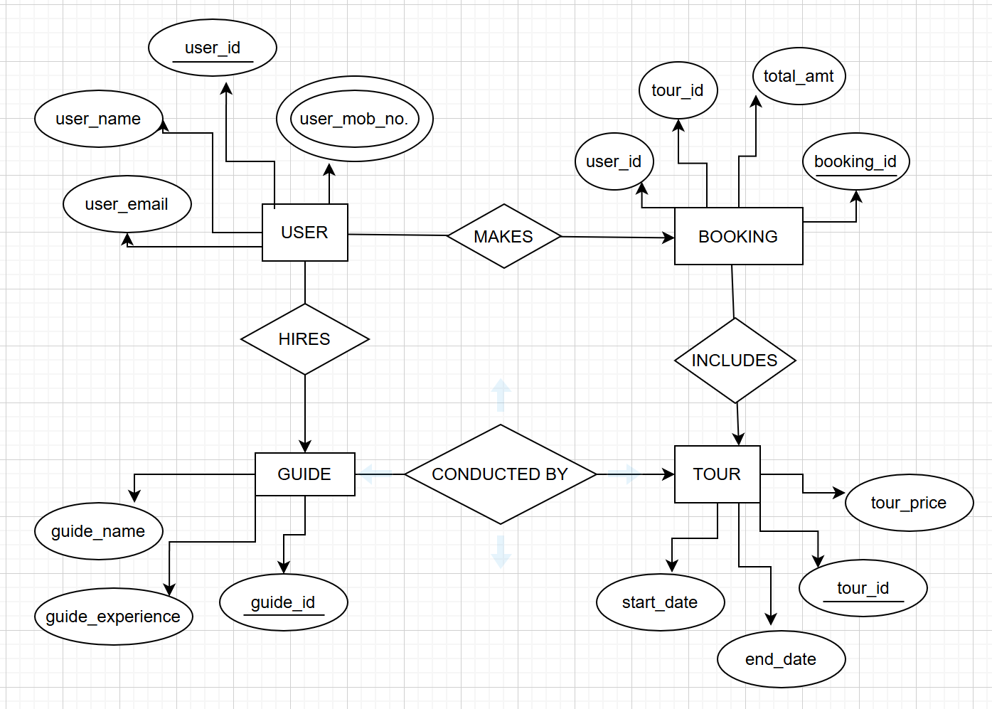
ER Diagram:-

Slide 7
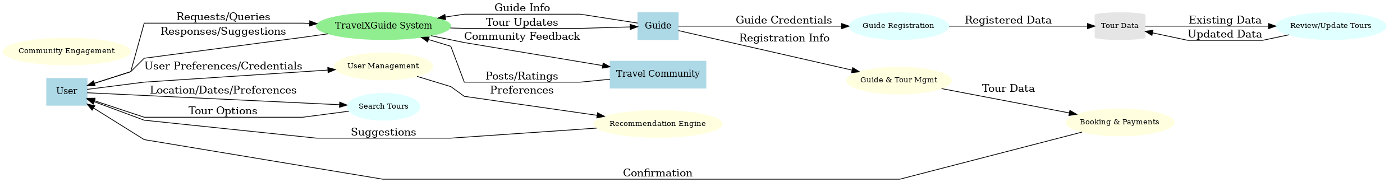
DFD:

Slide 8
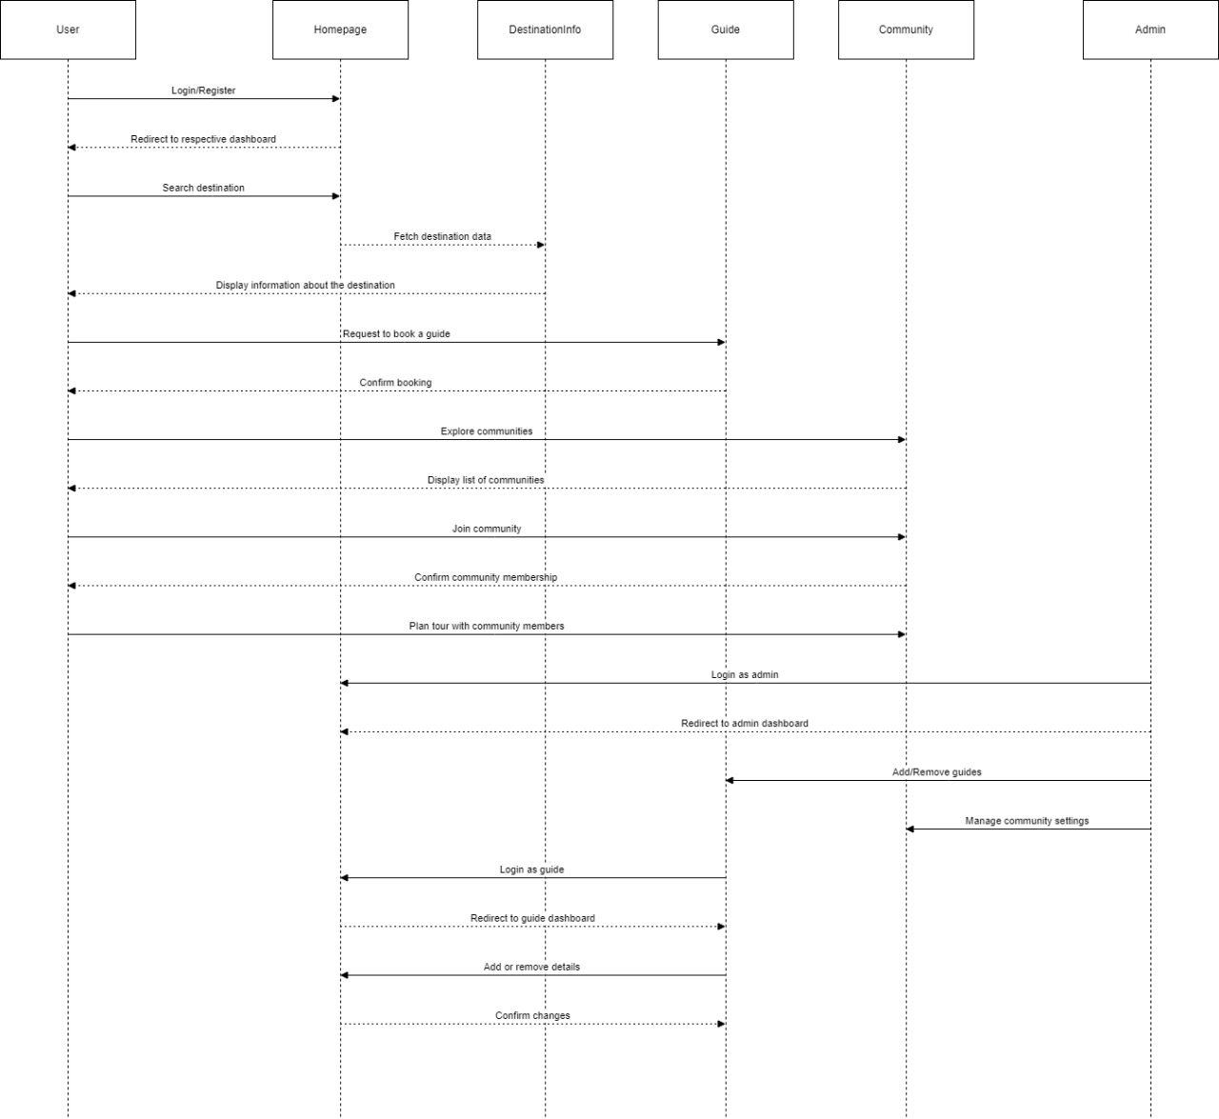
Sequence Diagram:

Slide 9
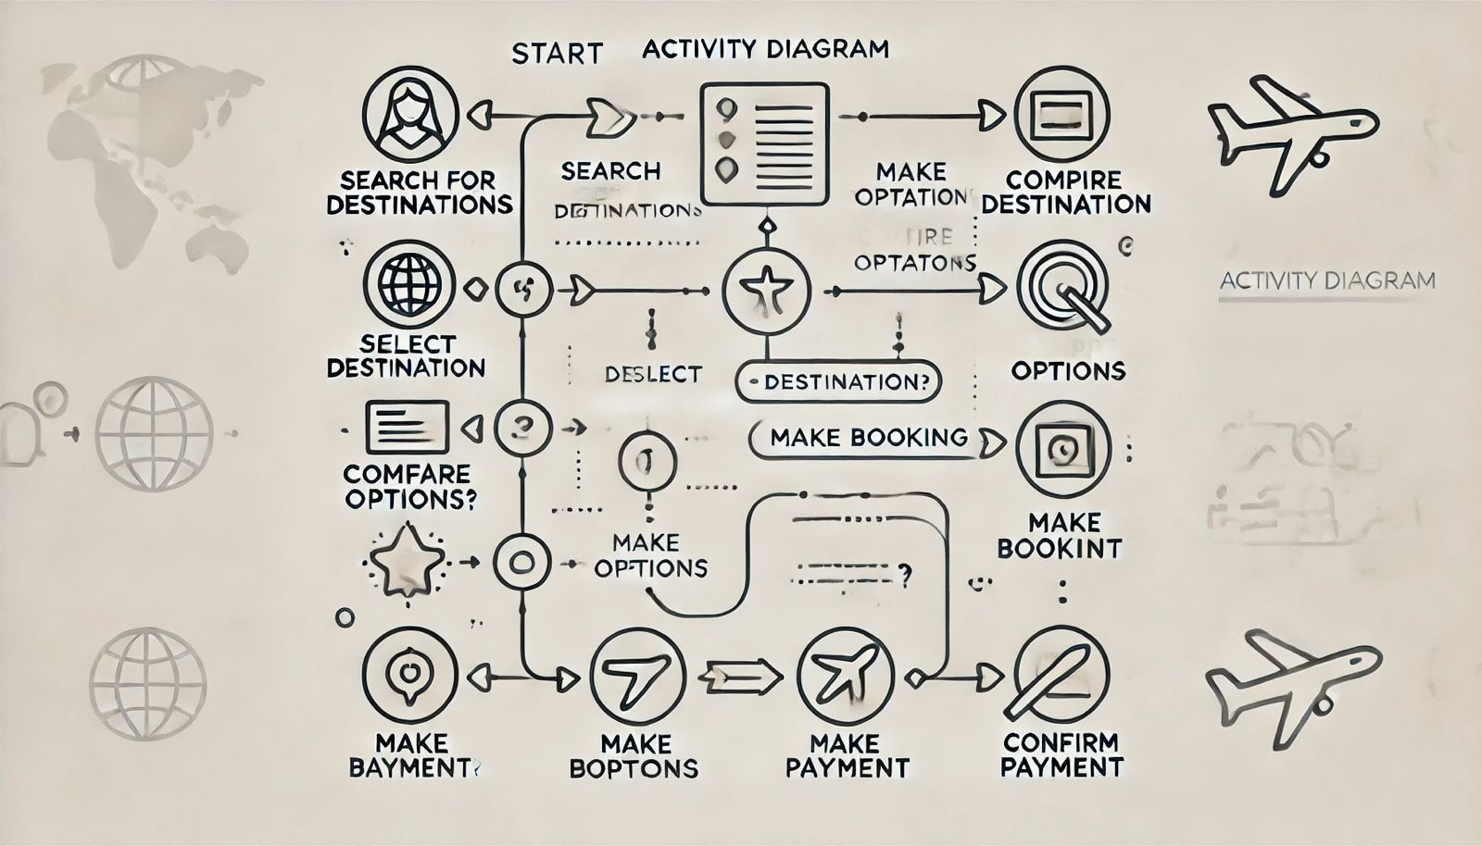
Activity Diagram:

Slide 10
Methodology
Conducting user surveys to understand traveler needs.
Designing an intuitive and user-friendly interface using web technologies like ReactJS for scalability.
Implementing backend services with database integration for features such as bookings, reviews, and community posts.
Testing the application in phases to ensure functionality and user satisfaction.

Slide 11
Scope and Limitations
Scope:
Personalized travel recommendations.
Integration of social media platforms.
Scalable cloud infrastructure.
Limitations:
Initial dependency on user-generated data.
Limited features for offline usage.

Slide 12
Expected Outcomes
A fully functional travel platform with an engaged user base.
Empowerment of local communities through tourism.
Adoption of eco-friendly travel practices.

Slide 13
Software Requirements
Software:
Frontend: React.js .
Backend: Node.js, Express.js.
Database: MongoDB

Slide 14
Implementation Plan
1. Backend and frontend integration.
2. Deployment to cloud servers.
3. Testing with initial users.
4. Continuous updates based on feedback.

Slide 15
Conclusion
Summary of TravelXGuide’s goals and vision.
Importance of sustainable and community-driven tourism.
Future enhancements and scalability potential.

Slide 16
References
Skift Research, “The Rise of Travel”.
IEEE Xplore, “AI in Travel: Chatbots and the Future of Travel Assistants”.
UNWTO, “Tourism for Sustainable Development”.
Journal of Sustainable Tourism.

Slide 17
THANK YOU

