Slide 1

Bank Loan Analysis

Slide 2

Summary
Our objective is to develop a comprehensive Bank Loan Report to effectively monitor and evaluate lending activities.
This report provides key insights into critical loan metrics, enabling data-driven decision-making and strategic planning.
By analyzing trends and changes over time, it helps ensure the overall health, performance, and sustainability of the loan portfolio.

Slide 3
Overview
The dataset consists of 39,717 loan applications.
It is analyzed across multiple categories to identify patterns between verified and non-verified customers based on year and interest rates. Additionally, the analysis examines the impact of payment modes on loan performance and customer behavior.
Total Records: 39,717
Total Loan Amount : $ 445.6 M
Total Funded Amount : $ 434.8 M
Good Loan % : 85.8 %
Bad Loan % : 14.2 %

Slide 4
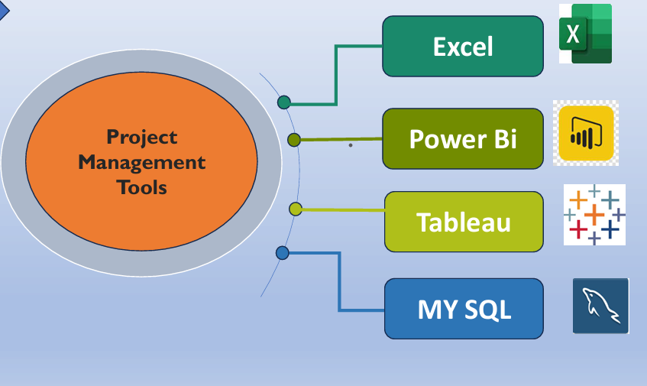

Slide 5
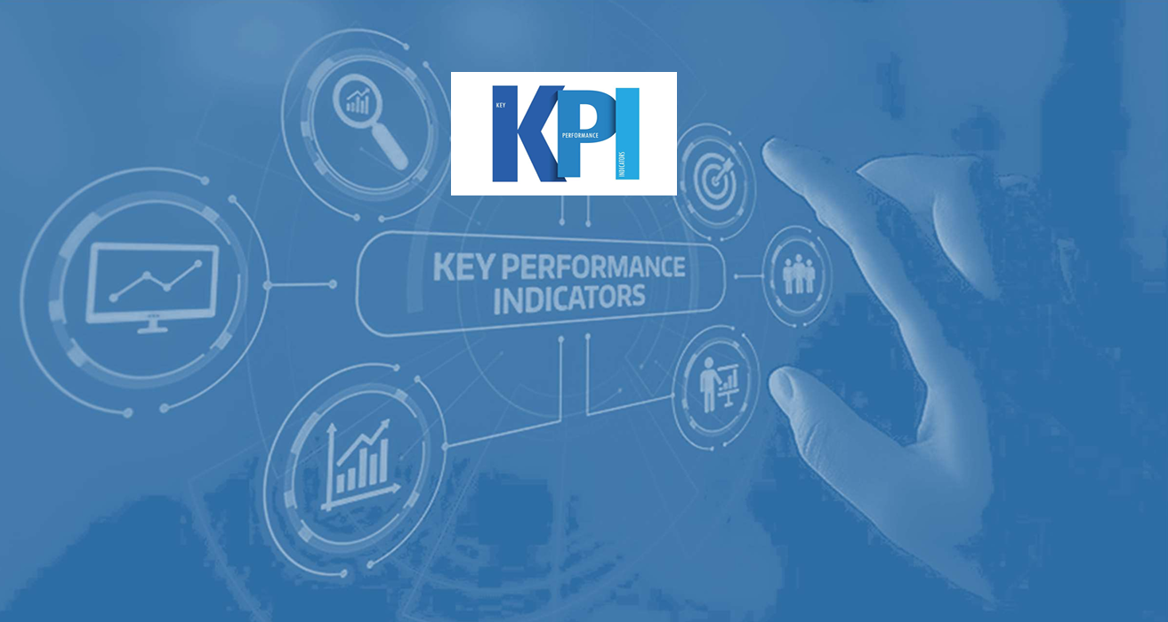

Slide 6
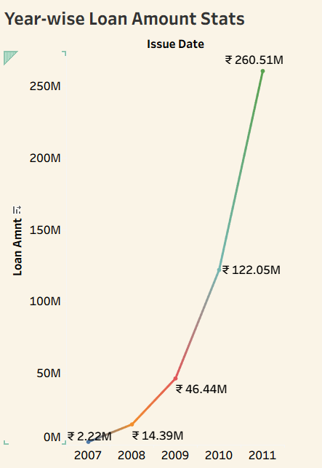
Year-wise LoAN Amount Stats
🔍 Key Insights:
Loan amount shows a consistent increasing trend over years
Highest growth observed between 2007–2010Indicates rising demand for loans
Possible reason: economic expansion or relaxed lending policies
💡 Business Solutions:
Increase loan approval capacity for high-demand years
Introduce risk control policies to avoid over-lending Target high-growth years with marketing campaigns
Improve credit risk assessment models

Slide 7
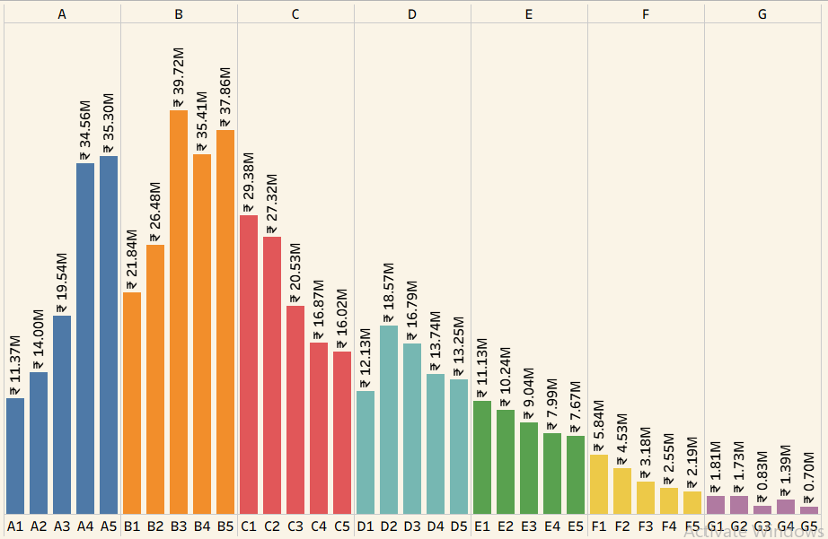
Grade & Sub-grade wise Revolving Balance
🔍 Key Insights:
Lower grades (like C, D, E) have higher revolving balance
Higher grades (A, B) maintain lower debt levels
Indicates higher credit risk in lower-grade customers
💡 Business Solutions:
Apply strict credit policies for lower grades
Increase interest rates for risky segments.
Offer financial planning support to high-debt users
Focus marketing on high-grade customers (low risk)

Slide 8
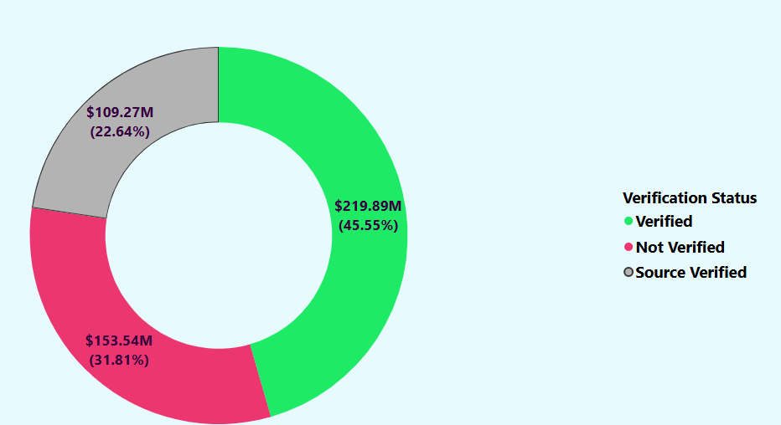
Verified vs Non-Verified Total Payment Analysis
Key Insights:
Verified customers contribute higher total payments
Non-verified customers show lower repayment reliability
Verification improves trust and repayment behavior
Business Solutions:
Encourage mandatory verification process Provide faster approval for verified users
Restrict loan limits for non-verified applicants
Improve KYC and document verification systems

Slide 9
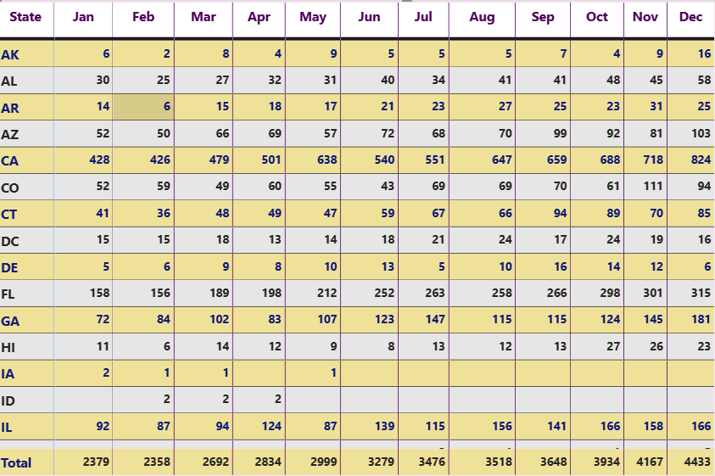
State-wise & Month-wise Loan Status
🔍 Key Insights:
Some states show higher loan defaults or delays
Loan activity varies by month (seasonal trends)
Peak months indicate higher loan demand
💡 Business Solutions:
Focus on high-performing states for expansion
Apply strict policies in high-default states
Launch seasonal loan offers during peak months
Allocate resources based on regional performance

Slide 10
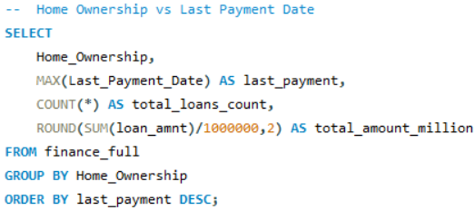
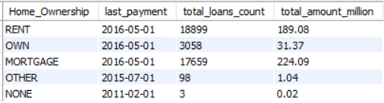
Home Ownership vs Repayment Behaviour
🔍 Key Insights:
Customers with home ownership tend to repay more regularly
Renters show higher delay in last payments Ownership indicates financial stability
💡 Business Solutions:
Offer better interest rates to homeowners
Apply risk checks for renters
Introduce flexible EMI plans for unstable customers
Use ownership as a key credit evaluation factor

Slide 11
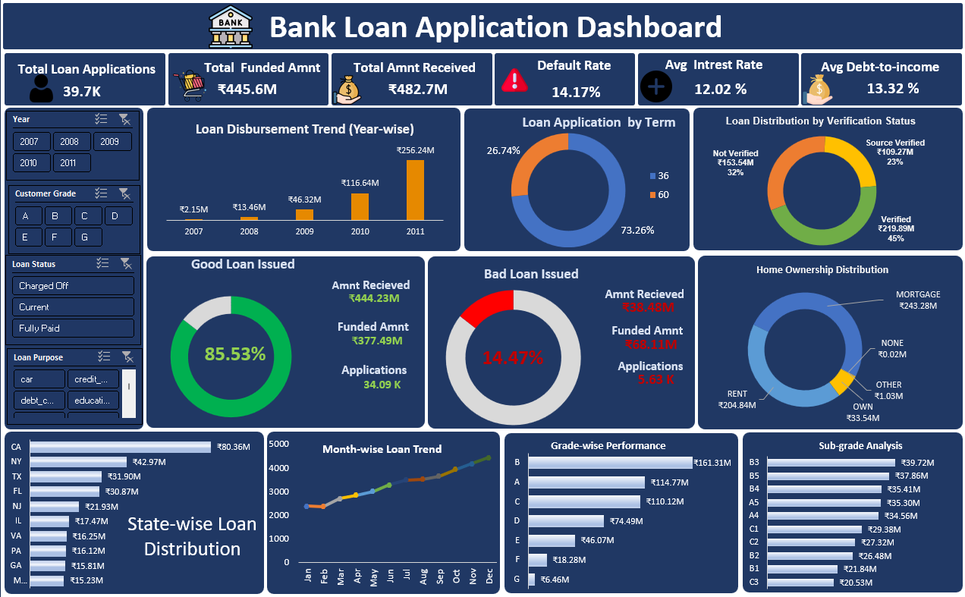
Excel Dashboard

Slide 12
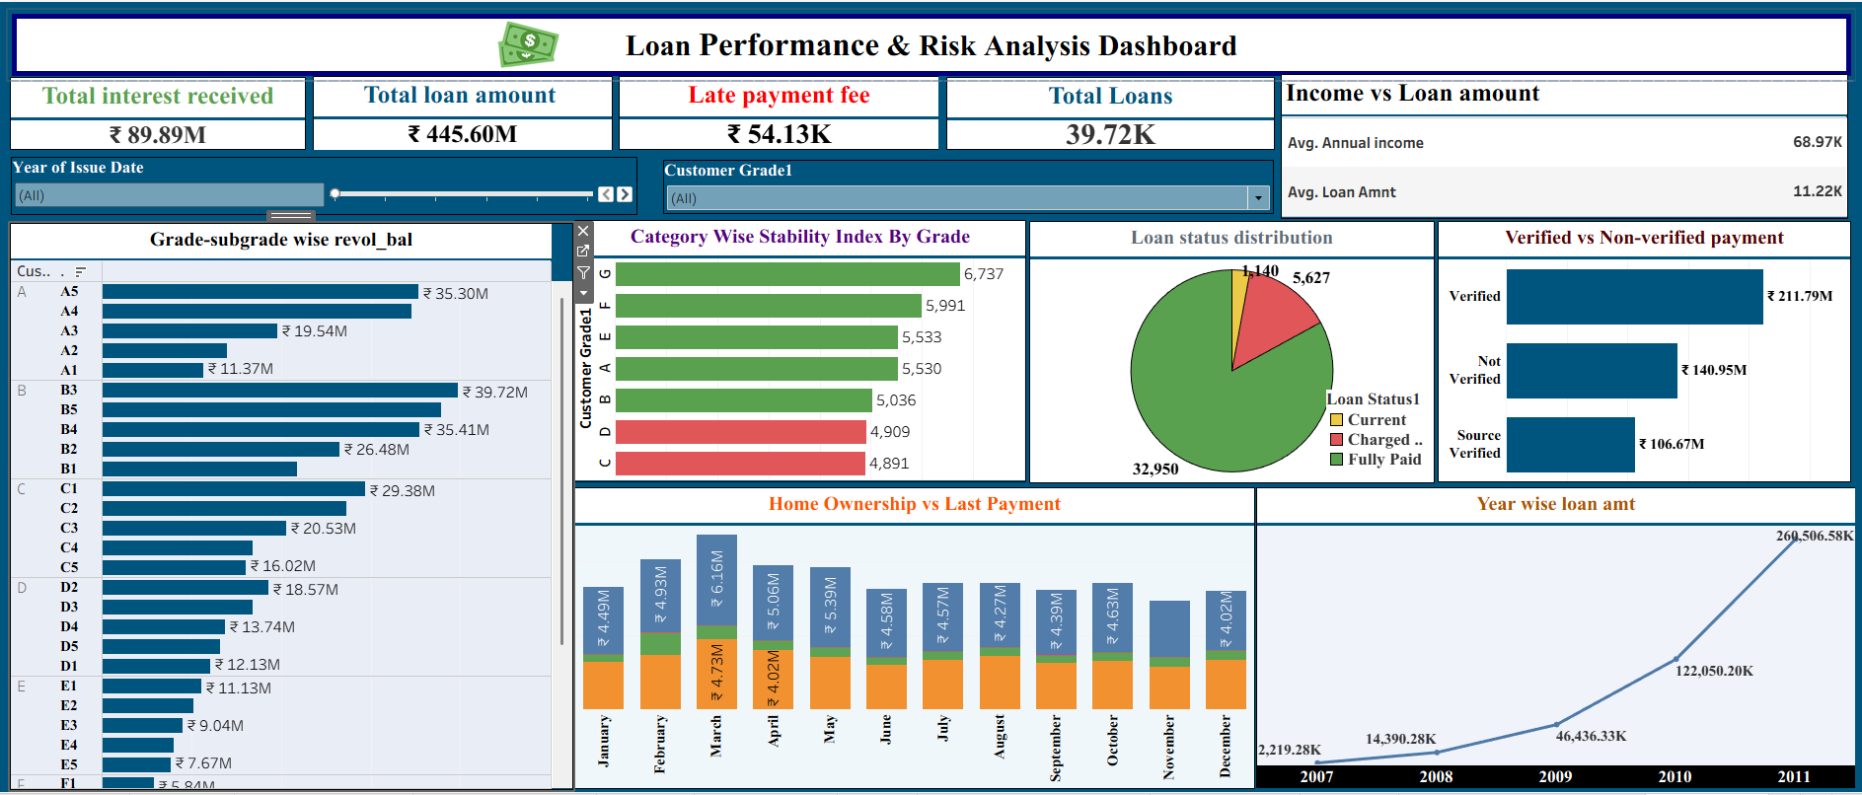
Tableau Dashboard

Slide 13
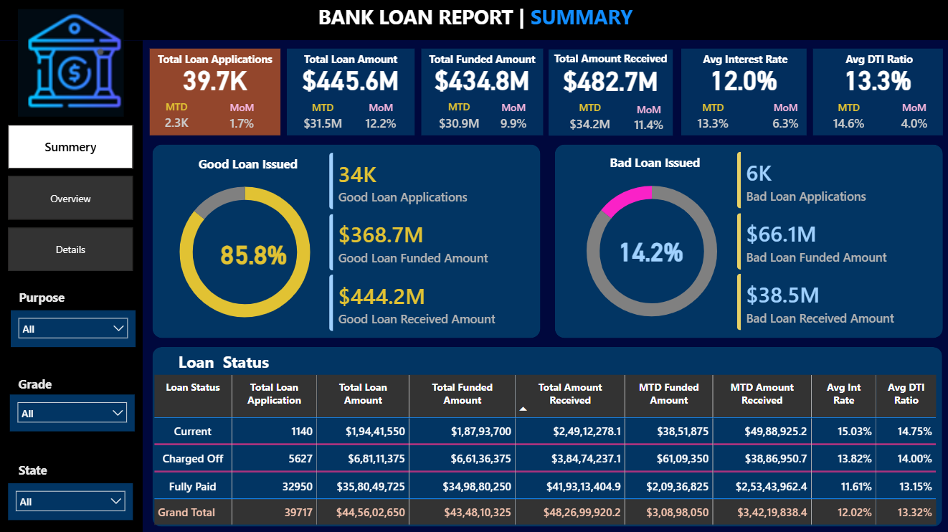
Power BI Dashboard - Summary View

Slide 14
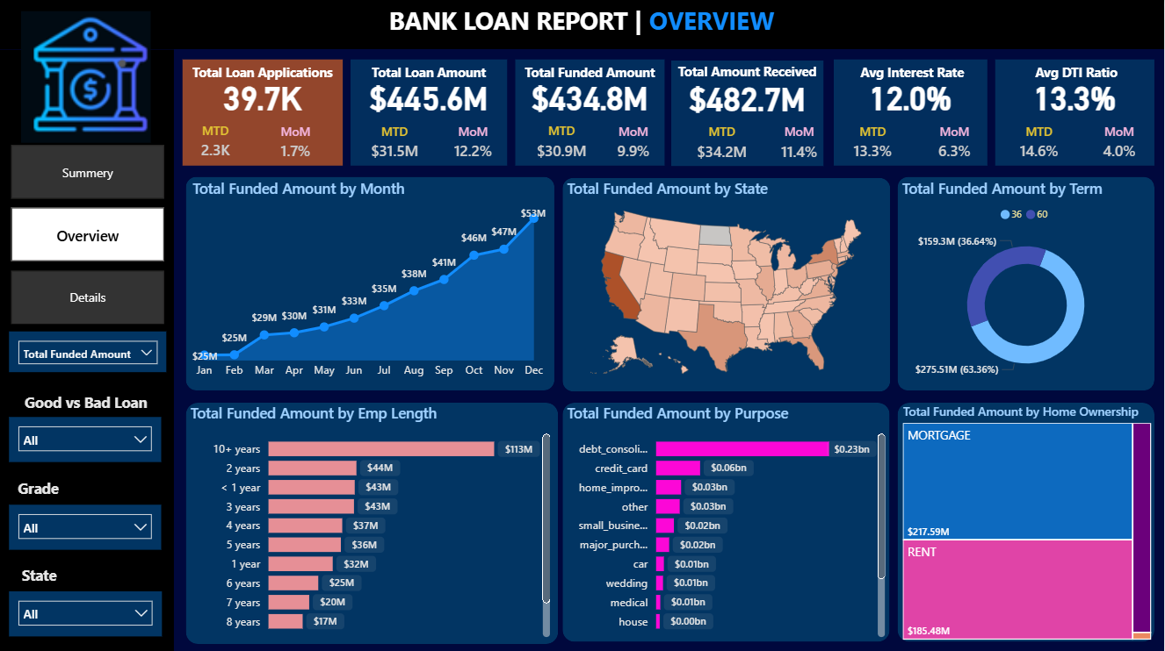
Power BI Dashboard - Risk Analysis

Slide 15
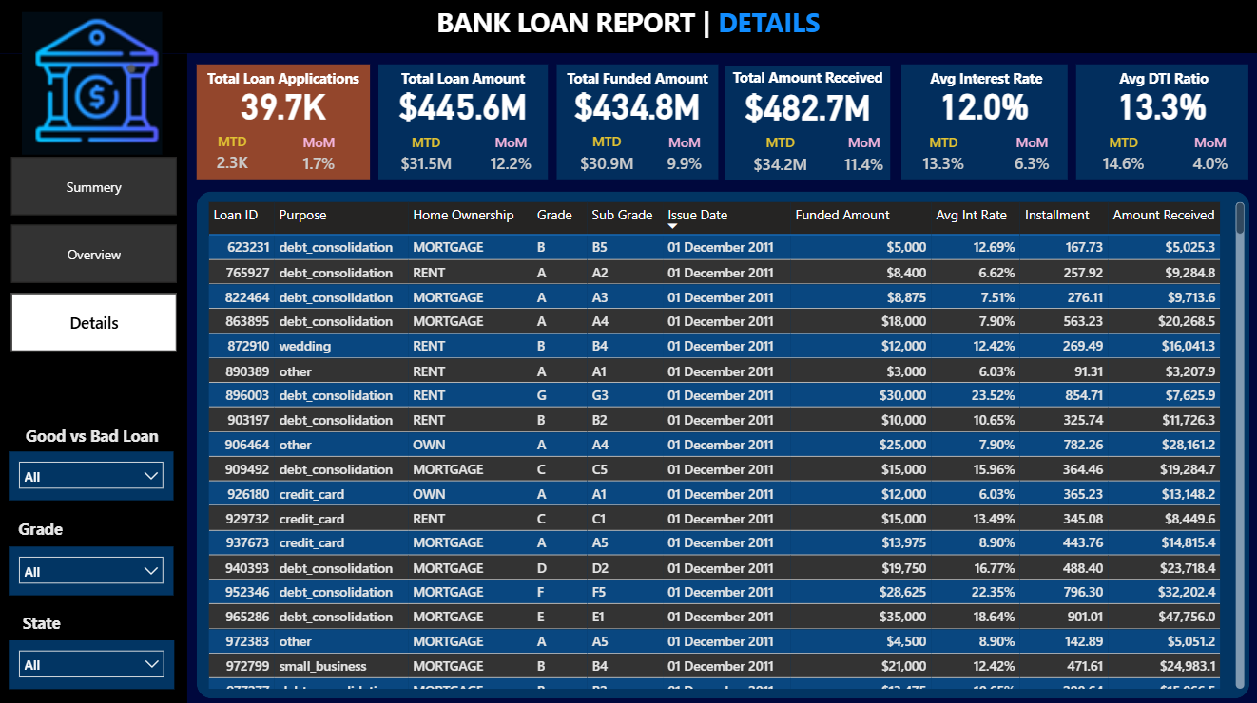
Power BI Dashboard - Regional Performance

Slide 16
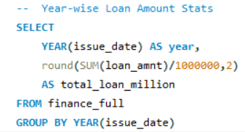
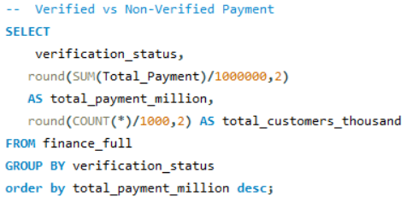
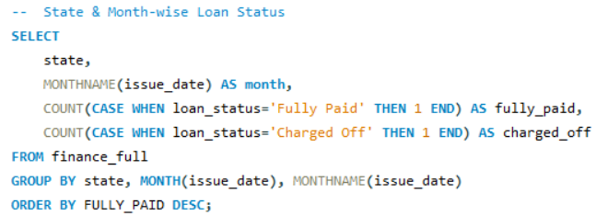

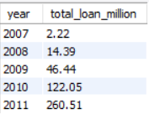
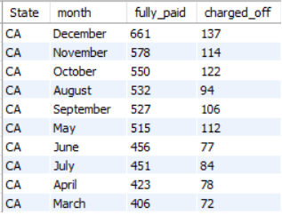

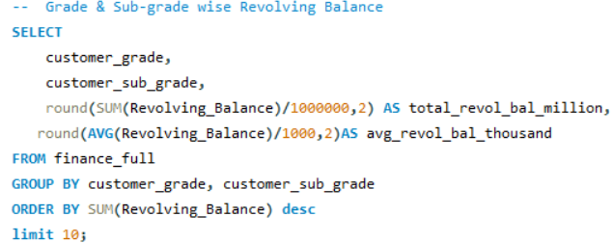
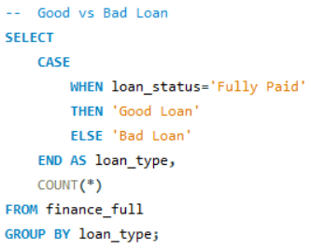
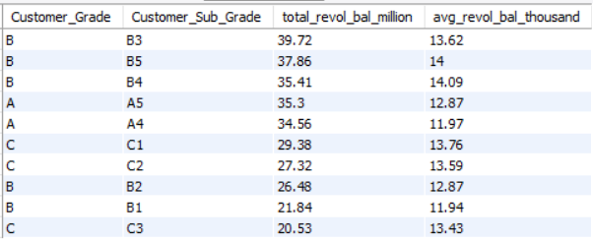

SQL Analysis & Business Queries

Slide 17
Conclusion
Banks need to understand customer demographics such as income level, home ownership, verification status, and credit behavior before approving loans. This helps in better risk assessment and targeted loan offerings.
Analysis of loan purposes such as debt consolidation, home improvement, education, and personal use helps banks understand customer needs and design suitable financial products.
Grade, sub-grade, and revolving balance analysis helps identify high-risk customer segments and improve lending strategies for better profitability.
Good Loan vs Bad Loan analysis helps banks measure portfolio health by identifying fully paid loans and high-risk default loans. This supports better decision-making and default prevention.
Verified customers and homeowners generally show better repayment behavior, indicating stronger financial stability and lower default risk.
State-wise and month-wise loan analysis helps identify high-performing regions and seasonal loan demand trends for better business planning.

Slide 18
Thank YOU
Questions & Suggestions

